Slide 1





Signal Cartel A Probabilistic Directional Trading STRATEGY
A Random Forest based direction modelling using price-volume structure and volatility-adjusted position sizing
STOCK : SONATSOFTW.NS
*from constrained Universe

Slide 2
Strategy Intuition: Probabilistic Directional Edge
MARKET DATA
Daily OHLCV, returns, realized volatility
RANDOM FOREST MODEL
Estimates P (Price ↑ | Market State)
Momentum , Volatility , Price–Volume Structure
CONFIDENCE & RISK SCALING
Position size ∝ Model certainty
TRADE EXECUTION
MARKET STATE ENCODING
Directional entries & exits with controlled exposure
CORE HYPOTHESIS
Short-horizon markets exhibit weak but persistent directional biases driven by price-volume dynamics and volatility regimes.
WHY RANDOM FOREST?
Financial Signals are non-linear, noisy, and regime-dependent, requiring a model that prioritizes robustness over point accuracy.
WELL SUITED BECAUSE :
Captures non-linear interactions without assuming functional form
Is resilient to noise and feature collinearity
It Aggregates multiple weak predictors into a stable probability estimate
This makes it well-suited for directional probability estimation, not point forecasting.

Slide 3
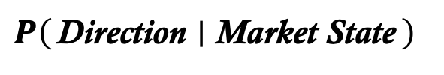
Trading Logic: From Probability to Position
SIGNAL DEFINITION:
The strategy trades on the model-estimated directional probability:
TRADE DIRECTION
ENTRY CONDITIONS
EXIT CONDITIONS
$$P\left(\text{Direction} ∣ \text{Market} \text{State}\right)$$
Long if upward probability > entry threshold
Short if downward probability > entry threshold
Enter a trade only when:
Probability exceeds a predefined confidence threshold
Signal aligns with current market state
Effect: Selective participation in high-signal regimes
Exit a position when:
Model confidence drops below exit threshold
Signal direction reverses
Maximum holding horizon is reached
Effect: Prevents overstaying decayed signals and regime transitions

Slide 4

Feature Design: Encoding Market State
The model does not rely on raw prices. Instead, it learns from transformed features that capture momentum, volatility, and price–volume structure.
VOLATILITY & REGIME
VOLATILTY AND REGIME FEATURES:
Captures market uncertainty and regime shifts.
Rolling Volatility (20-day) Measures risk regime (calm vs turbulent)
High–Low Range / Close Captures intraday uncertainty and price compression/expansion
Why volatility? Directional signals behave differently in low vs high volatility regimes.
PRICE STRUCTURE FEATURES:
Captures relative price positioning.
RSI (14) Identifies overbought / oversold pressure
Bollinger %B
Normalized price position within volatility bands
Why structure? Directional edges depend on where price is, not just where it’s going.
MOMENTUM FEATURES:
Captures trend persistence and direction strength.
MACD Histogram Measures short-term vs long-term momentum imbalance
Lagged Returns Captures immediate directional continuation or reversal
Why momentum? Short-horizon trends often persist due to delayed market reaction.
MOMENTUM
FEATURE
CATEGORIES
PRICE
STRUCTURE
*All features are lagged by one day to avoid look-ahead bias.

Slide 5
THRESHOLDS & PARAMETER DESIGN LOGIC
Probability Thresholding (Signal Quality Control)
Symmetric Long / Short Thresholds
WHAT?
Model Capacity & Training Discipline
Volatility-Targeted Position Scaling
Predictions near 0.5 are statistically noisy
Creates an explicit no-trade region
IMPACT
Identical confidence thresholds for long and short
WHY?
WHAT?
Position size ∝ $\frac{\text{Target} \text{Volatility}}{\text{Recent} \text{Realized} \text{Volatility}}$
Position size ∝ "Target Volatility" /"Recent Realized Volatility"
WHY?
Normalizes risk across time
Automatically de-leverages in volatile regimes
IMPACT
Comparable risk per trade
Lower drawdowns during volatility spikes
WHAT?
Limited tree depth
Minimum samples per split
Walk-forward retraining
WHY?
IMPACT
Reduces model variance
Avoids memorization
WHAT?
WHY?
Fewer trades
Higher conditional return per trade
Enforces directional neutrality
Prevents sample-driven bias
IMPACT
Stable behaviour across bull and bear regimes
Robust out-of-sample performance
Strict temporal causality (no look-ahead)
$$P\left(Direction ∣ Market State\right)∉ \left[0.5−ε,0.5+ε\right]$$
*Explicit no-trade buffer around 50%
𝑃(Direction∣Market State)∉ [0.5−ε,0.5+ε]
*Explicit no-trade buffer around 50%

Slide 6
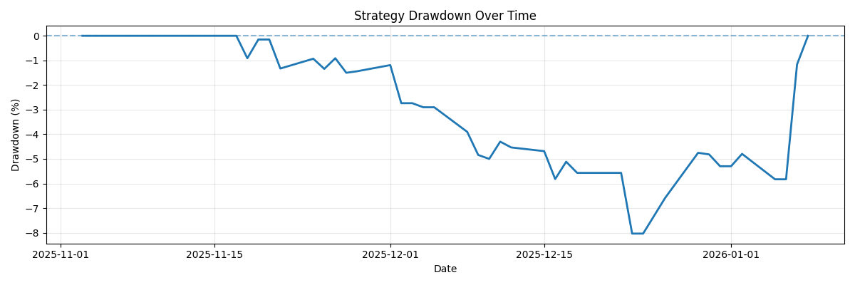
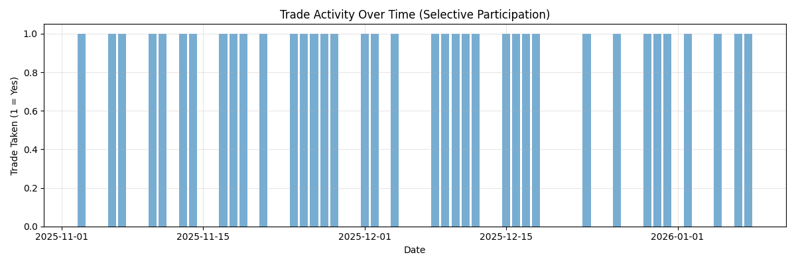
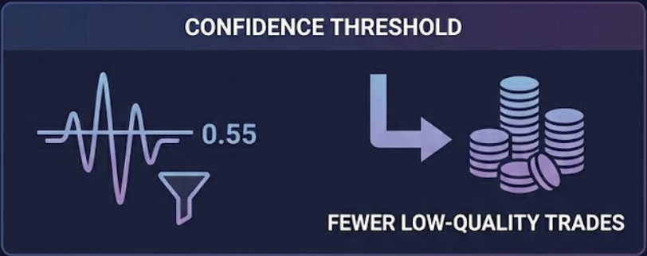
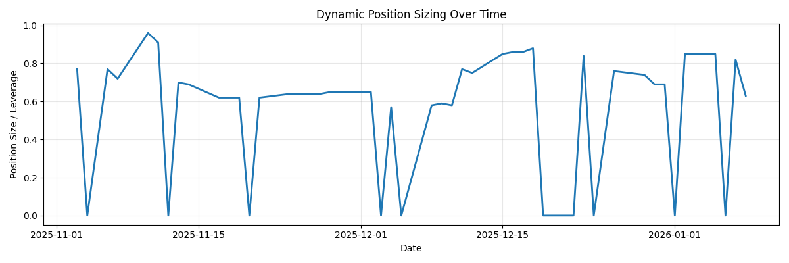
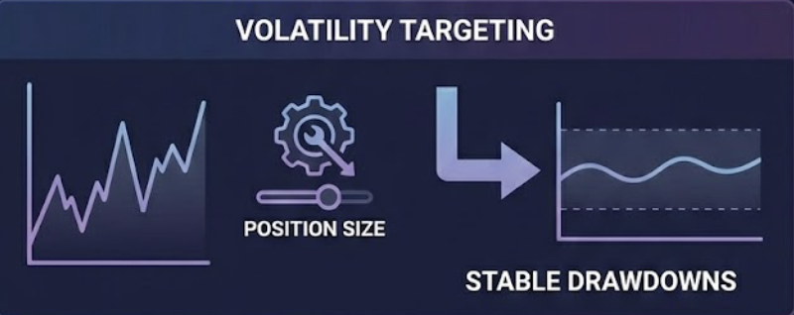
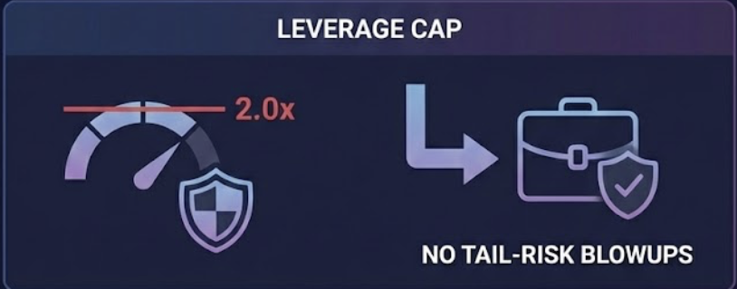
RISK MANAGEMENT & DRAWDOWN CONTROL
Drawdowns are structurally bounded De-leveraging during volatility spikes prevents drawdown acceleration.
Risk is controlled structurally via signal selectivity, volatility scaling, and disciplined exits. Not reactive stop-losses.
Explicit no-trade region around uncertainty
Selective participation
Trades occur only when model confidence exceeds threshold, creating a natural no-trade zone.
Risk normalized across volatility regimes
Hard upper bound on exposure
Automatic Risk Scaling Position size contracts during high volatility and expands in stable regimes.
*Volatility-targeted exposure

Slide 7
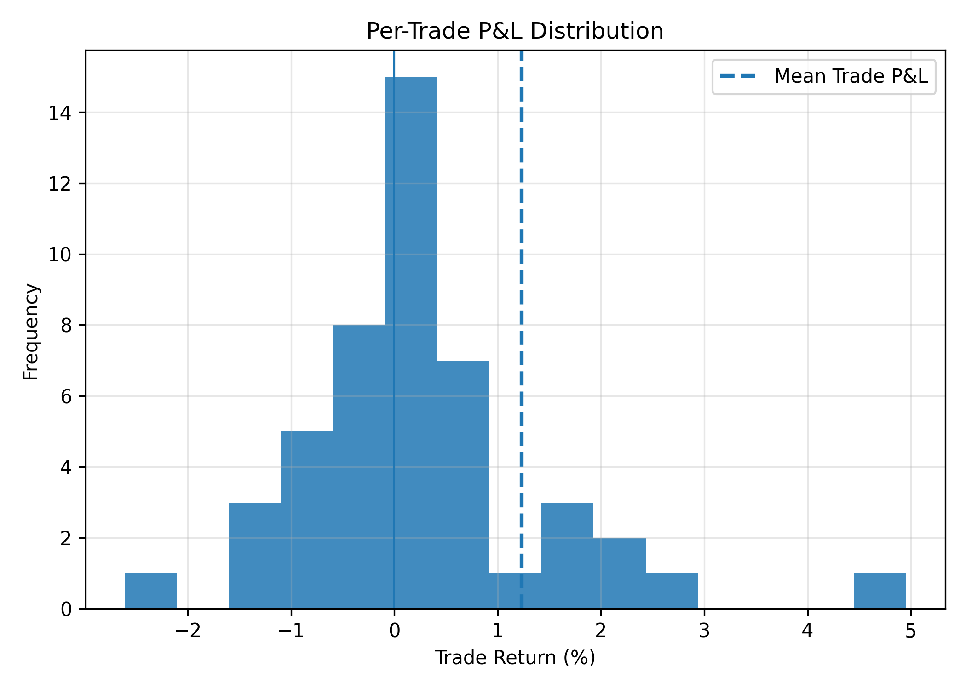
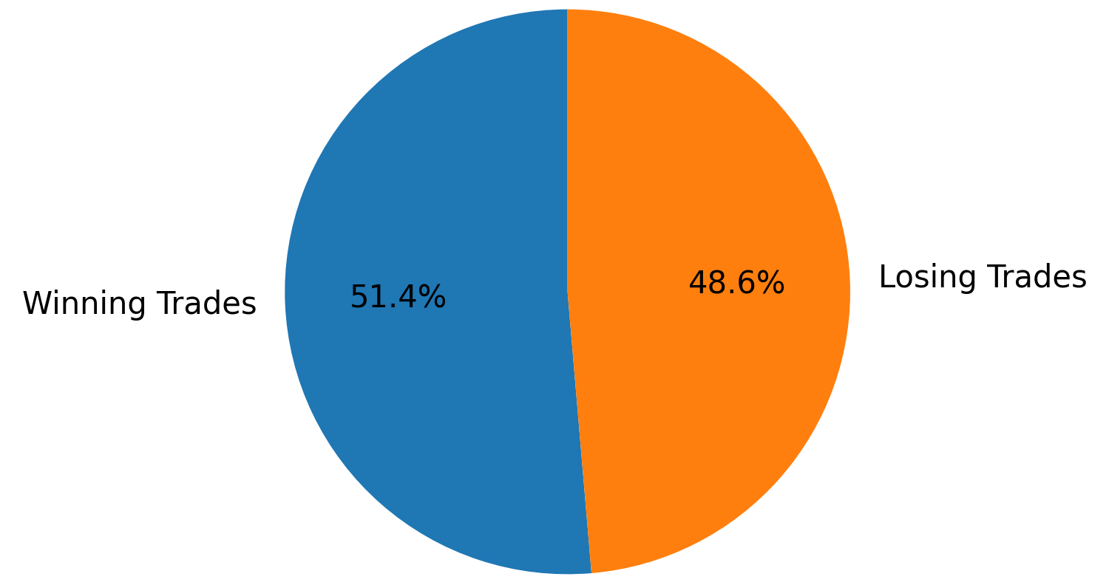
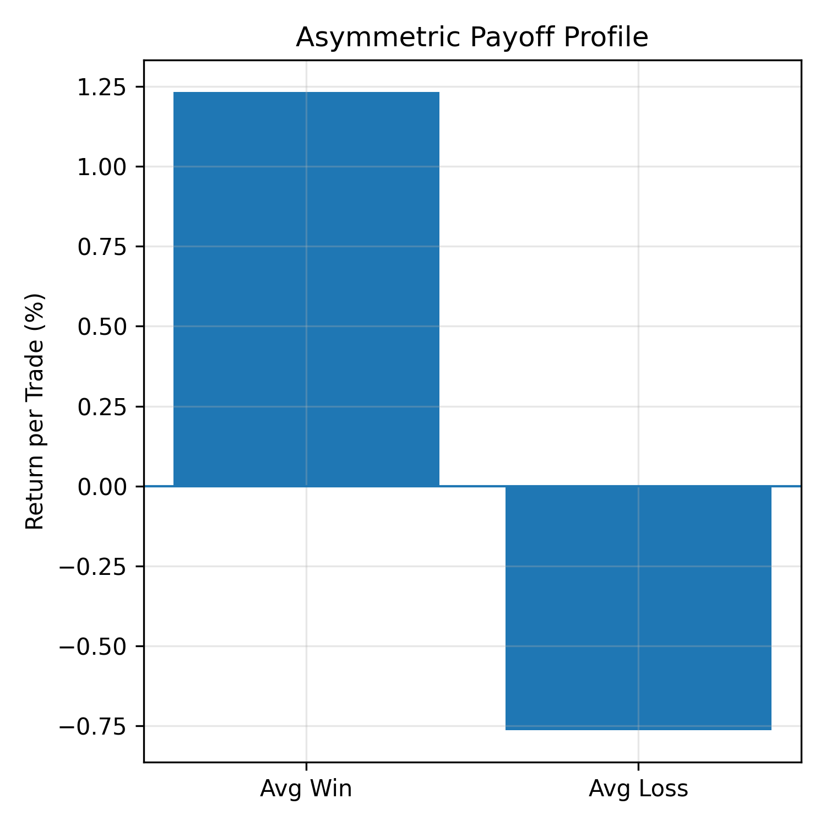
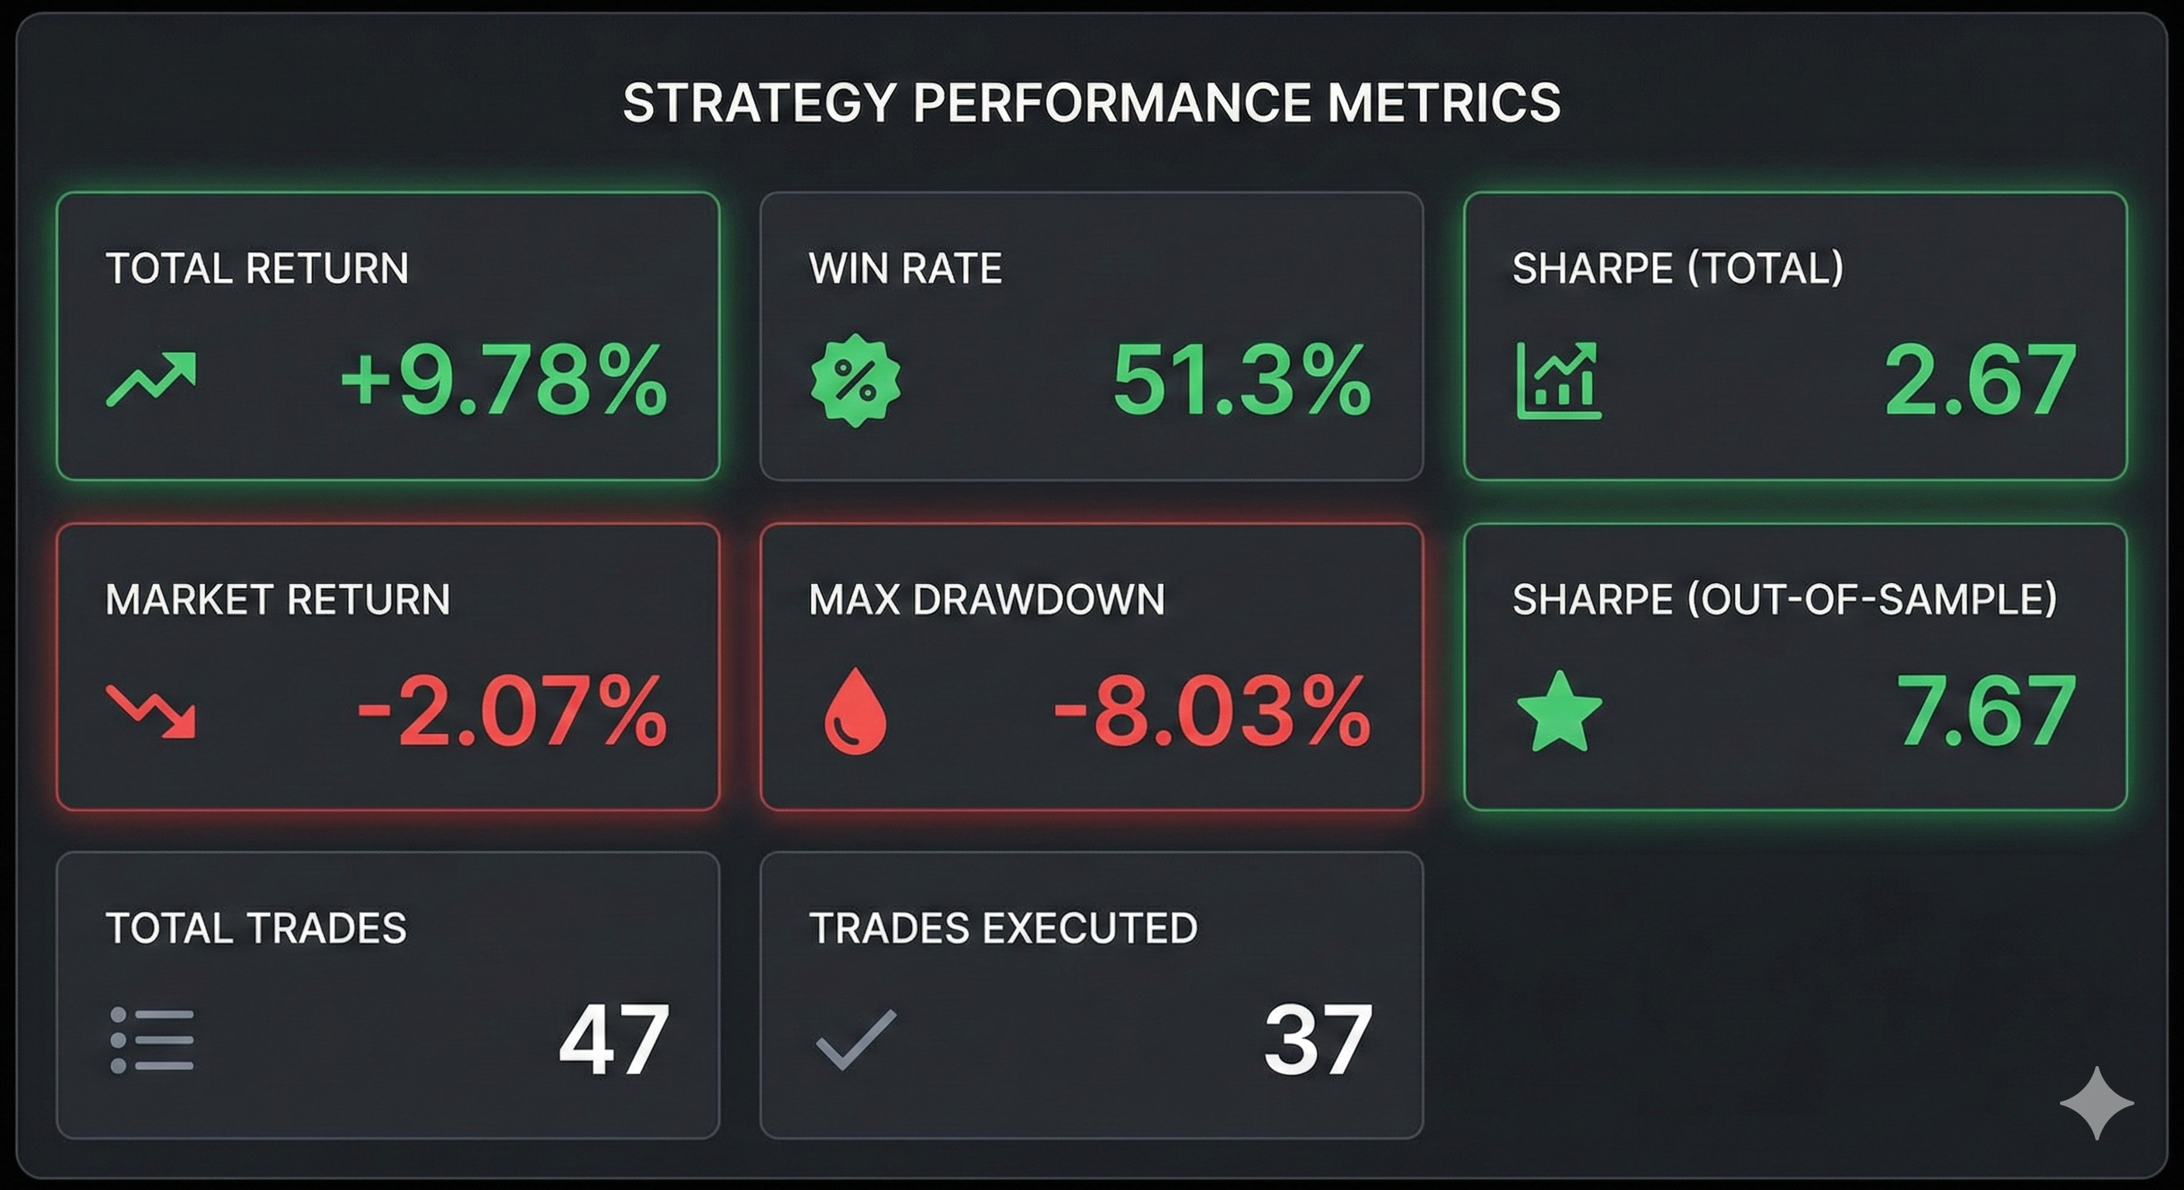
RESULTS & TRADE QUALITY
Per-Trade P&L Distribution:
Centered near zero with right-skewed payoff distribution
Indicates controlled losses and occasional outsized gains
Positive mean P&L confirms persistent edge
Win vs Loss Breakdown
Win rate is healthy but not the edge
Strategy focuses on expectancy, not hit-rate optimization
Average Win vs Average Loss
Average win > Average loss
Positive trade-level expectancy observed Losses tightly controlled, gains occasionally outsized
Returns not dependent on high win rate Profitability driven by payoff size, not frequency.
Right-skewed payoff distribution Larger winners dominate cumulative returns.
Outperformance is structurally driven by payoff asymmetry and selective participation, not by high win rate or aggressive leverage.

Slide 8
ROBUSTNESS & GENERALIZATION
TEMPORAL INTEGRITY
Out-of-Sample STRENGTH
CAPACITY CONTROL
REGIME ROBUSTNESS
Walk-forward training ensures every prediction uses only past data. No look-ahead, no leakage, deployment-faithful by construction.
Sharpe improves out-of-sample, indicating the signal is not overfit and stabilizes under unseen market conditions.
Random Forest depth capped and minimum samples enforced to prevent memorization of short-term noise.
Strategy adapts exposure across volatility regimes instead of forcing constant market exposure.
RISK & PERFORMANCE COMPARISON | IN - SAMPLE (IS) | OUT-OF- SAMPLE (OS)
Sharpe Ratio | 1.33 | 7.67
Max Drawdown | -8.03% | -1.08%
• Drawdown contracts out-of-sample • Performance improves without increased tail risk exposure • Confirms structural generalization, not curve-fit behavior
Design choices that prevent overfitting

Slide 9
LIMITATIONS & SCOPE OF INFERENCE
Contextual constraints imposed by the problem statement
LIMITATIONS
Short Backtest Horizon (Problem-Imposed)
47 total days, 37 executed trades
Data window restricted to ~2 months (1 Nov 2025 – 31 Dec 2025)
Limits exposure to few market regimes
Restricts long-horizon statistics (e.g., crisis behaviour)
Backtest length is not a modeling choice
Performance metrics have higher variance
Sharpe and drawdown estimates are directional, not asymptotic
Emphasis shifts from magnitude → behavioral consistency
Strategy tested on one NSE-listed equity
No cross-sectional diversification
Results reflect signal quality, not portfolio construction
Generalization tested temporally, not cross-sectionally
FUTURE SCOPE & ROADMAP Moving from Signal Generation to Fund Management
From Single-Stock to Portfolio:
Dynamic Regime Adaptation:
Production Hardening:
Deploy strategy across Nifty 50 universe to diversify idiosyncratic risk.
Instead of fixed thresholds (0.55),
implement Adaptive Thresholding based on real-time market volatility
Deploy Slippage Modelling and Transaction Cost Optimization to simulate realistic institutional trading environments.

Slide 10
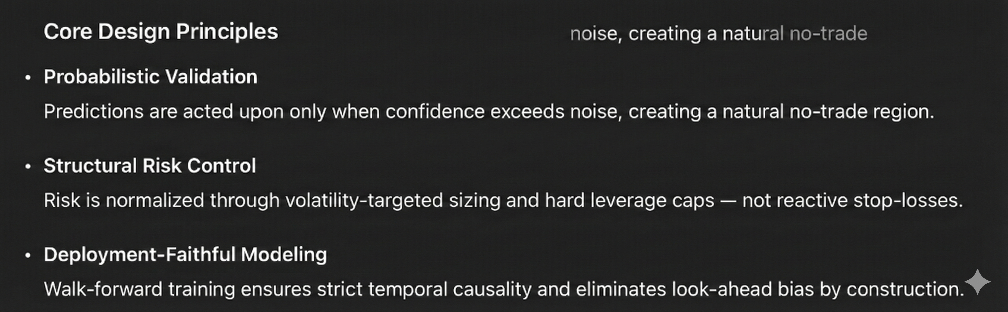
STRATEGY DNA & FINAL TAKEAWAY
Probabilistic • Selective • Risk-Normalized
This strategy does not predict prices.
It estimates when odds are favorable, participates selectively, and scales risk ex-ante.
WHAT RESULTS ACTUALLY PROVE
Performance is driven by payoff asymmetry, not win-rate inflation.
Drawdowns contract out-of-sample, confirming robustness
Risk does not increase with performance
Signal strength improves under unseen market conditions
Designed for execution. Built for uncertainty.

