Slide 1
Ted Talks Content Analysis Which is more persuasive?

Slide 2
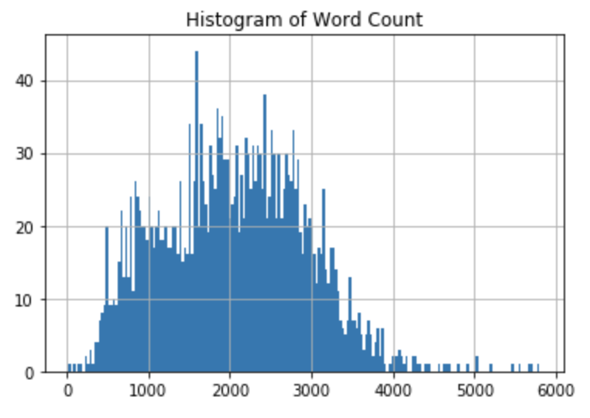
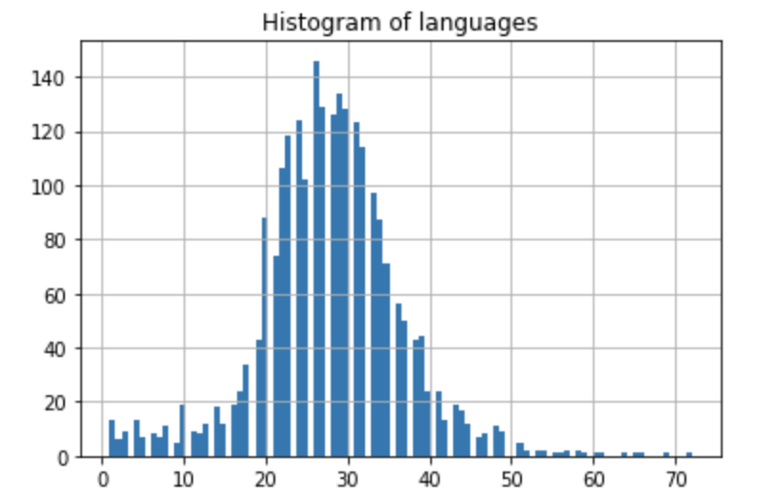
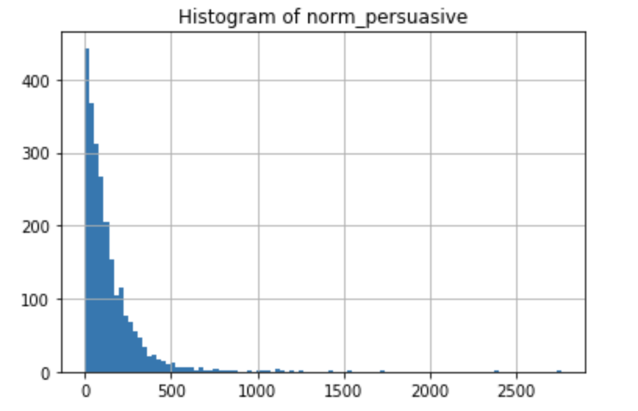
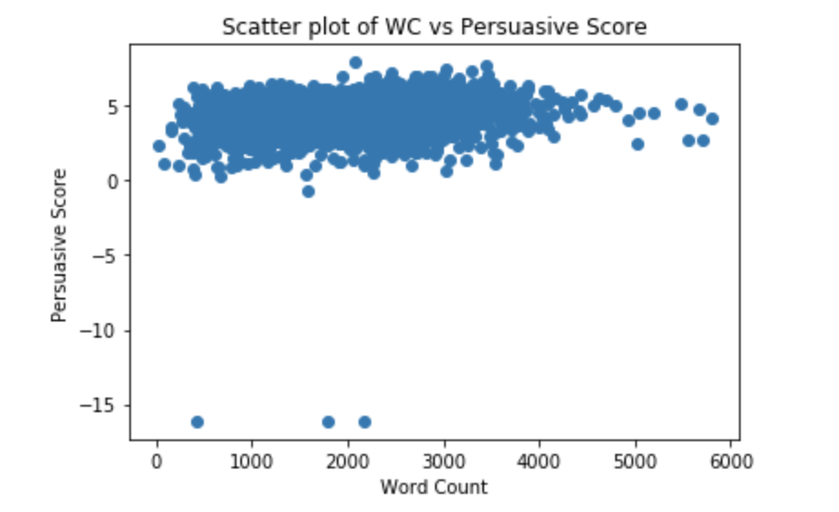
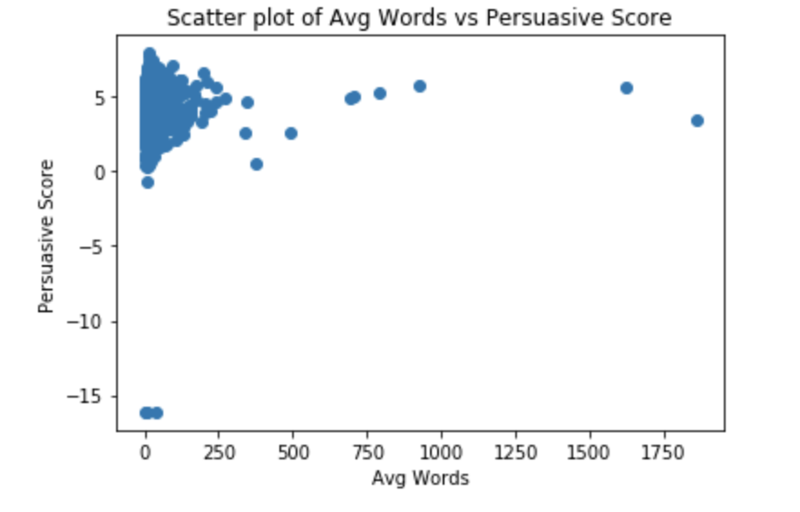
Data
Feature Engineering
Log transformation – persuasive score
Sentence Tokenizing
Compute the number of sentences
Compute the average length of sentences
Word count
Language available
Talk Transcript
--Predict object:
Persuasive score
No Missing Value

Slide 3
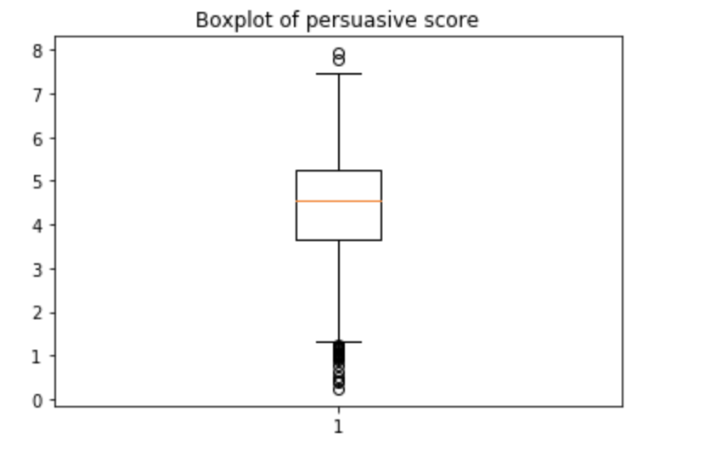
Tokenizing and Frequency counts
Using kmeans to classify words into 80 categories;
Count the frequency of each categories in every transcript of talk;
Build new dataframe for modeling
Labeling
Persuasive ： 1 if score > 3.5
Not Persuasive : 0 if score < 3.5

Slide 4
Model comparing
Accuracy | With stop words | Without stop words | With stop words & under- sampling | With stop words & over- sampling
Random Forest | 0.784 | 0.782 | 0.782 | 0.778
Logistics Regression | 0.762 | 0.762 | 0.775 | 0.684
SVC | 0.784 | 0.784 | 0.784 | 0.773

Slide 5
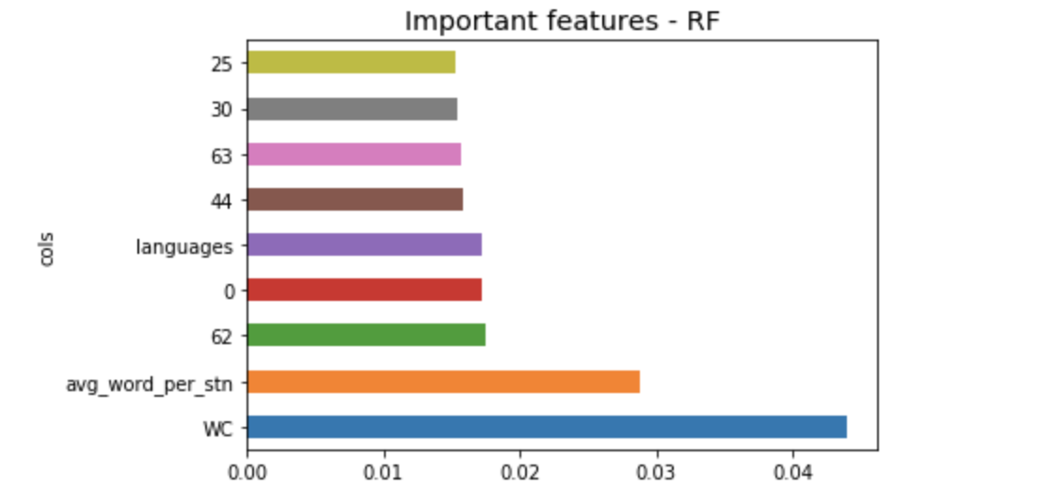
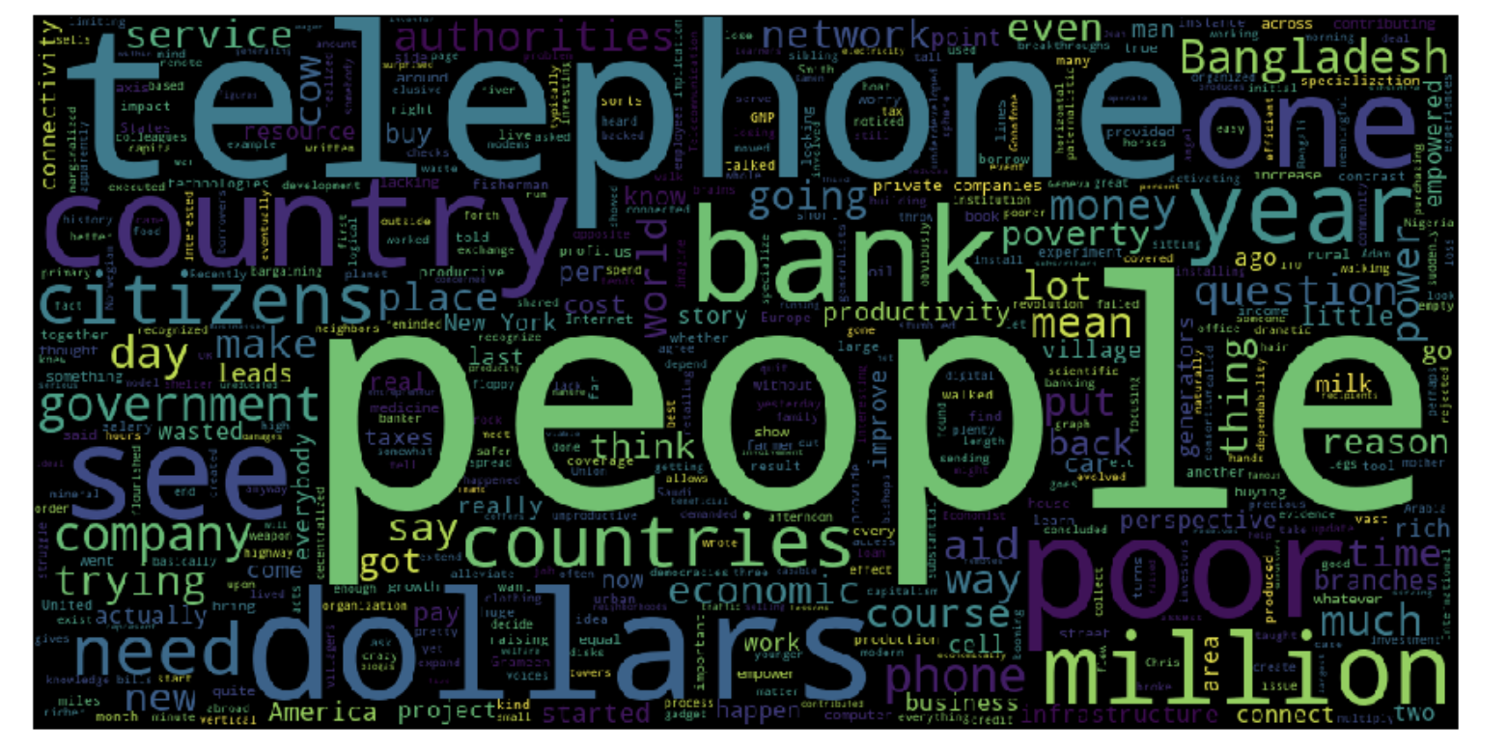
Importance Features
Length of the talk
some groups of specific words
An example of group of words

