Slide 1
SF BAY AREA BIKE SHARE
MSAN697
Cara Qin Qian Li Sangyu Shen

Slide 2

Overview
Kaggle competition- “SF Bay Area Bike Share”
The emergence of bike-share system transform the way we travel.
We want to predict number of daily bike-share trips and analyze how much effect weather has on this number
Notes:
The data we worked on is the one from kaggle competition called SF Bay Area Bike Share.
We are interested in this data because we love the idea of sharing. The emergency of carshare, bike share and ride share has transformed the way we travel greatly. By reading and analyzing the dataThe specific research goal we reached is predicting

Slide 3
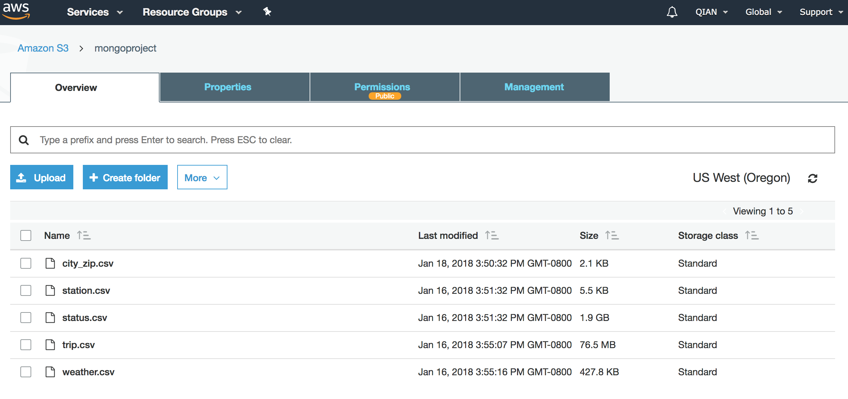
Launch S3 to store data

Slide 4
Understanding Data Structure
Weather
Status
date
max_temperature
mean_temperature
min_temperature
humidity
sea_level
wind speed
visibility
…
events
zip code
station_id
name
bikes_available
time
…
Trip
Station
duration
station_id
start_date
start_station
…
zip code
id
name
dock_count
…
city

Slide 5
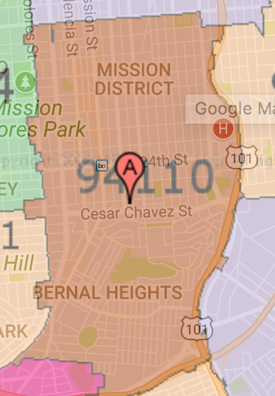
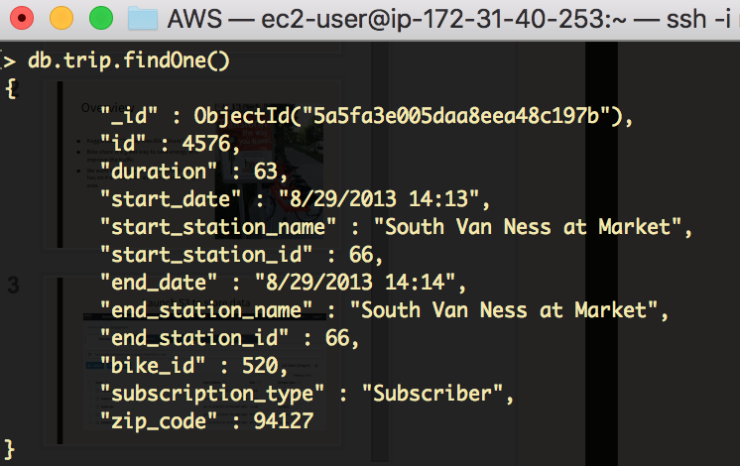
Imported data from S3 into MongoDB on EC2
94127
not accurate

Slide 6
Understanding Data Structure
Weather
Status
date
max_temperature
mean_temperature
min_temperature
humidity
sea_level
wind speed
visibility
…
events
zip code
station_id
name
bikes_available
time
…
Trip
Station
duration
station_id
start_date
start_station
…
zip code
id
name
dock_count
…
city
X
X

Slide 7
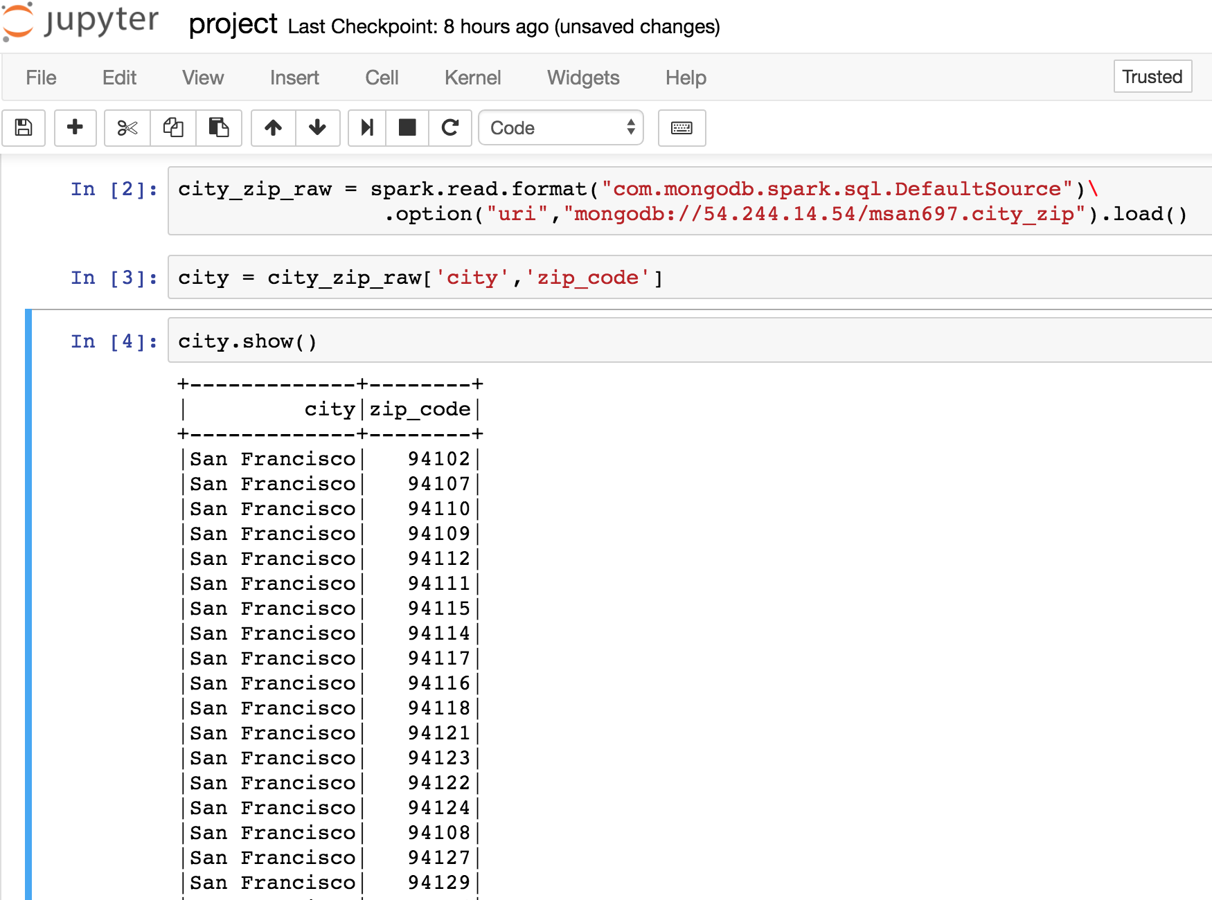
Import data from MongoDB on EMR (1 master 2 workers)

Slide 8
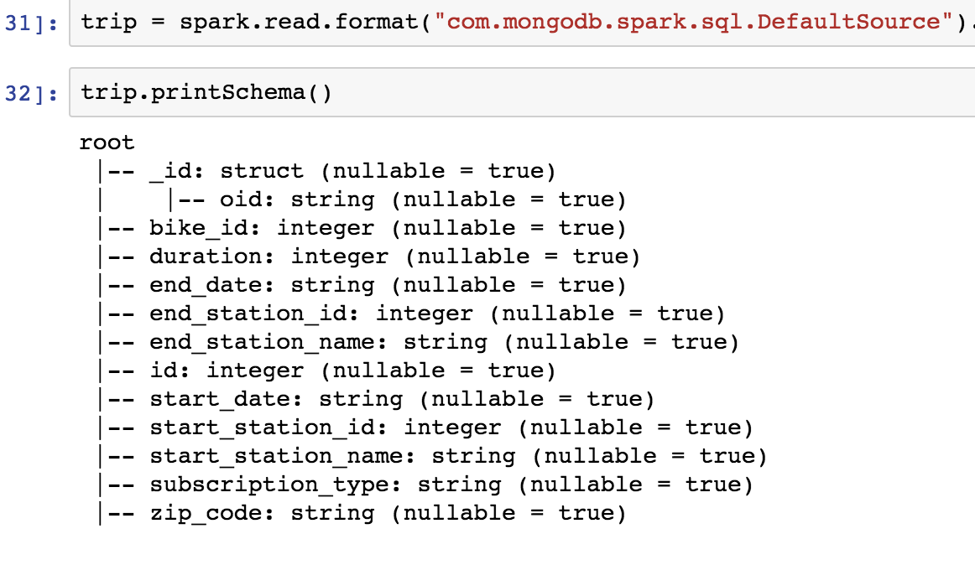
Create New DataFrame
Column types should be changed
Assigned defaultly
should be deleted
Type
string -- timestamp
Notes:
Now we have imported our data from MongoDB to EMR. They are already dataframes. However, when we have a look into their schemas, we figure out that some of the columns should be modified. For instance, it is the trip dataframe and the column type of end_date and start date should be timestamp instead of string. The id column assigned defaultly has no use for us.

Slide 9
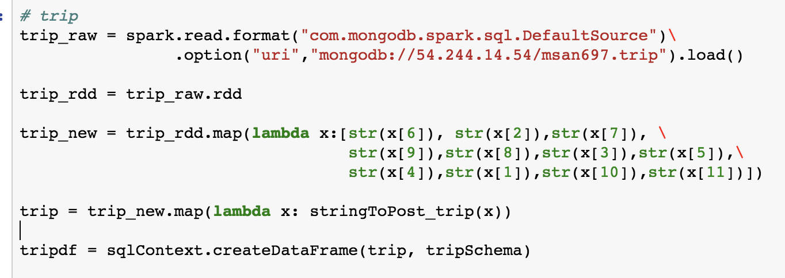
Create New DataFrame
step 1 : create schema
step 2 : create new RDD
step 3 : create new DF
Notes:
However, a dataframe is immutable so we have to create a new dataframe. So firstly , A schema with our preferred column types is created and then we generate RDD based on the original dataframe. We used the RDD and schema to build a new dataframe.

Slide 10
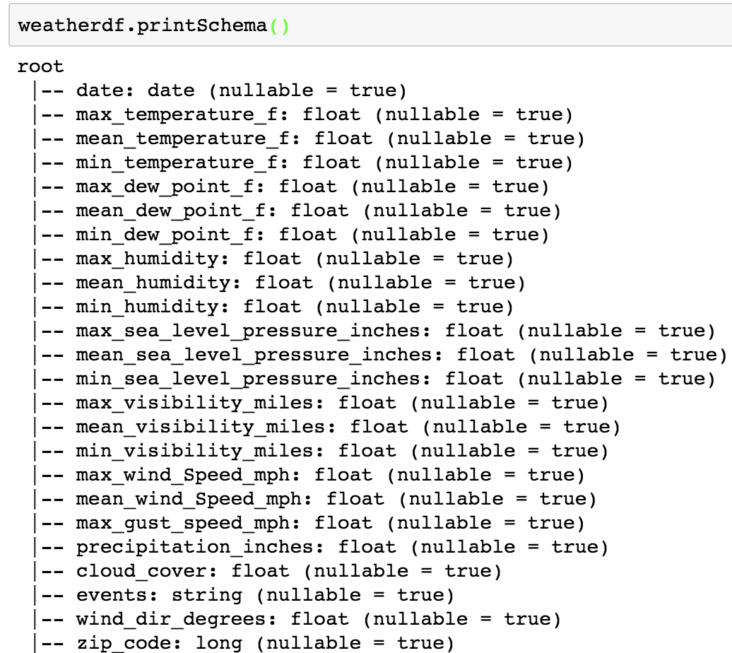
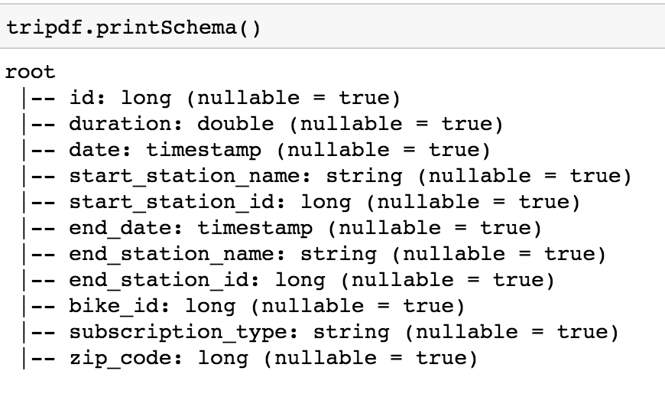
Create New DataFrame
Notes:
In this way, we get our new trip and weather dataframes.

Slide 11
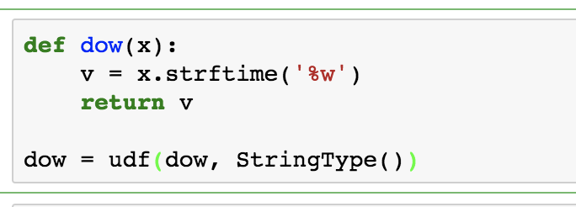
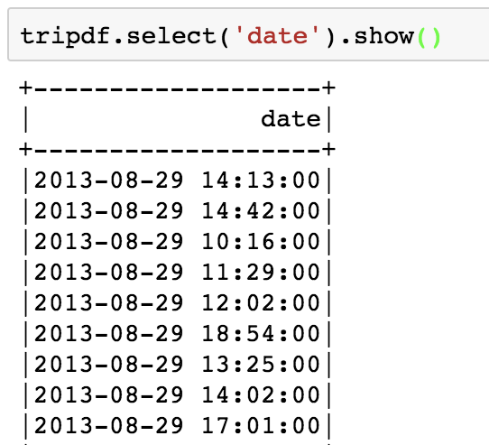
Extract day of week
Weather
Trip
date
max_temperature
mean_temperature
…
events
zip code
duration
start_date
...
end_station
…
zip code
Notes:
Both of these dataframes have column of date. The column type is timestamp now and we would like to extract the information of day of week because we think it might be more reasonable to predict the daily bike rentals based on the day of week instead of the date.

Slide 12
Join DataFrame
Weather
date
max_temperature
mean_temperature
mean_temperature
humidity
sea_level
wind speed
visibility
…
events
zip_code
Trip
duration
start_date
...
start_station
…
zip code
City_zip
zip_code
city
Station
id
name
dock_count
…
city
Notes:
After adding the new column of day of week and imputing missing values, we join the dataframes together. As mentioned, the zip_code in trip and weather dataframes are not actually a common id. In order to join them together, we firstly join trip and station on the same station_id and then join the city_zip built by ourself to map city and their zip code.Finally, we join weather into the large dataframe based on zipcode and date. Now we get our combined dataframe ready for machine learning.

Slide 13
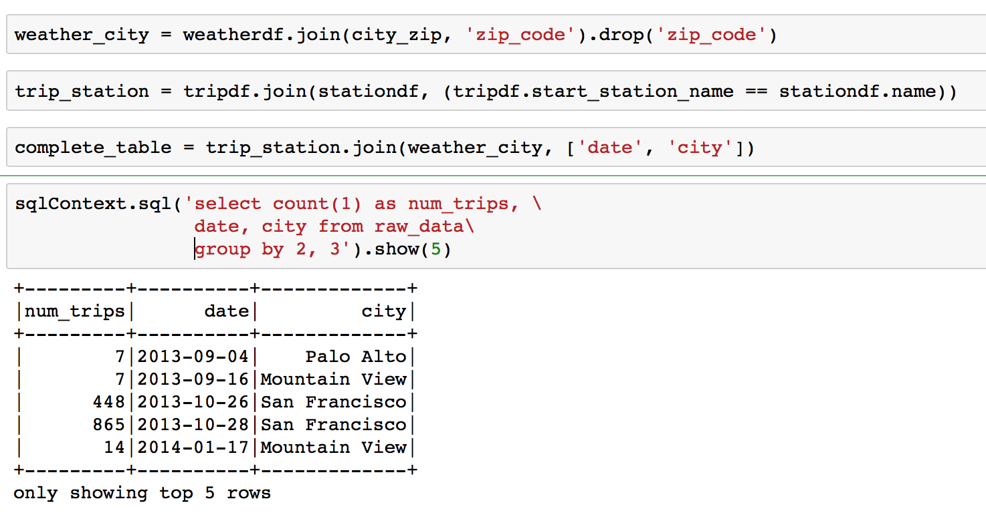
SparkSQL
Response

Slide 14
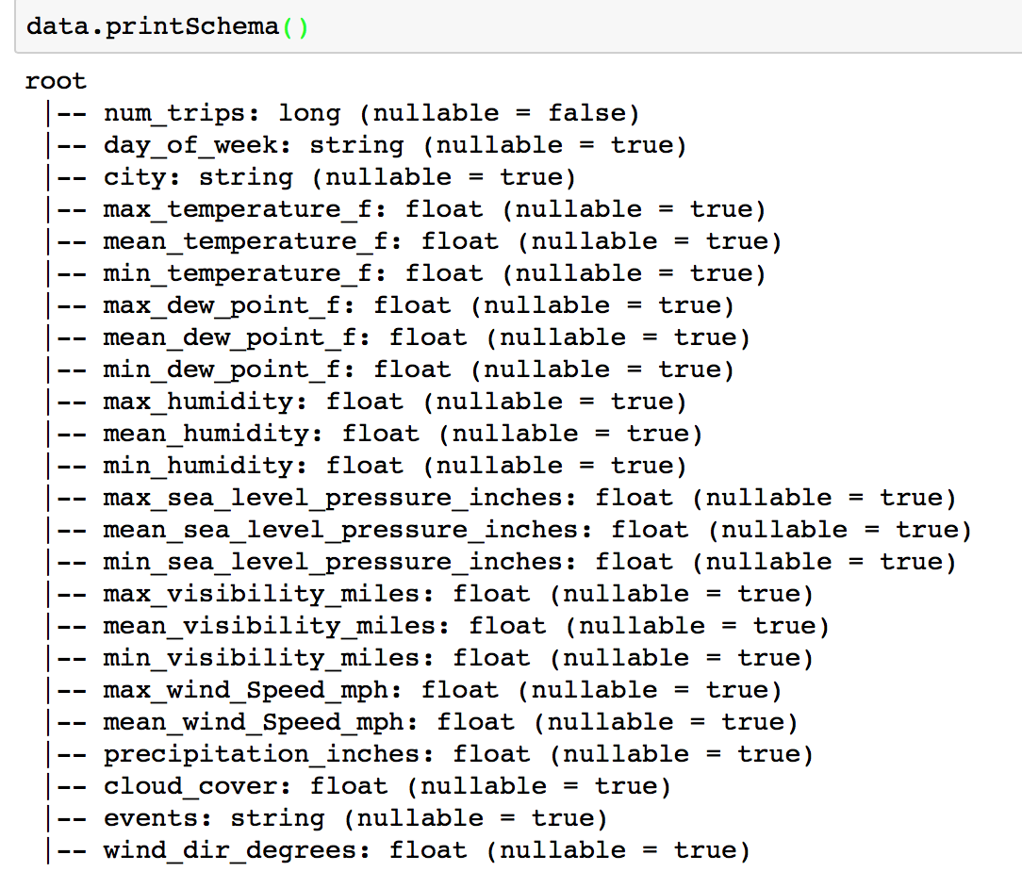
Imputing & Encoding
OneHotEncode

Slide 15
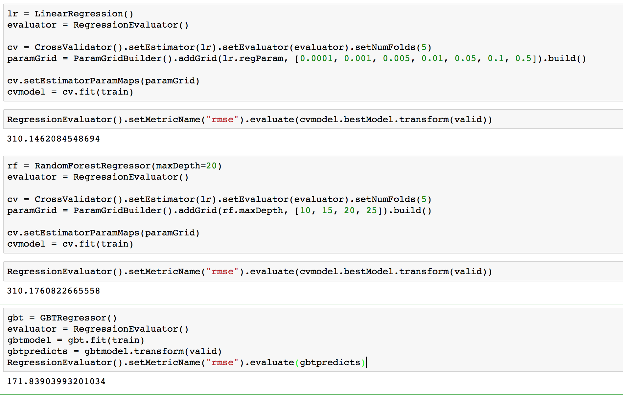
Machine Learning
Training set: 60%
Validation set: 20%
Test set: 20%
RMSE

Slide 16
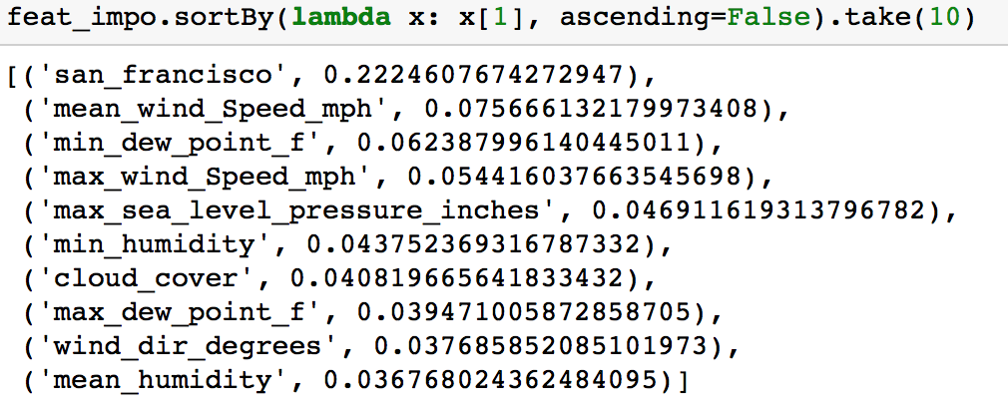
Conclusion
The GBT model has a R2
score of 9.4
Most Important features
San Francisco,
Mean Wind Speed

Slide 17
Lesson learned
Different operating systems have different characters representing the new line. We cannot discern difference except displaying in vim. The difference will interfere mongoimport command.
AWS EC2 has its architecture and space distribution that we usually have to go to a memory space much larger than the data we need to store
t2.small (2GB), t2.medium(4GB), t2.xlarge(16GB) - EBS
m3.2xlarge, 30GB - 2*80 SSD
s3 and ec2 put in the same region has higher connection success rate

Slide 18
Lesson Learned
Work with pyspark dataframe efficiently
Create dataframe with RDD and schema
pros: safe, easy to change column type
cons: heavy boring finger workout when the dataframe is wide
load data using spark.read.format()
pros: generate dataframe automatically without specifying schema
cons: sometimes hard to coerce to desired column type

