Slide 1
Computer System - 1

Slide 2
Contents
Computer Science?
Why?

Slide 3
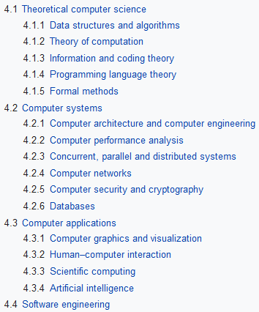
Computer Science?
Design and use of computers
Theory
Experimentation
Engineering

Slide 4
Why?
What does “Digital” mean?
Why do we have to know it?

Slide 5
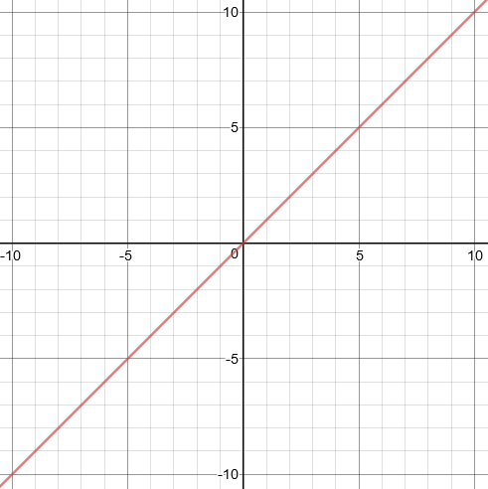
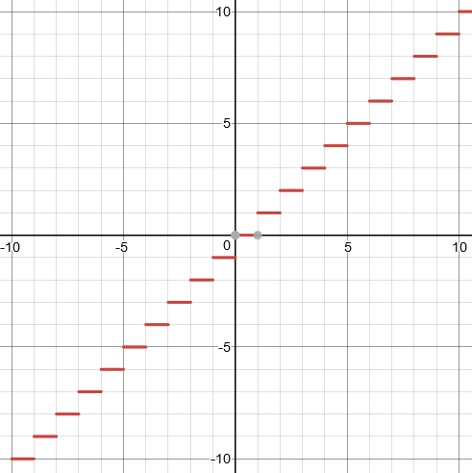
Digital?

Slide 6
bit?
Basic unit of information
0
1
false
true
on
off

Slide 7
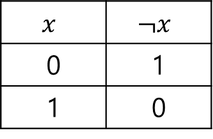
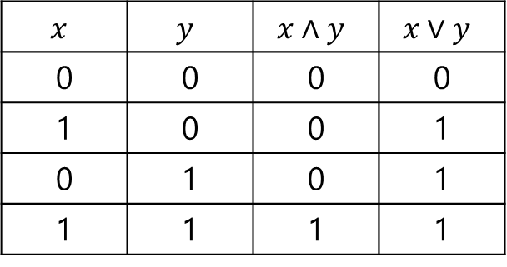
Boolean algebra
$$x$$ | $$y$$ | $$x∧y$$ | $$x∨y$$
0 | 0 | 0 | 0
1 | 0 | 0 | 1
0 | 1 | 0 | 1
1 | 1 | 1 | 1
$$x$$ | $$¬x$$
0 | 1
1 | 0

Slide 8
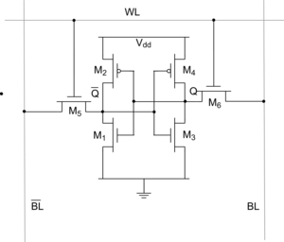
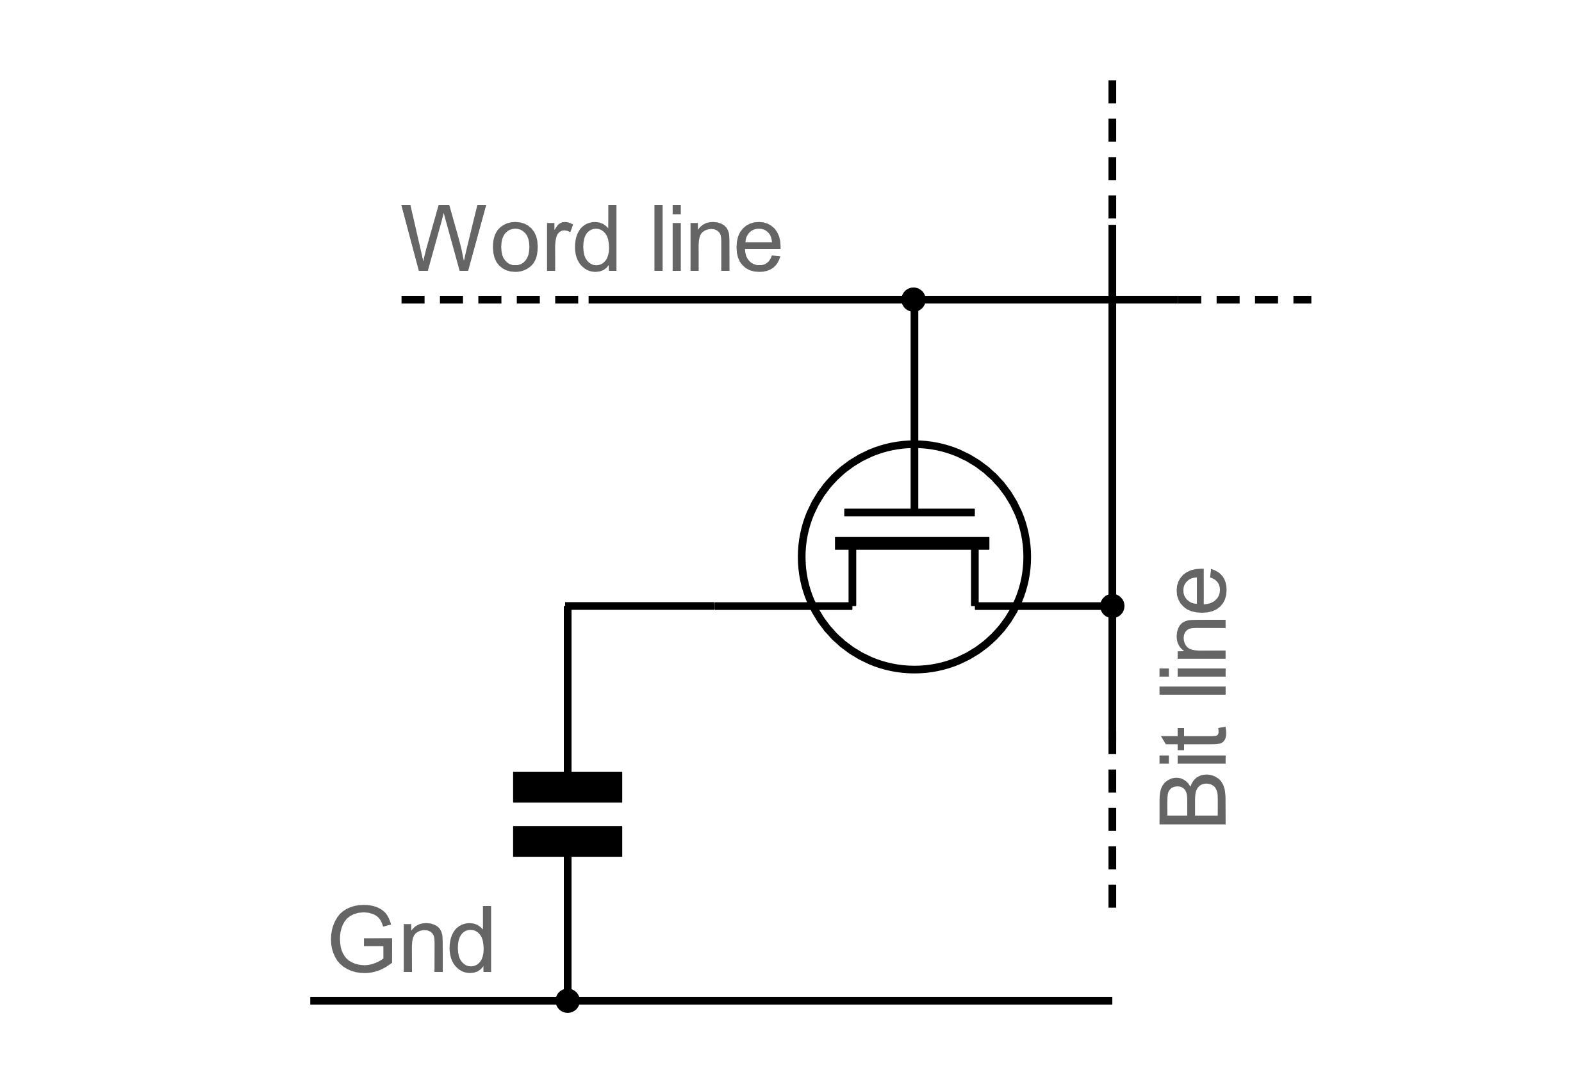
bit?
SRAM
DRAM

Slide 9
bit?
Random Access Memory(Virtual Memory Address)
byte
byte
byte
…

Slide 10
How to represent data?
Number, image, sound, character…
Everything in computer is bit!

Slide 11
Hexadecimal representation
Dec | 0 | 1 | 2 | 3 | 4 | 5 | 6 | 7 | 8 | 9 | 10 | 11 | 12 | 13 | 14 | 15
Hex | 0 | 1 | 2 | 3 | 4 | 5 | 6 | 7 | 8 | 9 | A | B | C | D | E | F
Ex)
13 = 00001101 = 0xD
89 = 01011001 = 0x59
255 = 11111111 = 0xFF

Slide 12
Overall
Mainly about computer architecture
A bit of exercise quiz

