Slide 1
CS:APP - 2

Slide 2
Contents
How to represent data?
Word
Bitwise operation

Slide 3
How to represent data?
How to interpret bit pattern into various forms
00000000000001001100100110001011 -> 0x0004C98B
Integer | Real(IEEE-754) | Character(ASCII) | Colour(ARGB)
313739 | 4.39642E-40 | NULL EQT É ‹

Slide 4
Word
Natural unit of data - instruction
Fixed-size data

Slide 5
Bitwise operation
a | b | a & b | a | b | a ^ b
0 | 0 | 0 | 0 | 0
1 | 0 | 0 | 1 | 1
0 | 1 | 0 | 1 | 1
1 | 1 | 1 | 1 | 0
a | !a
0 | 1
1 | 0

Slide 6
Bitwise operation
Bit field / Masking
Linux file permission ( umask / chmod )
Etc…

Slide 7
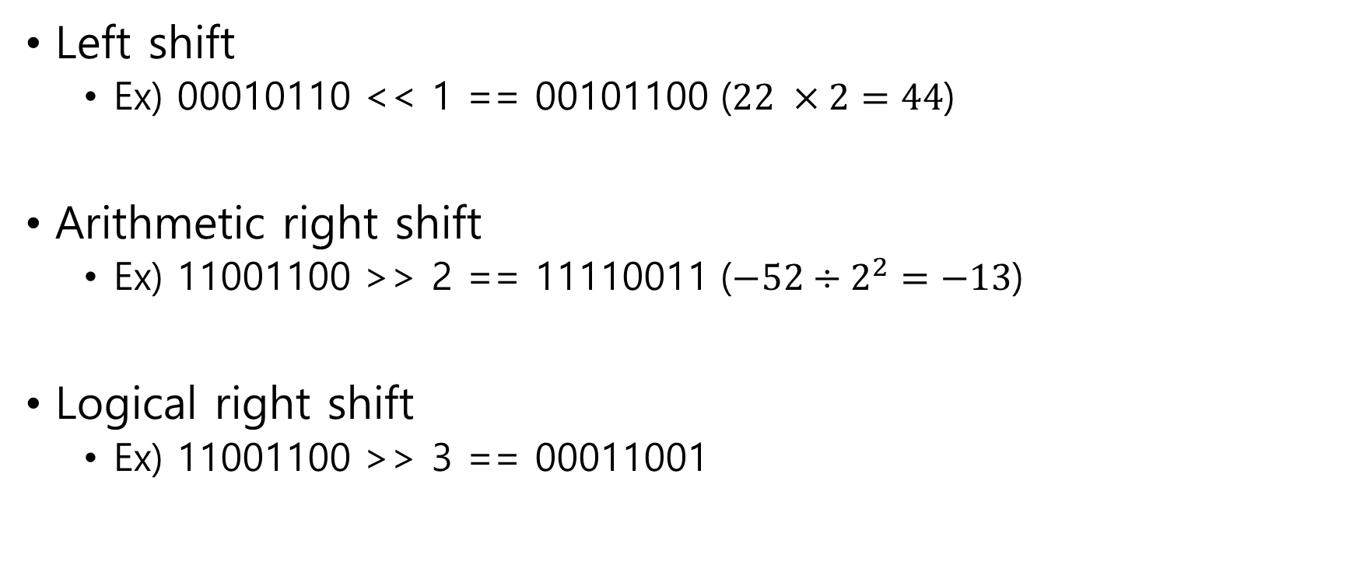
Bitwise left/right shift
Left shift
Ex) 00010110 << 1 == 00101100 ($22 ×2=44$)
Arithmetic right shift
Ex) 11001100 >> 2 == 11110011 ($−52÷2^{2}=−13$)
Logical right shift
Ex) 11001100 >> 3 == 00011001

