Slide 1

Arabic letter recognition and pronunciation evaluation
May Hanoon, Dalal Yassin and Hatem Ratrout
Supervisor: Dr. Othman Othman Department: Computer Science
1

Slide 2
Introduction What is the program? What does it do? How it work?
2

Slide 3
Our Target
Our main target is for children elementary school student, Non native children even the blind children.
3

Slide 4

Aims and problems we solved
Little work is done for Arabic speech recognition especially for kids.
The teaching problems with E-learning.
Letting them pronounce well.
Games are the fun way to learn.
4

Slide 5
Methods and Tools
We used Python language, Matlab and C# for Unity Engine.
We used Tensorflow and Keras framework and used in Matlab Deep Learning Toolbox and Audio Toolbox.
5

Slide 6
The models we used
Our CNN layers.
Alexnet.
Vgg16 use transfer learning with and without tuning.
Yamnet use transfer learning.
6

Slide 7

The methods we used to build the recognition system
Collected the data set for the 28 Arabic letters.
Pre-processed the audio dataset.
Split the audio dataset to train, test and validation sets.
Extracted features from the audio.
We had 2 form datasets one is MFCCS.
The second one is mel-spectrogram.
Then we used these data as inputs for the models we use and built.
Then trained the model with different epochs and batch size and learning rate.
7

Slide 8
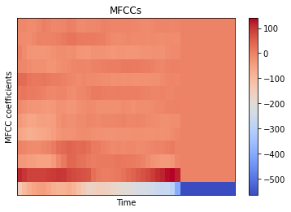
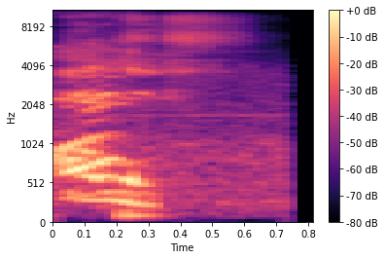

Slide 9
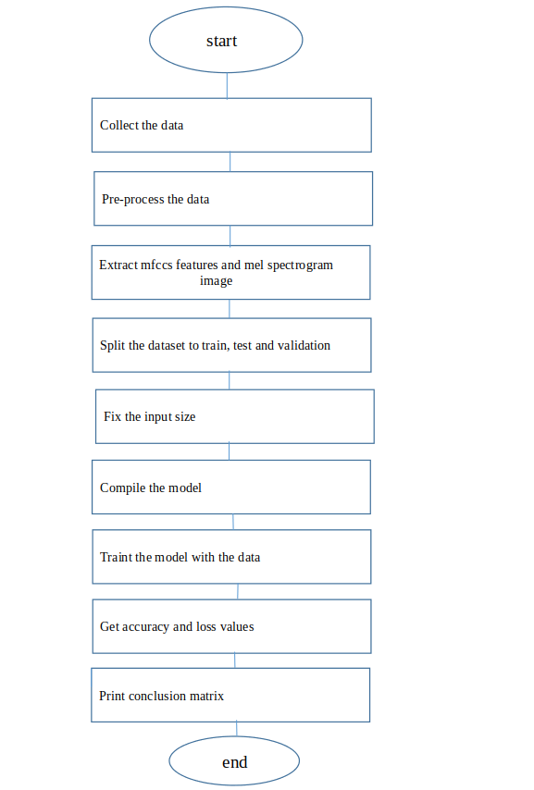
The flowchart show the steps to make the CNN models:

Slide 10

The methods to use recognition system
Sound pre-process.
Extract features.
Load the model.
Input the sound.
Evaluate the prediction.
Get the output which is text.
Compare text with correct text.
10

Slide 11
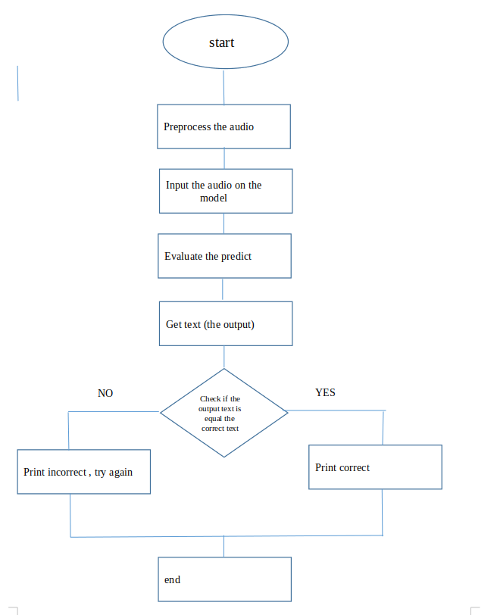
The flowchart for how to use this model to check if the pronounce is correct or not:

Slide 12
Results
The result of training differs from model to another, they are vary between good and bad results.
12

Slide 13
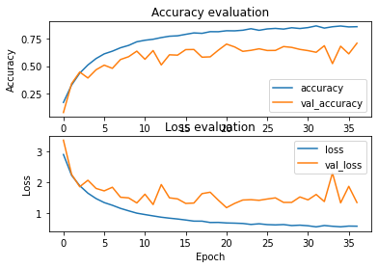
CNN

Slide 14
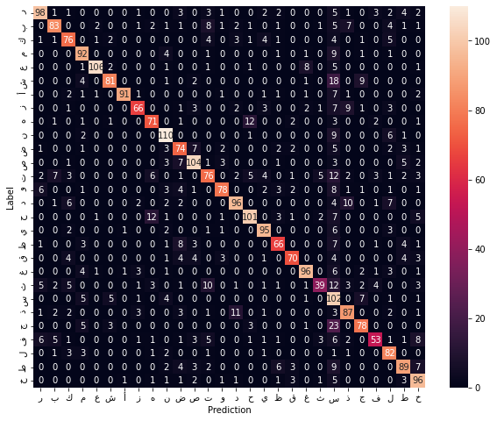
CNN

Slide 15
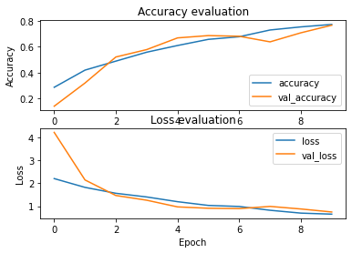
Alexnet

Slide 16
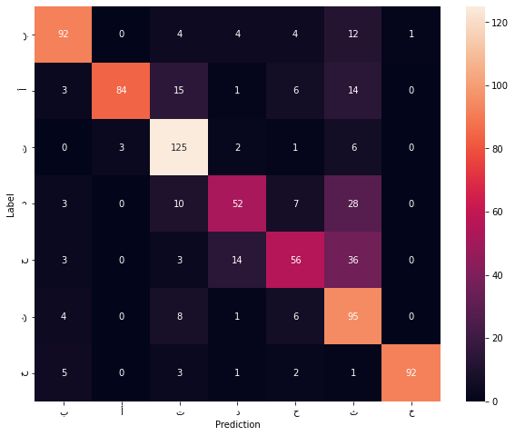
Alexnet

Slide 17
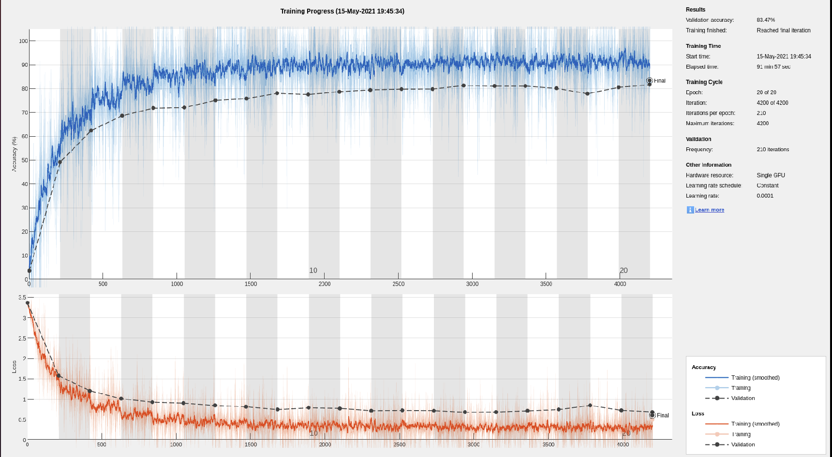
Yamnet

Slide 18
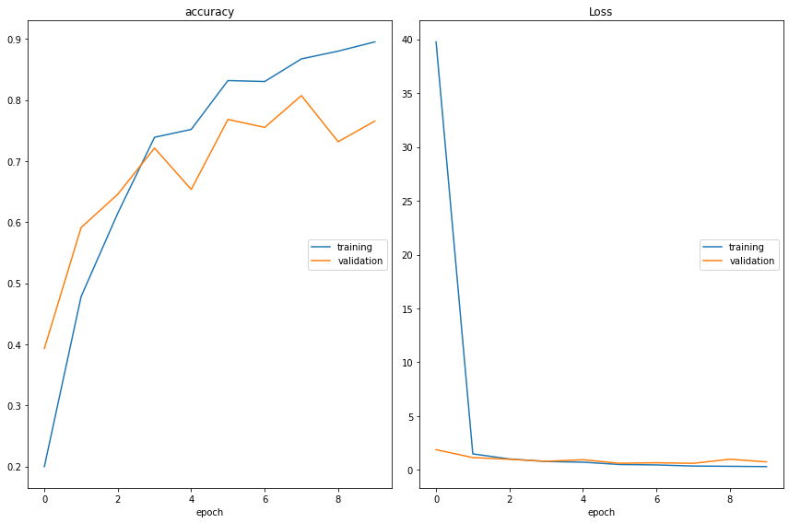
Vgg16 - without tuning

Slide 19
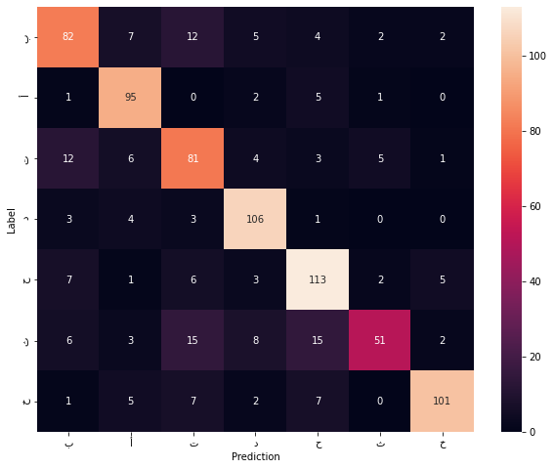
Vgg16 - without tuning

Slide 20
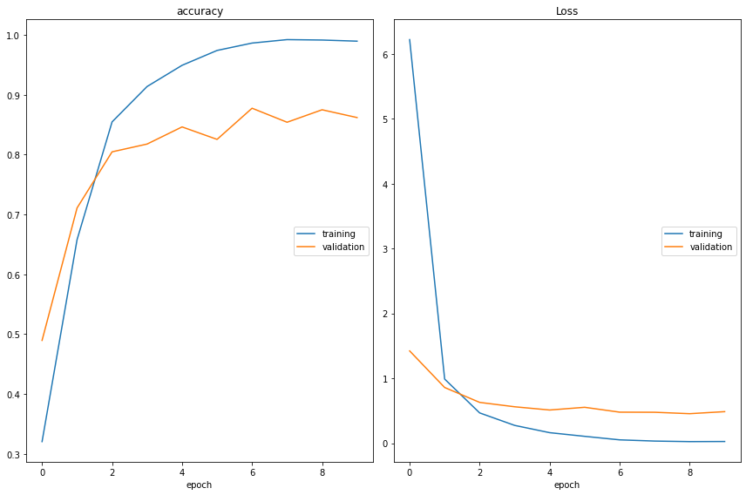
Vgg16 - with tuning

Slide 21
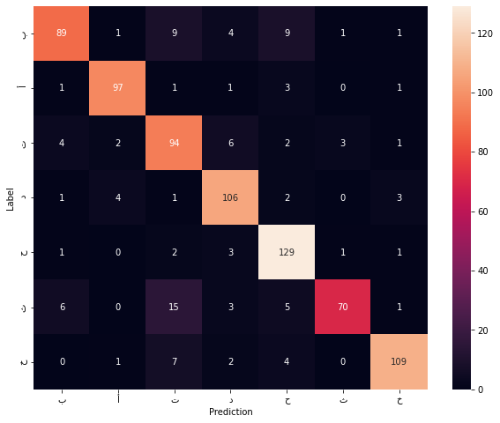
Vgg16 - with tuning

Slide 22
Challenges and difficulties
1
Small Data
2
Noise
3
Overfitting
22

Slide 23

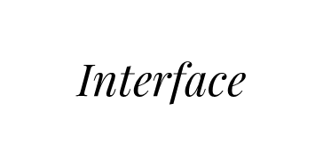

Place your screenshot here

Slide 24

Any question?

