Slide 1
COMPUTER VISION AND IMAGE PROCESSING — BOCCONI UNIVERSITY
Feedback-Augmented RT-DETR
A Cross-Attention Refinement Strategy for Enhanced Small-Object Detection
Hatem Saadallah · Nour Jennane
Final Project · April 2026

Slide 2
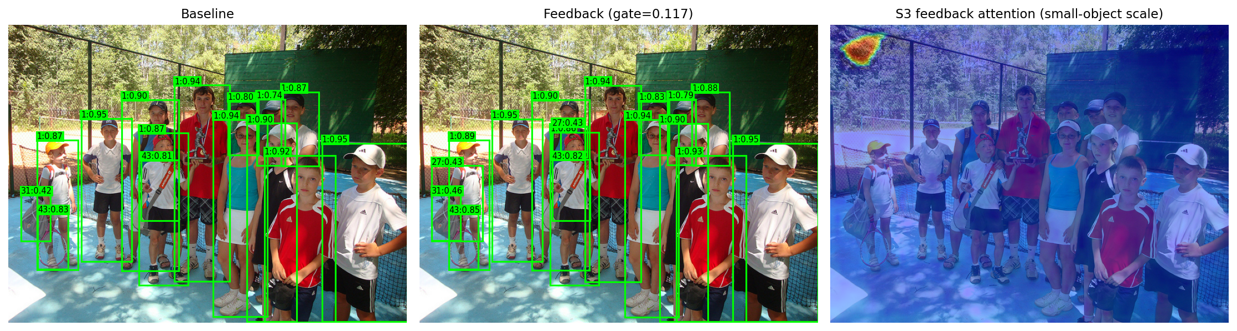
The problem: small objects in RT-DETR
RT-DETR is fast and NMS-free — but small-object AP lags.
AP_S (small)
AP_L (large)
34.7
67.7
33-point gap on the same model. Why?
Encoder memory is computed once before any decoder layer fires. It is never refined as the decoder accumulates information. Small objects need every available cue at every layer.
Feedback-Augmented RT-DETR • Hatem Saadallah & Nour Jennane • Bocconi University
2 / 10

Slide 3
The idea: feed early predictions back into memory
After decoder layer 1, refine encoder memory using its own predictions.
Cross-attention with a learnable scalar gate g_eff.
75% of memory tokens live at stride 4 — the natural resolution for small objects.
Feedback-Augmented RT-DETR • Hatem Saadallah & Nour Jennane • Bocconi University
3 / 10

Slide 4

v1: the mechanism trained — but contributed nothing
Same-checkpoint inference ablation on COCO val2017 @ 640:
Toggling feedback on/off at inference made zero difference.
The cross-attention weights were trained, but the gate had decayed to ≈0.12 during training. The feedback signal was being multiplied by ~zero before reaching memory.
Feedback-Augmented RT-DETR • Hatem Saadallah & Nour Jennane • Bocconi University
4 / 10

Slide 5
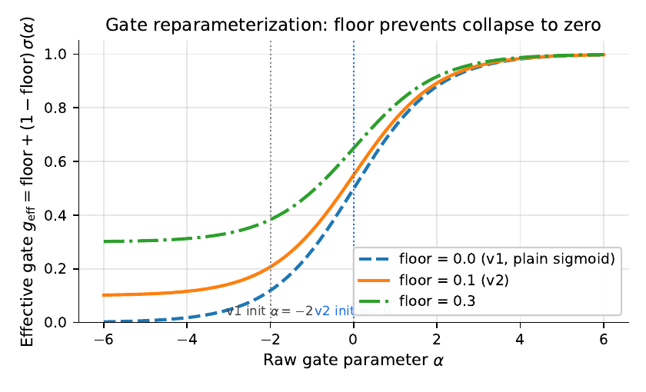
Diagnosis: the gate had an escape route
Plain sigmoid gate.
• Gradient → 0 as α → −∞ • If the rest of the network can compensate, the optimizer pushes α arbitrarily negative at no cost. • Nothing pulls the gate back up.
Feedback-Augmented RT-DETR • Hatem Saadallah & Nour Jennane • Bocconi University
5 / 10

Slide 6
Fix 1: gate floor reparameterization
Bound the effective gate below by a floor. The optimizer can attenuate, never silence.
floor = 0.1
α_init = 0
0 new params
v2 choice
→ g_eff = 0.55 at start
purely a reparameterization
Feedback-Augmented RT-DETR • Hatem Saadallah & Nour Jennane • Bocconi University
6 / 10

Slide 7
Fix 2: refine only where small objects live
P2 (stride 4) and P3 (stride 8) carry small-object signal. S4/S5 pass through unchanged.
P2
P3
P4
P5
160×160 = 25,600
80×80 = 6,400
40×40 = 1,600
20×20 = 400
stride 4
stride 8
stride 16
stride 32
✓ refined
✓ refined
— skipped
— skipped
Feedback-Augmented RT-DETR • Hatem Saadallah & Nour Jennane • Bocconi University
7 / 10

Slide 8

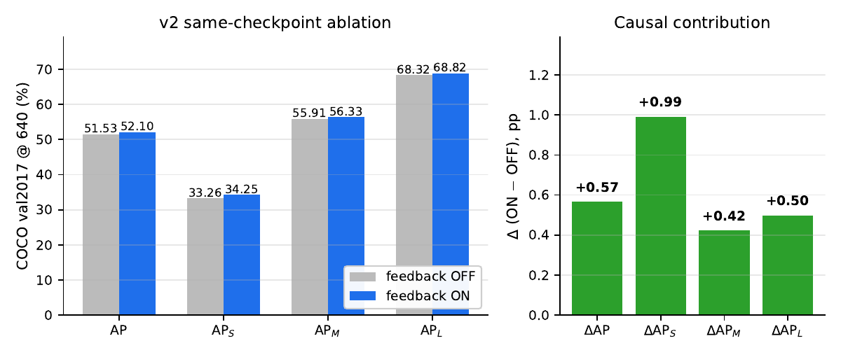
Result: the mechanism is now causally measurable
 | ON | OFF | Δ (causal)
AP | 52.10 | 51.53 | +0.57
AP_S | 34.25 | 33.26 | +0.99
AP_M | 56.33 | 55.91 | +0.42
AP_L | 68.82 | 68.32 | +0.50
Same checkpoint, only inference-time toggle. AP_S @ 800 reaches 37.01.
Feedback-Augmented RT-DETR • Hatem Saadallah & Nour Jennane • Bocconi University
8 / 10

Slide 9
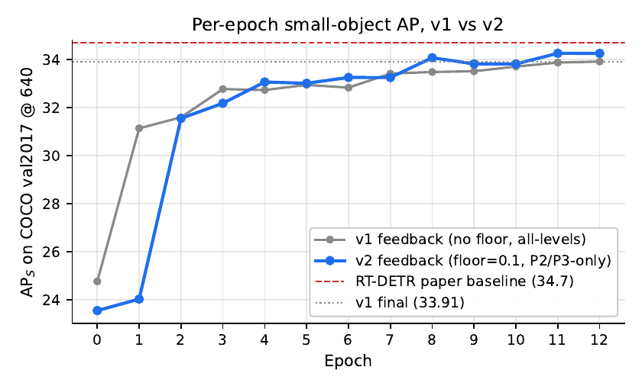
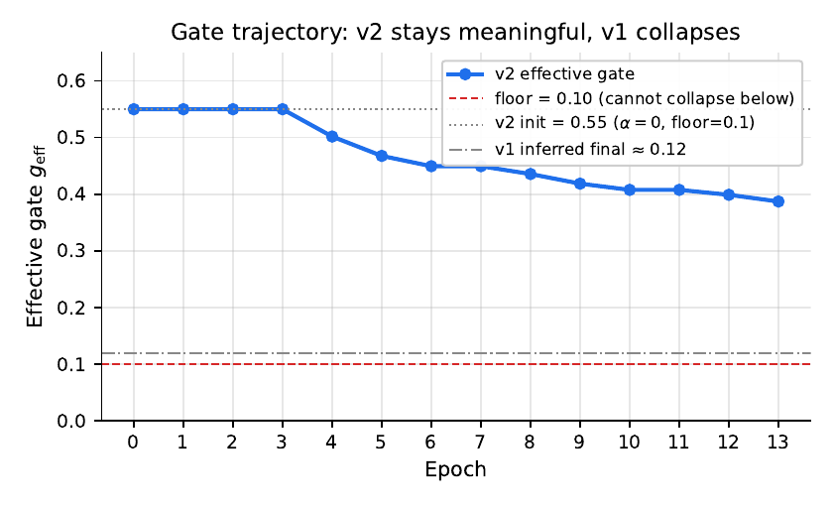
v2 climbs faster and ends higher
v2 first crosses v1's eventual final 33.91 at epoch 8 — four epochs early.
Gate stays at ≈0.39 (well above the 0.1 floor).
Feedback-Augmented RT-DETR • Hatem Saadallah & Nour Jennane • Bocconi University
9 / 10

Slide 10
Limitations and resources
Limitations
Resources
13 epochs instead of the 72 of the standard 6× schedule (compute-limited finetune from public weights).
📦 GitHub repository
github.com/HatemSaadallah/feedback-augmented-rtdetr
Single seed — multi-seed reproducibility study is open.
📄 Full 16-page report (PDF)
Floor & mask not isolated — a 2×2 ablation would resolve.
report/main.pdf · view on GitHub
2× slower than baseline — cost is from the P2 stride-4 level, not the feedback module.
🔬 Reproduce the ablation
tools/full_ablation.py → --feedback-off
COCO only — aerial / surveillance datasets are obvious next steps.
🏛 Course
Computer Vision and Image Processing
Bocconi University — MSc AI
Thank you. Questions welcome.
Feedback-Augmented RT-DETR • Hatem Saadallah & Nour Jennane • Bocconi University
10 / 10

