Slide 1
BOCCONI UNIVERSITY · COMPUTER VISION & IMAGE PROCESSING
Feedback-Augmented RT-DETR
for Small Object Detection
Hatem Saadallah · Nour Jennane
Final Project · April 2026

Slide 2
SECTION 1 / 5
Problem Formulation
What is small-object detection, and why does RT-DETR struggle?
1. Problem Formulation • Feedback-Augmented RT-DETR • Hatem Saadallah & Nour Jennane
1 / 28

Slide 3
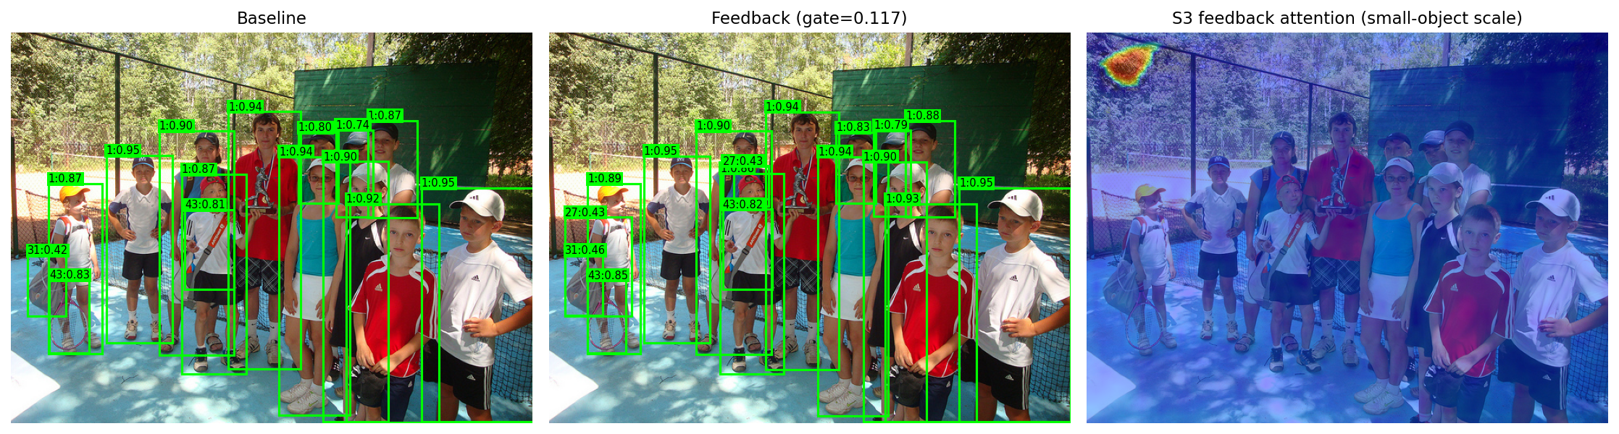
Small objects are harder to detect
AP_{L} (large)
67.7
AP_{S} (small)
34.7
33-point gap. Why?
1. Problem Formulation • Feedback-Augmented RT-DETR • Hatem Saadallah & Nour Jennane
2 / 28

Slide 4
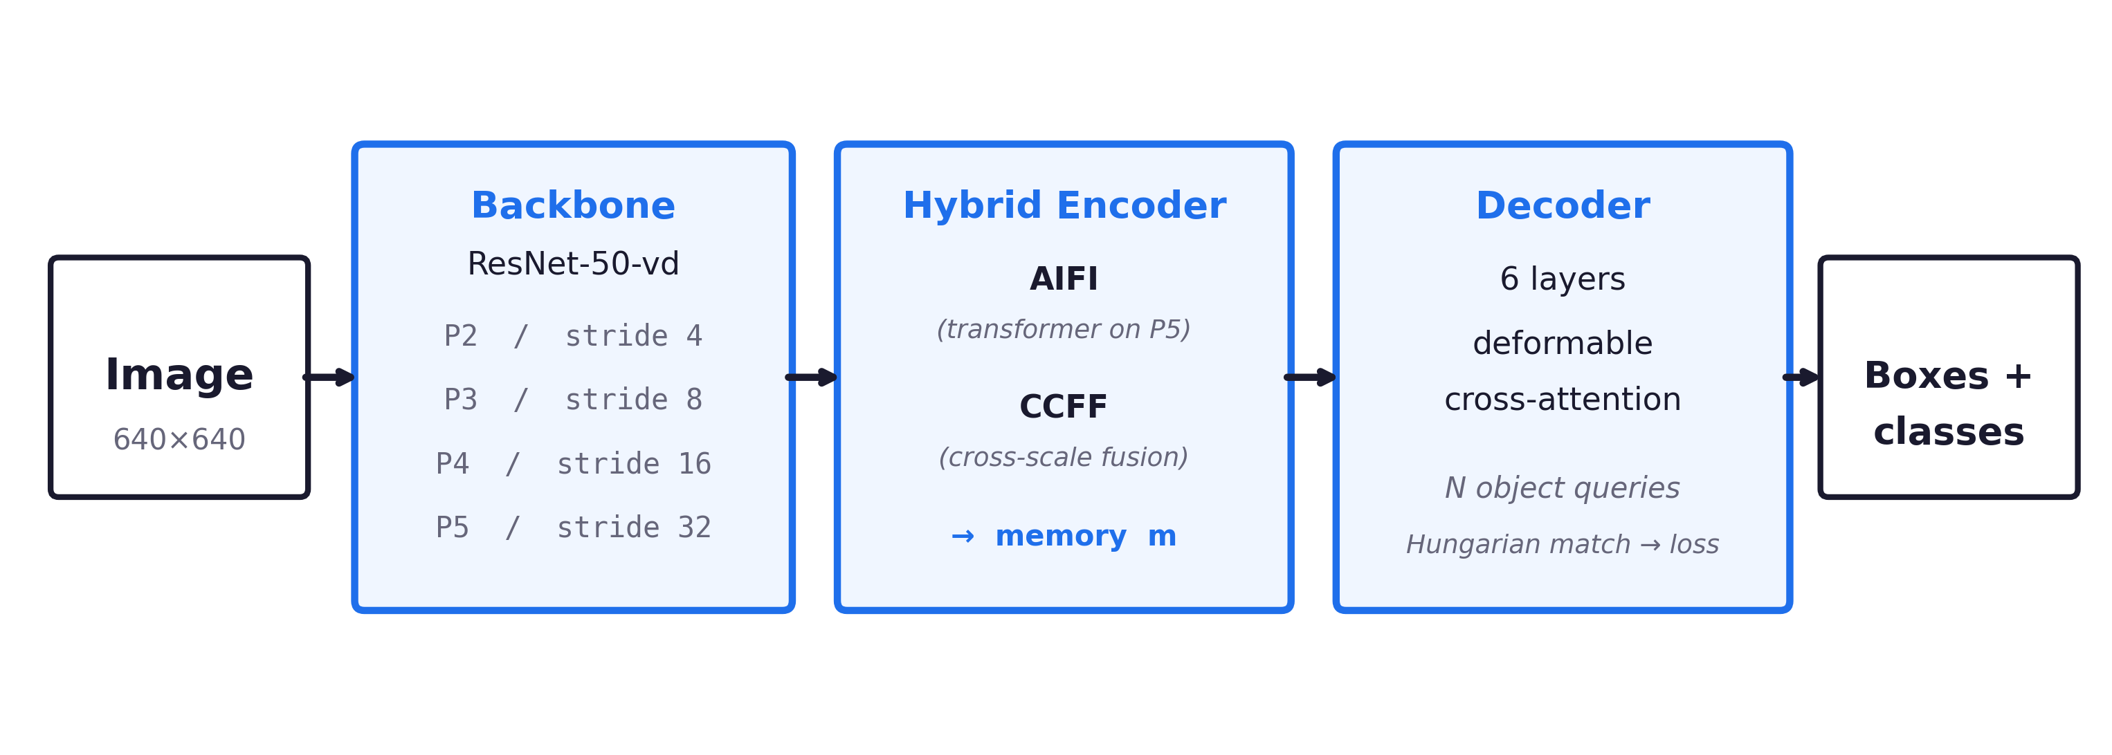
RT-DETR: backbone → encoder → decoder
End-to-end, NMS-free. Six decoder layers all attend over the same encoder memory.
Backbone extracts a feature pyramid (P2–P5); the hybrid encoder fuses scales; the decoder cross-attends.
1. Problem Formulation • Feedback-Augmented RT-DETR • Hatem Saadallah & Nour Jennane
3 / 28

Slide 5

The reason is structural
Encoder memory is computed once. The decoder cannot revise it.
Refinement of the features small objects live in is a one-way street.
1. Problem Formulation • Feedback-Augmented RT-DETR • Hatem Saadallah & Nour Jennane
4 / 28

Slide 6
SECTION 2 / 5
Data Sourcing Strategy
What dataset we used and why it is appropriate.
2. Data Sourcing Strategy • Feedback-Augmented RT-DETR • Hatem Saadallah & Nour Jennane
5 / 28

Slide 7
COCO 2017 — the standard small-object benchmark
Dataset
Why COCO?
Microsoft COCO 2017
• Standard benchmark — directly comparable to RT-DETR, DETR, YOLO.
Splits
train2017: 118k images, 860k boxes
• Has explicit small / medium / large size buckets (S / M / L).
val2017: 5k images (held out)
• ~41% of annotated boxes are small (area < 32² px).
Pre-trained weights
rtdetr_r50vd_6x_coco.pth (public, finetuned 13 ep)
• Same pre-training corpus as our baseline → fair comparison.
2. Data Sourcing Strategy • Feedback-Augmented RT-DETR • Hatem Saadallah & Nour Jennane
6 / 28

Slide 8
SECTION 3 / 5
Proposed Solution
The feedback module, the math behind it, and the two fixes that make it work.
3. Proposed Solution • Feedback-Augmented RT-DETR • Hatem Saadallah & Nour Jennane
7 / 28

Slide 9

Our idea: let the model refine its own features
Feed early decoder predictions back into the encoder memory.
3. Proposed Solution • Feedback-Augmented RT-DETR • Hatem Saadallah & Nour Jennane
8 / 28

Slide 10
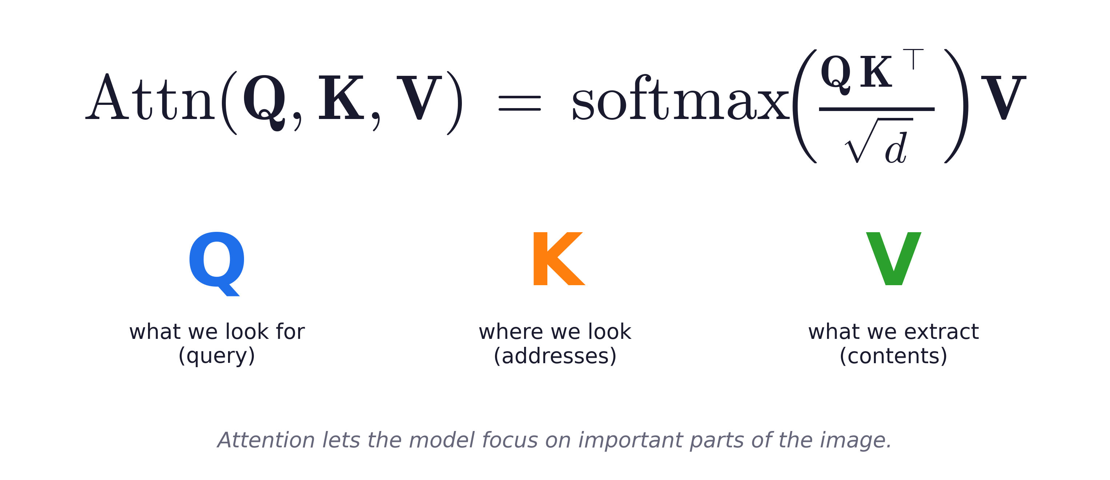
Attention, in one line
3. Proposed Solution • Feedback-Augmented RT-DETR • Hatem Saadallah & Nour Jennane
9 / 28

Slide 11
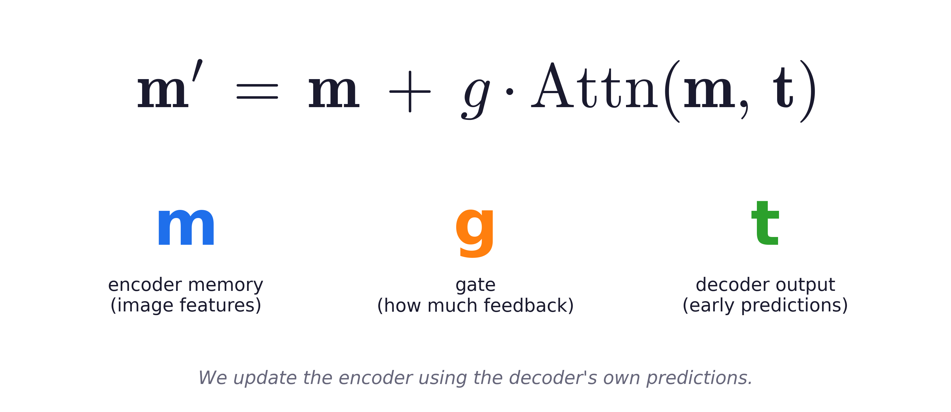
Our feedback rule
3. Proposed Solution • Feedback-Augmented RT-DETR • Hatem Saadallah & Nour Jennane
10 / 28

Slide 12
First attempt (v1) — and why it failed
Plain sigmoid gate, applied to all four pyramid levels.
Why?
Δ AP_{S} = 0.00
α drifts to −∞ → gate ≈ 0. The feedback signal is multiplied by zero before reaching memory.
the mechanism contributed nothing
3. Proposed Solution • Feedback-Augmented RT-DETR • Hatem Saadallah & Nour Jennane
11 / 28

Slide 13
First attempt (v1) — and why it failed
Plain sigmoid gate, applied to all four pyramid levels.
Why?
Δ AP_{S} = 0.00
α drifts to −∞ → gate ≈ 0. The feedback signal is multiplied by zero before reaching memory.
the mechanism contributed nothing
3. Proposed Solution • Feedback-Augmented RT-DETR • Hatem Saadallah & Nour Jennane
12 / 28

Slide 14
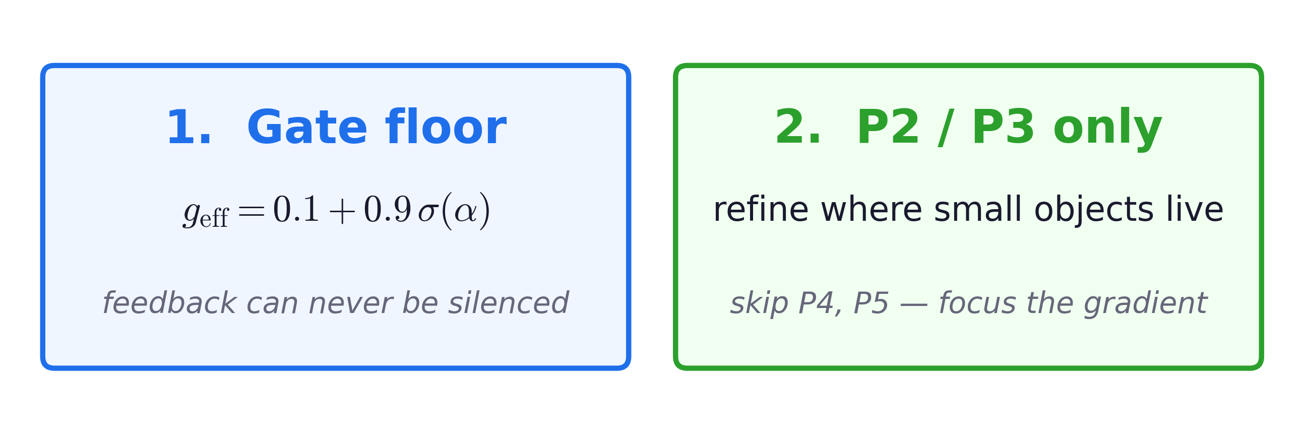
v2: two fixes — zero new parameters
Reparameterize the gate. Refine only the levels small objects live in.
3. Proposed Solution • Feedback-Augmented RT-DETR • Hatem Saadallah & Nour Jennane
13 / 28

Slide 15
SECTION 4 / 5
Performance Evaluation Approach
Metrics, baselines, and the same-checkpoint ablation that isolates causality.
4. Evaluation Approach • Feedback-Augmented RT-DETR • Hatem Saadallah & Nour Jennane
14 / 28

Slide 16
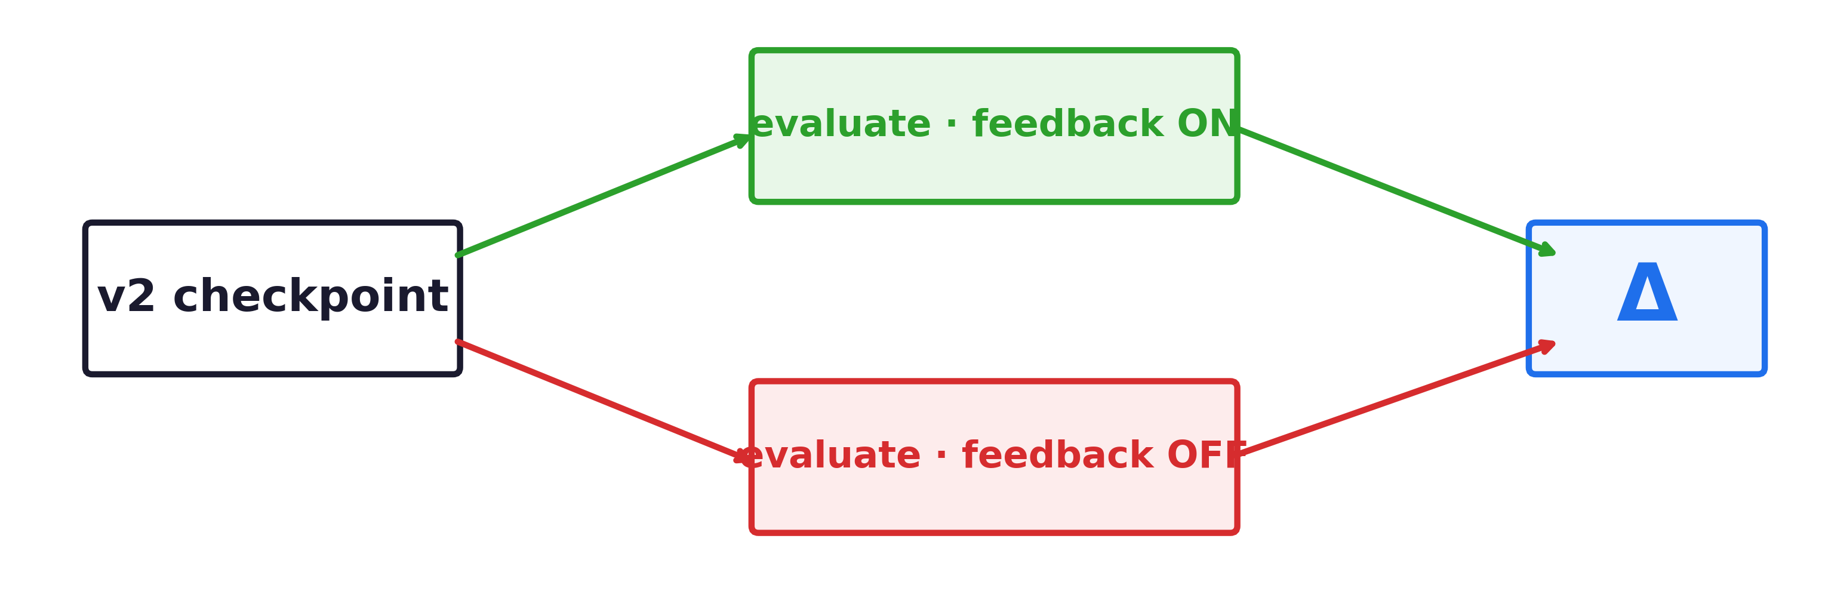
How we evaluate the contribution
Metrics (COCO standard)
Baselines
AP, AP_{S}, AP_{M}, AP_{L} — IoU 0.5..0.95
RT-DETR-R50 (published)
AP_{S} is the headline metric (area < 32² px)
v1 feedback (before the fix)
Others verify we don't degrade easier categories.
v2 feedback (with the fix)
Same-checkpoint ablation — isolates causal contribution
Toggle feedback ON / OFF at inference. Identical weights, identical inputs.
4. Evaluation Approach • Feedback-Augmented RT-DETR • Hatem Saadallah & Nour Jennane
15 / 28

Slide 17
SECTION 5 / 5
Final Results
Training trajectory, the causal effect, robustness, trade-offs, and what's next.
5. Final Results • Feedback-Augmented RT-DETR • Hatem Saadallah & Nour Jennane
16 / 28

Slide 18
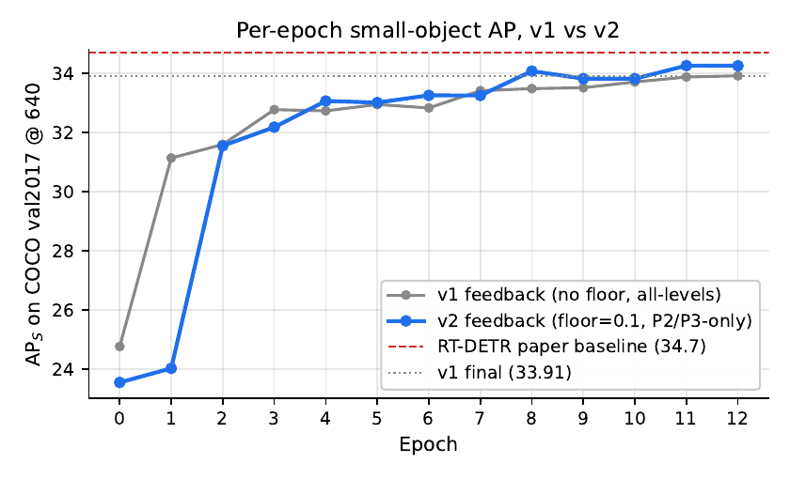
Training: v2 climbs faster, ends higher
v2 first crosses v1's final 33.91 at epoch 8 — four epochs early.
5. Final Results • Feedback-Augmented RT-DETR • Hatem Saadallah & Nour Jennane
17 / 28

Slide 19
Training: v2 climbs faster, ends higher
v2 crosses here
at epoch 8 (4 early)
v2 first crosses v1's final 33.91 at epoch 8 — four epochs early.
5. Final Results • Feedback-Augmented RT-DETR • Hatem Saadallah & Nour Jennane
18 / 28

Slide 20
Final performance (with feedback ON)
v1
v2
33.91
34.30
AP_{S}
AP_{S} +0.4
5. Final Results • Feedback-Augmented RT-DETR • Hatem Saadallah & Nour Jennane
19 / 28

Slide 21
Causal effect of feedback
ON
OFF
Δ
34.25
33.26
+0.99
feedback enabled
feedback bypassed
the contribution
Feedback has a real causal impact on small-object detection.
5. Final Results • Feedback-Augmented RT-DETR • Hatem Saadallah & Nour Jennane
20 / 28

Slide 22
Causal effect of feedback
ON
OFF
Δ
34.25
33.26
+0.99
feedback enabled
feedback bypassed
the contribution
Feedback has a real causal impact on small-object detection.
5. Final Results • Feedback-Augmented RT-DETR • Hatem Saadallah & Nour Jennane
21 / 28

Slide 23
Higher resolution → bigger gain
640 × 640
800 × 800
34.25
37.01
+2.76 from more pixels.
Feedback helps. Spatial sampling helps too.
5. Final Results • Feedback-Augmented RT-DETR • Hatem Saadallah & Nour Jennane
22 / 28

Slide 24
Higher resolution → bigger gain
640 × 640
800 × 800
34.25
37.01
+2.76 from more pixels.
Feedback helps. Spatial sampling helps too.
5. Final Results • Feedback-Augmented RT-DETR • Hatem Saadallah & Nour Jennane
23 / 28

Slide 25
Strengths and limitations
+ Strengths
− Limitations
• Causal contribution: +0.99 on small-object AP, same checkpoint.
• Single seed — multi-seed variance unmeasured.
• Zero new parameters relative to v1.
• 13-epoch finetune (vs 72-epoch from scratch).
• Consistent improvement on every metric (AP, S, M, L).
• Floor and mask not isolated (a 2×2 ablation is missing).
• Robust at higher resolution (37.01 small-object AP at 800×800).
• ≈2× slower than baseline (53 → 26 FPS) — cost is the P2 level.
Strong on accuracy; pays in inference speed. The next slide proposes a way to recover speed.
5. Final Results • Feedback-Augmented RT-DETR • Hatem Saadallah & Nour Jennane
24 / 28

Slide 26
Future work: recovering inference speed
The 2× slowdown comes from the P2 level, not the feedback module.
1
Train with P2, infer without
2
Lighter P2 path
3
Knowledge distillation
fastest path
compromise
principled
How
How
How
Use P2 during training to improve small-object learning, then remove it at inference.
Reduce the cost of P2 — fewer channels, or a simpler projection layer.
Transfer v2's small-object improvements into a faster baseline RT-DETR student.
Goal
Goal
Goal
Keep most of the +0.99 small-object AP gain without the P2 computational cost.
Preserve small-object improvements while reducing the high-resolution P2 slowdown.
Recover baseline inference speed while retaining the small-object AP gains learned from P2 feedback.
Common goal: keep the +0.99 small-object AP gain while approaching the 53 FPS baseline.
5. Final Results • Feedback-Augmented RT-DETR • Hatem Saadallah & Nour Jennane
25 / 28

Slide 27
Conclusion
1
Feedback improves small-object detection
+0.99 small-object AP, causal contribution at inference.
2
Only works with proper design
Floor the gate; restrict to small-object levels.
3
Modest but real
Consistent across metrics; reproducible from the same checkpoint.
5. Final Results • Feedback-Augmented RT-DETR • Hatem Saadallah & Nour Jennane
26 / 28

Slide 28
Thank you.
Questions?
Hatem Saadallah · Nour Jennane
github.com/HatemSaadallah/feedback-augmented-rtdetr

