Slide 1
2026 DATA STACK — FIVE LAYERS DEEP DIVE
TM-20 · Primer
UNCLASSIFIED
UNCLASSIFIED
USAREUR-AF · C2DAO · MSS
UNCLASSIFIED

Slide 2
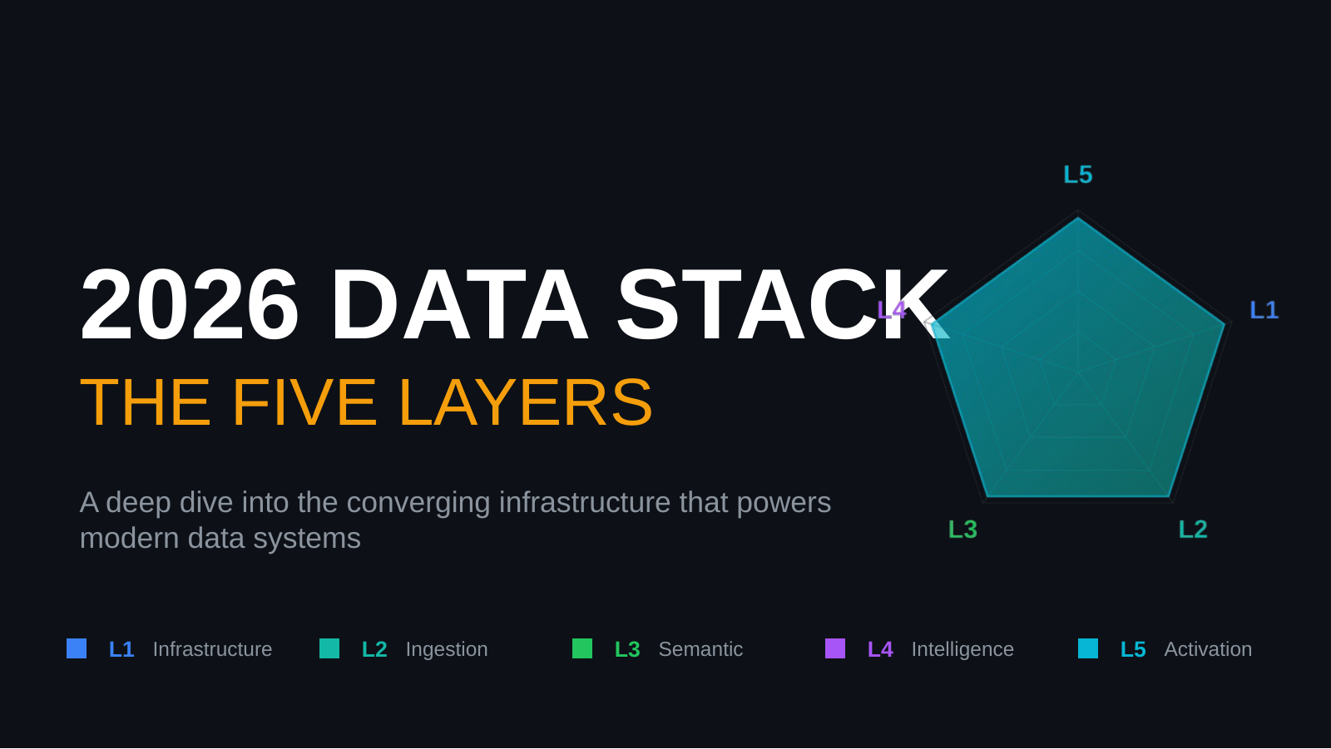
UNCLASSIFIED
2026 DATA STACK — FIVE LAYERS DEEP DIVE · TM-20 · Primer
UNCLASSIFIED

Slide 3
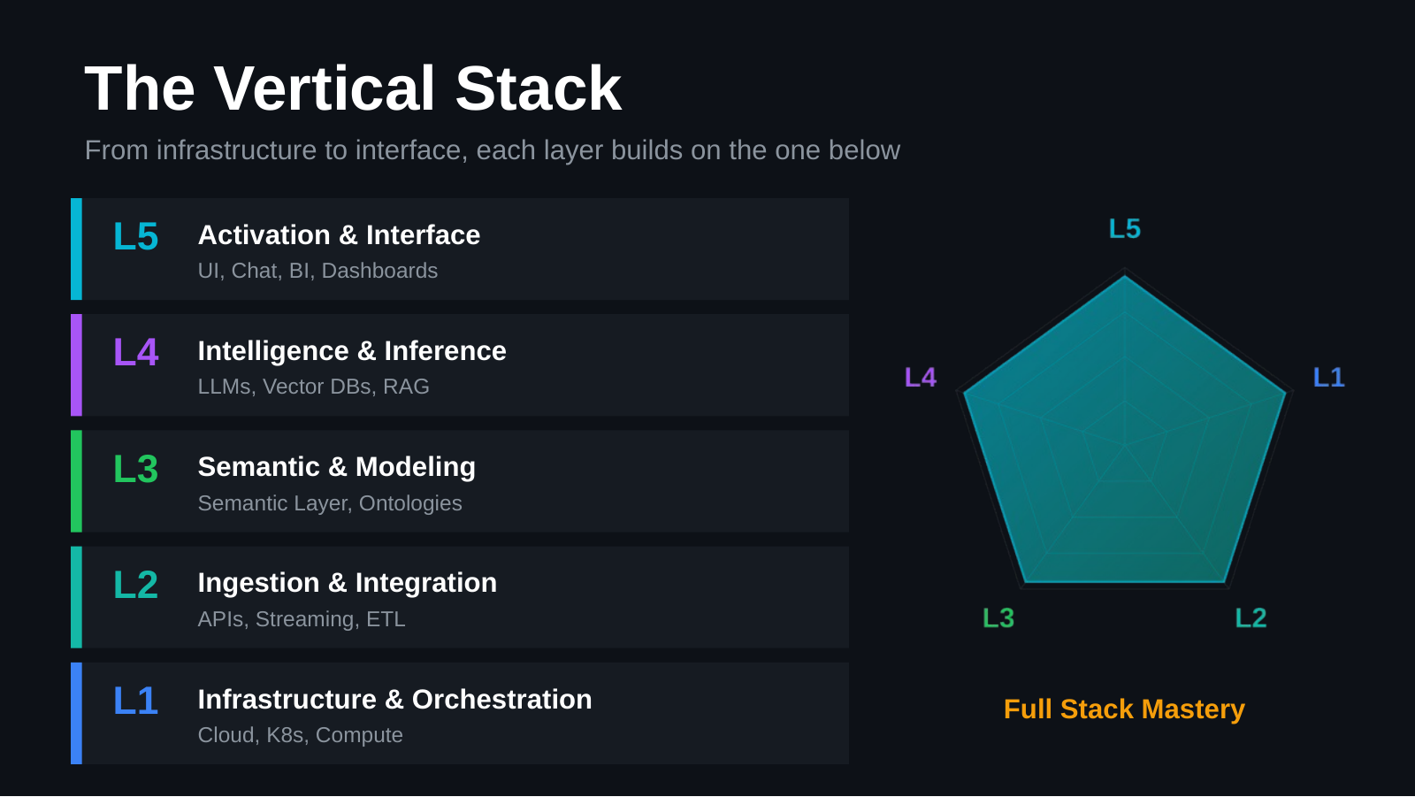
UNCLASSIFIED
2026 DATA STACK — FIVE LAYERS DEEP DIVE · TM-20 · Primer
UNCLASSIFIED

Slide 4
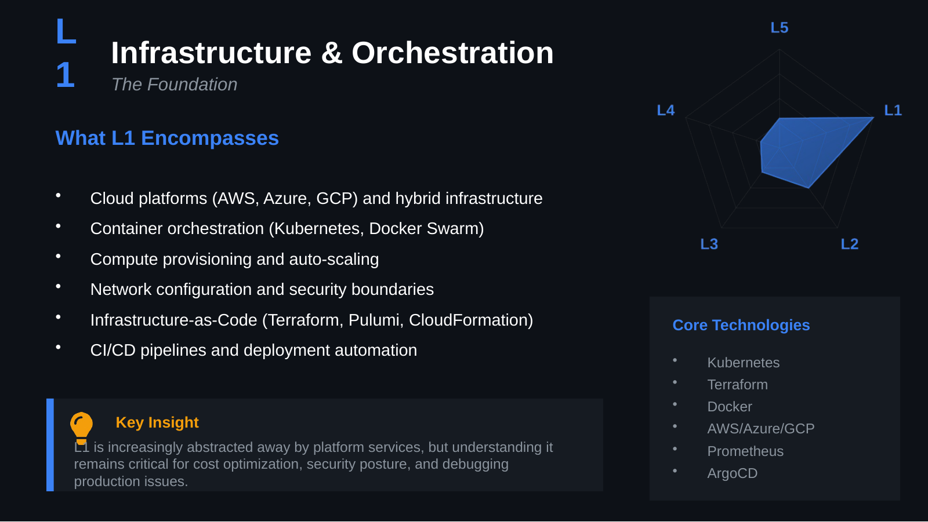
UNCLASSIFIED
2026 DATA STACK — FIVE LAYERS DEEP DIVE · TM-20 · Primer
UNCLASSIFIED

Slide 5
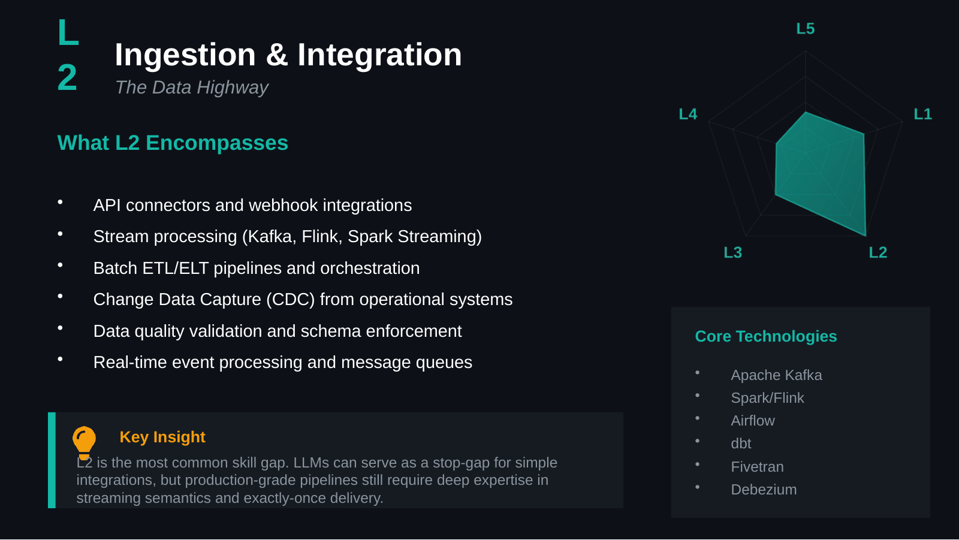
UNCLASSIFIED
2026 DATA STACK — FIVE LAYERS DEEP DIVE · TM-20 · Primer
UNCLASSIFIED

Slide 6
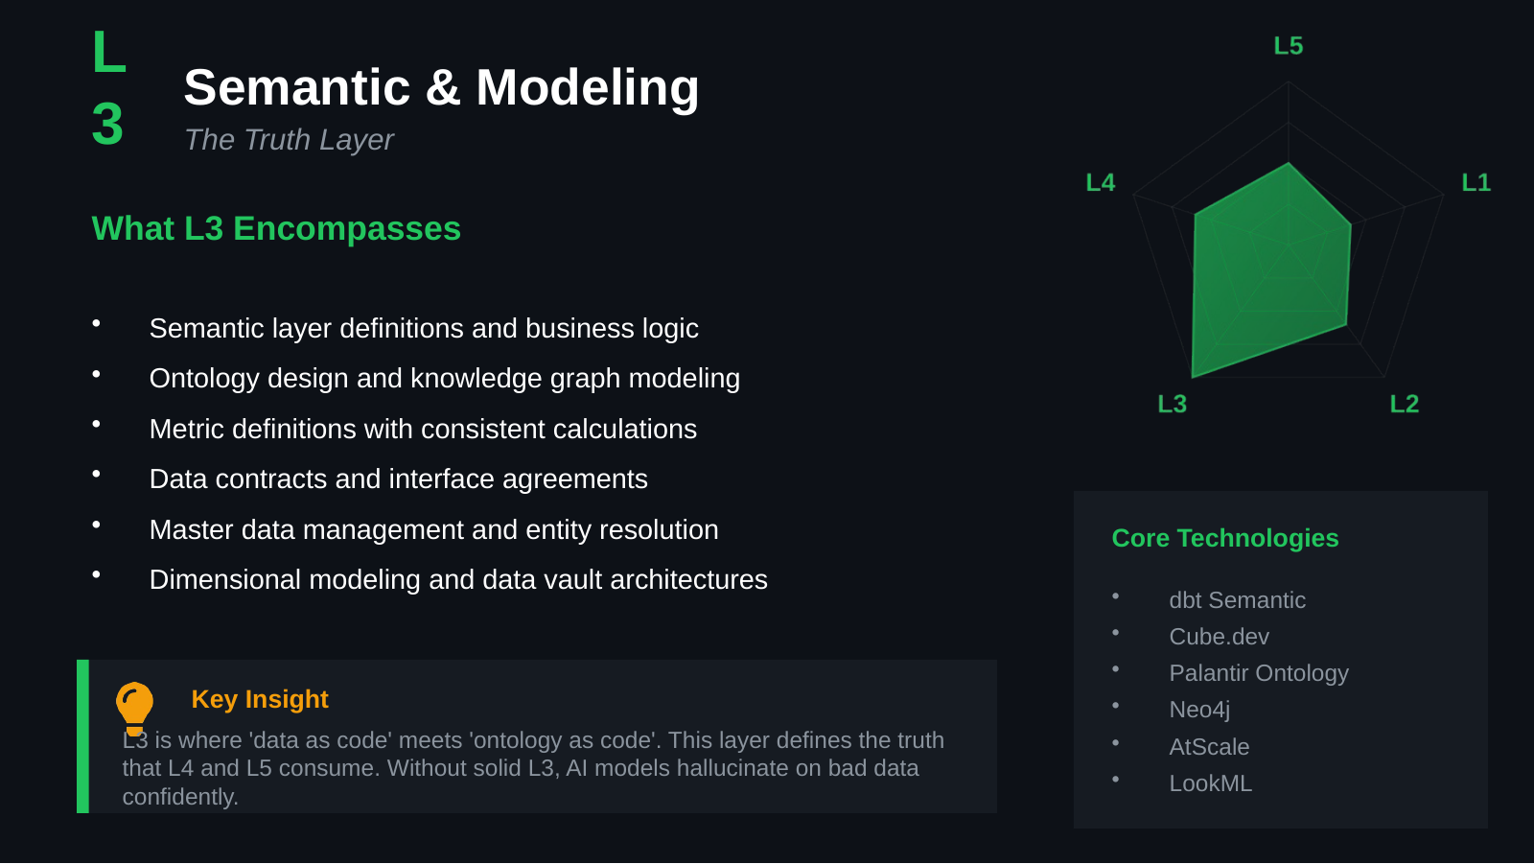
UNCLASSIFIED
2026 DATA STACK — FIVE LAYERS DEEP DIVE · TM-20 · Primer
UNCLASSIFIED

Slide 7
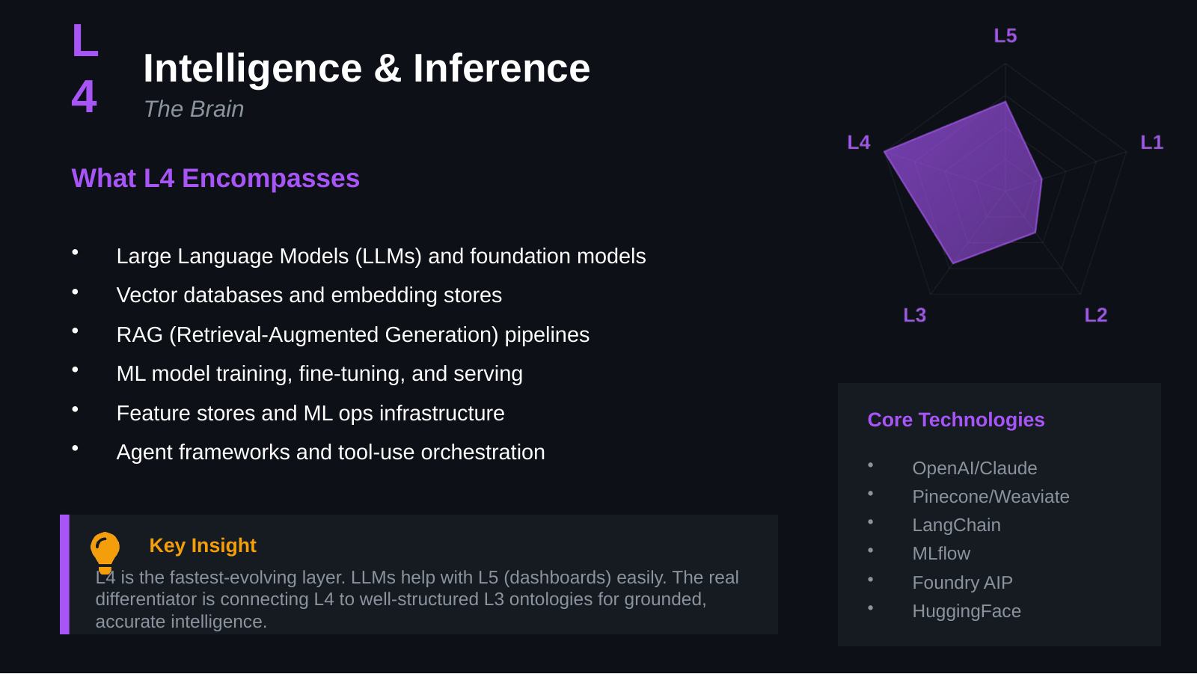
UNCLASSIFIED
2026 DATA STACK — FIVE LAYERS DEEP DIVE · TM-20 · Primer
UNCLASSIFIED

Slide 8
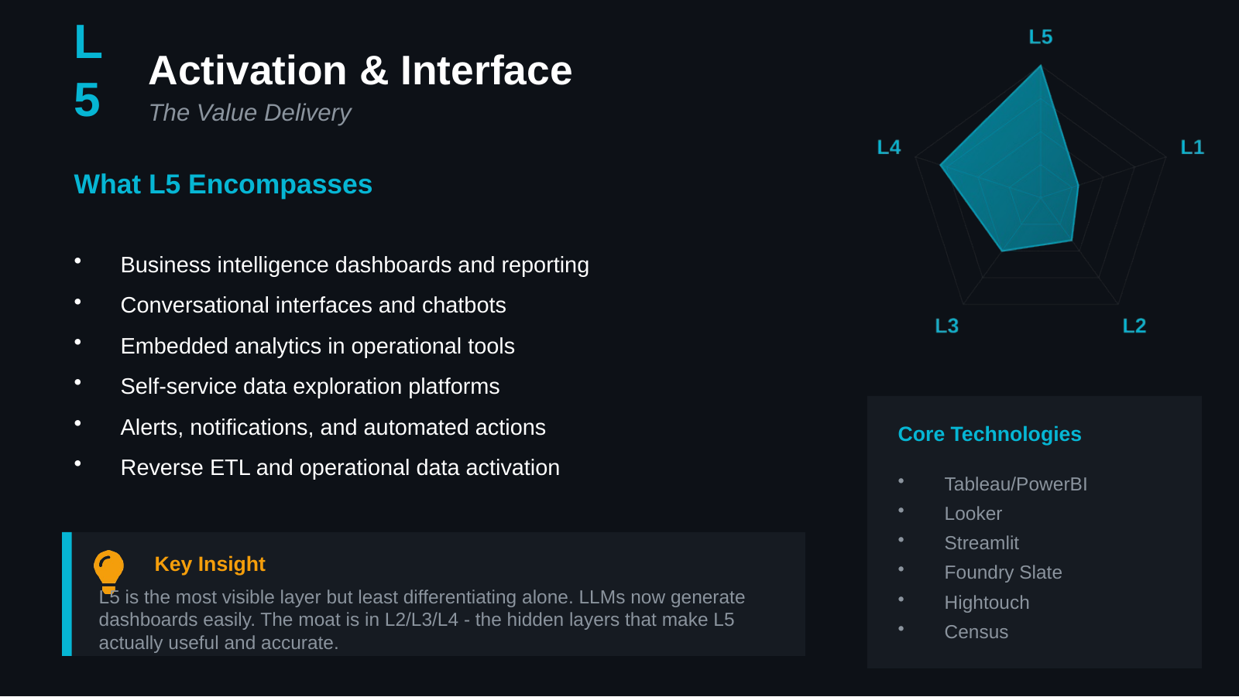
UNCLASSIFIED
2026 DATA STACK — FIVE LAYERS DEEP DIVE · TM-20 · Primer
UNCLASSIFIED

Slide 9
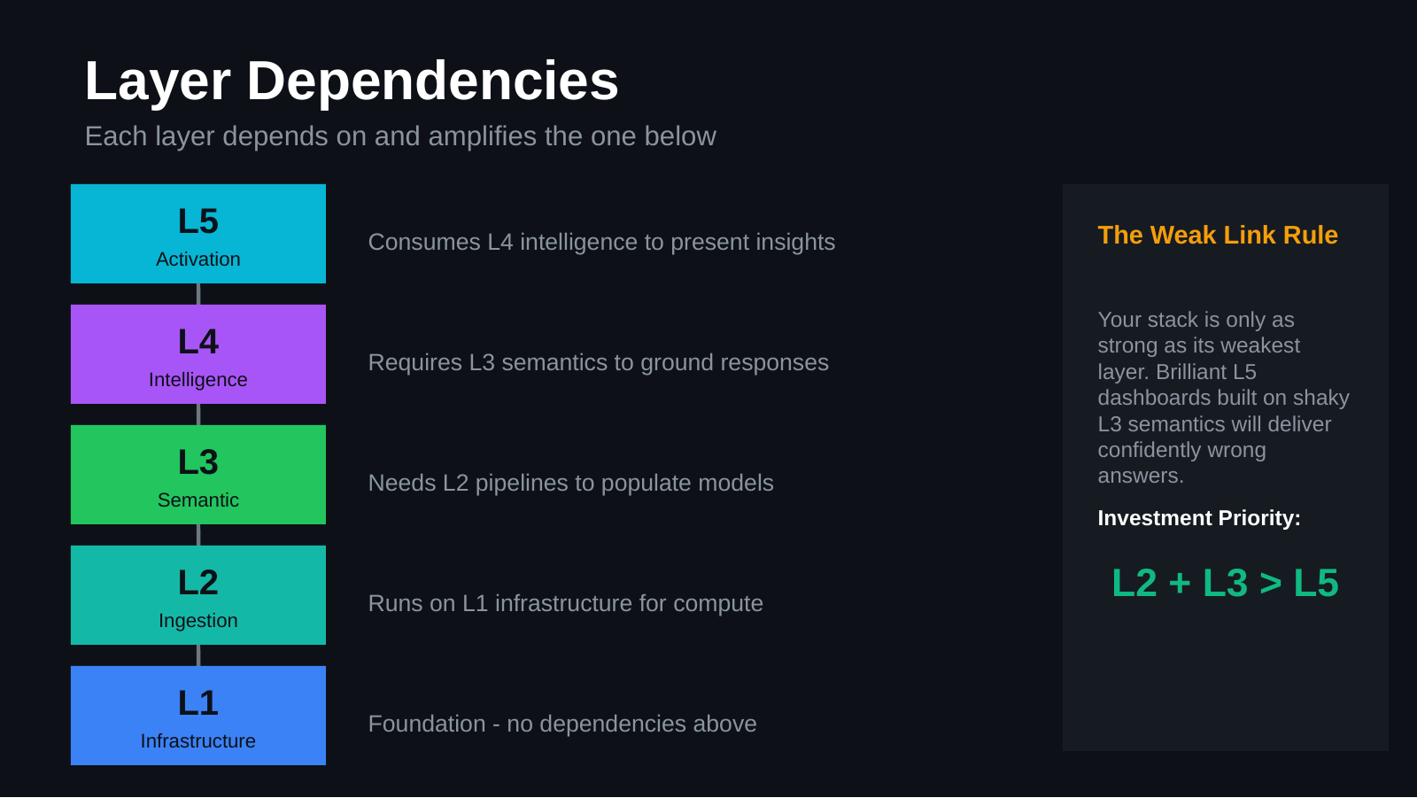
UNCLASSIFIED
2026 DATA STACK — FIVE LAYERS DEEP DIVE · TM-20 · Primer
UNCLASSIFIED

Slide 10
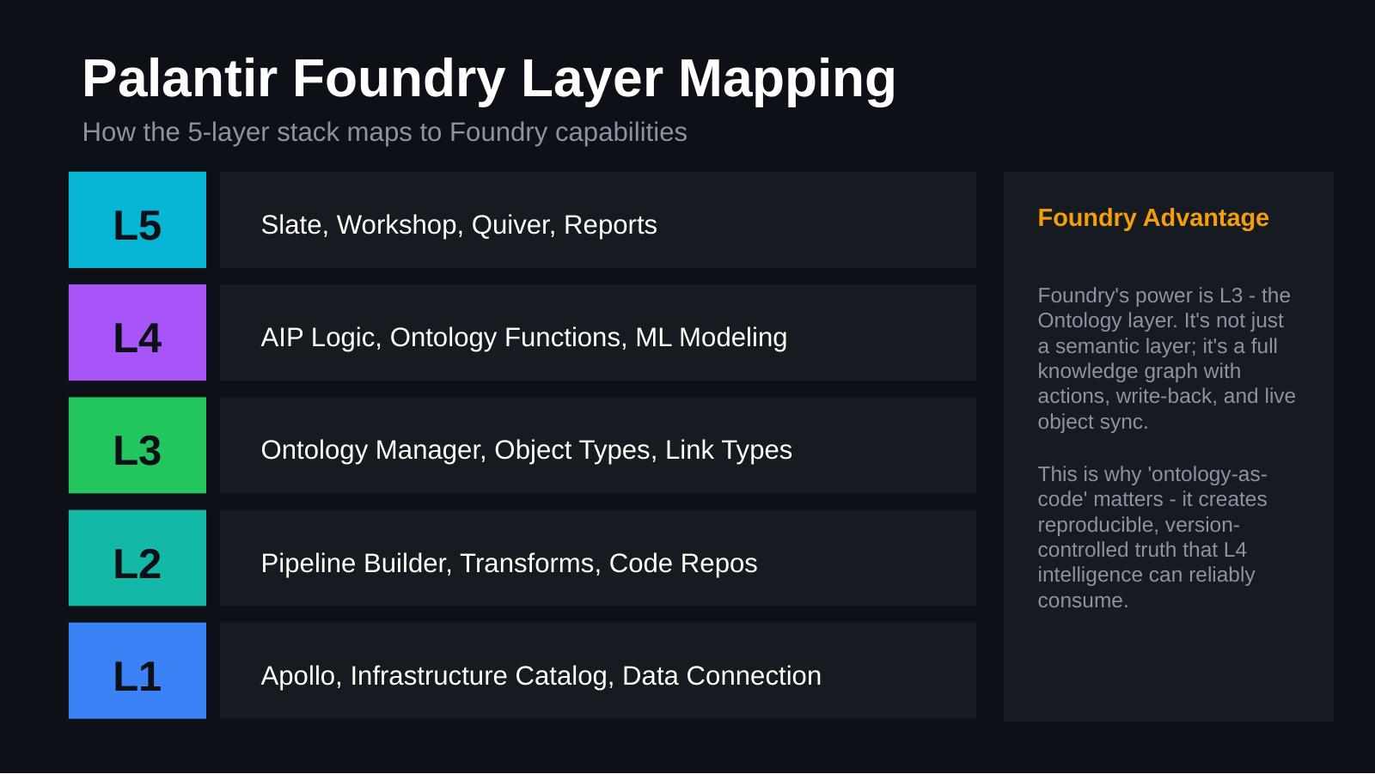
UNCLASSIFIED
2026 DATA STACK — FIVE LAYERS DEEP DIVE · TM-20 · Primer
UNCLASSIFIED

Slide 11
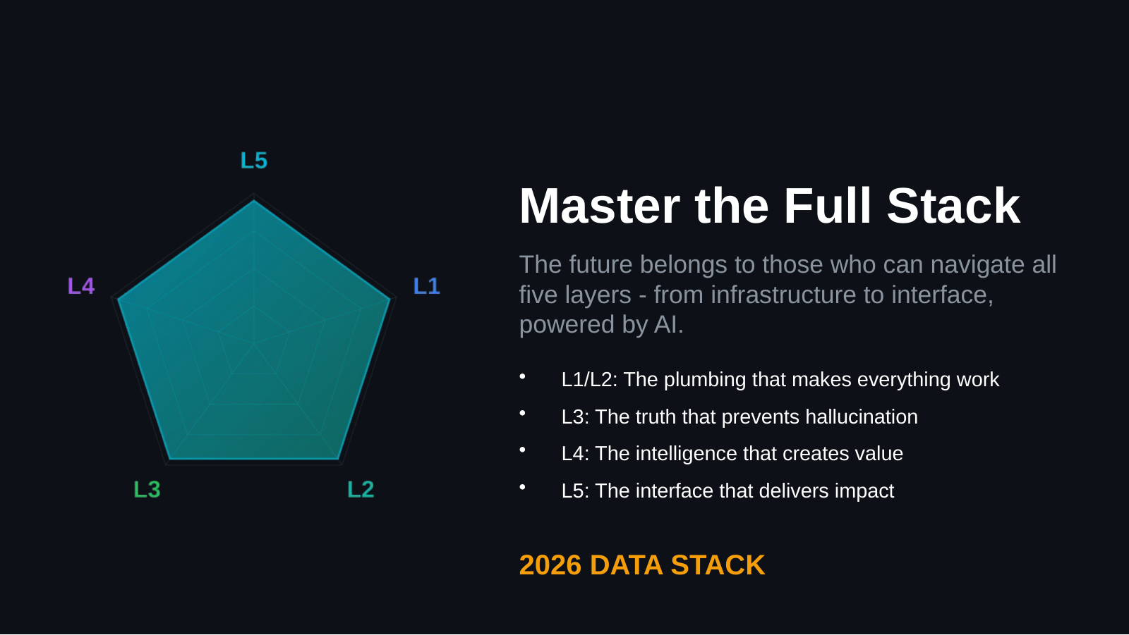
UNCLASSIFIED
2026 DATA STACK — FIVE LAYERS DEEP DIVE · TM-20 · Primer
UNCLASSIFIED

