Slide 1
AI/ML — BEYOND THE HYPE
TM-40H · Specialist · also: TM-40I
UNCLASSIFIED
UNCLASSIFIED
USAREUR-AF · C2DAO · MSS
UNCLASSIFIED

Slide 2

UNCLASSIFIED
AI/ML — BEYOND THE HYPE · TM-40H · Specialist
UNCLASSIFIED

Slide 3
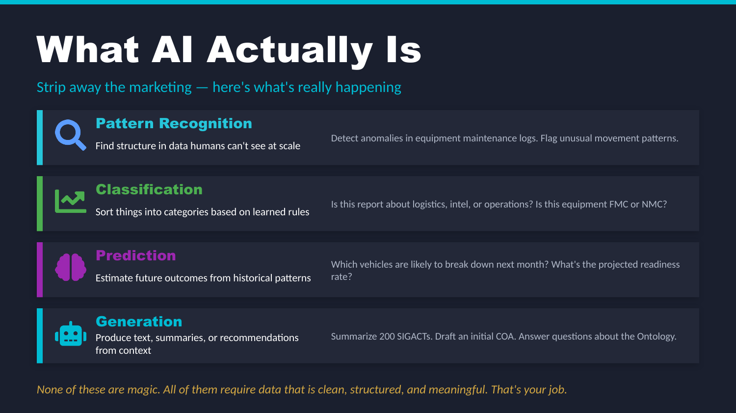
UNCLASSIFIED
AI/ML — BEYOND THE HYPE · TM-40H · Specialist
UNCLASSIFIED

Slide 4
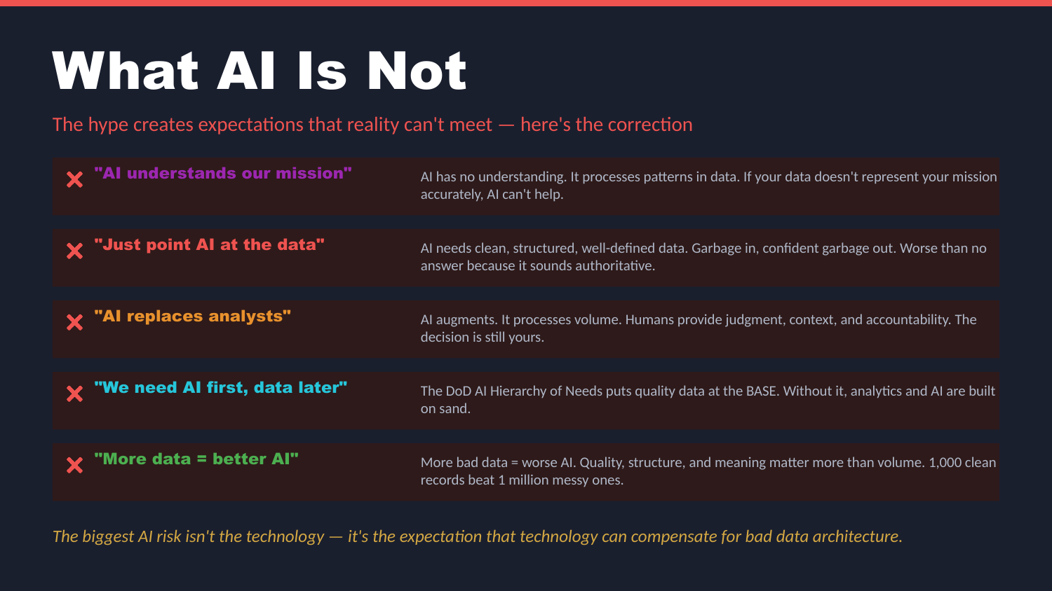
UNCLASSIFIED
AI/ML — BEYOND THE HYPE · TM-40H · Specialist
UNCLASSIFIED

Slide 5
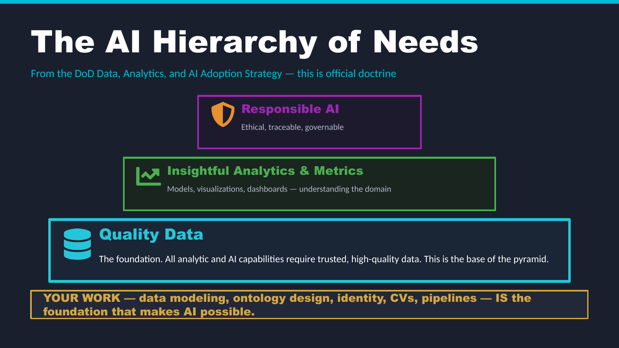
UNCLASSIFIED
AI/ML — BEYOND THE HYPE · TM-40H · Specialist
UNCLASSIFIED

Slide 6
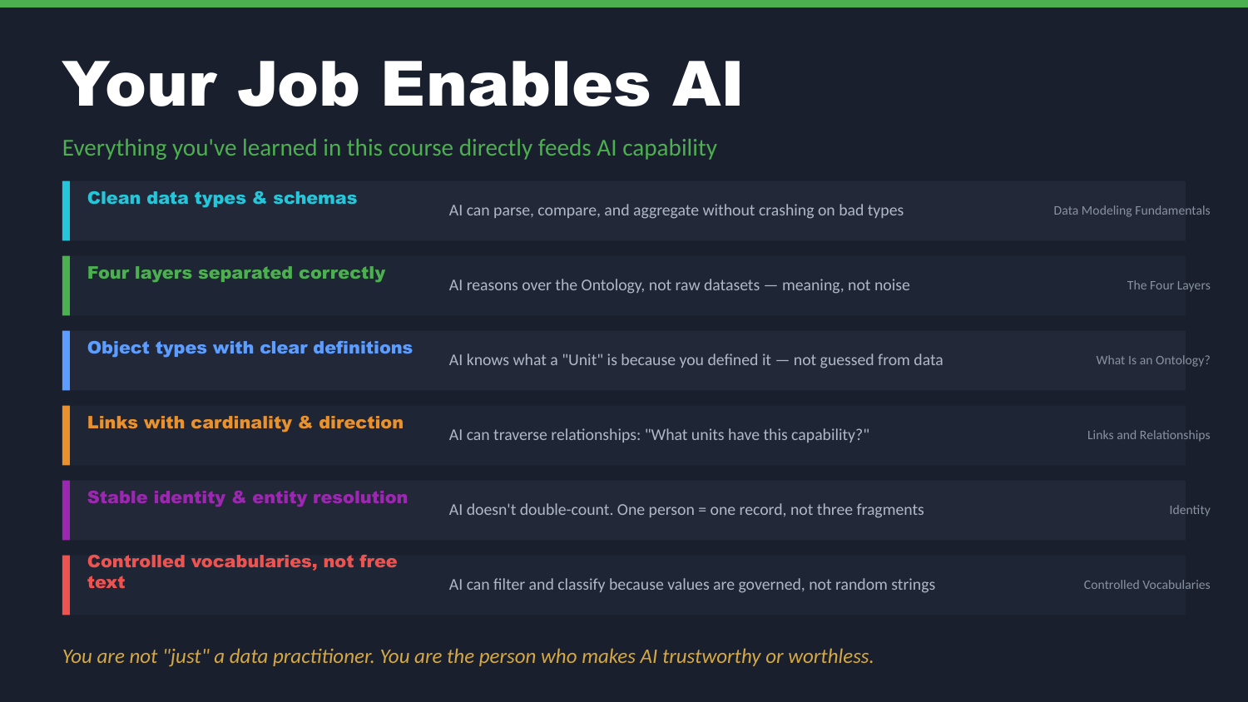
UNCLASSIFIED
AI/ML — BEYOND THE HYPE · TM-40H · Specialist
UNCLASSIFIED

Slide 7
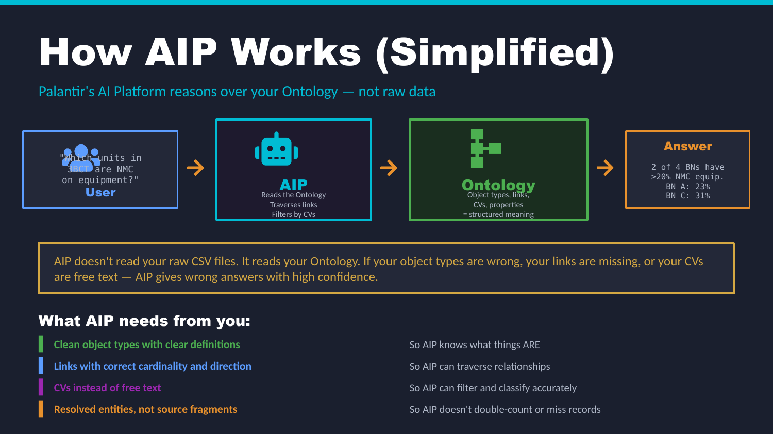
UNCLASSIFIED
AI/ML — BEYOND THE HYPE · TM-40H · Specialist
UNCLASSIFIED

Slide 8
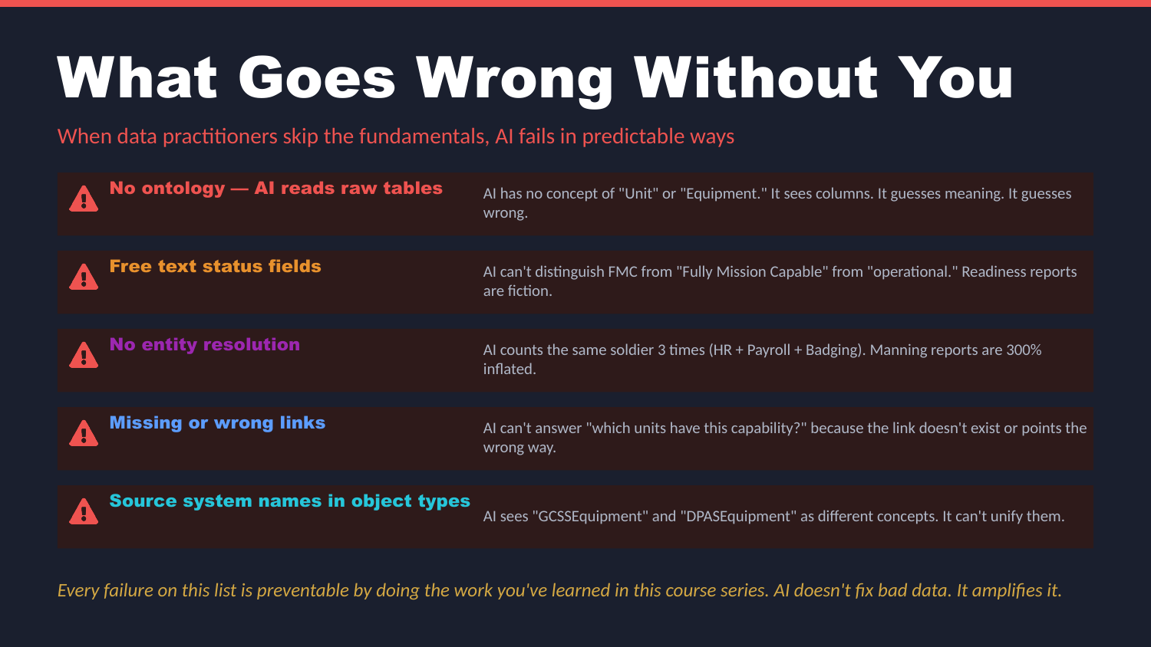
UNCLASSIFIED
AI/ML — BEYOND THE HYPE · TM-40H · Specialist
UNCLASSIFIED

Slide 9
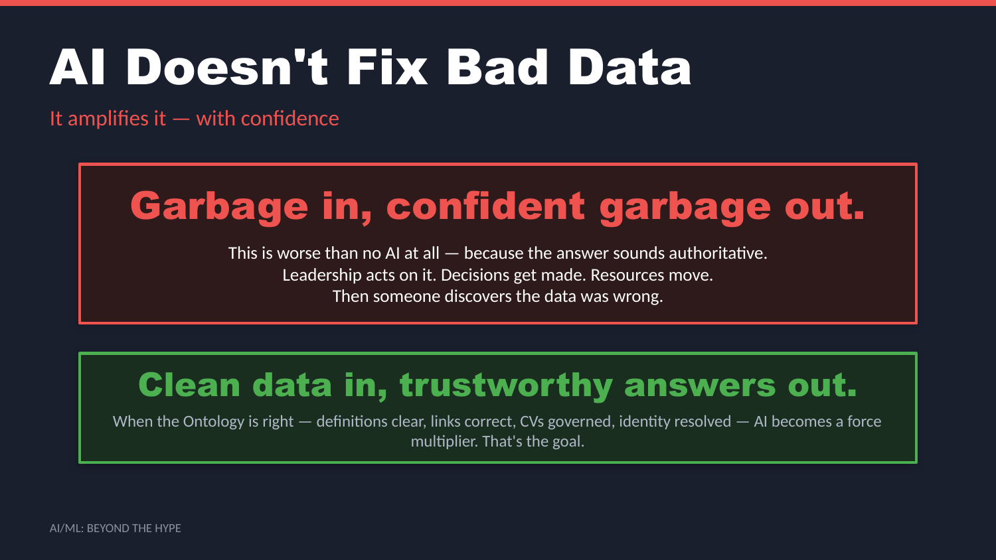
UNCLASSIFIED
AI/ML — BEYOND THE HYPE · TM-40H · Specialist
UNCLASSIFIED

Slide 10

UNCLASSIFIED
AI/ML — BEYOND THE HYPE · TM-40H · Specialist
UNCLASSIFIED

Slide 11
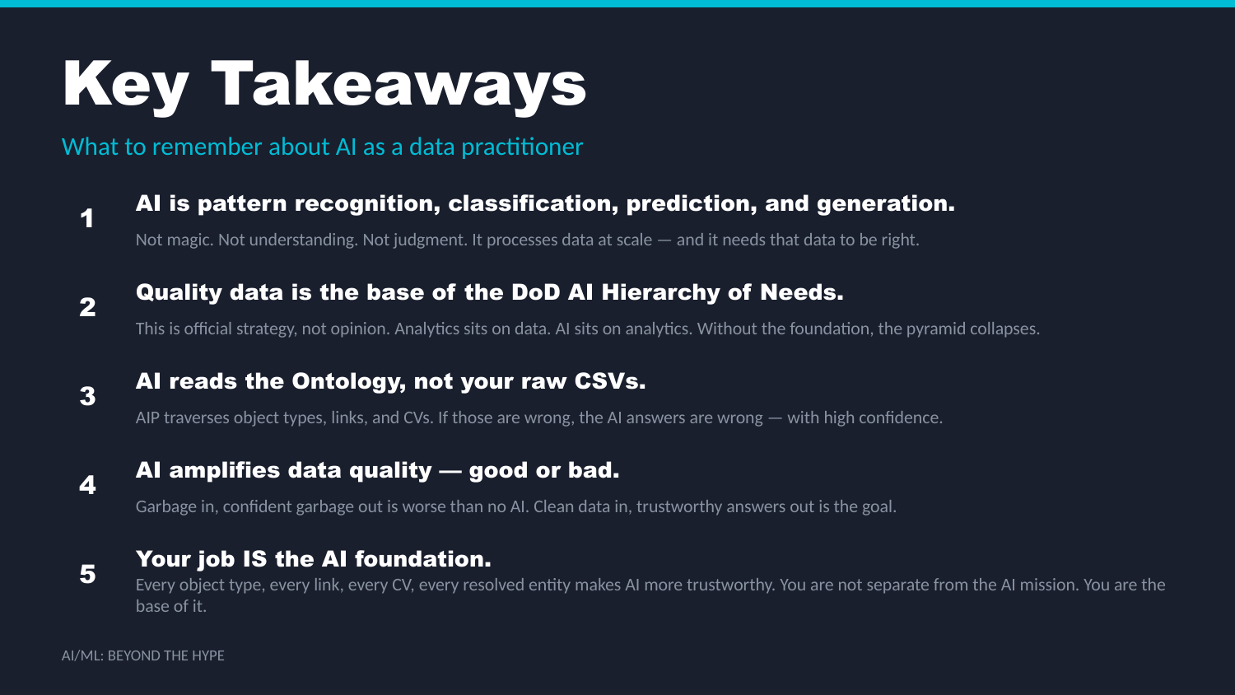
UNCLASSIFIED
AI/ML — BEYOND THE HYPE · TM-40H · Specialist
UNCLASSIFIED

Slide 12
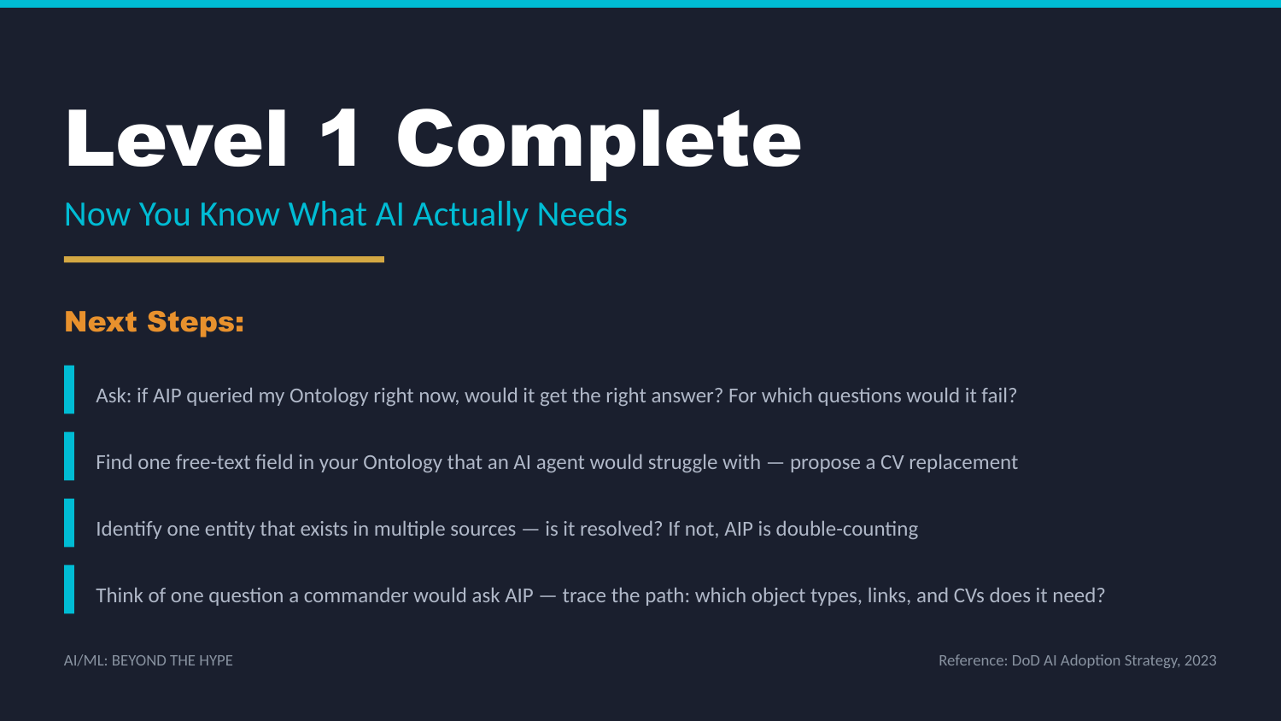
UNCLASSIFIED
AI/ML — BEYOND THE HYPE · TM-40H · Specialist
UNCLASSIFIED

