Slide 1
DATA ARCHITECTURE DEEP DIVE
TM-10 · Primer
UNCLASSIFIED
UNCLASSIFIED
USAREUR-AF · C2DAO · MSS
UNCLASSIFIED

Slide 2

UNCLASSIFIED
DATA ARCHITECTURE DEEP DIVE · TM-10 · Primer
UNCLASSIFIED

Slide 3

UNCLASSIFIED
DATA ARCHITECTURE DEEP DIVE · TM-10 · Primer
UNCLASSIFIED

Slide 4
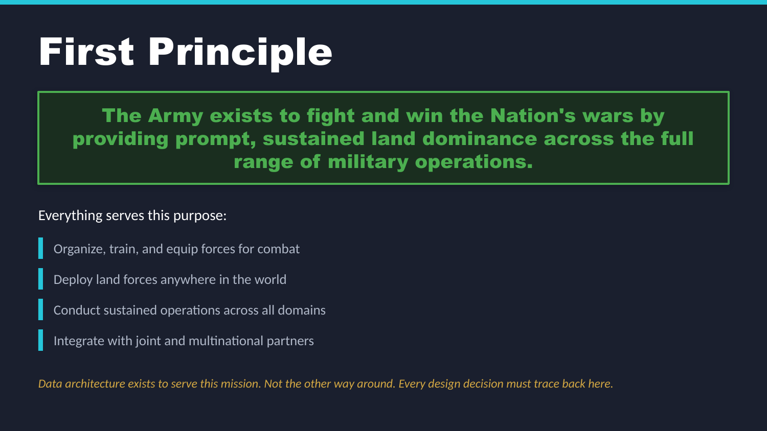
UNCLASSIFIED
DATA ARCHITECTURE DEEP DIVE · TM-10 · Primer
UNCLASSIFIED

Slide 5
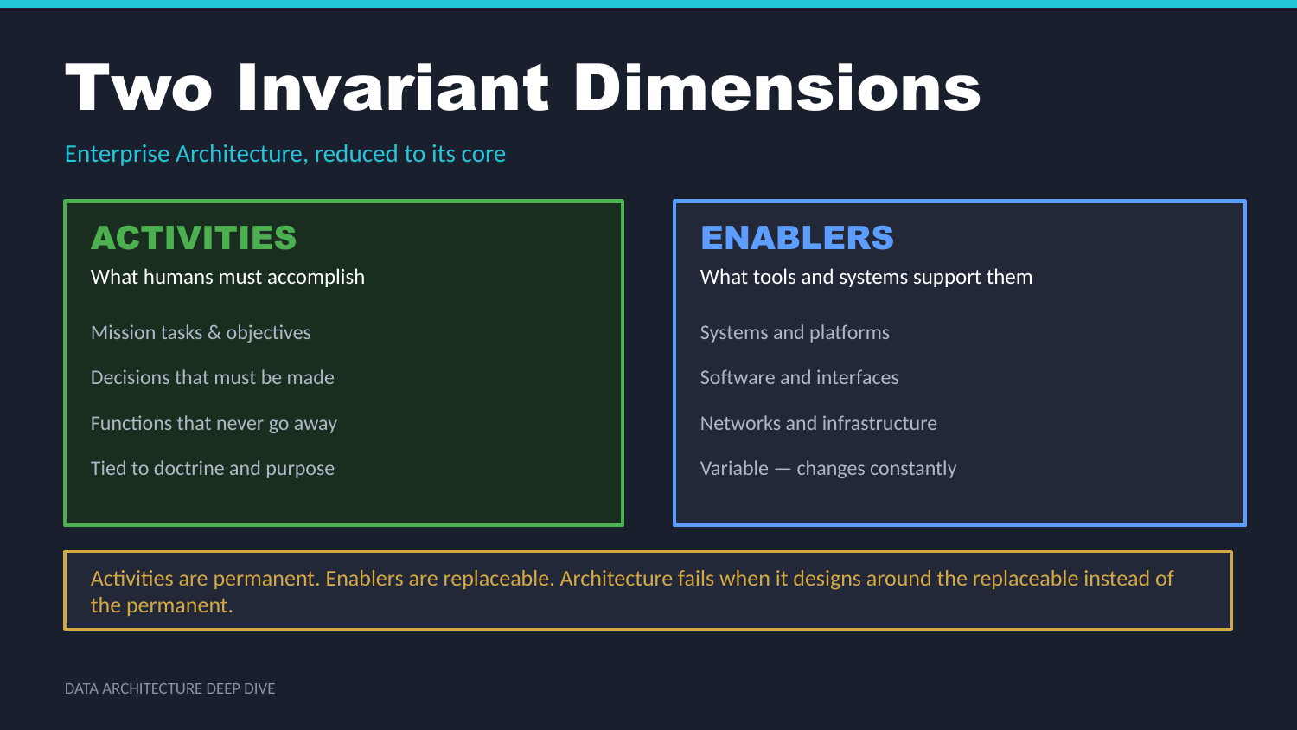
UNCLASSIFIED
DATA ARCHITECTURE DEEP DIVE · TM-10 · Primer
UNCLASSIFIED

Slide 6
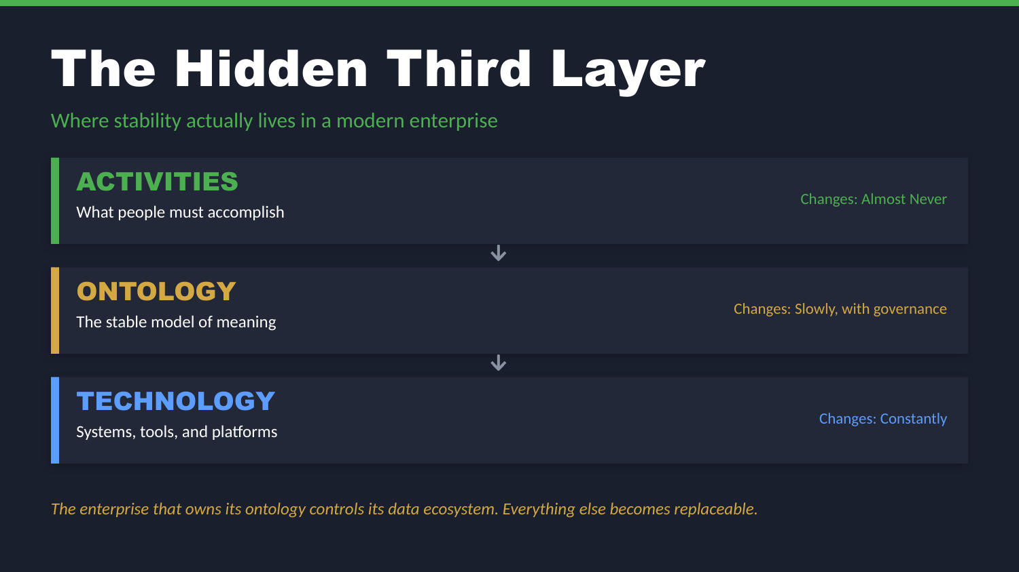
UNCLASSIFIED
DATA ARCHITECTURE DEEP DIVE · TM-10 · Primer
UNCLASSIFIED

Slide 7
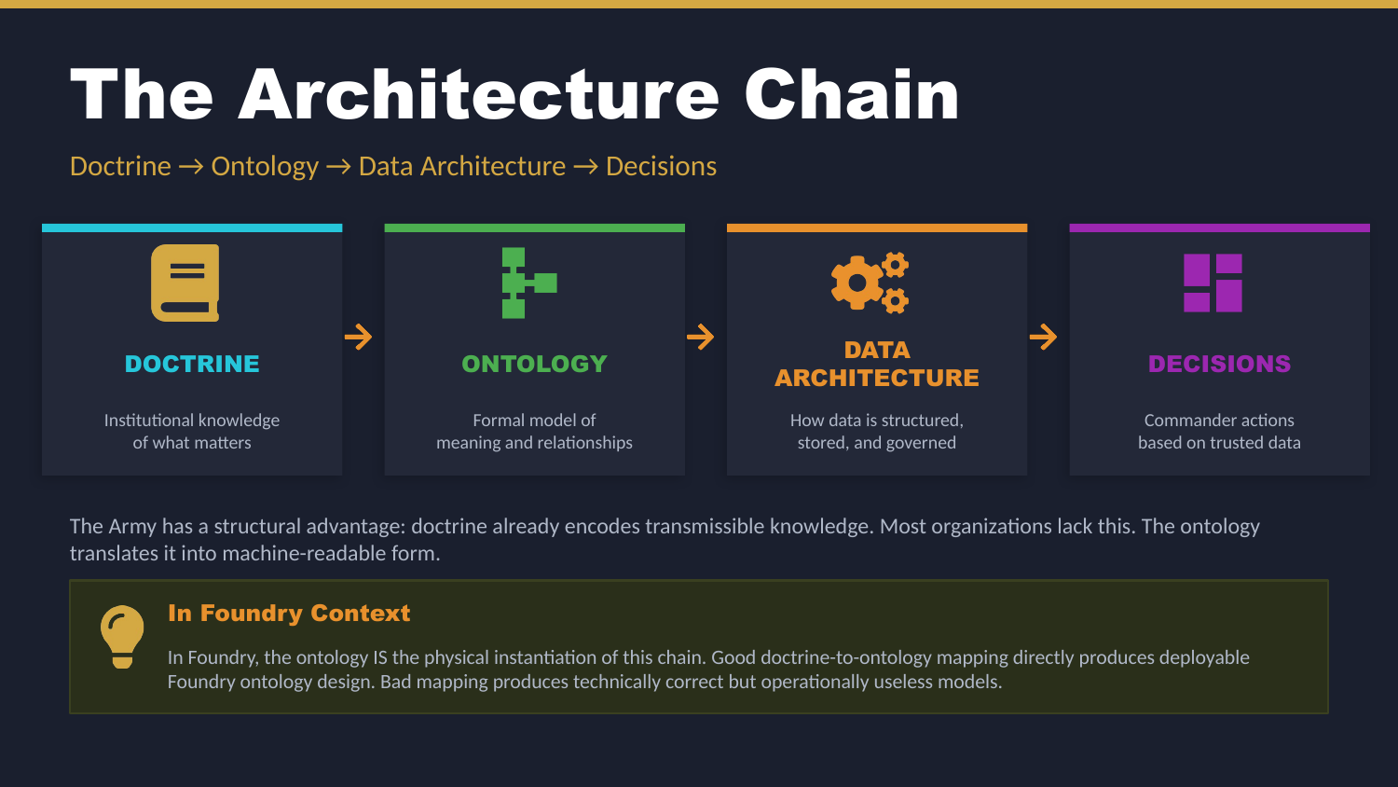
UNCLASSIFIED
DATA ARCHITECTURE DEEP DIVE · TM-10 · Primer
UNCLASSIFIED

Slide 8

UNCLASSIFIED
DATA ARCHITECTURE DEEP DIVE · TM-10 · Primer
UNCLASSIFIED

Slide 9

UNCLASSIFIED
DATA ARCHITECTURE DEEP DIVE · TM-10 · Primer
UNCLASSIFIED

Slide 10
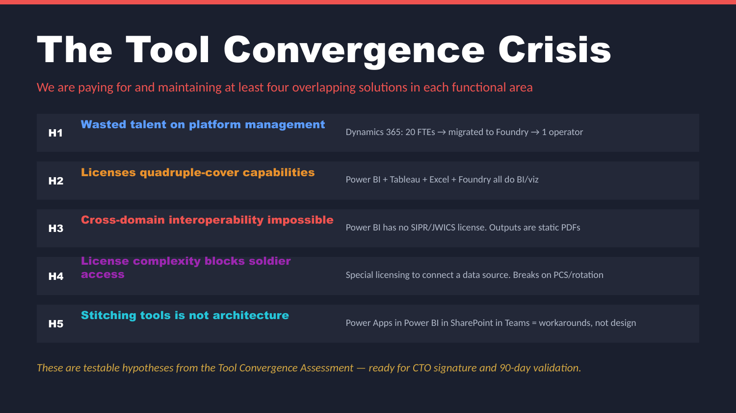
UNCLASSIFIED
DATA ARCHITECTURE DEEP DIVE · TM-10 · Primer
UNCLASSIFIED

Slide 11
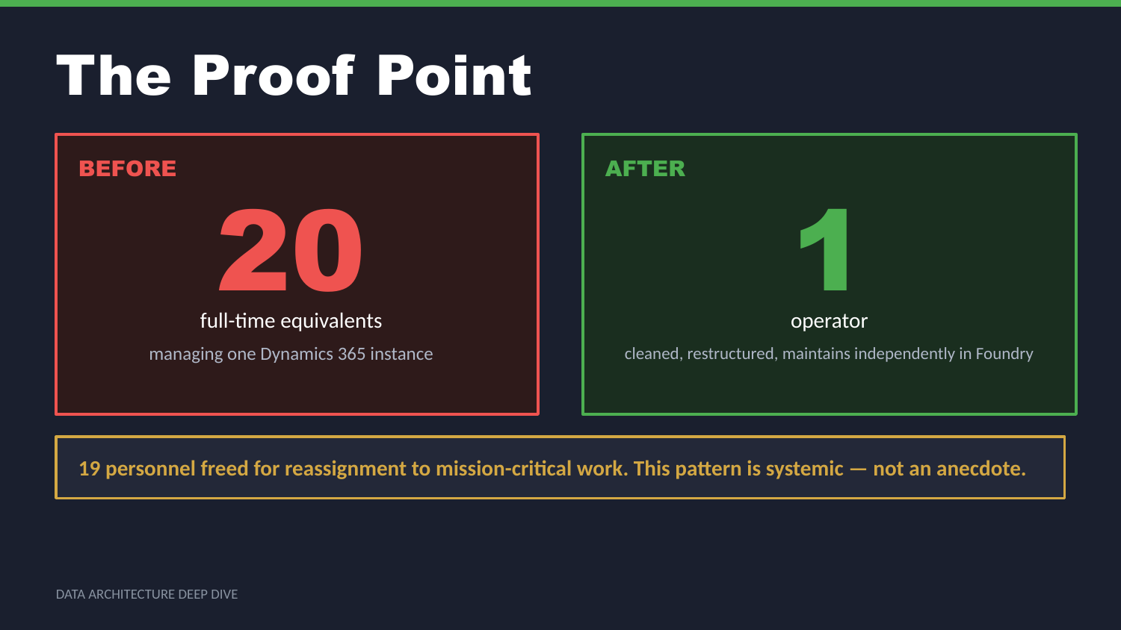
UNCLASSIFIED
DATA ARCHITECTURE DEEP DIVE · TM-10 · Primer
UNCLASSIFIED

Slide 12
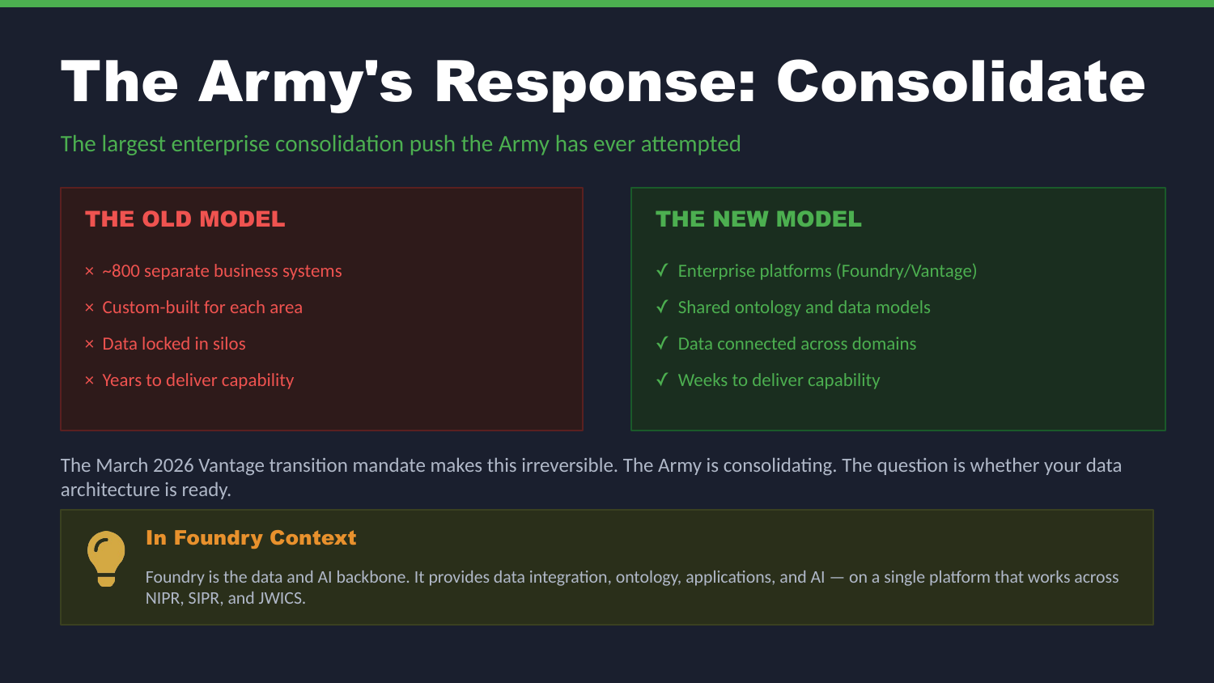
UNCLASSIFIED
DATA ARCHITECTURE DEEP DIVE · TM-10 · Primer
UNCLASSIFIED

Slide 13

UNCLASSIFIED
DATA ARCHITECTURE DEEP DIVE · TM-10 · Primer
UNCLASSIFIED

Slide 14
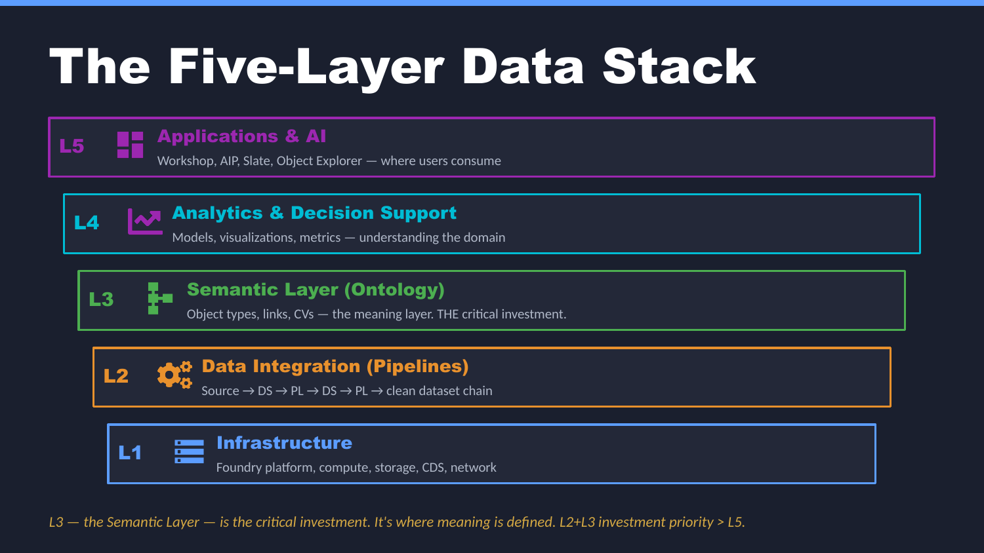
UNCLASSIFIED
DATA ARCHITECTURE DEEP DIVE · TM-10 · Primer
UNCLASSIFIED

Slide 15
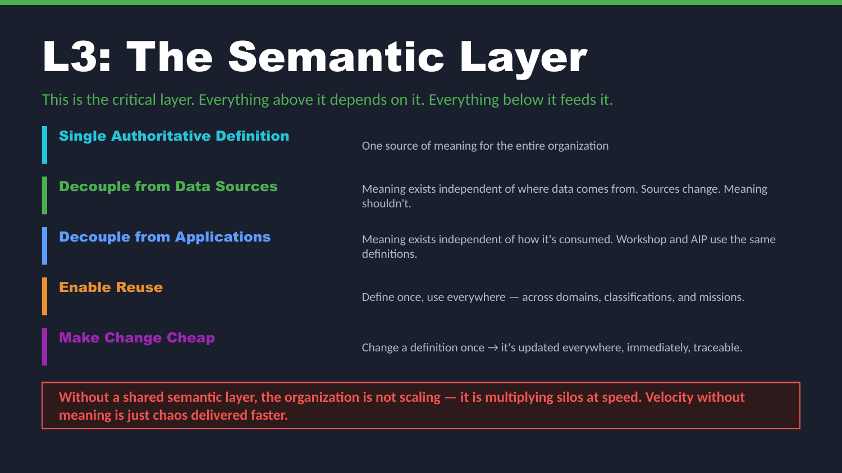
UNCLASSIFIED
DATA ARCHITECTURE DEEP DIVE · TM-10 · Primer
UNCLASSIFIED

Slide 16
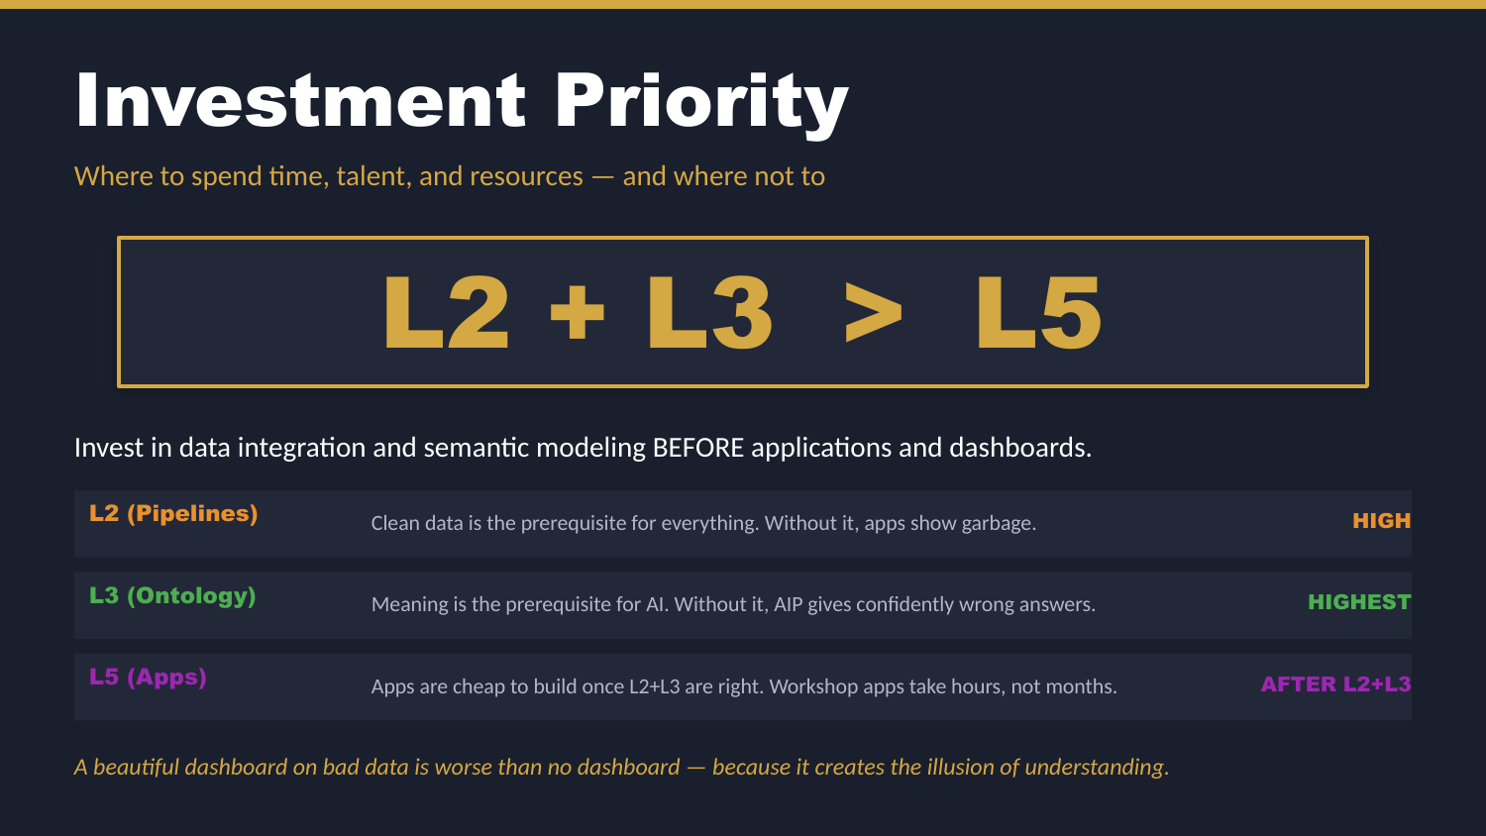
UNCLASSIFIED
DATA ARCHITECTURE DEEP DIVE · TM-10 · Primer
UNCLASSIFIED

Slide 17

UNCLASSIFIED
DATA ARCHITECTURE DEEP DIVE · TM-10 · Primer
UNCLASSIFIED

Slide 18

UNCLASSIFIED
DATA ARCHITECTURE DEEP DIVE · TM-10 · Primer
UNCLASSIFIED

Slide 19
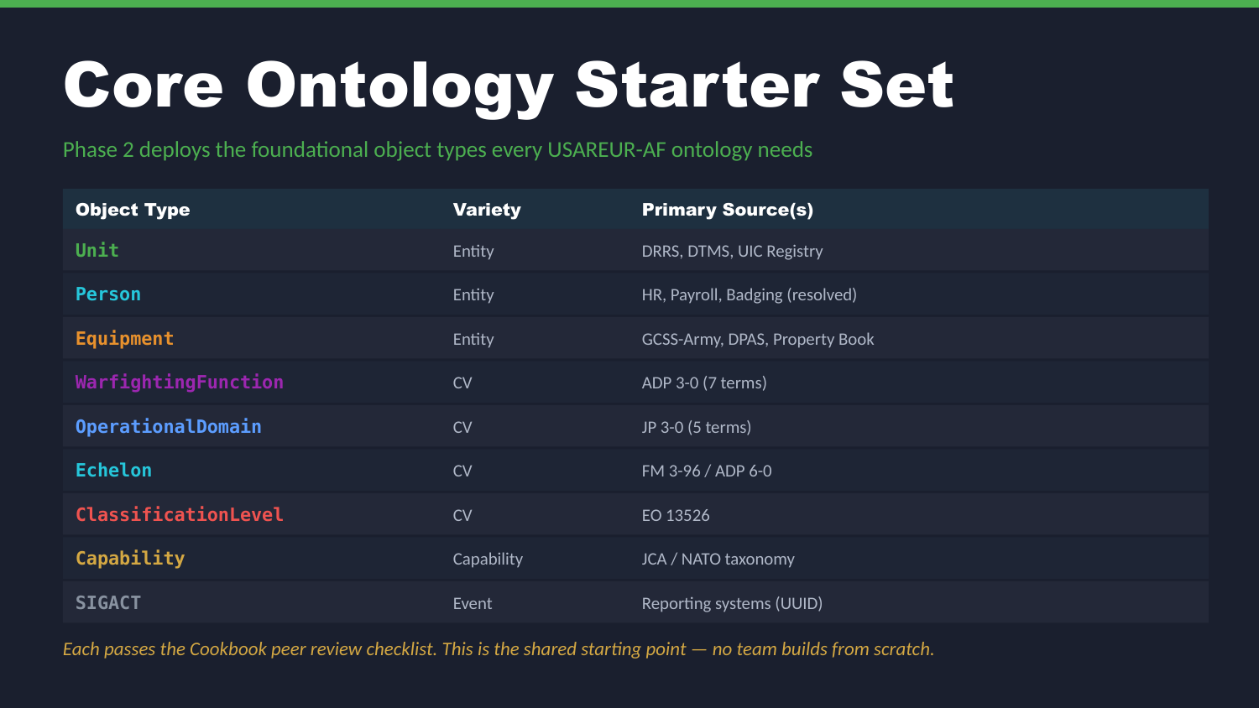
UNCLASSIFIED
DATA ARCHITECTURE DEEP DIVE · TM-10 · Primer
UNCLASSIFIED

Slide 20
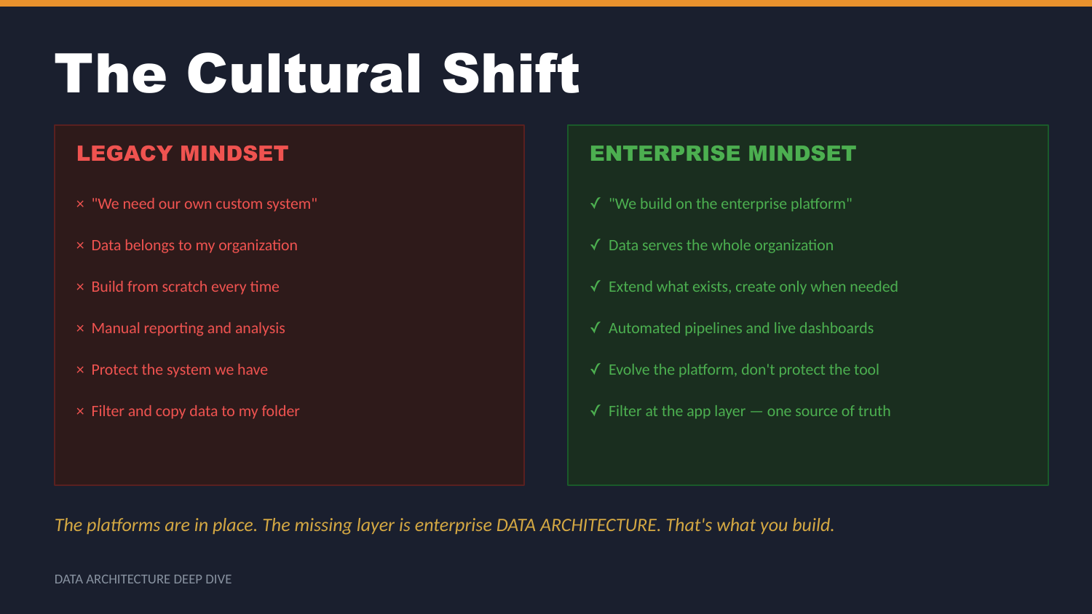
UNCLASSIFIED
DATA ARCHITECTURE DEEP DIVE · TM-10 · Primer
UNCLASSIFIED

Slide 21

UNCLASSIFIED
DATA ARCHITECTURE DEEP DIVE · TM-10 · Primer
UNCLASSIFIED

Slide 22

UNCLASSIFIED
DATA ARCHITECTURE DEEP DIVE · TM-10 · Primer
UNCLASSIFIED

