Slide 1
DATA MODELING FUNDAMENTALS — LEVEL 2
TM-40L · Specialist · also: TM-40G, TM-40I, TM-40K
UNCLASSIFIED
UNCLASSIFIED
USAREUR-AF · C2DAO · MSS
UNCLASSIFIED

Slide 2
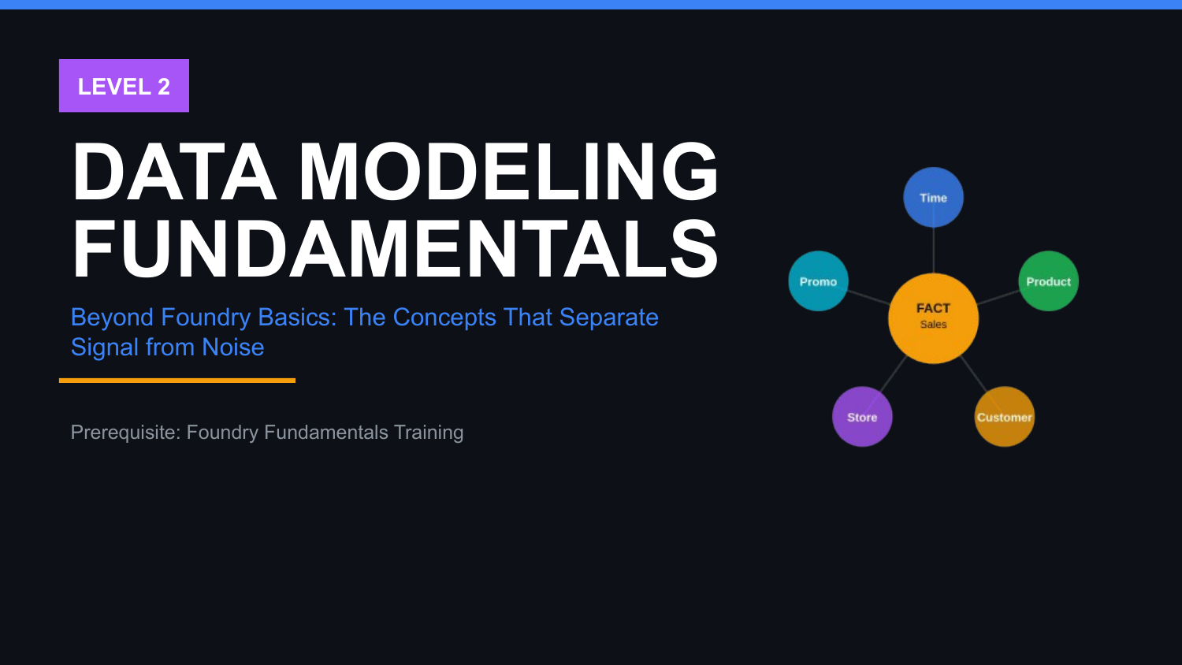
UNCLASSIFIED
DATA MODELING FUNDAMENTALS — LEVEL 2 · TM-40L · Specialist
UNCLASSIFIED

Slide 3
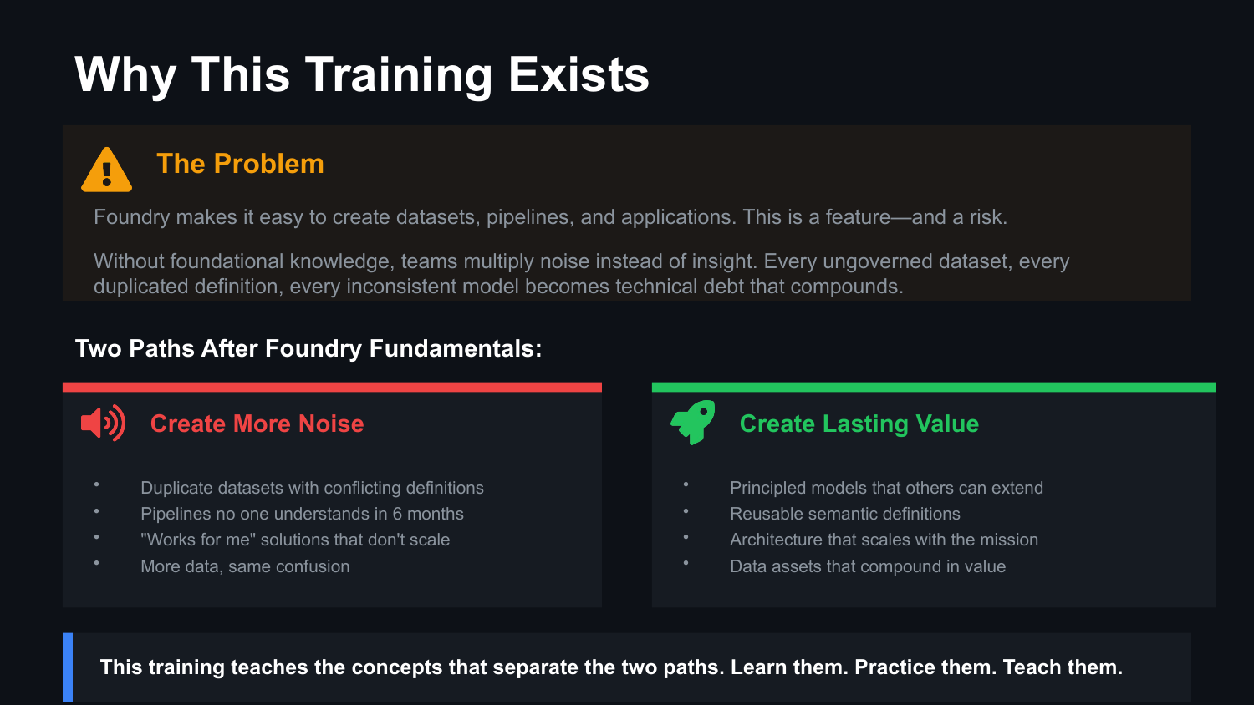
UNCLASSIFIED
DATA MODELING FUNDAMENTALS — LEVEL 2 · TM-40L · Specialist
UNCLASSIFIED

Slide 4
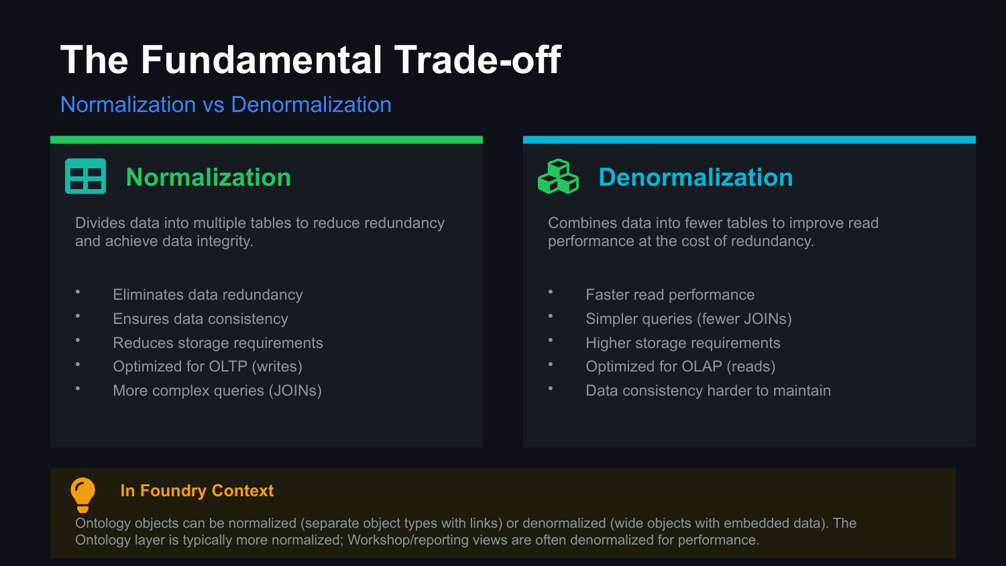
UNCLASSIFIED
DATA MODELING FUNDAMENTALS — LEVEL 2 · TM-40L · Specialist
UNCLASSIFIED

Slide 5
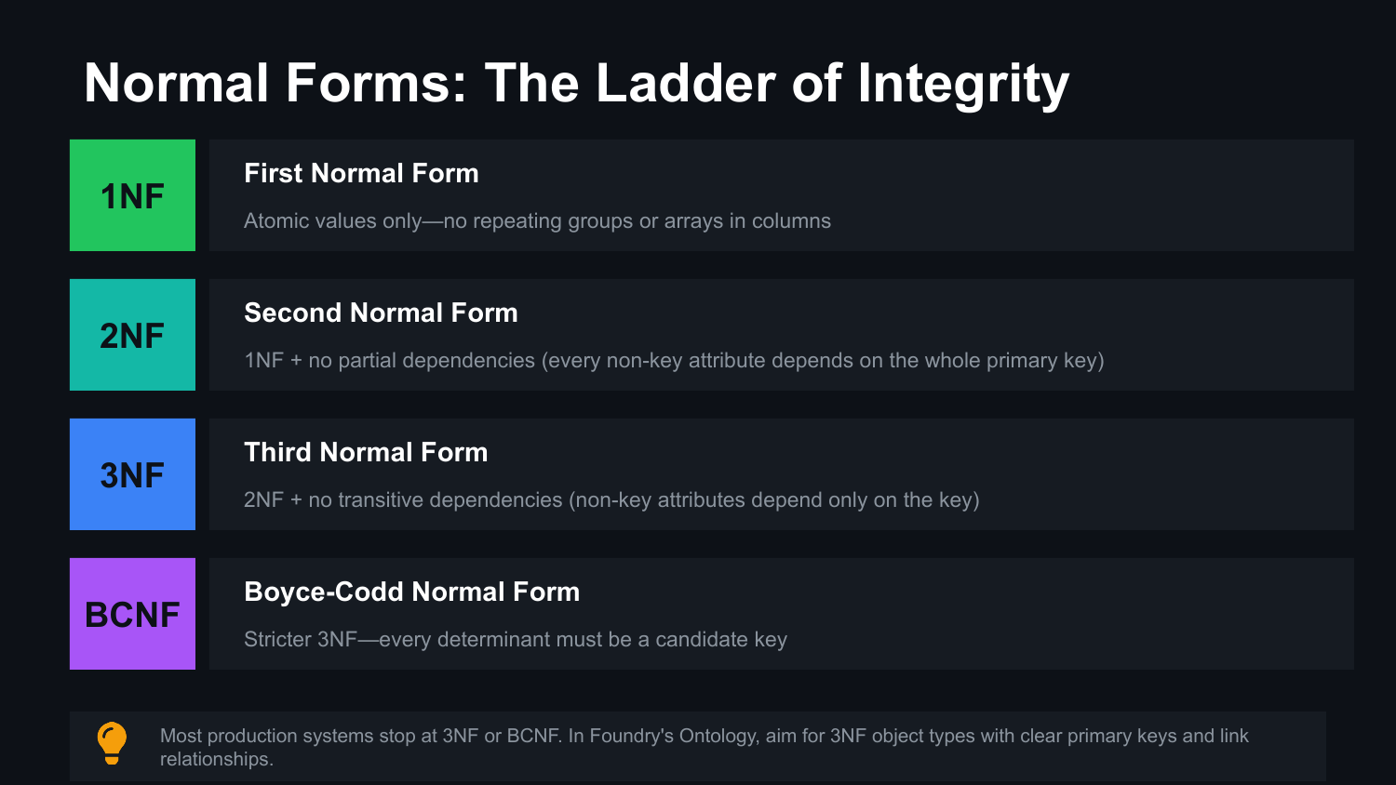
UNCLASSIFIED
DATA MODELING FUNDAMENTALS — LEVEL 2 · TM-40L · Specialist
UNCLASSIFIED

Slide 6
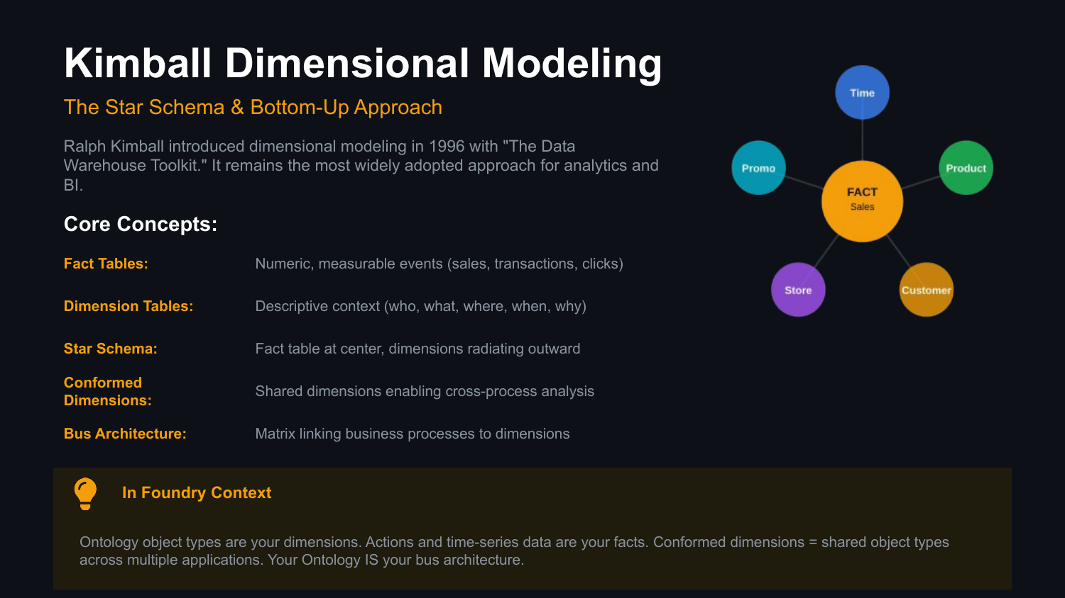
UNCLASSIFIED
DATA MODELING FUNDAMENTALS — LEVEL 2 · TM-40L · Specialist
UNCLASSIFIED

Slide 7
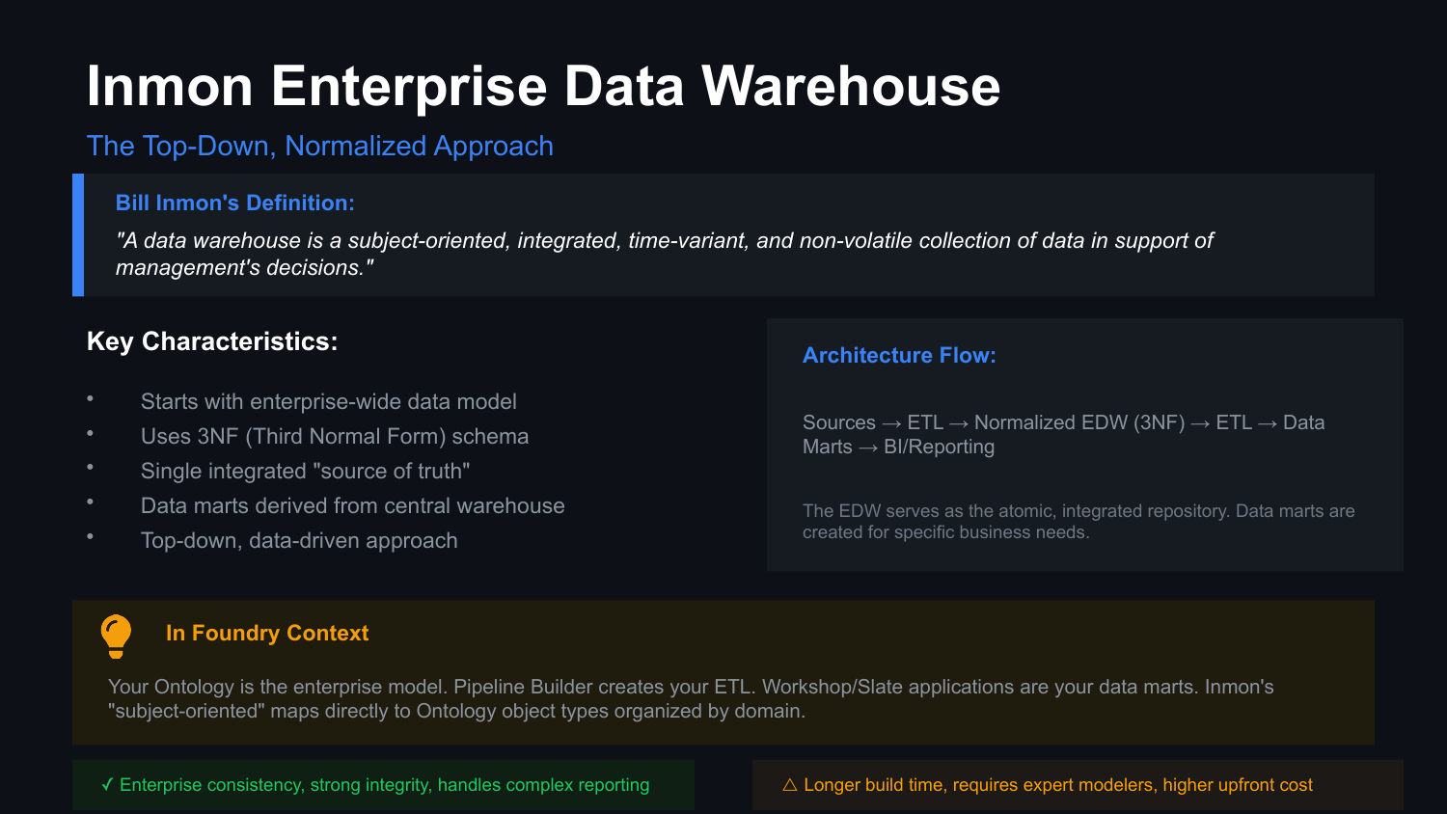
UNCLASSIFIED
DATA MODELING FUNDAMENTALS — LEVEL 2 · TM-40L · Specialist
UNCLASSIFIED

Slide 8
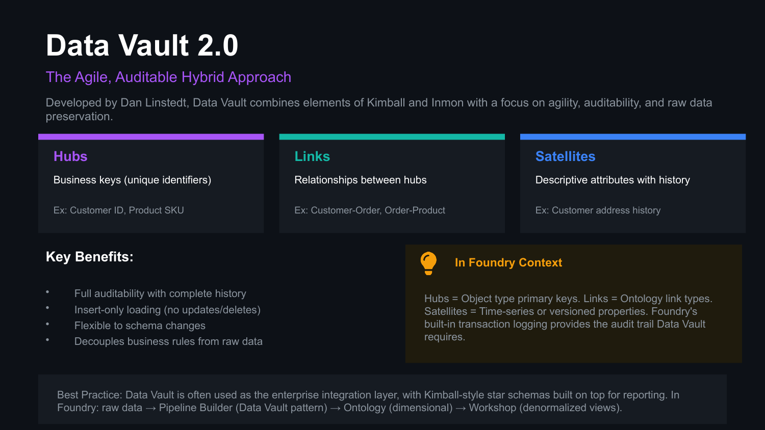
UNCLASSIFIED
DATA MODELING FUNDAMENTALS — LEVEL 2 · TM-40L · Specialist
UNCLASSIFIED

Slide 9
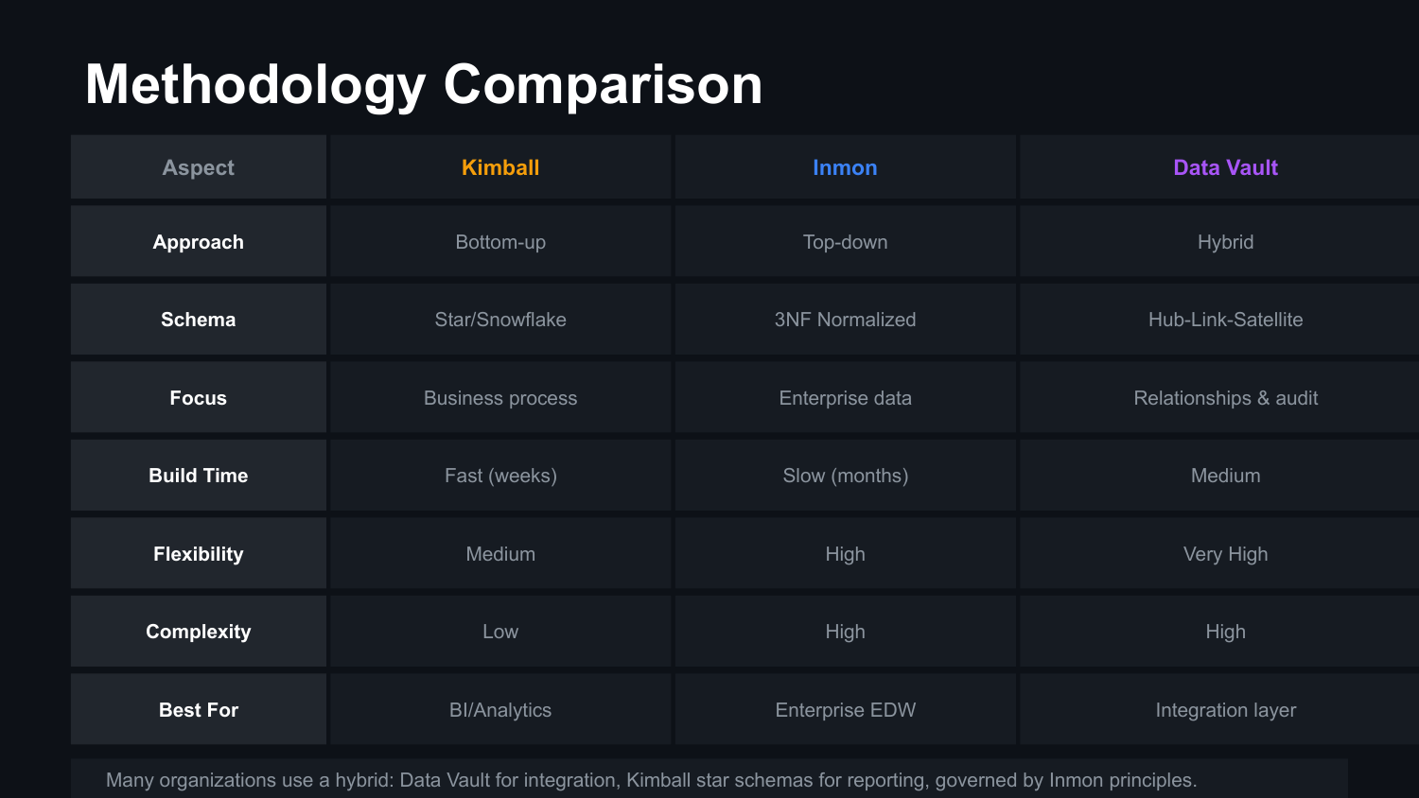
UNCLASSIFIED
DATA MODELING FUNDAMENTALS — LEVEL 2 · TM-40L · Specialist
UNCLASSIFIED

Slide 10
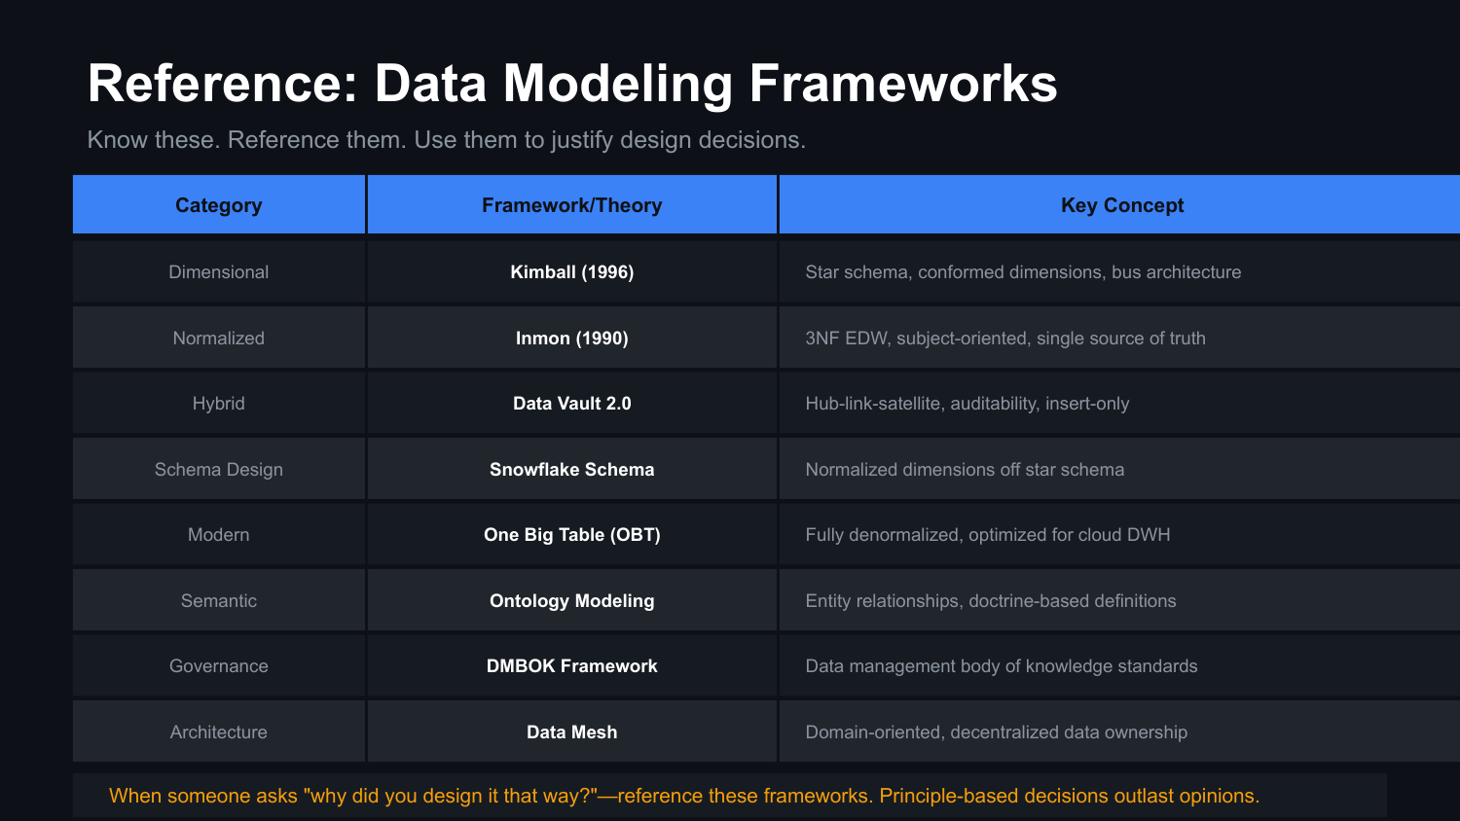
UNCLASSIFIED
DATA MODELING FUNDAMENTALS — LEVEL 2 · TM-40L · Specialist
UNCLASSIFIED

Slide 11
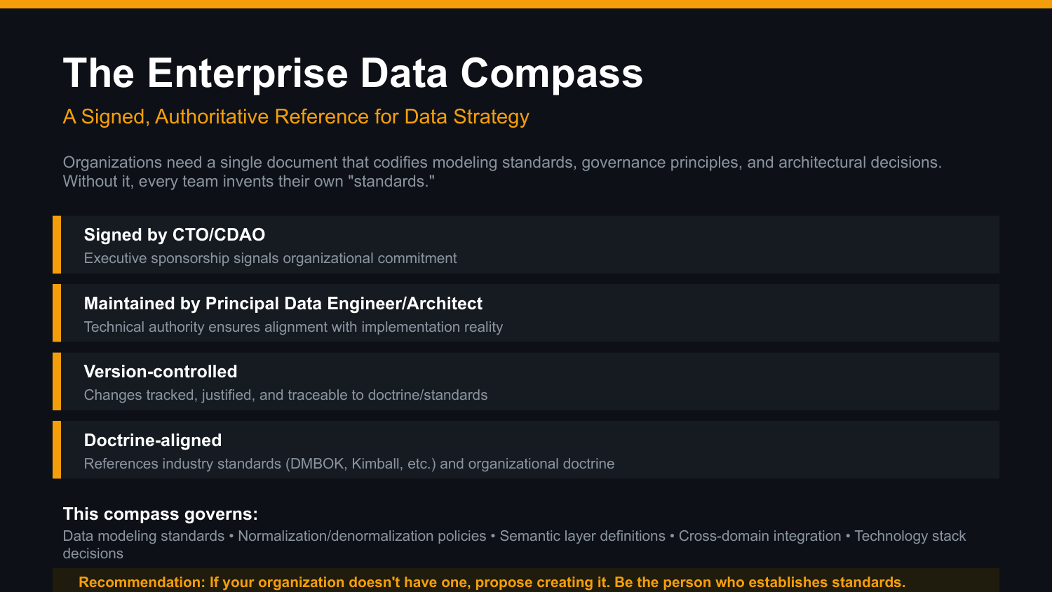
UNCLASSIFIED
DATA MODELING FUNDAMENTALS — LEVEL 2 · TM-40L · Specialist
UNCLASSIFIED

Slide 12

UNCLASSIFIED
DATA MODELING FUNDAMENTALS — LEVEL 2 · TM-40L · Specialist
UNCLASSIFIED

Slide 13

UNCLASSIFIED
DATA MODELING FUNDAMENTALS — LEVEL 2 · TM-40L · Specialist
UNCLASSIFIED

Slide 14

UNCLASSIFIED
DATA MODELING FUNDAMENTALS — LEVEL 2 · TM-40L · Specialist
UNCLASSIFIED

