Slide 1
01 — ARCHITECTURE FIRST PRINCIPLES
TM-30 · Data 201
UNCLASSIFIED
UNCLASSIFIED
USAREUR-AF · C2DAO · MSS
UNCLASSIFIED

Slide 2

UNCLASSIFIED
01 — ARCHITECTURE FIRST PRINCIPLES · TM-30 · Data 201
UNCLASSIFIED

Slide 3

UNCLASSIFIED
01 — ARCHITECTURE FIRST PRINCIPLES · TM-30 · Data 201
UNCLASSIFIED

Slide 4
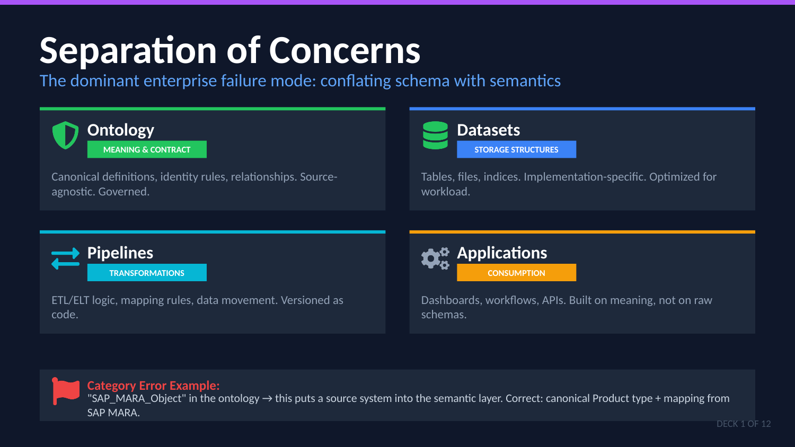
UNCLASSIFIED
01 — ARCHITECTURE FIRST PRINCIPLES · TM-30 · Data 201
UNCLASSIFIED

Slide 5

UNCLASSIFIED
01 — ARCHITECTURE FIRST PRINCIPLES · TM-30 · Data 201
UNCLASSIFIED

Slide 6
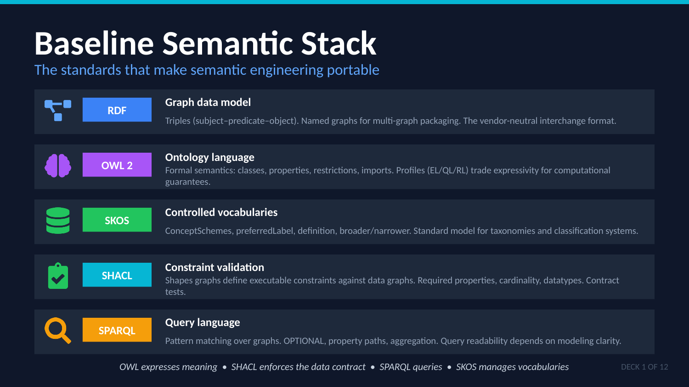
UNCLASSIFIED
01 — ARCHITECTURE FIRST PRINCIPLES · TM-30 · Data 201
UNCLASSIFIED

Slide 7

UNCLASSIFIED
01 — ARCHITECTURE FIRST PRINCIPLES · TM-30 · Data 201
UNCLASSIFIED

Slide 8
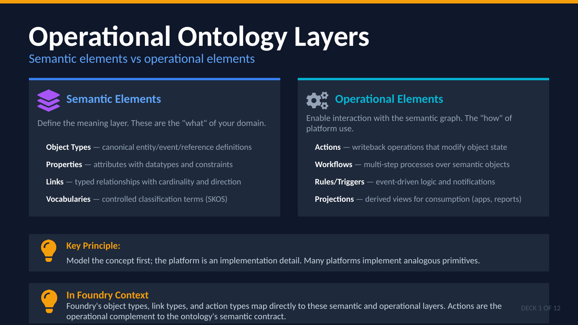
UNCLASSIFIED
01 — ARCHITECTURE FIRST PRINCIPLES · TM-30 · Data 201
UNCLASSIFIED

Slide 9

UNCLASSIFIED
01 — ARCHITECTURE FIRST PRINCIPLES · TM-30 · Data 201
UNCLASSIFIED

Slide 10
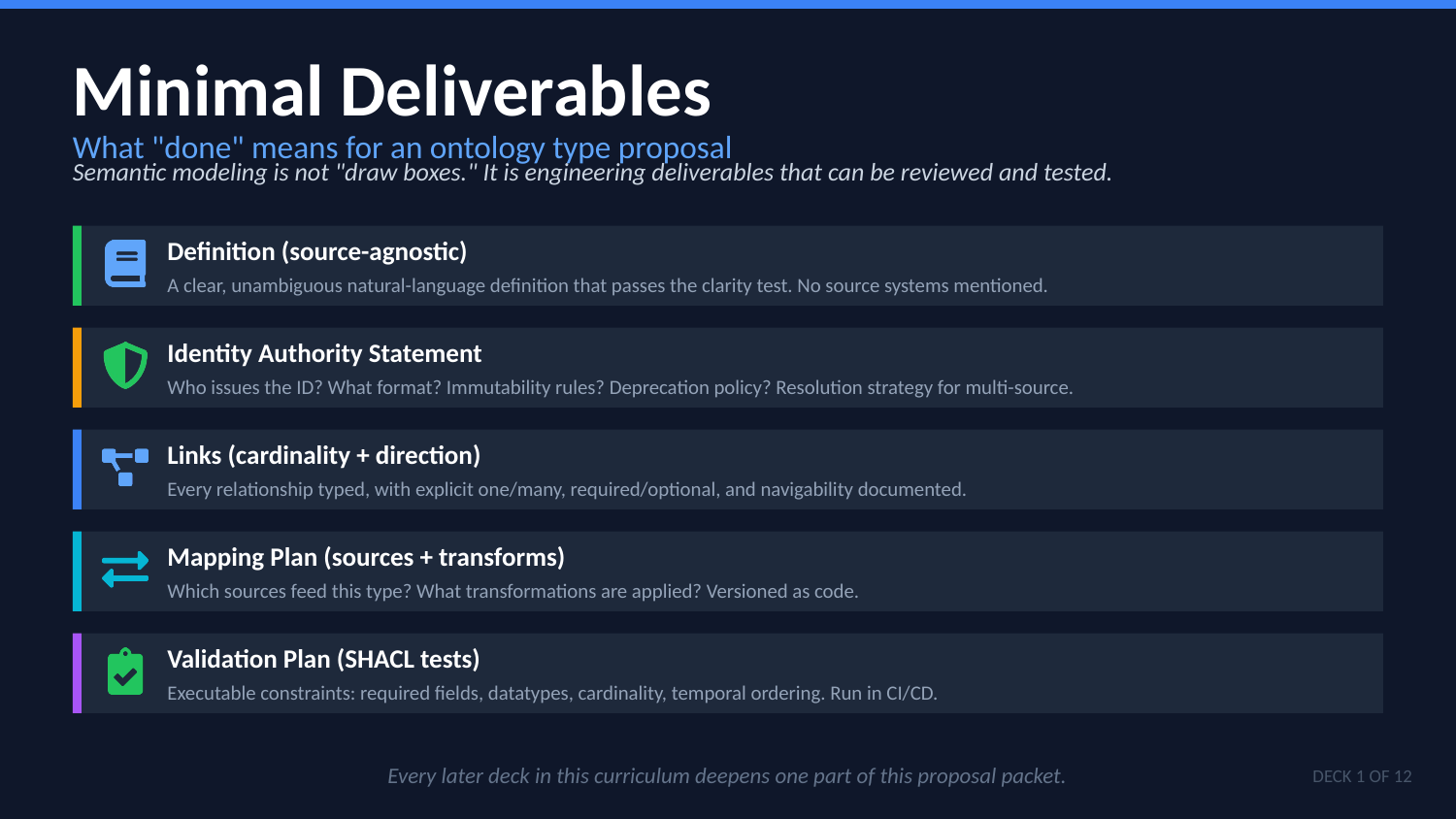
UNCLASSIFIED
01 — ARCHITECTURE FIRST PRINCIPLES · TM-30 · Data 201
UNCLASSIFIED

Slide 11

UNCLASSIFIED
01 — ARCHITECTURE FIRST PRINCIPLES · TM-30 · Data 201
UNCLASSIFIED

