Slide 1
02 — SCOPE ENGINEERING
TM-30 · Data 201
UNCLASSIFIED
UNCLASSIFIED
USAREUR-AF · C2DAO · MSS
UNCLASSIFIED

Slide 2

UNCLASSIFIED
02 — SCOPE ENGINEERING · TM-30 · Data 201
UNCLASSIFIED

Slide 3
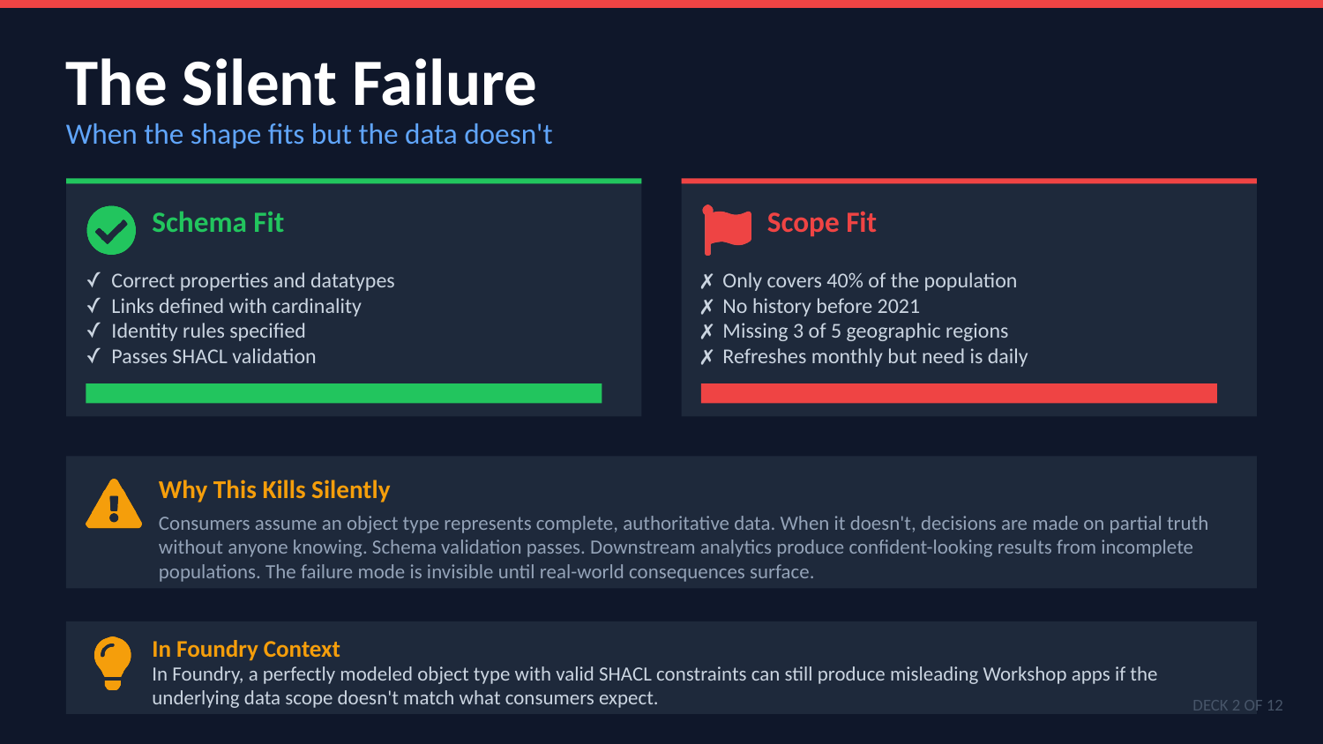
UNCLASSIFIED
02 — SCOPE ENGINEERING · TM-30 · Data 201
UNCLASSIFIED

Slide 4

UNCLASSIFIED
02 — SCOPE ENGINEERING · TM-30 · Data 201
UNCLASSIFIED

Slide 5
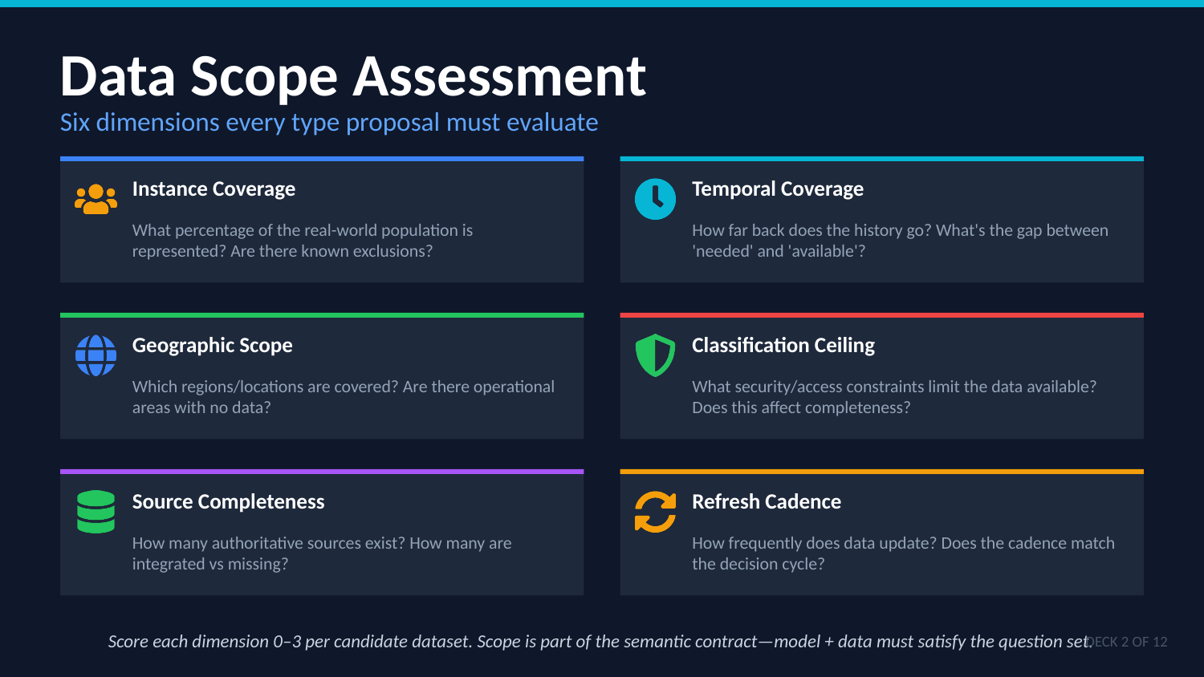
UNCLASSIFIED
02 — SCOPE ENGINEERING · TM-30 · Data 201
UNCLASSIFIED

Slide 6
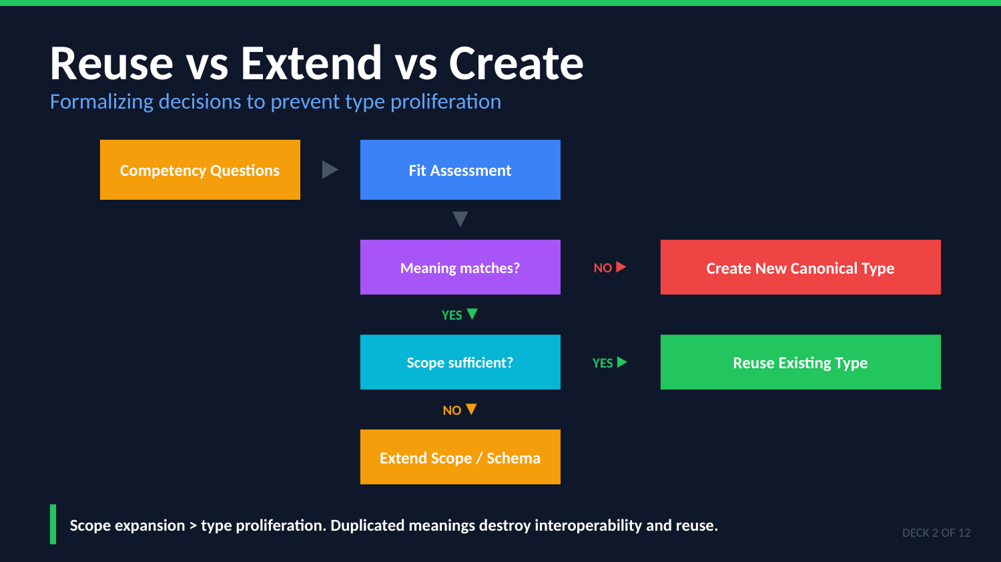
UNCLASSIFIED
02 — SCOPE ENGINEERING · TM-30 · Data 201
UNCLASSIFIED

Slide 7
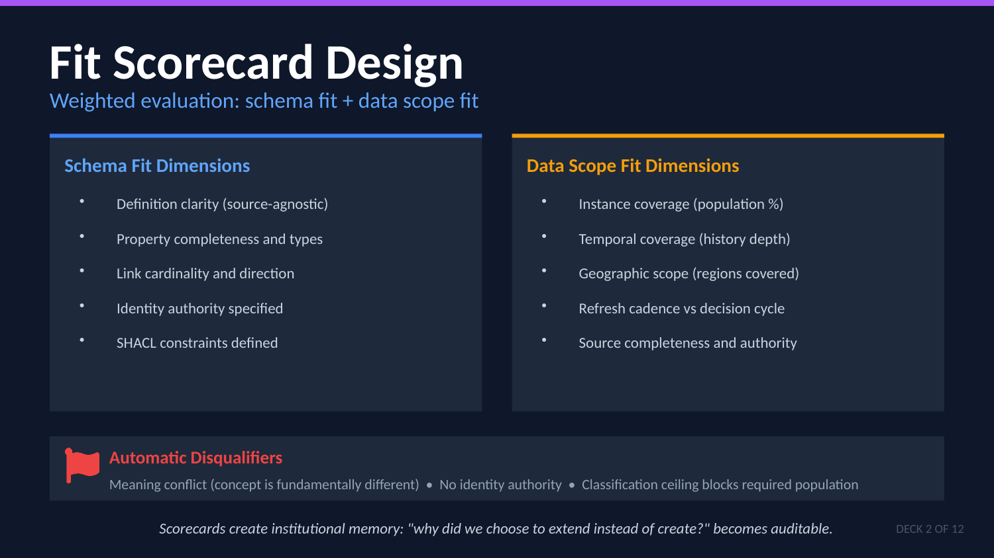
UNCLASSIFIED
02 — SCOPE ENGINEERING · TM-30 · Data 201
UNCLASSIFIED

Slide 8

UNCLASSIFIED
02 — SCOPE ENGINEERING · TM-30 · Data 201
UNCLASSIFIED

Slide 9
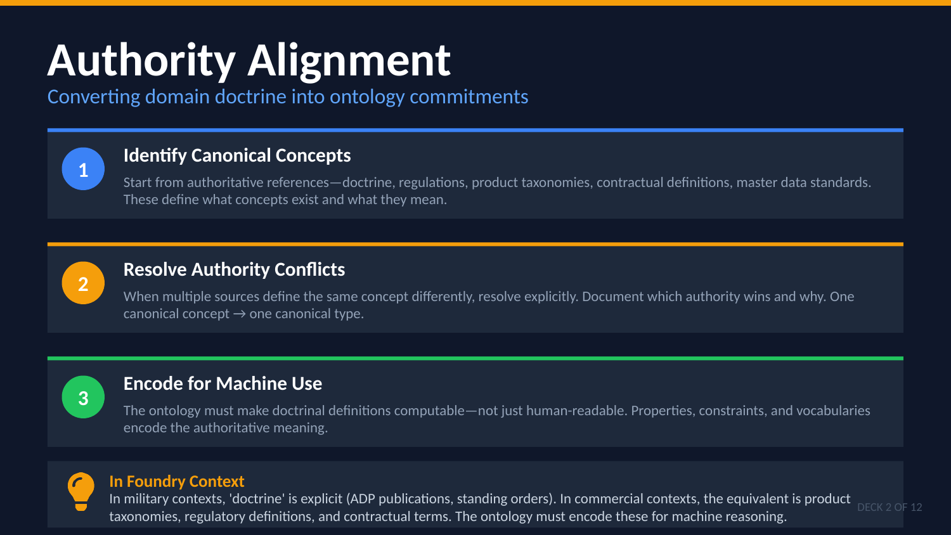
UNCLASSIFIED
02 — SCOPE ENGINEERING · TM-30 · Data 201
UNCLASSIFIED

Slide 10
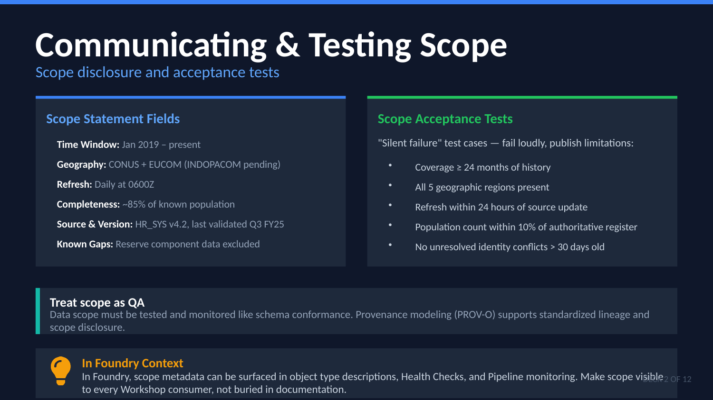
UNCLASSIFIED
02 — SCOPE ENGINEERING · TM-30 · Data 201
UNCLASSIFIED

Slide 11

UNCLASSIFIED
02 — SCOPE ENGINEERING · TM-30 · Data 201
UNCLASSIFIED

