Slide 1
03 — RDF & OWL FOUNDATIONS
TM-40K · Specialist · also: TM-40L
UNCLASSIFIED
UNCLASSIFIED
USAREUR-AF · C2DAO · MSS
UNCLASSIFIED

Slide 2

UNCLASSIFIED
03 — RDF & OWL FOUNDATIONS · TM-40K · Specialist
UNCLASSIFIED

Slide 3
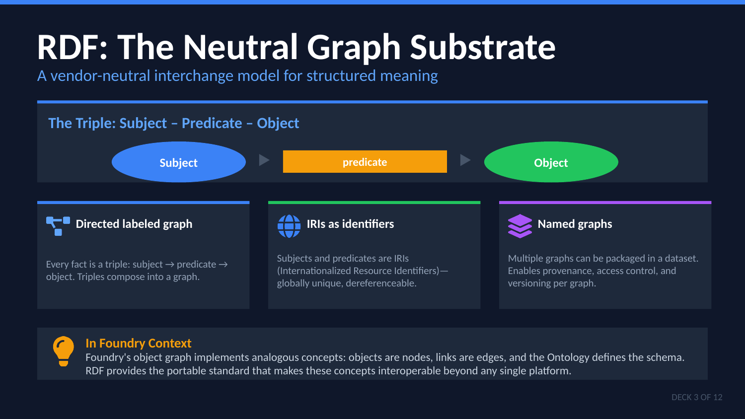
UNCLASSIFIED
03 — RDF & OWL FOUNDATIONS · TM-40K · Specialist
UNCLASSIFIED

Slide 4
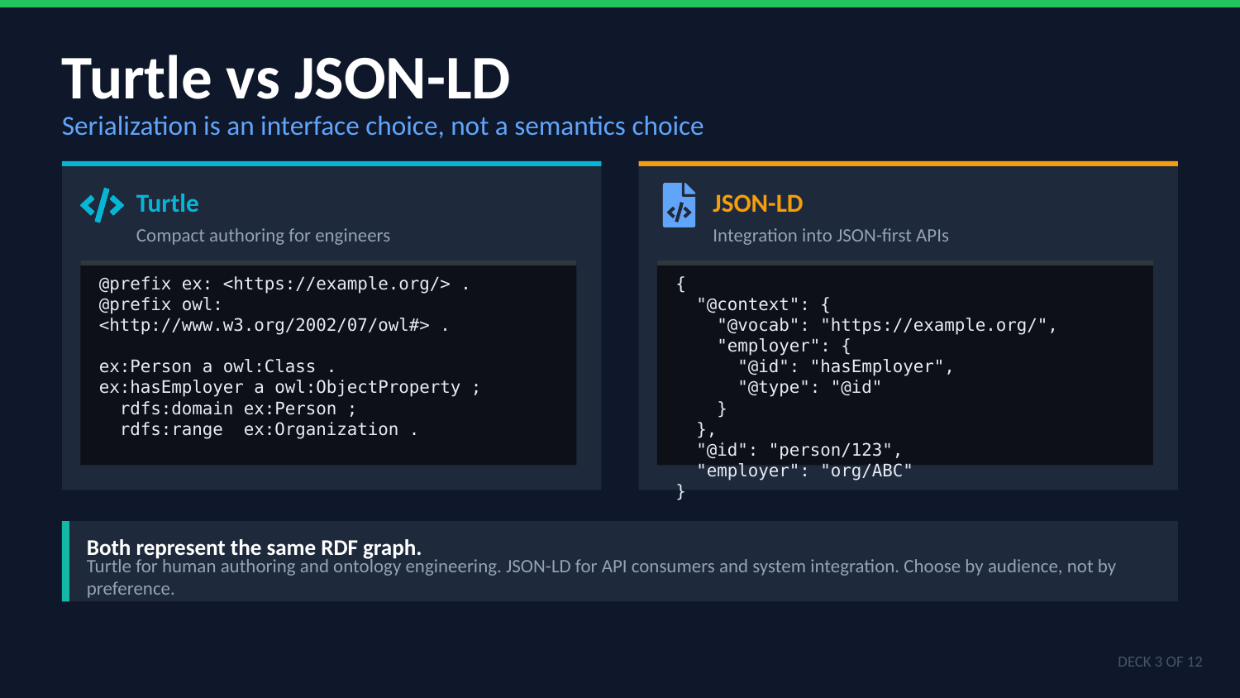
UNCLASSIFIED
03 — RDF & OWL FOUNDATIONS · TM-40K · Specialist
UNCLASSIFIED

Slide 5

UNCLASSIFIED
03 — RDF & OWL FOUNDATIONS · TM-40K · Specialist
UNCLASSIFIED

Slide 6
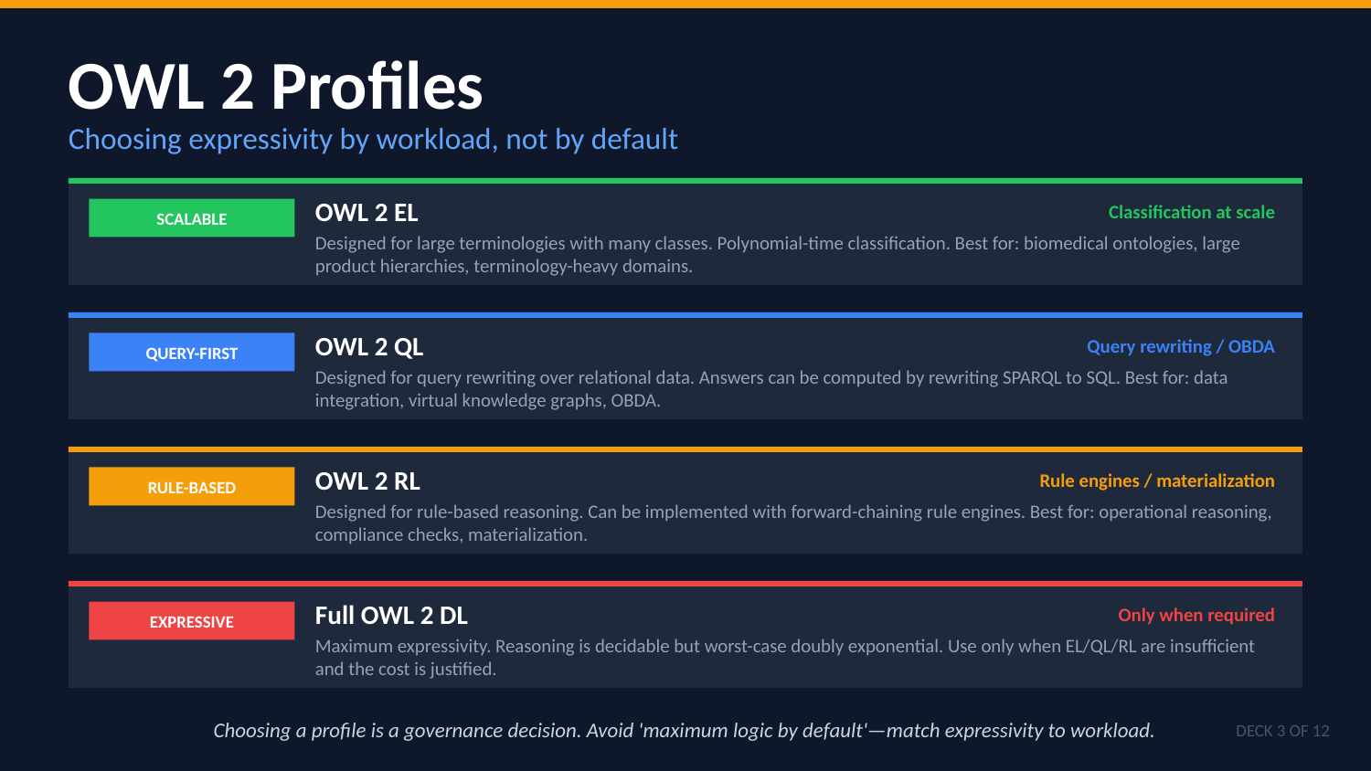
UNCLASSIFIED
03 — RDF & OWL FOUNDATIONS · TM-40K · Specialist
UNCLASSIFIED

Slide 7
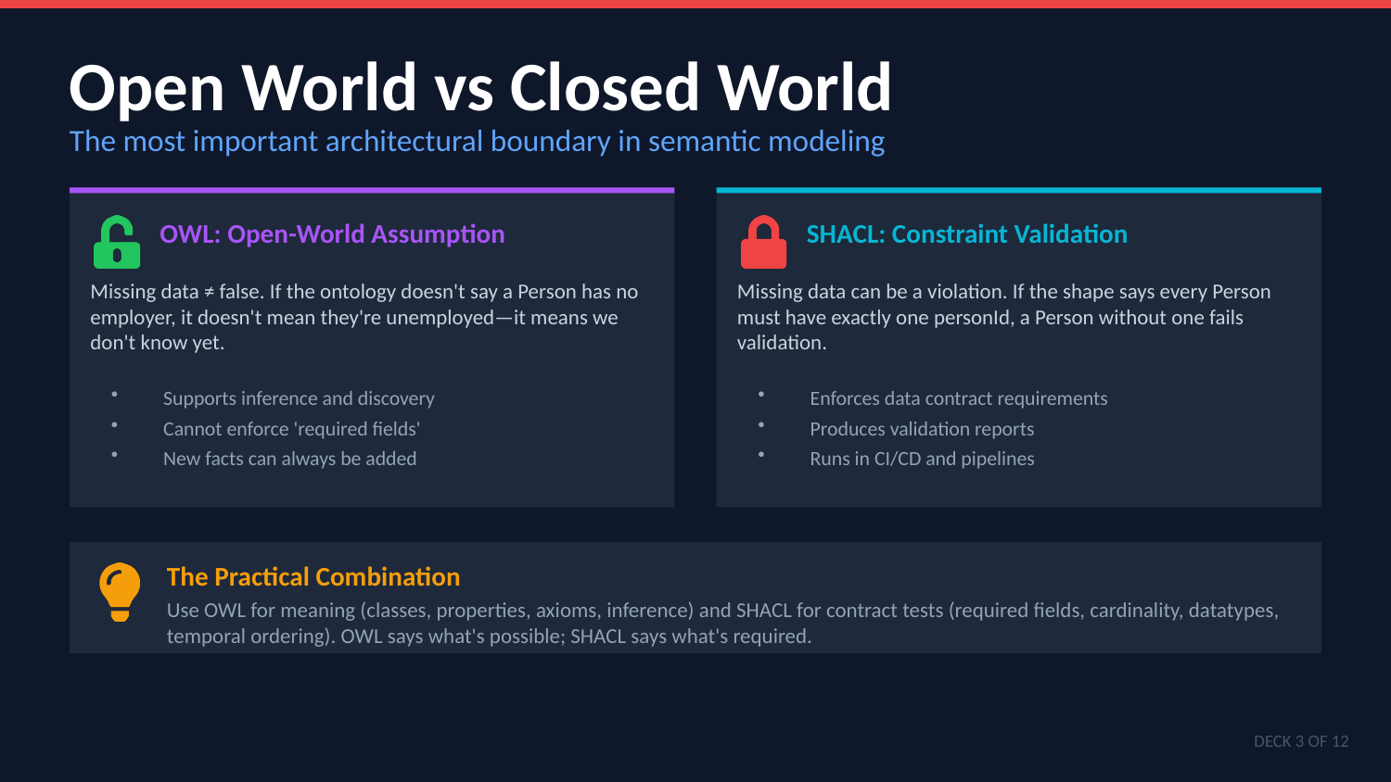
UNCLASSIFIED
03 — RDF & OWL FOUNDATIONS · TM-40K · Specialist
UNCLASSIFIED

Slide 8
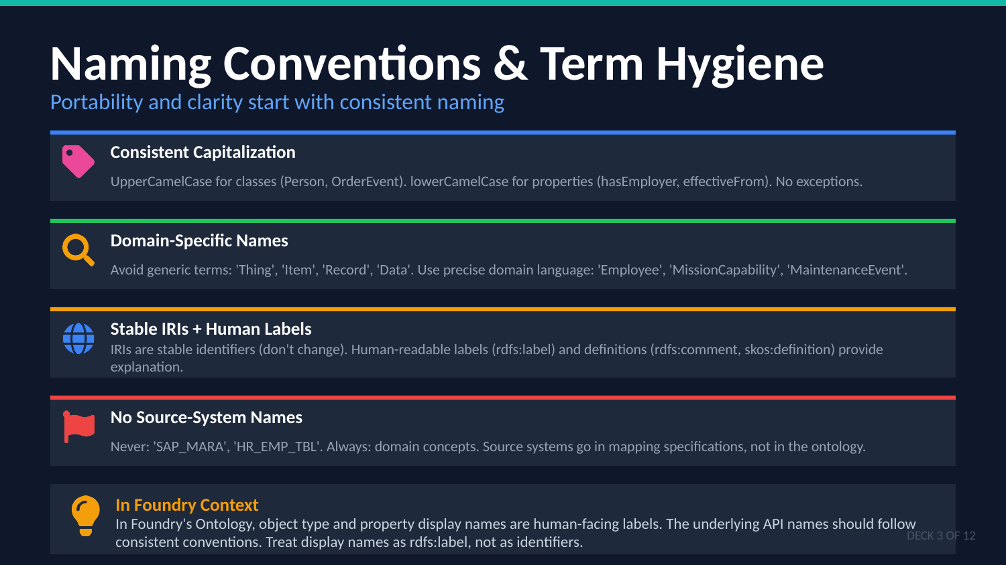
UNCLASSIFIED
03 — RDF & OWL FOUNDATIONS · TM-40K · Specialist
UNCLASSIFIED

Slide 9
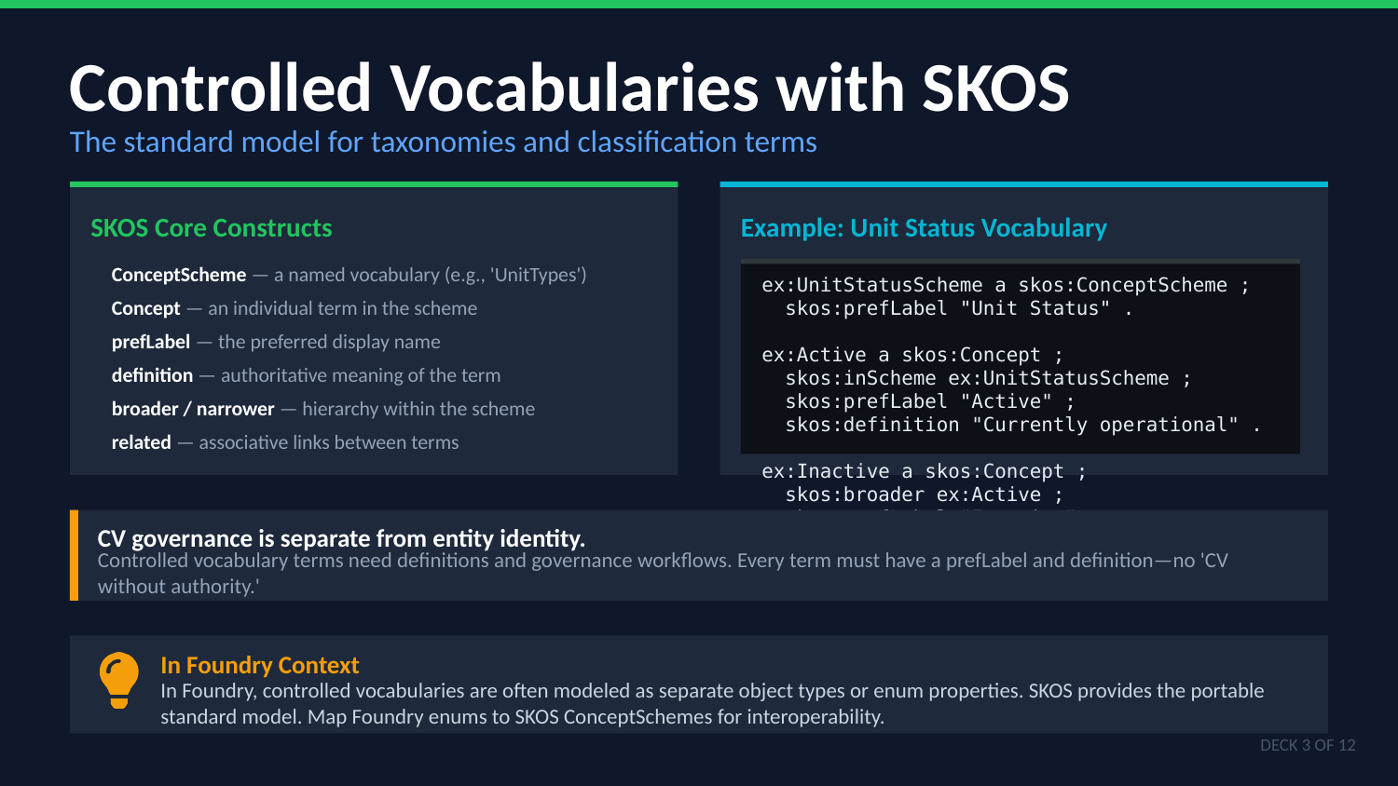
UNCLASSIFIED
03 — RDF & OWL FOUNDATIONS · TM-40K · Specialist
UNCLASSIFIED

Slide 10
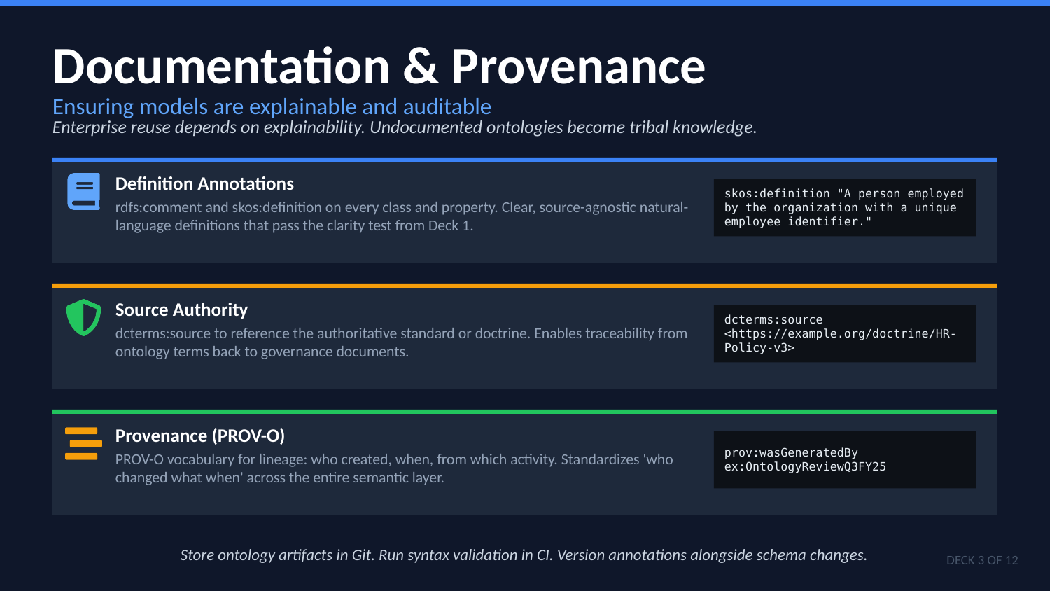
UNCLASSIFIED
03 — RDF & OWL FOUNDATIONS · TM-40K · Specialist
UNCLASSIFIED

Slide 11
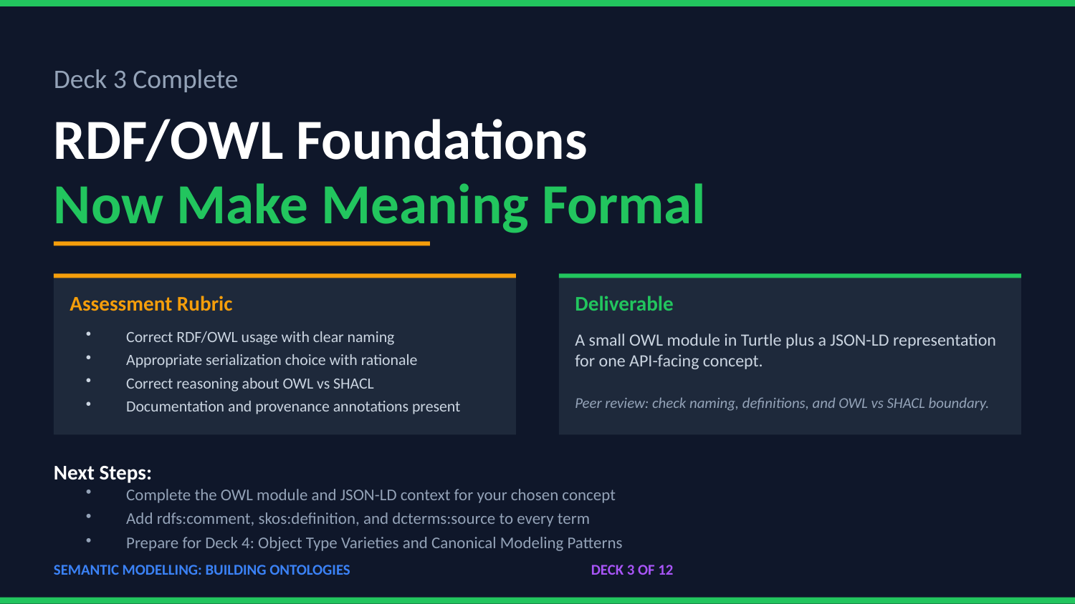
UNCLASSIFIED
03 — RDF & OWL FOUNDATIONS · TM-40K · Specialist
UNCLASSIFIED

