Slide 1
07 — TEMPORAL & BITEMPORAL
TM-40L · Specialist · also: TM-40G, TM-40I, TM-40K
UNCLASSIFIED
UNCLASSIFIED
USAREUR-AF · C2DAO · MSS
UNCLASSIFIED

Slide 2

UNCLASSIFIED
07 — TEMPORAL & BITEMPORAL · TM-40L · Specialist
UNCLASSIFIED

Slide 3
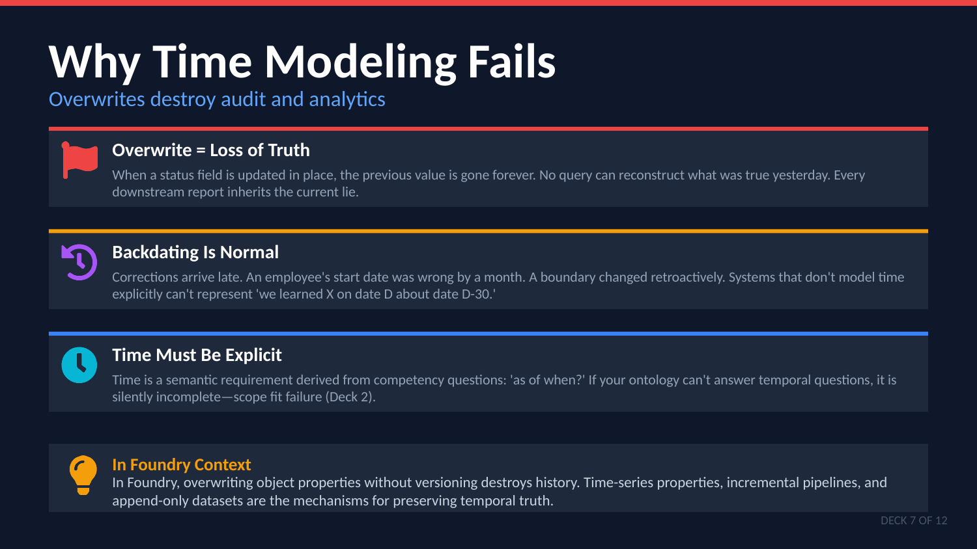
UNCLASSIFIED
07 — TEMPORAL & BITEMPORAL · TM-40L · Specialist
UNCLASSIFIED

Slide 4
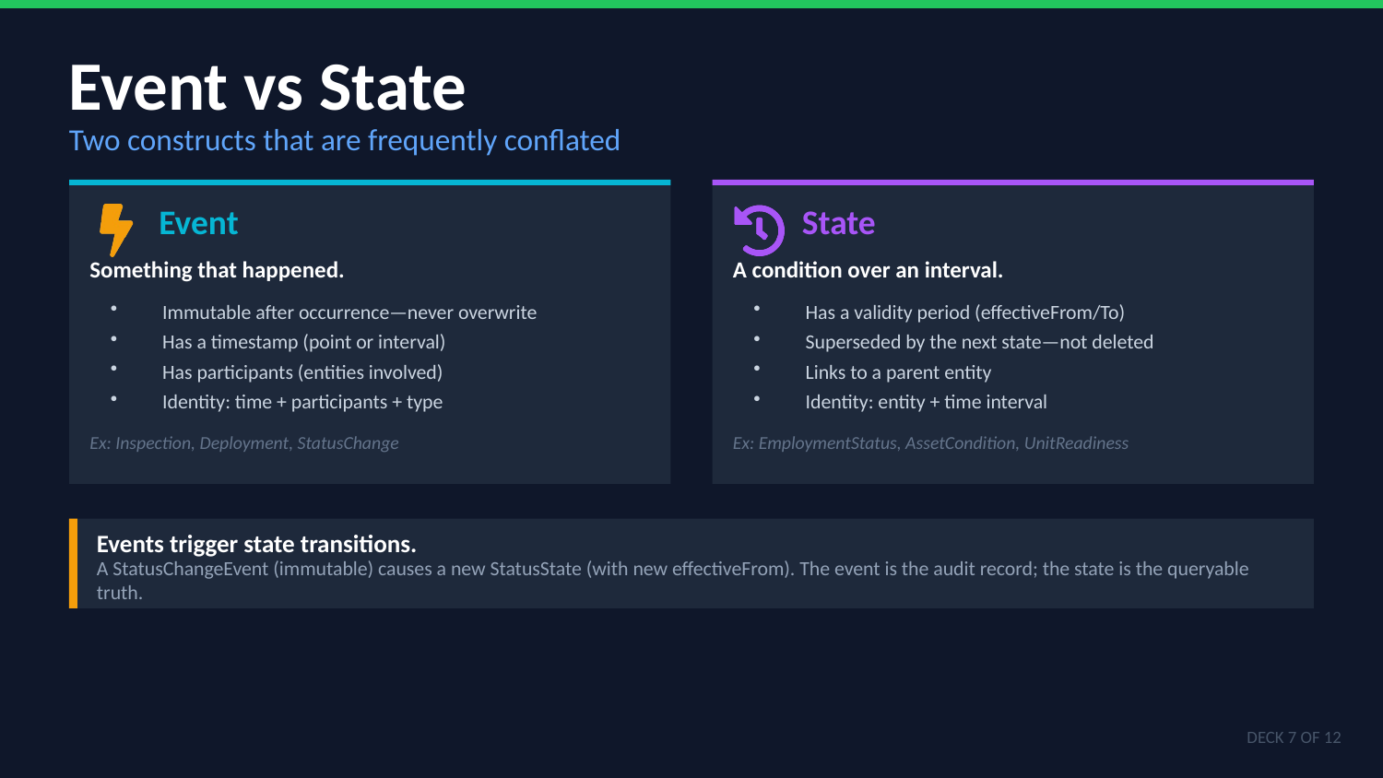
UNCLASSIFIED
07 — TEMPORAL & BITEMPORAL · TM-40L · Specialist
UNCLASSIFIED

Slide 5
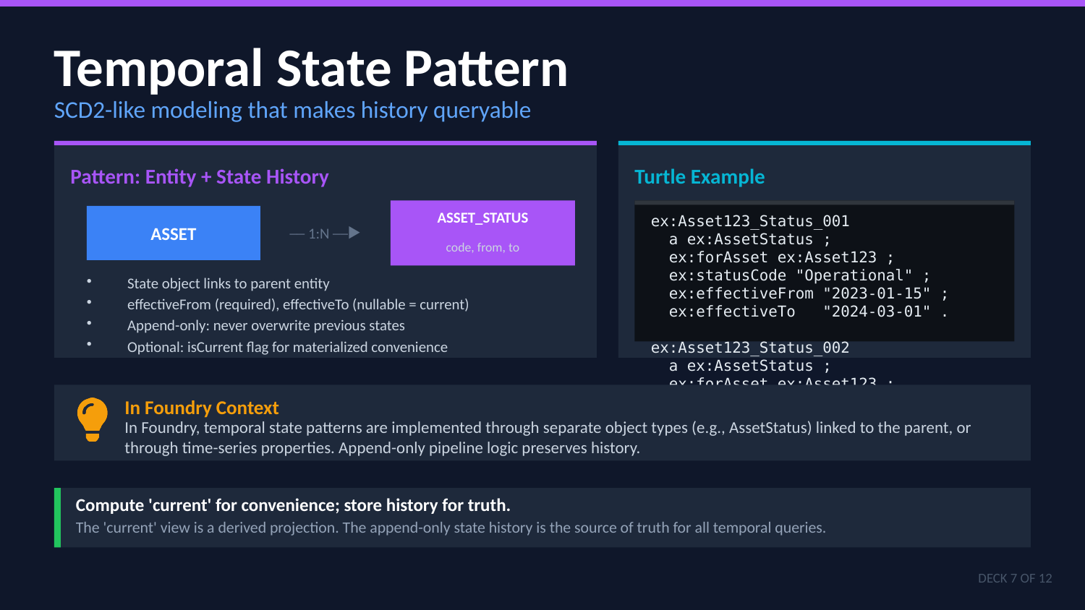
UNCLASSIFIED
07 — TEMPORAL & BITEMPORAL · TM-40L · Specialist
UNCLASSIFIED

Slide 6
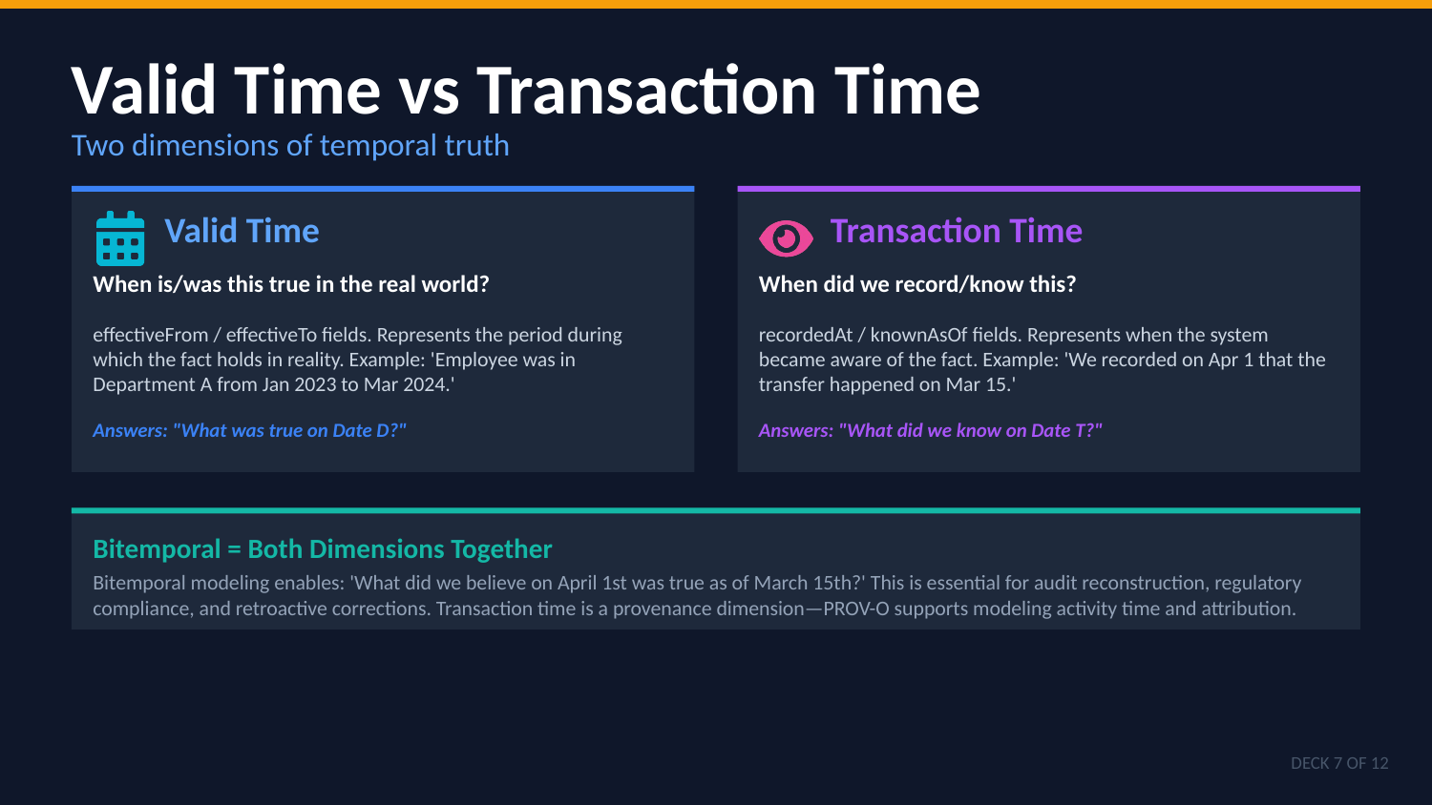
UNCLASSIFIED
07 — TEMPORAL & BITEMPORAL · TM-40L · Specialist
UNCLASSIFIED

Slide 7
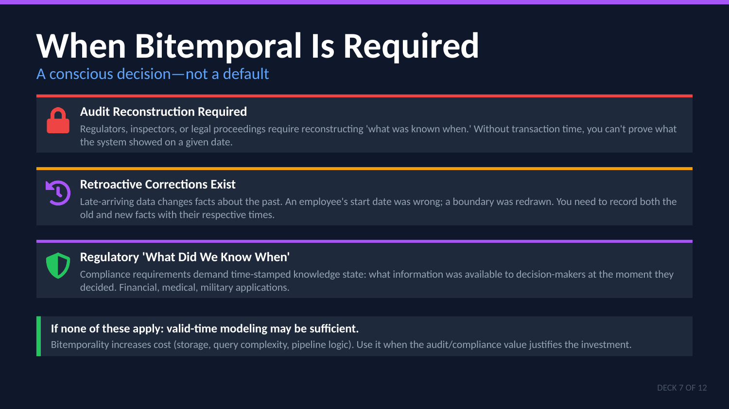
UNCLASSIFIED
07 — TEMPORAL & BITEMPORAL · TM-40L · Specialist
UNCLASSIFIED

Slide 8
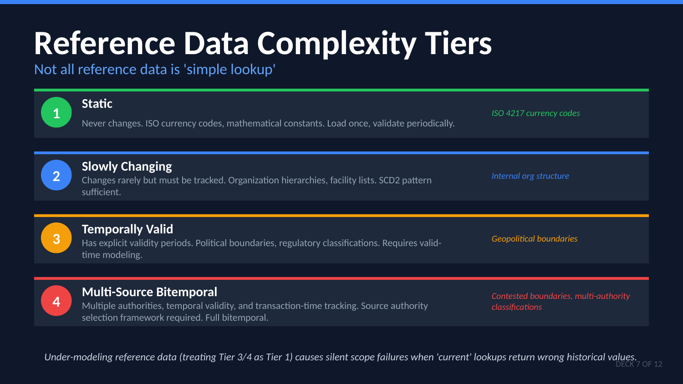
UNCLASSIFIED
07 — TEMPORAL & BITEMPORAL · TM-40L · Specialist
UNCLASSIFIED

Slide 9
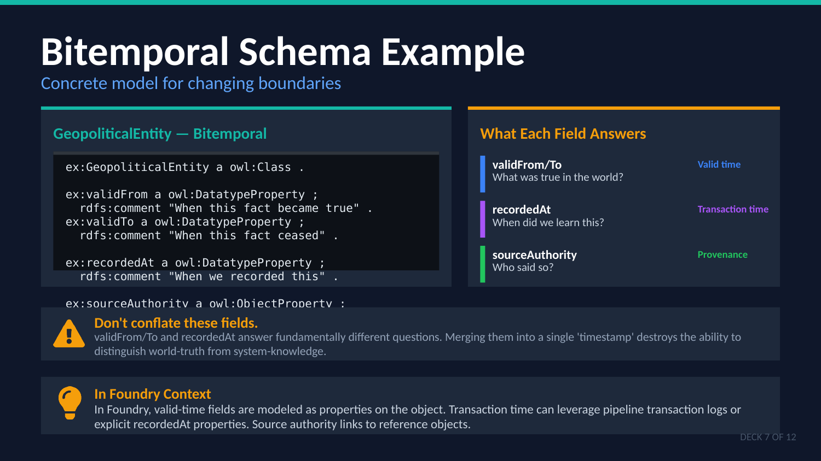
UNCLASSIFIED
07 — TEMPORAL & BITEMPORAL · TM-40L · Specialist
UNCLASSIFIED

Slide 10
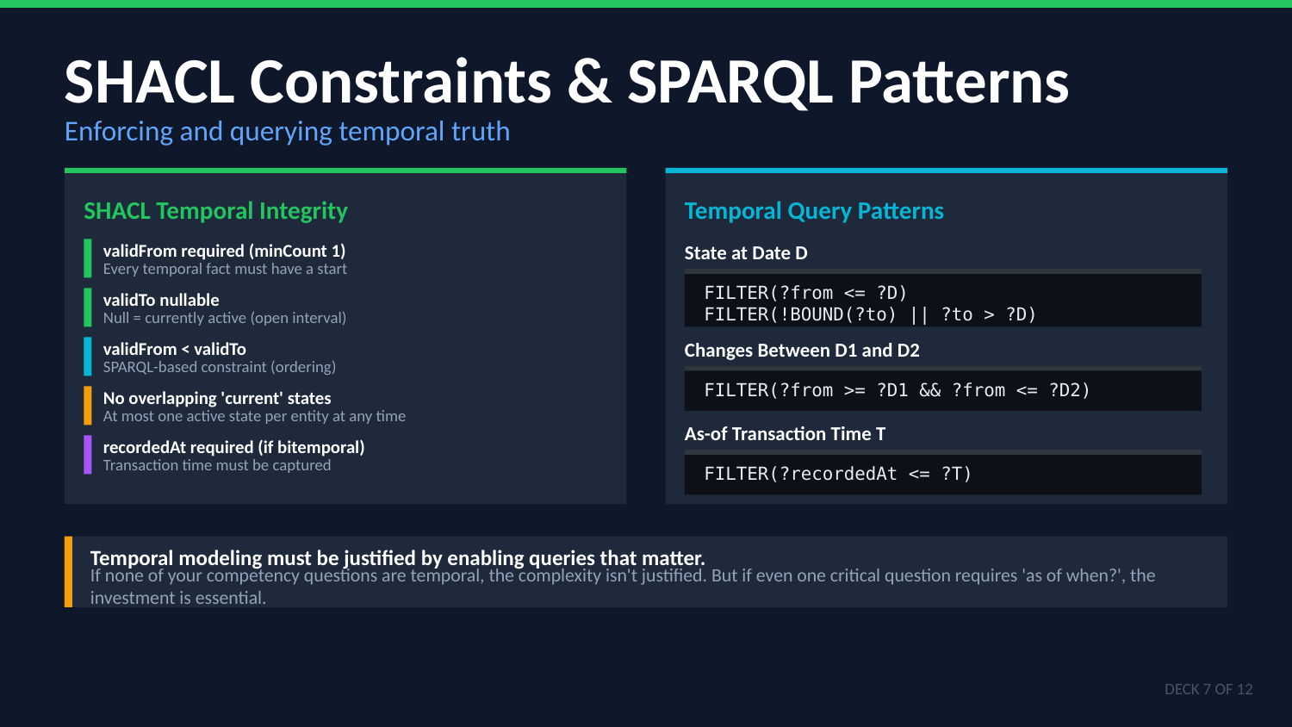
UNCLASSIFIED
07 — TEMPORAL & BITEMPORAL · TM-40L · Specialist
UNCLASSIFIED

Slide 11

UNCLASSIFIED
07 — TEMPORAL & BITEMPORAL · TM-40L · Specialist
UNCLASSIFIED

