Slide 1
12 — CAPSTONE: FOUNDRY
TM-40G · Specialist · also: TM-40H, TM-40I, TM-40J, TM-40K, TM-40L
UNCLASSIFIED
UNCLASSIFIED
USAREUR-AF · C2DAO · MSS
UNCLASSIFIED

Slide 2
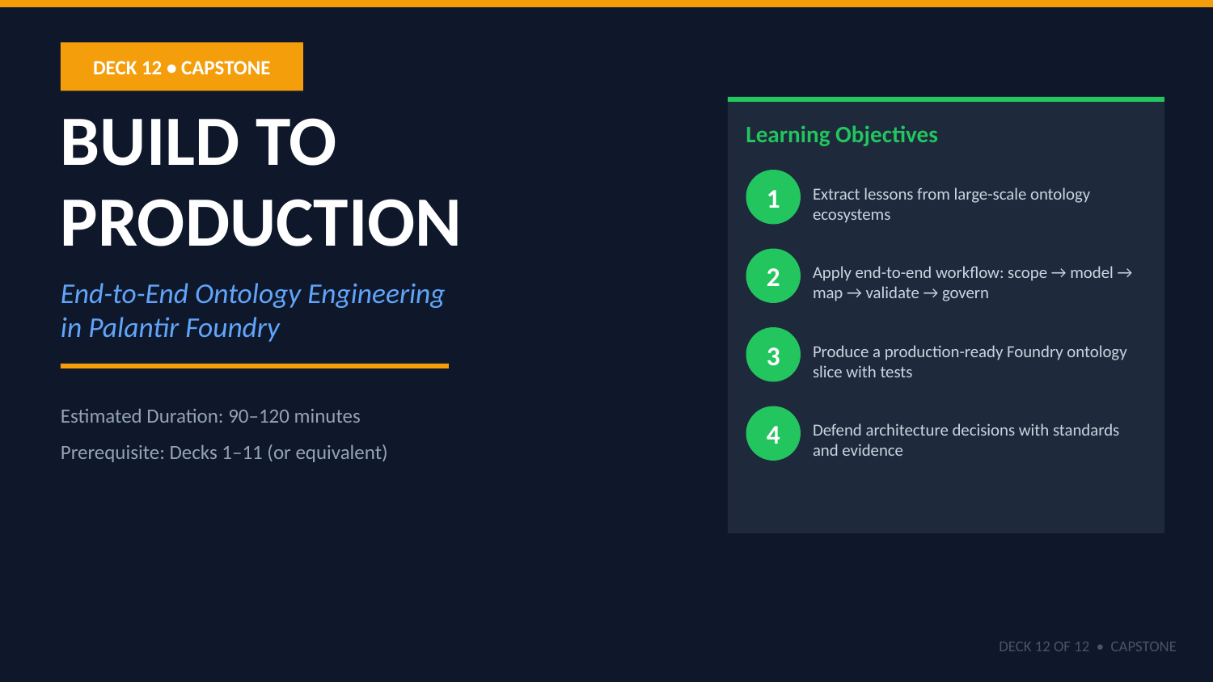
UNCLASSIFIED
12 — CAPSTONE: FOUNDRY · TM-40G · Specialist
UNCLASSIFIED

Slide 3
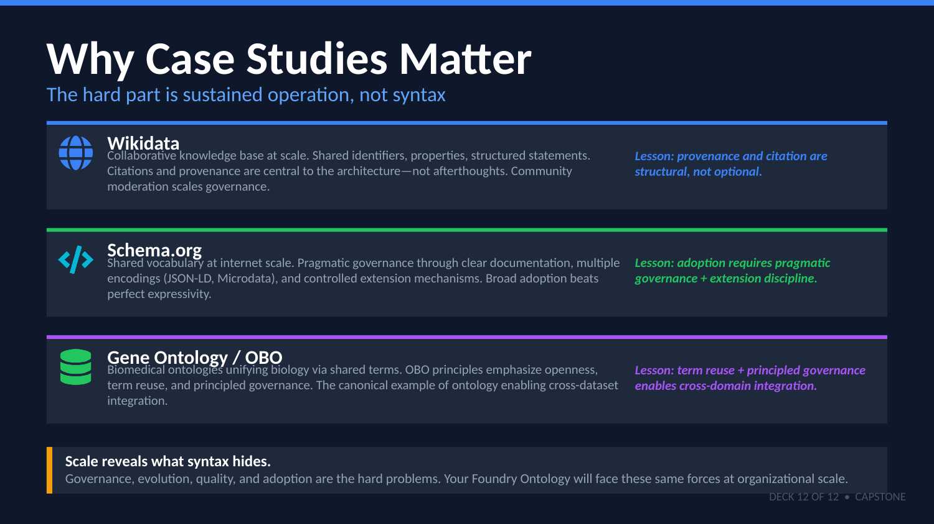
UNCLASSIFIED
12 — CAPSTONE: FOUNDRY · TM-40G · Specialist
UNCLASSIFIED

Slide 4
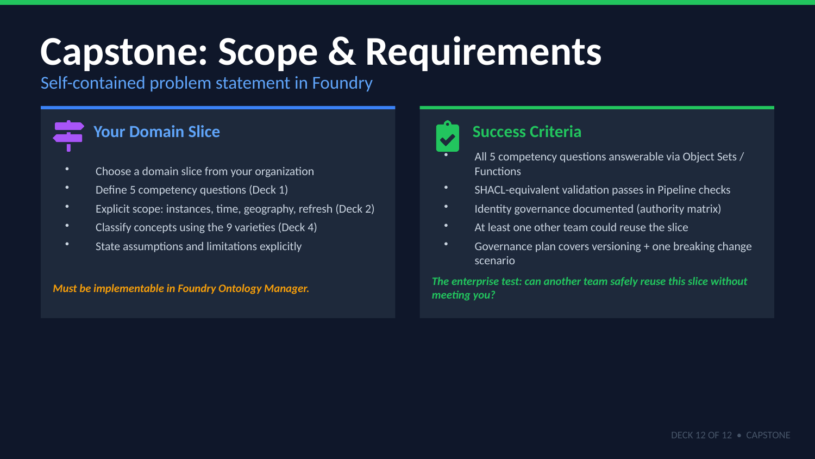
UNCLASSIFIED
12 — CAPSTONE: FOUNDRY · TM-40G · Specialist
UNCLASSIFIED

Slide 5
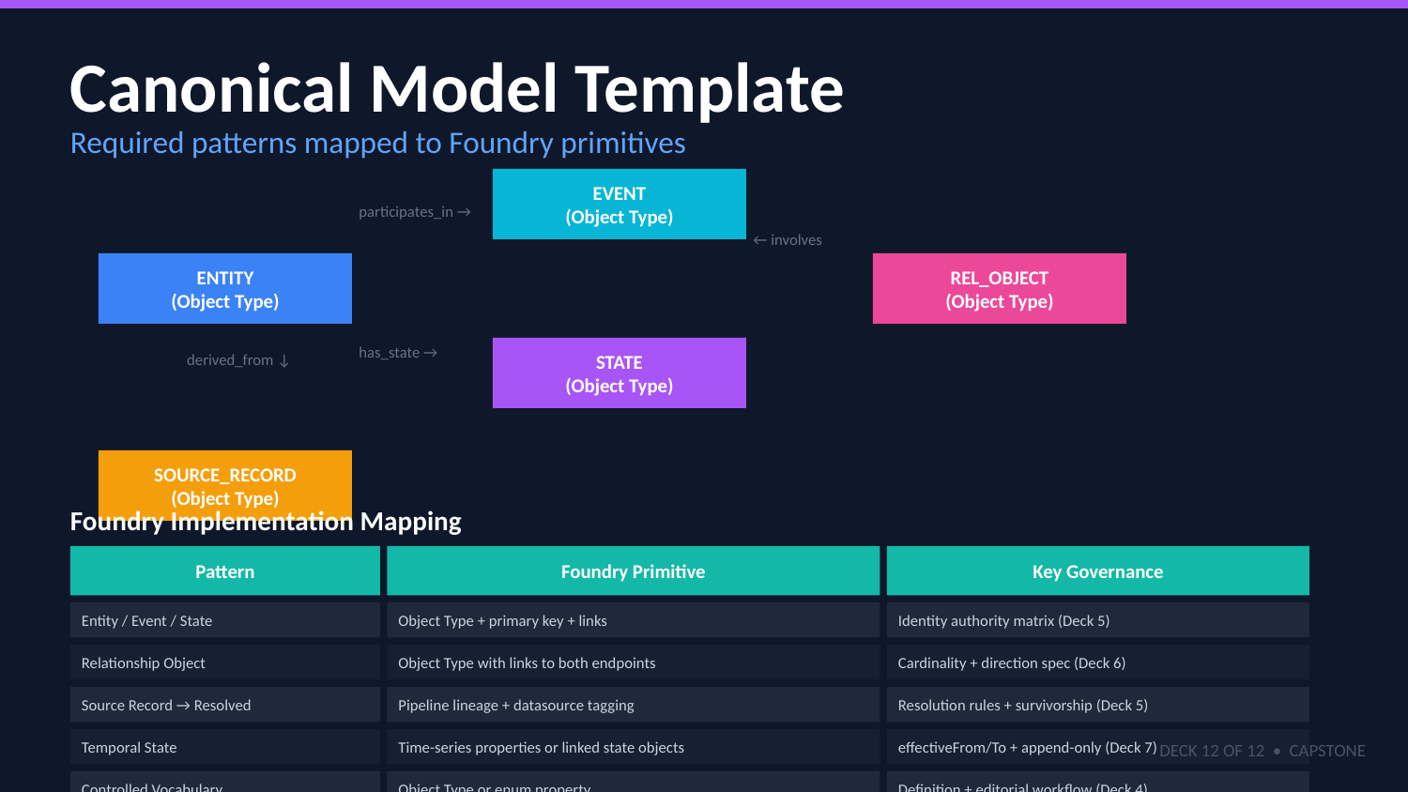
UNCLASSIFIED
12 — CAPSTONE: FOUNDRY · TM-40G · Specialist
UNCLASSIFIED

Slide 6
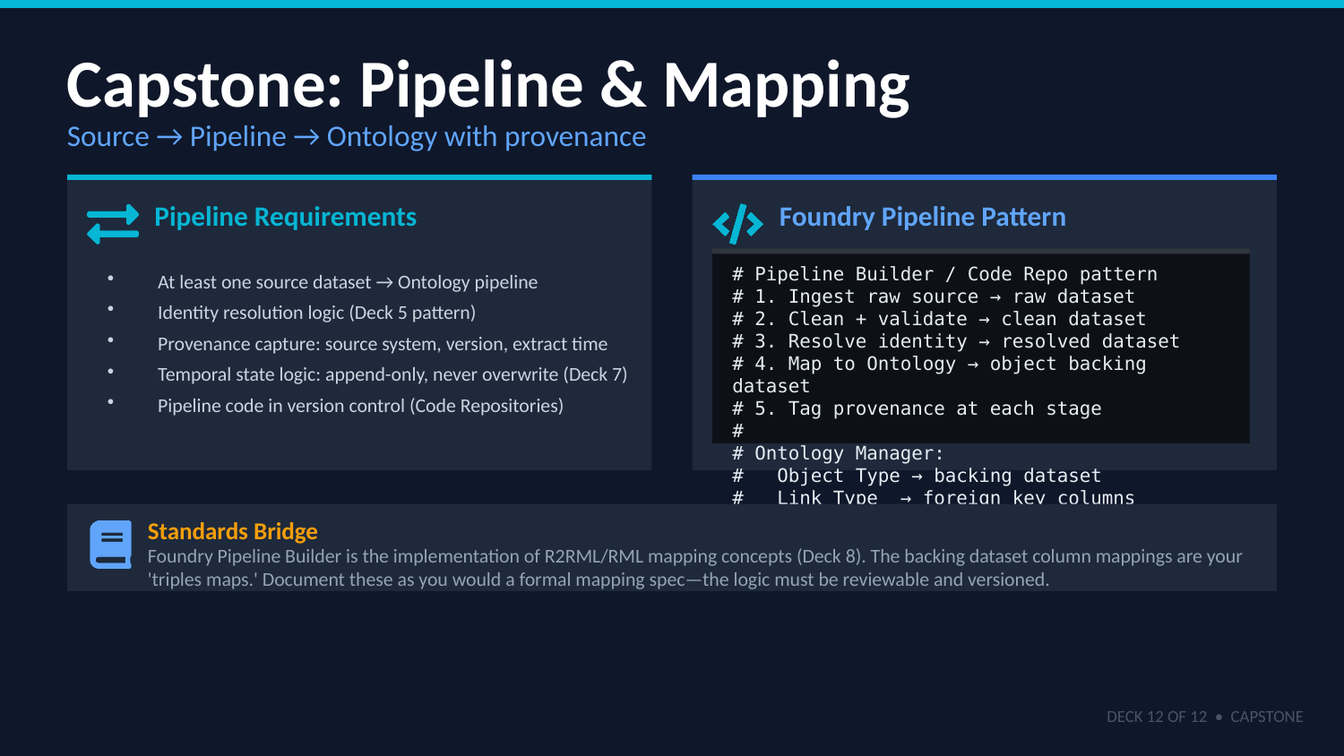
UNCLASSIFIED
12 — CAPSTONE: FOUNDRY · TM-40G · Specialist
UNCLASSIFIED

Slide 7
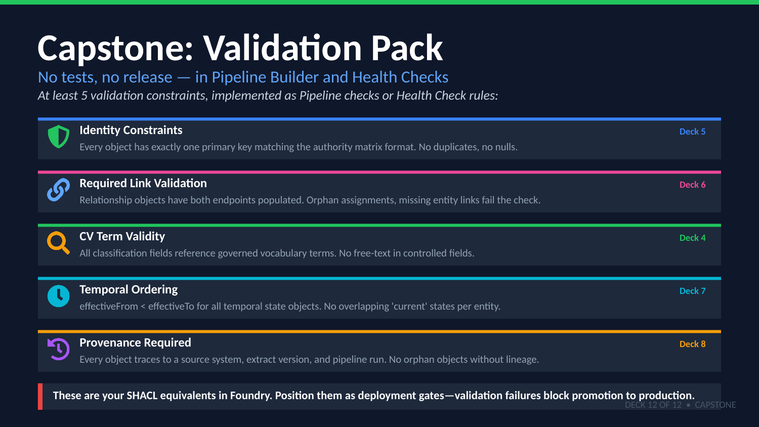
UNCLASSIFIED
12 — CAPSTONE: FOUNDRY · TM-40G · Specialist
UNCLASSIFIED

Slide 8
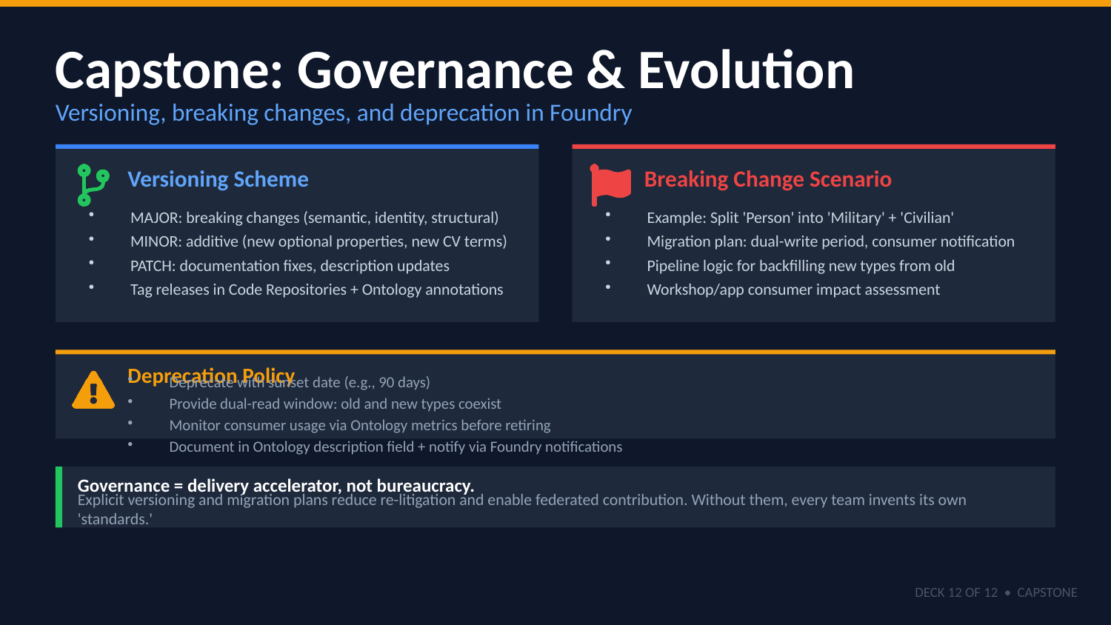
UNCLASSIFIED
12 — CAPSTONE: FOUNDRY · TM-40G · Specialist
UNCLASSIFIED

Slide 9
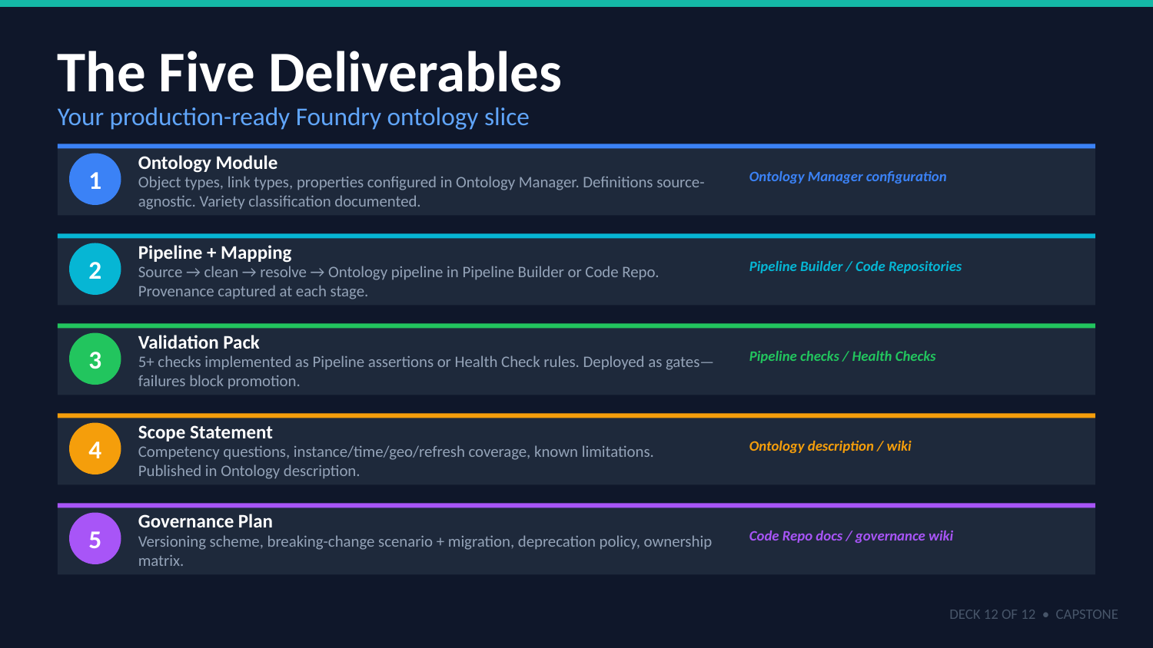
UNCLASSIFIED
12 — CAPSTONE: FOUNDRY · TM-40G · Specialist
UNCLASSIFIED

Slide 10
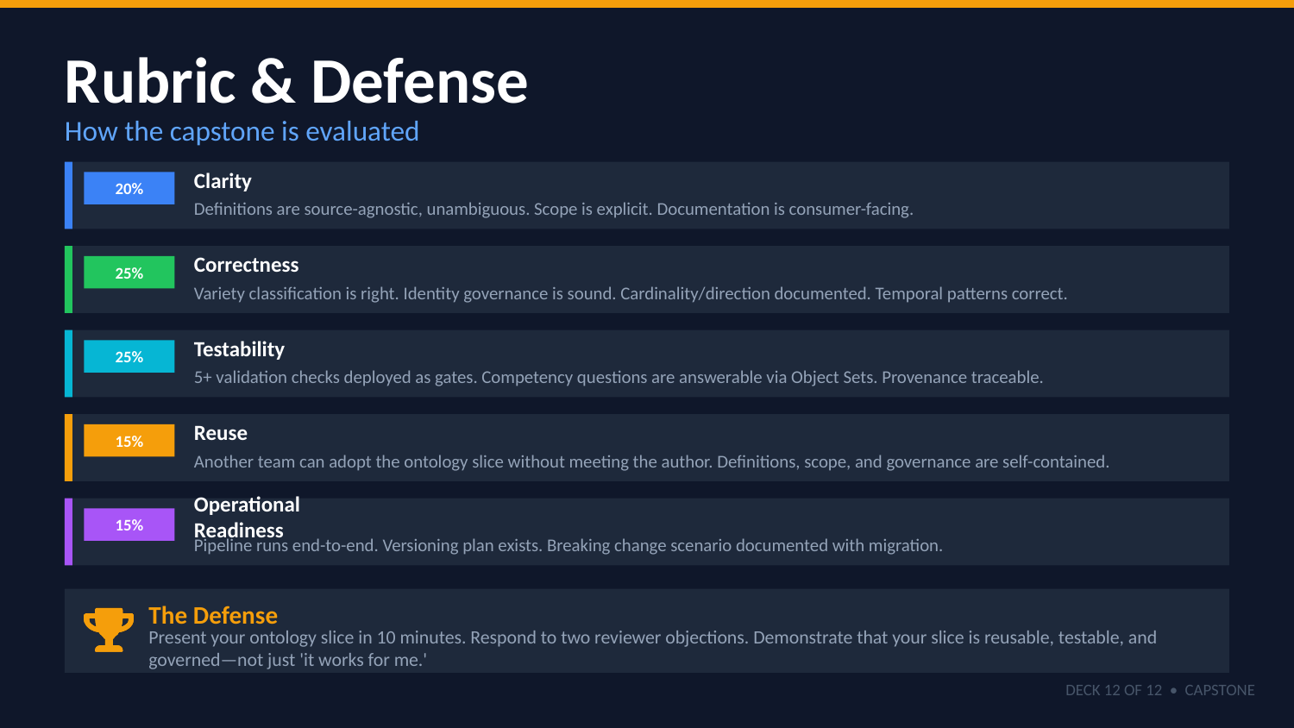
UNCLASSIFIED
12 — CAPSTONE: FOUNDRY · TM-40G · Specialist
UNCLASSIFIED

Slide 11

UNCLASSIFIED
12 — CAPSTONE: FOUNDRY · TM-40G · Specialist
UNCLASSIFIED

