Slide 1
DON'T FILTER — THIS ISN'T EXCEL
TM-20 · Data 101
UNCLASSIFIED
UNCLASSIFIED
USAREUR-AF · C2DAO · MSS
UNCLASSIFIED

Slide 2
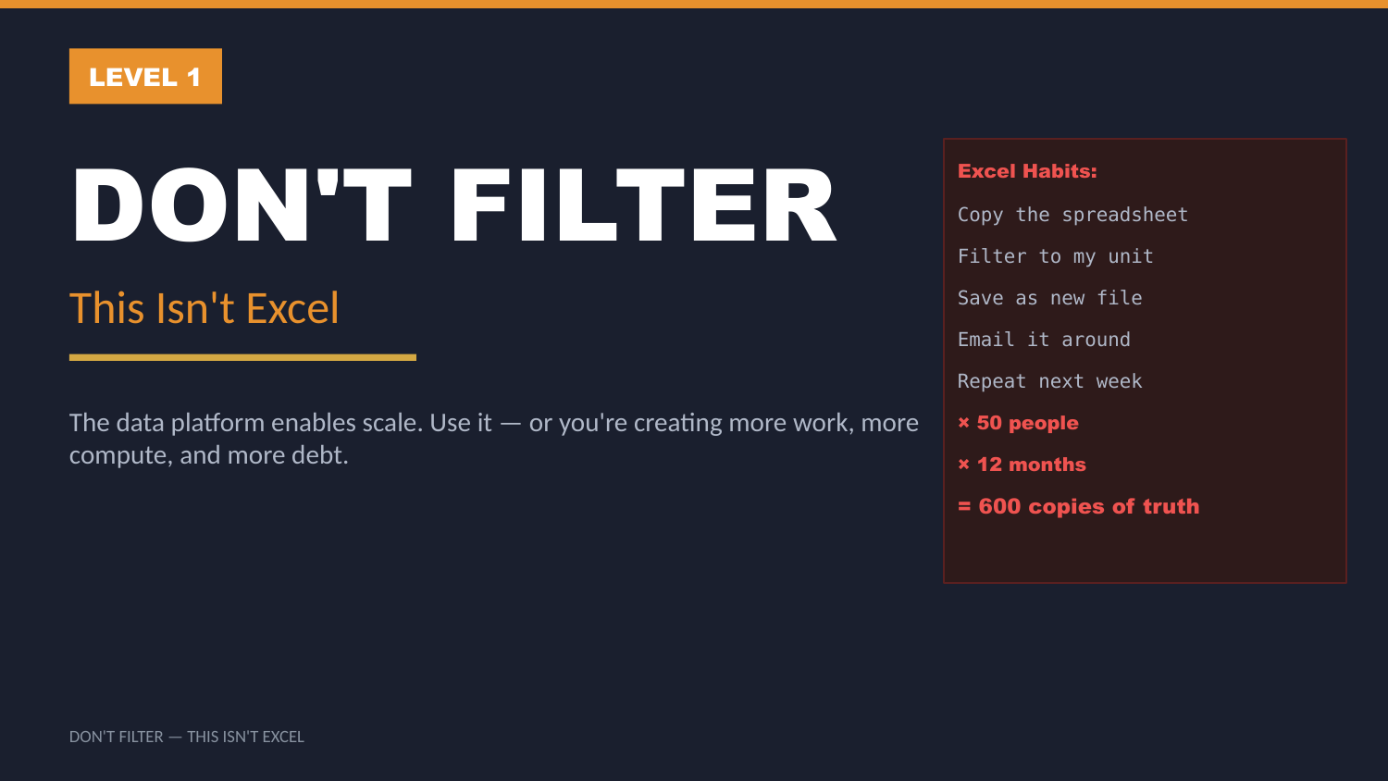
UNCLASSIFIED
DON'T FILTER — THIS ISN'T EXCEL · TM-20 · Data 101
UNCLASSIFIED

Slide 3
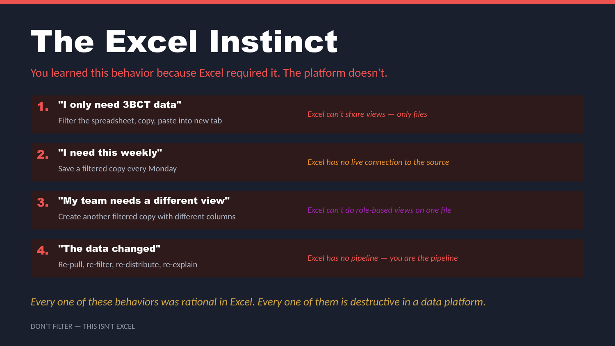
UNCLASSIFIED
DON'T FILTER — THIS ISN'T EXCEL · TM-20 · Data 101
UNCLASSIFIED

Slide 4
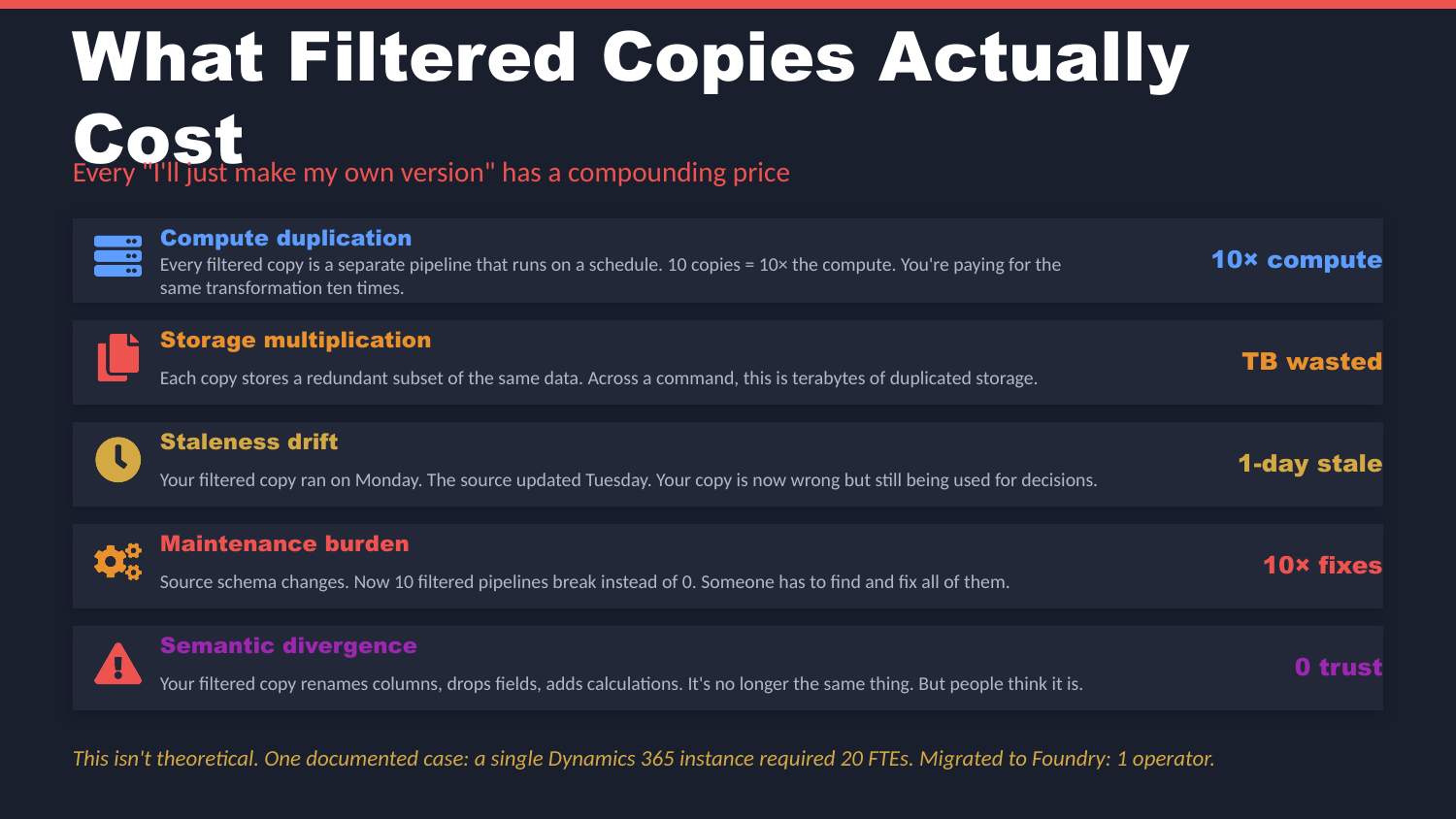
UNCLASSIFIED
DON'T FILTER — THIS ISN'T EXCEL · TM-20 · Data 101
UNCLASSIFIED

Slide 5
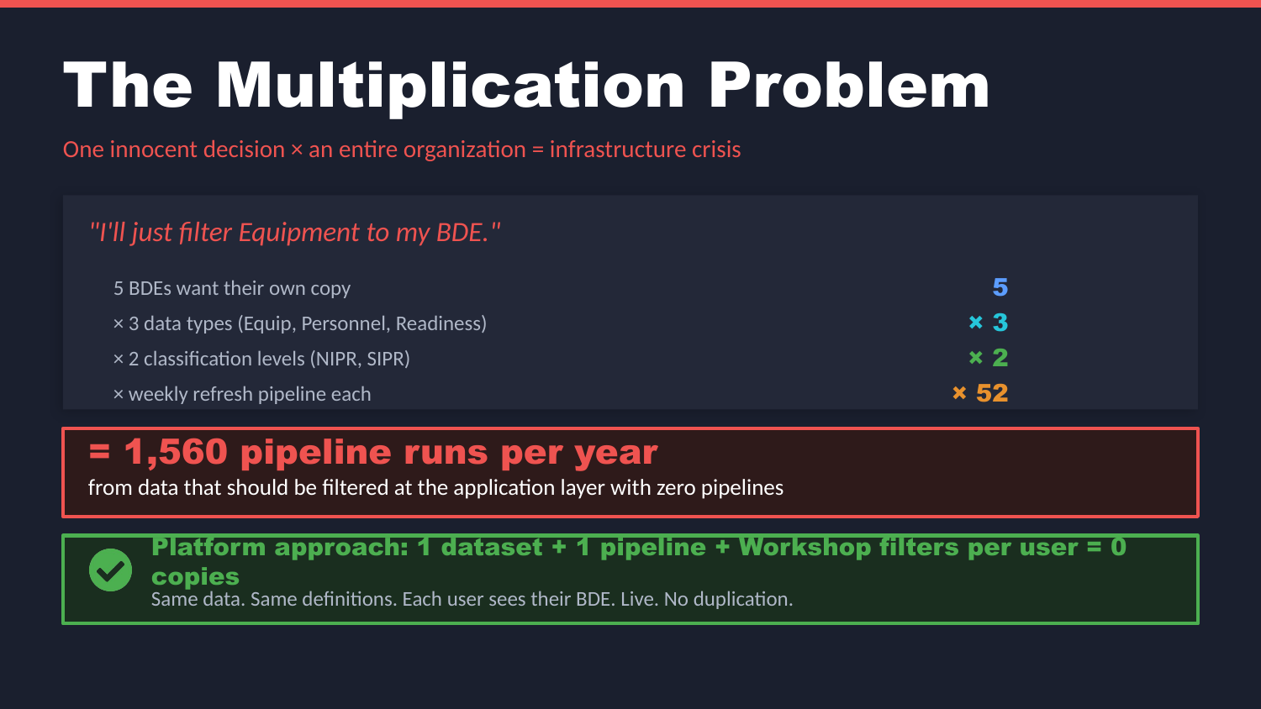
UNCLASSIFIED
DON'T FILTER — THIS ISN'T EXCEL · TM-20 · Data 101
UNCLASSIFIED

Slide 6
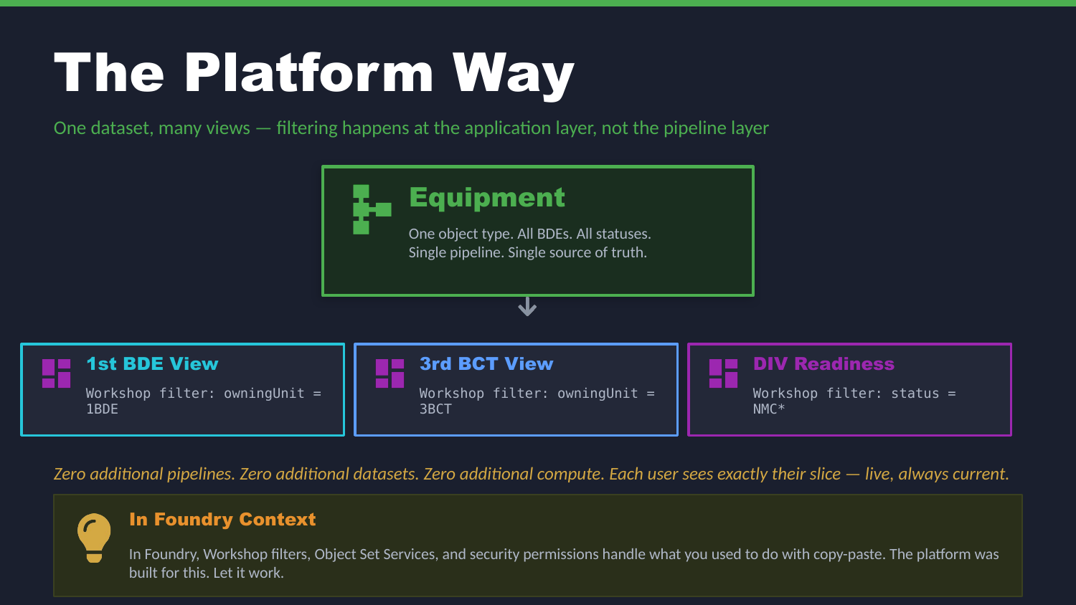
UNCLASSIFIED
DON'T FILTER — THIS ISN'T EXCEL · TM-20 · Data 101
UNCLASSIFIED

Slide 7
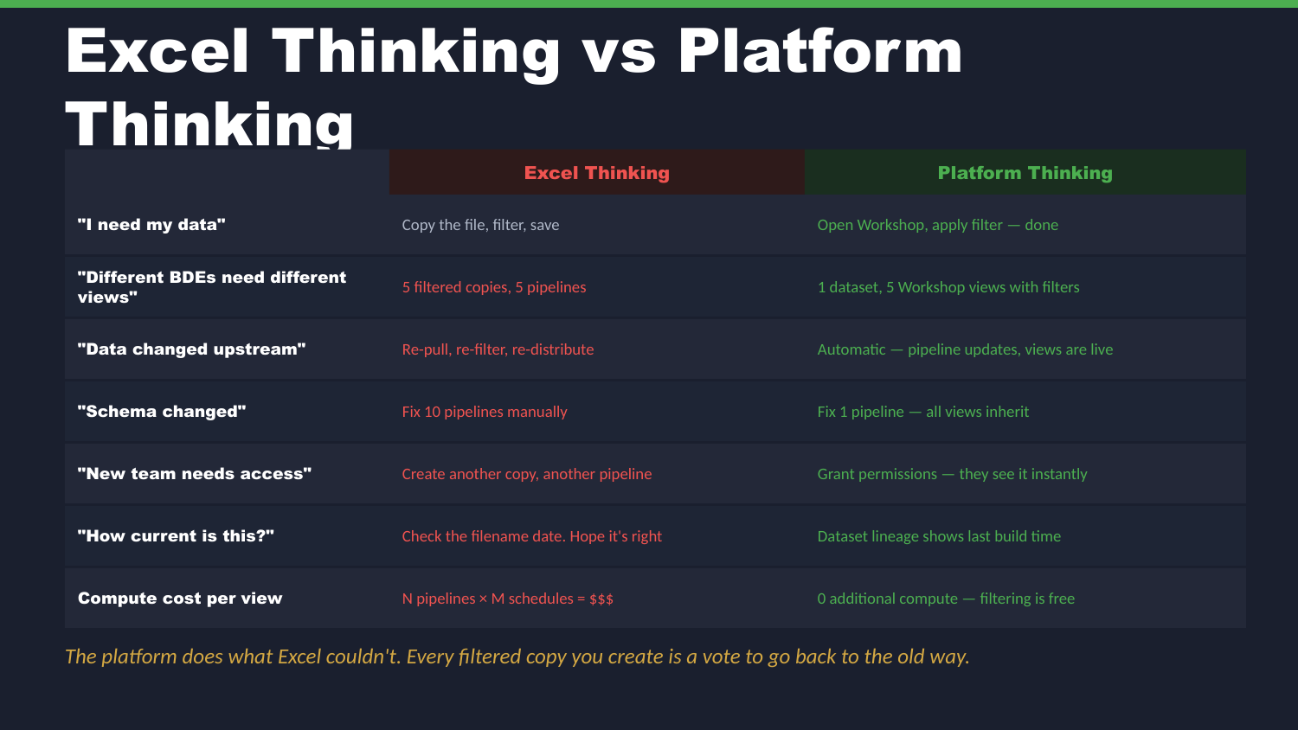
UNCLASSIFIED
DON'T FILTER — THIS ISN'T EXCEL · TM-20 · Data 101
UNCLASSIFIED

Slide 8
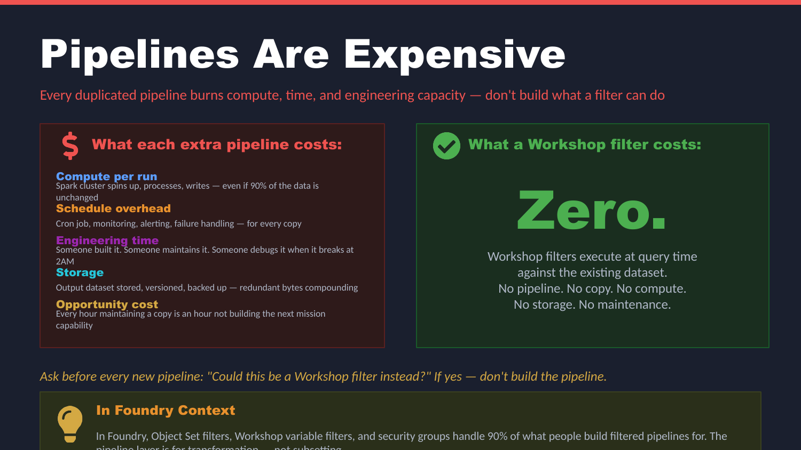
UNCLASSIFIED
DON'T FILTER — THIS ISN'T EXCEL · TM-20 · Data 101
UNCLASSIFIED

Slide 9
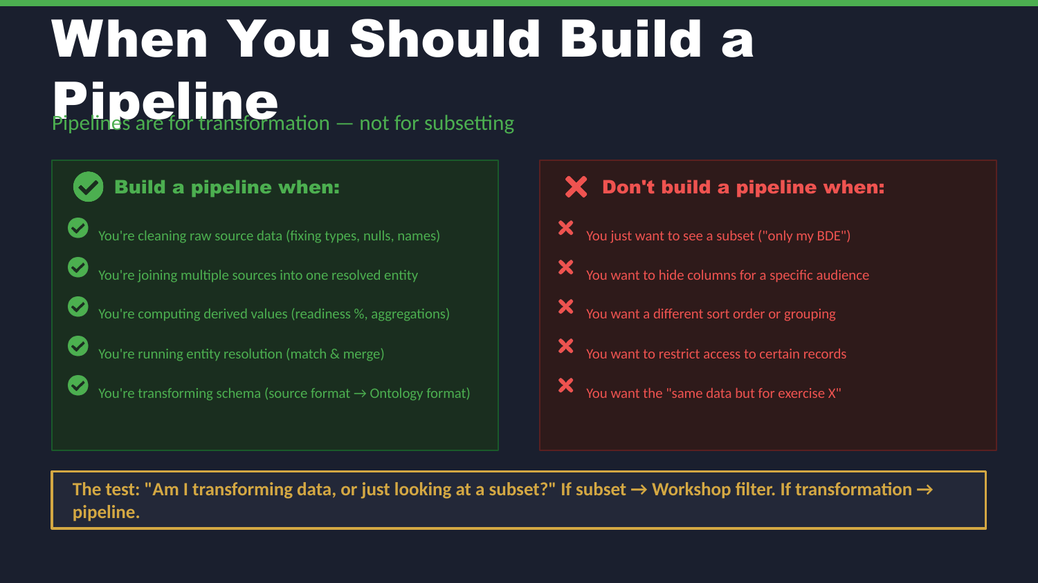
UNCLASSIFIED
DON'T FILTER — THIS ISN'T EXCEL · TM-20 · Data 101
UNCLASSIFIED

Slide 10
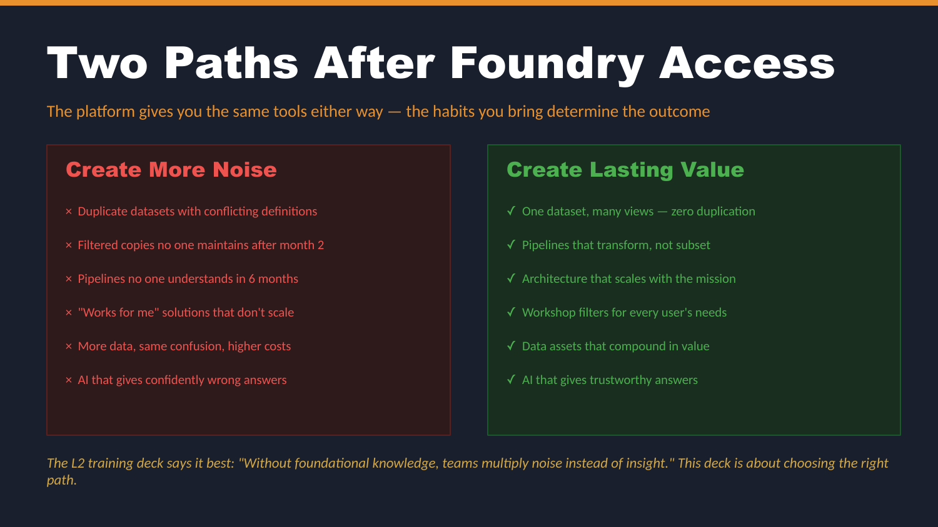
UNCLASSIFIED
DON'T FILTER — THIS ISN'T EXCEL · TM-20 · Data 101
UNCLASSIFIED

Slide 11
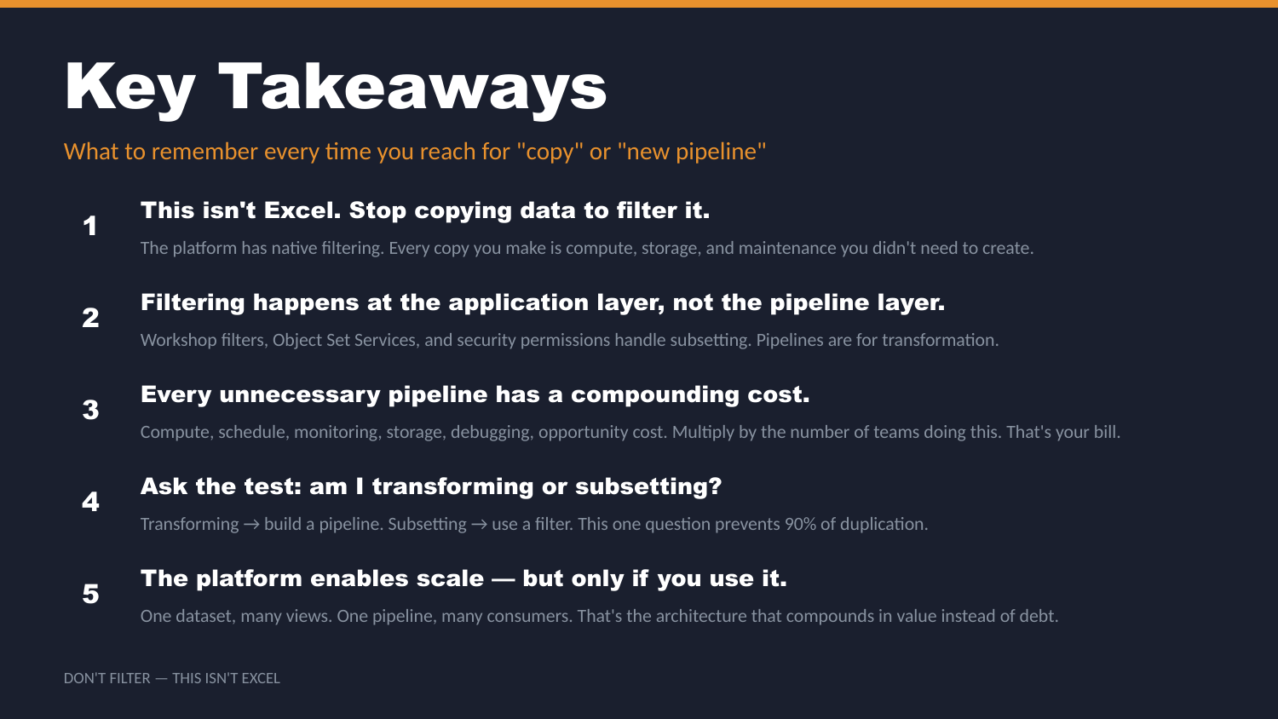
UNCLASSIFIED
DON'T FILTER — THIS ISN'T EXCEL · TM-20 · Data 101
UNCLASSIFIED

Slide 12
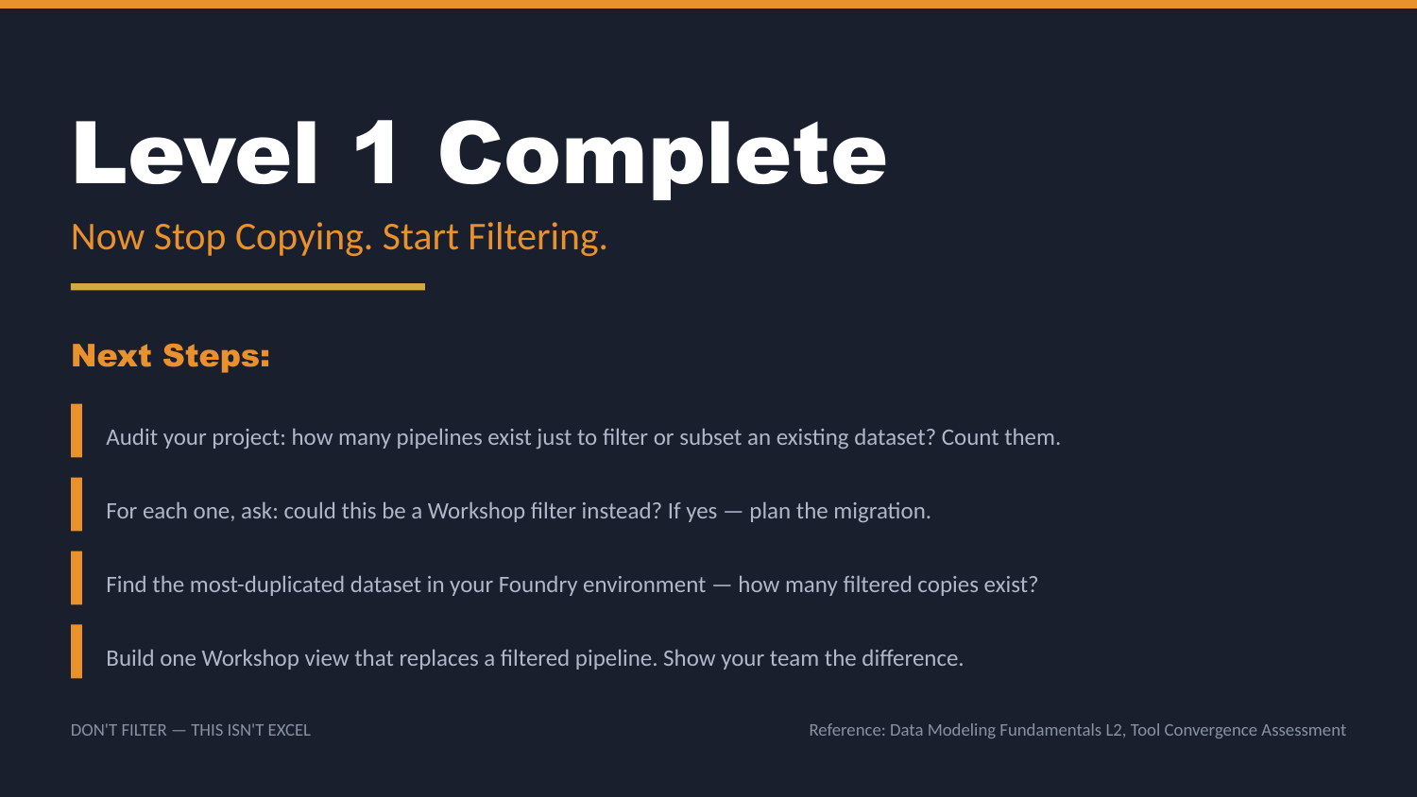
UNCLASSIFIED
DON'T FILTER — THIS ISN'T EXCEL · TM-20 · Data 101
UNCLASSIFIED

