Slide 1
IDENTITY — WHO OWNS THE KEY?
TM-30 · Data 101 · also: TM-40K, TM-40L
UNCLASSIFIED
UNCLASSIFIED
USAREUR-AF · C2DAO · MSS
UNCLASSIFIED

Slide 2
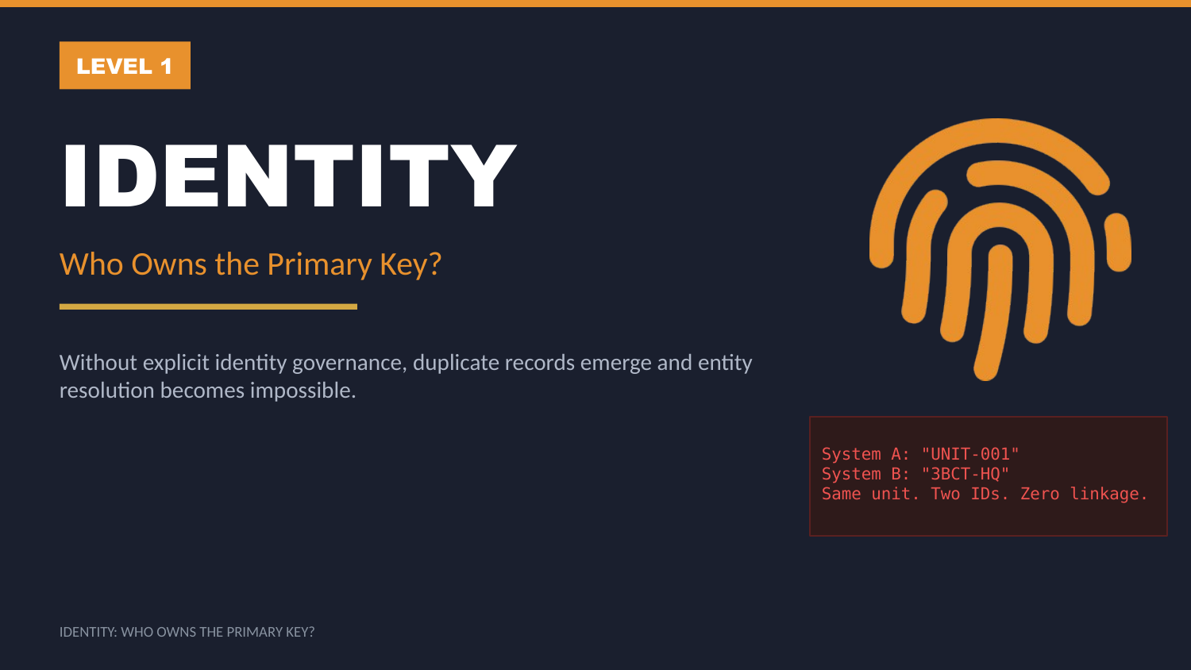
UNCLASSIFIED
IDENTITY — WHO OWNS THE KEY? · TM-30 · Data 101
UNCLASSIFIED

Slide 3
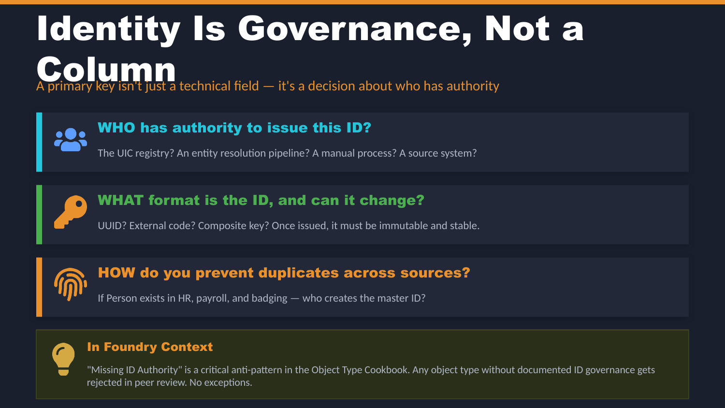
UNCLASSIFIED
IDENTITY — WHO OWNS THE KEY? · TM-30 · Data 101
UNCLASSIFIED

Slide 4
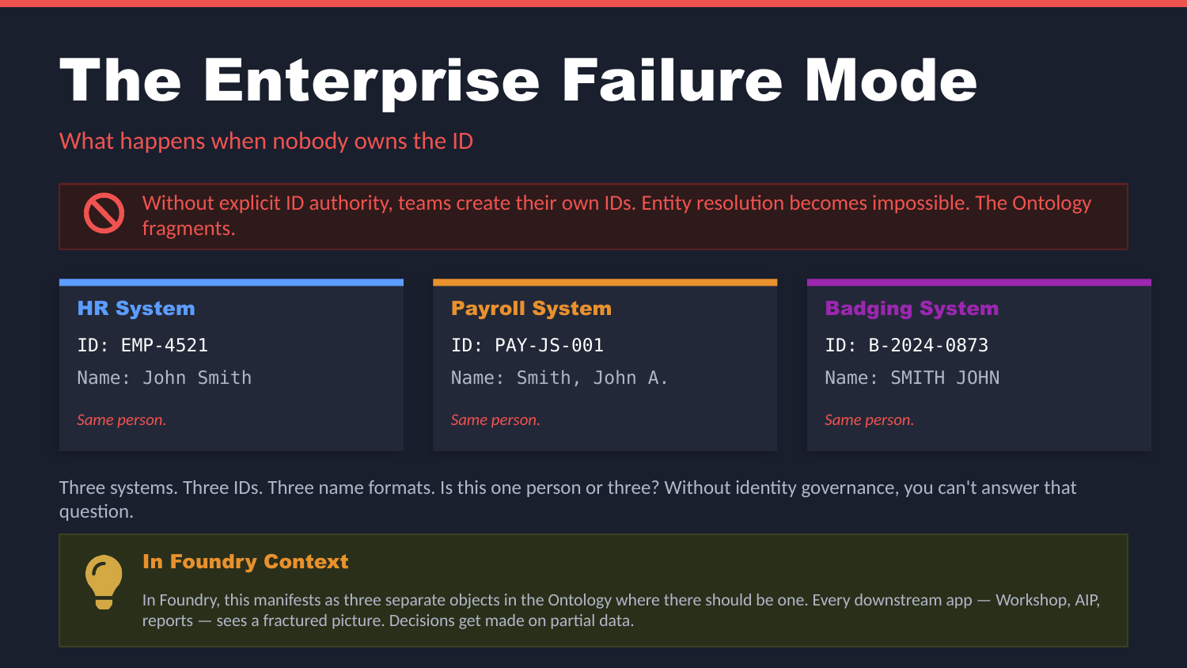
UNCLASSIFIED
IDENTITY — WHO OWNS THE KEY? · TM-30 · Data 101
UNCLASSIFIED

Slide 5
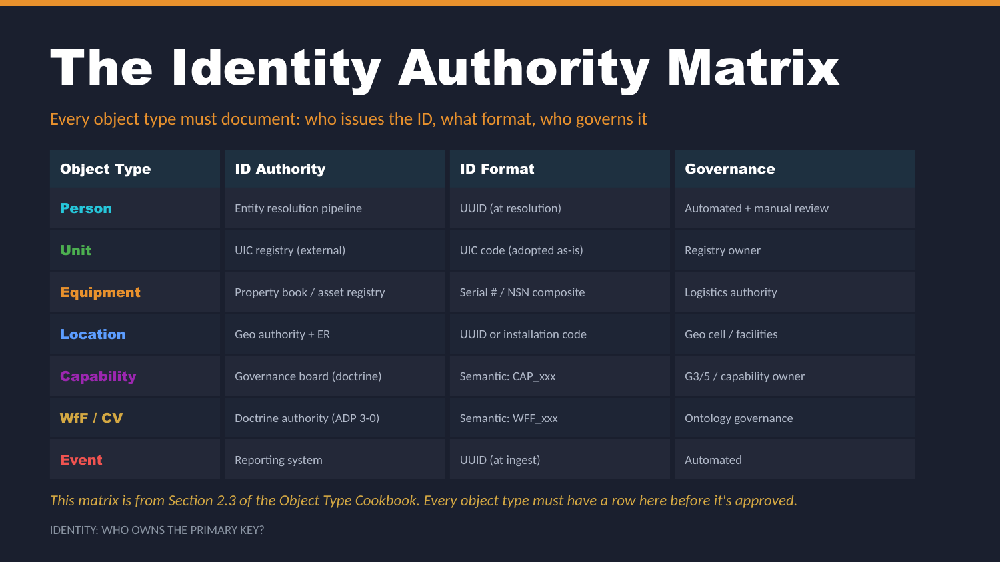
UNCLASSIFIED
IDENTITY — WHO OWNS THE KEY? · TM-30 · Data 101
UNCLASSIFIED

Slide 6
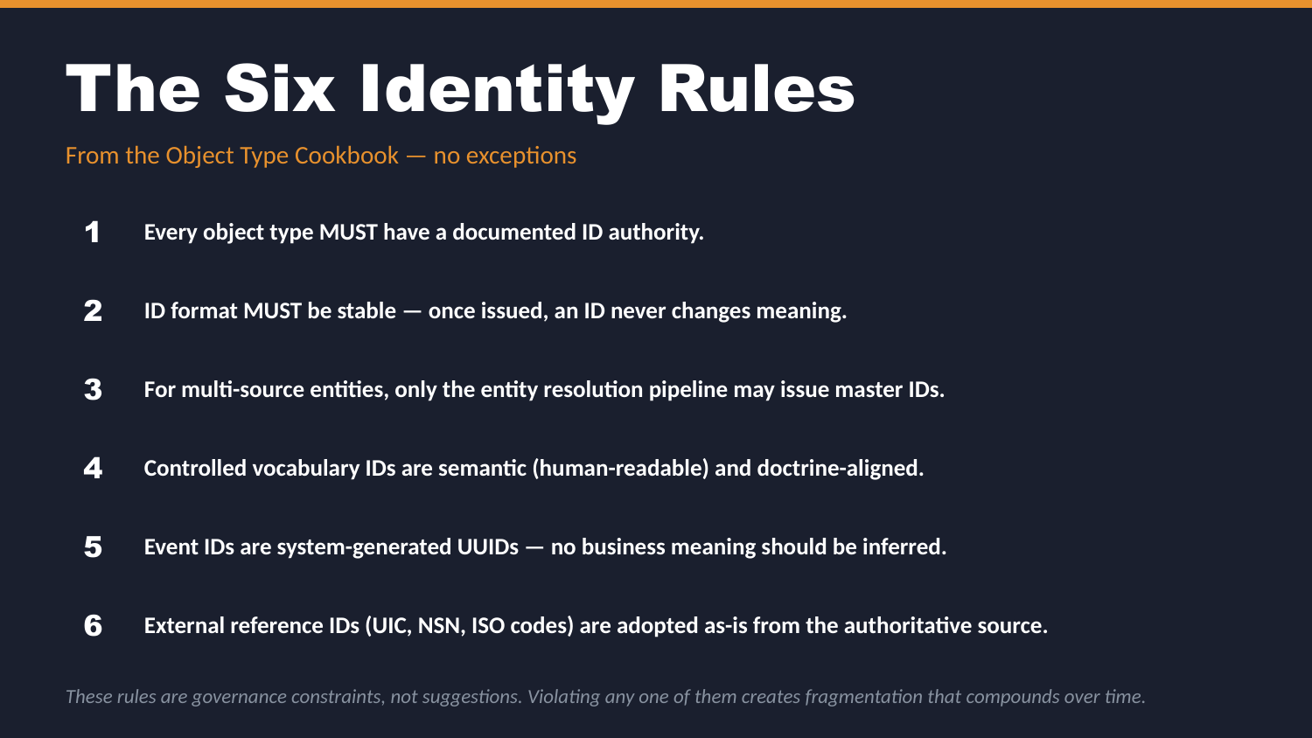
UNCLASSIFIED
IDENTITY — WHO OWNS THE KEY? · TM-30 · Data 101
UNCLASSIFIED

Slide 7
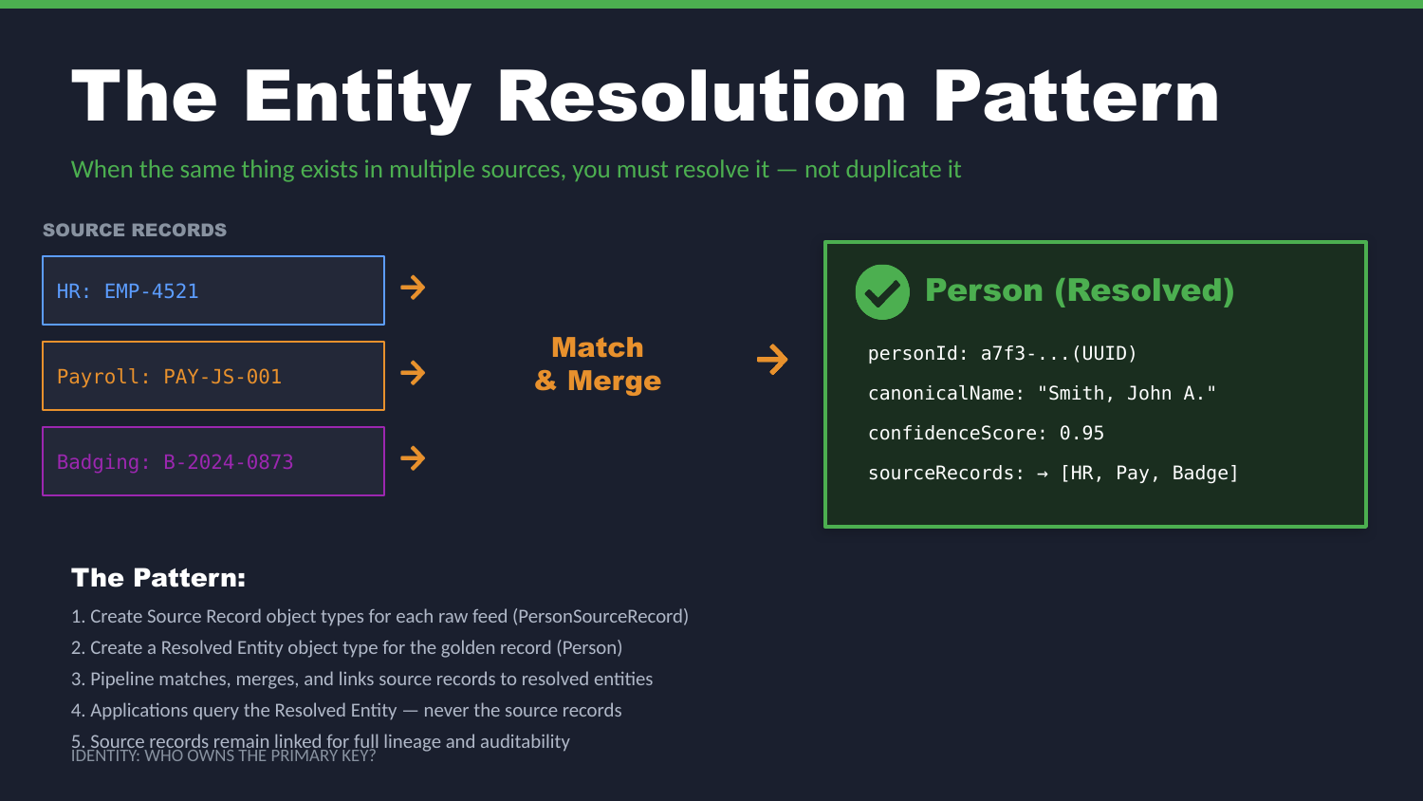
UNCLASSIFIED
IDENTITY — WHO OWNS THE KEY? · TM-30 · Data 101
UNCLASSIFIED

Slide 8
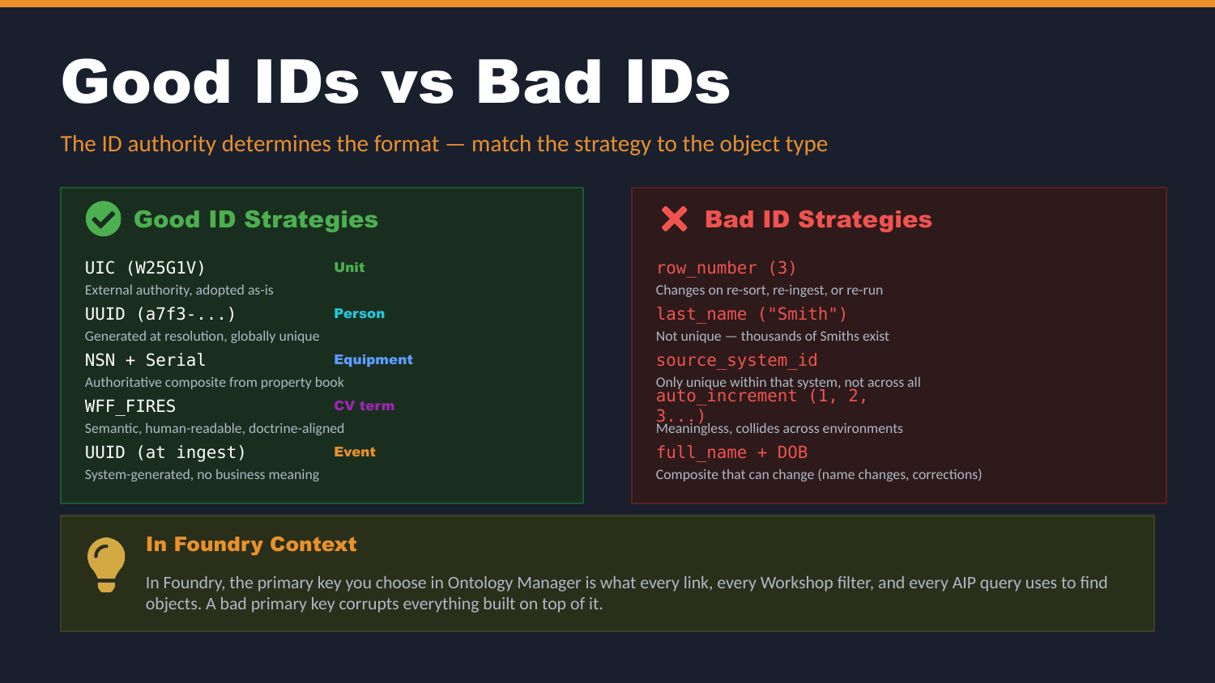
UNCLASSIFIED
IDENTITY — WHO OWNS THE KEY? · TM-30 · Data 101
UNCLASSIFIED

Slide 9
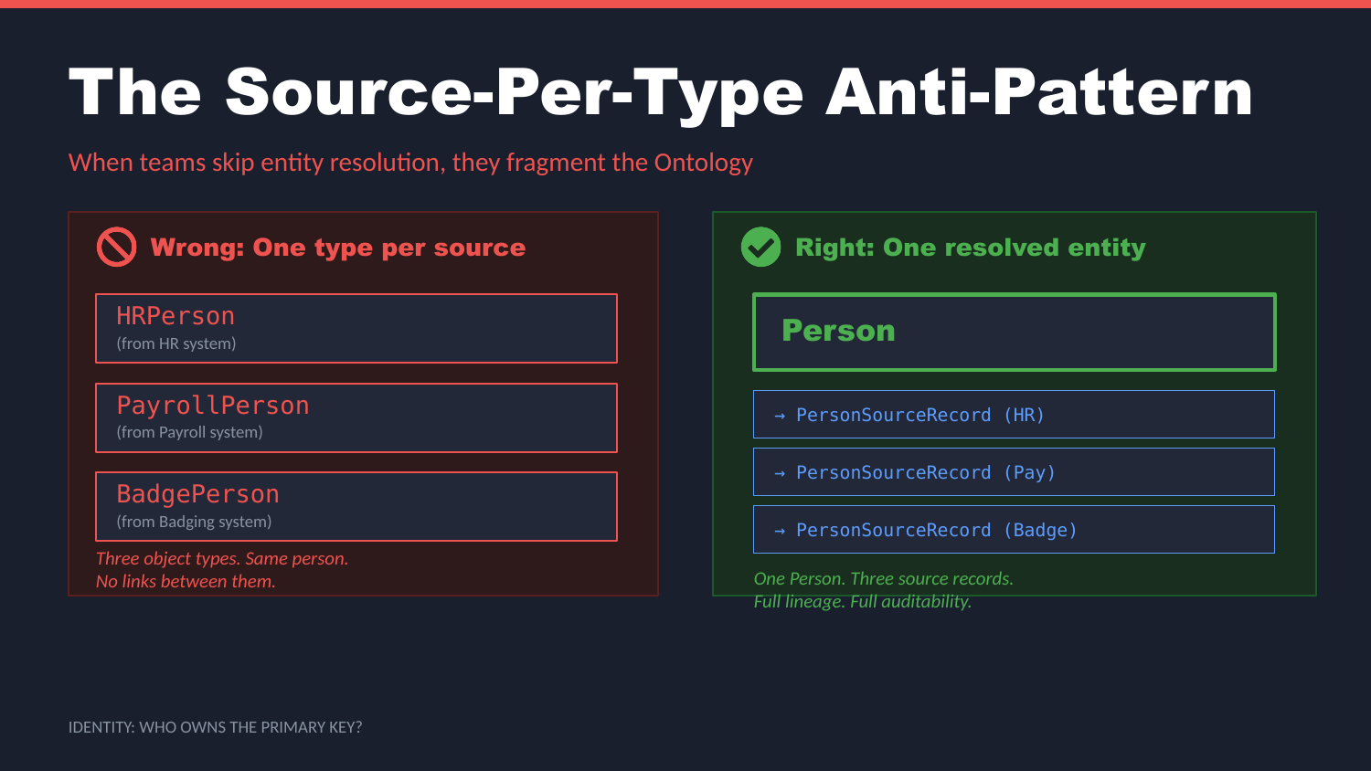
UNCLASSIFIED
IDENTITY — WHO OWNS THE KEY? · TM-30 · Data 101
UNCLASSIFIED

Slide 10
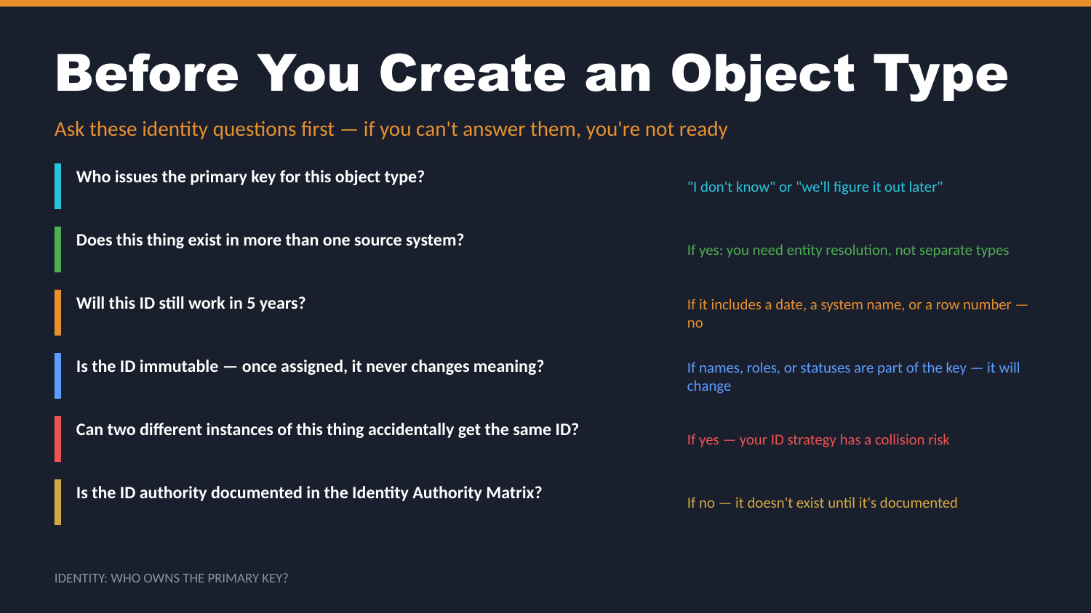
UNCLASSIFIED
IDENTITY — WHO OWNS THE KEY? · TM-30 · Data 101
UNCLASSIFIED

Slide 11
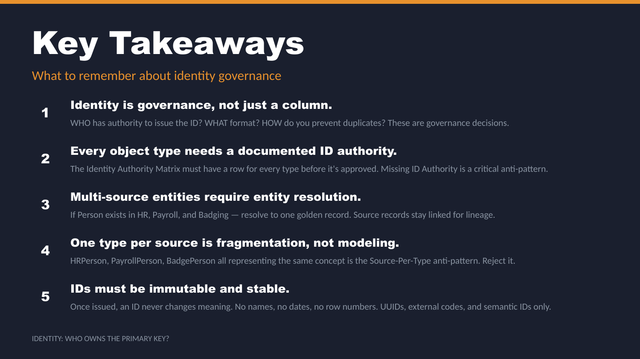
UNCLASSIFIED
IDENTITY — WHO OWNS THE KEY? · TM-30 · Data 101
UNCLASSIFIED

Slide 12
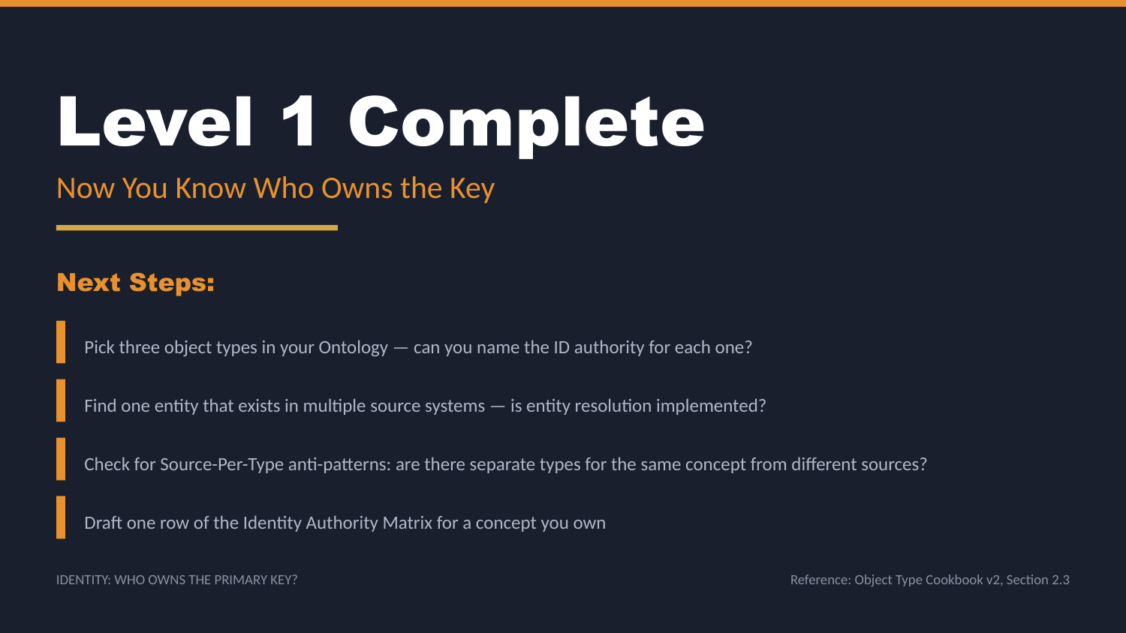
UNCLASSIFIED
IDENTITY — WHO OWNS THE KEY? · TM-30 · Data 101
UNCLASSIFIED

