Slide 1
L5 — ACTIVATION & INTERFACE DEEP DIVE
TM-20 · Primer
UNCLASSIFIED
UNCLASSIFIED
USAREUR-AF · C2DAO · MSS
UNCLASSIFIED

Slide 2
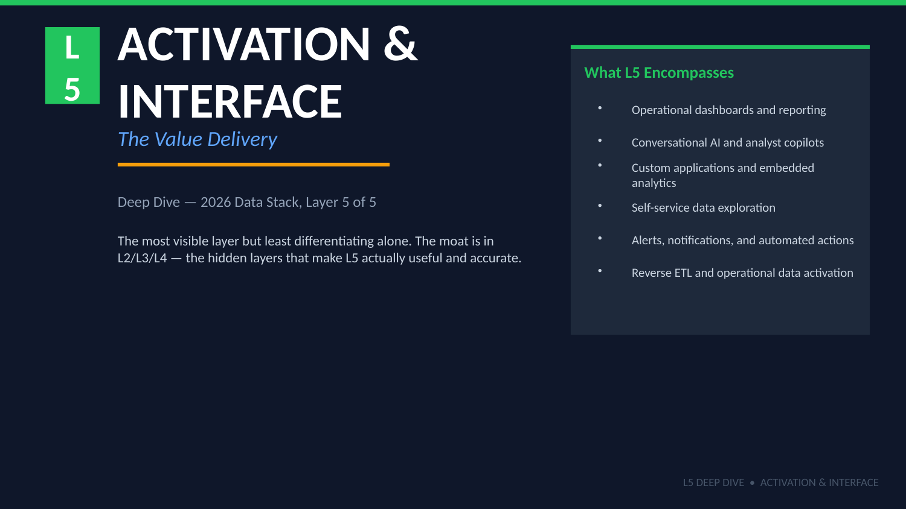
UNCLASSIFIED
L5 — ACTIVATION & INTERFACE DEEP DIVE · TM-20 · Primer
UNCLASSIFIED

Slide 3
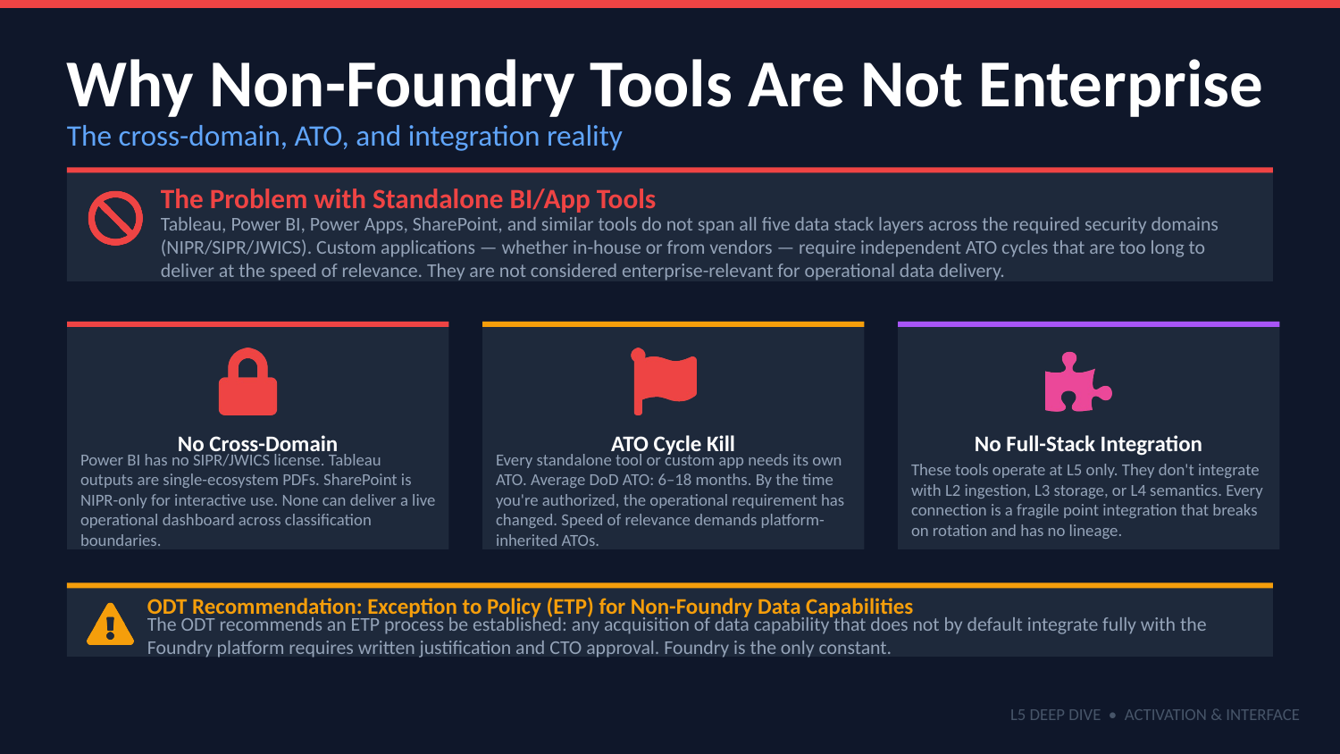
UNCLASSIFIED
L5 — ACTIVATION & INTERFACE DEEP DIVE · TM-20 · Primer
UNCLASSIFIED

Slide 4
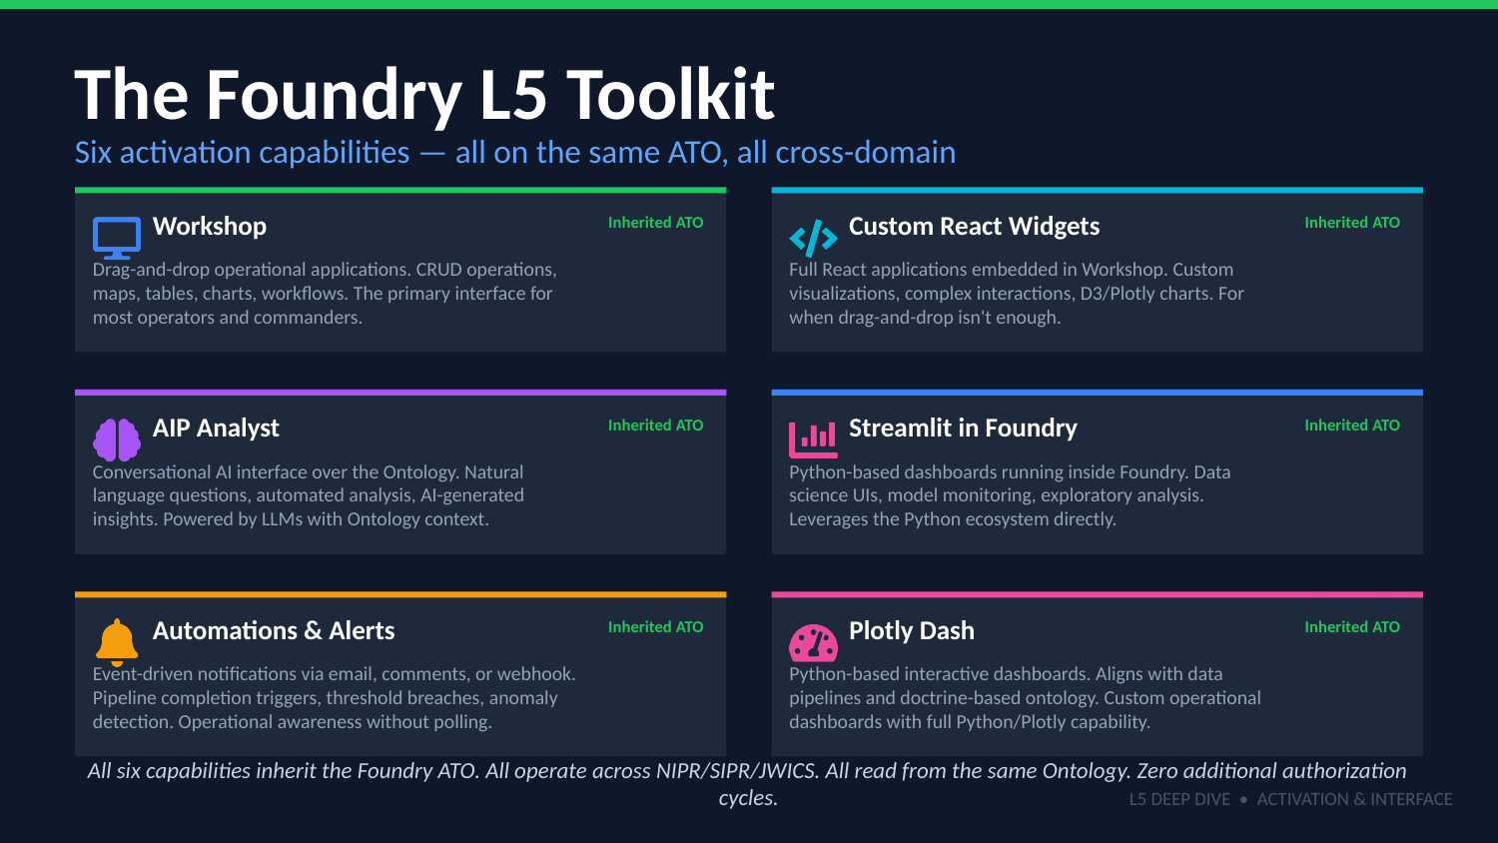
UNCLASSIFIED
L5 — ACTIVATION & INTERFACE DEEP DIVE · TM-20 · Primer
UNCLASSIFIED

Slide 5
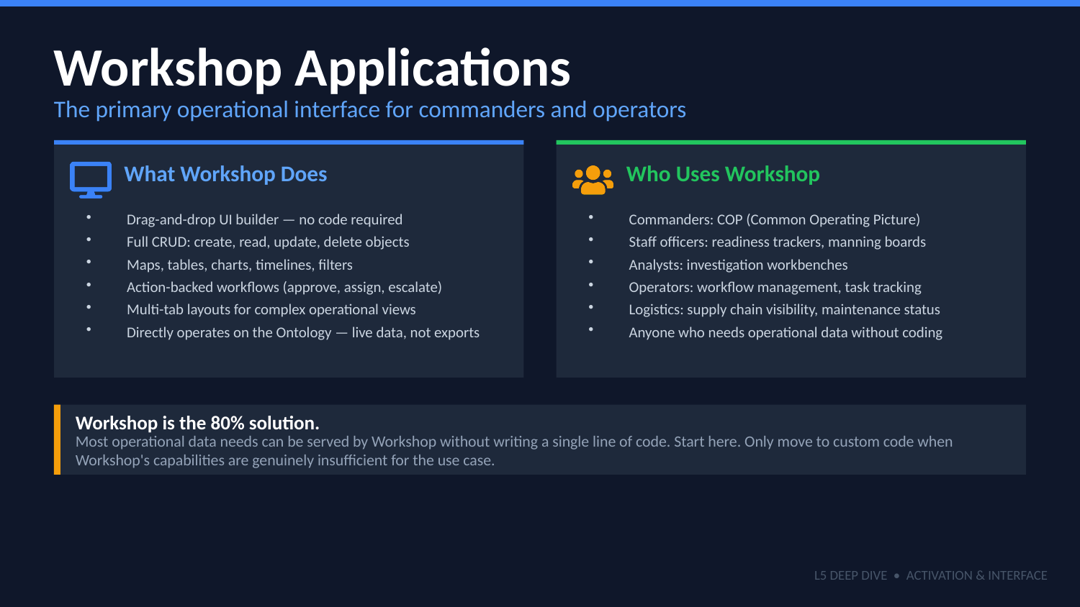
UNCLASSIFIED
L5 — ACTIVATION & INTERFACE DEEP DIVE · TM-20 · Primer
UNCLASSIFIED

Slide 6
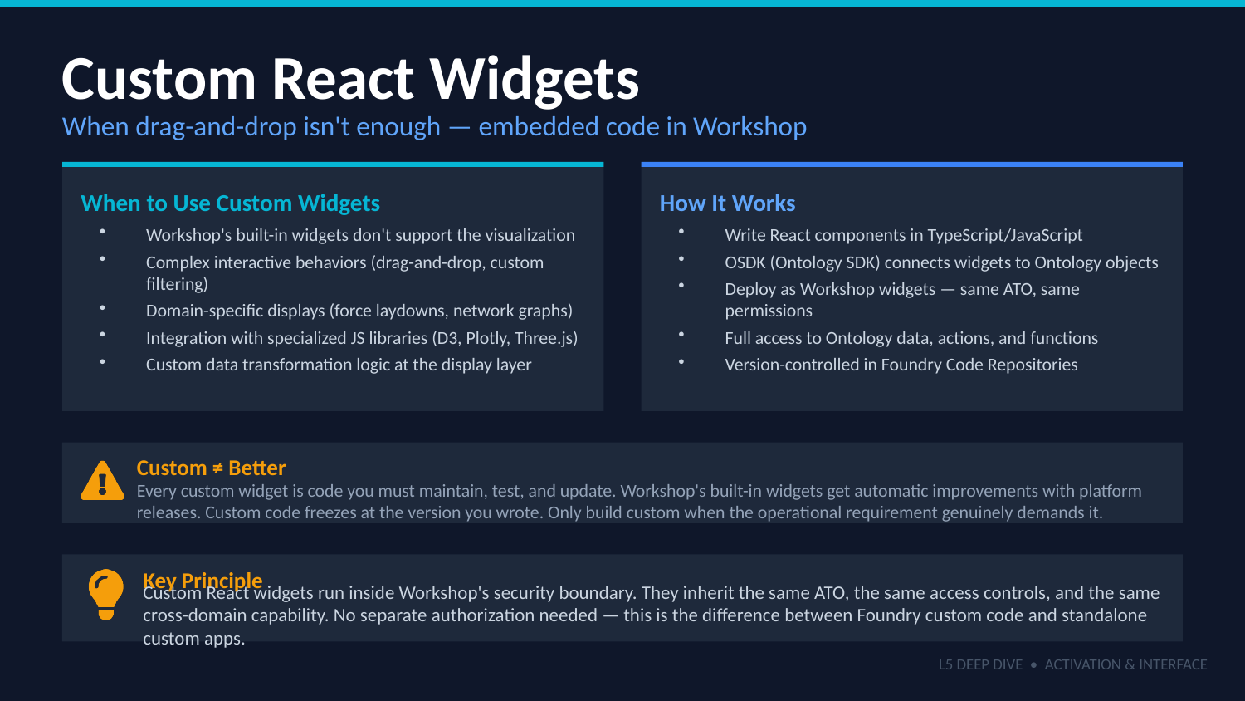
UNCLASSIFIED
L5 — ACTIVATION & INTERFACE DEEP DIVE · TM-20 · Primer
UNCLASSIFIED

Slide 7
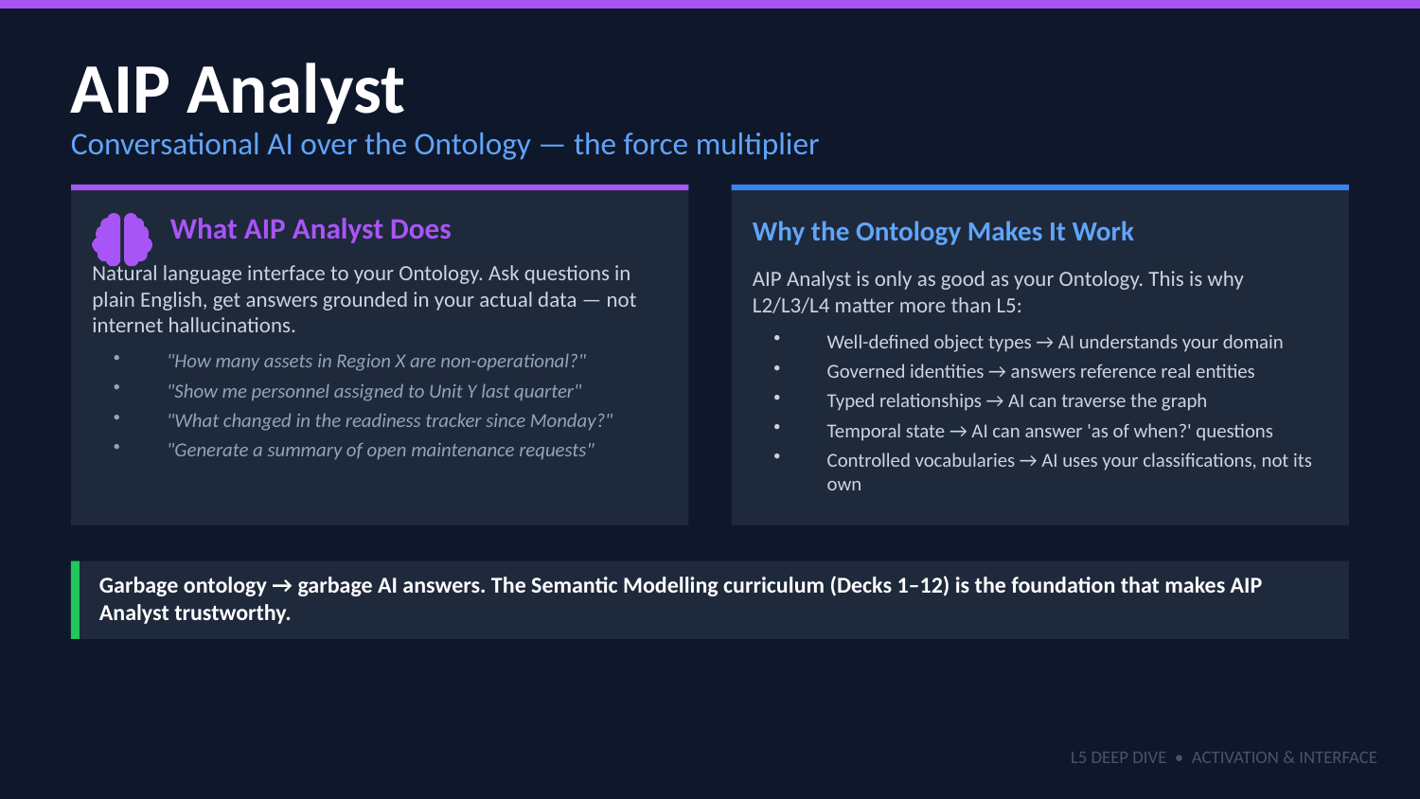
UNCLASSIFIED
L5 — ACTIVATION & INTERFACE DEEP DIVE · TM-20 · Primer
UNCLASSIFIED

Slide 8
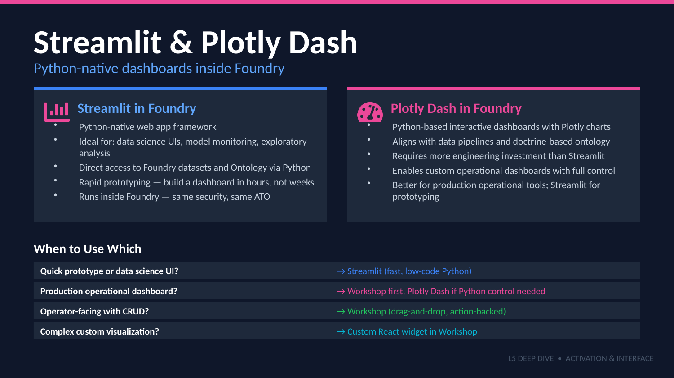
UNCLASSIFIED
L5 — ACTIVATION & INTERFACE DEEP DIVE · TM-20 · Primer
UNCLASSIFIED

Slide 9
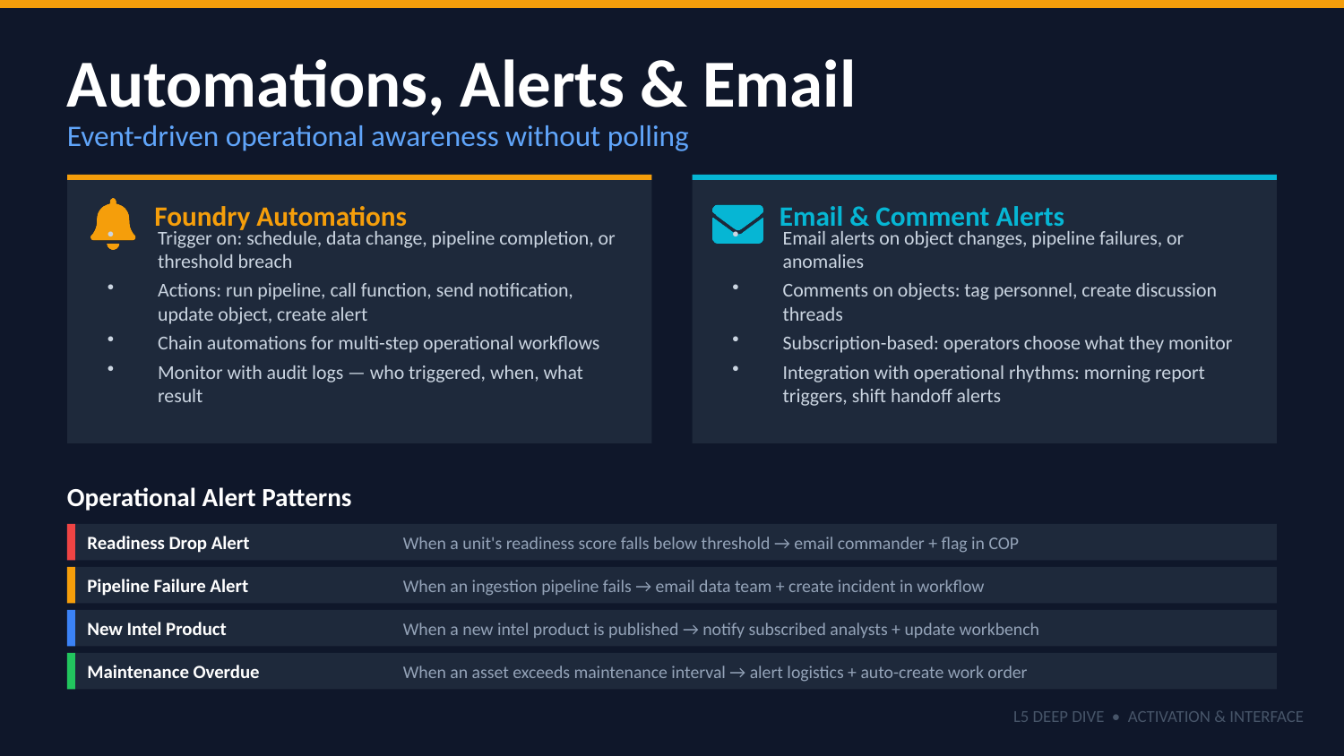
UNCLASSIFIED
L5 — ACTIVATION & INTERFACE DEEP DIVE · TM-20 · Primer
UNCLASSIFIED

Slide 10
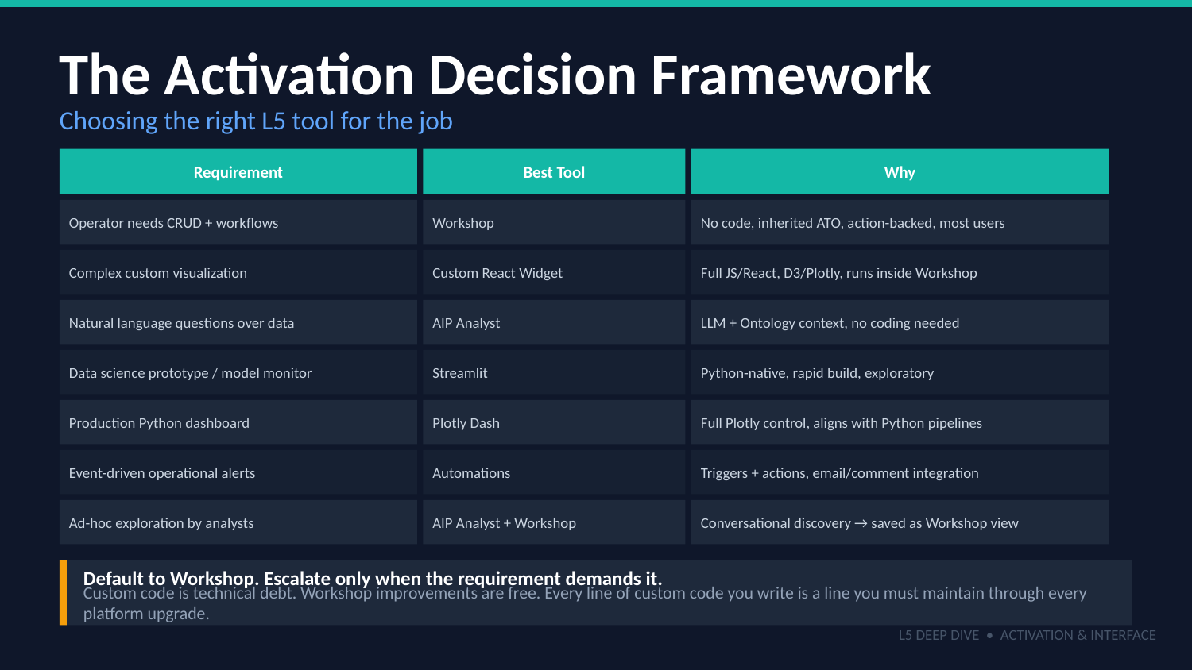
UNCLASSIFIED
L5 — ACTIVATION & INTERFACE DEEP DIVE · TM-20 · Primer
UNCLASSIFIED

Slide 11
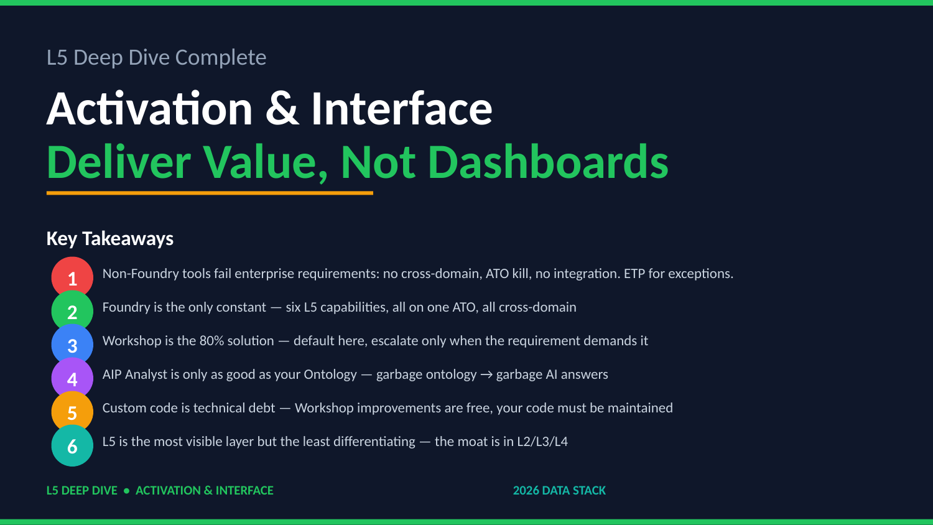
UNCLASSIFIED
L5 — ACTIVATION & INTERFACE DEEP DIVE · TM-20 · Primer
UNCLASSIFIED

