Slide 1
OBJECT TYPES — WHAT TO WATCH FOR
TM-20 · Data 101
UNCLASSIFIED
UNCLASSIFIED
USAREUR-AF · C2DAO · MSS
UNCLASSIFIED

Slide 2
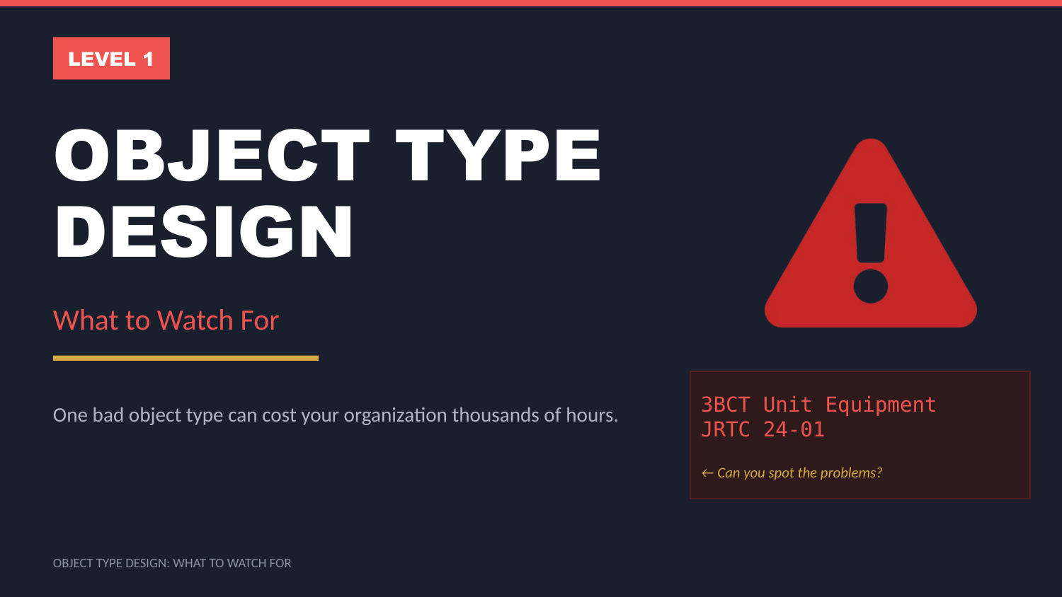
UNCLASSIFIED
OBJECT TYPES — WHAT TO WATCH FOR · TM-20 · Data 101
UNCLASSIFIED

Slide 3
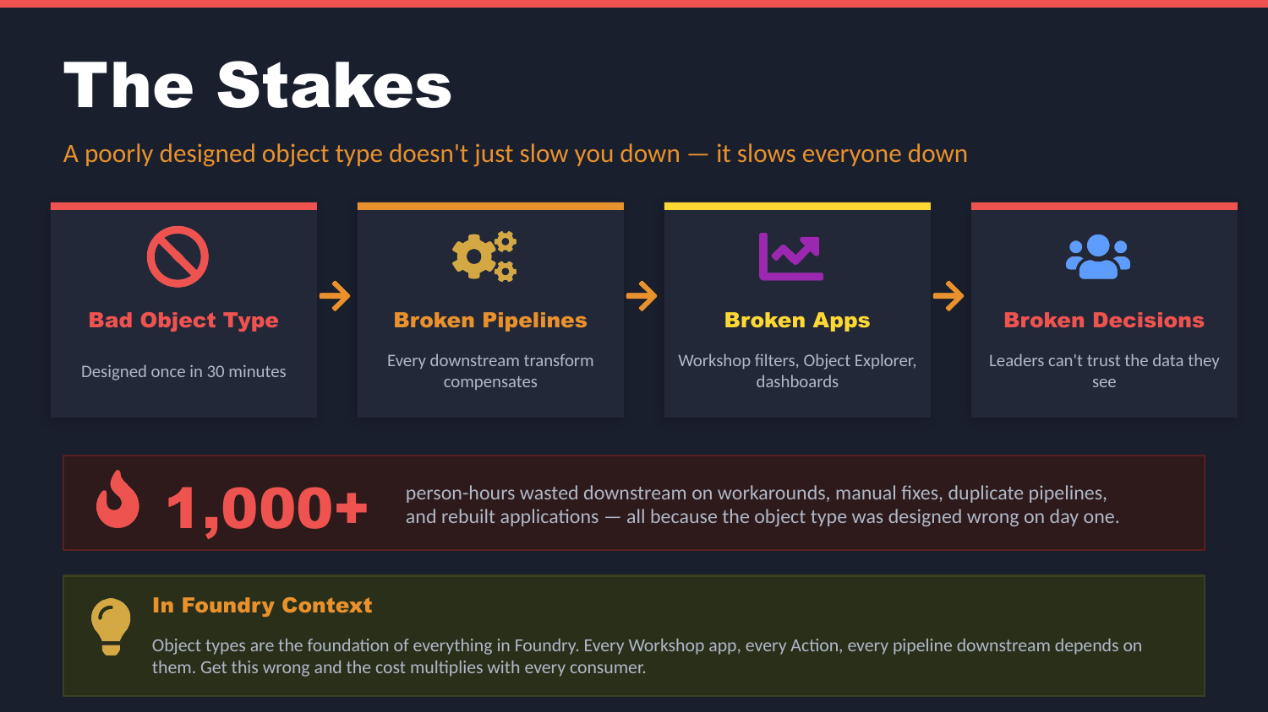
UNCLASSIFIED
OBJECT TYPES — WHAT TO WATCH FOR · TM-20 · Data 101
UNCLASSIFIED

Slide 4
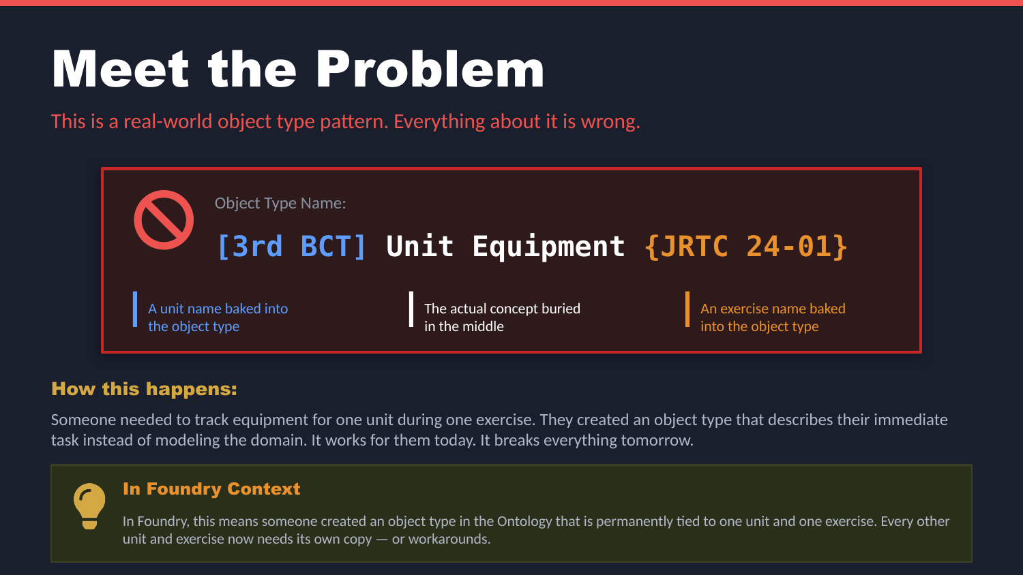
UNCLASSIFIED
OBJECT TYPES — WHAT TO WATCH FOR · TM-20 · Data 101
UNCLASSIFIED

Slide 5
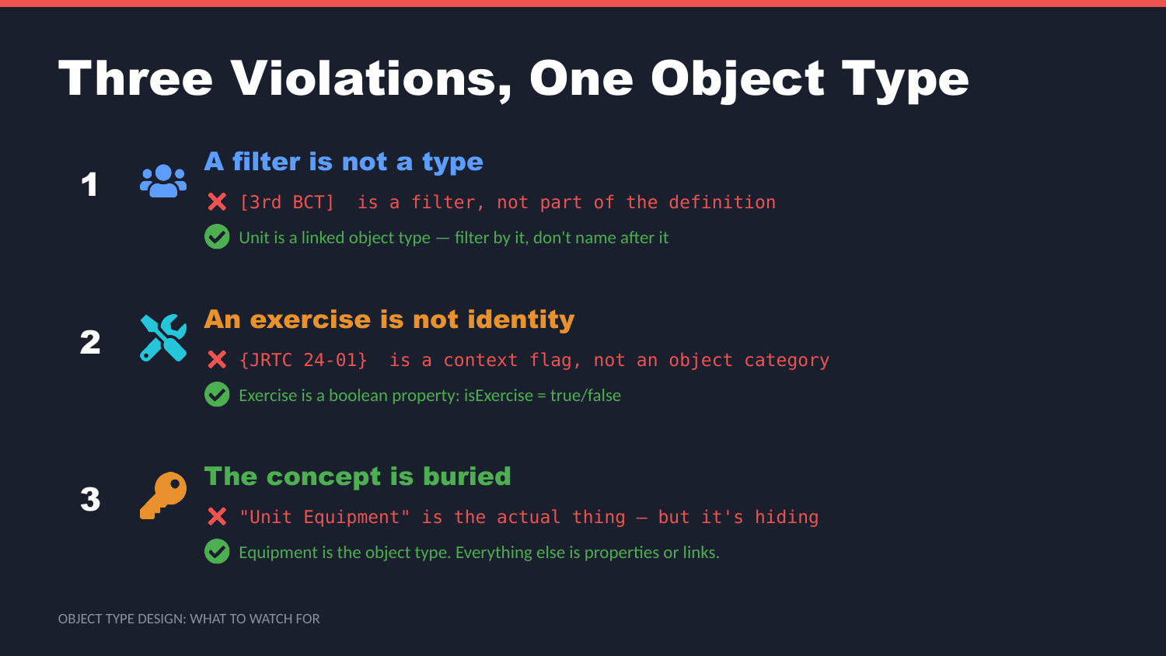
UNCLASSIFIED
OBJECT TYPES — WHAT TO WATCH FOR · TM-20 · Data 101
UNCLASSIFIED

Slide 6
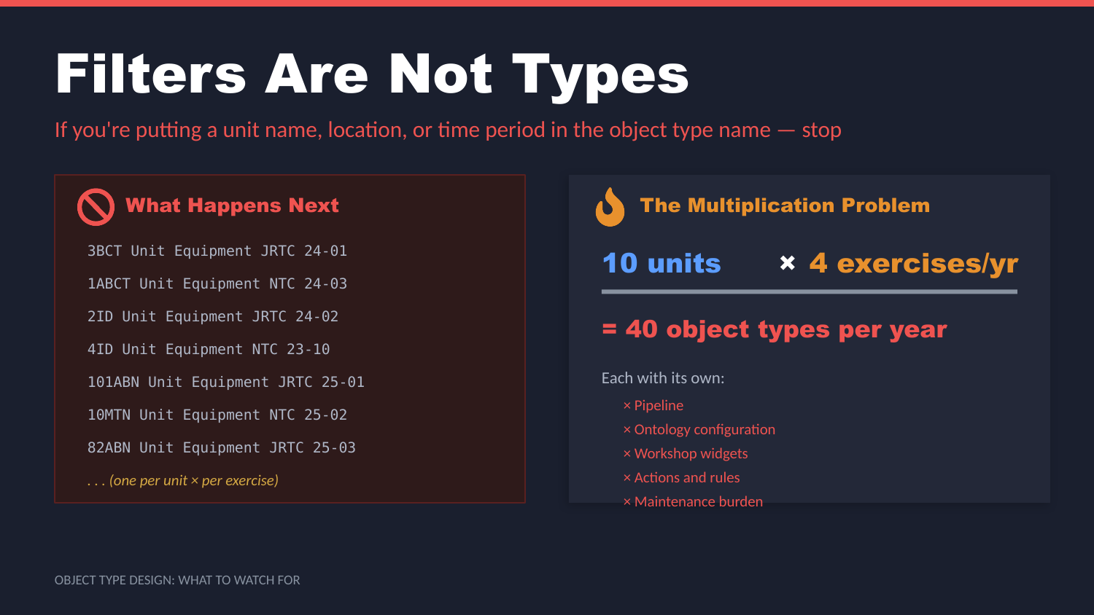
UNCLASSIFIED
OBJECT TYPES — WHAT TO WATCH FOR · TM-20 · Data 101
UNCLASSIFIED

Slide 7
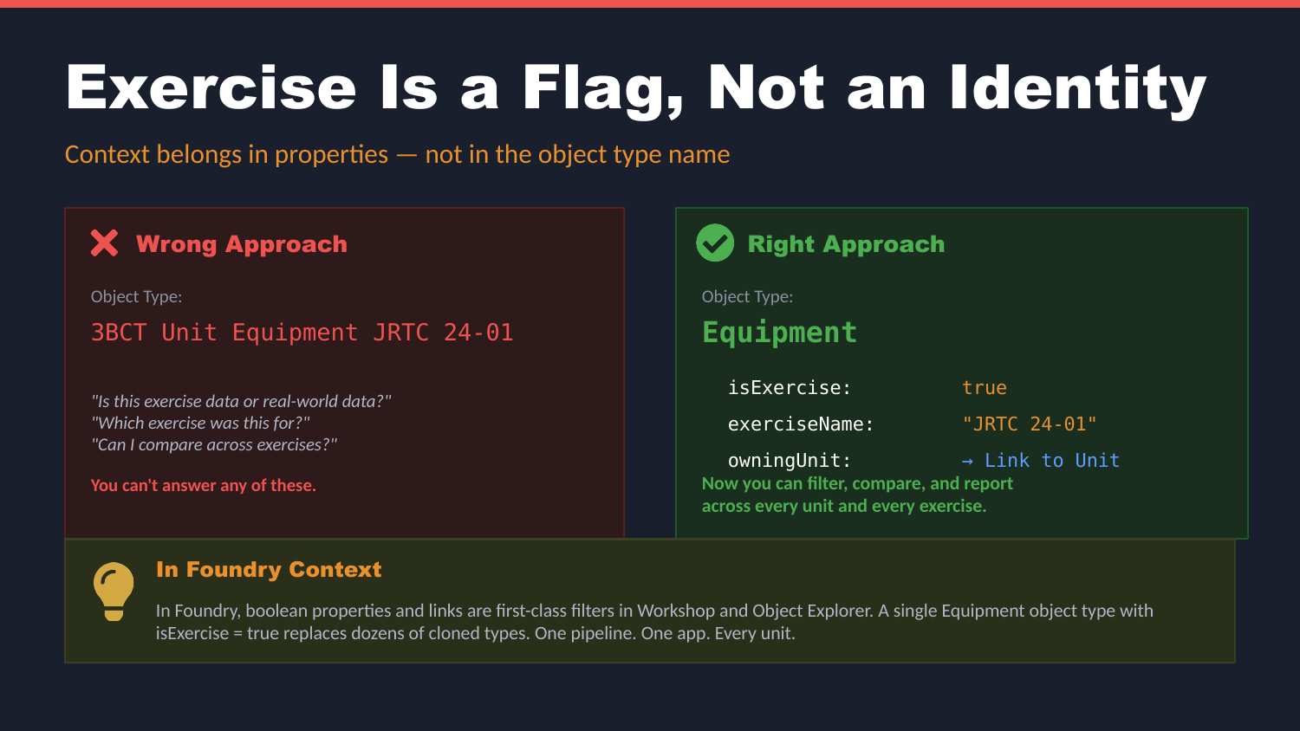
UNCLASSIFIED
OBJECT TYPES — WHAT TO WATCH FOR · TM-20 · Data 101
UNCLASSIFIED

Slide 8
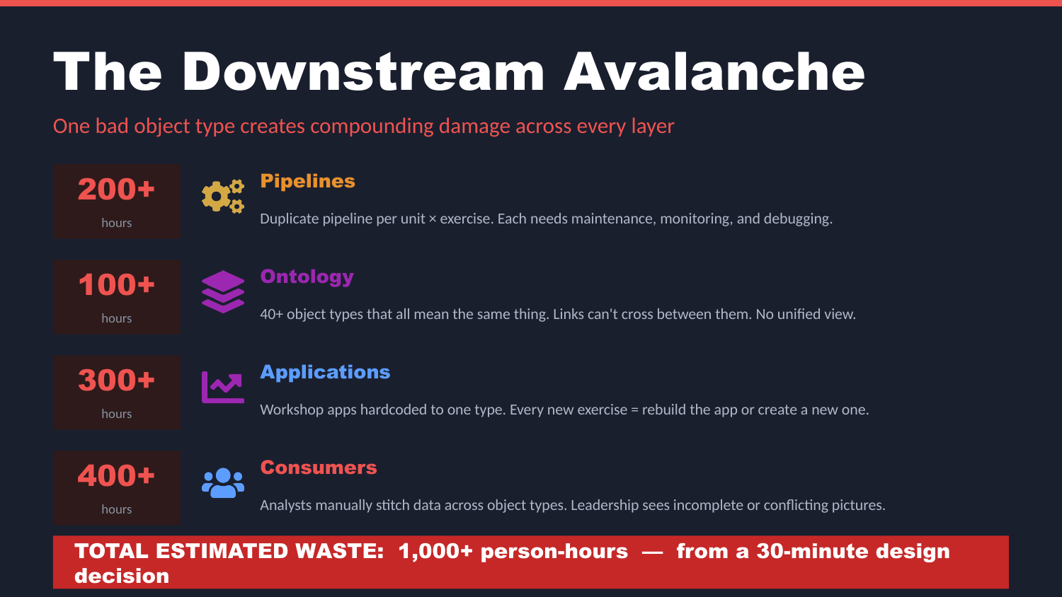
UNCLASSIFIED
OBJECT TYPES — WHAT TO WATCH FOR · TM-20 · Data 101
UNCLASSIFIED

Slide 9
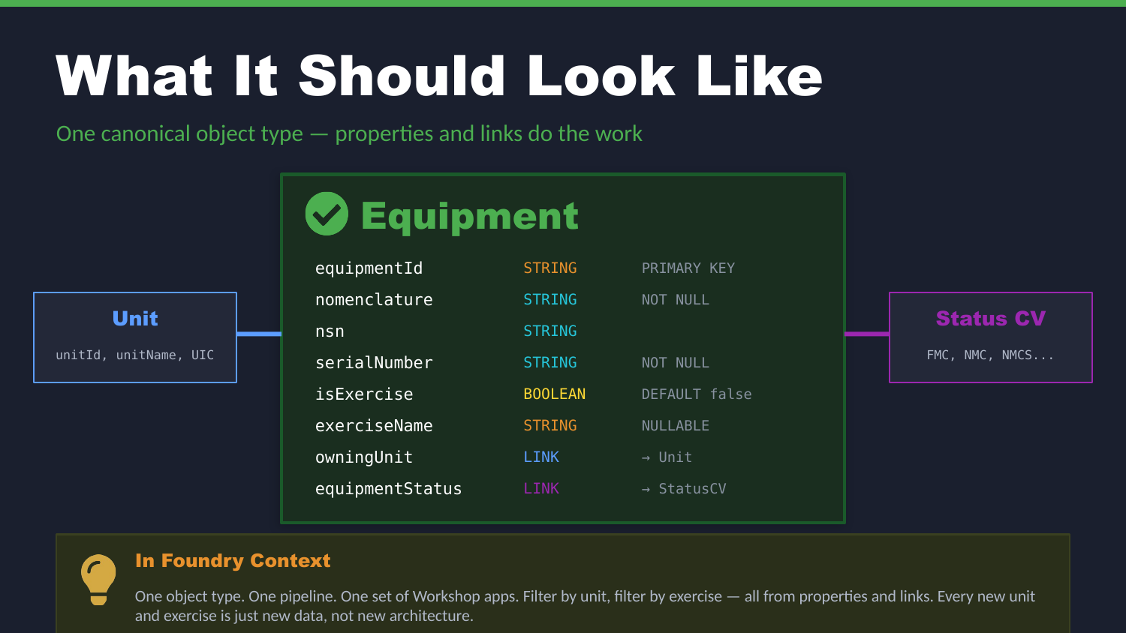
UNCLASSIFIED
OBJECT TYPES — WHAT TO WATCH FOR · TM-20 · Data 101
UNCLASSIFIED

Slide 10
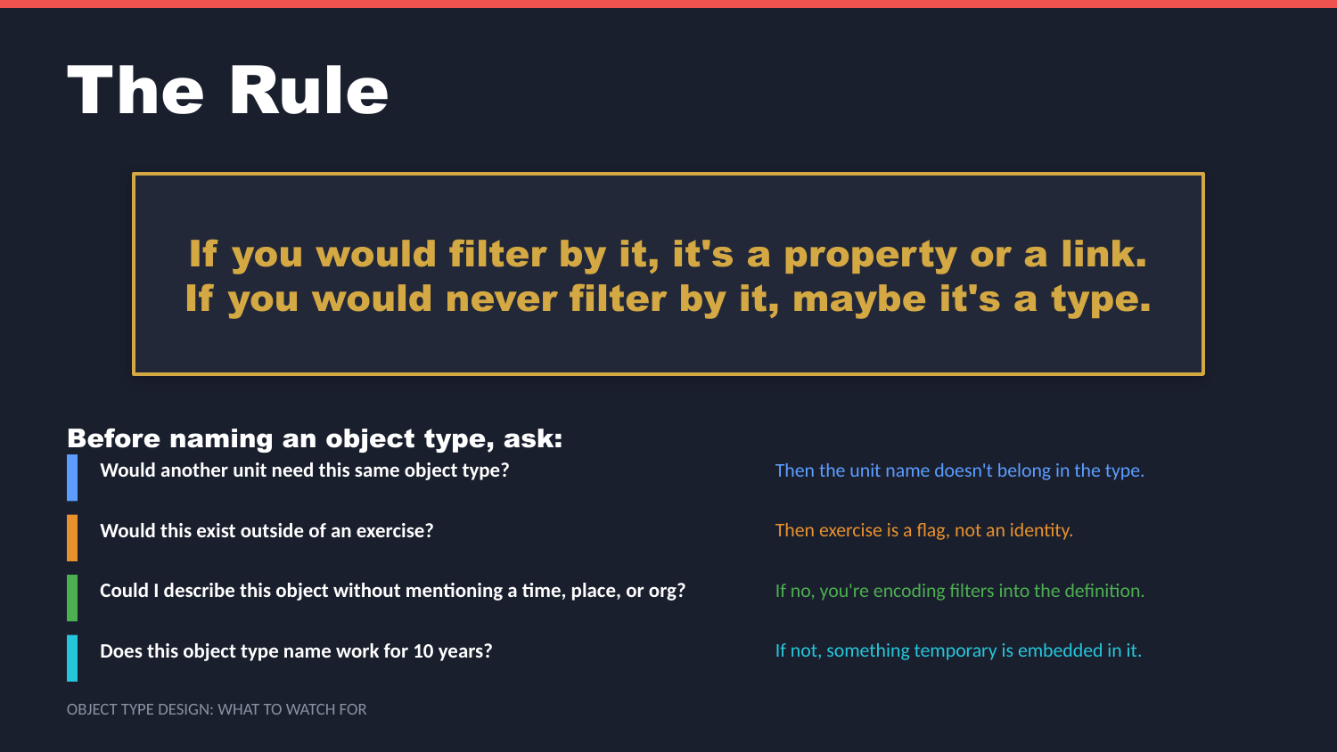
UNCLASSIFIED
OBJECT TYPES — WHAT TO WATCH FOR · TM-20 · Data 101
UNCLASSIFIED

Slide 11
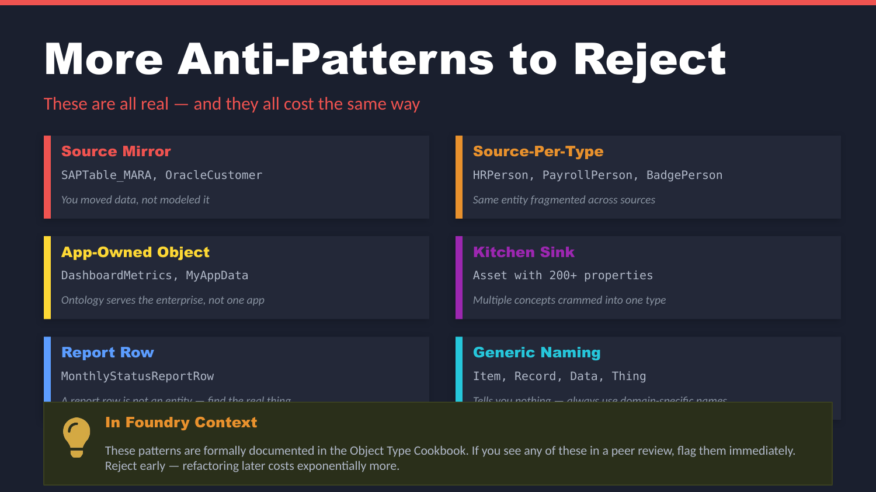
UNCLASSIFIED
OBJECT TYPES — WHAT TO WATCH FOR · TM-20 · Data 101
UNCLASSIFIED

Slide 12
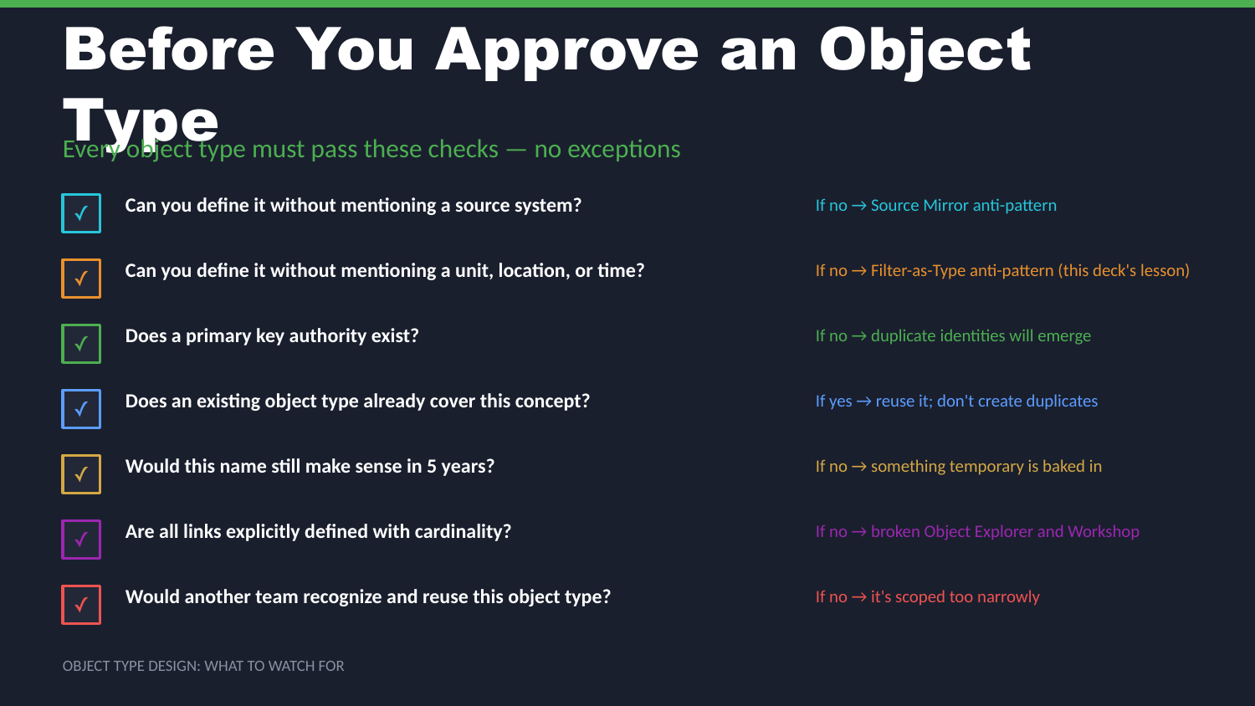
UNCLASSIFIED
OBJECT TYPES — WHAT TO WATCH FOR · TM-20 · Data 101
UNCLASSIFIED

Slide 13
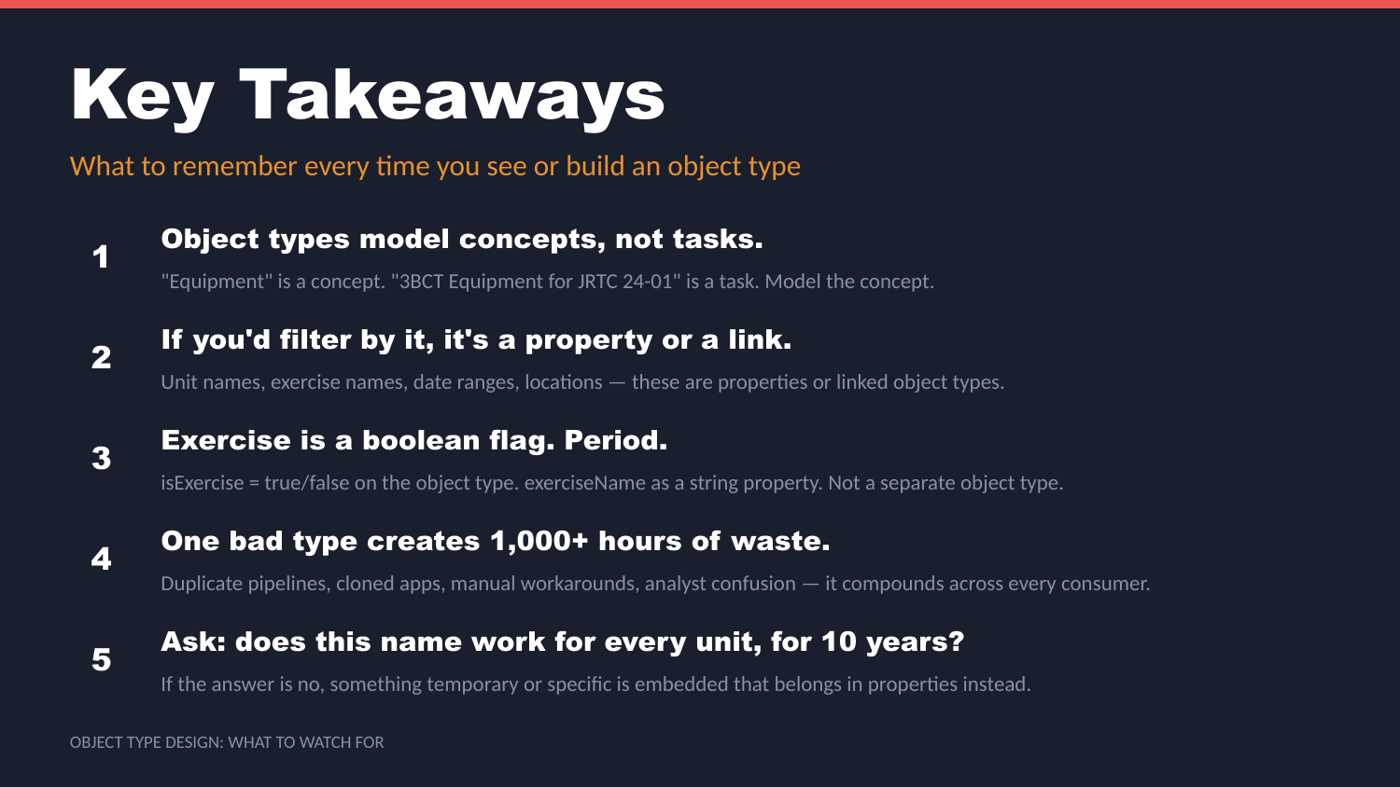
UNCLASSIFIED
OBJECT TYPES — WHAT TO WATCH FOR · TM-20 · Data 101
UNCLASSIFIED

Slide 14
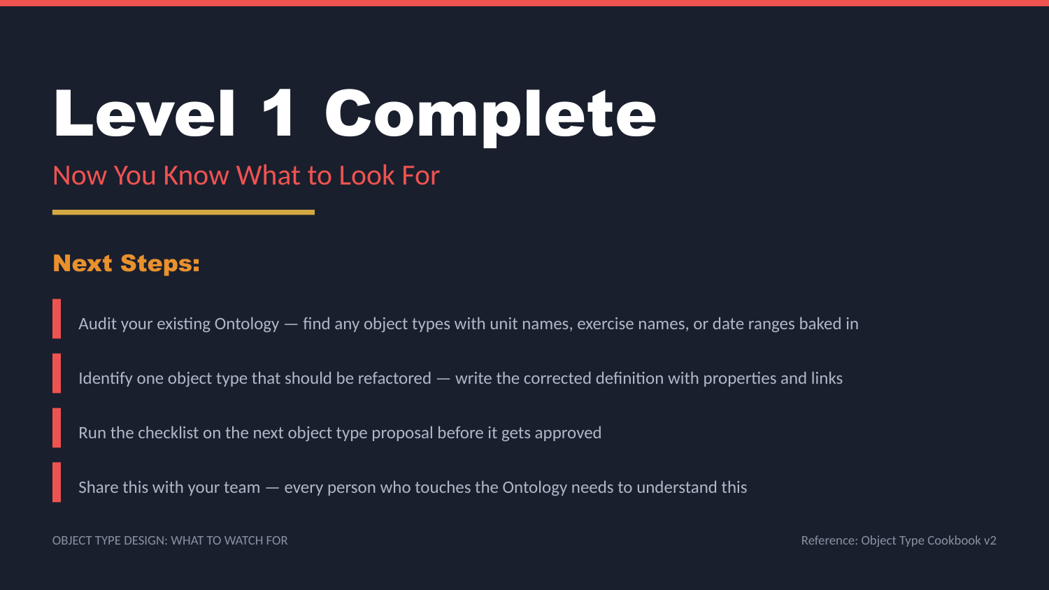
UNCLASSIFIED
OBJECT TYPES — WHAT TO WATCH FOR · TM-20 · Data 101
UNCLASSIFIED

