Slide 1
WHAT IS AN ONTOLOGY?
TM-20 · Primer
UNCLASSIFIED
UNCLASSIFIED
USAREUR-AF · C2DAO · MSS
UNCLASSIFIED

Slide 2
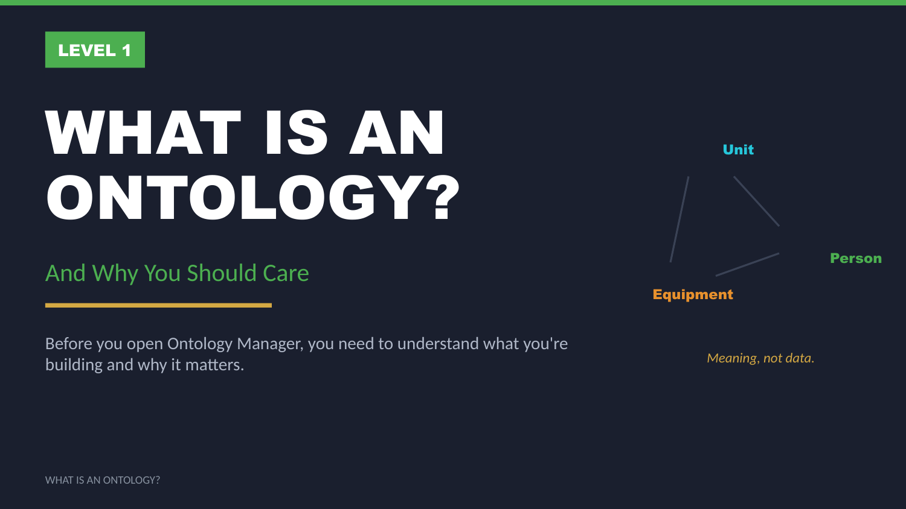
UNCLASSIFIED
WHAT IS AN ONTOLOGY? · TM-20 · Primer
UNCLASSIFIED

Slide 3
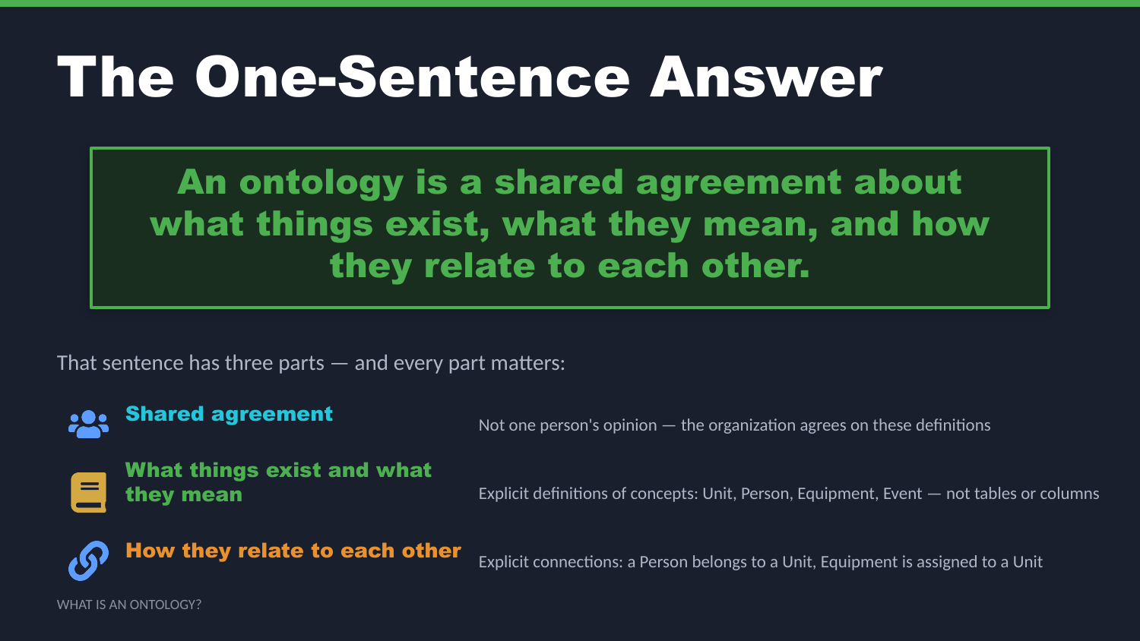
UNCLASSIFIED
WHAT IS AN ONTOLOGY? · TM-20 · Primer
UNCLASSIFIED

Slide 4
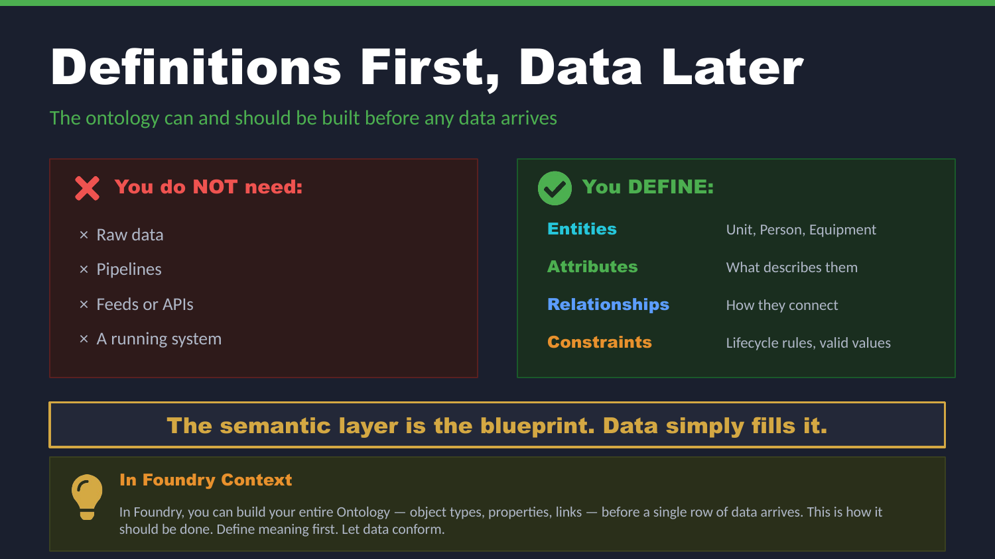
UNCLASSIFIED
WHAT IS AN ONTOLOGY? · TM-20 · Primer
UNCLASSIFIED

Slide 5
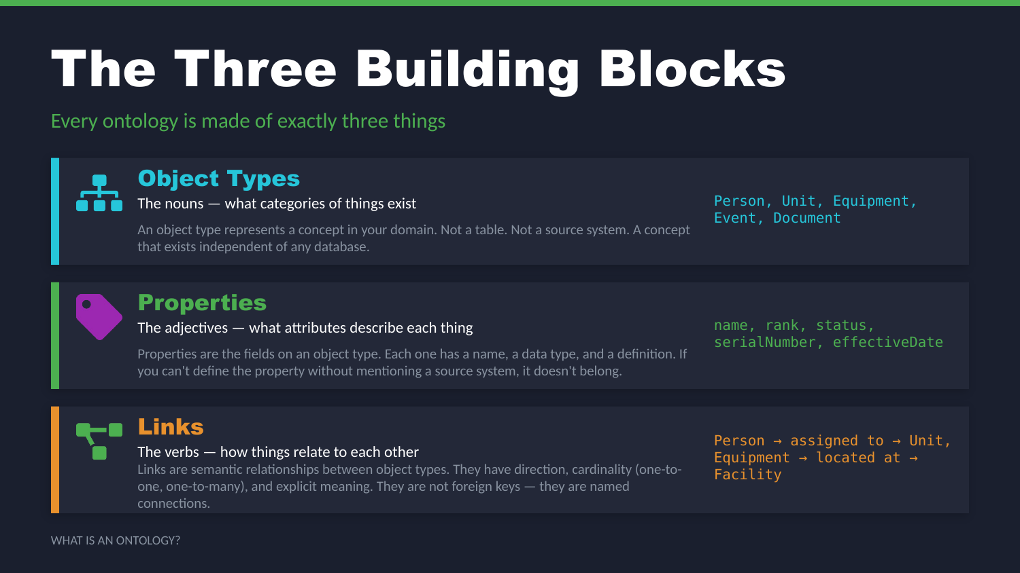
UNCLASSIFIED
WHAT IS AN ONTOLOGY? · TM-20 · Primer
UNCLASSIFIED

Slide 6
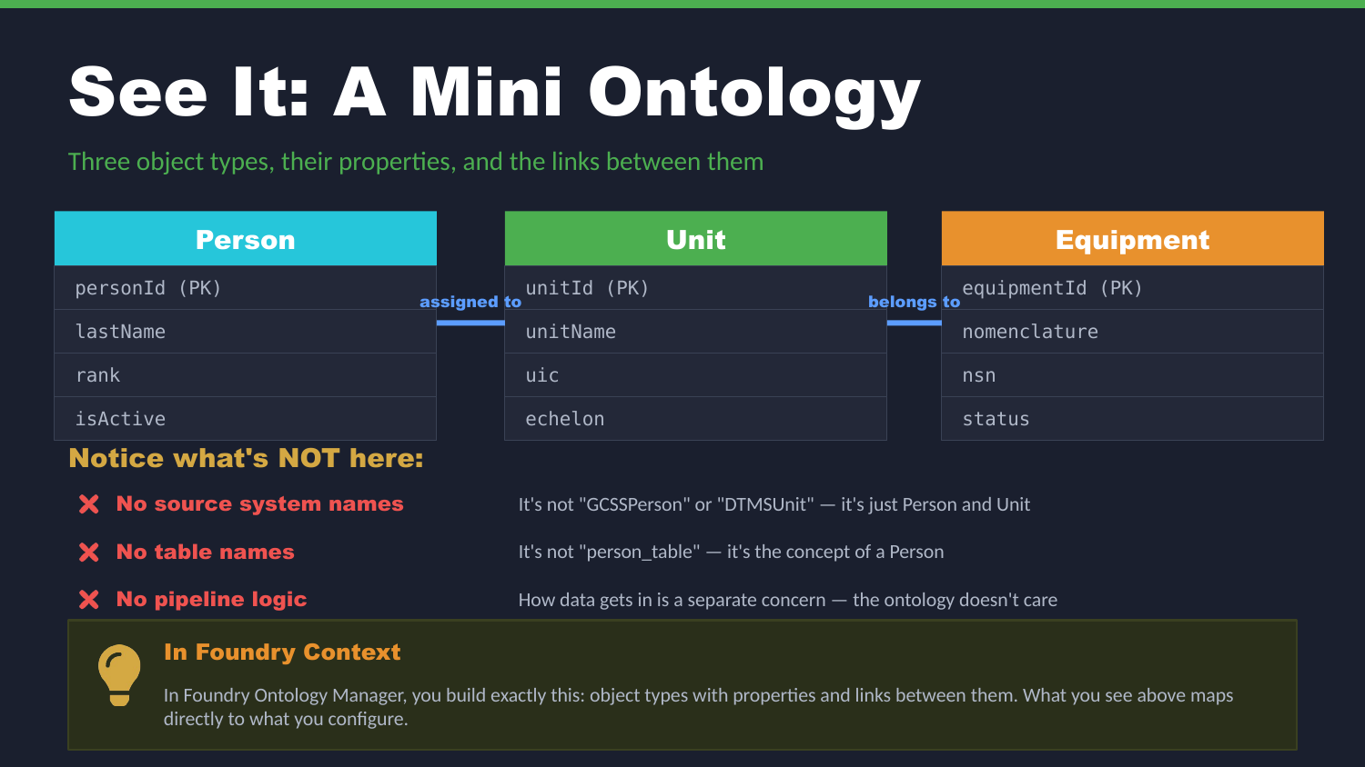
UNCLASSIFIED
WHAT IS AN ONTOLOGY? · TM-20 · Primer
UNCLASSIFIED

Slide 7
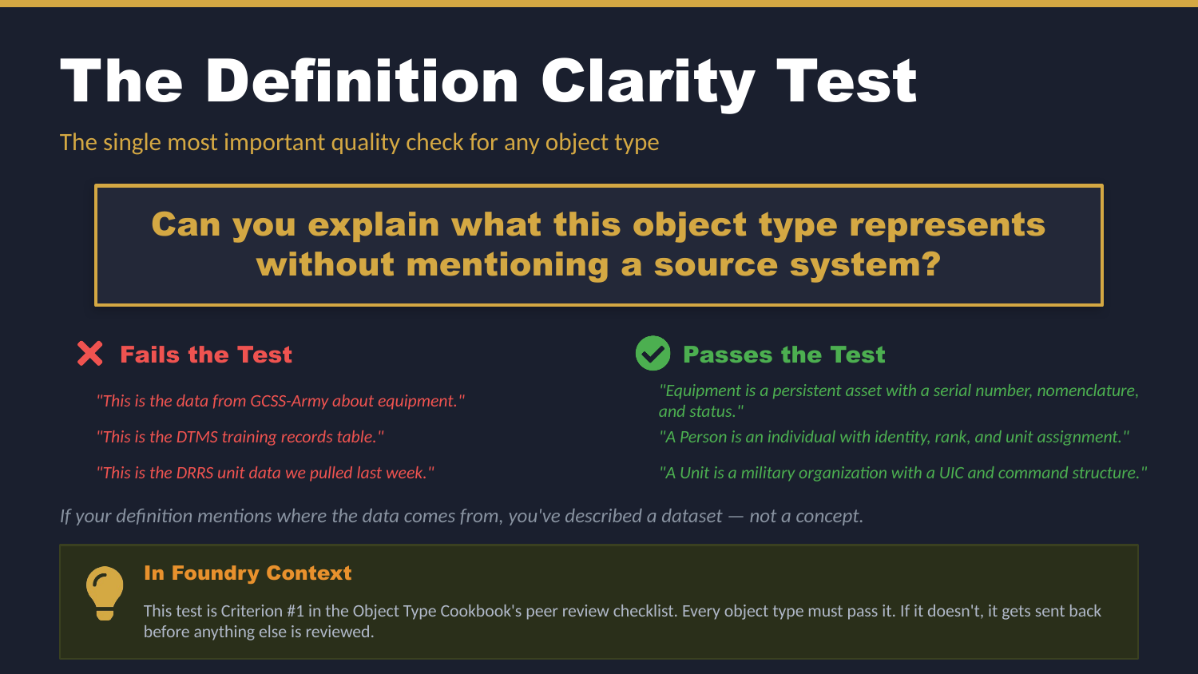
UNCLASSIFIED
WHAT IS AN ONTOLOGY? · TM-20 · Primer
UNCLASSIFIED

Slide 8
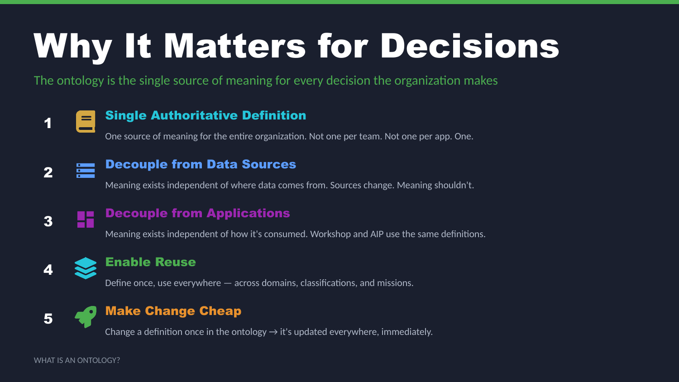
UNCLASSIFIED
WHAT IS AN ONTOLOGY? · TM-20 · Primer
UNCLASSIFIED

Slide 9
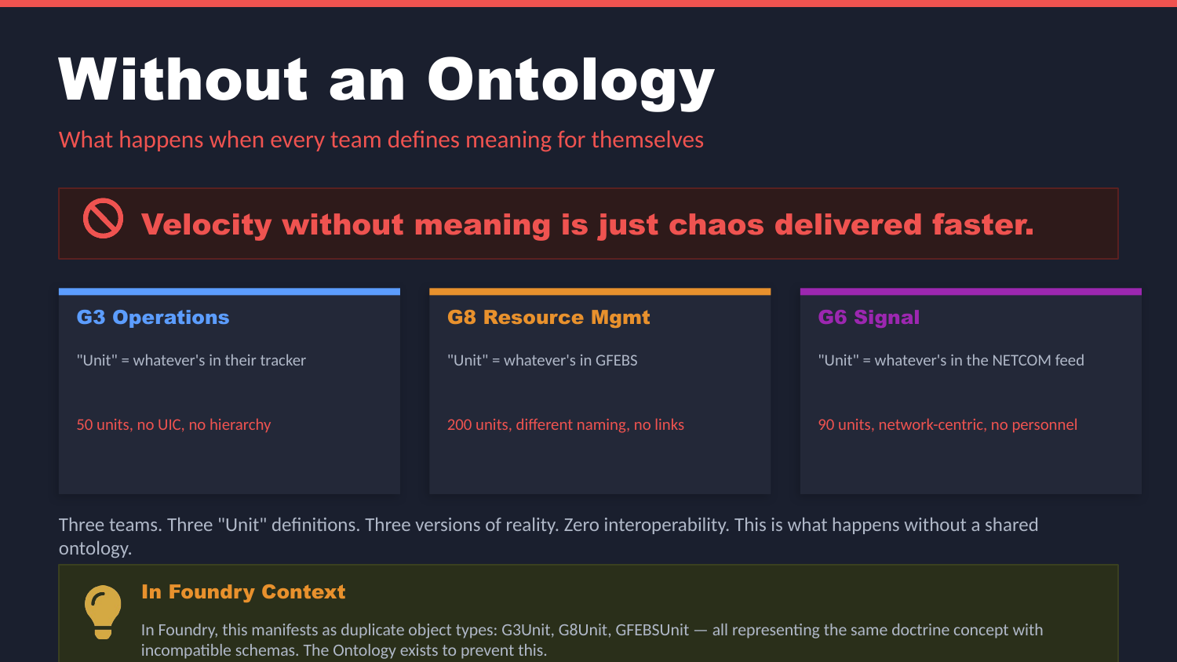
UNCLASSIFIED
WHAT IS AN ONTOLOGY? · TM-20 · Primer
UNCLASSIFIED

Slide 10
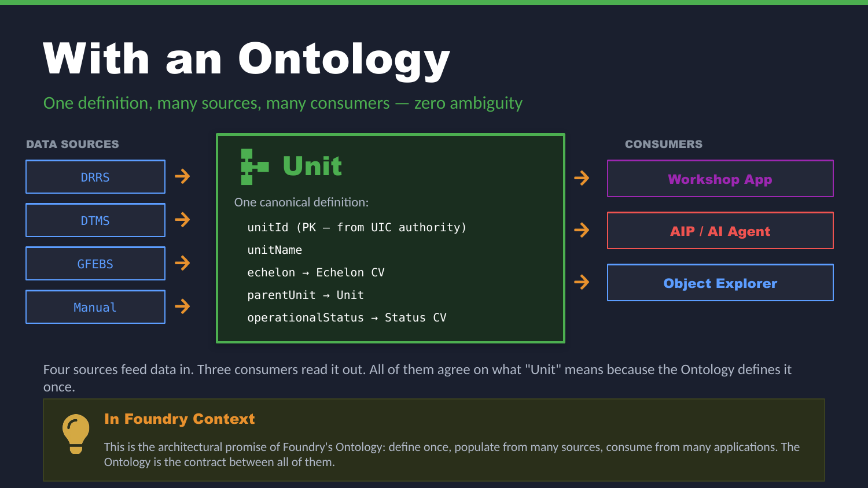
UNCLASSIFIED
WHAT IS AN ONTOLOGY? · TM-20 · Primer
UNCLASSIFIED

Slide 11
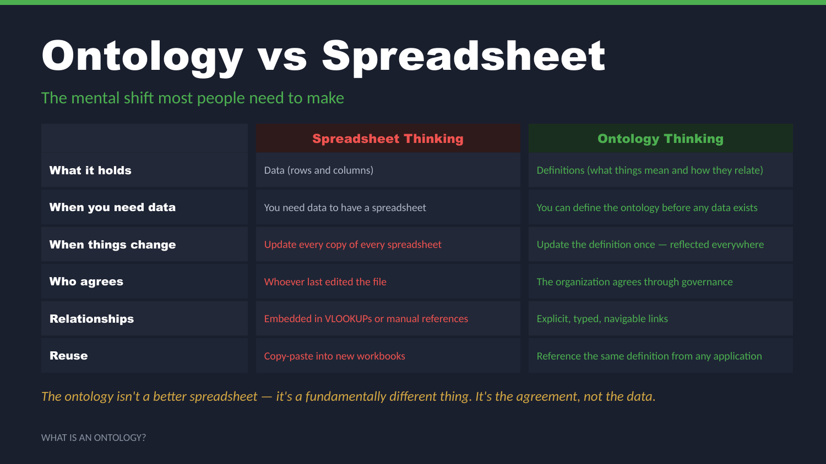
UNCLASSIFIED
WHAT IS AN ONTOLOGY? · TM-20 · Primer
UNCLASSIFIED

Slide 12
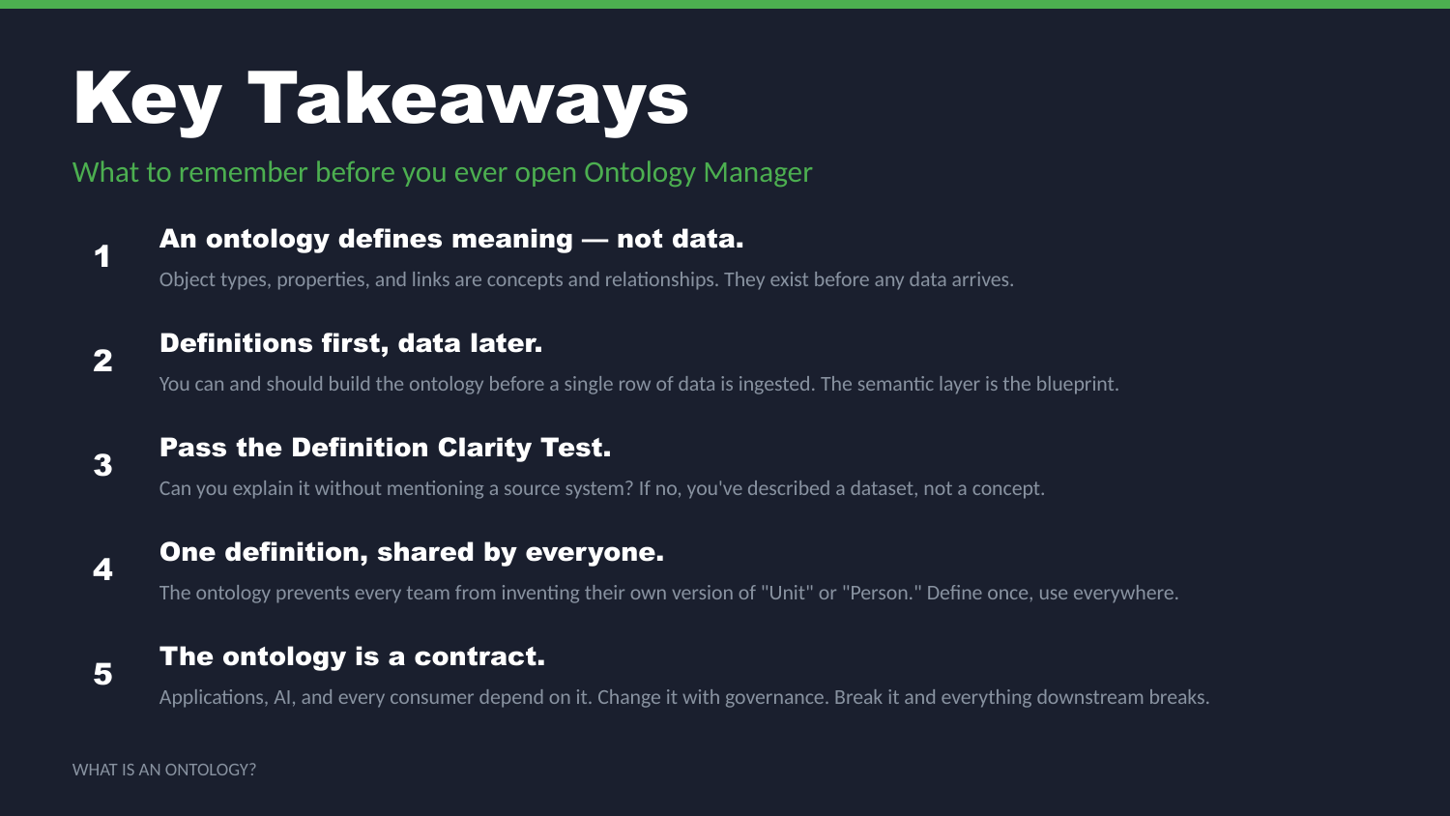
UNCLASSIFIED
WHAT IS AN ONTOLOGY? · TM-20 · Primer
UNCLASSIFIED

Slide 13
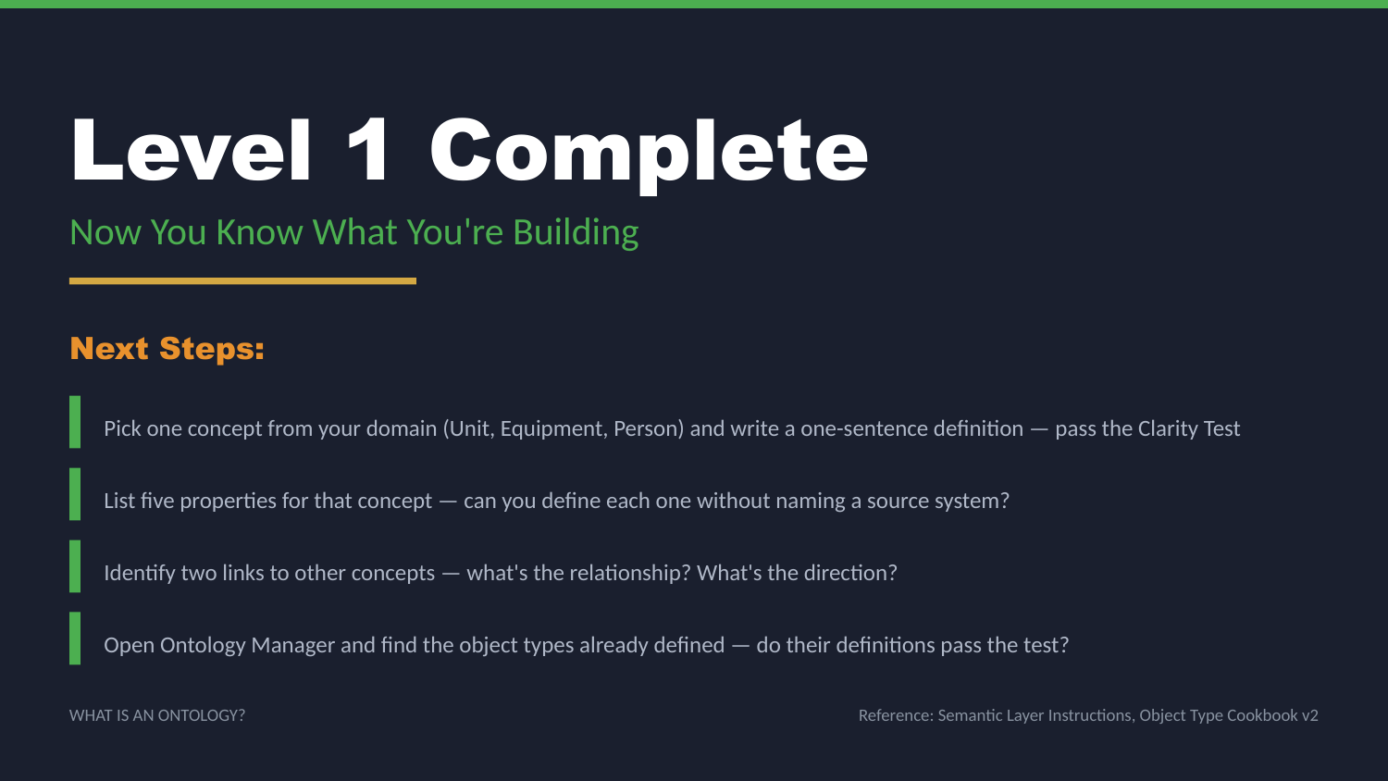
UNCLASSIFIED
WHAT IS AN ONTOLOGY? · TM-20 · Primer
UNCLASSIFIED

