Slide 1
ARMY DATA ORIENTATION (V2 — END USER)
TM-10 · TM-10 User
UNCLASSIFIED
UNCLASSIFIED
USAREUR-AF · C2DAO · MSS
UNCLASSIFIED

Slide 2
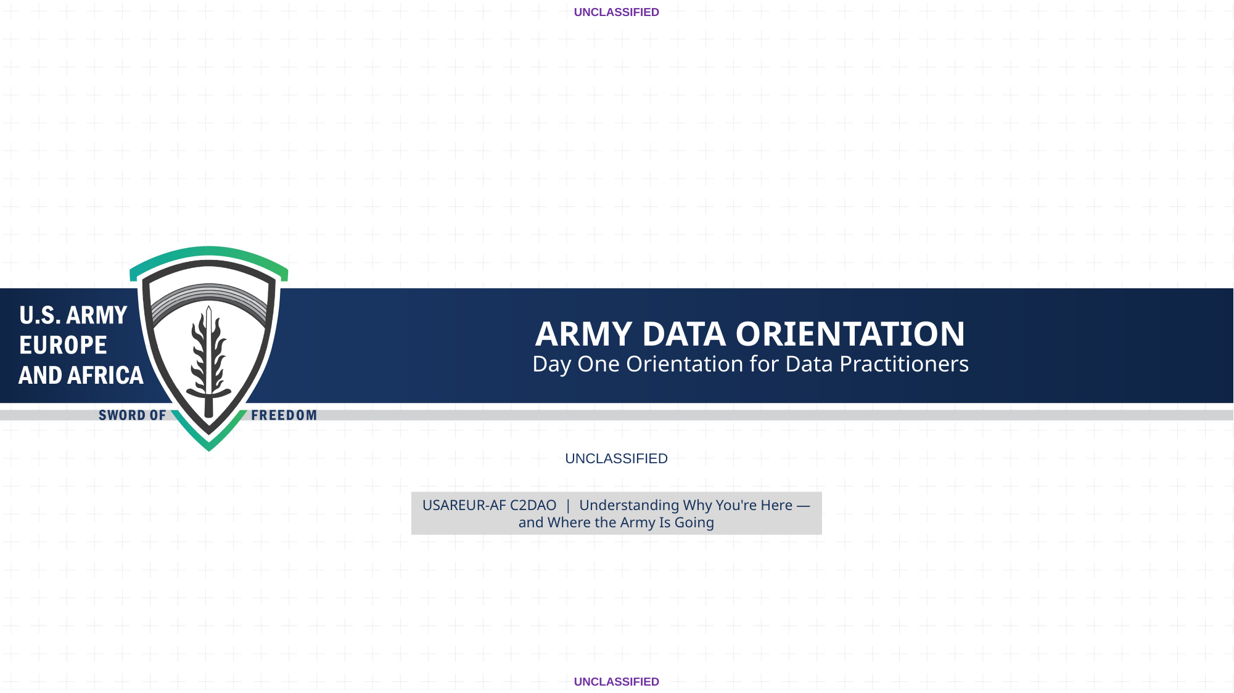
UNCLASSIFIED
ARMY DATA ORIENTATION (V2 — END USER) · TM-10 · TM-10 User
UNCLASSIFIED

Slide 3

UNCLASSIFIED
ARMY DATA ORIENTATION (V2 — END USER) · TM-10 · TM-10 User
UNCLASSIFIED

Slide 4

UNCLASSIFIED
ARMY DATA ORIENTATION (V2 — END USER) · TM-10 · TM-10 User
UNCLASSIFIED

Slide 5
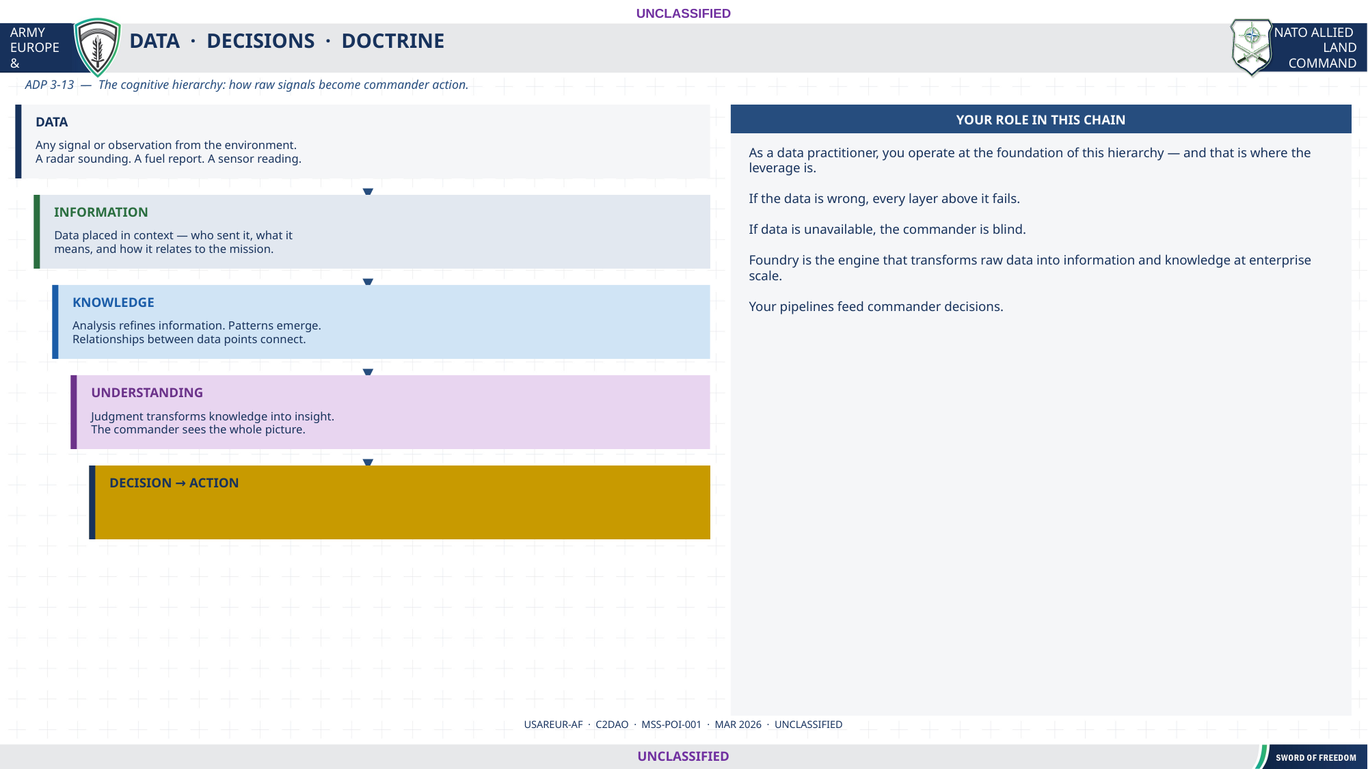
UNCLASSIFIED
ARMY DATA ORIENTATION (V2 — END USER) · TM-10 · TM-10 User
UNCLASSIFIED

Slide 6
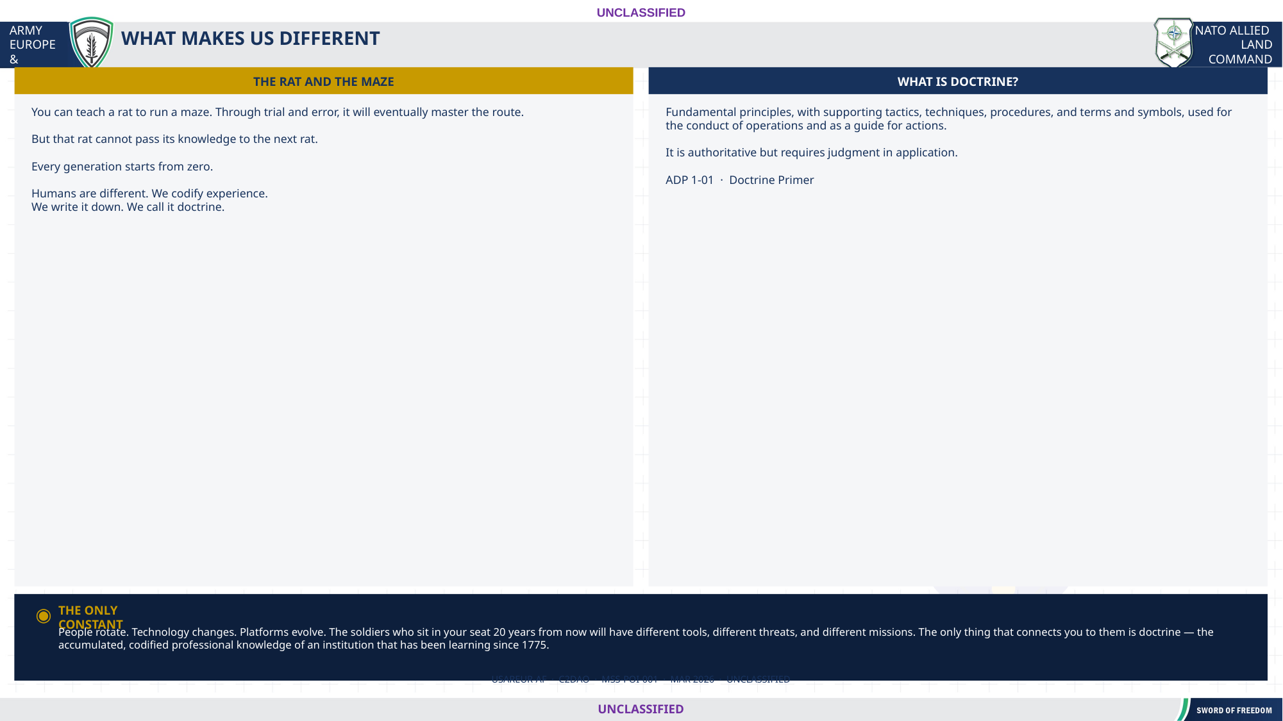
UNCLASSIFIED
ARMY DATA ORIENTATION (V2 — END USER) · TM-10 · TM-10 User
UNCLASSIFIED

Slide 7
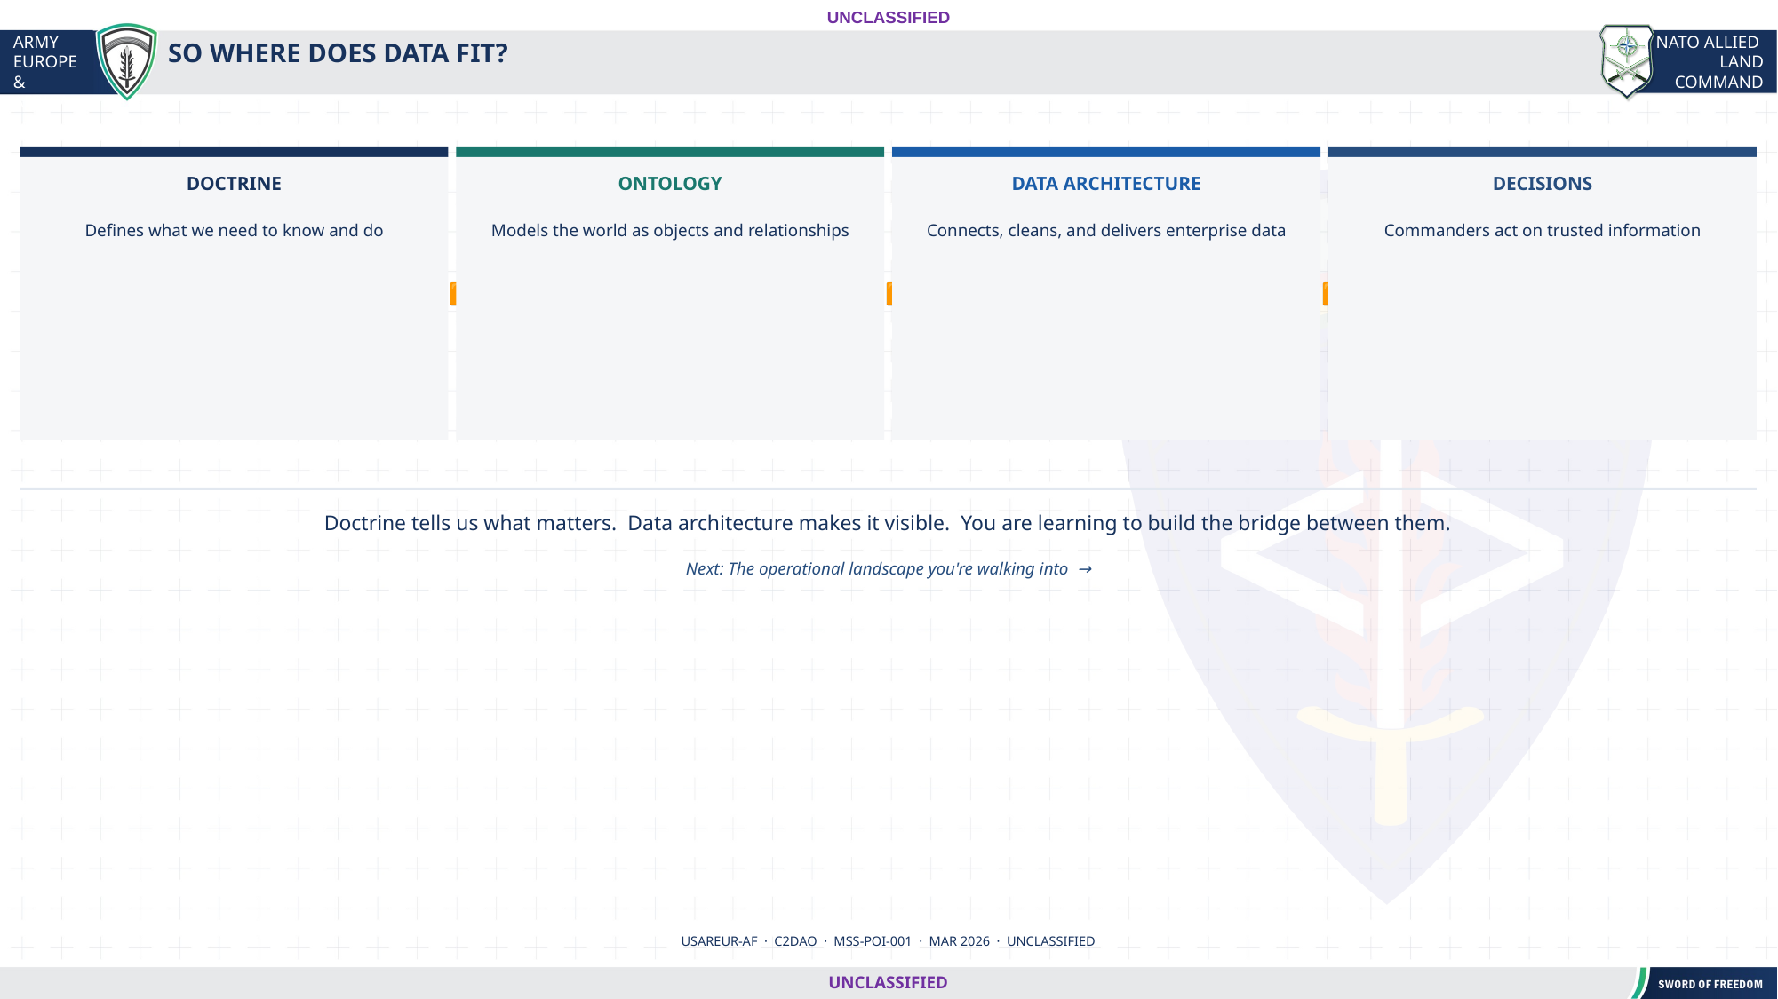
UNCLASSIFIED
ARMY DATA ORIENTATION (V2 — END USER) · TM-10 · TM-10 User
UNCLASSIFIED

Slide 8

UNCLASSIFIED
ARMY DATA ORIENTATION (V2 — END USER) · TM-10 · TM-10 User
UNCLASSIFIED

Slide 9
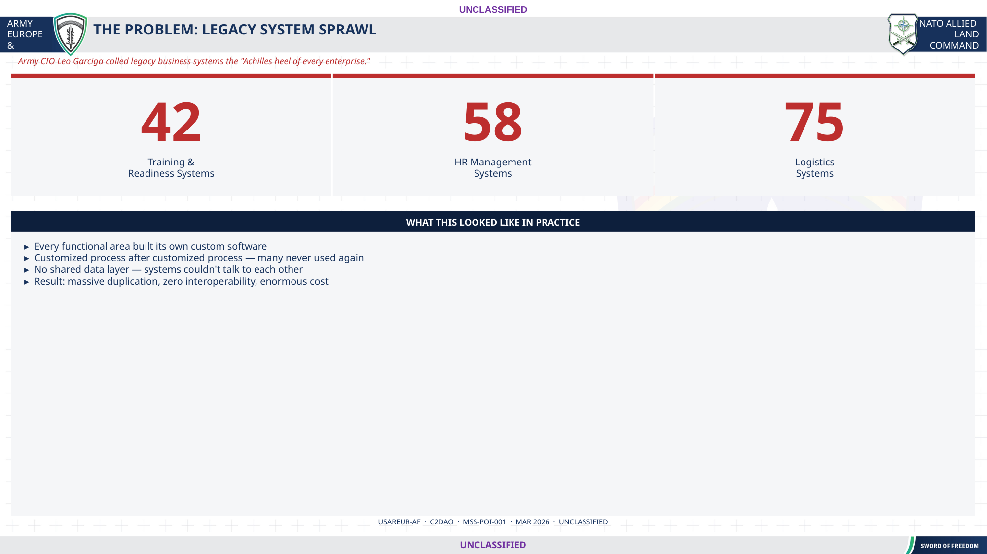
UNCLASSIFIED
ARMY DATA ORIENTATION (V2 — END USER) · TM-10 · TM-10 User
UNCLASSIFIED

Slide 10
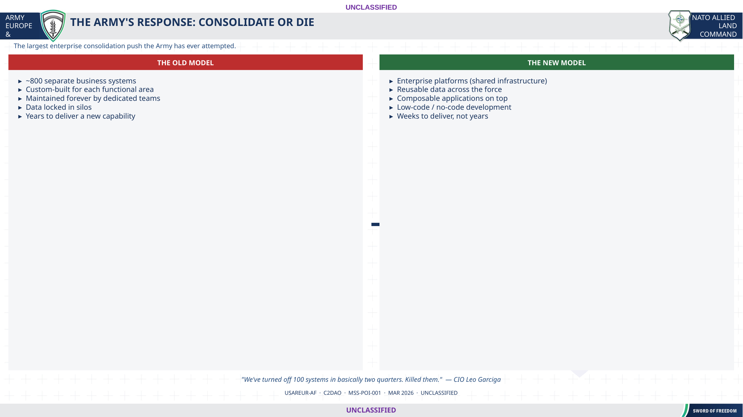
UNCLASSIFIED
ARMY DATA ORIENTATION (V2 — END USER) · TM-10 · TM-10 User
UNCLASSIFIED

Slide 11
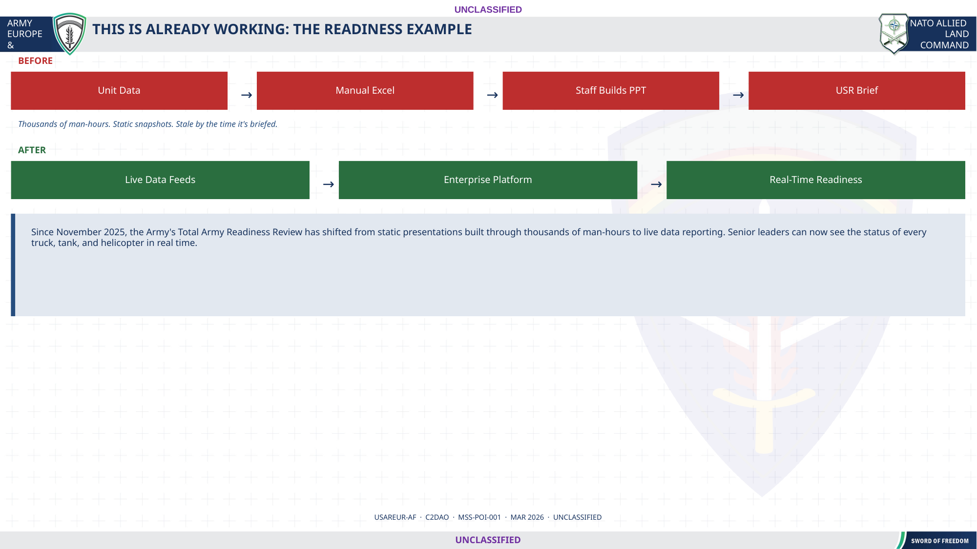
UNCLASSIFIED
ARMY DATA ORIENTATION (V2 — END USER) · TM-10 · TM-10 User
UNCLASSIFIED

Slide 12
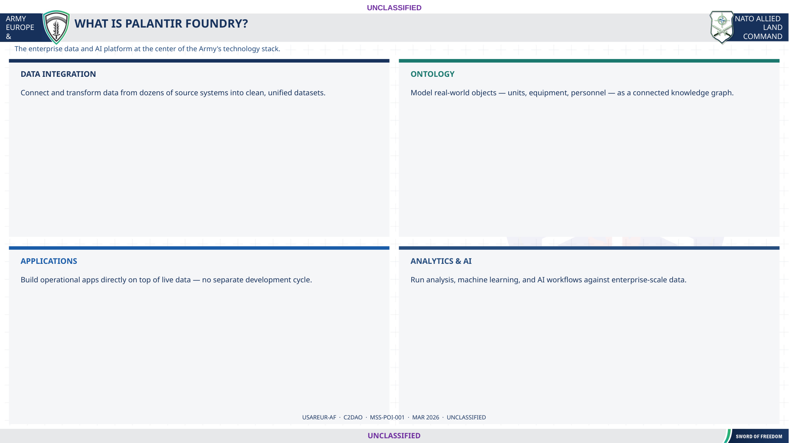
UNCLASSIFIED
ARMY DATA ORIENTATION (V2 — END USER) · TM-10 · TM-10 User
UNCLASSIFIED

Slide 13
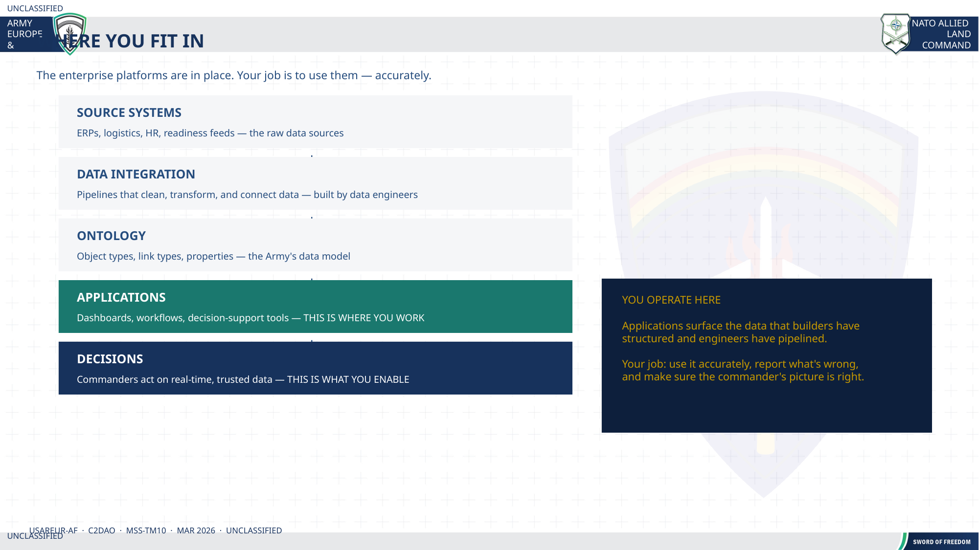
UNCLASSIFIED
ARMY DATA ORIENTATION (V2 — END USER) · TM-10 · TM-10 User
UNCLASSIFIED

Slide 14
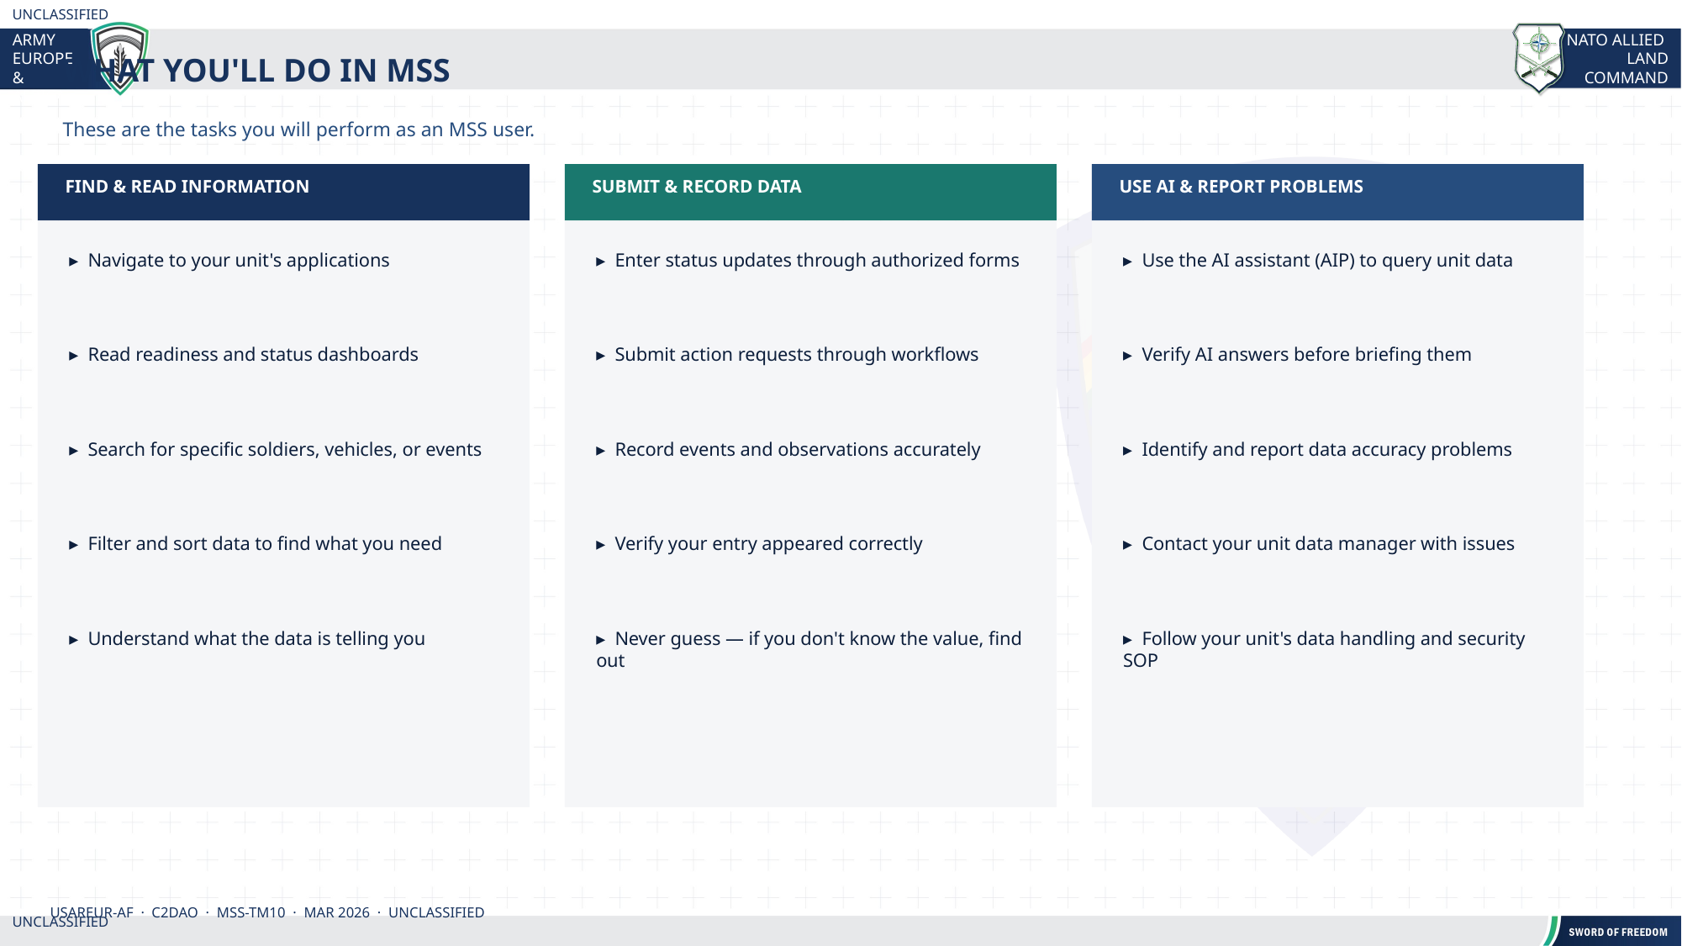
UNCLASSIFIED
ARMY DATA ORIENTATION (V2 — END USER) · TM-10 · TM-10 User
UNCLASSIFIED

Slide 15
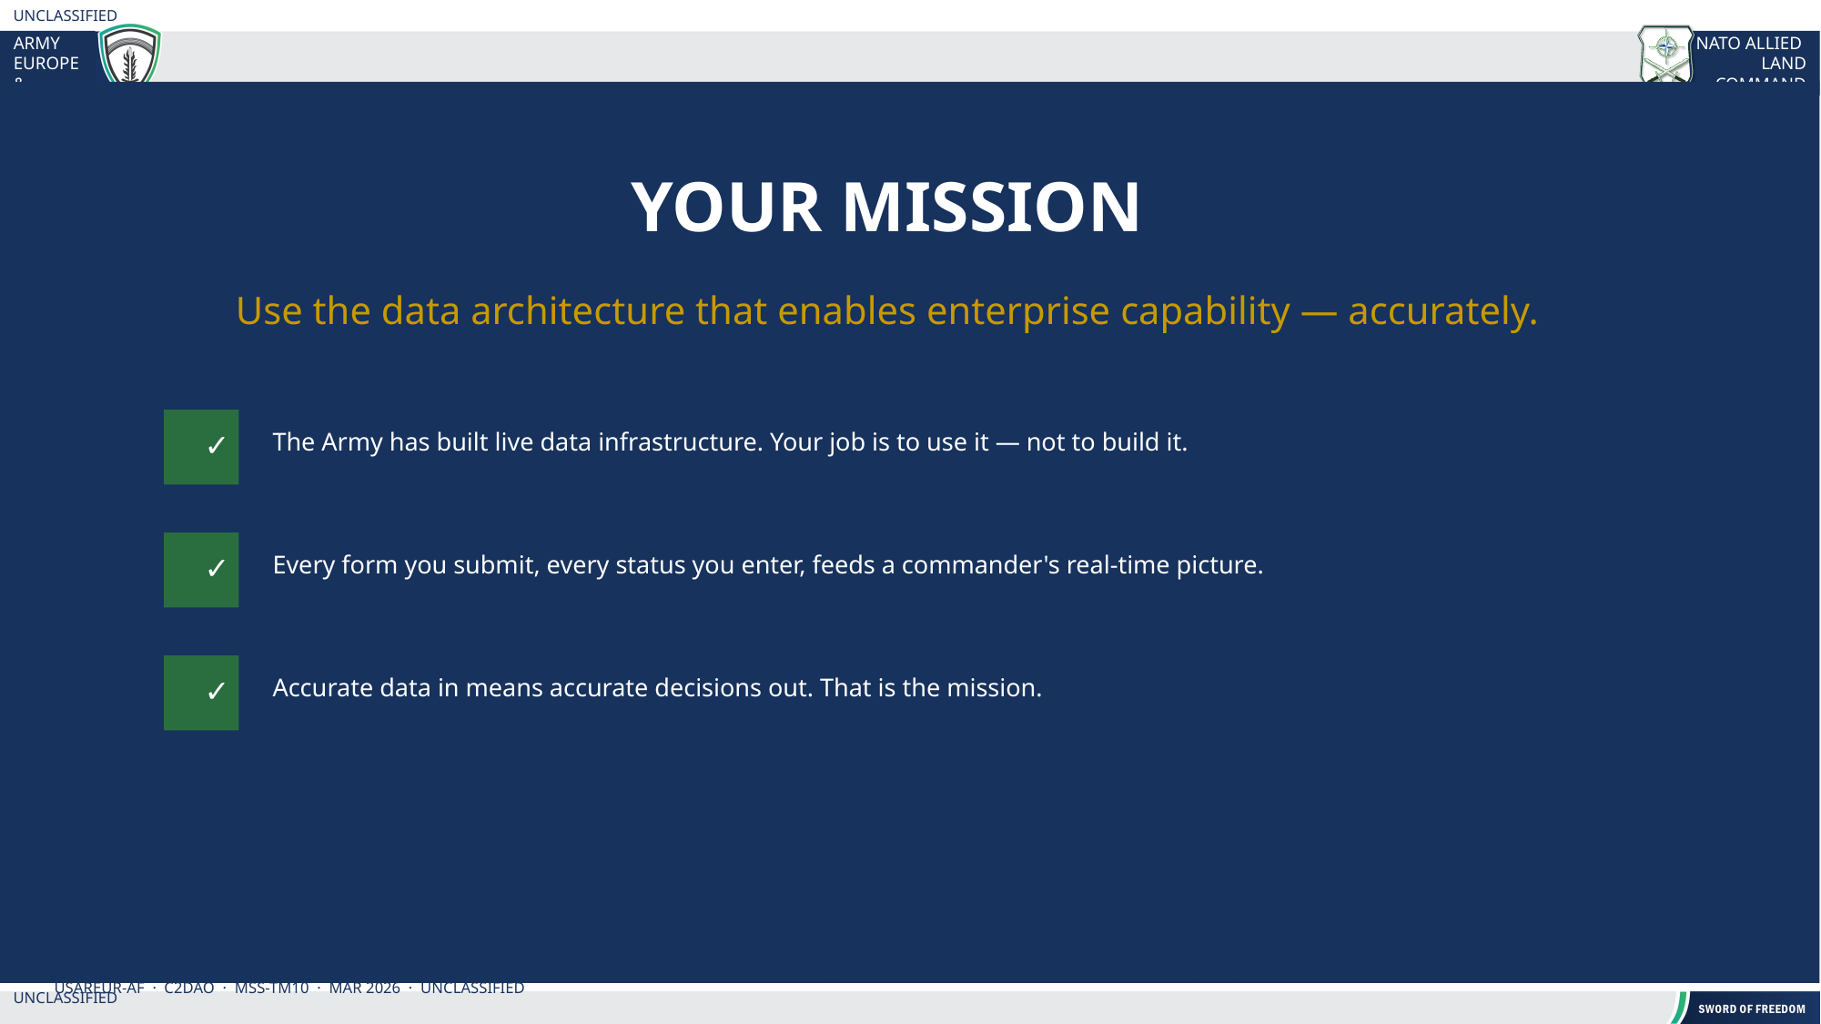
UNCLASSIFIED
ARMY DATA ORIENTATION (V2 — END USER) · TM-10 · TM-10 User
UNCLASSIFIED

Slide 16
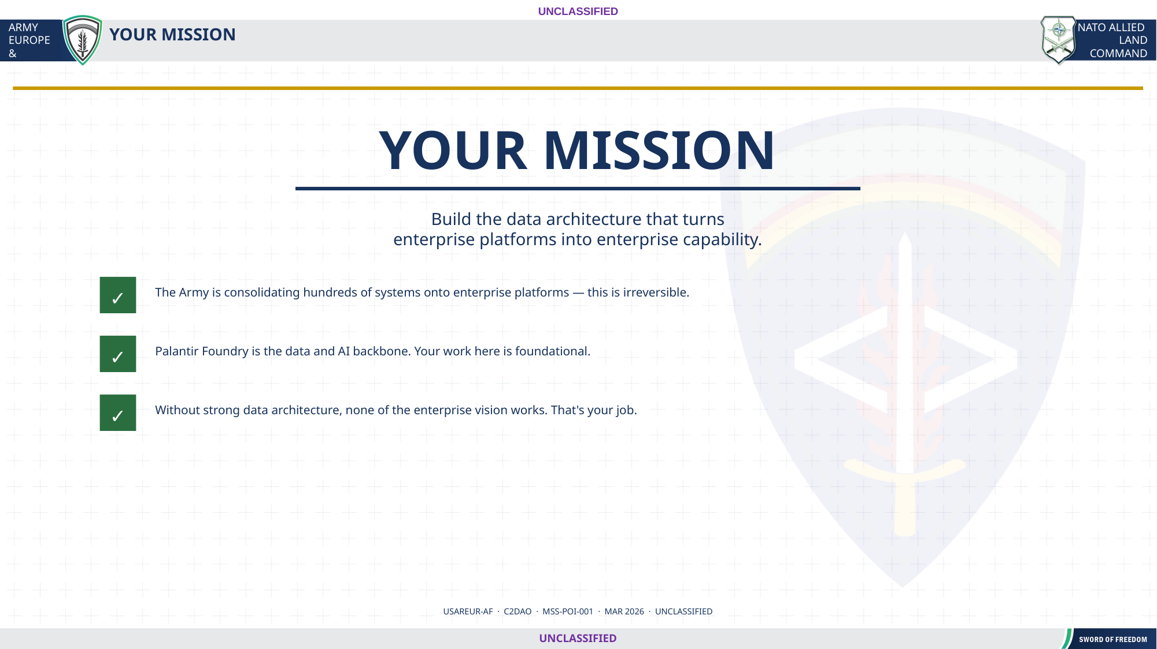
UNCLASSIFIED
ARMY DATA ORIENTATION (V2 — END USER) · TM-10 · TM-10 User
UNCLASSIFIED

