Slide 1
DECISION ADVANTAGE DEEP DIVE
TM-40A · WFF · also: TM-40B, TM-40C, TM-40D, TM-40E, TM-40F
UNCLASSIFIED
UNCLASSIFIED
USAREUR-AF · C2DAO · MSS
UNCLASSIFIED

Slide 2

UNCLASSIFIED
DECISION ADVANTAGE DEEP DIVE · TM-40A · WFF
UNCLASSIFIED

Slide 3
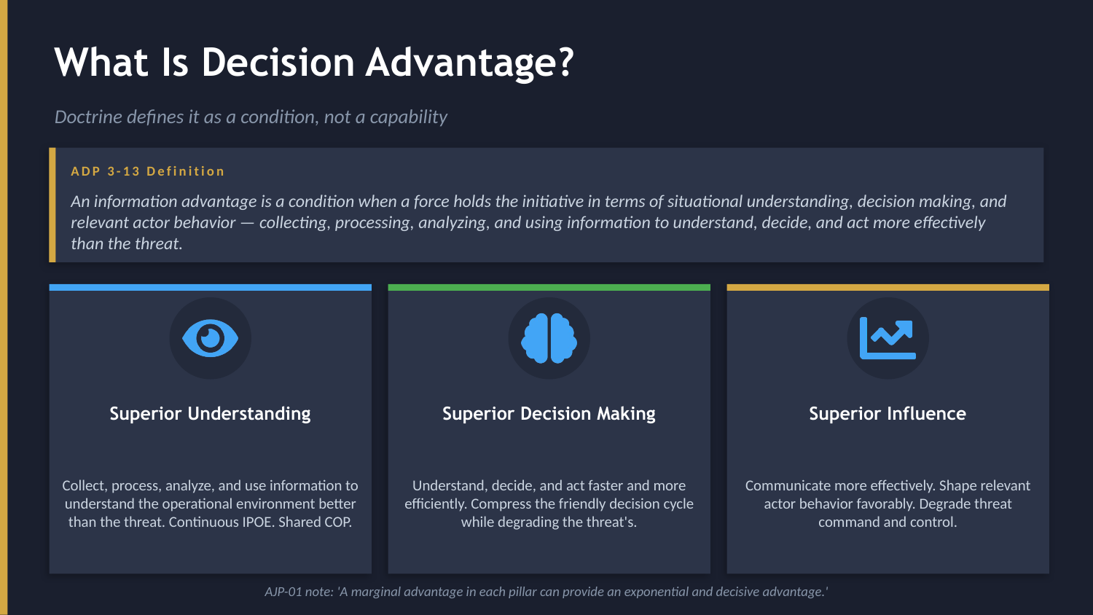
UNCLASSIFIED
DECISION ADVANTAGE DEEP DIVE · TM-40A · WFF
UNCLASSIFIED

Slide 4
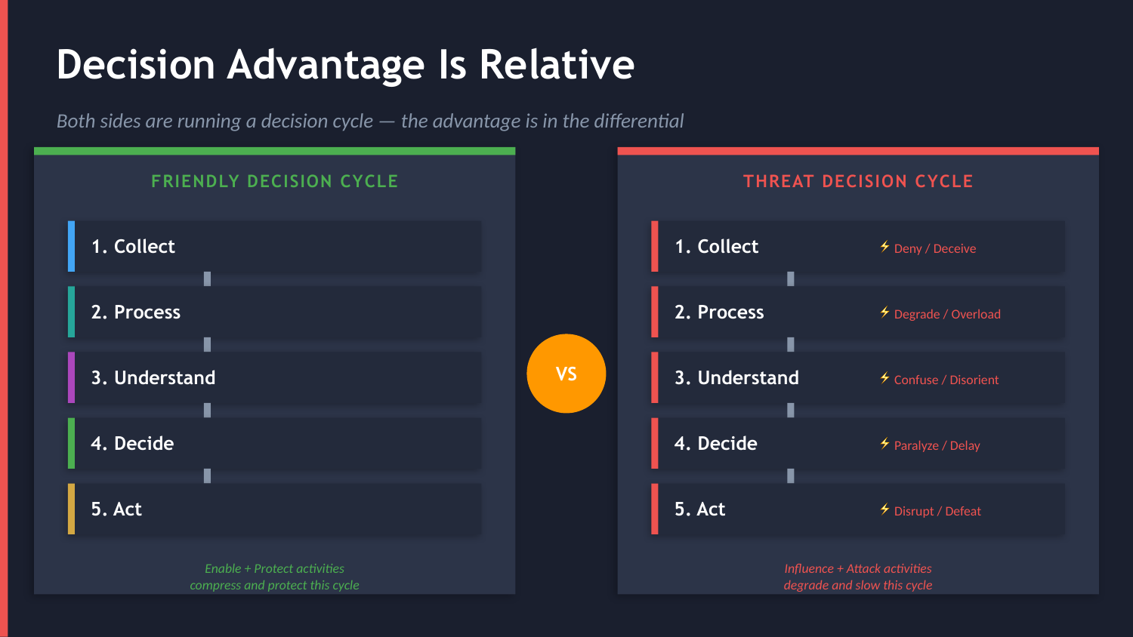
UNCLASSIFIED
DECISION ADVANTAGE DEEP DIVE · TM-40A · WFF
UNCLASSIFIED

Slide 5
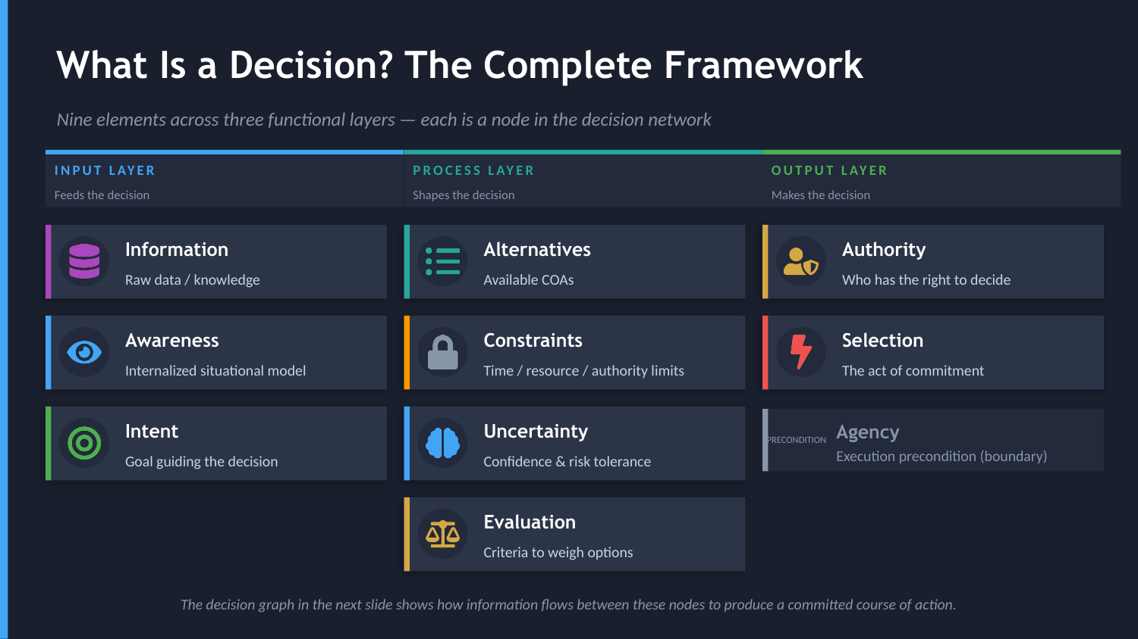
UNCLASSIFIED
DECISION ADVANTAGE DEEP DIVE · TM-40A · WFF
UNCLASSIFIED

Slide 6
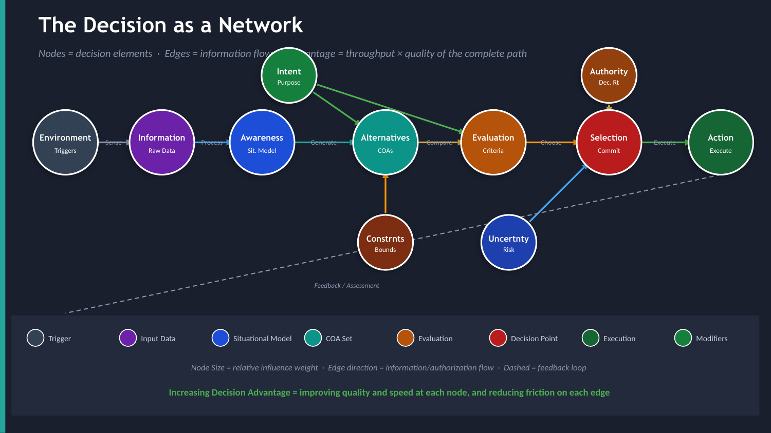
UNCLASSIFIED
DECISION ADVANTAGE DEEP DIVE · TM-40A · WFF
UNCLASSIFIED

Slide 7
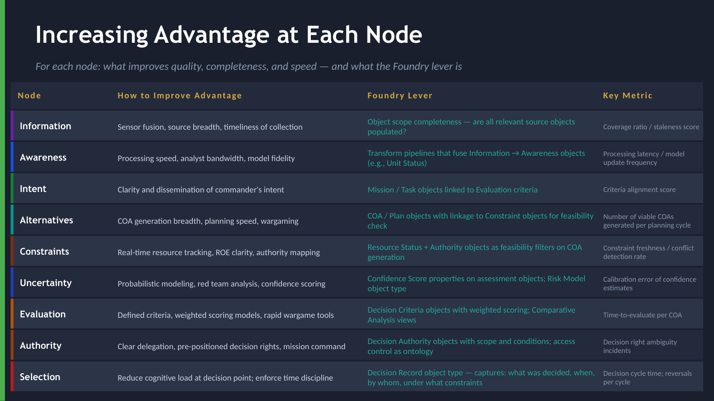
UNCLASSIFIED
DECISION ADVANTAGE DEEP DIVE · TM-40A · WFF
UNCLASSIFIED

Slide 8
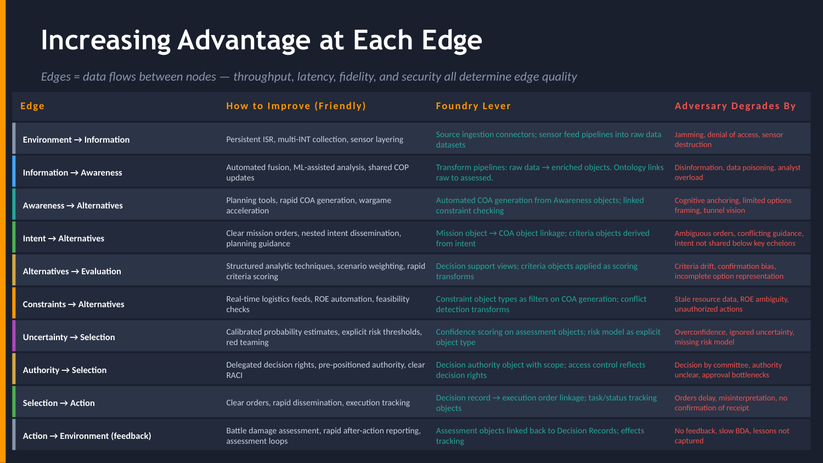
UNCLASSIFIED
DECISION ADVANTAGE DEEP DIVE · TM-40A · WFF
UNCLASSIFIED

Slide 9
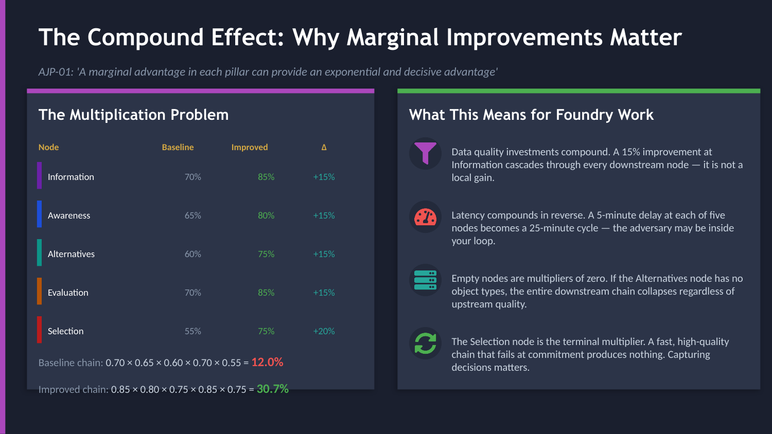
UNCLASSIFIED
DECISION ADVANTAGE DEEP DIVE · TM-40A · WFF
UNCLASSIFIED

Slide 10
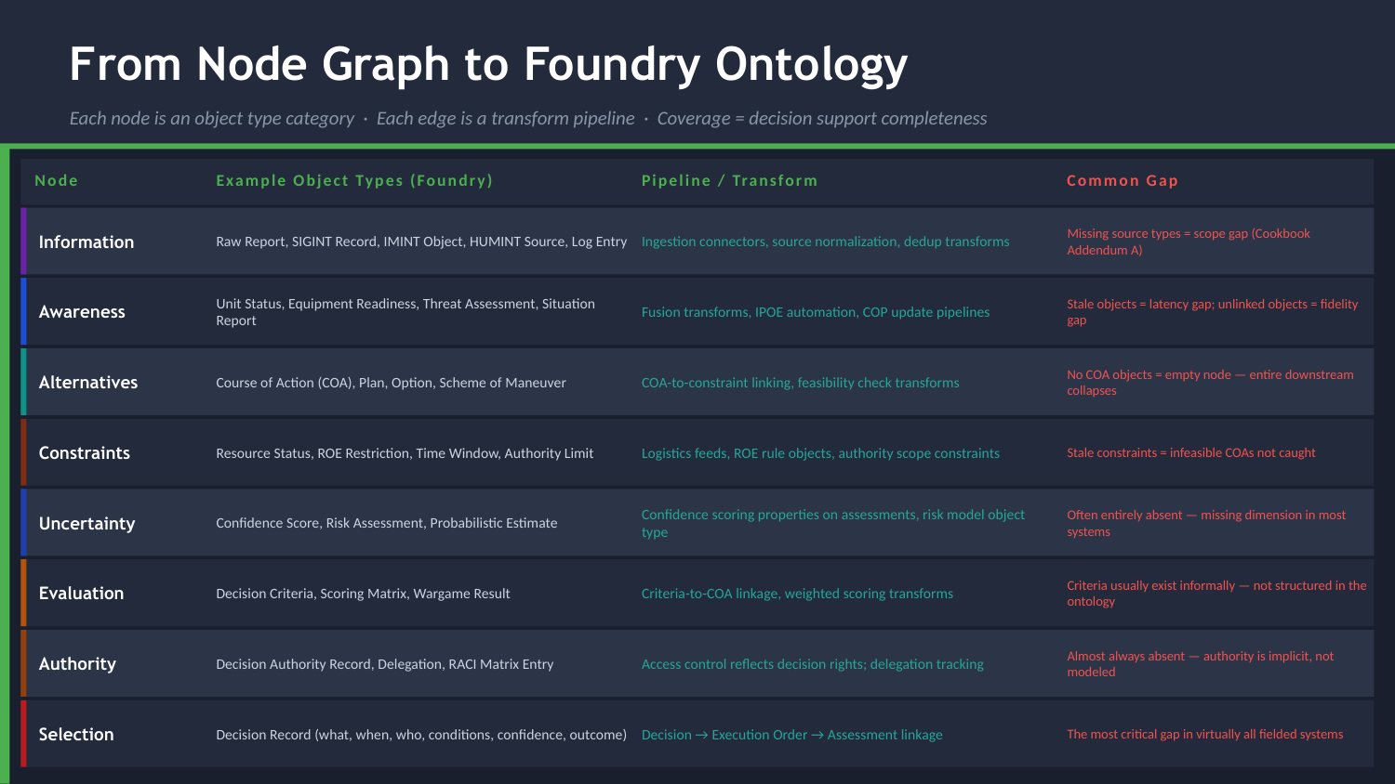
UNCLASSIFIED
DECISION ADVANTAGE DEEP DIVE · TM-40A · WFF
UNCLASSIFIED

Slide 11

UNCLASSIFIED
DECISION ADVANTAGE DEEP DIVE · TM-40A · WFF
UNCLASSIFIED

