Slide 1
MSS PLATFORM OVERVIEW
TM-10 · TM-10 User
UNCLASSIFIED
UNCLASSIFIED
USAREUR-AF · C2DAO · MSS
UNCLASSIFIED

Slide 2
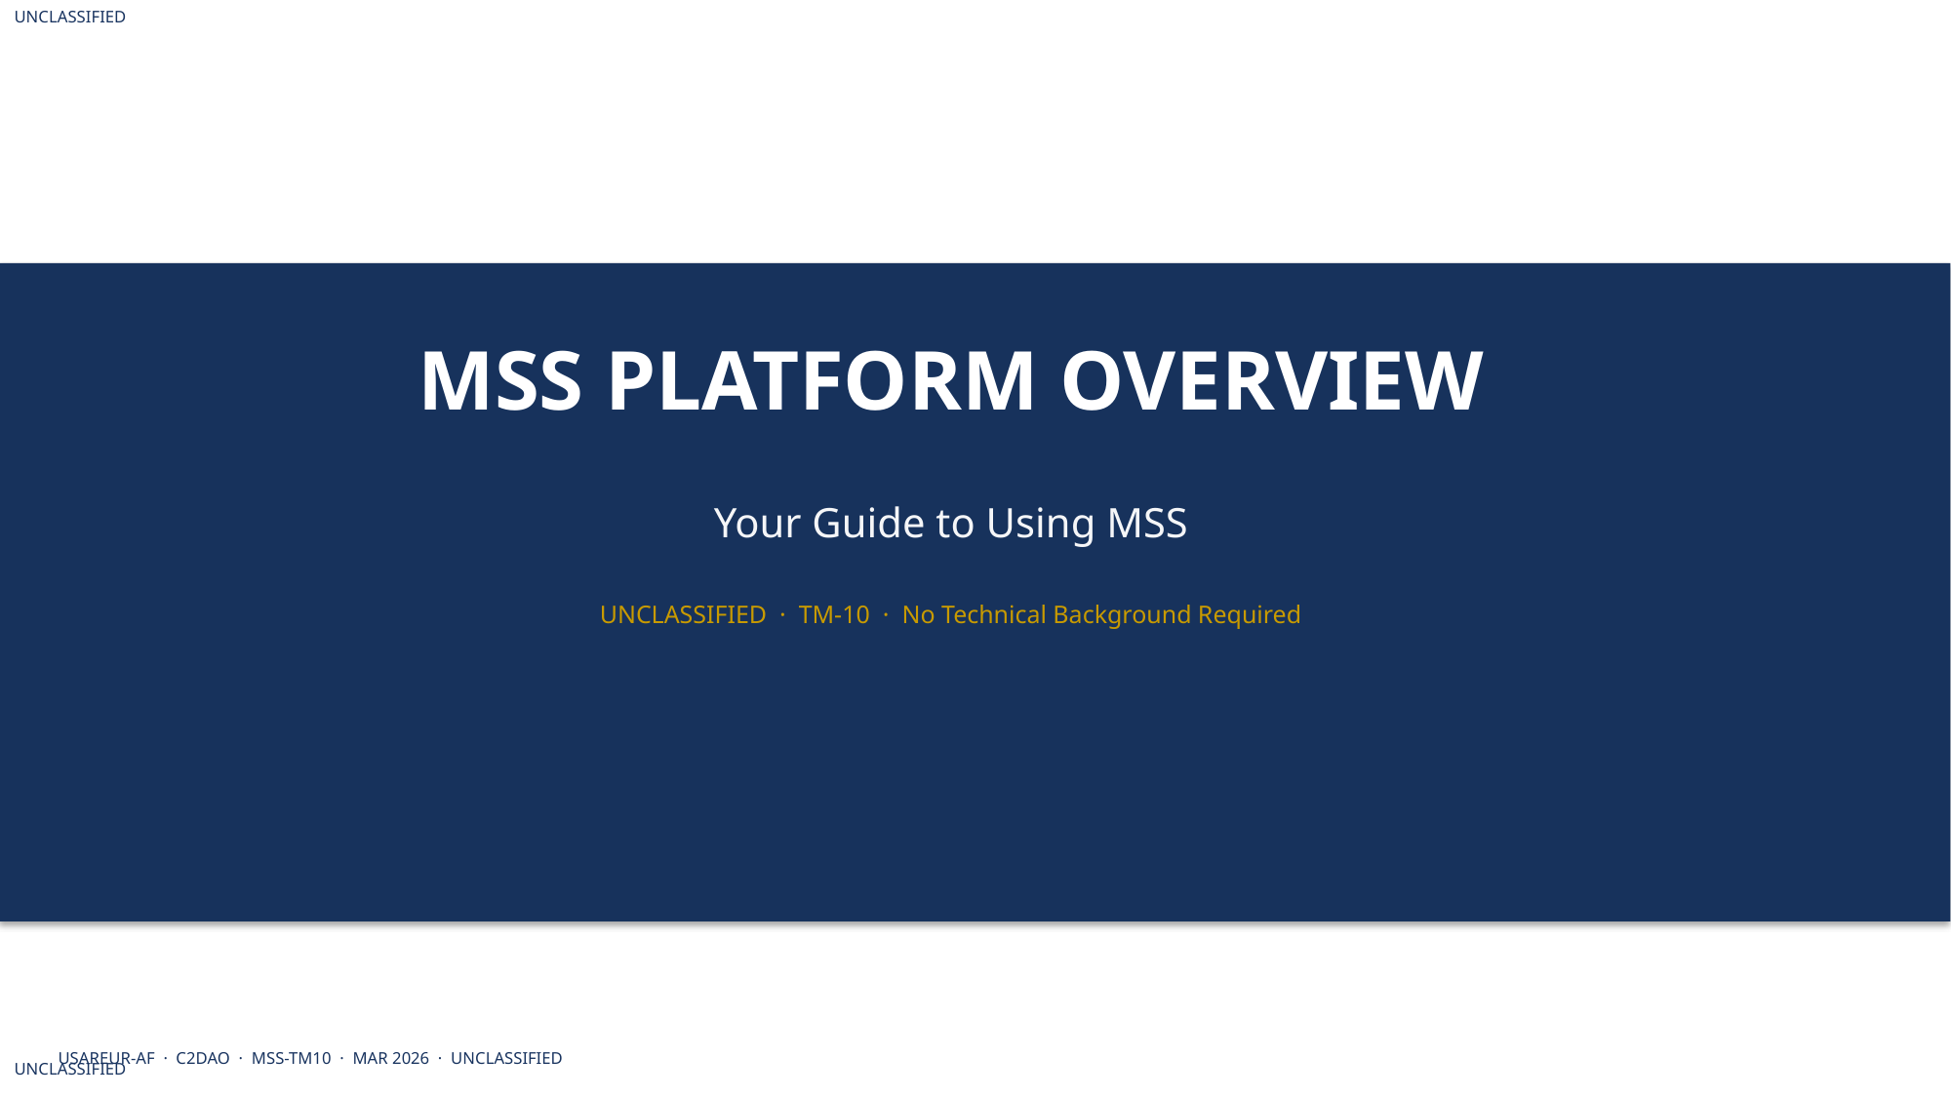
UNCLASSIFIED
MSS PLATFORM OVERVIEW · TM-10 · TM-10 User
UNCLASSIFIED

Slide 3
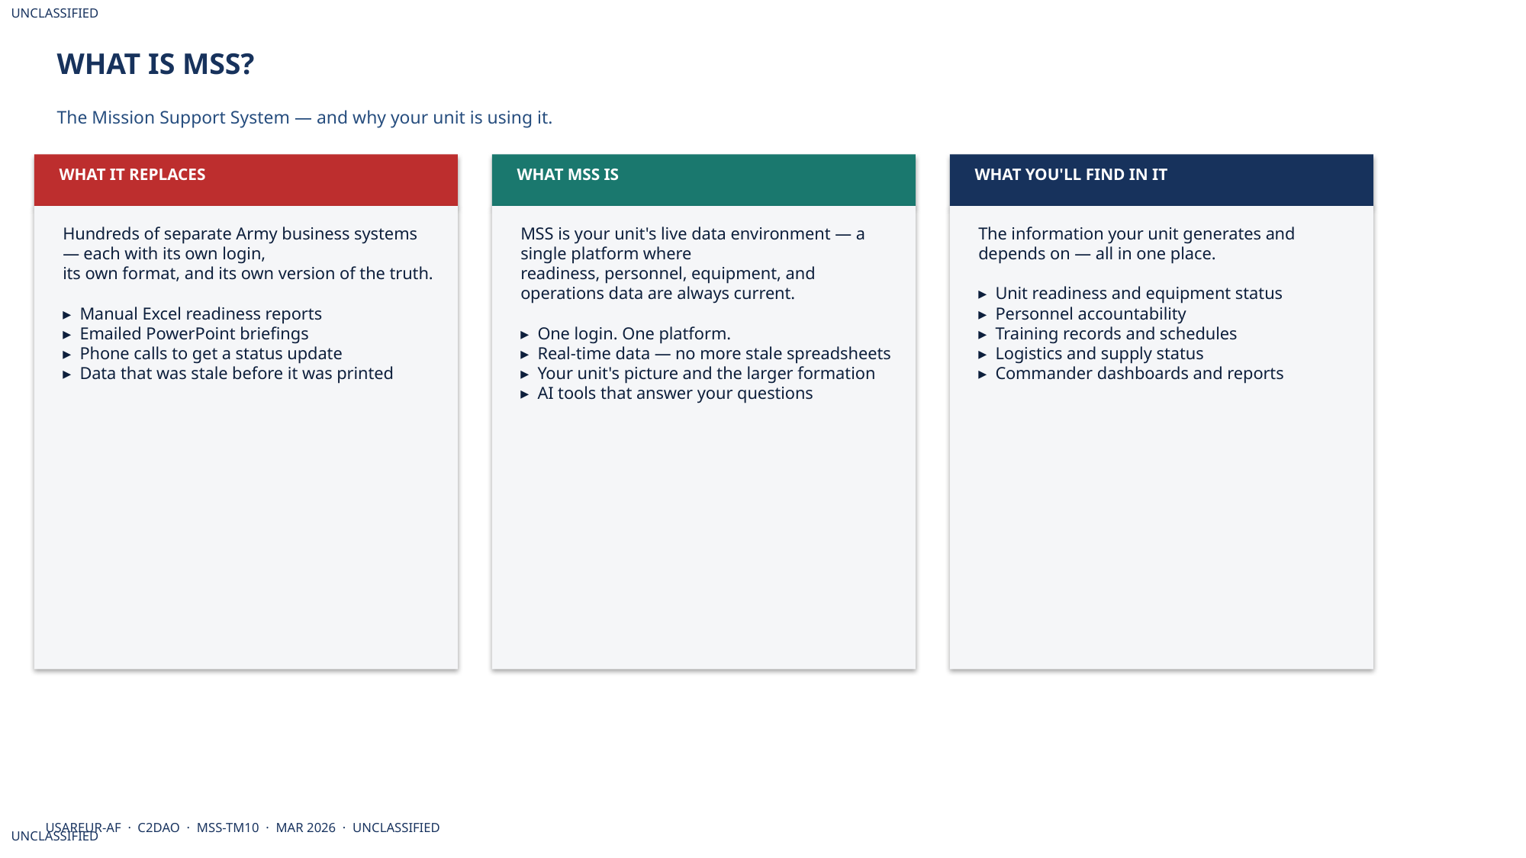
UNCLASSIFIED
MSS PLATFORM OVERVIEW · TM-10 · TM-10 User
UNCLASSIFIED

Slide 4
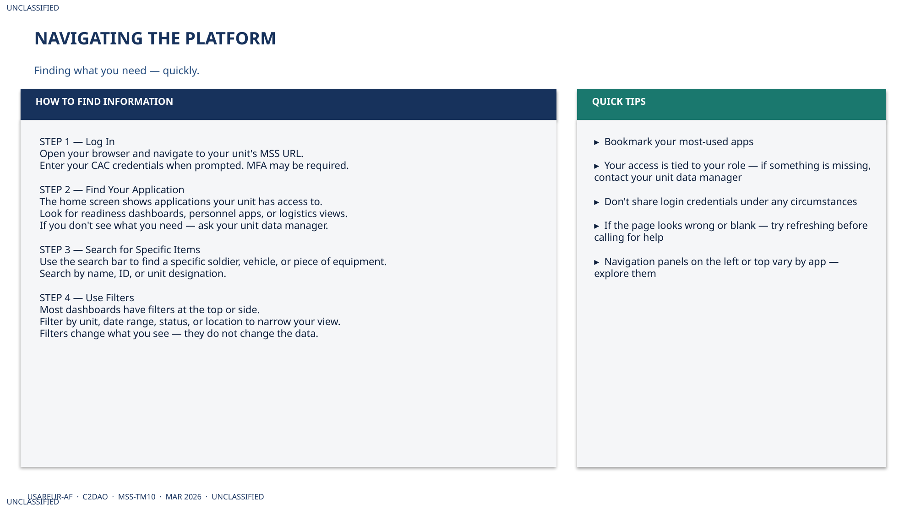
UNCLASSIFIED
MSS PLATFORM OVERVIEW · TM-10 · TM-10 User
UNCLASSIFIED

Slide 5
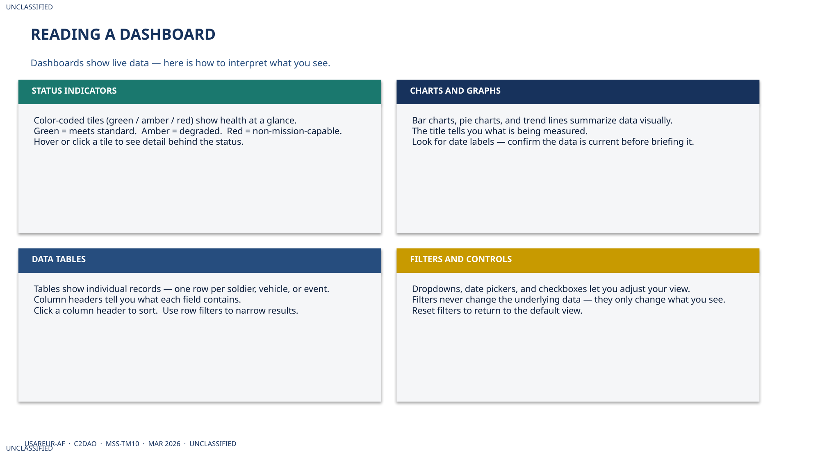
UNCLASSIFIED
MSS PLATFORM OVERVIEW · TM-10 · TM-10 User
UNCLASSIFIED

Slide 6
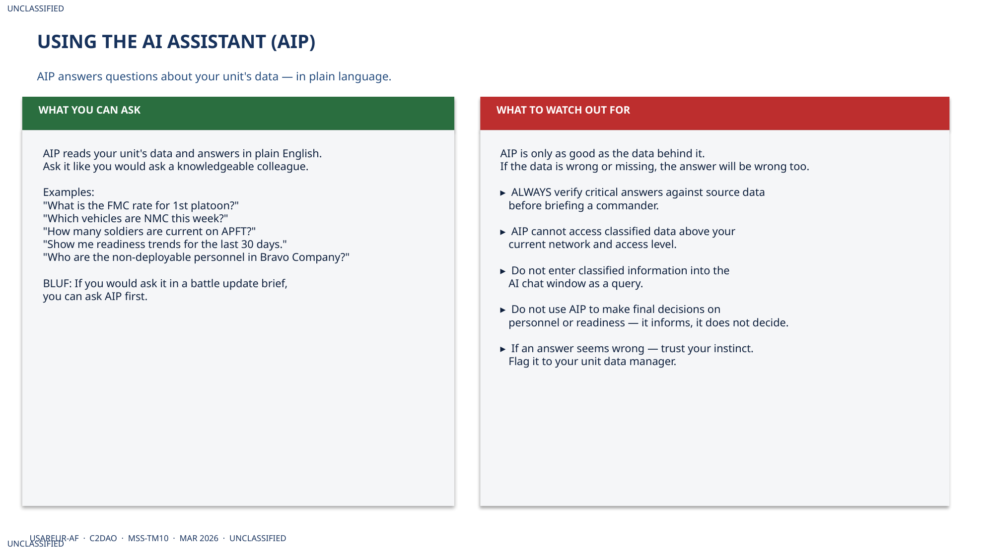
UNCLASSIFIED
MSS PLATFORM OVERVIEW · TM-10 · TM-10 User
UNCLASSIFIED

Slide 7
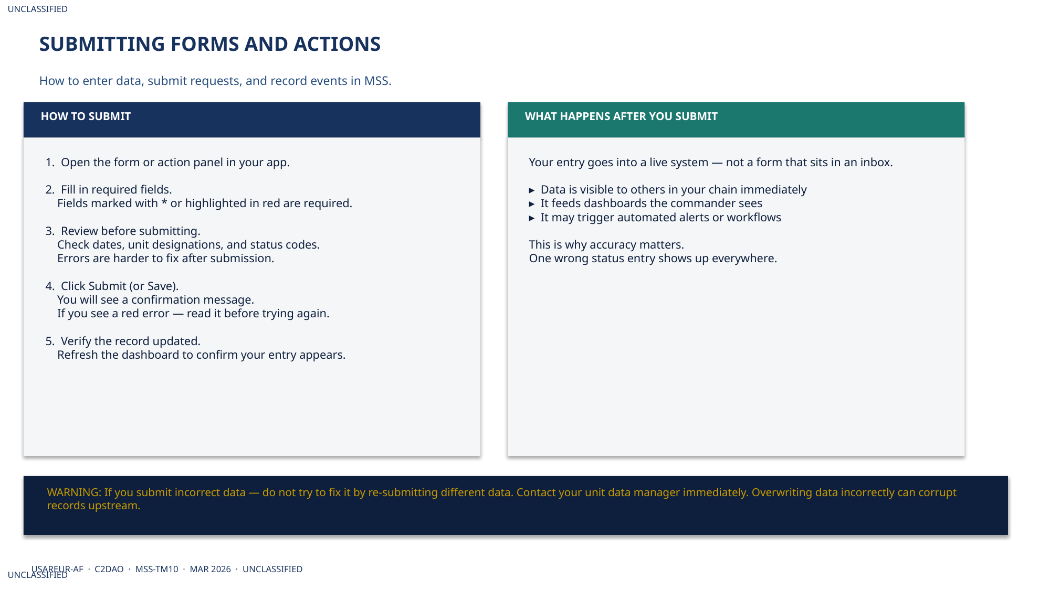
UNCLASSIFIED
MSS PLATFORM OVERVIEW · TM-10 · TM-10 User
UNCLASSIFIED

Slide 8
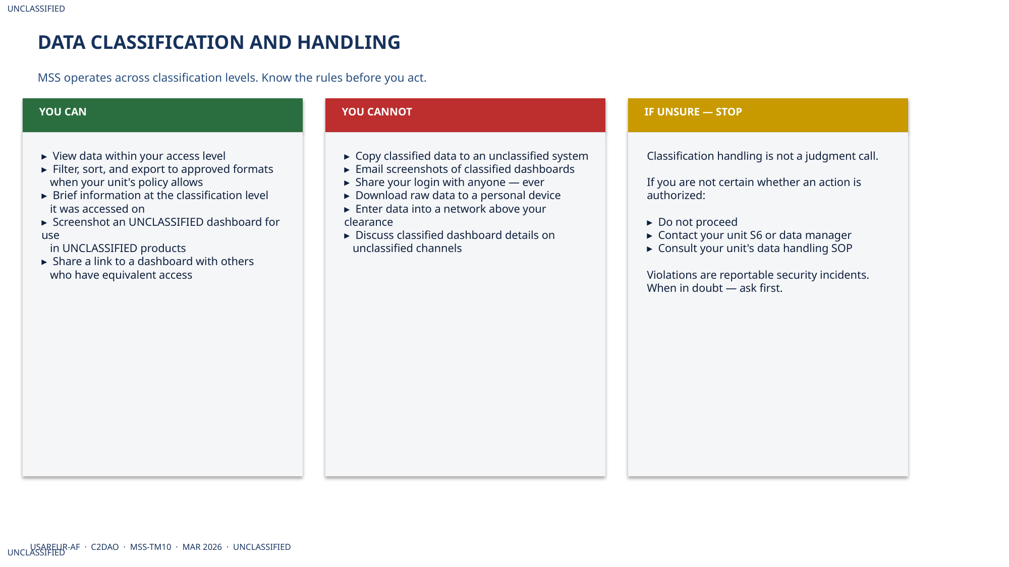
UNCLASSIFIED
MSS PLATFORM OVERVIEW · TM-10 · TM-10 User
UNCLASSIFIED

Slide 9
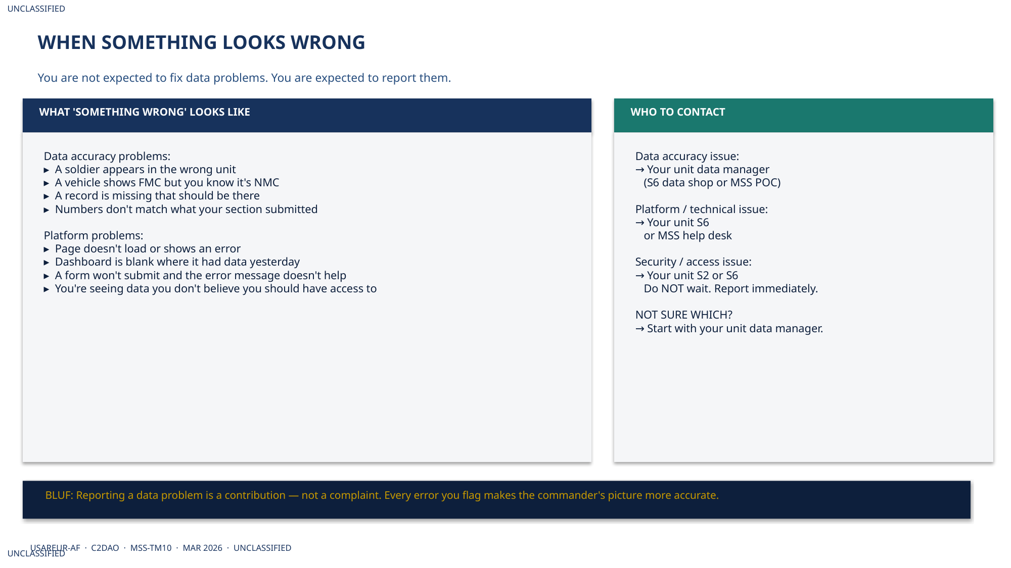
UNCLASSIFIED
MSS PLATFORM OVERVIEW · TM-10 · TM-10 User
UNCLASSIFIED

Slide 10
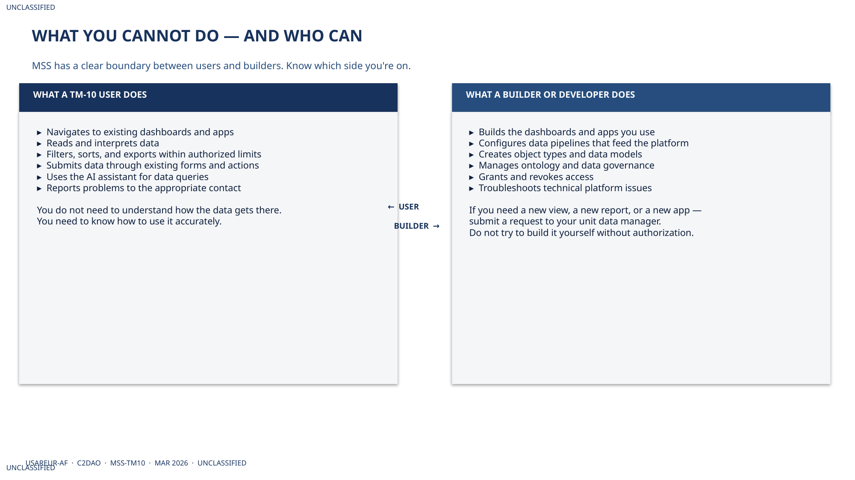
UNCLASSIFIED
MSS PLATFORM OVERVIEW · TM-10 · TM-10 User
UNCLASSIFIED

Slide 11
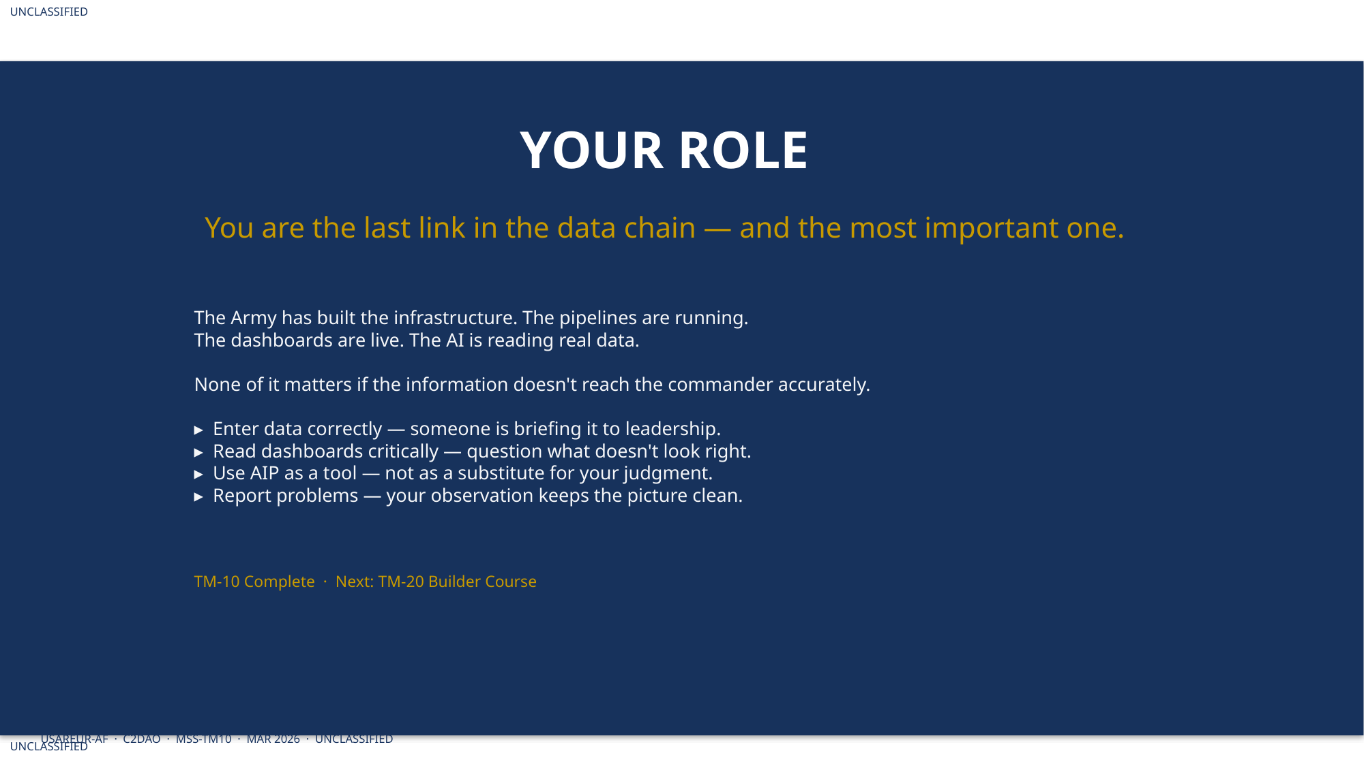
UNCLASSIFIED
MSS PLATFORM OVERVIEW · TM-10 · TM-10 User
UNCLASSIFIED

