Slide 1

Fundamentals of Artificial Intelligence: Lab1
Dr. Hatim Alsuwat

Slide 2
Lab1
Topics
Downloading python
2. Installing python
3. A Code Sample
Basic Data types
Getting the Data Type
Enough to Understand the Code
Adding Comments
Examples
Exercises

Slide 3
Lab1
Topics
Downloading python
In class I will be using python.
To download python please visit this link:
https://www.python.org/downloads/

Slide 4
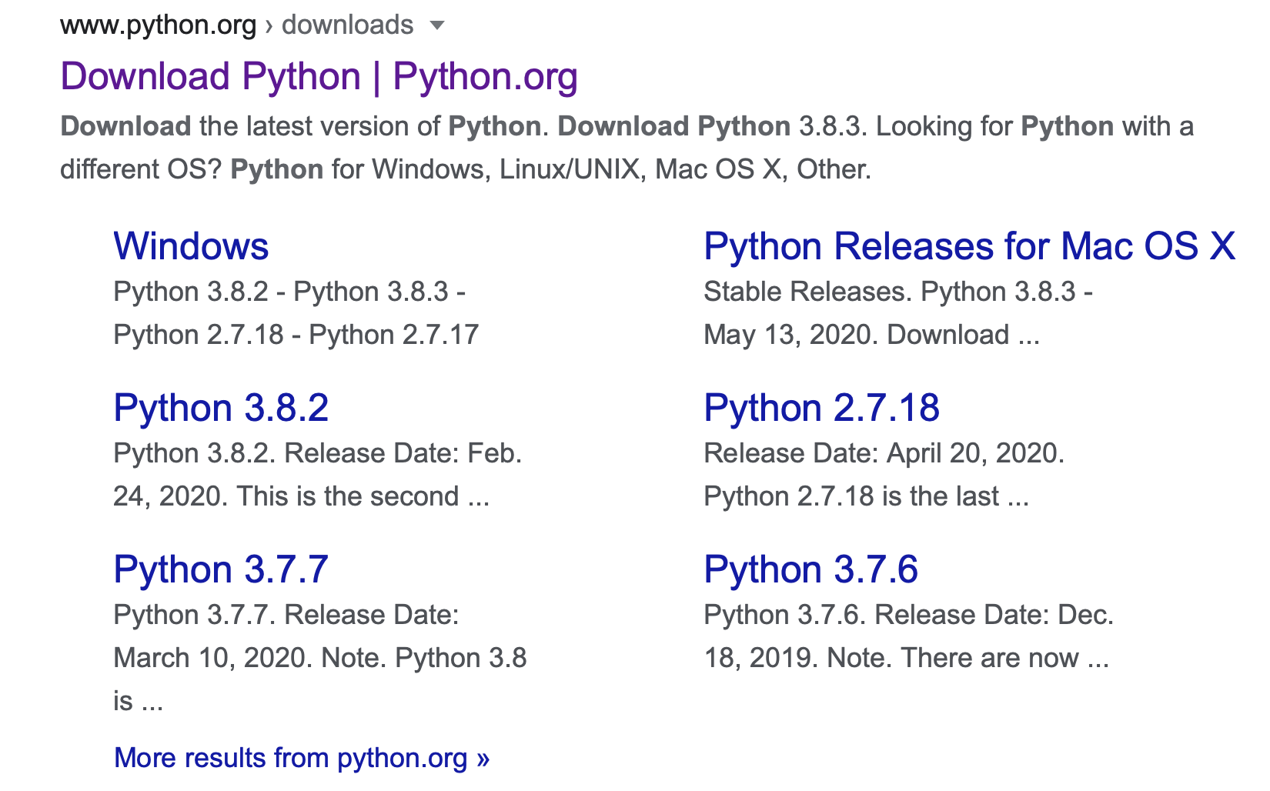
Lab1
Topics
Downloading python

Slide 5
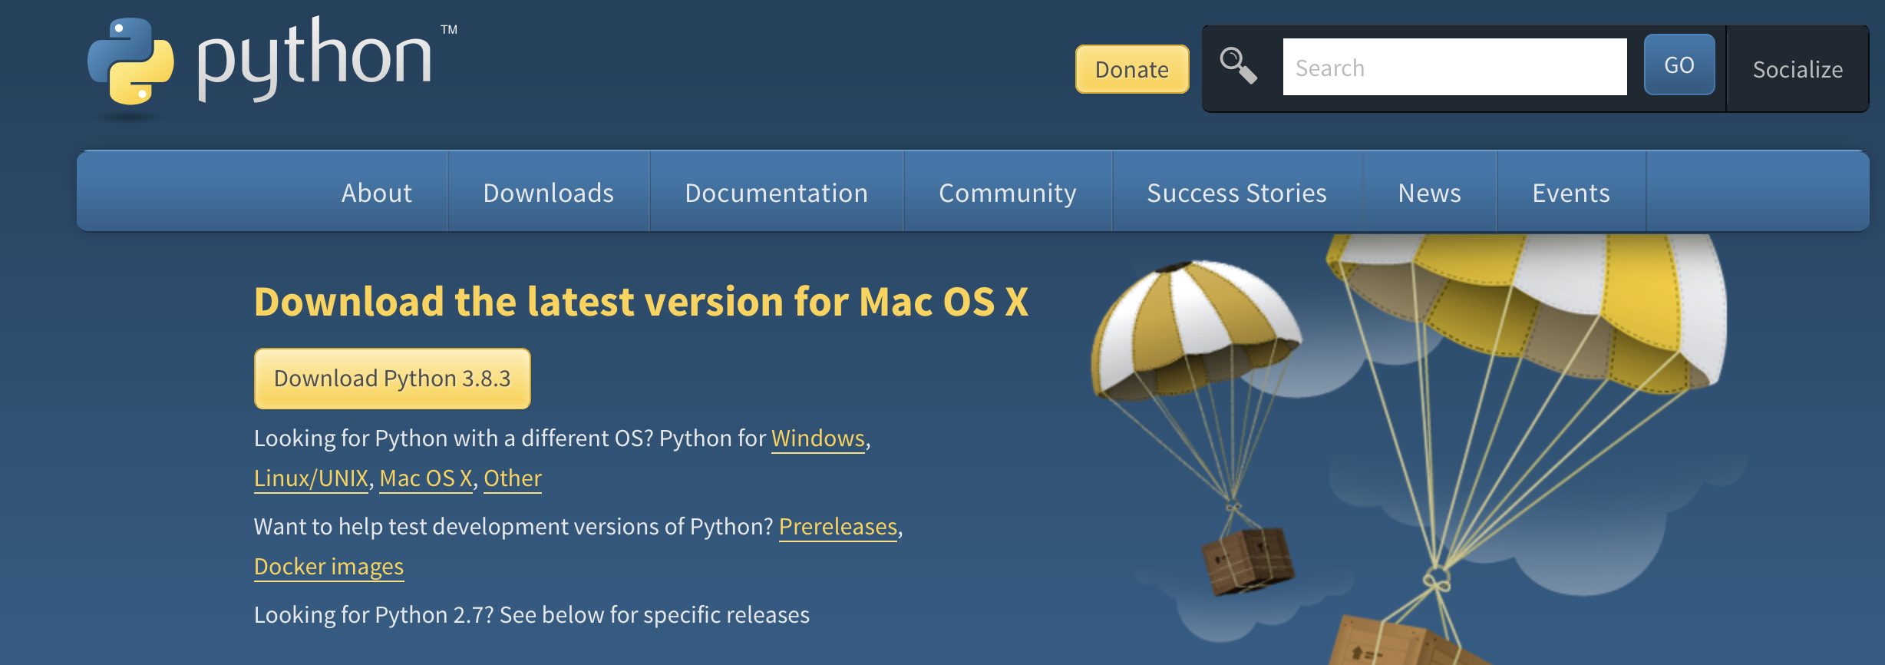
Lab1
Topics
2. Installing python

Slide 6
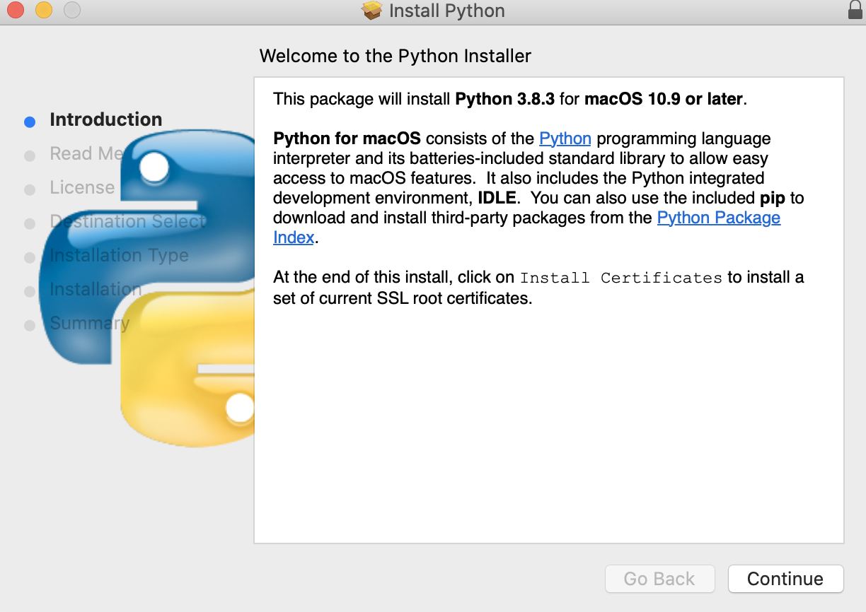
Lab1
Topics
2. Installing python

Slide 7
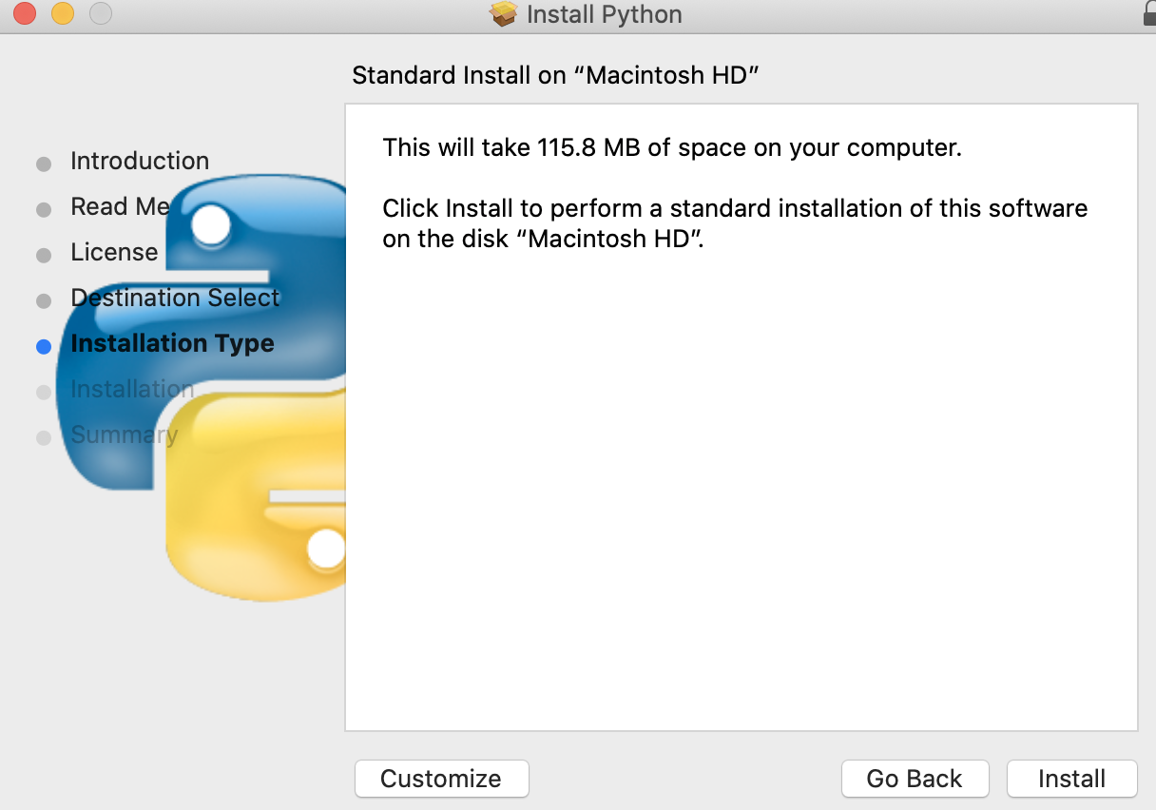
Lab1
Topics
2. Installing python

Slide 8
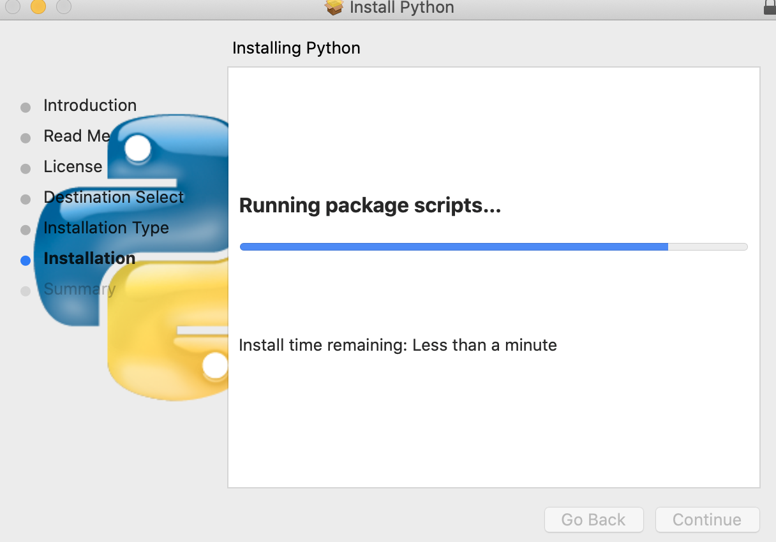
Lab1
Topics
2. Installing python

Slide 9
Lab1
Topics
2. Installing python

Slide 10
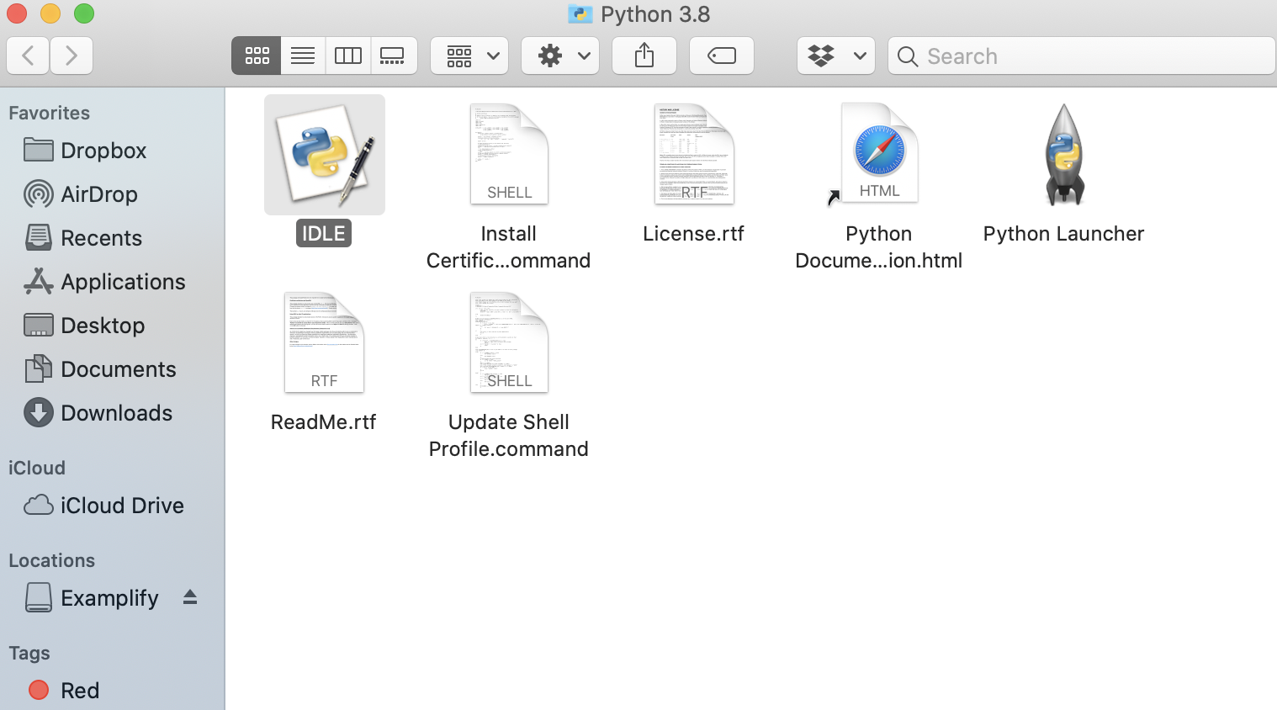
Lab1
Topics
2. Installing python

Slide 11
Lab1
The Basics
3. A Code Sample
x = 34 - 23 # A comment.
y = “Hello” # Another one.
z = 3.45 if z == 3.45 or y == “Hello”:
x=x+1
y = y + “ World” # String concat.
print x
print y

Slide 12
Lab1
The Basics
4. Basic Data types
Integers (default for numbers)
z = 5 / 2 # Answer is 2, integer division.
Floats
x = 3.456
Strings
Can use “ ” or ‘ ’ to specify.
“abc” ‘abc’ (Same thing.)
Example:
x = "John" # is the same as x = 'John'

Slide 13
Lab1
The Basics
4. Basic Data types
Text Type: | str
Numeric Types: | int, float, complex
Sequence Types: | list, tuple, range
Mapping Type: | dict
Set Types: | set, frozenset
Boolean Type: | bool
Binary Types: | bytes, bytearray, memoryview

Slide 14
Lab1
The Basics
5. Getting the Data Type
You can get the data type of any object by using the type() function:
Example:
x = 5 print(type(x))
Output
<class ’int’>

Slide 15
Lab1
The Basics
Try yourself
Exercise:
a = 6 b = 10.8 c = 1h
d = "Hello World”
e = [”car", ”door", ”food"]
f = (”car", ”door", ”food")
g = range(6)
h = {”car", ”door", ”food"}
x = False
Print the data type of the variable a, b, c, d, e, f, g, h and x.

Slide 16
Lab1
The Basics
6. Enough to Understand the Code
Assignment uses = and comparison uses ==.
For numbers + - * / % are as expected.
Special use of + for string concatenation.
Special use of % for string formatting (as with printf in C)
Logical operators are words (and, or, not) not symbols
The basic printing command is print.
The first assignment to a variable creates it.
Variable types don’t need to be declared.
Python figures out the variable types on its own.

Slide 17
Lab1
The Basics
6. Enough to Understand the Code
Example:
x = 4 # x is of type int x = "Sally" # x is now of type str print(x)

Slide 18
Lab1
Topics
7- Adding Comments
The symbol # is used for indicating a comment line.
Start comments with # – the rest of line is ignored.
Example:
Output:
x = 23 # A comment. Print(x)
23

Slide 19
Lab1
Topics
8- Examples:
Q: Write a program that accepts the first and last name from the user and print them in reverse order with a space between them.

Slide 20
Lab1
Topics
8- Examples:
Q: Write a program that asks the user for a number. Depending on whether the number is even or odd, print out an appropriate message to the user.

Slide 21
Lab1
Topics
9- Exercises:
Q: Write a program that asks the user to enter their name and their age. Print out a message addressed to them that tells them the year that they will turn 90 years old.

Slide 22
Lab1
Topics
9- Exercises:
Q: Print the following pattern:
1
1 2
1 2 3
1 2 3 4
1 2 3 4 5

