Slide 1

Python Dictionary, Stacks and Queues
Dr. Hatim Alsuwat
October 10,2020

Slide 2
Dictionaries
Dictionaries are similar to lists, but with a different index system. The elements of a dictionary are stored using a key-value system.
A key is used similarly to the indices of a list, but it must be of any immutable type.
A value is simply the element associated with that key and can be anything.
This means that dictionaries are useful for storing elements best identified by a description or name rather than a strict order.

Slide 3
How to Create a Dictionary in Python
Creating a dictionary is as simple as placing items inside curly braces {} separated by commas.
An item has a key and a corresponding value that is expressed as a pair
(key : value).
While the values can be of any data type and can repeat, keys must be of immutable type (string, number or tuple with immutable elements) and must be unique.

Slide 4
How to Create a Dictionary in Python
Example
>>> dict1= {'name':'Hatim', 'address':'Makkah', 'year': 2020} # dictionary with string keys
>>> dict1
{'name': 'Hatim', 'address': 'Makkah', 'year': 2020}
dict2= {1:2, 3:4, 5:1} # dictionary with integer keys
>>> dict2
{1: 2, 3: 4, 5: 1}
>>> dict3={ 'name’: 'Ahmed', 1:[12,13,14]} # dictionary with mixed keys
>>> dict3
{'name': 'Ahmed', 1: [12, 13, 14]}
>>> dict1= dict({'name':'Hatim', 'address':'Makkah', 'year': 2020}) #another way of making a dict.
>>> dict1
{'name': 'Hatim', 'address': 'Makkah', 'year': 2020}
dict4= dict([(1, 'apple'), (2,’grape’)]) #another way of making a dict.
>>> dict4
{1: 'apple', 2: ‘grape'}

Slide 5
Accessing Elements from Dictionary
While indexing is used with other data types to access values, a dictionary uses keys. Keys can be used either inside square brackets [] or with the get() function.
If we use the square brackets [], KeyError is raised in case a key is not found in the dictionary.
On the other hand, the get() function returns None if the key is not found.

Slide 6
Accessing Elements from Dictionary
Example
>>> dict1= {'name’:’Ali', ‘age’: 25}
>>> dict1
{'name': ‘Ali', ‘age’: 25}
>>> dict1[‘name’]
'Ali’
>>> dict1.get('age')
25
>>> dict1['address']
Traceback (most recent call last):
File "<pyshell#17>", line 1, in <module>
dict1['address']
KeyError: 'address’
>>> print(dict1.get('address'))
None

Slide 7
Changing and Adding Dictionary Elements
Dictionaries are mutable.
We can add new items or change the value of existing items using an assignment = operator.
If the key is already present, then the existing value gets updated.
In case the key is not present, a new (key: value) pair is added to the dictionary.

Slide 8
Changing and Adding Dictionary Elements
Example
>>> dict1= {'name’:’Ali', ‘age’: 25}
>>> dict1
{'name': ‘Ali', ‘age’: 25}
>>> dict1['age']=27
>>> dict1
{'name': 'Ali', 'age': 27}
>>> dict1['address']='Makkah' #adding a new item
>>> dict1
{'name': 'Ali', 'age': 27, 'address': 'Makkah'}

Slide 9
Removing Elements from Dictionary
We can remove a particular item in a dictionary by using the pop() method.
The pop() method removes an item with the provided key and returns its value.
The popitem() method can be used to remove and return an arbitrary (key, value)item pair from the dictionary.
All the items can be removed at once, using the clear() method.
We can also use the del keyword to remove individual items or the entire dictionary itself.

Slide 10
Removing elements from Dictionary
Example
>>> dict1= {'name’:’Ali', ‘age’: 27, 'address': 'Makkah}
>>> dict1
{'name': 'Ali', 'age': 27, 'address': 'Makkah’}
>>> print(dict1.pop('age’)) # remove a particular item, returns its value
27
>>> print(dict1.popitem()) # remove an arbitrary item, return (key,value)
('address', 'Makkah’)
>>> dict1
{'name': 'Ali’}

Slide 11
Removing elements from Dictionary
Example
>>> dict1.clear()
>>> dict1
{}
>>> del dict1
>>> dict1
Traceback (most recent call last):
File "<pyshell#35>", line 1, in <module>
dict1
NameError: name 'dict1' is not defined

Slide 12
Stacks
Stacks, like the name suggests, follow the Last-in-First-Out (LIFO) principle
A stack is a collection of objects that supports fast last-in, first-out (LIFO)semantics for inserts and deletes.
The insert and delete operations are also often called push and pop.

Slide 13
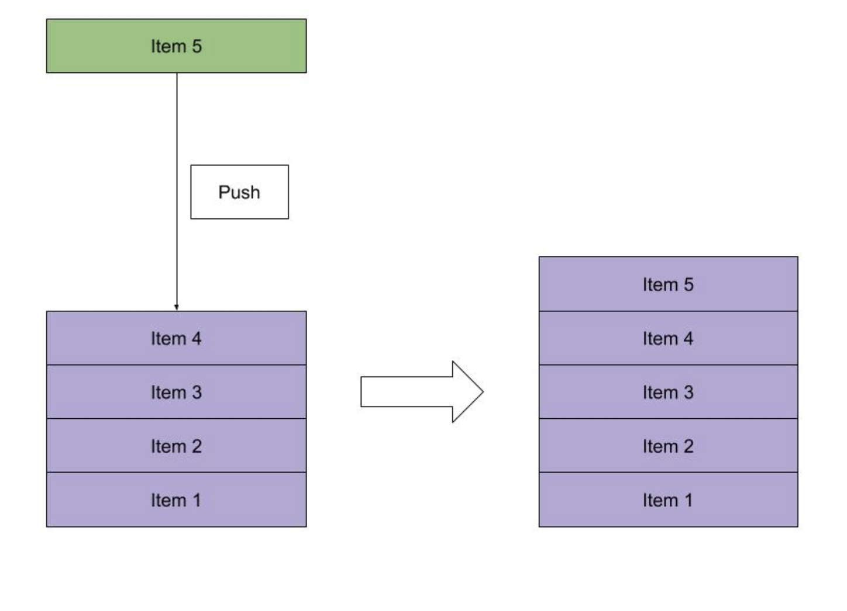
Stacks
push - adds an element to the top of the stack:

Slide 14
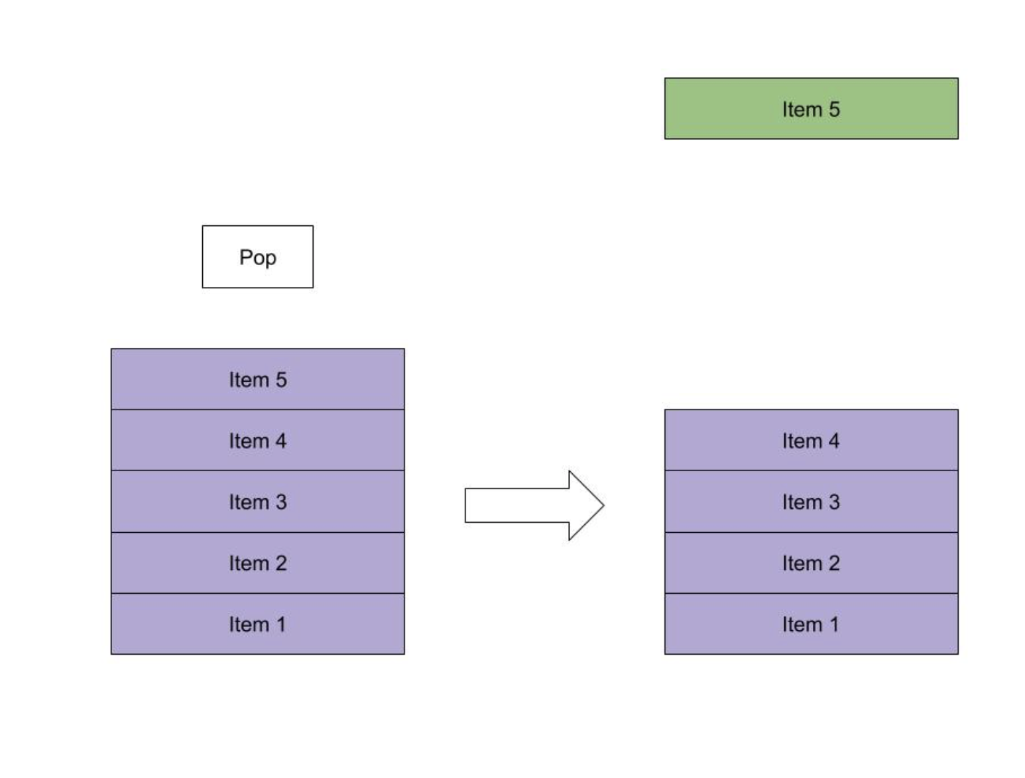
Stacks
pop - removes the element at the top of the stack:

Slide 15
Stacks
Queues, like the name suggests, follow the First-in-First-Out (FIFO) principle.
As if waiting in a queue for the Disney World tickets, the first one to stand in line is the first one to buy a ticket.
The insert and delete operations are also often called enqueue and dequeue.

Slide 16
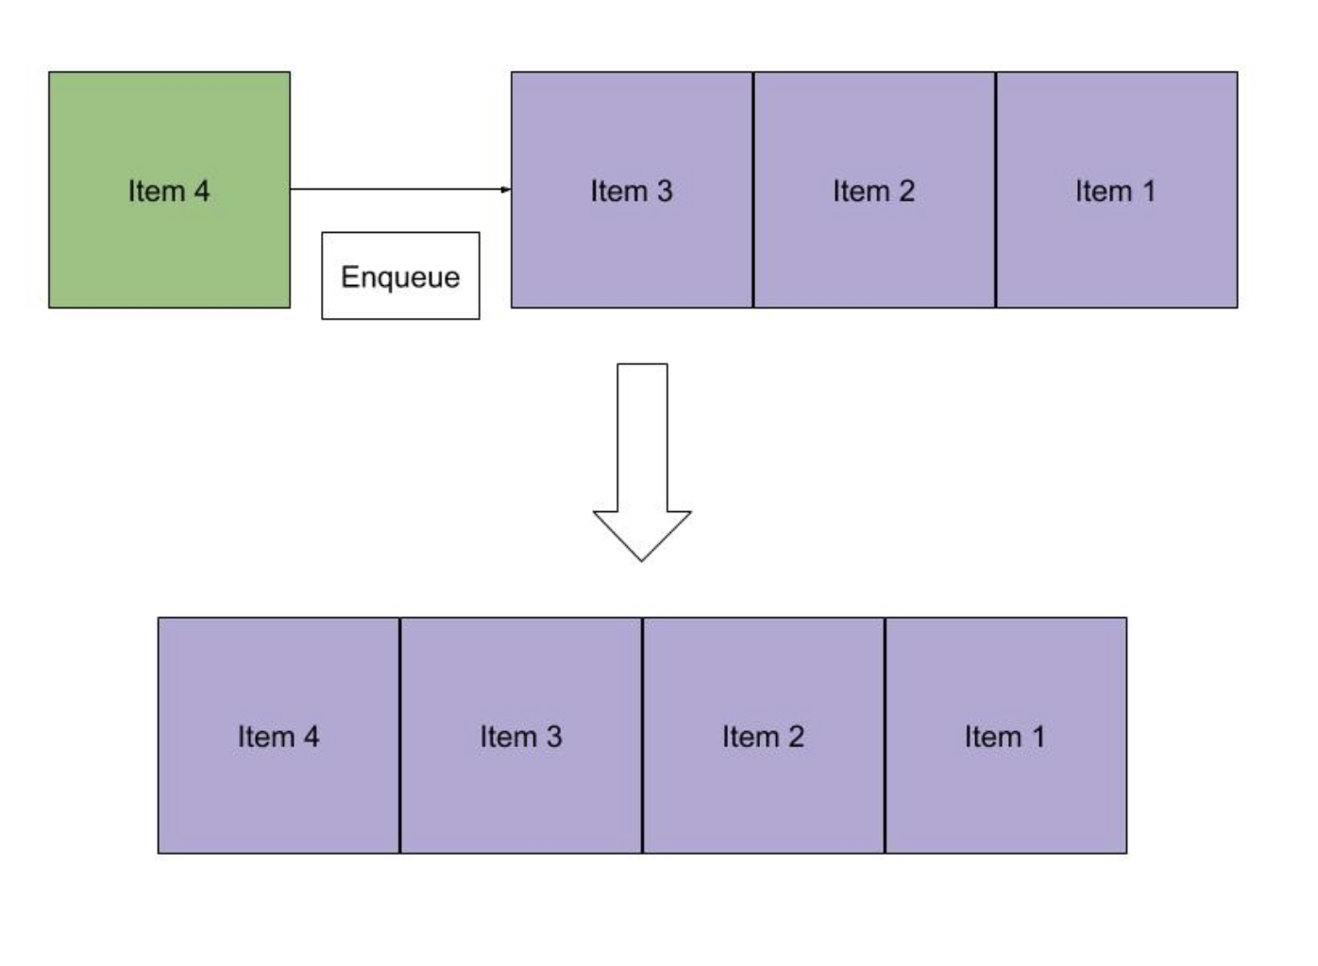
Stacks
enqueue - adds an element to the end of the queue:

Slide 17
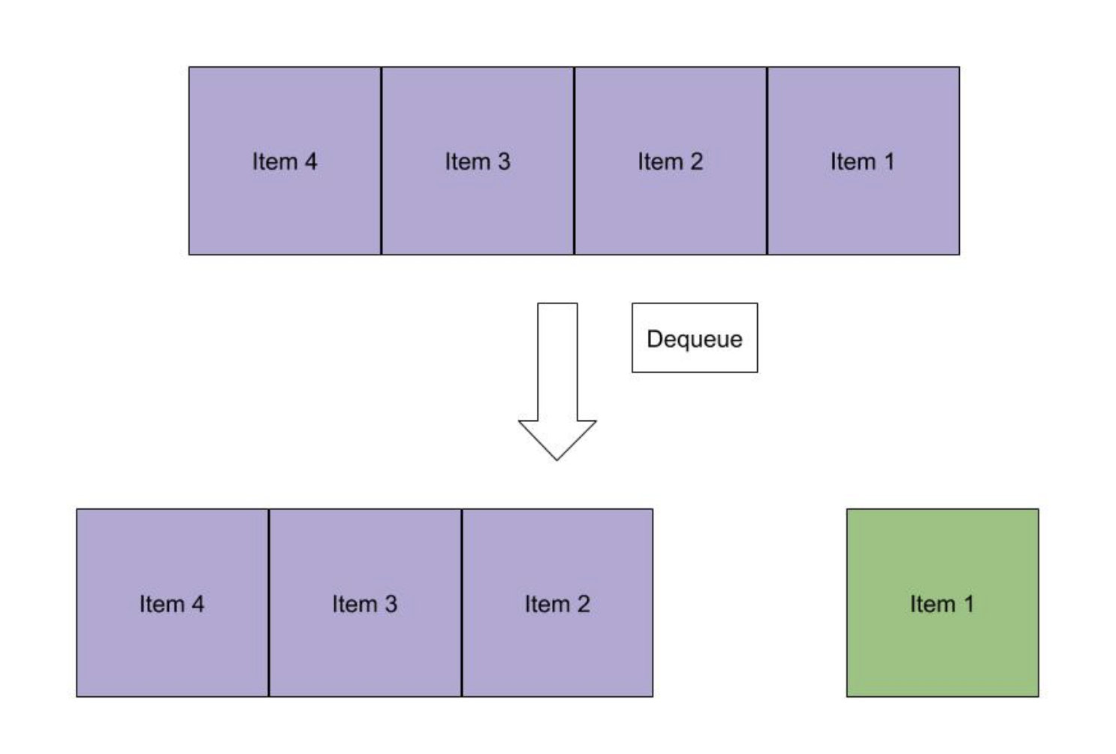
Stacks
dequeue - removes the element at the beginning of the queue:

