Slide 1
CRYPTOGRAPHY
One Time Pad (OTP)
Dr. Emad Alsuwat

Slide 2
One Time Pad (OTP)
Vigener cipher is a bit better solution than Caesar cipher but again
there is information leaking ...
It was first constructed by Frank Miller in 1882
→ intuition: let’s use as many letters in the key as the length of the plaintext
→ but then we can use frequency analysis on the ciphertext because
english letters have a well-known distribution
→ solution: let’s use totally random numbers to shift the letters in the plaintext
~ the key must have the same size as the plaintext
+ key must contain random numbers
WE CAN ELIMINATE INFORMATION LEAKING WITH RANDOM NUMBERS

Slide 3
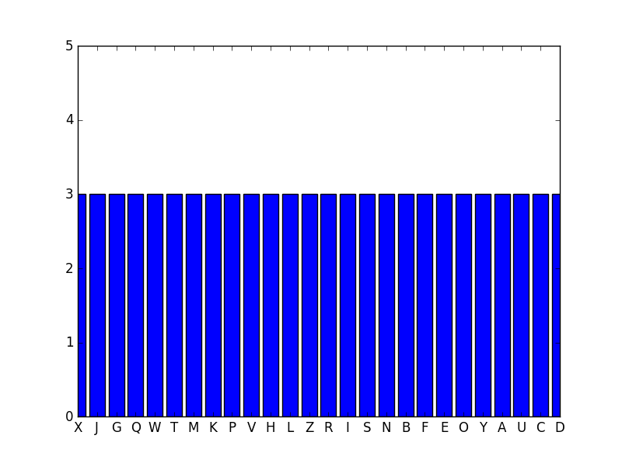
One Time Pad (OTP)
Algorithm:
1.) generate a truly random sequence (as many random numbers as the letters in the plaintext)
DO NOT REUSE THE SAME NUMBERS OVER AN OVER AGAIN
~ the private key is used one time as well (it is not reused for other messages)
2.) shift the letters in the plaintext with the random numbers in the same manner
as in Vigenere cipher or Caesar cipher
What will happen if we analyze the ciphertext with Kasiski-method?
→ there is no information leaking because every
letter in the ciphertext is equally likely
RANDOM NUMBERS CAN ELIMINATE INFORMATION LEAKING

Slide 4
One Time Pad (OTP)
EXAMPLE
Originally one time pad algorithm used XOR operation so first
we consider the binary representation
we find the ASCII value for every letter in the text
→ then we convert the decimal value into binary
For example: character a has the ASCII value 97. So what is the binary
representation of 97? It is 01100001
0
1
2
3
4
5
6
7
01100001 = 1x2 + 0x2 + 0x2 + 0x2 + 0x2 + 1x2 + 1x2 + 0x2 = 97

Slide 5
One Time Pad (OTP)
„XOR is an involution so
the function’s inverse is
the function itself”
EXAMPLE
Originally one time pad algorithm used XOR operation so first
we consider the binary representation
we find the ASCII value for every letter in the text
output is 0 or 1
with 50% probability
→ then we convert the decimal value into binary
So we want to shift every letter in the plaintext which means addition
Addition is the same as bitwise XOR (if there are no carry bits)
x
y
x XOR y
0
0
For example: let’s use XOR to add 16 and 10
0
0
1
2
3
4
5
6
7
0
1
1
00010000 = 0x2 + 0x2 + 0x2 + 0x2 + 1x2 + 0x2 + 0x2 + 0x2 = 16
0
1
2
3
4
5
6
7
00001010 = 0x2 + 1x2 + 0x2 + 1x2 + 0x2 + 0x2 + 0x2 + 0x2 = 10
1
0
1
00010000 | 00001010 = 00011010 = 26
1
1
0

Slide 6
One Time Pad (OTP)
EXAMPLE
Plaintext: HELLO
Key: 11001000001011101111011011000000

Slide 7
One Time Pad (OTP)
EXAMPLE
Plaintext: HELLO
Key: 11001000001011101111011011000000
1.) let’s convert the ASCII values of the letters into binary
72
69
76
76
79
H E L L O = 01001000010001010100110001001111
72 = 01001000
69 = 01000101
76 = 01001100
79 = 01001111

Slide 8
One Time Pad (OTP)
EXAMPLE
Plaintext: HELLO
Key: 11001000001011101111011011000000
2.) let’s do the XOR operation
01001000010001010100110001001111
11001000001011101111011011000000
XOR
10000000011010111011101010001111
This is the result of the XOR operation which means
this is the ciphertext !!!

Slide 9
One Time Pad (OTP)
EXAMPLE
Plaintext: HELLO
Key: 11001000001011101111011011000000
3.) because XOR operation’s inverse is XOR operation itself, we have to apply the same
transformation to get the plaintext again
10000000011010111011101010001111
11001000001011101111011011000000
XOR
01001000010001010100110001001111
This is how we get the plaintext from the ciphertext
with the same XOR operation

Slide 10
One Time Pad (OTP)
A B C D E F G H I J K L M N O P Q R S T U V W X Y Z
EXAMPLE
0
1
2
3
4
5
6
7
8
9
10
11
12
13
14
15
16
17
18
19
20
21
22
23
24
25
Plaintext: THIS IS JUST AN EXAMPLE
Random sequence: 49163259164381642843561
Ciphertext:
4
9
1
6
2
5
1
6
4
3
1
6
2
8
4
3
5
6
1
T H I S I S J U S T A N E X A M P L E
XQJY KX KAWW BT GFEPURF
E (x ) = (x + OTP ) mod 26
i
i
i
i

Slide 11
One Time Pad (OTP)
A B C D E F G H I J K L M N O P Q R S T U V W X Y Z
EXAMPLE
0
1
2
3
4
5
6
7
8
9
10
11
12
13
14
15
16
17
18
19
20
21
22
23
24
25
Ciphertext: XQJY KX KAWW BT GFEPURF
Random sequence: 49163259164381642843561
Plaintext: THIS IS JUTS AN EXAMPLE
4
9
1
6
2
5
1
6
4
3
1
6
2
8
4
3
5
6
1
X Q J Y K X K A W W B T G F E P U R F
D (x ) = (x - OTP ) mod 26
i
i
i
i

Slide 12
One Time Pad (OTP)
The main problem as far as one time pad is concerned is how
to generate the random numbers
„Random number generation is the generation of sequence of numbers
that can not be reasonably predicted better than by a random chance”
TRUE RANDOM NUMBERS PSEUDO-RANDOM NUMBERS (fake randomness)
If we measure some physical phenomenon then
we end up with true random numbers
For example: radioactive decay or atmospheric noise
→ values have uniform distribution
→ the values are independent of each other
→ not so efficient: quite expensive to
generate (measure) these numbers
Instead of measuring some physical phenomenon, we
use computers to generate random numbers
PROBLEM: computers are deterministic !!!
→ values have uniform distribution
→ values are NOT independent of each other
→ there are efficient algorithms to generate
these pseudo-random values

Slide 13
One Time Pad (OTP)
Pseudo-random numbers can repeat themself: so they may become quite predictable
~ which means the one-time-pad is no more secure
THE SECURITY OF ONE TIME PADS RELY ON PSEUDO-RANDOM NUMBERS
Computers are inherently deterministic so it is impossible to define
algorithms to generate true random numbers. But we can generate
pseudo-random numbers with these algorithms:
1.) middle-square method
2.) Mersenne twister
3.) linear congruential generators

Slide 14
One Time Pad (OTP)
MIDDLE-SQUARE METHOD
The input of the algorithm is a seed: because computers are programmed to
execute well-defined operations, it’s impossible to generate random numbers
→ but we can define algorithms to mimic randomness
~ these are the pseudo-random numbers
→ the initial position (this is the seed) determines the sequence itself
It was invented by
John von Neumann in 1949
The seed should be a truly random number: measurement of noise or
current time in milliseconds
THE SEED IS THE INPUT OF A SIMPLE CALCULATION
ALGORITHM: 1.) multiply the seed by itself
2.) get the middle of the result
3.) the result is the seed in the next iteration
The randomness of the sequence depends on the randomness of the seed exclusively

Slide 15
One Time Pad (OTP)
MIDDLE-SQUARE METHOD
ALGORITHM: 1.) multiply the seed by itself
2.) get the middle of the result
3.) the result is the seed in the next iteration

Slide 16
One Time Pad (OTP)
MIDDLE-SQUARE METHOD
ALGORITHM: 1.) multiply the seed by itself
2.) get the middle of the result
3.) the result is the seed in the next iteration
seed: 152

Slide 17
One Time Pad (OTP)
MIDDLE-SQUARE METHOD
ALGORITHM: 1.) multiply the seed by itself
2.) get the middle of the result
3.) the result is the seed in the next iteration
seed: 152
152 x 152 = 23104

Slide 18
One Time Pad (OTP)
MIDDLE-SQUARE METHOD
ALGORITHM: 1.) multiply the seed by itself
2.) get the middle of the result
3.) the result is the seed in the next iteration
seed: 152
152 x 152 = 23104
310

Slide 19
One Time Pad (OTP)
MIDDLE-SQUARE METHOD
ALGORITHM: 1.) multiply the seed by itself
2.) get the middle of the result
3.) the result is the seed in the next iteration
seed: 310
310 x 310= 96100
310

Slide 20
One Time Pad (OTP)
MIDDLE-SQUARE METHOD
ALGORITHM: 1.) multiply the seed by itself
2.) get the middle of the result
3.) the result is the seed in the next iteration
seed: 310
310 x 310= 96100
310610

Slide 21
One Time Pad (OTP)
MIDDLE-SQUARE METHOD
ALGORITHM: 1.) multiply the seed by itself
2.) get the middle of the result
3.) the result is the seed in the next iteration
seed: 610
610 x 610= 372100
310610

Slide 22
One Time Pad (OTP)
MIDDLE-SQUARE METHOD
ALGORITHM: 1.) multiply the seed by itself
2.) get the middle of the result
3.) the result is the seed in the next iteration
seed: 610
610 x 610= 372100
310610210

Slide 23
One Time Pad (OTP)
MIDDLE-SQUARE METHOD
It is a pseudo-random number sequence: so first problem is that if we
know the initial seed, we can reproduce the sequence
→ if the algorithm reaches a seed it previously used then
the sequence keeps repeating itself
→ this is called the period: the length before a pseudo-random
sequence repeats
→ the period depends on the initial seed exclusively
2 digits seed: algorithm uses at most 100 digits before reusing the seed
3 digits seed: algorithm uses at most 1000 digits before reusing the seed
.
.
N digits seed: algorithm uses 10 digits before reusing the seed
N

Slide 24
One Time Pad (OTP)
MIDDLE-SQUARE METHOD
So if we use a pseudo-random numbers, there are many
sequences that can not occur
→ by using pseudo-random numbers, the key-space is
reduced to a much smaller seed-space
→ which means the one time pad is not that secure any more

Slide 25
One Time Pad (OTP)
LINEAR CONGRUENTIAL GENERATOR
X = ( a X + c ) mod m
n+1
n
as usual we have to define a seed which is the X
the values of the parameters a, c and m determine the period
0

Slide 26
One Time Pad (OTP)
Caesar cipher’s keyspace = 26
Vigenere cipher’s keyspace = 26
One time pad’s keyspace = 26
SIZE OF THE KEY
SIZE OF THE PLAINTEXT
In theory it is impossible to break a one time pad BUT:
→ generating perfectly random numbers (as keys) is extremely hard
~ almost impossible to get truly random numbers with computers
(random sequence with small period: Vigenere-cipher)
→ the key has the same length as the plaintext: if we are able to exchange this key
securely then why not to exchange the plaintext itself?

Slide 27
One Time Pad (OTP)
We are not able to break one time pad with brute-force approach
M {0,1}
C {0,1}
Because the size of the message space |M| is the same as
the size of the ciphertext space |C| it means perfect secrecy
SHANNON’S PERFECT SECRECY
n
n
P(M=m|C=c) = P(M=m)
message space
ciphertext space
perfect secrecy is when |M| = |C|
we are not able to use brute-force approach because we will find all the valid plaintexts
~ which contains every valid words and sentences in english
How to decide what was the original message?

