Slide 1
EYE BLINK DETECTION
HATLIN JOHEIT J A
22PDS807

Slide 2
CONTENT
Introduction
Company Profile
Description of the training programme
Technology Adopted
Problem Statement
Background work
Project Screenshots

Slide 3
INTRODUCTION
The human eye is a fascinating organ that performs vital functions in our daily lives. One of the intriguing aspects of the eye is the natural phenomenon of blinking, which involves the closure and subsequent opening of the eyelids. Blinking serves multiple purposes, including lubricating the eyes, protecting them from foreign particles, and maintaining visual clarity.
In recent years, eye blink detection has gained significant attention in various fields, ranging from driver drowsiness detection to human-computer interaction systems. The ability to accurately and efficiently detect eye blinks has important implications for improving safety, user experience, and overall performance in these domains.

Slide 4
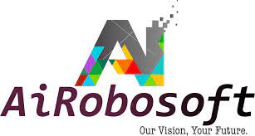
COMPANY PROFILE
AiRobsoft is an Bangalore based IT firm Leading a team of Data Scientist, Robotics & Electronics Engineers, experts in Machine Learning and more,
collaborated together to work on fascinating futuristic technologies.
Website : http://www.airobosoft.com
Industry : IT Services and IT Consulting
Company size : 51-200 employees
169 on LinkedIn
Includes members with current employer listed as AiROBOSOFT Products And Services, including part-time roles.
Headquarters : Bengaluru, Karnataka
Specialties : Robotics, Artificial intelligence, Machine Learning, IOT, and Software development
LinkedIn Profile link : https://www.linkedin.com/company/airobosoft-products-and-services/about/

Slide 5
DESCRIPTION OF THE TRAINING PROGRAMME
AiRoboSoft is a leading technology company based in Bangalore, India, specializing in the development and deployment of artificial intelligence (AI) and robotic software solutions. The company offers a comprehensive training program designed to equip individuals and organizations with the necessary skills and knowledge to effectively utilize their products and services.
The training program provided by AiRoboSoft encompasses a range of topics related to AI, Machine Learning, robotics, and software development.

Slide 6
TOPICS
Python 3 version, Anaconda navigator installation.
Basics of python
Built-in expressions
List methods
Tuples
Dictionaries
Iterators and Generators
Object oriented programme and file input/output
Modules and packages
Errors and Exception Handling
Database connectivity and operations using python

Slide 7


TECHNOLOGY ADOPTED
PyCharm
PyCharm is an integrated development environment used for programming in Python.
It provides code analysis, a graphical debugger, an integrated unit tester, integration
with version control systems, and supports web development with Django.
Anaconda Navigator
Anaconda Navigator is a desktop graphical user interface included in Anaconda that allows you to launch applications and easily manage conda packages, environments and channels without the need to use command line commands.

Slide 8
PROBLEM STATEMENT
The problem is to develop an eye blink detection system specifically designed for hospitalized patients. The system aims to monitor the blink patterns and frequency of patients, especially those who may be in critical conditions or have limited mobility. The detection of eye blinks can provide valuable insights into the patient's well-being, alertness, and overall health status.

Slide 9
BACKGROUND WORK
The Packages and libraries used for the development of the project is:
Face Recognition
Open CV
Dlib
Scipy
Pyttsx3
Imutils

Slide 10

PROJECT SCREENSHOTS

Slide 11
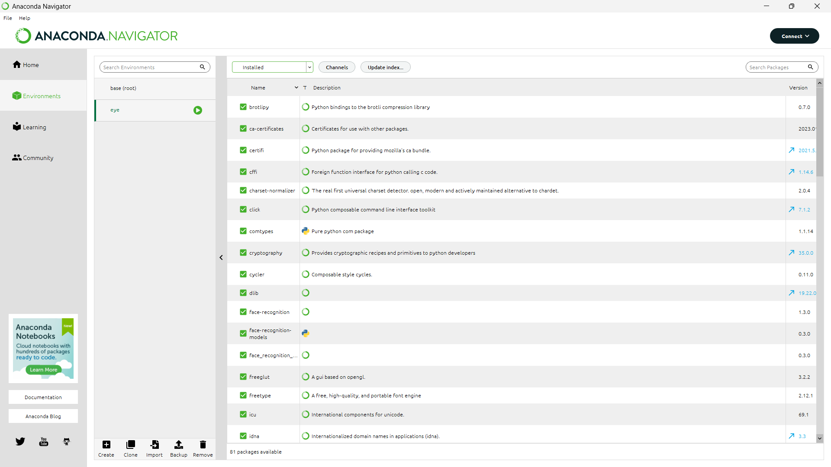

Slide 12
