Slide 1
Refinement Checking Implementation Correctness Simulation Relations Homomorphisms (whatever)
Ravi Hosabettu (Univ. of Utah) [thanks!]
Ganesh Gopalakrishnan (Univ. of Utah)
Mandayam Srivas (SRI International) [thanks!]

Slide 2
Where are we today?

Slide 3
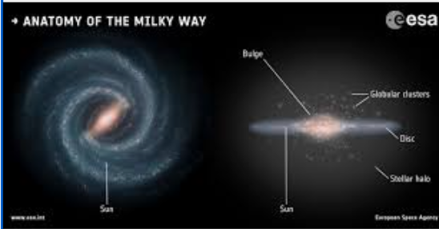
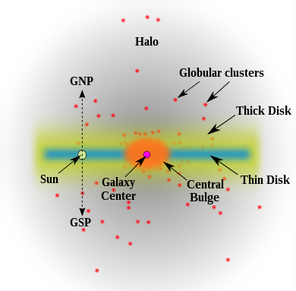
Where are we today? (fun to follow the JWST news…to feel suddenly good!). https://jwst.nasa.gov/ . Reading about their “salt lenses” was fun!

Slide 4
(more down-to-earth things now) Talk Organization
Motivation for studying implementation correctness in all its guises..
Completion Functions Approach
Key contribution of the talk
Detailed illustration
Conclusions

Slide 5
Motivations
Often, correctness is adherence to a more abstract specification
This notion recurs so much in formal verification that we have to be armed with a collection of techniques
In this talk I’ll present three methods:
Completion functions
Aggregation abstractions
Predicate abstraction

Slide 6
Motivations
The generality of these methods are (simply put) stunning!
Two examples from my readings in just the past week now follow

Slide 7
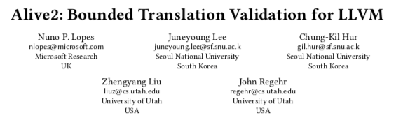
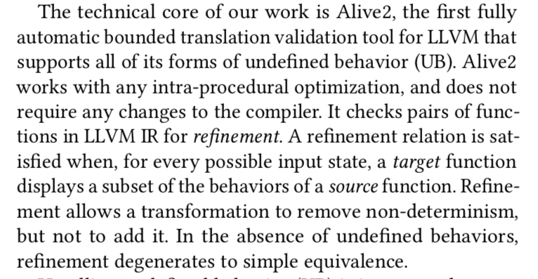
Alive2 (pldi’21) correctness
See how the paper introduces the problem

Slide 8
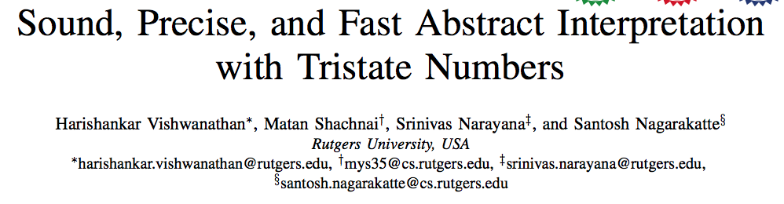
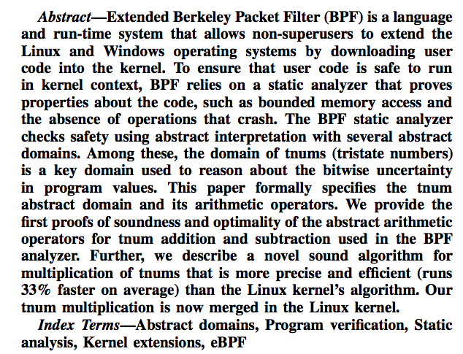
Tristate Values (cgo’22 best paper)

Slide 9
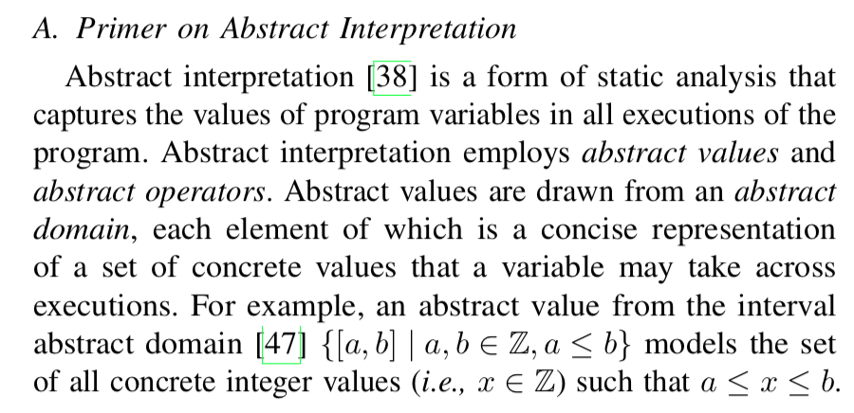
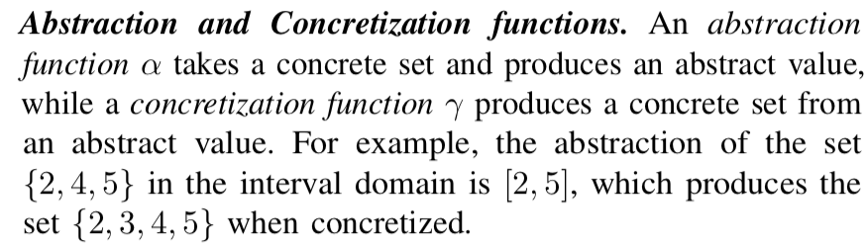
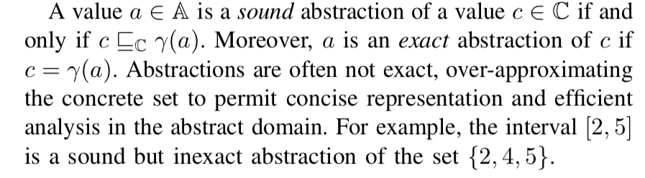
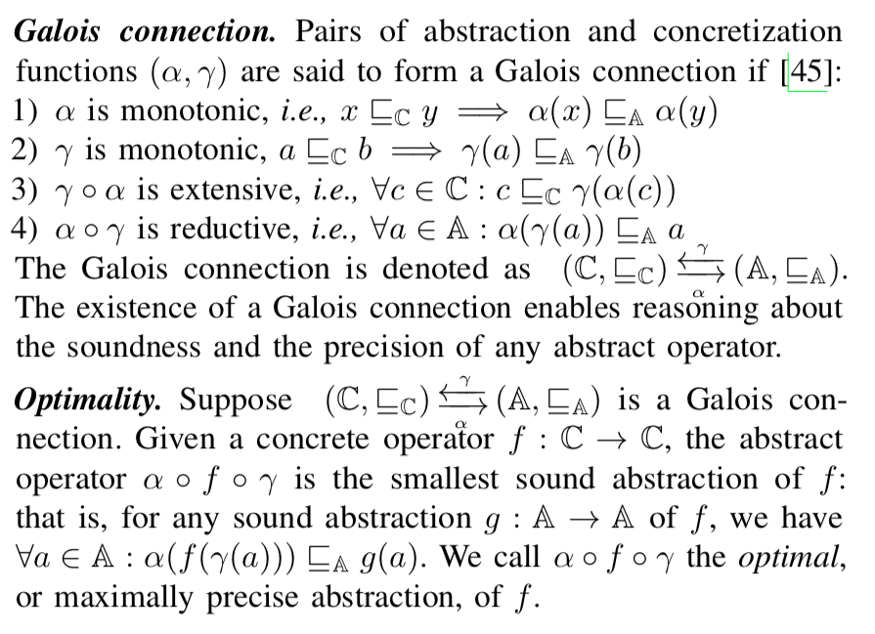
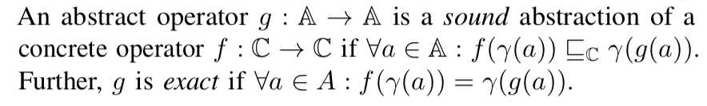

Slide 10
Motivations
In this talk I’ll present three methods:
Completion functions
Aggregation abstractions
Predicate abstraction

Slide 11
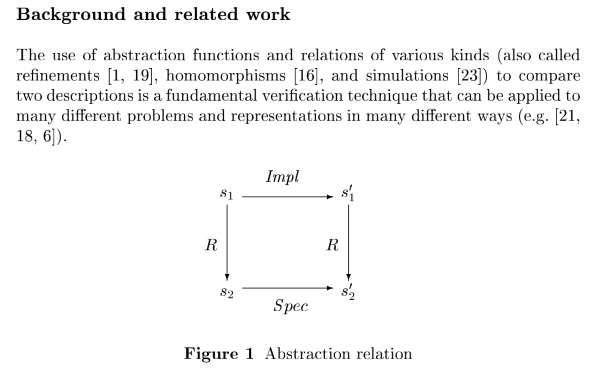
How can we model processor pipelining for FV?
The old idea for non-pipelined processors was the “standard commute diagram”;
but with pipelining, the operation boundaries are not “crisp” and rigid … things keep oozing along…

Slide 12
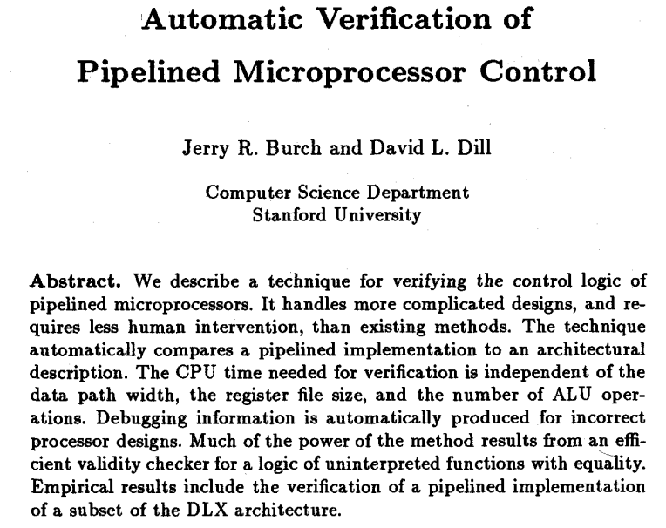
Burch and Dill 1994 introduced the idea of “flushing” – a breakthrough!
The new idea: let the implementation be in a ‘half-baked’ state. Flush it and project it; then claim as induction hypothesis that it matches the spec state. Then let the implementation process one more instruction. Now flush it and project it. As induction step, claim that the ”diagram now commutes!”

Slide 13
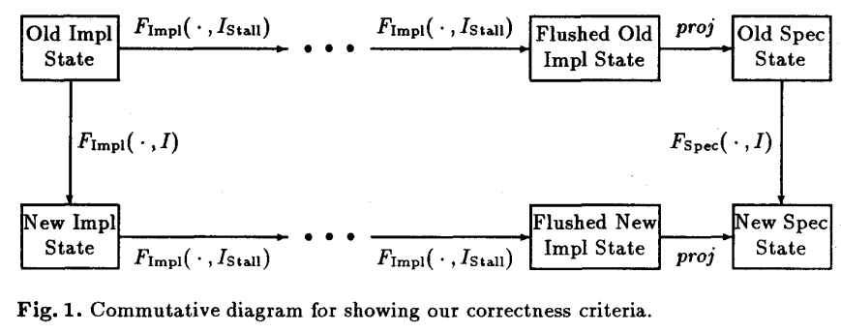
The new idea: let the implementation be in a ‘half-baked’ state. Flush it and project it; then claim as induction hypothesis that it matches the spec state. Then let the implementation process one more instruction. Now flush it and project it. As induction step, claim that the ”diagram now commutes!”

Slide 14
But ”flushing” was not incremental
Choked theorem provers
Did not provide a stage-wise proof
Bug-localization
Enter Ravi Hosabettu’s completion functions!
A “ladder commutes-diagram”!!

Slide 15
What are Completion Functions?
Desired effect of retiring an unfinished instruction in an atomic fashion
C_b
RF
a
b
c

Slide 16
Abstraction Function
Need to define an abstraction function
Flushing the pipeline
Our idea: Define abstraction function as a Composition of Completion Functions
Impl.
Machine
Step
Spec.
Machine
Step

Slide 17
Main Features
Decomposition into verification conditions
RF
C_a
C_b
C_c
a
b
c
L_ab
Abs. fn = C_a o C_b o C_c
One VC is: C_a == L_ab o C_b

Slide 18
Motivations
In this talk I’ll present three methods:
Completion functions
Aggregation abstractions
Predicate abstraction

Slide 19
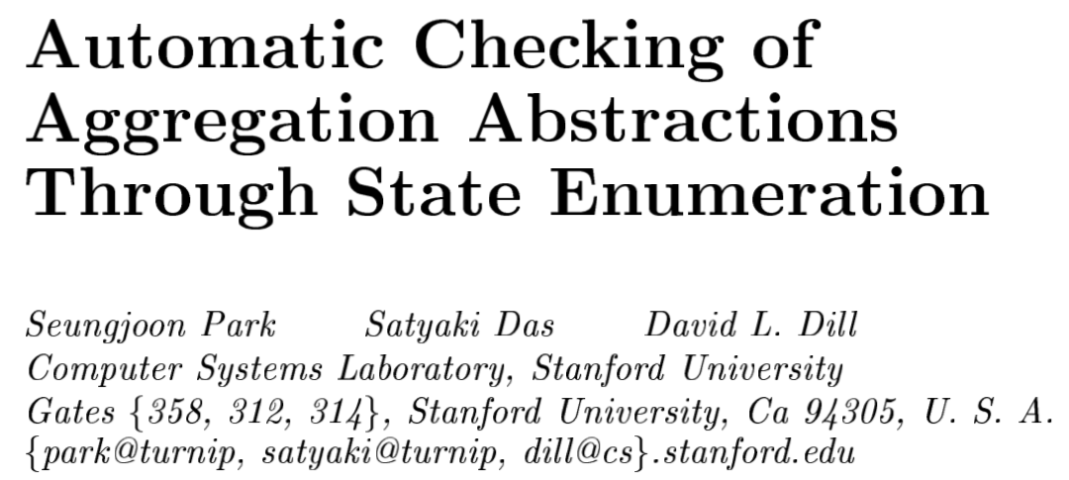

Slide 20
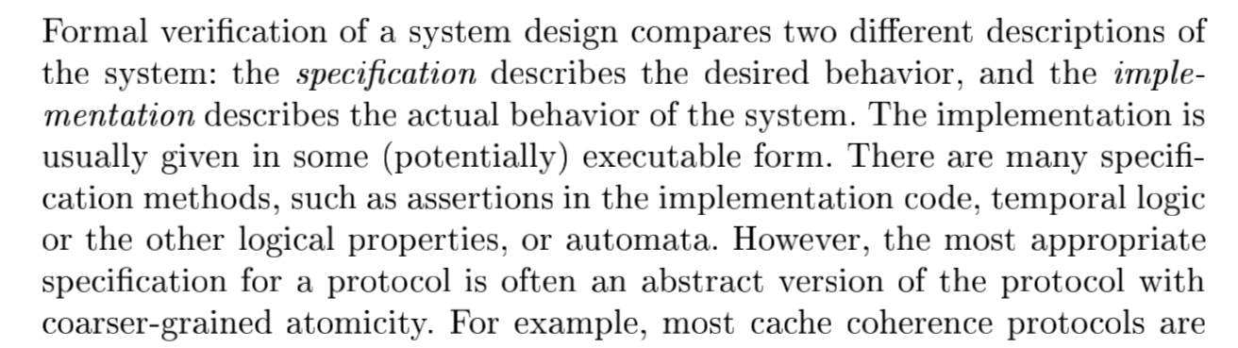

Slide 22
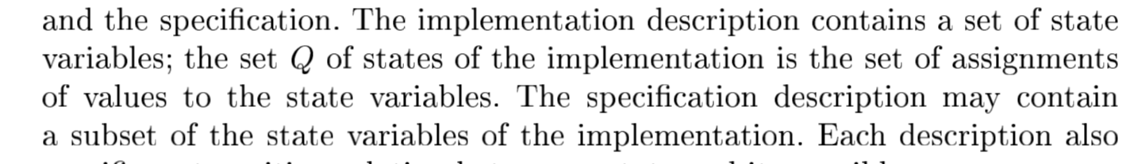
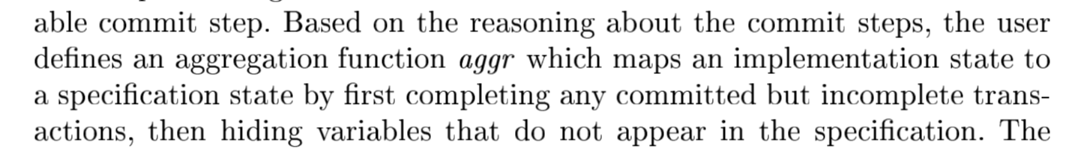

Slide 23
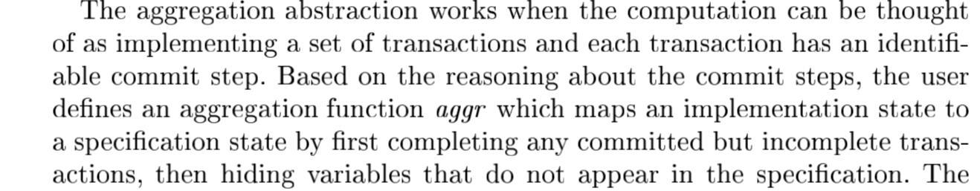
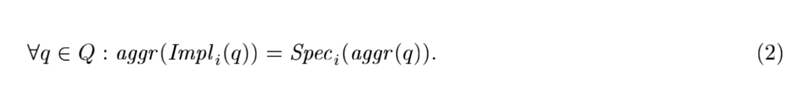
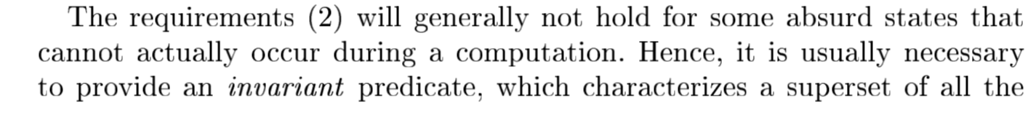

Slide 24
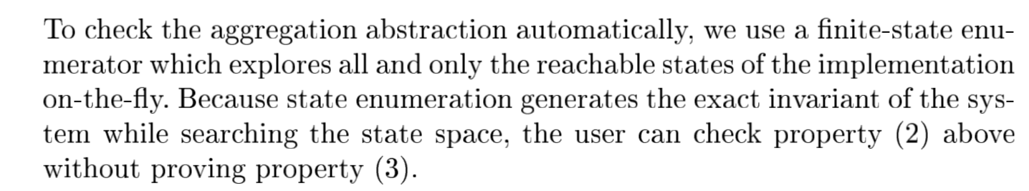
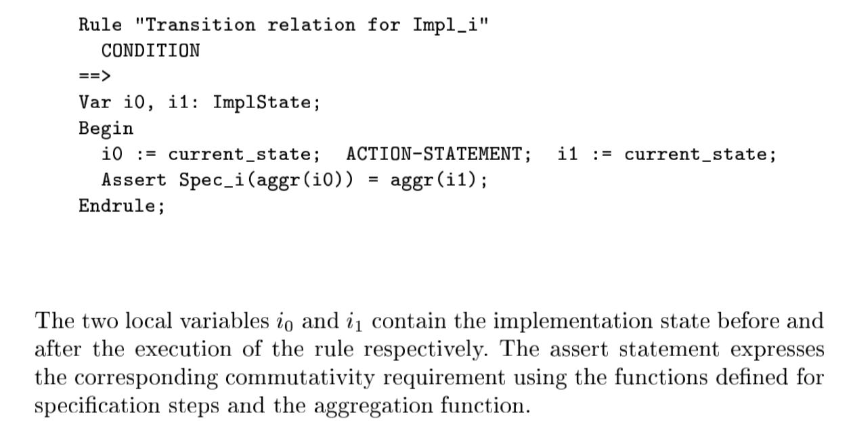

Slide 25
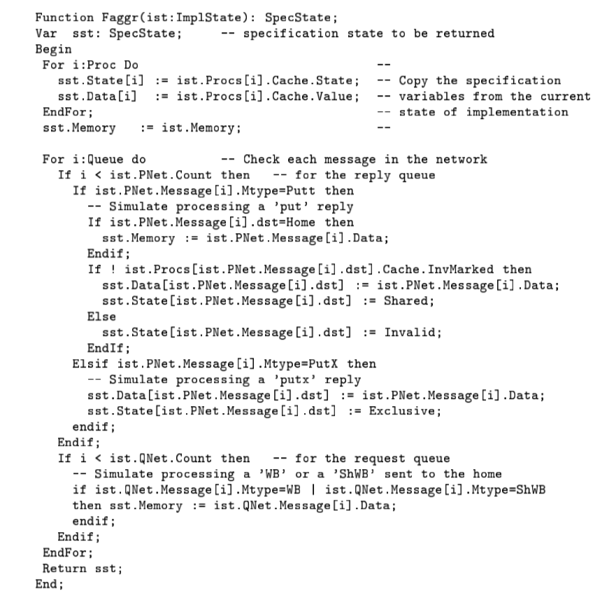

Slide 26
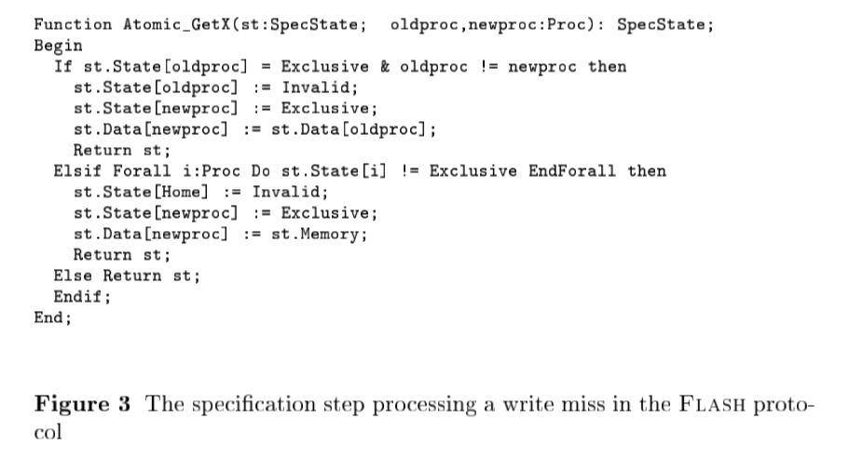

Slide 27
Motivations
In this talk I’ll present three methods:
Completion functions
Aggregation abstractions
Predicate abstraction

Slide 28
Predicate Abstraction
Method to compute Galois-Connections nicely using a bunch of predicates
The “shatter the mirror” analogy of Ashok Chandra (IBM)
Each mirror fragment is like an equivalence class under predicate abstraction
Graf and Saidi introduced Pred Abs
Das, Dill, Park explained it well!

Slide 29
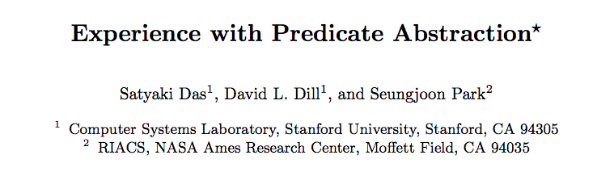
Predicate Abstraction using BDDs and SMT (cav’99 paper)

Slide 30
Predicate Abstraction Search (DDP)
Say a system has variable X,Y,Z over INT32, and say we want to observe the system via X<Y, X==Y+1, and X=Z-2 (p1,p2,p3 for now)
Form the 8 obvious truth-combinations of p1,p2,p3 (all Boolean cubes)
Each is like the ”Ashok Chandra Mirror Facet”
Say you are in facet 5 (p123 = 101)
A BDD path
Say you want to know what happens when we do
Atomic { X = Y ; Y = Z-1 ; Z = X+2 }
We do this
Concretize 101 into the pred combinations
Compute the strongest post-condition transformer … in a sense
Then discover the abstract state (mirror facet) we must be in!
If done “religiously” we will get ”nice” (strongest, I think - check) invariants wrt p1,2,3
Automated nicely in this paper by DDP’99

Slide 31
Conclusions
There are many ways to compare systems
Language containment
Simulation
Bisimulation
…
This is really the essence of safety verification
As Manna told me once, “my progress book is still in progress” ☺

