Slide 1

CS 5/6110, Software Correctness Analysis, Spring 2022
Ganesh Gopalakrishnan
School of Computing
University of Utah
Salt Lake City, UT 84112

Slide 2
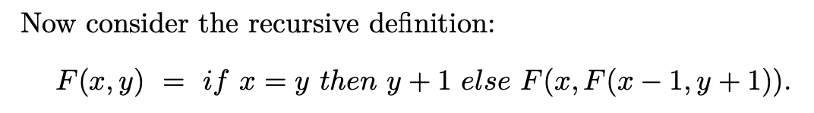
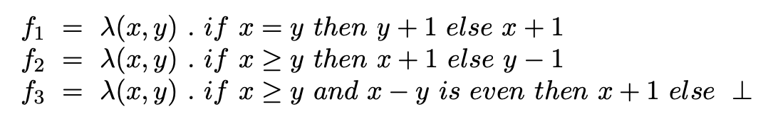
How I got hooked on this topic: Reading Manna, Chapter-5, these examples!
We can plug-in f1, f2, or f3 in lieu of F and “solve” the equation
Which solutions are computed when you
* Experiment with it in an I/O-gathering session
Normally (eagerly, as in Python)
Lazily (as in Haskell)
Why does running order determine the function computed?

Slide 3
What I’m trying to do
Tell you that an elephant can be viewed from many sides
A tube
A pancake
A pokey thing
Fixpoint theory is in many areas of CS
Context-free Languages
PL semantics
Static analysis
CTL model checking
Even CMOS transistor simulation
Learning it in “just one class” may give you the view that elephants are pokey objects ☺

Slide 4
What fixed-point/fixpoint theory is aimed at
Solving equations
Some equations make sense, some don’t
X = 2 – yes
X = X + 1 – no, in int
F(x) = F(x) – yes , but too many solutions
F(x) = F(x+1) - <your answer>
F(x) = F(x) + 1 - <your answer_

Slide 5
What fixed-point/fixpoint theory is aimed at
Solving equations
Some equations make sense, some don’t
X = 2 – yes
X = X + 1 – no, in int
F(x) = F(x) – yes , but too many solutions
F(x) = F(x+1) – sure it can
F(x) = F(x) + 1 - no

Slide 6
What fixed-point/fixpoint theory is aimed at
Solving equations
Some equations make sense, some don’t
X = 2 – yes
X = X + 1 – no, in int
F(x) = F(x) – yes , but too many solutions
F(x) = F(x+1) – sure it can
F(x) = F(x) + 1 – no
Main points
Recursion / circularity is natural
How do we solve when we have circular situations?

Slide 7
Fixpoint Theory to Explain CFGs
Context-free Grammars re-interpreted as recursive equations
S -> aSbS | bSaS | SS | epsilon
Versus
S -> aSbS | bSaS | epsilon
How do we view the above as language equations?

Slide 8
Fixpoint Theory to Explain CFGs
Context-free Grammars re-interpreted as recursive equations
S -> aSbS | bSaS | epsilon
Solve the recursive language equation
L_S = {a} L_S {b} L_S U {b} L_S {a} L_S U {e}

Slide 9
Fixpoint Theory to Explain CFGs
Context-free Grammars re-interpreted as recursive equations
S -> aSbS | bSaS | epsilon
Solve the recursive language equation
L_S = {a} L_S {b} L_S U {b} L_S {a} L_S U {e}
What do we get when we iterate from L_S = {} “upwards” ?

Slide 10
But for the grammar with the | … | SS rule
Context-free Grammars re-interpreted as recursive equations
S -> aSbS | bSaS | SS | epsilon
L_S = {a} L_S {b} L_S U {b} L_S {a} L_S U {e} U L_S L_S
We have two solutions!
What are they?

Slide 11
Fixpoint Theory to Explain CFGs
Context-free Grammars re-interpreted as recursive equations
S -> aSbS | bSaS | SS | epsilon
L_S = {a} L_S {b} L_S U {b} L_S {a} L_S U {e} U L_S L_S
One is the “usual solution”
Context-free rewrite schemes (productions) go after the LFP
“equal a’s and b’s”
We also have Sigma* as a solution
For the case we have S -> … | SS

Slide 12
Uniqueness of Solutions
People in general like things when solutions are unique
They sleep well at night
They are kinder to strangers, even smile at them
They remember to floss well at night
…
How about these situations : unique or not?
X^2 = 4
X^2 = -4
Quadratic equations
…

Slide 13
Uniqueness of Solutions
People in general like things when solutions are unique
A lot of Fixpoint Theory in CS and programming is aimed at seeking uniqueness
This is why equation systems on monotone lattices are important

Slide 14
Monotone is a “betterness order”
Or a worseness order
A <= B means
A is a better component than B (in static analysis at least)
A is a tighter approximation than B
Example
You can get resistors with 10% tolerance (a silver band on them)
Or a 5% tolerance (gold band on them)
5ohms@5% <= 5ohms@10%
Resistor parallel composition respects betterness
R1 || R2 = (R1*R2) / (R1 + R2)
Here if you initially use R2 == R2@10%
And stick in R2@5%
The whole ckt gets better
This is monotonicity
Not all systems are monotonic
Hence causes huge debugging headaches when monotonicity is violated!

Slide 15
Floating-point error behaves non-monotone
If you plug-in a component that introduces worse error, the overall error can decrease!
See plots next slide!

Slide 16
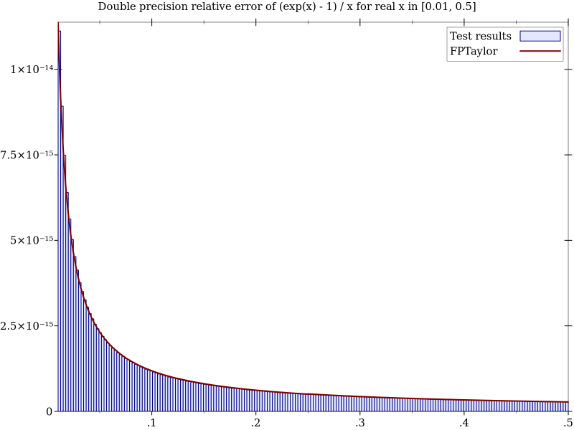
Example of non-monotonicity (FP example)
This example was discussed last class – here are the plots

Slide 17
Solving for a pair of unknowns is natural
Mutual recursion, i.e. defining two languages
S -> epsilon | ( W S
W -> ( W W | )
Solve
(L_S, L_W) = ( {e} U {(} L_W L_S , {(} L_W L_W U {)} )

Slide 18
Fixpoint Theory to Explain CFGs
Then discuss the system
S -> epsilon | ( W S
W -> ( W W | )
Solve
(L_S, L_W) = ( {e} U {(} L_W L_S , {(} L_W L_W U {)} )
What fixpoint obtained by iterating up from ({} , {}) ?
What is the lattice ordering?

Slide 19
Circular situations in circuits
Two inverters in a loop
X = not(not(X))
Three (or an odd number of) inverters in a loop
X = not(not(not(X)))
What are possible fixpoints?
Is there a “least” fixpoint?
This is again another glimpse of “fixpoint thinking”

Slide 20
Fixpoint theory in HW design
Oral history : Randy Bryant
https://youtu.be/1Ch-wjFT9VE

Slide 21
Connection w. (flow-sensitive) static-analysis
Flow-sensitive Static analysis ends up solving such mutually recursive situations

Slide 22
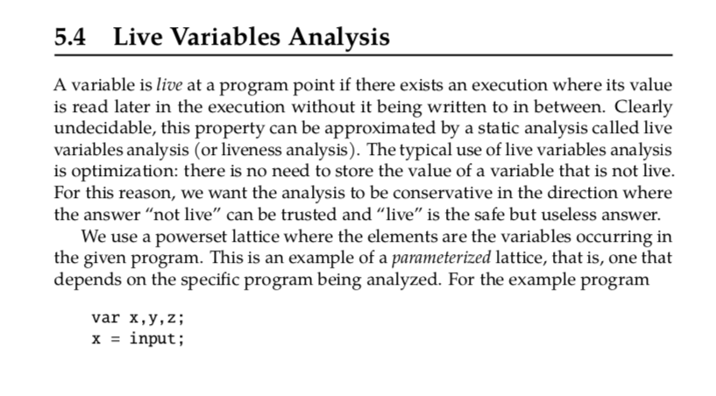
E.g., Analysis (from Moller/Schwartzbach)

Slide 23
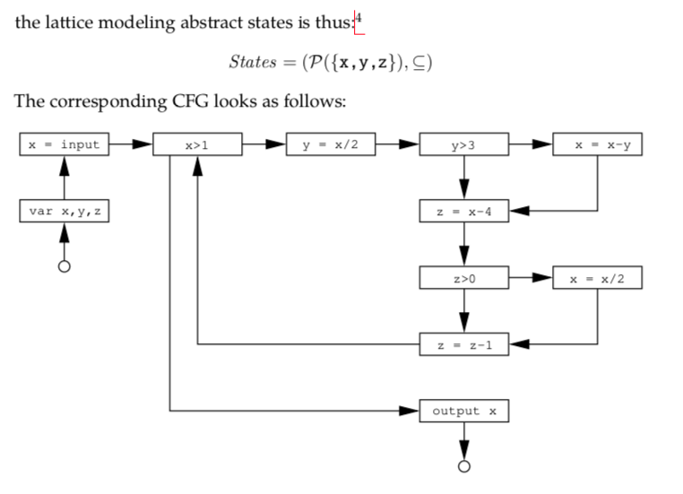
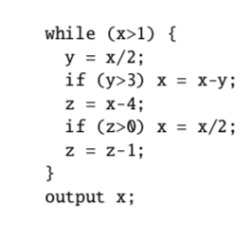
E.g., Analysis (from Moller/Schwartzbach)

Slide 24

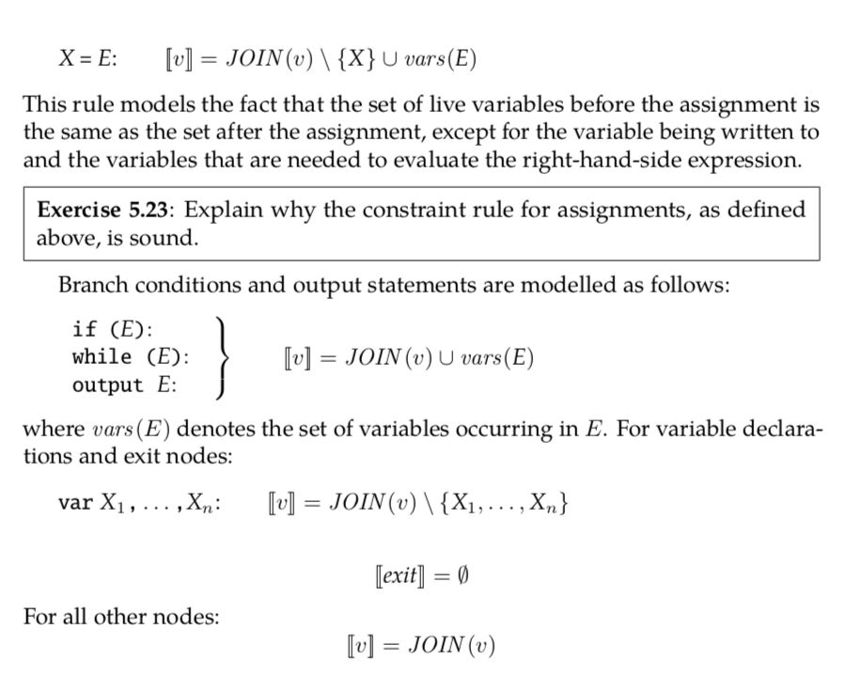
E.g., Analysis (from Moller/Schwartzbach)

Slide 25
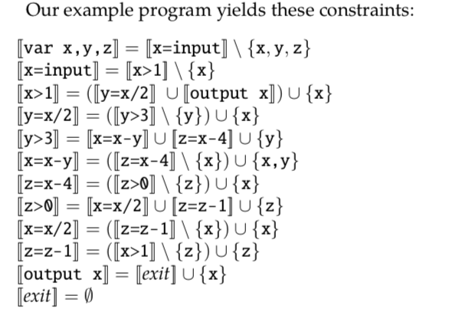
E.g., Analysis (from Moller/Schwartzbach)
See the recursion here!

Slide 26
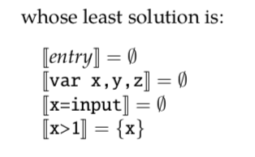
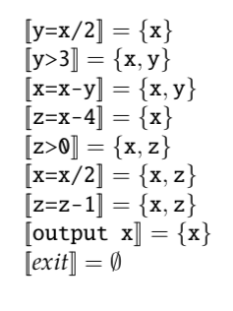
E.g., Analysis (from Moller/Schwartzbach)

Slide 27
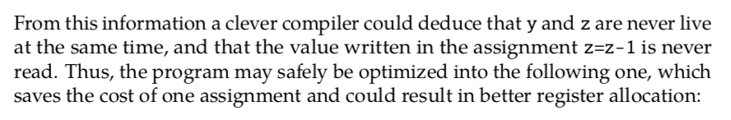
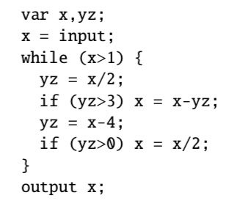
E.g., Analysis (from Moller/Schwartzbach)

Slide 28
Uniqueness of Least Fixpoints
Least fixpoints exist and are unique when Tau is
Monotonic
Continuous
For infinite lattices
Continuity implies Monotonicity
For finite lattices
Monotonicity implies Continuity

Slide 29
Fixpoint Theory to Explain CFGs
Context-free Grammars re-interpreted as recursive equations
S -> aSbS | bSaS | SS | epsilon
Versus
S -> aSbS | bSaS | epsilon
Then discuss the system
S -> epsilon | ( W S
W -> ( W W | )

Slide 30
Fixpoint Theory to Explain CFGs
Context-free Grammars re-interpreted as recursive equations
S -> aSbS | bSaS | epsilon
Solve the recursive language equation
L_S = {a} L_S {b} L_S U {b} L_S {a} L_S U {e}

Slide 31
Fixpoint Theory to Explain CFGs
Context-free Grammars re-interpreted as recursive equations
S -> aSbS | bSaS | epsilon
Solve the recursive language equation
L_S = {a} L_S {b} L_S U {b} L_S {a} L_S U {e}
What do we get when we iterate from L_S = {} “upwards” ?

Slide 32
Fixpoint Theory to Explain CFGs
Context-free Grammars re-interpreted as recursive equations
S -> aSbS | bSaS | SS | epsilon
L_S = {a} L_S {b} L_S U {b} L_S {a} L_S U {e} U L_S L_S

Slide 33
Fixpoint Theory to Explain CFGs
Context-free Grammars re-interpreted as recursive equations
S -> aSbS | bSaS | SS | epsilon
L_S = {a} L_S {b} L_S U {b} L_S {a} L_S U {e} U L_S L_S
Are there 2 fixpoints? Which is found using iteration using {} as the bottom (going up)?

Slide 34
Fixpoint Theory to Explain CFGs
Then discuss the system
S -> epsilon | ( W S
W -> ( W W | )
Solve
(L_S, L_W) = ( {e} U {(} L_W L_S , {(} L_W L_W U {)} )

Slide 35
Fixpoint Theory to Explain CFGs
Then discuss the system
S -> epsilon | ( W S
W -> ( W W | )
Solve
(L_S, L_W) = ( {e} U {(} L_W L_S , {(} L_W L_W U {)} )
What fixpoint obtained by iterating up from ({} , {}) ?
What is the lattice ordering?

Slide 36
Fixpoint Theory to understand Recursion
Function f3 corresponds to lim_i { Tau^i [ Bottom_fn ] }
Where Tau for “F” above is: …fill this… and is called
the “functional underlying the recursive definition (in Manna’s book)
In Chapter 18 of Book-3, it is called the “pre” function (e.g. PreFact etc) on
which the Y combinator is applied.
Applying the Y combinator gives the same effect as computing the limit of this chain of functions
What does Tau^1[Bottom] correspond to? What about Tau^2 ? Tau^3 ? …fill this…

Slide 37
Now discuss notes in this directory
Manna’s work on interpreting these functions
Which function can we “experimentally compute”?
If we keep experimenting with F in say Python , what function table can we fill ?
What if we did it in a different (lazy) language)?
That is, if we compute according to a fixpoint computation rule, we will get the “true answer”
None of this is largely of concern for finite lattices
Many static-analysis situations
But the general story is important to know.

Slide 38
CTL Model Checking
Least fixpoints exist and are unique when Tau is
Monotonic
Continuous
For infinite lattices
Continuity implies Monotonicity
For finite lattices
Monotonicity implies Continuity

Slide 39
State-Space Travel via BDDs
We will use BDDs to represent Kripke Structure
We will model Transition Relations using BDDs
Use Boolean operations to obtain the set of reachable states

Slide 40
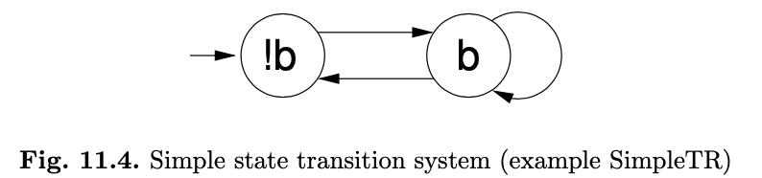

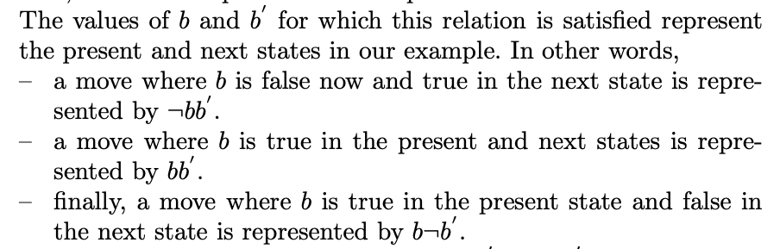
State Transition Systems via BDDs

Slide 41
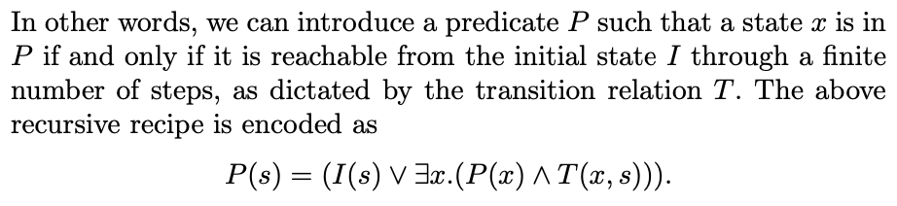
The set of reachable states defined by “P”

Slide 42
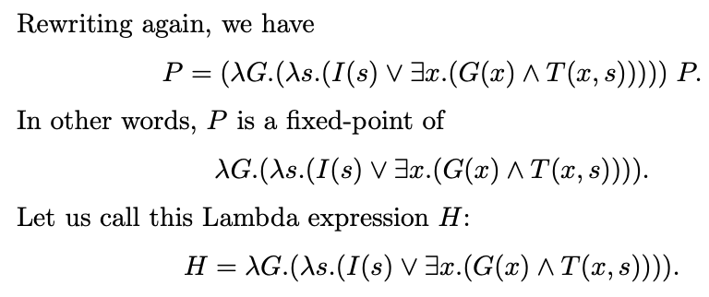

This can be computed via fixpoint iteration
Etc…

Slide 43
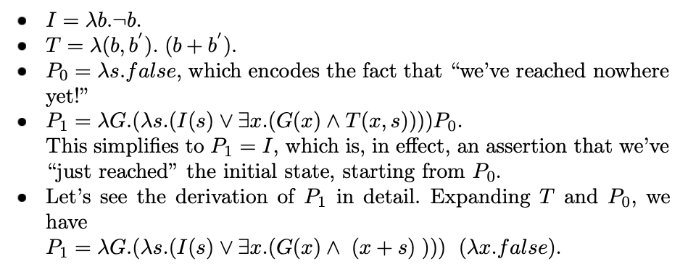
This can be computed via fixpoint iteration

Slide 44
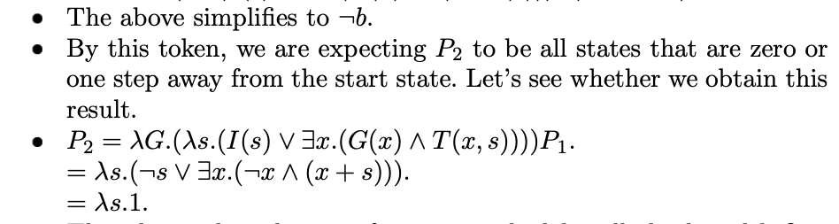
This can be computed via fixpoint iteration

Slide 45
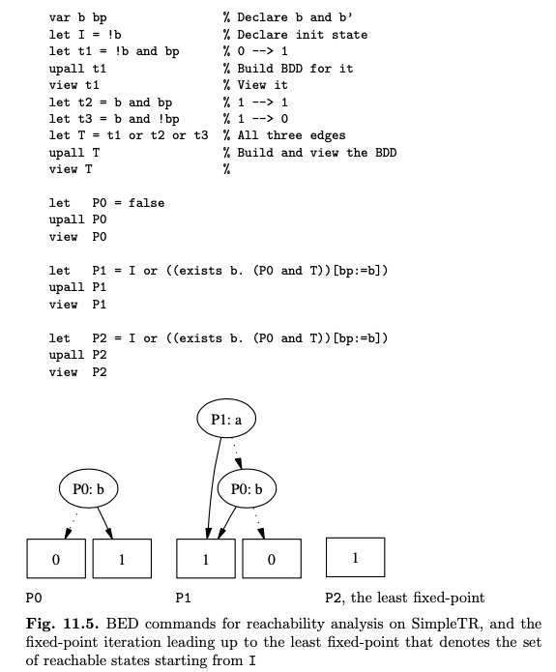
Forward Reahability via the BDD tool called “BED”

Slide 46
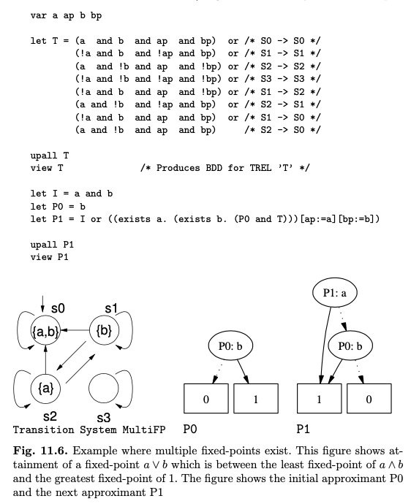
Forward Reahability via the BDD tool called “BED”: another example

Slide 47
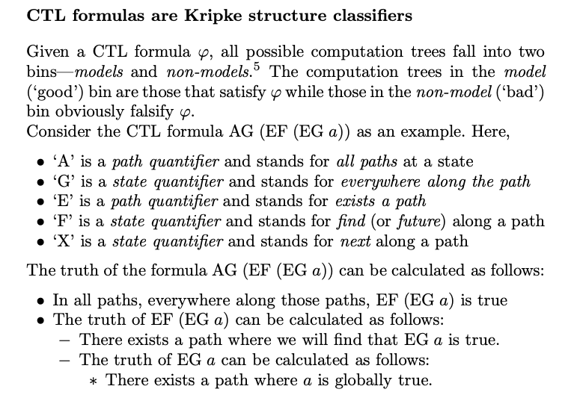
Now, for the CTL Logic, and Reachability using BDDs

Slide 48
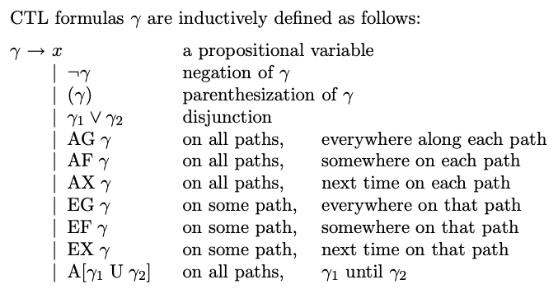
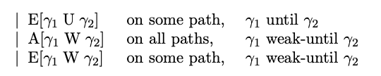
Now, for the CTL Logic, and Reachability using BDDs

Slide 49

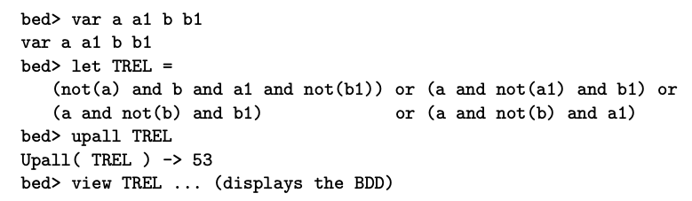
Now, for the CTL Logic, and Reachability using BDDs

Slide 50
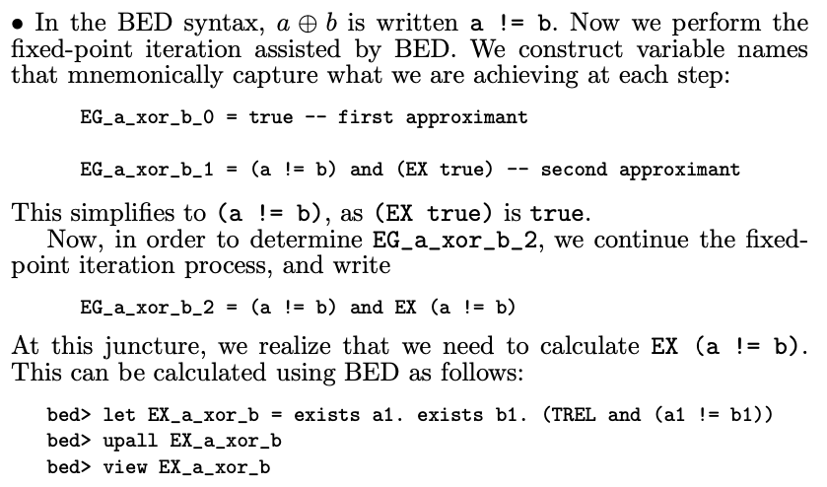
Now, for the CTL Logic, and Reachability using BDDs

Slide 51
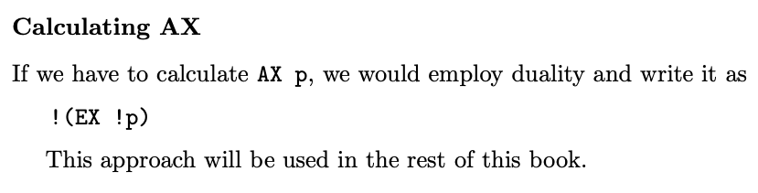
Now, for the CTL Logic, and Reachability using BDDs

Slide 52

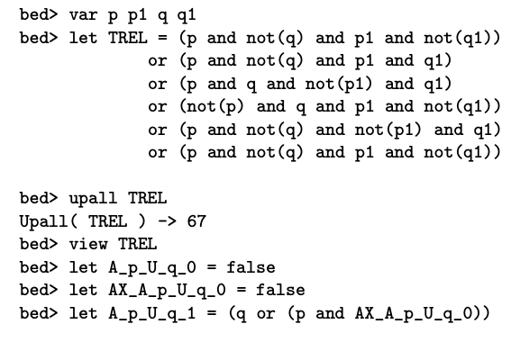
Now, for the CTL Logic, and Reachability using BDDs

Slide 53
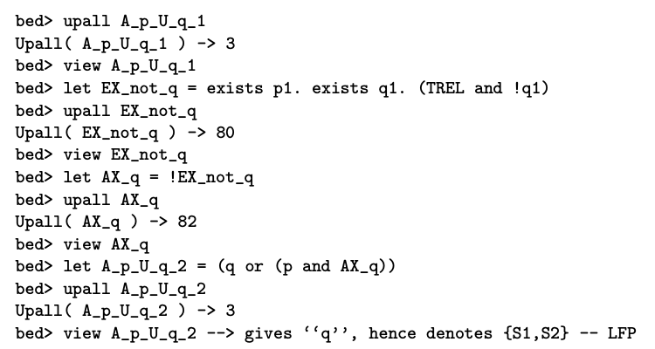
Now, for the CTL Logic, and Reachability using BDDs

Slide 54

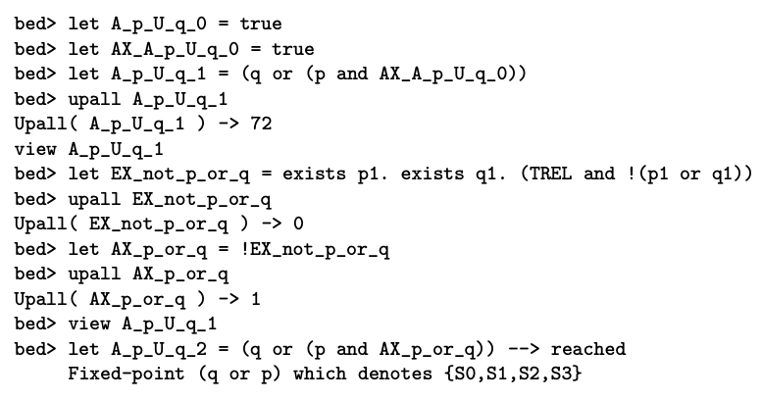
Now, for the CTL Logic, and Reachability using BDDs

Slide 55
Summary
Fixpoint theory is everywhere in CS
Static analysis
Recursive program analysis
CFG explanation
CTL model-checking
Finding lattices and monotonic + continuous functionals is key
Once set up this way, we usually go after the least fixpoint
Greatest fixpoints also “make sense”
But sometimes they are useless
as in the CFG example S -> aSbS | bSaS | SS | epsilon

Slide 56
Summary

