Slide 1

CS 6110 Software Correctness, Spring 2022
Ganesh Gopalakrishnan
School of Computing
University of Utah
Salt Lake City, UT 84112
URL: bit.ly/cs6110s22

Slide 2
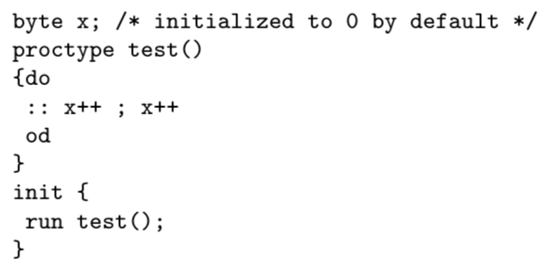
ex1

Slide 3
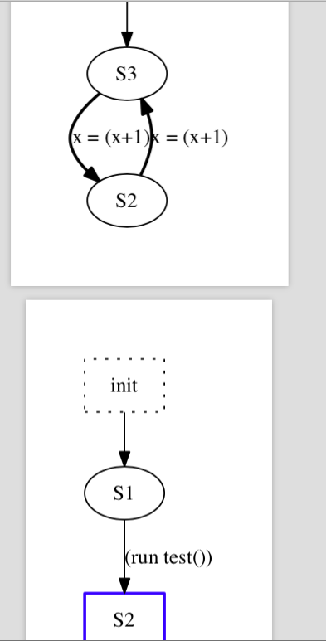
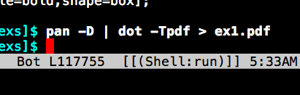
ex1

Slide 4
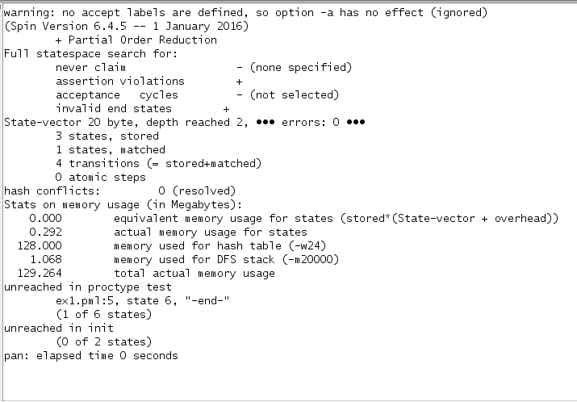
ex1

Slide 5
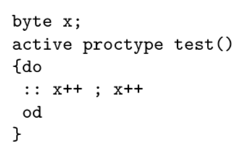
ex2 : fire up w/o init process

Slide 6
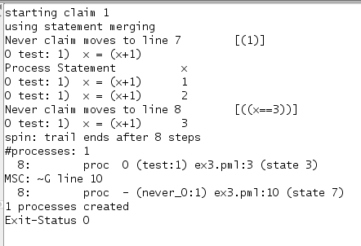
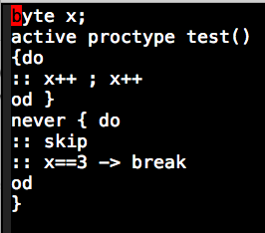
ex3

Slide 7
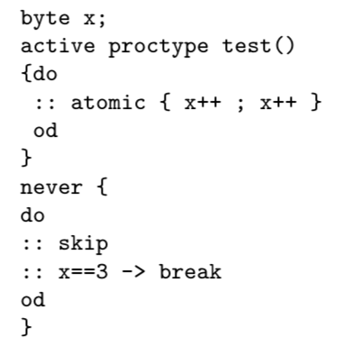
ex4

Slide 8
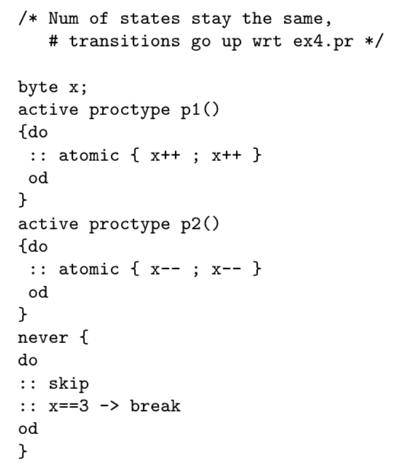
ex5

Slide 9
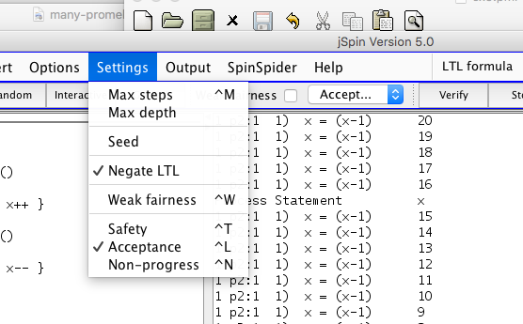
ex5

Slide 10
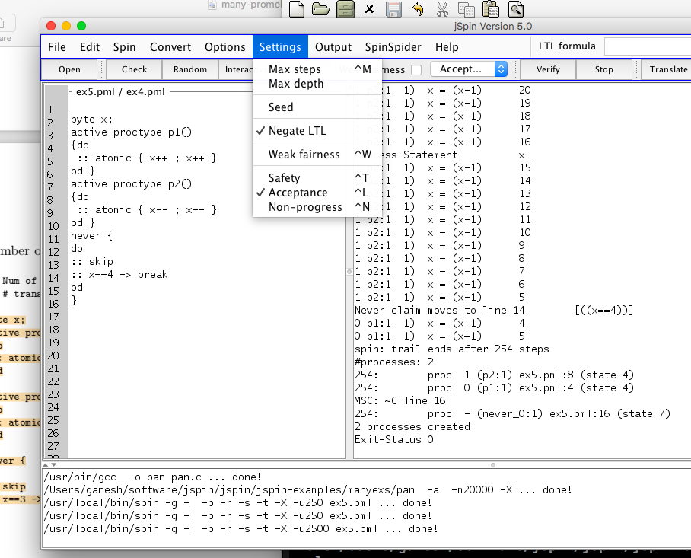
ex5

Slide 11
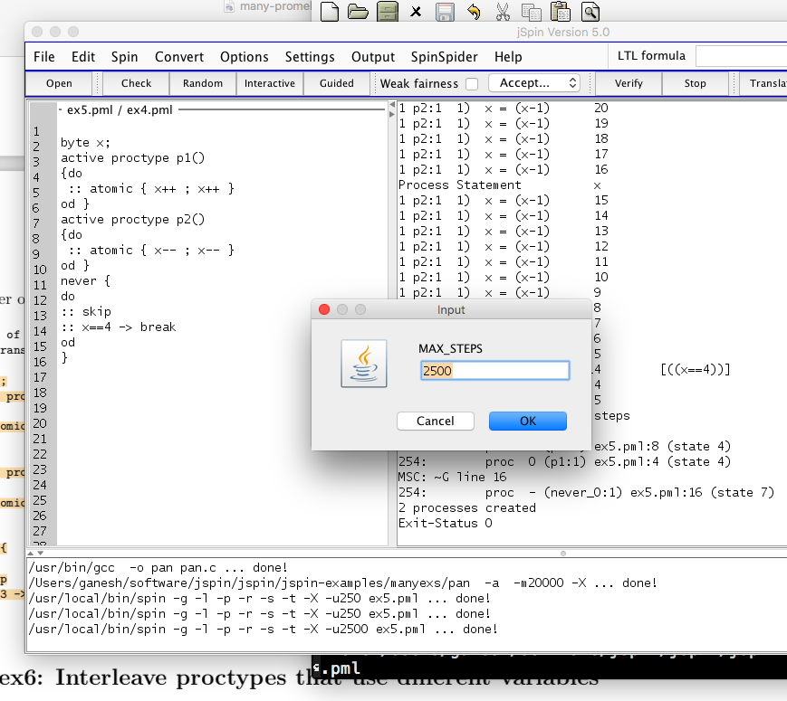
ex5

Slide 12
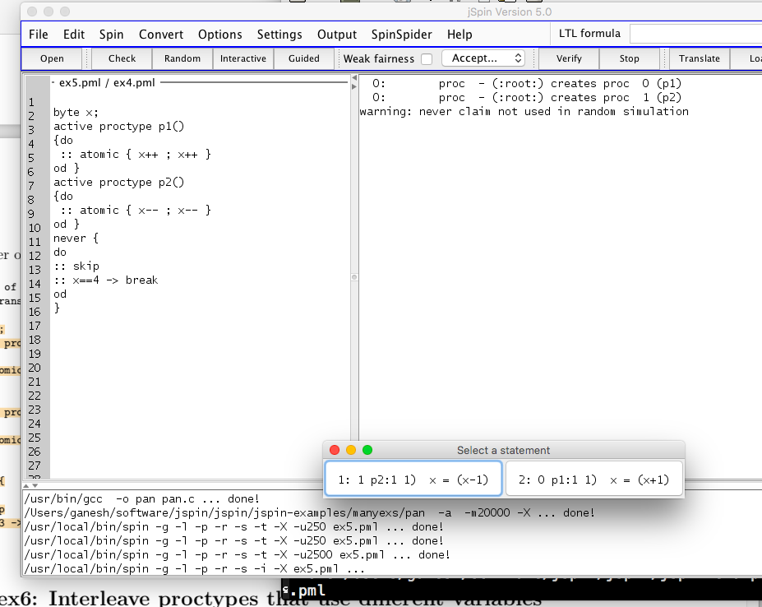
ex5

Slide 13
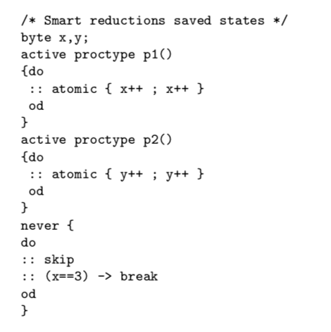
ex6

Slide 14
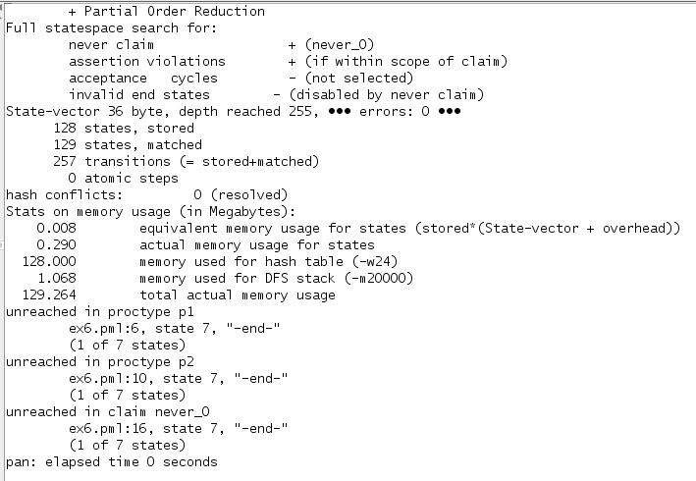
ex6

Slide 15
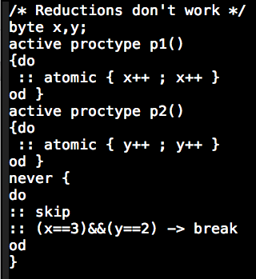
ex7

Slide 16
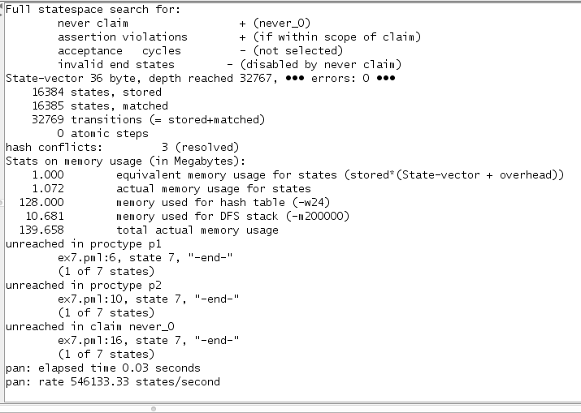
ex7 do the right depth setting!

Slide 17
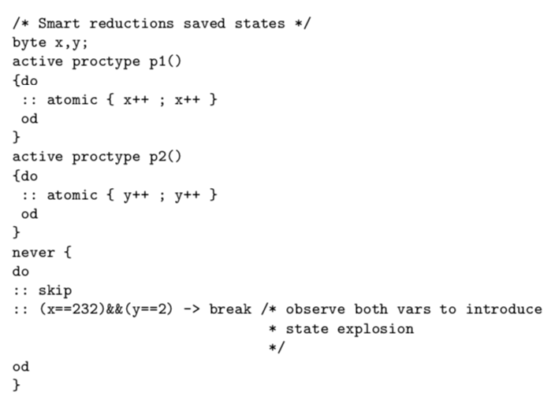
ex8 do the right depth setting!

Slide 18
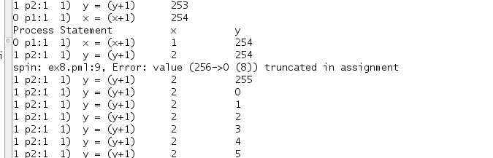
ex8 do the right depth setting!

Slide 19
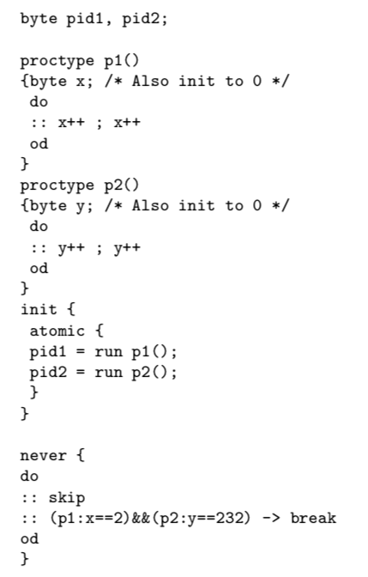
ex9

Slide 20
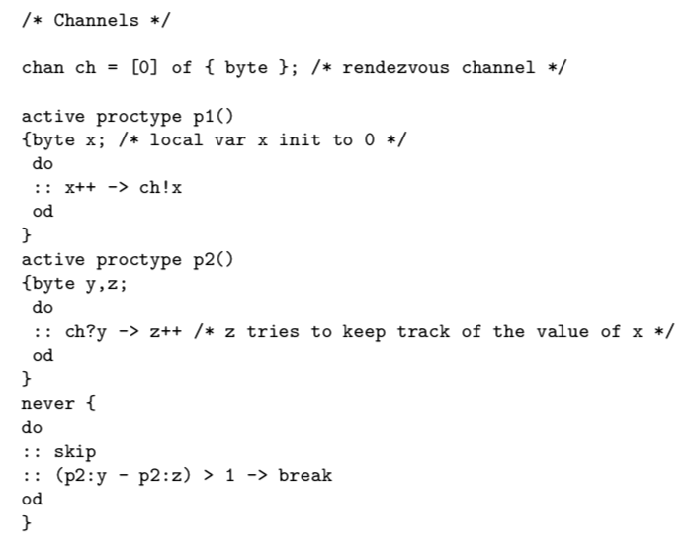
ex10

Slide 21
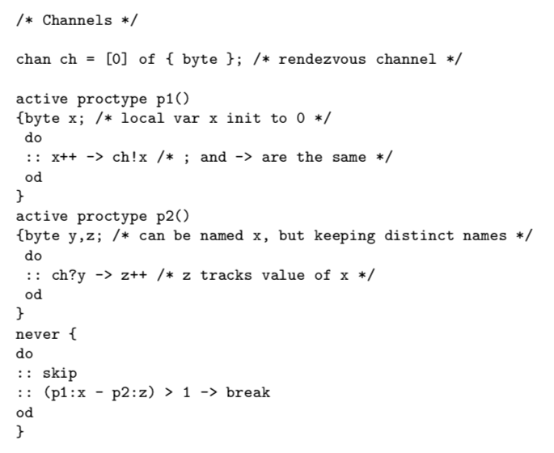
ex11

Slide 22
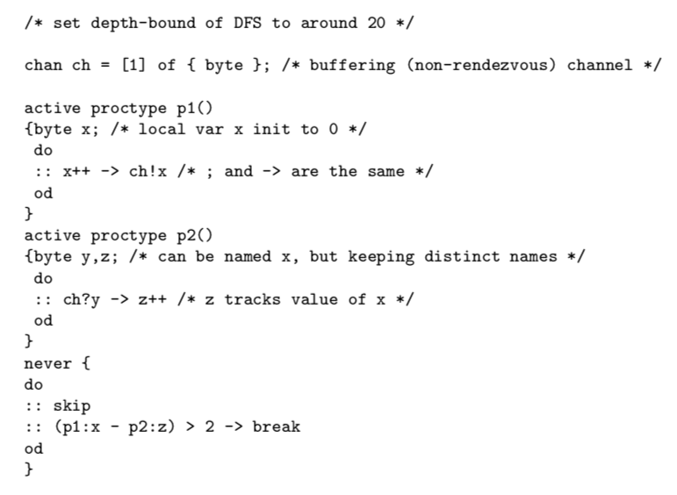
ex12

Slide 23
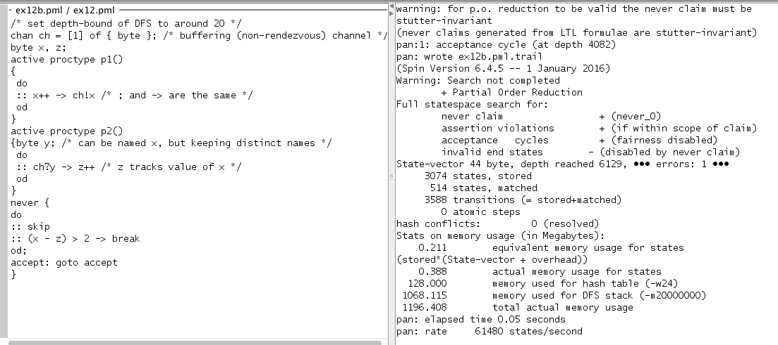
ex12b

Slide 24
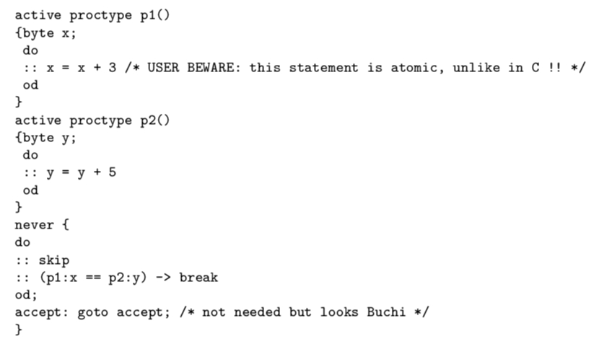
ex13

Slide 25
ex13
http://spinroot.com/spin/Man/Pan.html suggests using –DNOREDUCE
PO reductions not safe with remote references (must be stutter invariant)

Slide 26
ex13

Slide 27
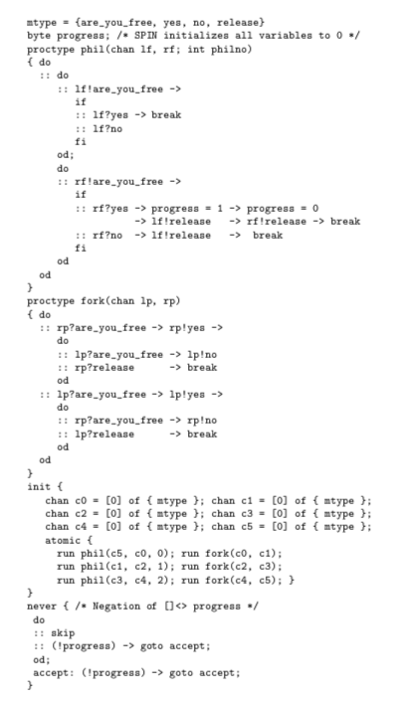
ex14

Slide 28
Lecture 4 : LTL model checking (CEAAT)

Slide 29
Question: What is the theory behind this checking? Answer: On-the-fly LTL Model Checking using Buchi Automata!

Slide 30
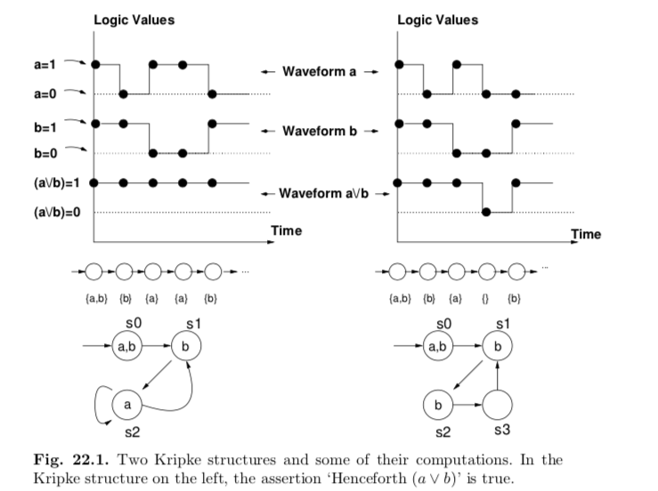
Lecture 4 : LTL model checking (CEAAT)

Slide 31
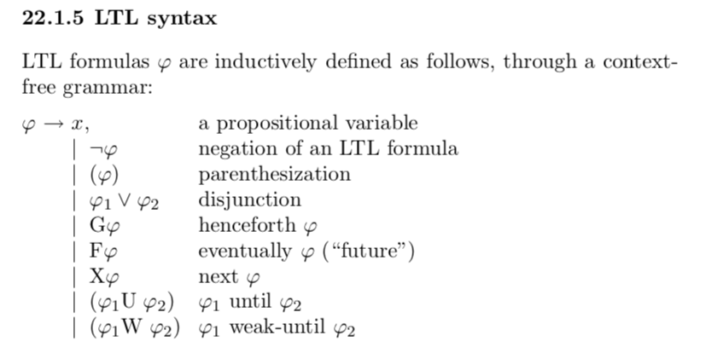
Lecture 4 : LTL model checking (CEAAT)

Slide 32
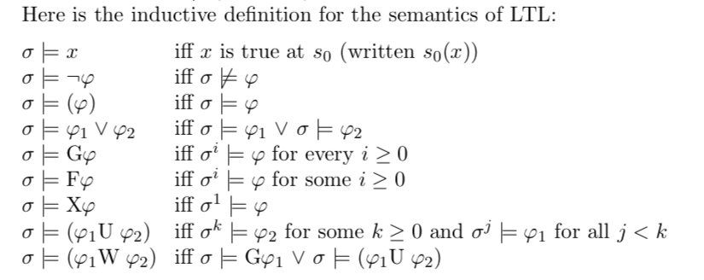
Lecture 4 : LTL model checking (CEAAT)

Slide 33

Lecture 4 : LTL model checking (CEAAT)

Slide 34
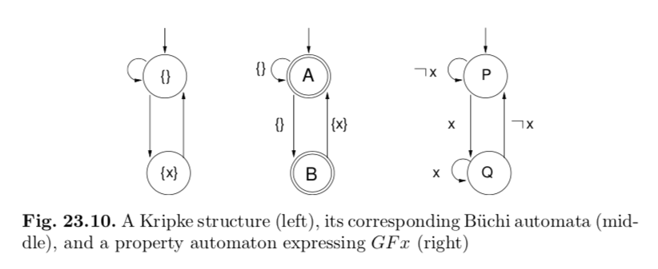
Lecture 4 : LTL model checking (CEAAT)

Slide 35
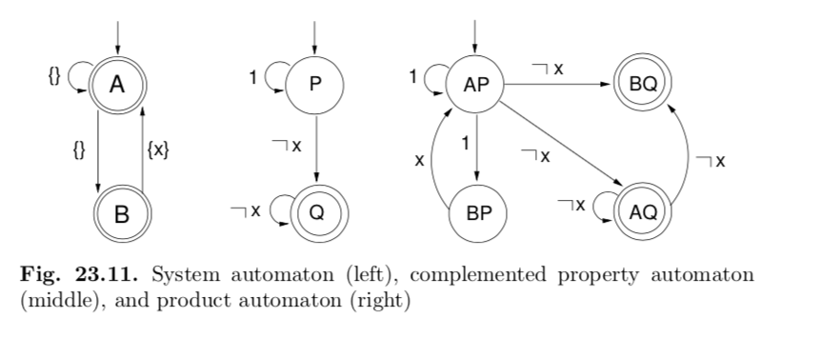
Lecture 4 : LTL model checking (CEAAT)

Slide 36
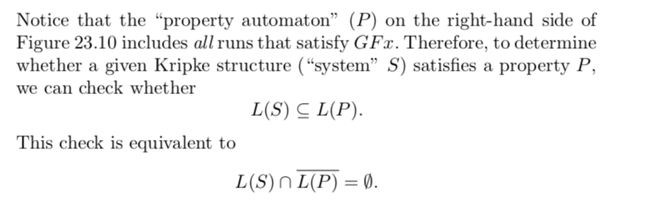
Lecture 4 : LTL model checking (CEAAT)

Slide 37

Lecture 4 : LTL model checking (CEAAT)

Slide 38
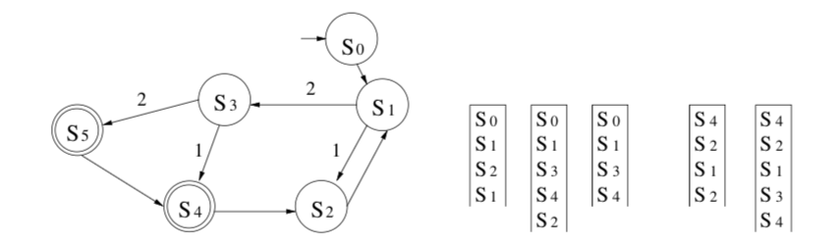
Lecture 4 : LTL model checking (CEAAT)

