Slide 1

CS 5/6110, Software Correctness Analysis, Spring 2022
Ganesh Gopalakrishnan
School of Computing
University of Utah
Salt Lake City, UT 84112

Slide 2
Seeding your FOL experience via a problem
See the solution to Sudoku in https://ericpony.github.io/z3py-tutorial/guide-examples.htm
Modify it to solve Kenken
I’ll give you the cage encoding in Python
See this folder – template Python file kenken-template.py
You should write the constraints and produce a Kenken solution

Slide 3
Overview of First Order Logic and Hoare Logic
Knowing FOL concepts is important in general
Hoare Logic treats program text laden with annotations as “theorems”
|- {Precondition} Command {Postcondition}
This says that under Precondition if Command is carried out, then Postcondition will be true
The basic approach
Annotate one’s program with Pre/Post and Loop Invariants
Finding loop invariants requires manual work
The prover generates verification conditions (VC)
If each VC is shown to be valid, then the program respects the pre/post annotation

Slide 4
Importance, and what we’ll do
Historically the first verification approach considered
Recently TimSort was found to be buggy and upgraded
See Wikipedia article on the TimSort bug
Proved by people using the theorem prover called Key
A good intuition about how Hoare Logic verifiers work is important
Next lecture (2/24): I’ll try and demo Dafny
Requires some “magic” on Macs to work (mine stopped working; will fix)
Will study a Lisp-based verifier in Gordon’s book meanwhile

Slide 5
Finishing up our study of FOL
Review of notions about interpretations
See discussions about Interpretations in the Bradley/Manna book
Soundness and Completeness
Decidability

Slide 6
How do we systematically prove in FOL?
One needs proof systems and proof rules
FOL has a sound proof system (many, actually)
One such proof system is Natural deduction (others are Hibert-style, …)
Sound means if a theorem is proven using proof-rules, it is true
in the sematic model, or in the space of interpretations
More on it soon
Sound proof systems can be rather simple: have no proof rules!
No proofs means no unsoundness!
What more do we need for proof systems?

Slide 7
How do we systematically prove in FOL?
One needs proof systems and proof rules
FOL has a sound proof system (many, actually)
One such proof system is Natural deduction (others are Hibert-style, …)
Sound means if a theorem is proven using proof-rules, it is true
in the sematic model, or in the space of interpretations
More on it soon
Sound proof systems can be rather simple: have no proof rules!
No proofs means no unsoundness!
FOL has a complete proof system
Complete means ”if it is true, then it is provable”
Thus, valid sentences in FOL are recursively enumerable
What is that? (next slide)

Slide 8
How do we systematically prove in FOL?
FOL has a complete proof system
Complete means ”if it is true, then it is provable”
Thus there is a proof
a sequence of proof-steps that chain together, some implying later ones, ending in the theorem of interest
Thus, valid sentences in FOL are recursively enumerable
That means, if true, we can find a proof
How?
Keep enumerating all proofs of all lengths, using a sound and complete proof system
If indeed true, there is a proof that will be discovered in a finite amount of time!
What if the sentence (FOL formula without free variables) is not valid?

Slide 9
How do we systematically prove in FOL?
What if the sentence (formula w/o free variables) is not valid?
Then the previously mentioned enumeration process will never terminate!
In other words, there is a procedure to check for FOL validity
Is there an algorithm to check for FOL validity?

Slide 10
No! Reduction from PCP
An undecidable problem involving arrangement of tiles
Undecidable problem
There is no TM to solve a PCP instance
We build a FOL sentence from a PCP instance such that the FOL sentence is valid IFF the PCP system has a solution!
https://colab.research.google.com/github/ganeshutah/Jove/blob/master/For_CS3100_Fall2020/19_Algo_Proc_PCP/CH15.ipynb

Slide 11
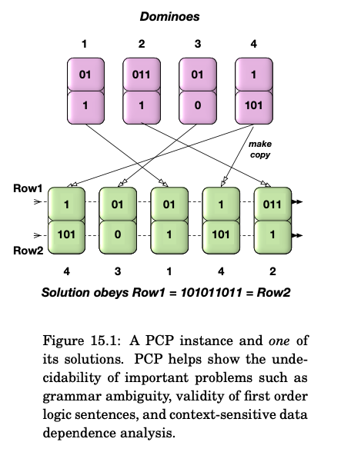
PCP

Slide 12
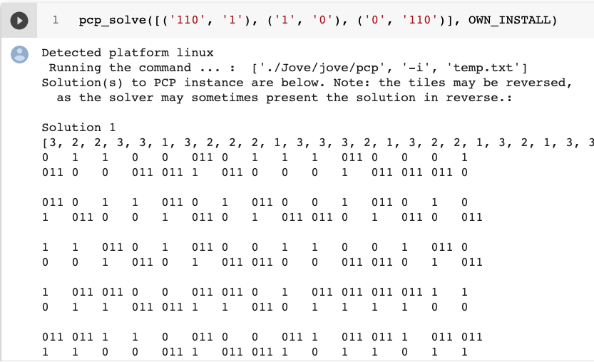
PCP

Slide 13
PCP : Run from here
https://github.com/ganeshutah/Jove/blob/master/For_CS3100_Fall2020/19_Algo_Proc_PCP/CH15.ipynb

Slide 14
Undecidability of Validity
Full proof on Monday
Read Book-1’s proof (taken from Manna who credits Floyd’s elegant proof)
It is a mapping reduction frop PCP to FOL-validity!
(all this in my version of CS 3100 – I tend to cover PCP always!)

Slide 15
FOL Validity is undecidable
Proof: Reduction from PCP
Given a PCP instance, build a specific FOL formula
Argue that the
FOL formula obtained via the translation (mapping reduction) from a given PCP instance { (alpha_1, beta_1), (alpha_2, beta_2), … }
is valid
IFF the PCP instance is solvable

Slide 16
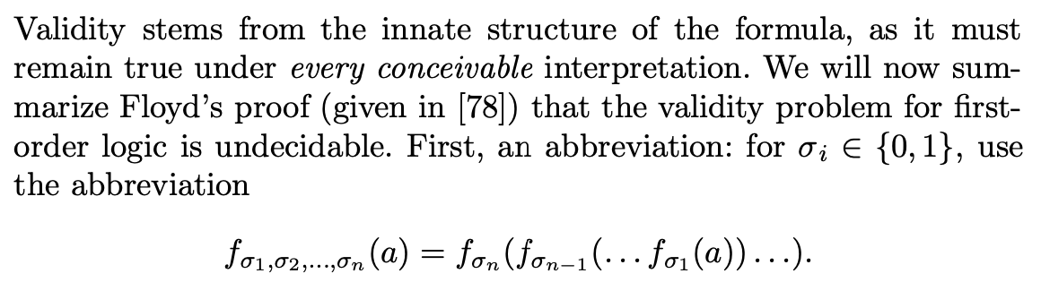
FOL Validity (from Book-1, Manna, Floyd)

Slide 17
Keep these definitions handy! Answer by Zoom Text!
Keep the definitions of alpha_i and beta_i handy
They are bit strings that describe the contents of the dominoes
E.g. given the dominoes [ (110,1), (1,0), (0, 110) ]
Draw the dominoes below
Alpha_1 is 110 and Beta_1 is 1: What are
Alpha_2 ?
Beta_2 ?
Alpha_3 ?
Beta_3 ?
What is f_{alpha_1} ( a ) ?
What is f_{beta_3} ( b ) ?

Slide 18
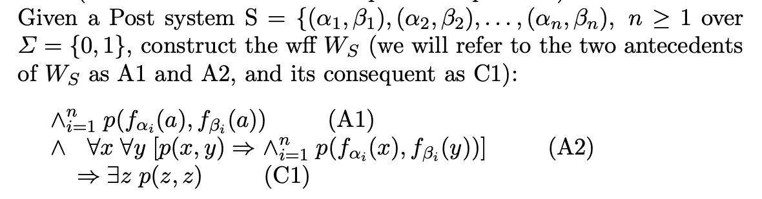
FOL Validity (from Book-1, Manna, Floyd)

Slide 19
Keep these aside! We will need ‘em later
A1
A2
C1

Slide 20
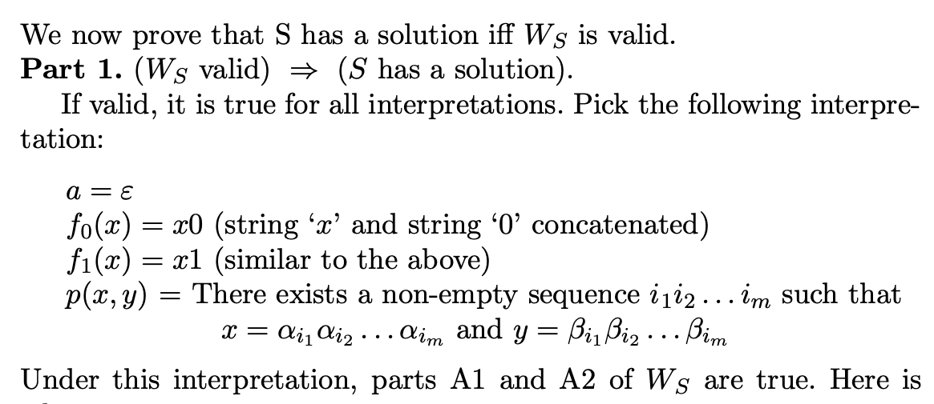
FOL Validity (from Book-1, Manna, Floyd)

Slide 21
Details
We are assuming that W_S, the FOL formula obtained by translating the PCP instance S is valid
Thus S is true under all interpretations
Thus we can choose any interpretation we like (to finish our proof)
Recall (from a previous lecture) that given a formula, we can choose the domain of interpretation D to be Nat or Sigma* and choose the function and predicate symbols’ meanings to be anything at all over that domain (those slides are provided next, to jog your memory)

Slide 22
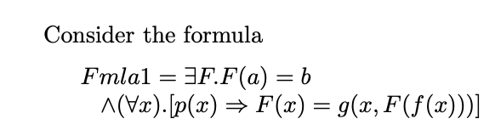
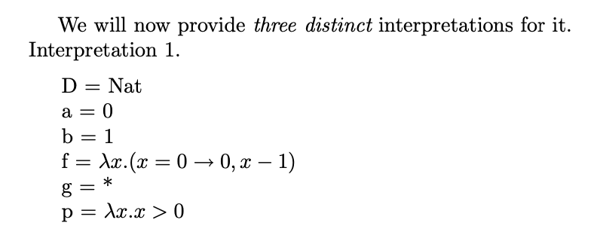
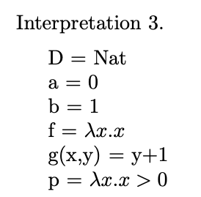
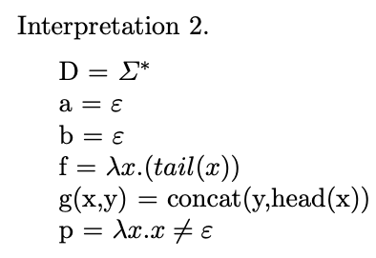
True under this interpretation? Your answer?
For this formula, it was true
Under two interpretations
And false under the third
Which one?

Slide 23
But we are now working on W_S being valid
That means, under ANY interpretation, it is the case that
A1 /\ A2 => C1 is true

Slide 24
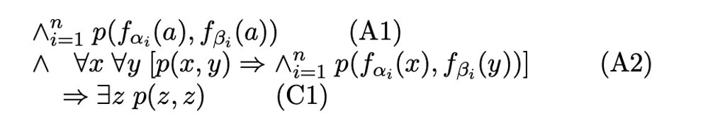
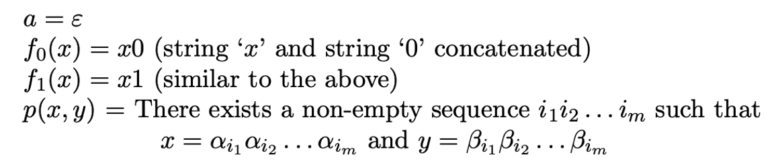
Proof setup for W_S is valid ➔ S is solvable
Thus, we are going to interpret A1 /\ A2 => C1 below, where…
Under THIS interpretation --- call it PI (for Post Interpretation!!)

Slide 25
Why is A1 true under PI? Let us break this down!
Thus, we are going to interpret A1 /\ A2 => C1 below, where…
Under THIS interpretation!

Slide 26
Why is p ( f_{alpha_1}(a), f_{beta_1}(a) ) true?
Thus, we are going to interpret A1 /\ A2 => C1 below, where…
Under THIS interpretation!

Slide 27
Why is p ( f_{alpha_1}(a), f_{beta_1}(a) ) true? Ans: Because it reduces to p ( alpha_1, beta_1 ) !!!
Thus, we are going to interpret A1 /\ A2 => C1 below, where…
Under THIS interpretation!

Slide 28
Why is p ( f_{alpha_2}(a), f_{beta_2}(a) ) true? Ans: YOU PLEASE TYPE IN !!
Thus, we are going to interpret A1 /\ A2 => C1 below, where…
Under THIS interpretation!

Slide 29
The conjunction of all these primitive applications of p are true! Thus A1 is true!
Thus, we are going to interpret A1 /\ A2 => C1 below, where…
Under THIS interpretation!

Slide 30
Now why is one p(x,y) => p(f_{alpha_i}(x), f_{beta_i}(x) ) true?
Thus, we are going to interpret A1 /\ A2 => C1 below, where…
Under THIS interpretation!

Slide 31
Now why is one p(x,y) => p(f_{alpha_i}(x), f_{beta_i}(x) ) true? ANS: see what “f” and “p” mean !!
Thus, we are going to interpret A1 /\ A2 => C1 below, where…
Under THIS interpretation!

Slide 32
Now why is one p(x,y) => p(f_{alpha_i}(x), f_{beta_i}(x) ) true? ANS: Basically, A2 keeps extending the alpha/beta sequences and they are in the matching order! Thus the whole nested A2 conjunction is true!
Thus, we are going to interpret A1 /\ A2 => C1 below, where…
Under THIS interpretation!

Slide 33
This means that A2 is true! We know that A1, A2 are true and A1, A2 => C1 is true [[ why ?? ]] Thus what about C1 ??
Thus, we are going to interpret A1 /\ A2 => C1 below, where…
Under THIS interpretation!

Slide 34
This means that A2 is true! We know that A1, A2 are true and A1, A2 => C1 is true [[ why? W_S is valid! ]] Thus what about C1 ?? True!
Thus, we are going to interpret A1 /\ A2 => C1 below, where…
Under THIS interpretation!

Slide 35
What does C1 being true mean ?
Thus, we are going to interpret A1 /\ A2 => C1 below, where…
Under THIS interpretation!

Slide 36
What does C1 being true mean ? Means that the PCP system S has a solution, namely z !!
Thus, we are going to interpret A1 /\ A2 => C1 below, where…
Under THIS interpretation!

Slide 37
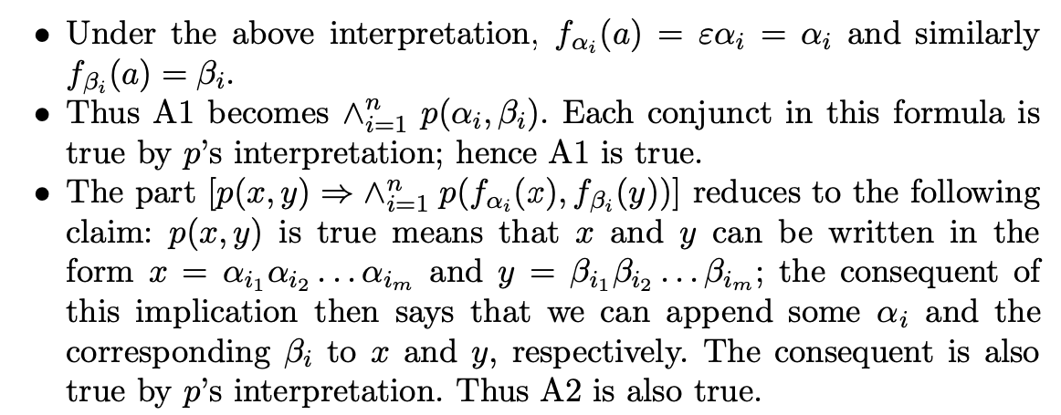
FOL Validity (from Book-1, Manna, Floyd)

Slide 38
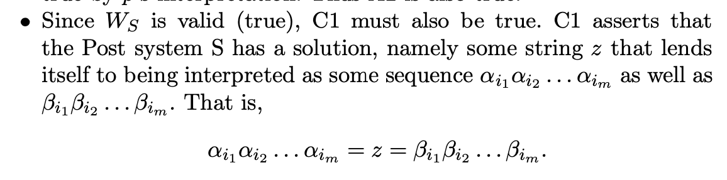
FOL Validity (from Book-1, Manna, Floyd)

Slide 39
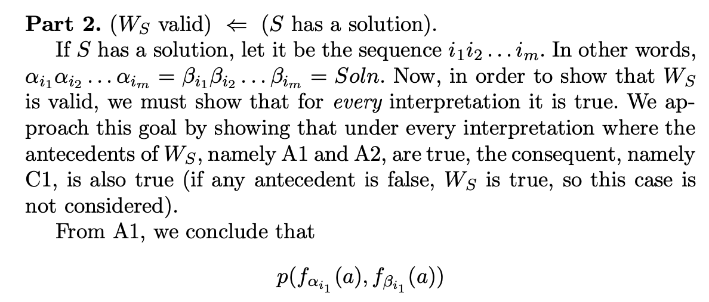
FOL Validity (from Book-1, Manna, Floyd)

Slide 40
Notes
Here we have to show that W_S is valid, given that S has a solution
If S has a solution, there exists a sequence
Alpha_{i1} Alpha_{i2} … Alpha_{iN} that equals a sequence
Beta_{i1} Beta_{i2} … Beta_{iN}
Thus, we proceed as follows

Slide 41
Notes
W_S being valid involves only one really interesting case
making A1 and A2 true
Why?

Slide 42
Notes
W_S being valid involves only one really interesting case
making A1 and A2 true
Why?
Because A1 and A2 being false renders W_S true ☺

Slide 43
Notes
But if A1 and A2 are true, we can use A1 as “axioms” and A2 as a whole bunch of implications
We can apply modus ponens using A1 and A2 instances
Then we can pump up the “f” nests
Pump it up to match the PCP solution given to us !!!

Slide 44
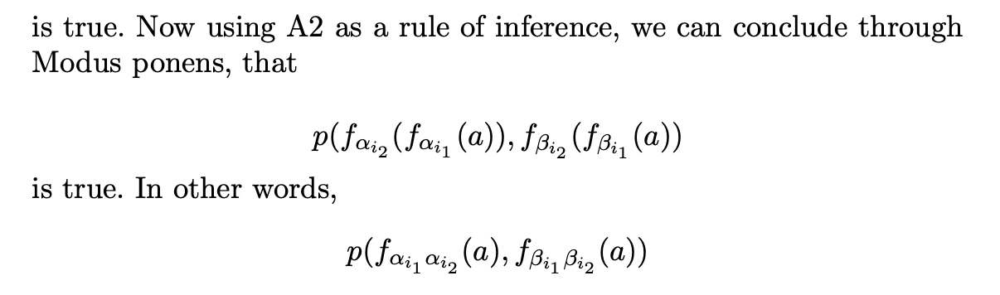
FOL Validity (from Book-1, Manna, Floyd)

Slide 45
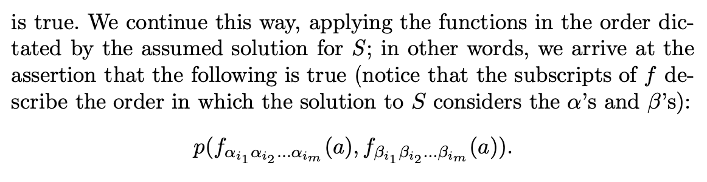
FOL Validity (from Book-1, Manna, Floyd)

Slide 46
Which z shall we pick?

Slide 47
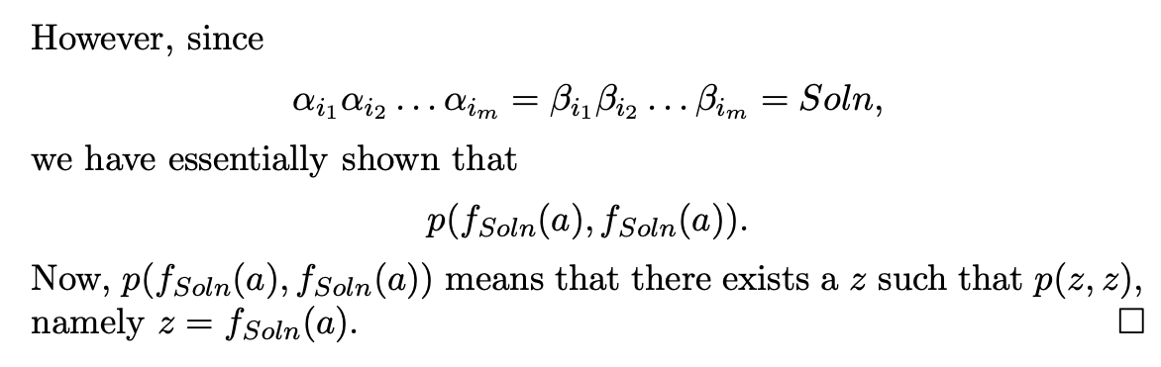
FOL Validity (from Book-1, Manna, Floyd)

Slide 48
Which z shall we pick?
The z picked is the nest of function applications we built up!

Slide 49
Floyd-Hoare Logic
Introduce the WLP rule
Introduce the SP rule
Do an XOR-swap proof by hand
Introduce Floyd’s method by hand on Binary Search
Onto Hoare-style proofs of Binary Search
E.g. using Dafny

Slide 50
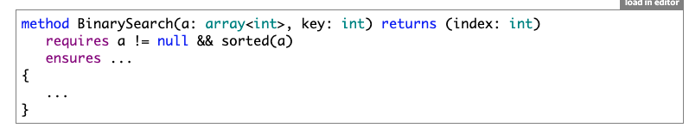
Dafny Bin Search

Slide 51
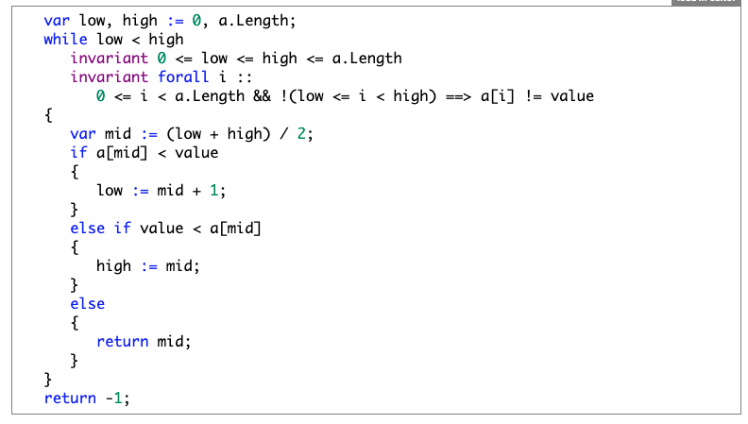
Dafny Bin Search

