Slide 1

CS 5/6110, Software Correctness Analysis, Spring 2022
Ganesh Gopalakrishnan
School of Computing
University of Utah
Salt Lake City, UT 84112

Slide 2
Summary of the basics of Static Analysis (0) where we left off was Live Variable Analysis Discuss that using slide-deck #4 of Andersson-Moller (1) Basics from PhD thesis by Dorra Ben Khalifa https://tel.archives-ouvertes.fr/tel-03509266 (2) from Moller/Schwartzbach (3) from the SPARTA team (Android)

Slide 3
Purpose of this lecture
To familiarize you with resources to learn and practice static analysis (these are more practical tools below)
Eva tool (part of Frama-C)
ASTREE tool (academic groups have used it)
industrial-strength
Used by Airbus, French companies, …
Coverity, Galois Inc tools, …
Similar deal in the US
SPARTA
Facebook’s academic incubator
Has a good set of tutorials

Slide 4
Purpose of this lecture
To familiarize you with resources to learn and pedagogical static analysis
Schwartzbach’s notes
SCALA implementation
LLVM Implementation
https://cs.au.dk/~amoeller/spa/

Slide 5
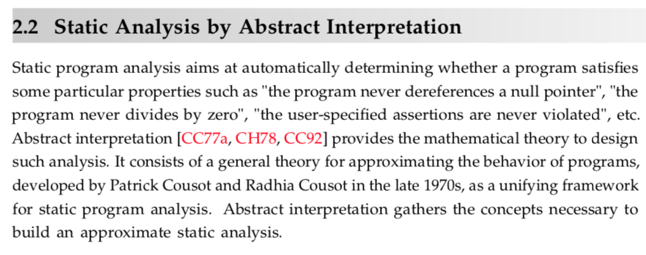
Excerpts from the Ben Khalifa thesis

Slide 6
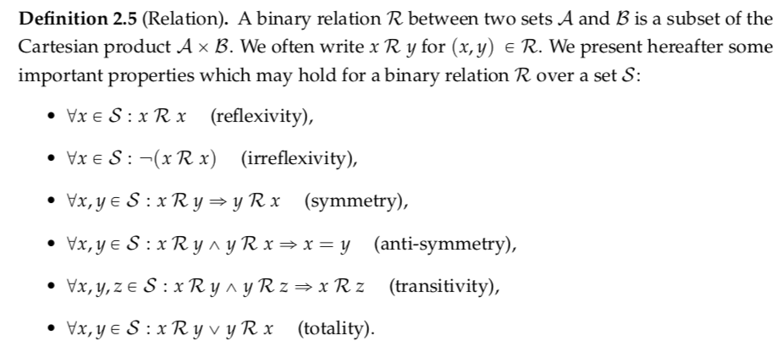
Excerpts from the Ben Khalifa thesis

Slide 7
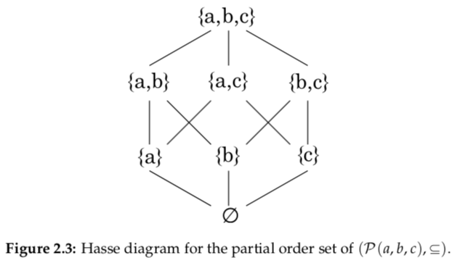
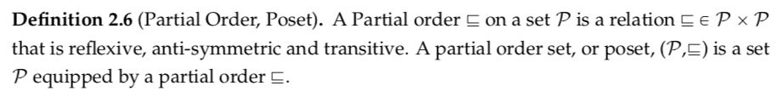
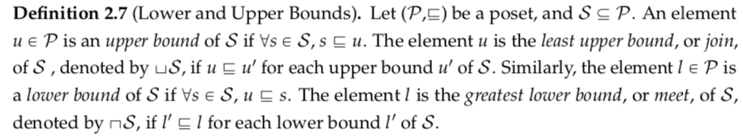
Ben Khalifa…

Slide 8
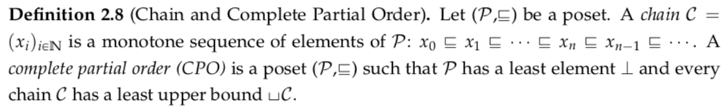
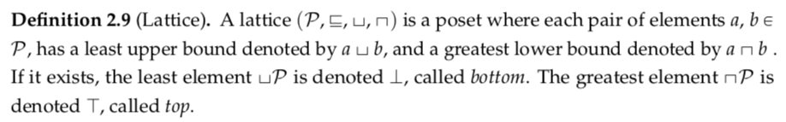
Ben Khalifa…

Slide 9
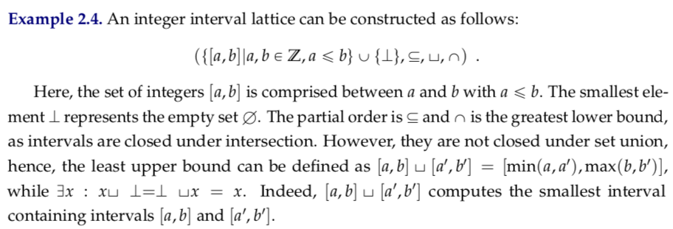
Ben Khalifa…

Slide 10
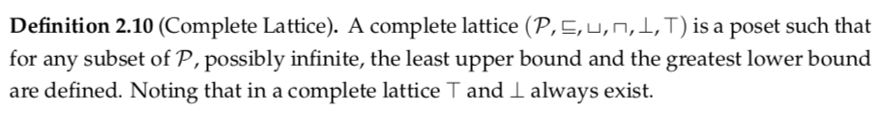
Ben Khalifa…

Slide 11
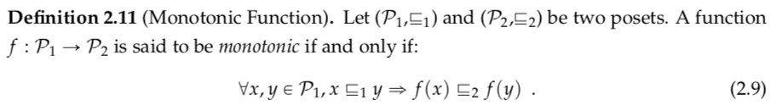
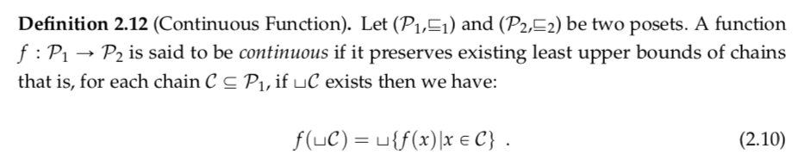
Ben Khalifa…

Slide 12
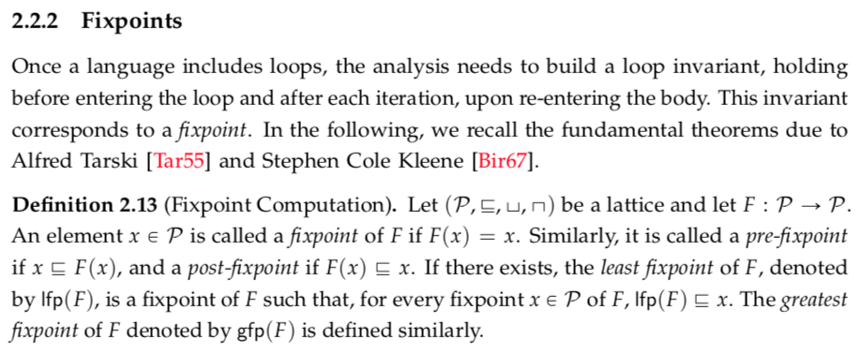
Ben Khalifa…

Slide 13
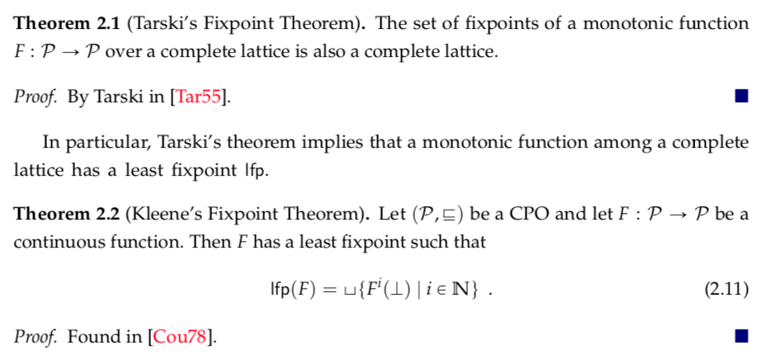
Ben Khalifa…

Slide 14
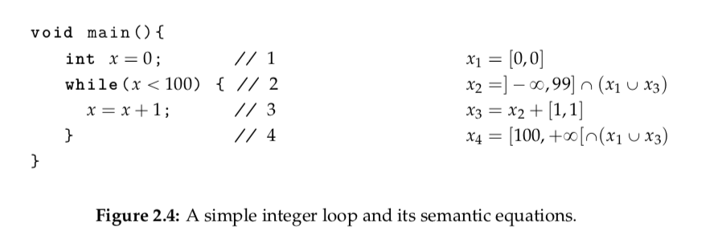
Ben Khalifa…

Slide 15
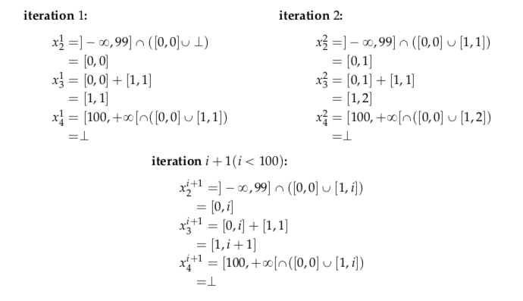
Ben Khalifa…

Slide 16

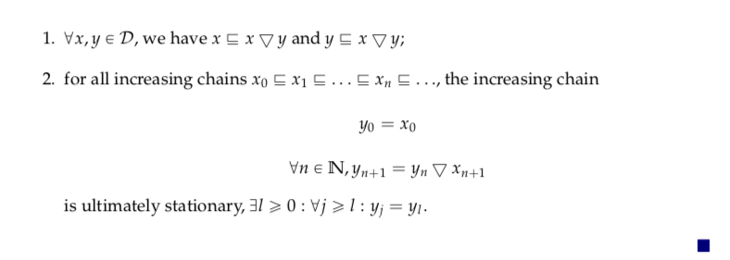
Ben Khalifa…

Slide 17
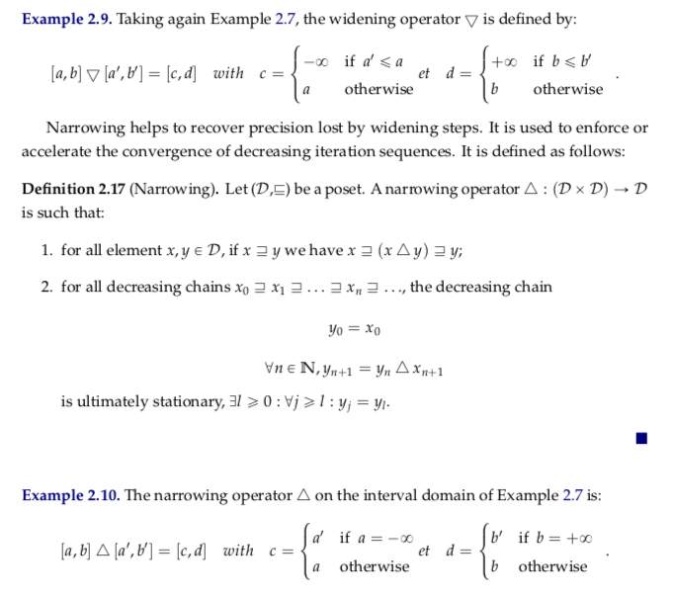
Ben Khalifa…

Slide 18
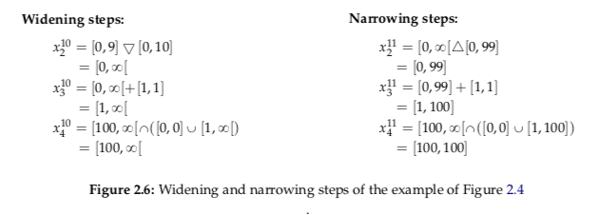
Ben Khalifa…

Slide 19
A good intro to widening and narrowing in the context of SPARTA (of Facebook) appears in https://youtu.be/_fA7vkVJhF8

Slide 20
Widening / Narrowing
Widening in Sparta seems to be based on existing program-level constraints
Apparently not practical always
See Slide 23 of Moller/Andersson
McCarthy’s “91 function” !
http://www.cs.us.es/~mjoseh/pub/Proving_termination_with_multiset_orderings_in_PVS.pdf
https://www.cs.umd.edu/~mvz/handouts/wift-tutorial.pdf
Narrowing “not implemented” in Sparta

Slide 21
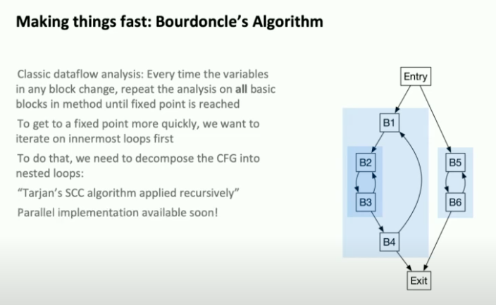
Cool things in the SPARTA talk

