Slide 1

CS 5/6110, Software Correctness Analysis, Spring 2022
Ganesh Gopalakrishnan
School of Computing
University of Utah
Salt Lake City, UT 84112

Slide 2
A study of two popular Hoare-logic Verifiers
Dafny
Verifast
Plus I plan to also include Frama-C
https://allan-blanchard.fr/publis/frama-c-wp-tutorial-en.pdf
I could get the GUI going on a local Linux machine
Install on Virtualbox failed on my mac..
It might work for you
https://frama-c.com/html/get-frama-c.html provides scripts
There is also a docker that one can connect to
Path is in Lec17/
It has many plug-ins
Eva, WP, ... and even mthread (for simulating concurrency)
Frama-C’s plug-ins are a fantastic idea
Read about Frama-C at https://cacm.acm.org/magazines/2021/8/254311-the-dogged-pursuit-of-bug-free-c-programs/fulltext
Refer to Mike-Gordon-Slides.pdf in Lec16/

Slide 3
From the Dafny Tutorial https://github.com/dafny-lang/dafny/blob/master/docs/OnlineTutorial/guide.md
Dafny lifts the burden of writing bug-free code into that of writing bug-free annotations.
(… and of course understanding the prover’s limitation…)
(when it comes to nonlinear arithmetic)
https://stackoverflow.com/questions/50395039/in-dafny-how-can-i-fix-the-value-does-not-satisfy-the-subset-constraints-of-n

Slide 4
More Tips from Rustan wrt nonlinear arithmetic (the said files are in this directory)
Hi Ganesh,
Nice to hear from you and to hear you’re using Dafny.
Your problem uses non-linear arithmetic, which can be a sore spot for the verifier. When dealing with non-linear arithmetic, it is usual that the verifier doesn’t do everything automatically and you instead have to supply some of the proofs yourself.
For your particular example, I, too, am surprised. I don’t have any explanation that I can offer, other than to say again that the verifier is weak when it comes to non-linear arithmetic. I tried some variations of your program and found that dafny3.dfy (enclosed) happens to work with both Y+Y and 2*Y. But why it works with both variations and your programs don’t, I can’t tell.
Are you by chance using Dafny in teaching or are planning to do so? I have written a textbook on verification that uses Dafny. The textbook is in draft form, but several colleagues at universities have used the draft version. If you’re interested, I can send you a hardcopy of the draft book. If so, please send me a good mailing address for it.
Best wishes,
Rustan

Slide 5
Where verification is crucial (the only way)
Bug in Timsort found and verified
http://envisage-project.eu/wp-content/uploads/2015/05/sorting-final.pdf
It is very easily the case that any algorithm that looks like Timsort (combinatorial complexity of cases) has, by definition, bugs!
Testing, fuzzing, and symb execution CANNOT hit many (most?) these in practice

Slide 6
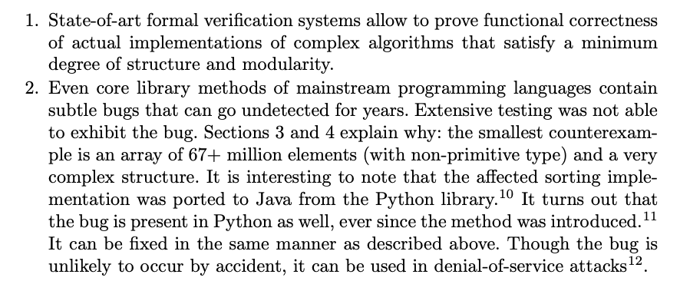
The “small model hypothesis” isn’t always true
Evidence of hardness (from their CAV’15 paper)

Slide 7
A Dafny Annotation
…

Slide 8
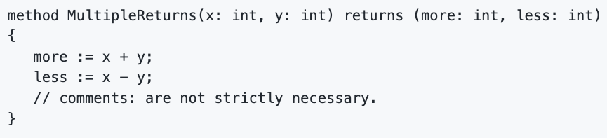
A Dafny method being verified – can have multiple returns
…

Slide 9
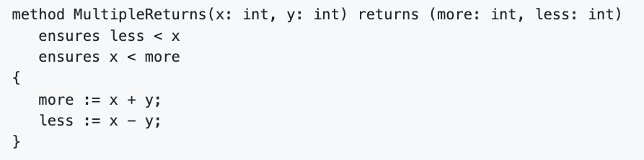
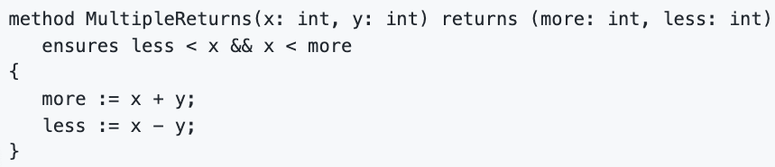

Annotated with pre/post in equivalent ways
Is allowed

Slide 10
Dafny tutorials (for various levels of reading)
https://dafny-lang.github.io/dafny/

Slide 11
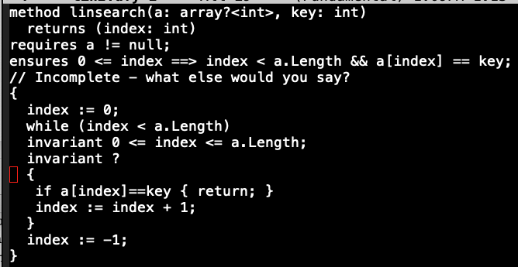
Dafny Exercises: Lin search

Slide 12
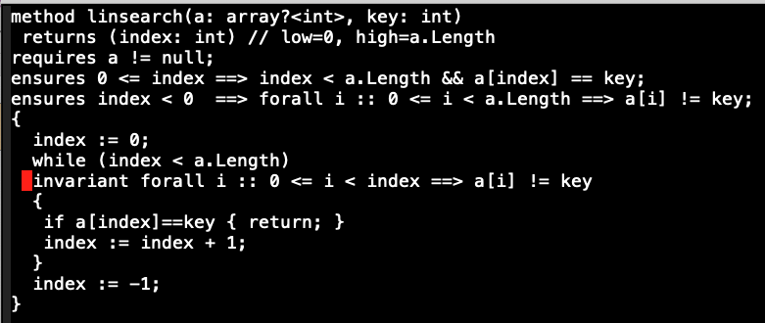
Dafny Exercises:

Slide 13
Will go through many Dafny exercises
See these folders
Power
Gcd
Fib
Sumarray
maxarray
Binsrch
The _fill file is the basic template
The _filled files provide what extra I had to do

Slide 14
Power _filled
Had to specify power recursively
Specs in most cases are functional programs
How else to mathematically specify imperative programs?
These functional programs employ well-founded recursion
According to Fixed-Point (or fixpoint) theory, such functions are
Uniquely defined
Had to state the obvious invariant
Had to specify the termination condition
Dafny is a total-correctness verifier (recall from Gordon’s slides)
It all worked out w/o additional help

Slide 15
Fib _filled
Had to state the obvious invariant pertaining to ‘a’ and ‘b’
Had to provide the termination condition
Had to bound ‘i’
Dafny seems unable to infer variable ranges from
their declared types
‘requires’ clauses
It all worked out after that

Slide 16
gcd _filled
Had to state the obvious invariant for gcd being maintained
Had to provide the termination condition
Had to give additional variable-range help
It could be done in one of many ways
It all worked out after that

Slide 17
Rustain_filled (multiplication)
Had to state the obvious invariant for both while loops
Termination for both whiles
In dafny3, an invariant x != 0 helps deal with nonlinear items
In dafny1, nonlinear theories tended to bother Dafny
In dafny2, we avoided nonlinearity

Slide 18
Maxarray _filled (maxarr and maxarrine)
Spec written using quantification
Obvious invariant for loop
Had to help loop index var also with range invariant
Termination – guessed by Dafny
Maxarrinte
Special check for 0-length avoided
Invariant suitably modified

Slide 19
sumarr _filled
Array summation recursively specified
Recursion made decreasing in func spec also by summing from highest
Obvious invariant for while loop
Help loop index with invariant
Invariant decorations given
Code must be written to match invariant
This was the recommended style in many books on programming

Slide 20
expsquaring
Exponentiation via squaring does not terminate
Nonlinear theory

Slide 21
Concluding Remarks (1)
Dafny is a great teaching tool
I’m told it is finding heightened use within Amazon
Where Dr. K. Rustan M. Leino now works
Very passionate about Dafny and very helpful contribution to an academic teaching tool!!
It generates executable files
The spirit of assertions can be carried into ordinary programming
Hoare’s “Assert Early, Assert Often” maxim
Decorating a program with known invariants (offered with sufficient calibration of level of trust in them) can be like gold, when maintaining code
Crucial for safety-critical codes
E.g. codes released into libraries
Then get to know the tool innards
And prove lemmas, and verify the theorems with manual interactions

Slide 22
Concluding Remarks (2)
Verifast is a young tool
Will experience on Thu
Written for Java and C
Their semantics matter wrt verification (good and bad)
Dafny avoids that and hence is an ideal teaching tool
Frama-C is more mature
Verifies modulo C-semantics (good and bad)
Both include separation logic
Frama-C’s plug-ins are a fantastic idea
Read about Frama-C at https://cacm.acm.org/magazines/2021/8/254311-the-dogged-pursuit-of-bug-free-c-programs/fulltext

