Slide 1

CS 5/6110, Software Correctness Analysis, Spring 2021
Ganesh Gopalakrishnan
School of Computing
University of Utah
Salt Lake City, UT 84112

Slide 2
Overview of Lecture 19
Projects
Please fix meeting this week (schedule online) to
Select/Refine projects
Seek resources
Projects will be the central aspect of your class
Today’s topic : Cache Coherence

Slide 3
What is cache coherence?
With shared-memory multiprocessors being the norm, we need a notion of sharing memory “as if it were one common area”
What does this mean?
Every write by Pi is readable by Pi as well as Pj where i != j
This is not precise-enough
A program can write more times to a location than once ☺
There could be multiple readers of a line
So,
Formally define when write-events are observable by read-events that match

Slide 4
What is cache coherence?
To define memory views as shared by multiple processors, we need to define a formal shared memory consistency model
Coherence is one of the basic models
Each location has a latest data that every reader agrees on
Also known as “per-location sequential consistency”
There are some interesting complexity results that help us understand coherence
Given a “finished execution trace”, checking coherence is NP-Complete
Very insightful proof by Jason Cantin et al
https://ieeexplore.ieee.org/stamp/stamp.jsp?arnumber=1435343

Slide 5
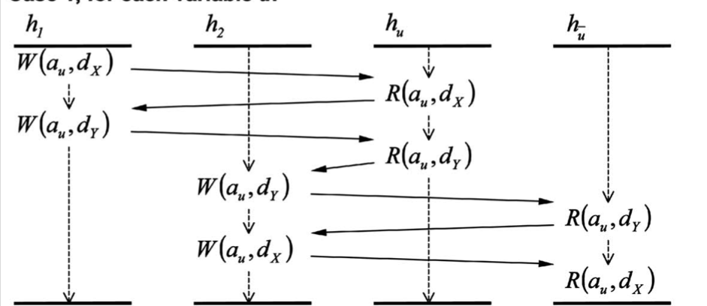
How a programmer sees coherence (Cantin paper)
Given four processes (or hardware threads) and reads/writes
Per location (“a_u” in this case) explain read-value outcomes.
Here we explain as if this interleaving took place.
The inability find such an explanation means the system is incoherent
Cool piece of encoding by Cantin: Given a 3SAT formula, he generates a shared memory execution such that the formula is SAT iff the execution is coherent!
If you are looking forward to challenging yourself in your growth as a professional CS researcher, you should not pass up such opportunities (follow such proofs). I can help if you are interested!
When you finish this, you’ll feel a faint glow around your head ;-)
ASIDE: There is a panel on “how to become a faculty” tomorrow. I’d say that solving these kinds
of puzzles can help you!
i.e. before you get out of the SoC, try to get the union of knowledge of the SoC faculty
* Getting the intersection is a bad idea → you’ll get close to the null set ☺

Slide 6
Implementing coherence
Snoopy-bus protocols (still present at smaller scales)
Directory-based protocols (more scalable)
See https://www.morganclaypool.com/doi/pdf/10.2200/S00962ED2V01Y201910CAC049 for Thu’s colloq speaker’s book

Slide 7
Coherence Verification
Given the complexity of coherence protocols, formal methods (model-checking mainly) is essential
Let us take a look at an academic protocol called The German Protocol
How does coherence verification scale?
Not well – today, large protocols take days to cover for one bit of data and 3 processors
Solutions
Derive cutoff bounds – Emerson and Kahlon
The bounds are large (7-8) and automatically computing bounds is not practical for large protocols
Do a parametric verification
Prove coherence for all ”N” – N is the number of cores/threads
This involves modeling 2-3 nodes explicitly and involves a manual abstraction/refinement loop – called CEGAR
Counter-Example Guided Abstraction Refinement
Involves designer input of non-interference lemmas
Do formal synthesis
Dr. Nagarajan will be presenting this on Thu

Slide 8
Basics about Transition Systems
Before we study the German protocol and how the parametric verification method I’m going to present works, let us discuss basic concepts about formal transition systems

Slide 9
Almost all specs for safety property checking look like this
Based on Guarded Commands
Rule1: g1 ==> a1
Rule2: g2 ==> a2
…
RuleN: gN ==> aN
Invariant P
Supported by tools such as Murphi (Stanford, Dill’s group)
Presents the behavior declaratively
Good for specifying “message packet” driven behaviors
Sequentially dependent actions can be strung using guards
“Rule Sets” can specify behaviors across axes of symmetry
Processors, memory locations, etc.
Simple and Universally Understood Semantics

Slide 10
Let us understand how we may safely transform such rule-based specifications (this is what we have to do in the parametric verification approach to be presented). The method is called the CMP method named after its inventors at Intel.

Slide 11
The name of the game – “invariants” !!
Much like loop invariants, except
These are invariants pertaining to formal state-transition systems
We are really talking about inductive invariants
Invariants P such that
They are true in the initial state
When held at a state, every transition rule preserves it
This is a hugely important topic (inductive invariant discovery)
Then you can do program-proofs by walking each path or transition rule!

Slide 12
Invariants, Inductive Invariants
Consider the transition system
Init : X == 1 (X is an int var … i.e. +, 0, - )
Tr1 : true ➔ x += 2
Tr2 : true => x += 3
An invariant is x != 0
But is it inductive?
(X != 0) ==?==Tr1➔ (X!=0) ?
(X != 0) ==?==Tr2➔ (X!=0)?

Slide 13
Invariants, Inductive Invariants
Consider the transition system
Init : X == 1 (X is an int var … i.e. +, 0, - )
Tr1 : true ➔ x += 2
Tr2 : true => x += 3
An invariant is x != 0
But is it inductive?
(X != 0) ==?==Tr1➔ (X!=0) ?
(X != 0) ==?==Tr2➔ (X!=0)?
No, for X == -2, it is not true!
So what is one inductive invariant for this transition system?

Slide 14
Invariants, Inductive Invariants
Consider the transition system
Init : X == 1 (X is an int var … i.e. +, 0, - )
Tr1 : true ➔ x += 2
Tr2 : true => x += 3
An invariant is x != 0
But is it inductive?
(X != 0) ==?==Tr1➔ (X!=0) ?
(X != 0) ==?==Tr2➔ (X!=0)?
No, for X == -2, it is not true!
So what is one inductive invariant for this transition system?
How about X >= 0 ?
How about X >= -1 ?
How about X >= 1 ?
…
What is the strongest inductive invariant of the above three?
What is the strongest inductive invariant (period) ?
Answer : = reachable state space!

Slide 15
New cool find today
New cool find: The I4 tool, and this hotos paper !
https://web.eecs.umich.edu/~manosk/assets/papers/i4-hotos19.pdf
https://web.eecs.umich.edu/~manosk/projects.html
https://web.eecs.umich.edu/~manosk/assets/papers/i4-hotos19-slides.pdf
I AM SUPER-EXCITED – A PROJECT to read and reconstruct
https://researchr.org/publication/fmcad-2021 (automated paxos proof ?!)

Slide 16
Let us understand how we may safely transform such rule-based specifications. The first few will be warmups. Then the real thing!
Observation: Weakening a guard is sound
Suppose we add a disjunct as below (Cond1) and still manage to show that P is an invariant, then without adding Cond1, the result must still hold
Rule1: g1 \/ Cond1 ==> a1
Rule2: g2 ==> a2
Invariant P
Reason: Rule1 fires more often with Cond1 added!
May get false alarms (P may fail if Rule1 fires spuriously)
For many “weak properties” P, we can “get away” by guard weakening
This is a standard abstraction, first proposed by Kurshan (E.g. removing a module that is driving this module, letting inputs “dangle”)
BUT in the CMP method, we won’t do this – rather we will do guard strengthening!
Except it is useful to know this disjunction property in thinking about certain steps of CMP

Slide 17
But… Guard Strengthening is, by itself, Unsound
Strengthening a guard is not sound
Rule1: g1 /\ Cond1 ==> a1
Rule2: g2 ==> a2
Invariant P
Reason: Rule1 fires only when g1 /\ Cond1
So, less behaviors examined in checking P
Thus, verifying _with_ Cond1 means nothing for verification without Cond1
But hang on, there is more in the CMP method ☺

Slide 18
Guard Strengthening can be made sound, if the conjunct is implied by the guard
This is sound
Rule1: g1 /\ Cond1 ==> a1
Rule2: g2 ==> a2
Invariant P /\ (g1 ==> Cond1)
Reason: Rule1 fires only when g1 /\ Cond1
BUT, Cond1 is always implied by g1; we are showing g1➔Cond1 is an invariant also , so no real loss of states over which Rule1 fires…
Call this “Guard Strengthening Supported by Lemma”
Except, you are showing the invariant in the same modified system!
This is fine:
Initial state satisfies P, and also (g1 ➔ Cond1). Thus, whenever g1 is true in the initial state, Cond1 is an implied fact. So g1 /\ Cond1 is like g1 by itself.
Thus “a1” can be conducted in the initial state , to obtain the next set of states. (No change wrt g2 and a2, so they are like before.)
In general
At state t (by induction over time), we have P true and (g1 ➔ Cond1) true.
Thus , g1, when true, implies Cond1 at time t. Thus g1 /\ Cond1 is like g1 (same truth status) at time t
Thus we can obtain the state at t+1 safely via “a1”

Slide 19
Summary of Transformations so far (checkmark shows what’s safe)
X
✓
✓

Slide 20
The CMP Approach
Weaken to the Extreme
Then Strengthen Back Just Enough (to pass all properties)

Slide 21
Weaken to the Extreme sounds crazy at first!
Rule1: g1 \/ True ==> a1
Rule2: g2 ==> a2
Invariant P
The transition system above
can be transformed to the one below without any issues
(except the proof of P being an invariant might not go through) – but that will be fixed momentarily
Rule1: True ==> a1
Rule2: g2 ==> a2
Invariant P

Slide 22
Strengthen Back Some
Rule1: True /\ C1 ==> a1
Rule2: g2 ==> a2
Invariant P /\ (g1 => C1)
“Not Enough!” may be
the outcome of strengthening.
That is, while we added C1 back,
it may not be strong-enough.
How to pick C1 will be discussed soon.

Slide 23
Strengthen Back More…
Rule1: True /\ C1 ==> a1
Rule2: g2 ==> a2
Invariant P /\ g1 => C1
“Not Enough!”
Rule1: True /\ C1 /\ C2 ==> a1
Rule2: g2 ==> a2
Invariant P /\ (g1 => C1) /\ (g1 => C2)
“OK, just right!”

Slide 24
A Variation of Guard Strengthening Supported by Lemma: Doing it in a meta-circular manner (i.e., the temporal induction I alluded to earlier…)
✓
This is the approach in our work

Slide 25
Now the secret: in the CMP method, the designer decouples all nodes beyond k (typically 2) explicitly modeled nodes. Then, brings back the N-k nodes, but in ‘spirit’ – i.e., in terms of the non-interference conditions they must obey (note that “N” is a free parameter). The Ci are thus the non-interference lemmas. Each is discovered upon seeing a counterexample, and then added back into the system! If the coherence invariant is proved (usually this happens), then you ended up having used a model-checker to prove a parametric theorem – which is a big deal!
✓
This is the approach in our work

Slide 26
This method has been perfected at Intel and in production use!
See https://www.cs.utexas.edu/~hunt/FMCAD/FMCAD09/slides/talupur.pdf
https://dl.acm.org/doi/pdf/10.5555/1517424.1517434
Designers write “protocol flow” diagrams as part of standard documentation
These are mined to obtain the non-interference lemmas
See http://formalverification.cs.utah.edu/presentations/fmcad04_tutorial2/chou/ctchou-tutorial.pdf for details of how this is done
NOTE the table-style specification recommended in the above tutorial at fmcad04 !!

Slide 27
We will now present highlights of the German Protocol to tell you how coherence protocols look like (but this is like a “hello world” of cache protocols)
See german.m , german.pdf , and abs-german.pdf in the class directory
We will note down some highlights in the coming slides

Slide 28
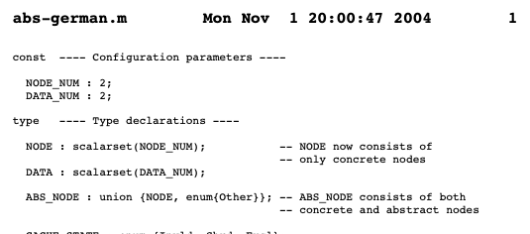
CMP highlights from paper of C-T Chou

Slide 29
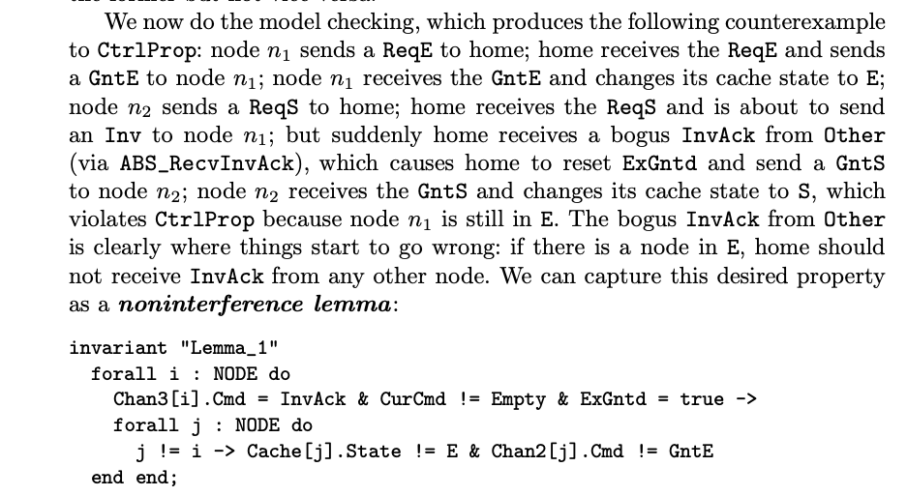
CMP highlights from paper of C-T Chou

Slide 30
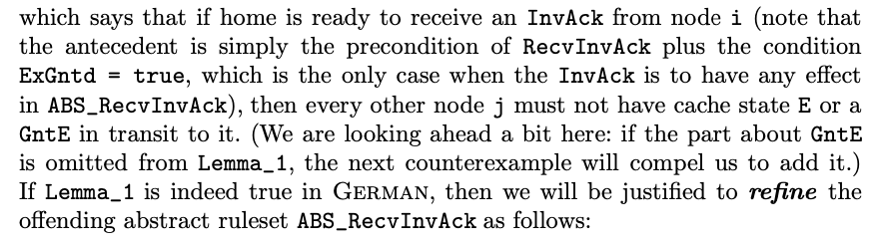
CMP highlights from paper of C-T Chou

Slide 31
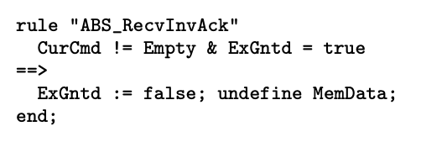
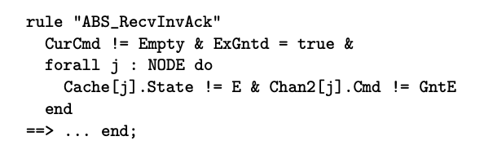
CMP highlights from paper of C-T Chou
The top-left rule is changed to the bottom-right rule in the CMP method, by introducing non-interference lemmas to strengthen the guards. These lemmas are proven in the same model being refined.

Slide 32
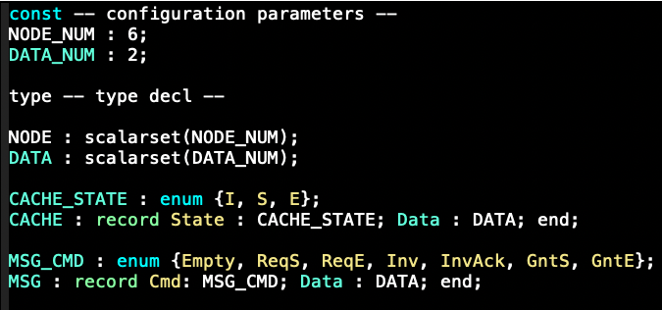
German protocol

Slide 33
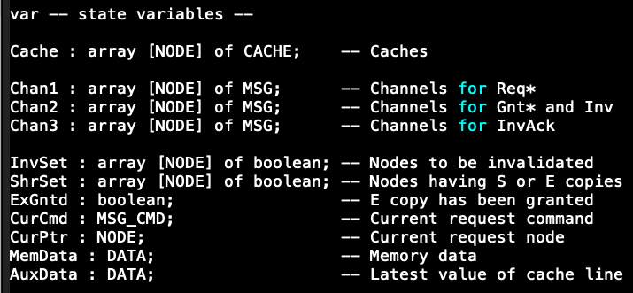
German protocol

Slide 34
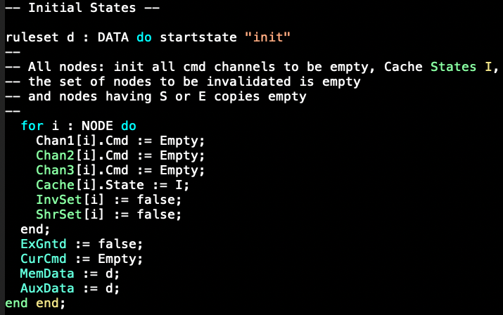
German protocol

Slide 35
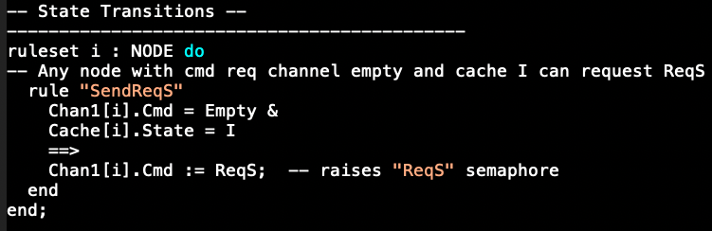
German protocol

Slide 36
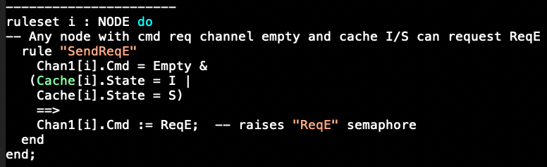
German protocol

Slide 37
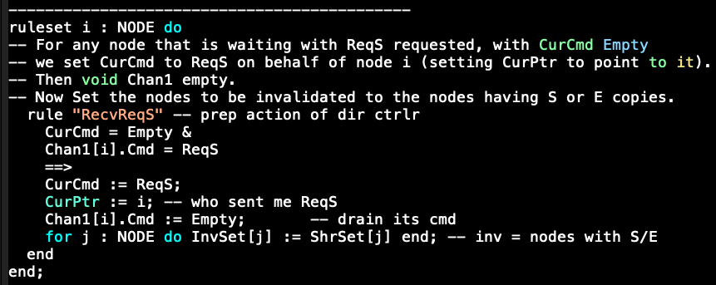
German protocol

Slide 38
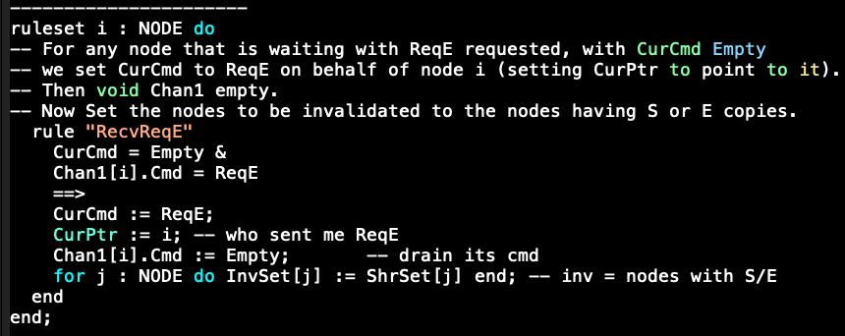
German protocol

Slide 39
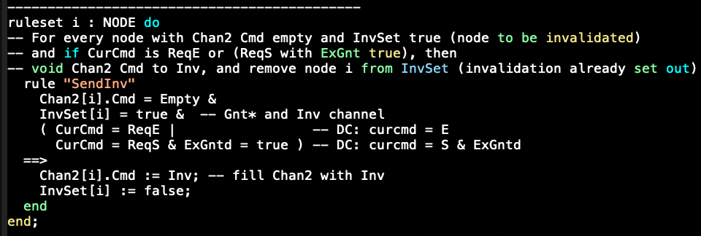
German protocol

Slide 40
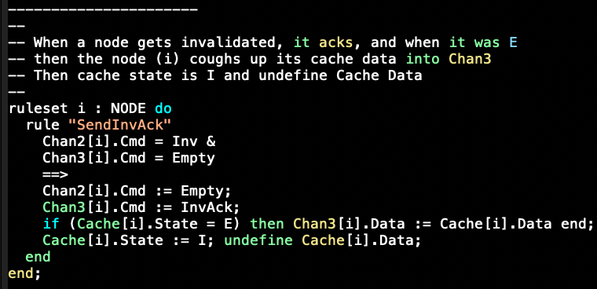
German protocol

Slide 41
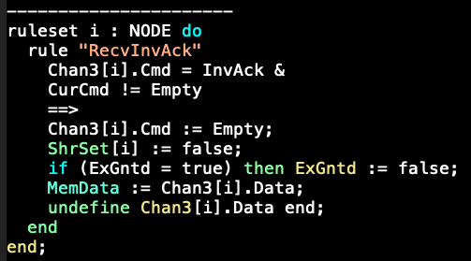
German protocol

Slide 42
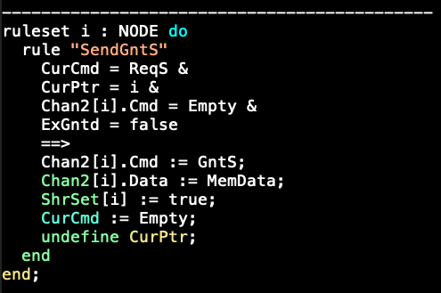
German protocol

Slide 43
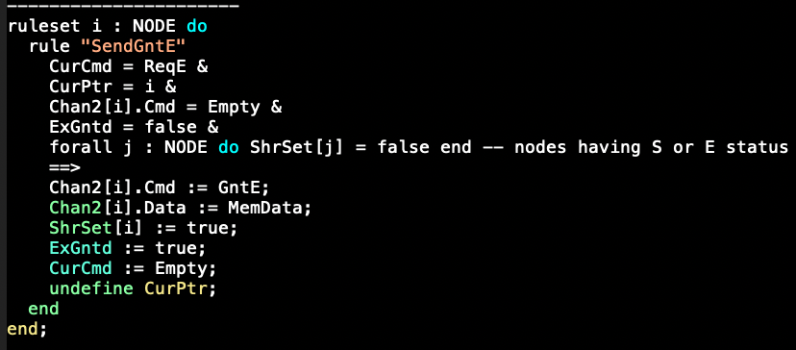
German protocol

Slide 44
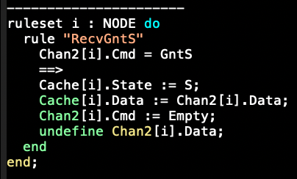
German protocol

Slide 45
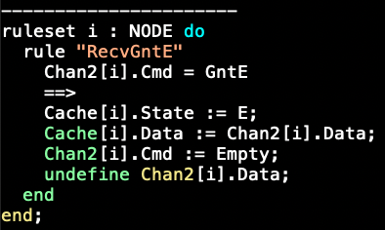
German protocol

Slide 46
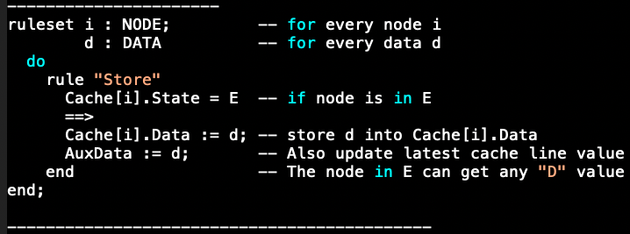
German protocol

Slide 47
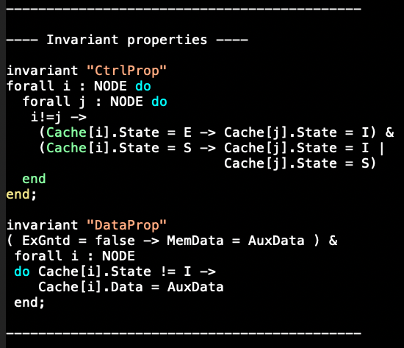
Invariants of the German protocol

