Slide 1

CS 5/6110, Software Correctness Analysis, Spring 2022
Ganesh Gopalakrishnan
School of Computing
University of Utah
Salt Lake City, UT 84112

Slide 2
Static Analysis
Let us follow the slides at https://cs.au.dk/~amoeller/spa/
Then learn the basics by doing some exercises, encoding things in Prolog

Slide 3
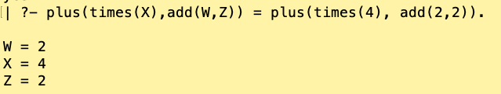
Why Prolog? Why Prolog in 6110?
Prolog is a useful declarative language to know
Type inference illustrated in spa.pdf uses unification
Unification is central to Prolog – happens at each “clause call”
Unification is “two-way pattern matching”
computes the most general unifier – e.g. mgu below is X=4, Y=2, Z=2
This substitution when applied to both sides makes them both the same
In this case makes them both plus(times(4), add(2,2))
Information flows both ways
Example of Unification ====➔
Pattern matching: one-way info flow

Slide 4
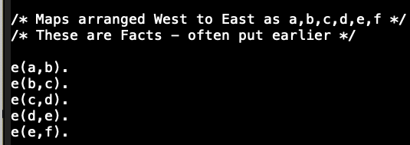
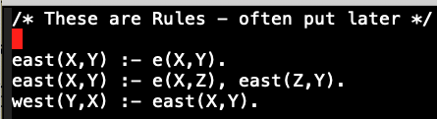
Prolog Illustration: a ‘map’ of linearly situated states a,b,c,d,e,f
Prolog’s goal : compute the “mgu” at each clause call
Suppose six states a,b,c,d,e,f are situated like that, going east to west
Here is a Prolog program that calculates the state positions relative to each other:

Slide 5
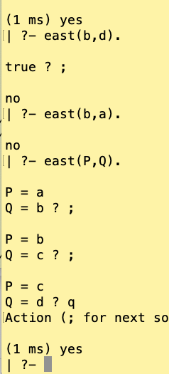
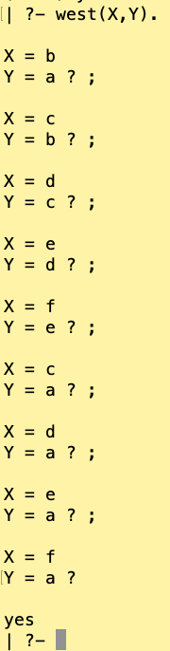
Prolog Illustration: a ‘map’ of linearly situated states a,b,c,d,e,f

Slide 6
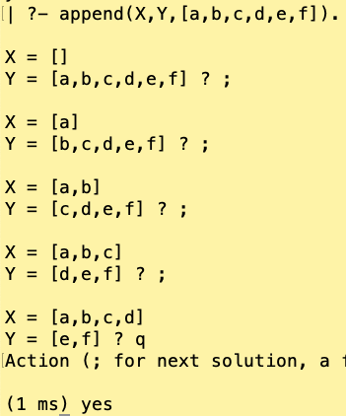
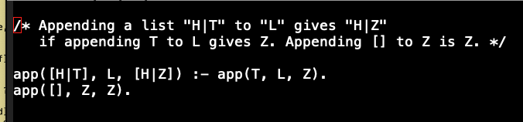
Prolog Illustration: appending lists reversed (and a 2-line Append relation)

Slide 7
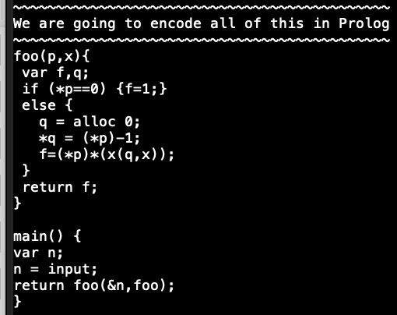
Unification in type-inference : We will study flow-insensitive type inference

Slide 8
Unification in type-inference

Slide 9
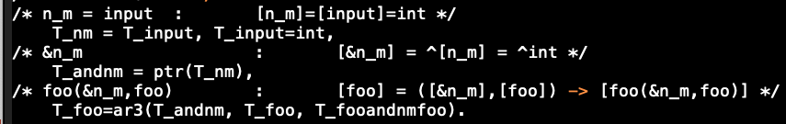
Unification in type-inference

Slide 10
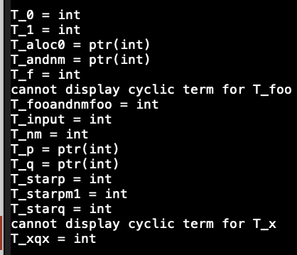
Unification in type-inference

Slide 11
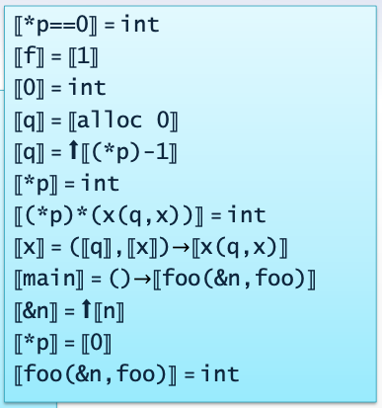
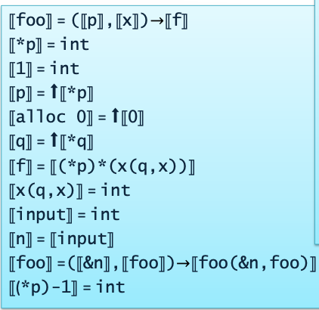
Unification in type-inference

Slide 12
Flow-Sensitive Type Inference
We will use lattices (and perform Abstract Interpretation)
Lattices help establish an information-theoretic order
We will perform fixed-point iterations on lattices
All this will be broken down via examples and then illustrations using Alloy

Slide 13



Lattice-Engineering is important!
Used in studying denotational semantics using fixed-point theory
Used in type-inference
Used in circuit simulation
Solving Recursion
The “f” function that is recursively defined
Has an increasing chain of approximations
Going top to bottom
And these functions can all
Be situated in
Lattice-Like structures
(often Complete Partial Orders)

Slide 14
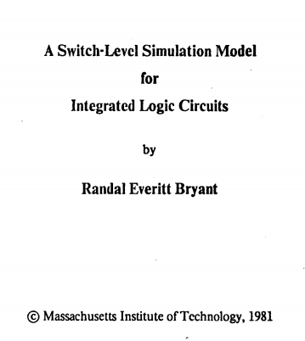
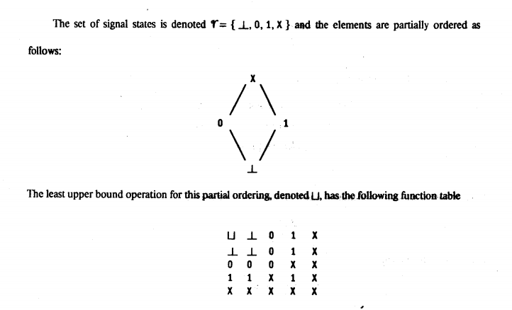
Lattices in Circuit Simulation

Slide 15
Definitions pertaining to lattices in Alloy
Loosely (see spa.pdf for precise definitions…) Lattices are partially ordered sets with the notion of “le” or [= showing the ordering. There is a notion of upper-bound and lower-bound for any subset of the lattice. There is a notion of a greatest lower-bound and least upper bound. They prove to be unique (because of the set being a partial order). A partial order is a lattice if the GLB and LUB exist for any pair of elements. Finite lattices are complete (only those will be illustrated using Alloy). Infinite lattices require there to be a GLB and LUB for every set – even empty sets. Think of the set of all finite subsets of Nat ordered by [=. We can make this a complete lattice using subset inclusion, but must artificially add a “top” element.
All this flies past – let’s pin it down using Alloy!

Slide 16
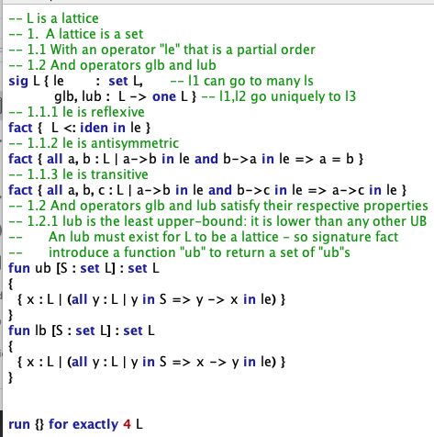

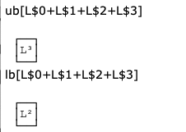
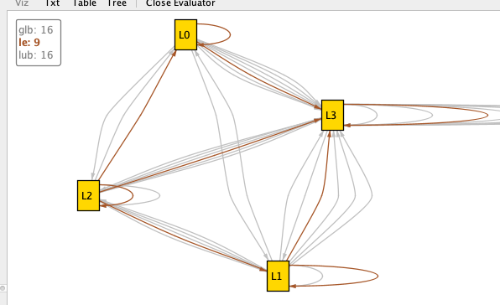
Lattices in Alloy

