Slide 1

CS 5/6110, Software Correctness Analysis, Spring 2021
Ganesh Gopalakrishnan
School of Computing
University of Utah
Salt Lake City, UT 84112

Slide 2
11
More Hoare Logic
Dafny Exercises
Gordon’s Prover (code read)

Slide 3
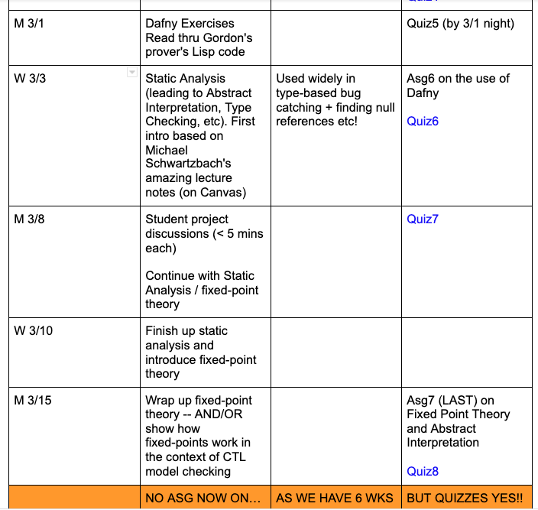
Where we are

Slide 4
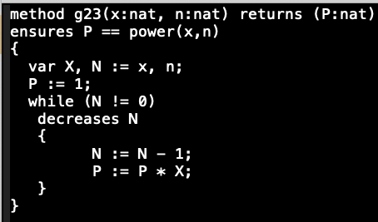
Dafny Exercises: Loop invariant?

Slide 5
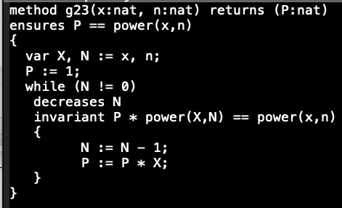
Dafny Exercises: specificiation of power?

Slide 6
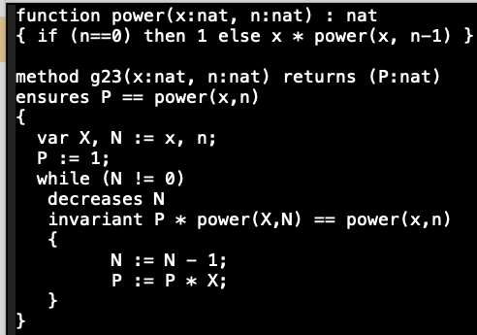
Dafny Exercises

Slide 7
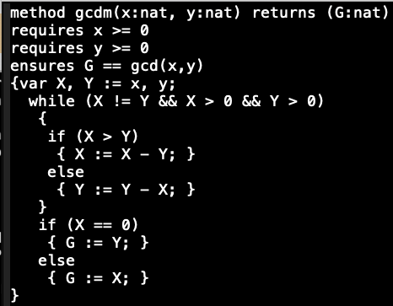
Dafny Exercises: Ranking function (“decreases”)?

Slide 8
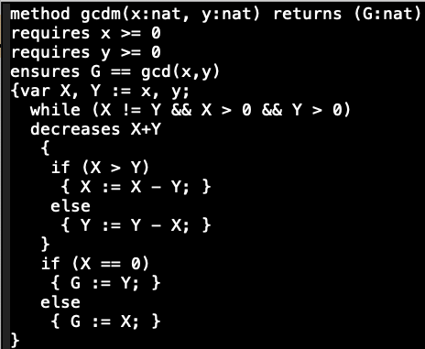
Dafny Exercises: Loop invariant?

Slide 9
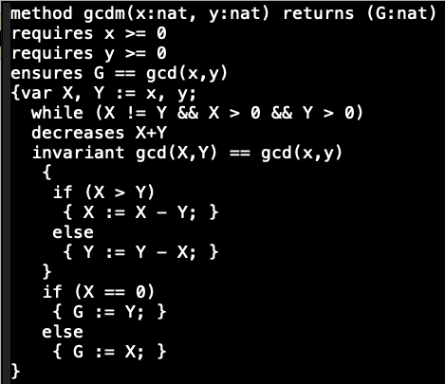
Dafny Exercises: Specification?

Slide 10
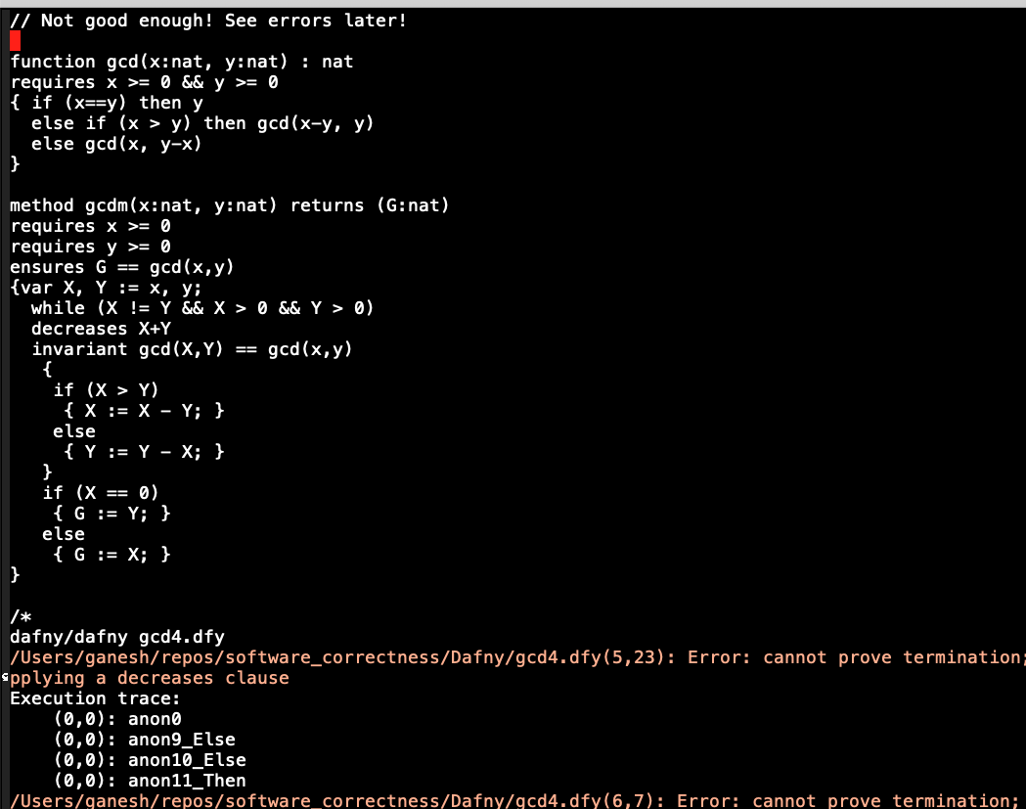
Dafny Exercises: Help prove termination!

Slide 11
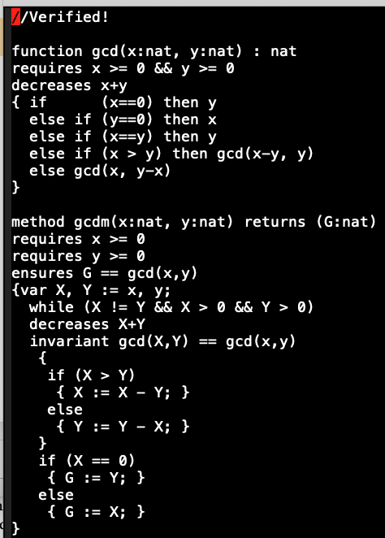
Dafny Exercises: Finally!

Slide 12
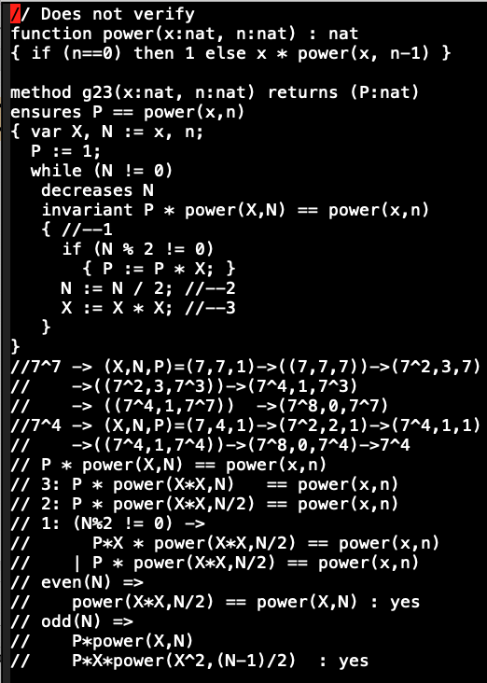
Dafny Exercises: Optimized exp (unfinished..) plz try with me! Two approaches: 1) more simple invariants 2) lemma

Slide 13
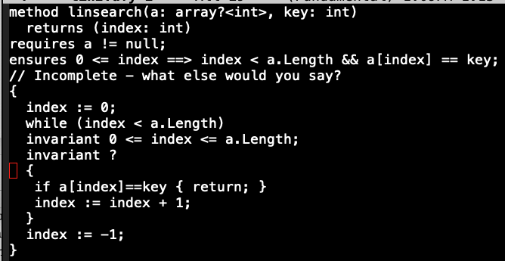
Dafny Exercises: Lin search

Slide 14
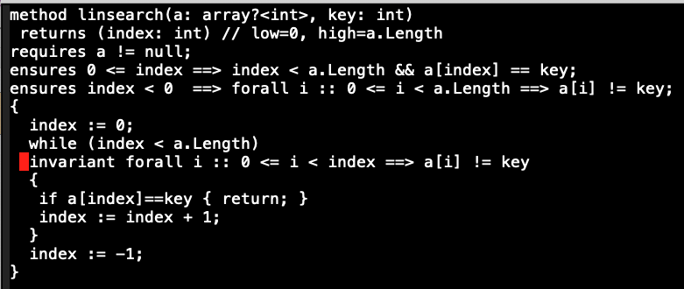
Dafny Exercises:

Slide 15
Dafny Exercises:
See other failures and successes – see files kept online

Slide 16
An intro to Hoare Logic and its rules
Follow Gordon’s prover code kept online

Slide 17
Dafny Exercises
We will continue with more Dafny in Asgs
Wed: Finish up Hoare Logic
Then Static Analysis

