Slide 1

CS 5/6110, Software Correctness Analysis, Spring 2021
Ganesh Gopalakrishnan
School of Computing
University of Utah
Salt Lake City, UT 84112

Slide 2
A study of two popular Hoare-logic Verifiers
Dafny
Verifast
Refer to Mike-Gordon-Slides.pdf in Lec16/

Slide 3
From the Dafny Tutorial https://github.com/dafny-lang/dafny/blob/master/docs/OnlineTutorial/guide.md
Dafny lifts the burden of writing bug-free code into that of writing bug-free annotations.

Slide 4
A Dafny Annotation
…

Slide 5
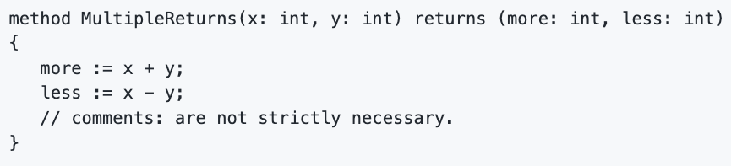
A Dafny method being verified – can have multiple returns
…

Slide 6
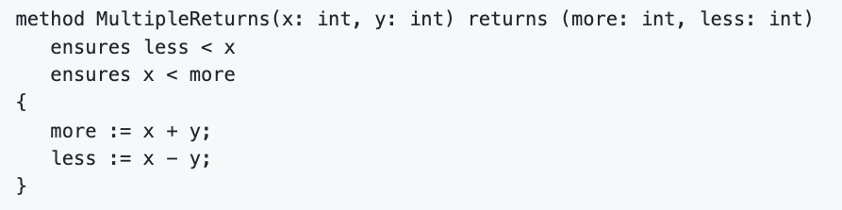
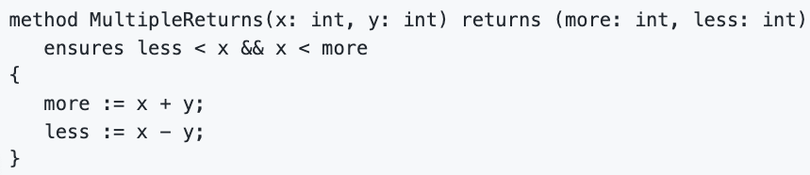

Annotated with pre/post in equivalent ways
Is allowed

Slide 7
…

Slide 8
…

Slide 9
…

Slide 10
…

Slide 11
…

Slide 12
…

Slide 13
…

Slide 14
…

Slide 15
…

Slide 16
…

Slide 17
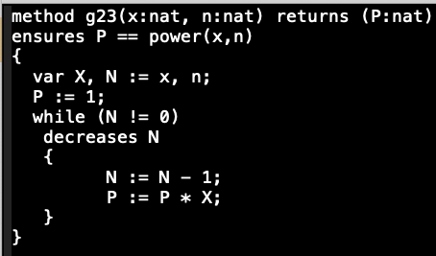
Dafny Exercises: Loop invariant?

Slide 18
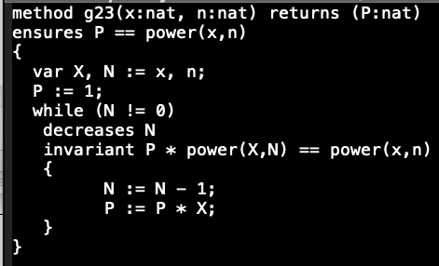
Dafny Exercises: specificiation of power?

Slide 19
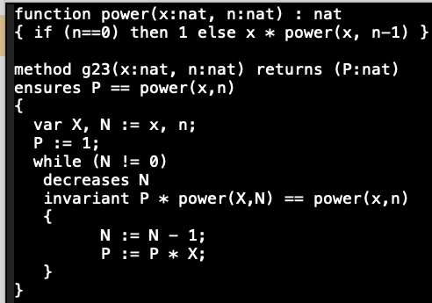
Dafny Exercises

Slide 20
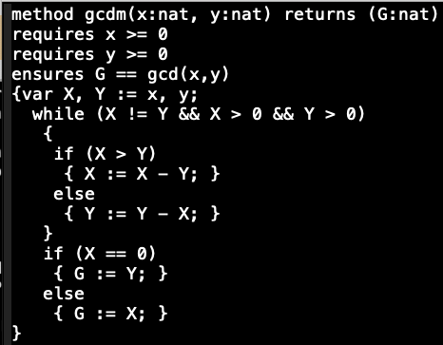
Dafny Exercises: Ranking function (“decreases”)?

Slide 21
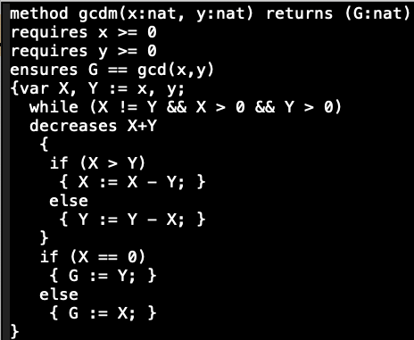
Dafny Exercises: Loop invariant?

Slide 22
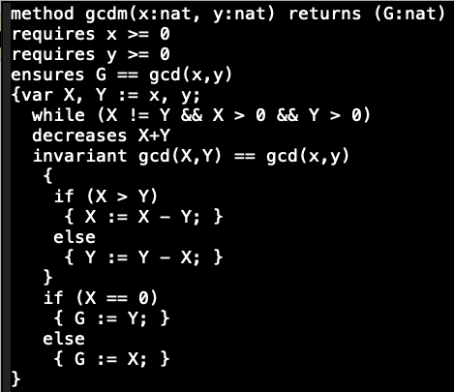
Dafny Exercises: Specification?

Slide 23
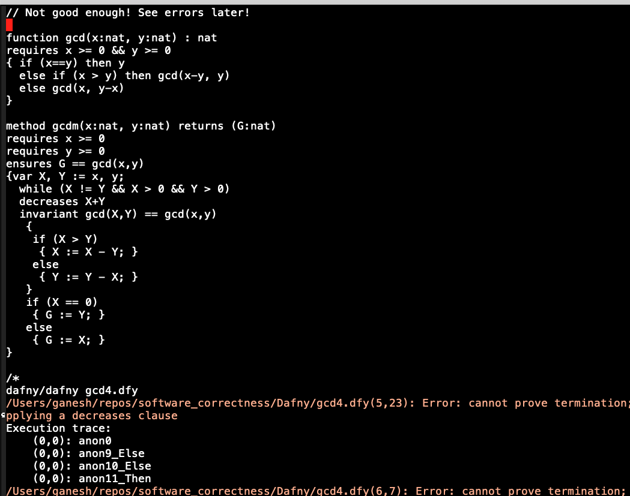
Dafny Exercises: Help prove termination!

Slide 24
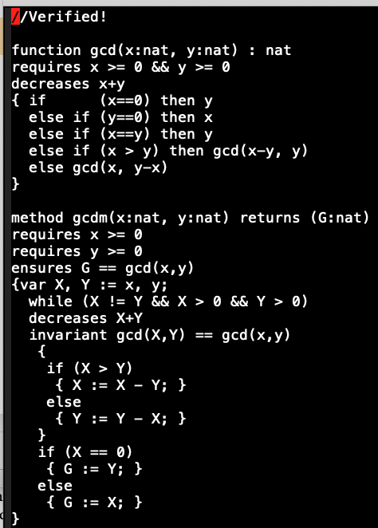
Dafny Exercises: Finally!

Slide 25
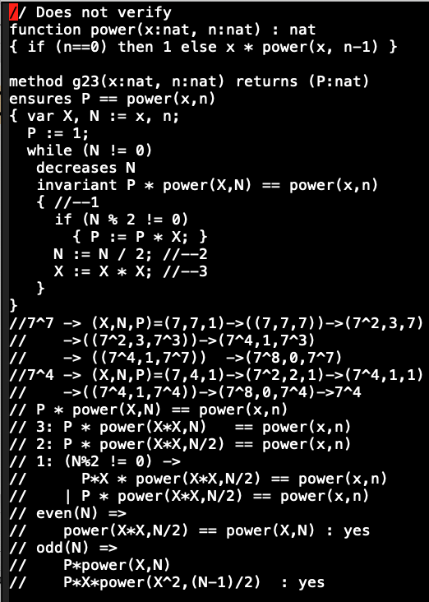
Dafny Exercises: Optimized exp (unfinished..) plz try with me! Two approaches: 1) more simple invariants 2) lemma

Slide 26
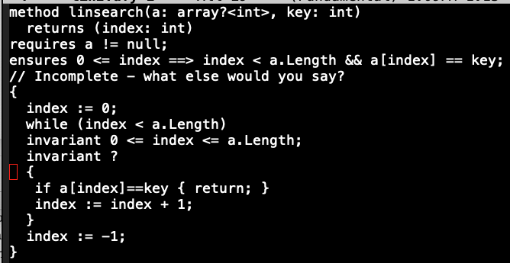
Dafny Exercises: Lin search

Slide 27
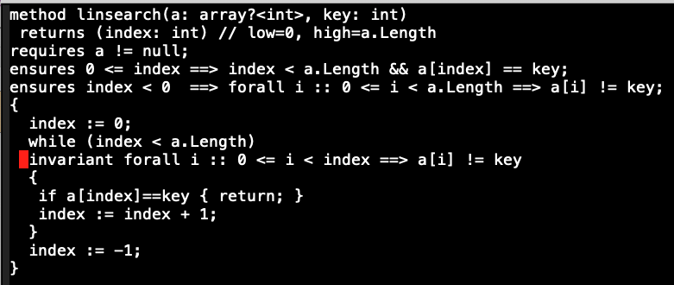
Dafny Exercises:

Slide 28
Verifast Tutorial
Illegal_access.c – following verifast-tutorial.pdf
Ran IDE using ctrl + open on vfide-core
Play with the if-check commented
Did express lack of ownership of myAccount
Click on any “Steps” step to know the status of symb execn
Path condition in Assumptions
Symbolic heap in “Heap chunks” pane
Symbolic store in the Locals pane
Uncomment and F5 (rerun verif)
Symb Execn succeeds
Symb execn tree for main can be viewed

Slide 29
Verifast Tutorial
The ‘run to cursor’ serves as a breakpoin
The “show execution tree” (^T) is a toggle
Come to “verifying function main” to see the full tree
If we have meanwhile selected a “run to cursor”, we will probably see a red node at the tip
If we add a double-free, we see that the permission isn’t available, and verification terminates with an error
The “include paths” option is interesting (under Verify)
The steps are visible by clicking the relevant tree nodes
“Leaf node” is not the green/red “closed/open” indicator node
It is rather the parent of such a node (black in color)

Slide 30
Verifast Tutorial
Trace the symb execution path
Select the leaf of the execution tree
Select the steps
Downarrow along steps
Observe the coloration in the code window and the changing assumptions
Producing and consuming assumptions
The malloc adds heap chunks
Accound_balance(myAccount, value) seems to say what resources are available
Myaccount is mem chunk
Value is its symbolic value
Fresh names are generated
This is really the act of exists handling or Skolemization in logic
“account_balance” and “malloc_block_account” seem like built-in concepts
Can see fresh var names

Slide 31
Illustration of symb constants
#include "stdlib.h"
struct account {
int balance;
};
int main()
//@ requires true;
//@ ensures true;
{
{ struct account *myAccount = malloc(sizeof(struct account));
if (myAccount == 0) { abort(); }
}
{ struct account *myAccount = malloc(sizeof(struct account));
if (myAccount == 0) { abort(); }
}
//myAccount->balance = 5;
// free(myAccount);
//free(myAccount);
return 0;
}

Slide 32
Verifast Tutorial
Trace step-thru reveals how heap chunks are alloc/dealloc
The locals are interesting
myAccount points to myAccount or myAccount0 etc as the case may be in symb execution
The assumption has myAccount != 0 which indicates that the malloc succeeded
Of interest to node
Symbols : … symbolic names allocated …
Assumptions : what path assumptions hold
Heap chunks : what heaps exist
Locals : how the locals are bound to the allocated symbols
Account_balance(myAccount, value –> changes to → 5 )

Slide 33
Verifast Tutorial
Consuming assertion
Then cleaning up dummy fraction chunks
Then leak check
Changing allocation to stack allocation to see why account_balance and malloc_block_account are allocated in the former code

Slide 34
Saved code
Saved code
#include "stdlib.h"
struct account {
int balance;
};
int main()
//@ requires true;
//@ ensures true;
{
struct account *myAccount = malloc(sizeof(struct account));
if (myAccount == 0) { abort(); }
myAccount->balance = 5;
free(myAccount);
return 0;
}

Slide 35
New code – error at “free” (no matching heap chunks)
#include "stdlib.h"
struct account {
int balance;
};
int main()
//@ requires true;
//@ ensures true;
{
struct account myAccountLocal;
struct account *myAccount = &myAccountLocal;
myAccount->balance = 5;
free(myAccount);
return 0;
}

Slide 36
Verifast Tutorial
Interesting things to note
Account_balance(myAccountLocal_addr, value)
This has a stack entry address myAccountLocal_addr
It holds “value”
What is struct_account_padding(myAccountLocal_addr) ?
Why are things being shown in heap?
Let us remove the free and see what happens
Then, things verify
Observe “result” being assigned 0
Designated return result

Slide 37
By looking at heap-chunks owned, form spec
include "stdlib.h"
struct account
{
int balance;
};
/*
predicate account_pred(struct account *myAccount, int theLimit, int theBalance)
=
myAccount->limit |-> theLimit &*& myAccount->balance |-> theBalance
&*& malloc_block_account(myAccount);
*/
struct account *create_account()
//@ requires true;
//@ ensures malloc_block_account(result) &*& account_balance(result, _);
{
struct account *myAccount = malloc(sizeof(struct account));
if (myAccount == 0) { abort(); }
return myAccount;
}
void account_set_balance(struct account *myAccount, int newBalance)
//@requires account_balance(myAccount, _);
//@ensures account_balance(myAccount, newBalance);
{
myAccount->balance = newBalance; }
int main()
//@ requires true;
//@ ensures true;
{
struct account *myAccount = create_account();
account_set_balance(myAccount, 5);
free(myAccount);
return 0;
}

