Slide 1

CS 6110 Software Correctness, Spring 2022 (edited from a previous class; look for bugs!)
Ganesh Gopalakrishnan
School of Computing
University of Utah
Salt Lake City, UT 84112
URL: bit.ly/cs6110s22

Slide 2
Slides for Lec4 : Agenda
Logic readings
Discussions
FSM material
Not familiar to many
Not taught as a practical tool in most courses
Not taught as the first real formal methods in most courses
E.g. context-free parsing is really the first dramatically successful FV tool
The horrible bugs in them
Fortran missing comma -> spacecraft in a coma ☺
The )))*((( rule for parsing!
Knuth’s article on how bad compilers were in the 1960s !!
Youtube version is pretty good (how he got his honeymoon paid for!)
https://archive.computerhistory.org/resources/text/Oral_History/Knuth_Don_1/Knuth_Don.oral_history.2007.102658053_all.pdf
OpSem basics → Sutter

Slide 3
Slides for Lec4 : Agenda
How the project discussions are proceeding
Notes being taken
References being catalogued
Not all are at the same point in learning about Logic, Automata, …
But they are all important to learn properly!
We will go through the Bradley/Manna book Ch 1,2
Discussion of readings from Ch1
SPIN Usage
Long trace
Search depth control

Slide 4
Slides for Lec4 : Agenda
Readings for next week + Asg-2
Posted tomorrow (1/21) evening
From Ben-Ari’s book
From CEATL
About NBA != DBA
About LTL
Nested DFS
How we can show LTL validity by creating the right Kripke Structure!
Reinforces idea of validity
Distributed Locking Protocol
In Promela
In Murphi

Slide 5
How SPIN helps
Helps you quickly model “situations”
See SPIN-Soldiers + SpinTutorialby Ruys
Debug your thoughts
Find flaws in design
Has a lot of power and will NEVER become irrelevant
The more complex a system gets, the less you need to get fancy wrt verification
(after a 1-month training), you can do this
When in doubt, whip up a SPIN model and find bugs (in system or in your head)
Has worked for large systems
Recent correctness workshop -> entire new Pthreads implementation modeled!
We don’t have the full month to train you
This is the last SPIN week … but I’ll give you a REAL protocol verif to read on Thu!

Slide 6
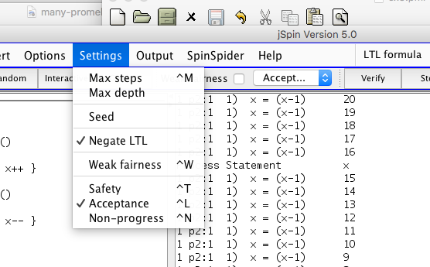
ex5

Slide 7
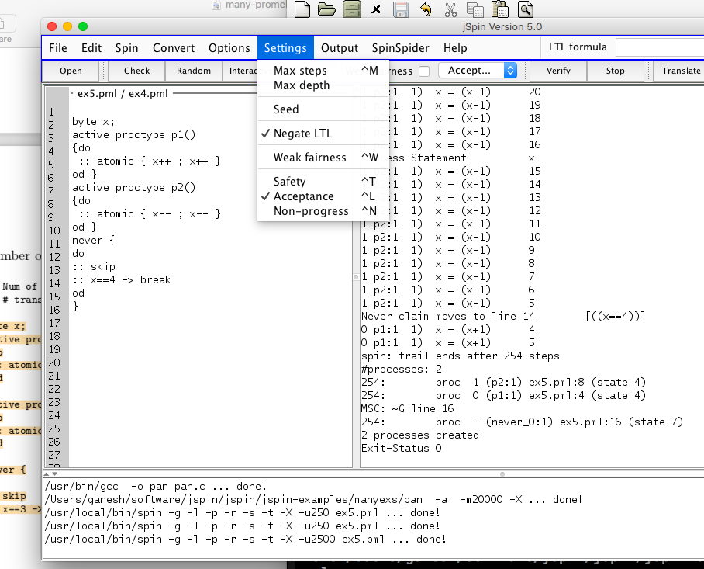
ex5

Slide 8
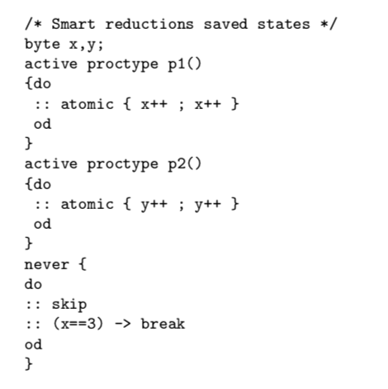
ex6

Slide 9
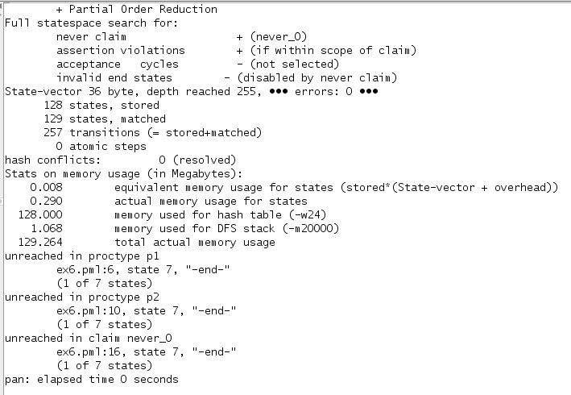
ex6

Slide 10
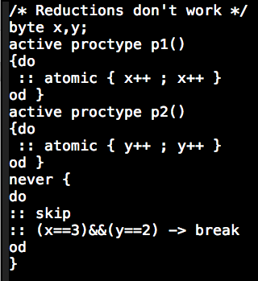
ex7

Slide 11
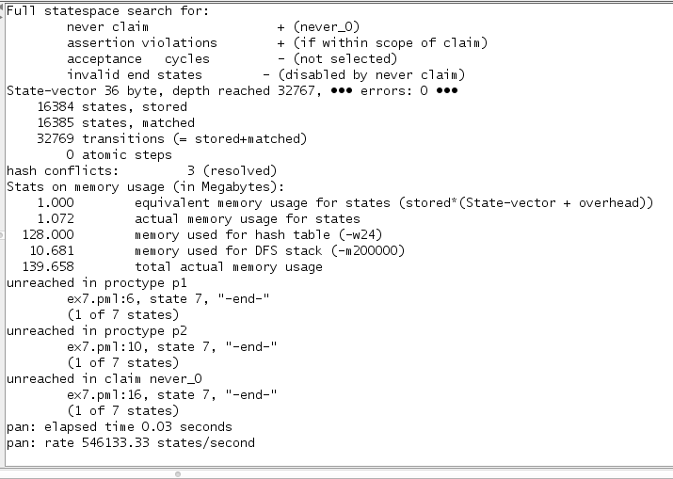
ex7 do the right depth setting!

Slide 12
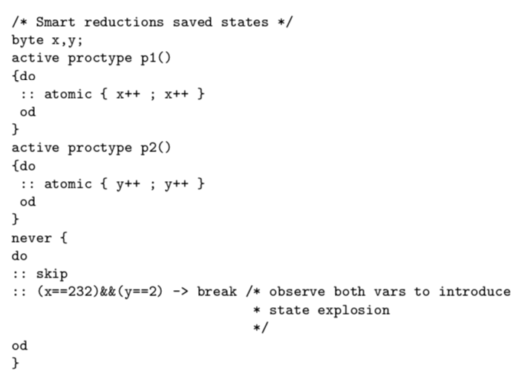
ex8 do the right depth setting!

Slide 13
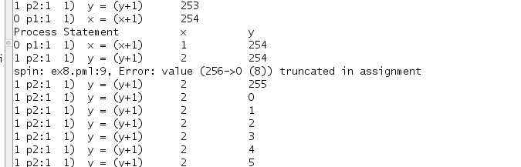
ex8 do the right depth setting!

Slide 14
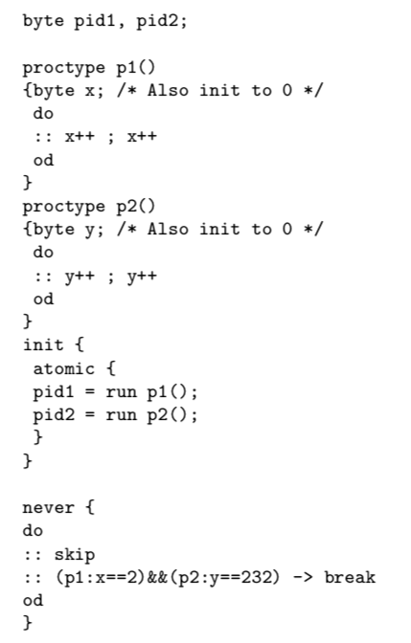
ex9

Slide 15
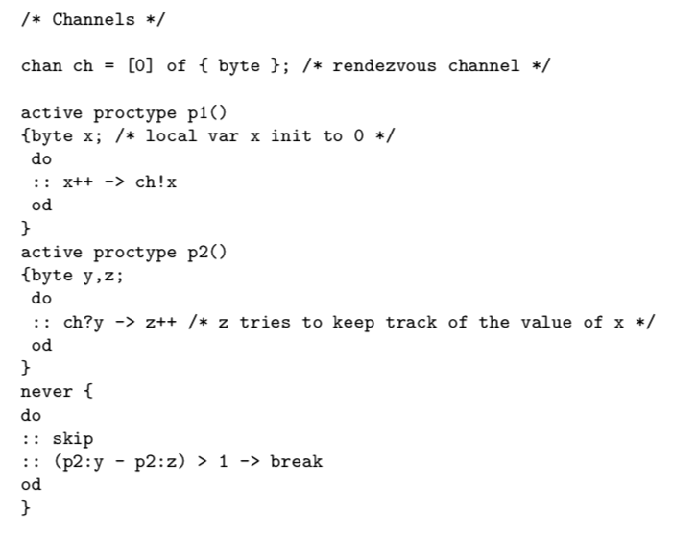
ex10

Slide 16
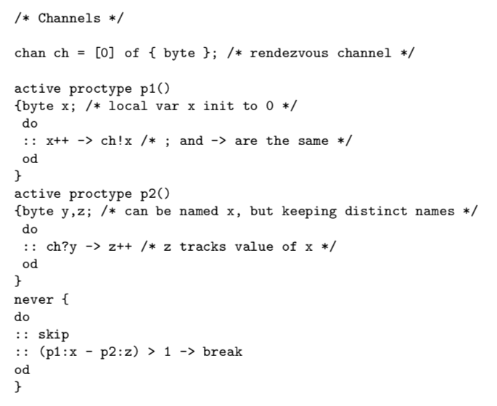
ex11

Slide 17
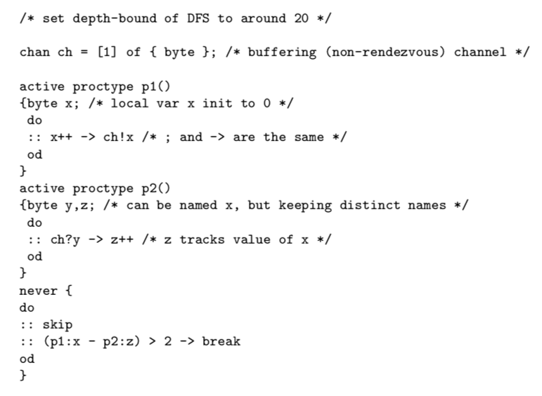
ex12

Slide 18
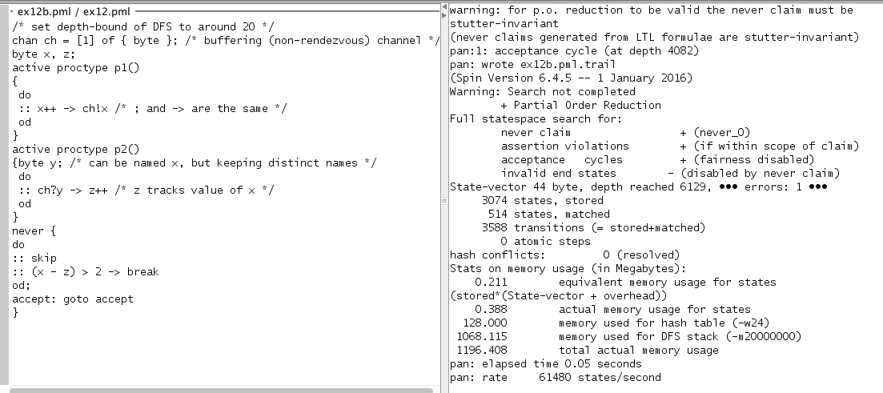
ex12b

Slide 19
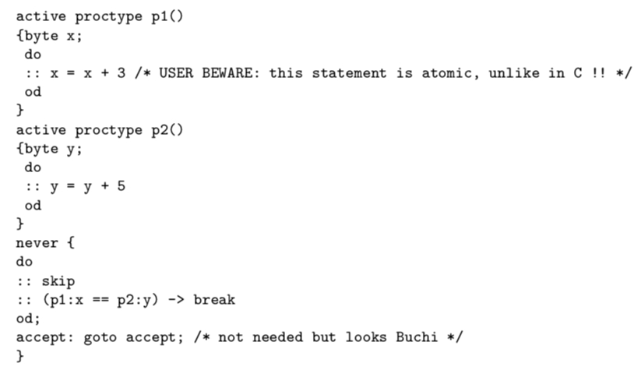
ex13

Slide 20
ex13
http://spinroot.com/spin/Man/Pan.html suggests using –DNOREDUCE
PO reductions not safe with remote references (must be stutter invariant)

Slide 21
ex13

Slide 22
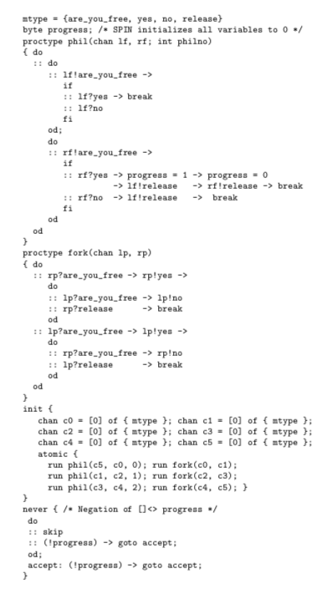
ex14

Slide 23
Lecture 4 : LTL model checking (CEAAT)

Slide 24
Question: What is the theory behind this checking? Answer: On-the-fly LTL Model Checking using Buchi Automata!

Slide 25
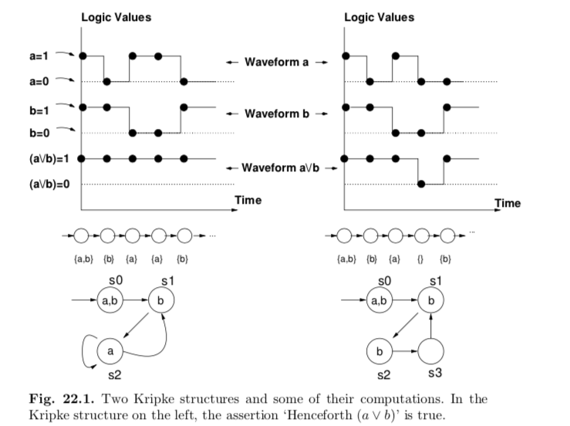
Lecture 4 : LTL model checking (CEAAT)

Slide 26
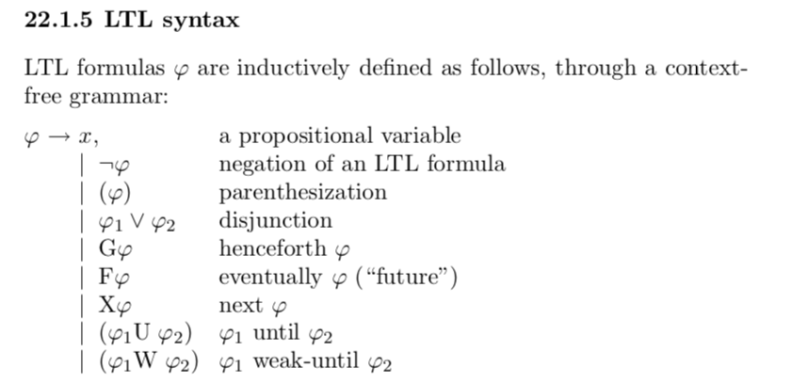
Lecture 4 : LTL model checking (CEAAT)

Slide 27
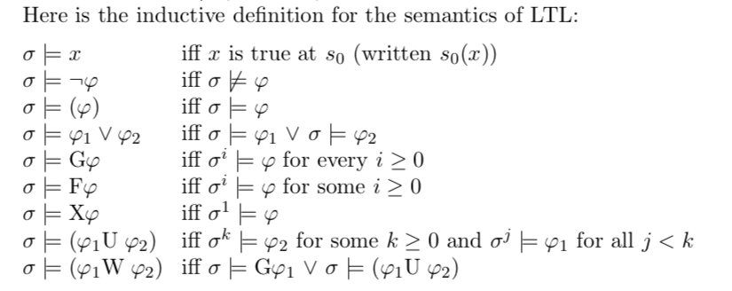
Lecture 4 : LTL model checking (CEAAT)

Slide 28

Lecture 4 : LTL model checking (CEAAT)

Slide 29
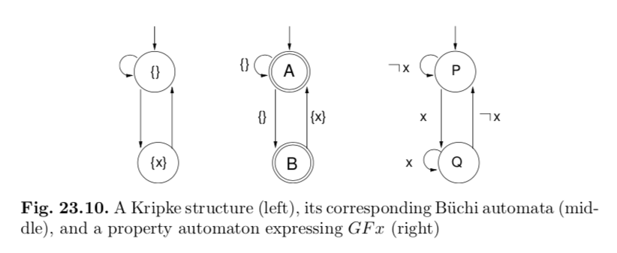
Lecture 4 : LTL model checking (CEAAT)

Slide 30
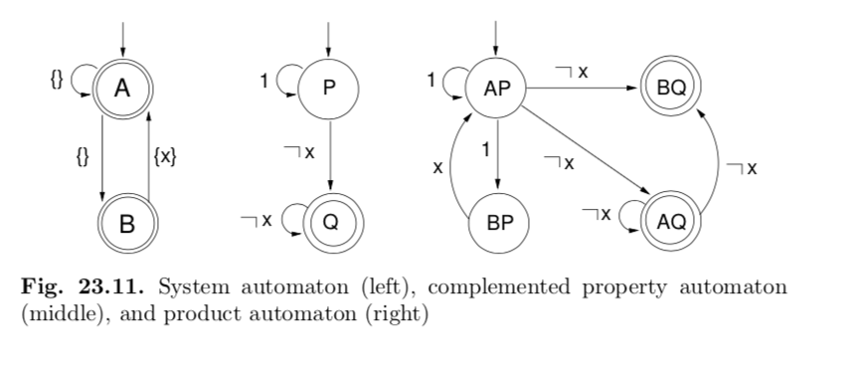
Lecture 4 : LTL model checking (CEAAT)

Slide 31
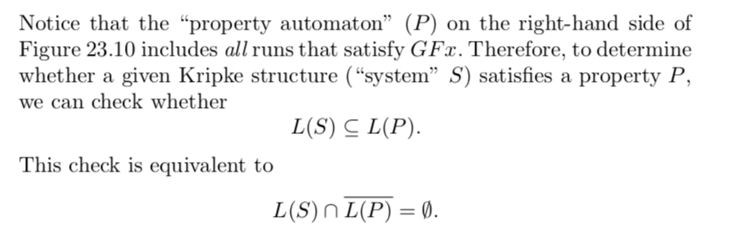
Lecture 4 : LTL model checking (CEAAT)

Slide 32

Lecture 4 : LTL model checking (CEAAT)

Slide 33
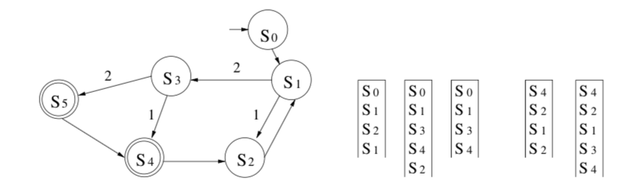
Lecture 4 : LTL model checking (CEAAT)

