Slide 1

CS 5/6110, Software Correctness Analysis, Spring 2022
Ganesh Gopalakrishnan
School of Computing
University of Utah
Salt Lake City, UT 84112

Slide 2
A study of two popular Hoare-logic Verifiers
Dafny
Verifast
Refer to Mike-Gordon-Slides.pdf in Lec16/

Slide 3
From the Dafny Tutorial https://github.com/dafny-lang/dafny/blob/master/docs/OnlineTutorial/guide.md
Dafny lifts the burden of writing bug-free code into that of writing bug-free annotations.
(… and of course understanding the prover’s limitation…)
(when it comes to nonlinear arithmetic)
https://stackoverflow.com/questions/50395039/in-dafny-how-can-i-fix-the-value-does-not-satisfy-the-subset-constraints-of-n

Slide 4
More Tips from Rustan wrt nonlinear arithmetic (the said files are in this directory)
Hi Ganesh,
Nice to hear from you and to hear you’re using Dafny.
Your problem uses non-linear arithmetic, which can be a sore spot for the verifier. When dealing with non-linear arithmetic, it is usual that the verifier doesn’t do everything automatically and you instead have to supply some of the proofs yourself.
For your particular example, I, too, am surprised. I don’t have any explanation that I can offer, other than to say again that the verifier is weak when it comes to non-linear arithmetic. I tried some variations of your program and found that dafny3.dfy (enclosed) happens to work with both Y+Y and 2*Y. But why it works with both variations and your programs don’t, I can’t tell.
Are you by chance using Dafny in teaching or are planning to do so? I have written a textbook on verification that uses Dafny. The textbook is in draft form, but several colleagues at universities have used the draft version. If you’re interested, I can send you a hardcopy of the draft book. If so, please send me a good mailing address for it.
Best wishes,
Rustan

Slide 5
Where verification is crucial (the only way)
Bug in Timsort found and verified
http://envisage-project.eu/wp-content/uploads/2015/05/sorting-final.pdf
It is very easily the case that any algorithm that looks like Timsort (combinatorial complexity of cases) has, by definition, bugs!
Testing, fuzzing, and symb execution CANNOT hit many (most?) these in practice

Slide 6
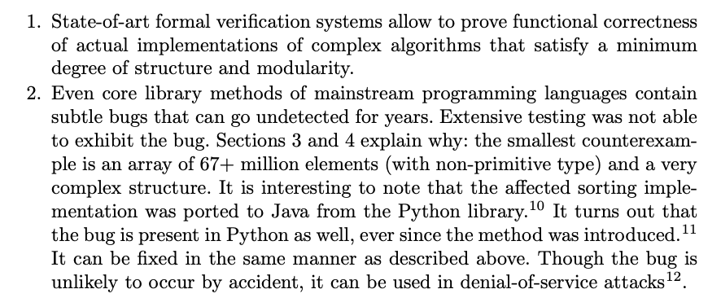
The “small model hypothesis” isn’t always true
Evidence of hardness (from their CAV’15 paper)

Slide 7
A Dafny Annotation
…

Slide 8
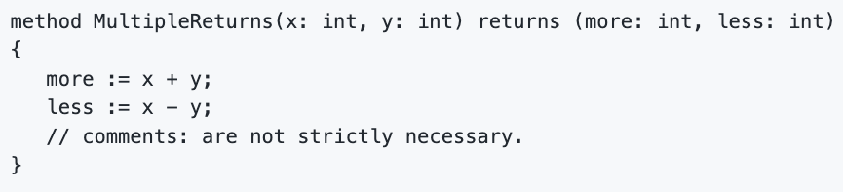
A Dafny method being verified – can have multiple returns
…

Slide 9
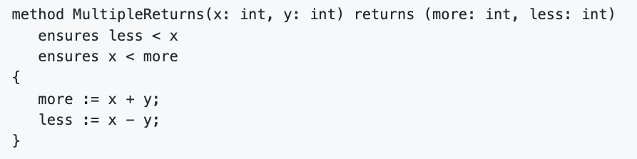
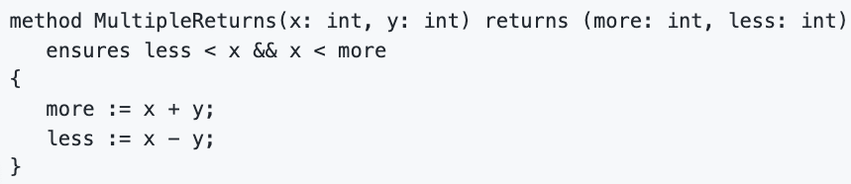

Annotated with pre/post in equivalent ways
Is allowed

Slide 10
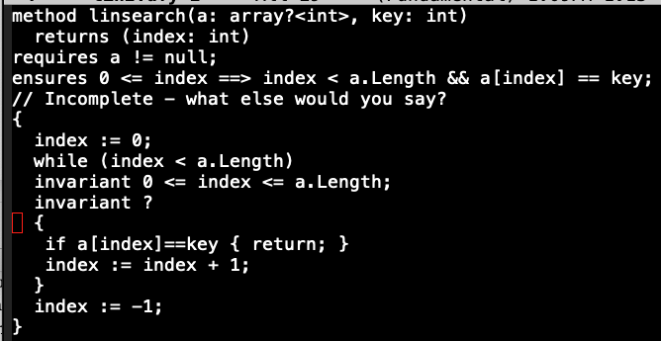
Dafny Exercises: Lin search

Slide 11
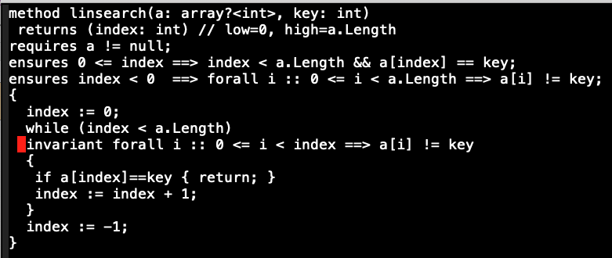
Dafny Exercises:

Slide 12
Will go through many Dafny exercises
See these folders
Power
Gcd
Fib
Sumarray
maxarray
binsrch

