Slide 1

CS 6110 Software Correctness, Spring 2022 Lec7
Ganesh Gopalakrishnan
School of Computing
University of Utah
Salt Lake City, UT 84112
URL: bit.ly/cs6110s22

Slide 2
Slides for Lec7 : Agenda
Review of material thus far
(If time permits): Intro to Murphi

Slide 3
Summary of basic topics in Logic studied
Review of Logic
Why review logic?
Logic is the “calculus of computer science”
Why focus on propositional logic (Boolean Logic)?
That is how most problems are modeled
Why SAT?
This is one of the central problems in CS
This is also one of the central success stories in verification
Tseitin transformation, equisat, equivalence
Help review notions coming in later chapters
Helped us reinforce our readings of Bradley/Manna
Tseitin transformation is central to SMT – a core verification success story
CNF, DNF
CNF preferred over DNF because of
Size-explosion possible if constraints arising in modeling problems turned into DNF
Naturalness of constraints modeled (thus, a majority of SAT-solvers are CNF-solvers)
BDDs and minimal DFA
BDDs are canonical representations of Boolean functions
We could visualize whether a formula is valid or satisfiable
Conversion of DNF to CNF via BDDs
This was not Tseitin transformation … but involved tracing paths to the “0” node

Slide 4
Review question
Q1: When a DNF formula
a.b.c.d + a.b.c.!d + a.b.!c.d + a.b.!c.!d + …. + !a.!b.!c.d + !a.!b.!c.!d
Is converted to CNF by distributing + over . , and vice-versa,
(a) The resulting CNF has
The same size
much higher size (typically exponential wrt the input formula size)
(b) The resulting CNF is
Equisat
Equivalent (pick the stronger of the two claims)
Select answers for Q1(a) [1 or 2] and Q1(b) [1 or 2]

Slide 5
Review question
Q2: When a BDD for a function has paths leading to ‘0’ labeled by
a.b.c ,
a.c.!d , and
!c.d
Then, the equivalent CNF for that BDD is
…fill your answer …

Slide 6
Review question
Q3: The size of a BDD depends on these; also this could be true
The order of the variables chosen
The nature of the Boolean function
Often we can improve the initial order obtain through an algorithm called sifting that locally rearranges variables to shrink the BDD
If the problem of determining the optimal variable for a BDD is solved in P-time, then we would have shown P=NP. (And if I don’t know what NP-completeness means, I promise I will make it a point to have a discussion about it on Piazza!)

Slide 7
Review question
Q4: These are true facts about BDDs and DFA
BDDs are minimal DFA in disguise. (And if I don’t understand DFA minimization, I’ll make it a point to ask on Piazza.)
While BDDs tend to resemble decision trees, there is one crucial difference: the order of variables going from root to leaf could be different for different paths in a decision tree. (There are also other differences.)
For some functions such as addition, BDDs tend to be always compact if one chooses the right var order
For some functions such as multiplication, BDDs are guaranteed exp (think of the Boolean function for the middle-answer-bit of the product of two numbers)

Slide 8
Review question
Q5: BDDs are
Just a curiosity
Were predominantly used for formal verification till about year 2000 when Boolean SAT tools started taking over
BDDs tend to saturate at 1000 variables (depending on the problem)
Boolean SAT can handle millions of variables, although there are cases where SAT can become expensive at lower number of variables. Formal verification has largely become a success story thanks to advances in SAT (SAT-solvers have become four orders of magnitude faster in the last two decades.)

Slide 9
Review question
Q6: Two formulae f1 and f2 are equivalent if
f1 -> f2
f2 XOR f1 is false
Q7: Two formulae f1 and f2 are equisat if
For all assignments sigma : sigma |= f1 if-and-only-if sigma |= f2
f1 is satisfiable IF-AND-ONLY-IF f2 is satisfiable
Which boils down to this
exists sigma1 : sigma1 |= f1 ⬄ exists sigma2 : sigma2 |= f2
Remember that in Equisat, f1 and f2 need not have the same set of variables

Slide 10
Review question
Q8: Consider f1 = a.!a
and f2 = (!a+a+p)(!p+a)(!p+!a)
Show that f1 and f2 are not equisat

Slide 11
Review question
Q9: Consider f1 = a.!a
and f2 = (!a+a+p)(!p+a)(!p+!a).(p)
Now show that f1 and f2 are equisat

Slide 12
Observation
Q8,Q9 gist: the main practical goal of equisat transformations is to preserve unsat in the transformation chain ☺

Slide 13
Basic topics in LTL and model-checking
When we want to verify systems, we often create models
They are like airplane scale models flown in wind tunnels
Experience shows that when you create a finite-state model of the “real system” and exhaustively examine the finite-state model, you often find corner cases that are missed when testing the real system
i.e. shrink the real system
By preserving all corner-cases
This is an art-form
This is error-prone → no guarantees
BUT
When you do it well, and you find a bug, then you have found a bug in the original
The idea of model-checking is to find bugs
NOT to prove a system correct
That is just too ambitious … can be done,but is a taller order!
We will write inductive-assertions proofs of loop programs later

Slide 14
Basic Model-Checking
System model = async product of proctypes (in Promela)
Property
Safety or Liveness
Safety Property
Any property whose violation is a finite trace
Liveness Property
Any property whose violation is an infinite trace
NOTE THAT infinite traces in a finite-state model are cycles
Thus
Safety violation is presented as a finite trace
Liveness violation is presented as a bad cycle

Slide 15
What do bad cycles look like
An example
Request ; ack ; Request ; ack ;
…do this 4 times… ; [then] Request ; <a cycle of no acks>

Slide 16
What is fairness?
Fairness properties are liveness properties
Thus an unfair execution is a bad cycle
We looked at two “classical” notions of fairness
Just to know they exist … no deeper look now
Justice
Compassion
We will revisit them soon
But there are many other “fairness” properties that one can define (we will see more examples soon)

Slide 17
Linear-time Temporal Logic
A logical system where one can produce truth-values based on infinite executions
i.e. based on executions that have cycles
A ready way to produce a “big bag of cyclic executions” is thru a Kripke Structure
Logic needs a STRUCTURE for interpretation
Hence we prefer to standardize executions into Kripke Structures

Slide 18
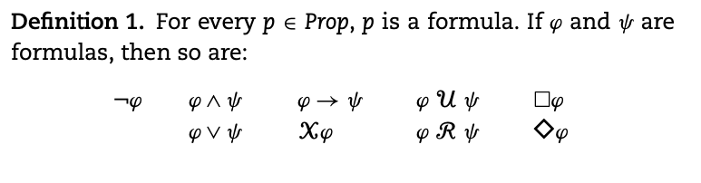
LTL from Rozier’s paper

Slide 19
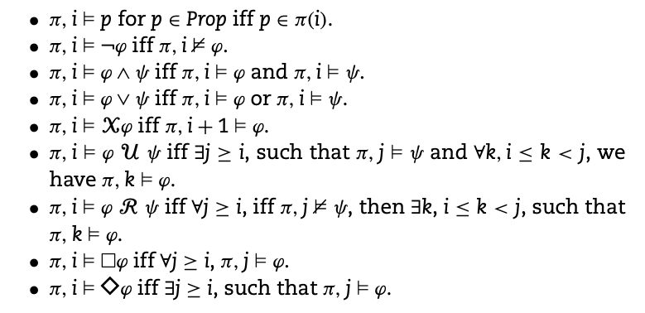
LTL satisfaction from Rozier’s paper

Slide 20
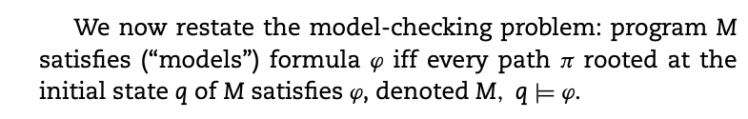
LTL satisfaction of a model (from Rozier)

Slide 21
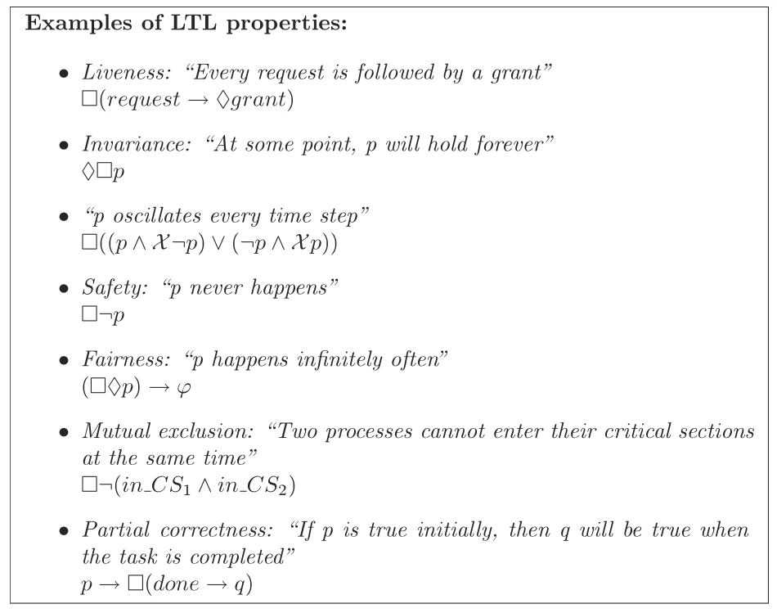
LTL examples (Rozier)

Slide 22
Which are safety? Which are liveness?
We will
Go by
What the
Evidence of
Failure
Looks
Like
(is it a
Non-cyclic
Trace?
Is it a cycle?)
We can negate
EACH OF THESE!
And find a
Satisfying
Trace / cycle!

Slide 23
How did I “hack” distinguishing formulae?
I hacked distinguishing formulae in CEATL – let’s see how

Slide 24
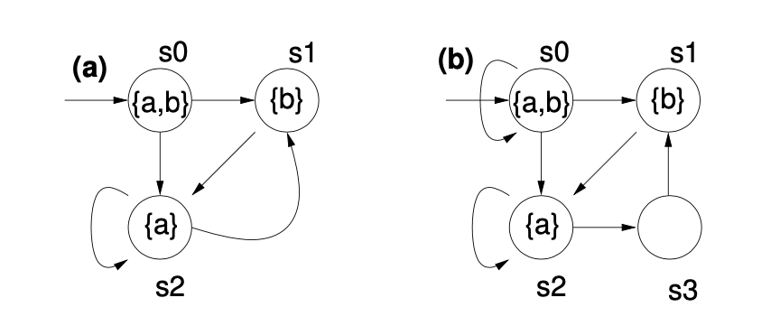
How did I “hack” distinguishing formulae?
I hacked distinguishing formulae in CEATL – let’s see how
Sb satisfies this and not Sa
I homed into the path that EXCLUDED
The ab loop
Then I summarized all the remaining
Paths!

Slide 25
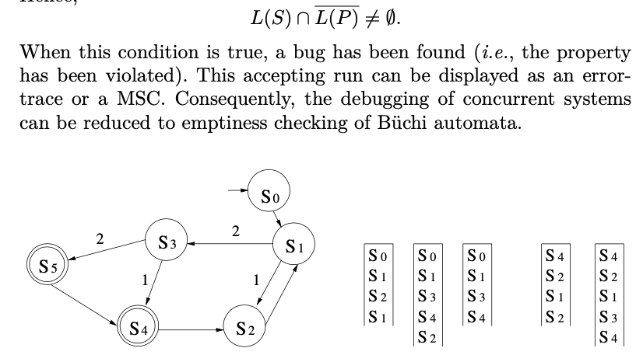
How does bad cycle detection work in SPIN?
Perform a
Nested
Depth-first
Search
(brief walk-thru)

Slide 26
Now we looked at practical stuff
Bubble-sorting
The 0/1 theorem for sorting networks
The analogy for programs is fairly OK
But can we build a bubbling argument with 0’s and 1’s?
I am going to try as follows
… explain…
The Philosophers in Promela
Ways to run SPIN
Then the distributed termination
What was the amazingly clever bug I put into Dist. Term?

