Slide 1

CS 6110 Software Correctness, Spring 2022 (edited from a previous class; look for bugs!)
Ganesh Gopalakrishnan
School of Computing
University of Utah
Salt Lake City, UT 84112
URL: bit.ly/cs6110s22

Slide 2
Overview
We encourage you to learn the basics of model-checking
Here is a very practical point of view
Often we are stuck thinking
Especially when modeling concurrent situations
E.g. Developing a protocol for monkeys to cross a rope-bridge L->R or R->L
Such that when one lead R monkey or lead L monkey claims the rope, then
All followers can cross
Till the rope is declared clear
We never have two packs enter, and end up “hanging in the middle”
These are upper-class monkeys; they can’t climb over each other and cross!
The next “turn” may be to allow the opposite pack to go
But often such “niceness” or ”priorities” are a second-level detail
Because we want to verify the protocol in a very simple set of circumstances
… and priority inversion is a nasty thing you should at least be aware (and afraid)

Slide 3
Overview
OS is full of such problems
So will self-driving cars face
If the basic protocols aren’t right…
Then the ML system’s intelligence is not going to help you ☺
We need to
Be able to model such protocols
State desired properties
Debug your thoughts
… and eventually “VERIFY” the protocol
But w.r.t. the stated properties
The longer the catalog of properties passed, the surer you are
This is really how HW debugging works
and w/o debugged hardware there is no modern society!! No CPUs, no nothing !!
I have to at least tell you one version of the BDD story of HW verification!
See UGResearchSeminarTalk21 : talks about the Pentium bug (story for another day)

Slide 4
How SPIN helps
Helps you quickly model “situations”
See SPIN-Soldiers + SpinTutorialby Ruys
Debug your thoughts
Find flaws in design
Has a lot of power and will NEVER become irrelevant
The more complex a system gets, the less you need to get fancy wrt verification
(after a 1-month training), you can do this
When in doubt, whip up a SPIN model and find bugs (in system or in your head)
Has worked for large systems
Recent correctness workshop -> entire new Pthreads implementation modeled!
We don’t have the full month to train you
This is the last SPIN week … but I’ll give you a REAL protocol verif to read on Thu!

Slide 5
The Promela language is very well designed!
It has some traps
E.g. “x = x + 1” is considered atomic
What is wrong ?!
But for a modeling language, this IS a good choice!
But it has many nifty constructs! (used in 10000.. Projects!)
P = Q + R ; // Some sundry statement
X == 0 ; // Await X == 0 . This is a language that allows expressions
at places you would expect commands to be
used!
So for the “monkeys on a rope”, the rope is a mutex (semaphore) and can be modeled as follows
atomic { rope == 0 ; rope = 1; } ; Enjoy the rope here! ; rope = 0; <-release rope

Slide 6
Let’s dive into SPIN
Go thru graded examples
Try all of them
Asg-2
Fix bubblesort in a specific way
…ditto… philosophers
Try answering questions wrt the examples in this slide-deck
Read / Try / Understand a wonderfully coded Locking Protocol !
Coded by my third PhD student Ratan Nalumasu (now at Google)
He wrote a new SPIN-like model-checker (more memory efficient, called PV)
That was a third of his PhD…

Slide 7
A brief look at some of the “myCHDL slides”
See ExternalSpinTuts/ in the class github
Basically lock-in an execution model in terms of
COMMUNICATING NON-DETERMINISTIC AUTOMATA !!
Will quickly go over 13 or so of the first 18 slides

Slide 8
Now for the graded list of examples

Slide 9
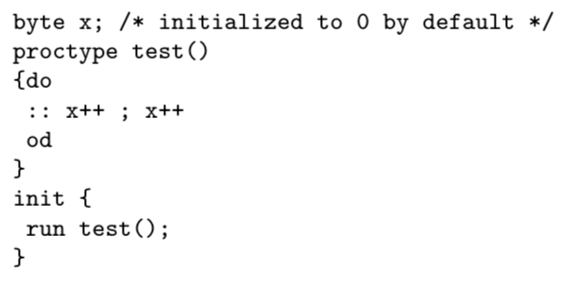
ex1

Slide 10
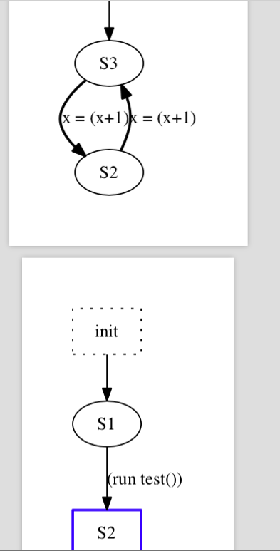
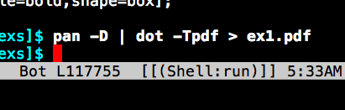
ex1

Slide 11
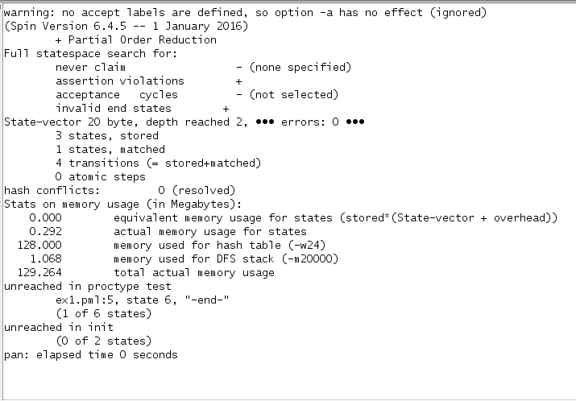
ex1

Slide 12
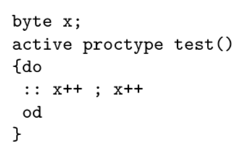
ex2 : fire up w/o init process
More elegant, the state vector does not need to store the state of “init”
(slightly more efficient; the state vector size is smaller; the # of states may be the same
as “init” often merely hangs around)

Slide 13
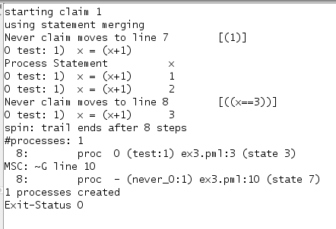
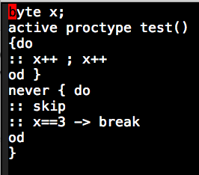
ex3
“when never sleeps, it does the ‘skip’ moves. It is good to let never sleep. Else it will be looking for x==3 right at the beginning which is perhaps not what you wanted. Also,leaving out skip and not finding x==3 at the outset means the “never” is stuck. And when ‘never’ is stuck, it truncates the whole global execution because one does a SYNCHRONOUS product of the system automata with “never”. The system automata are the proctypes.
This is saying “whenever the never
automaton wakes up and looks,
it won’t have an occasion to see x==3,
which causes ‘never’ to break out and reach
} , which is one way the “never” accepts.
“never” accepting is bad news !!

Slide 14
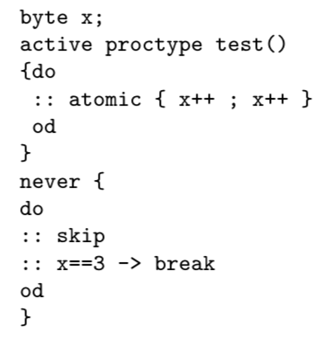
ex4

Slide 15
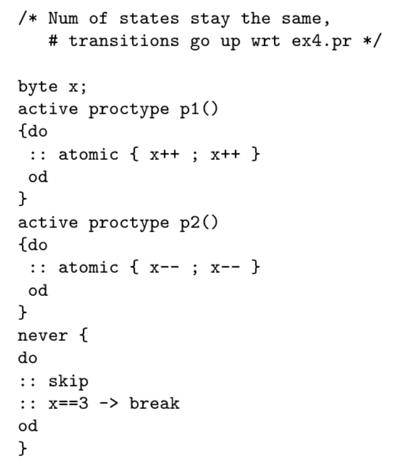
ex5

Slide 16
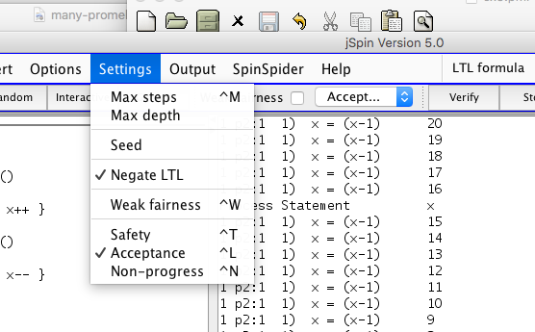
ex5

Slide 17
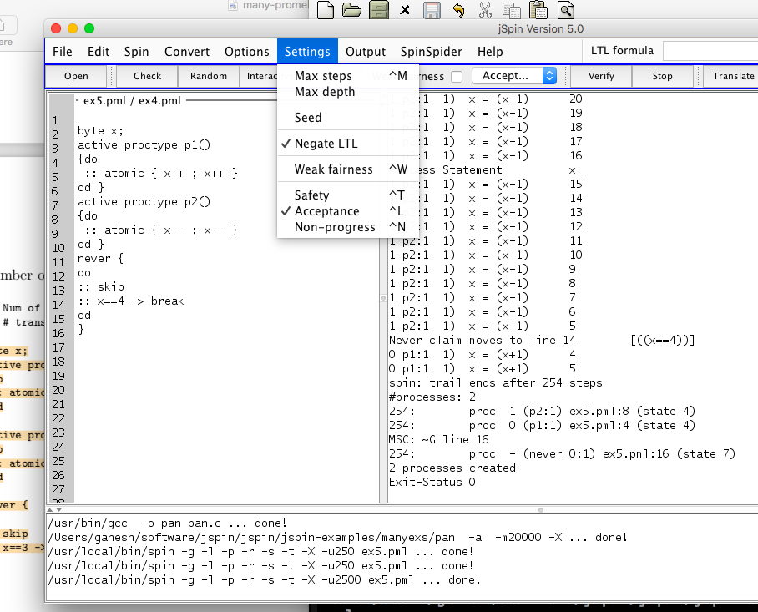
ex5

Slide 18
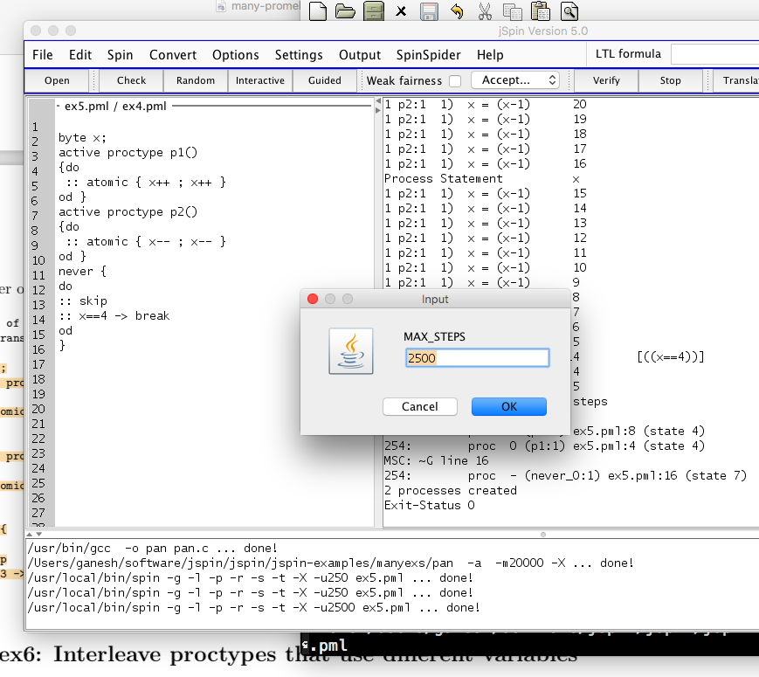
ex5

Slide 19
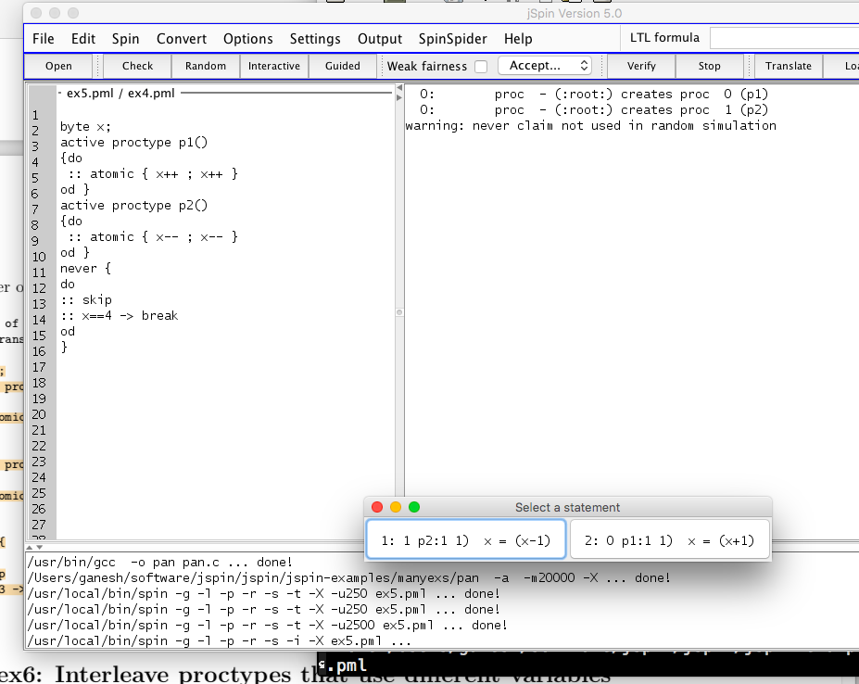
ex5

Slide 20
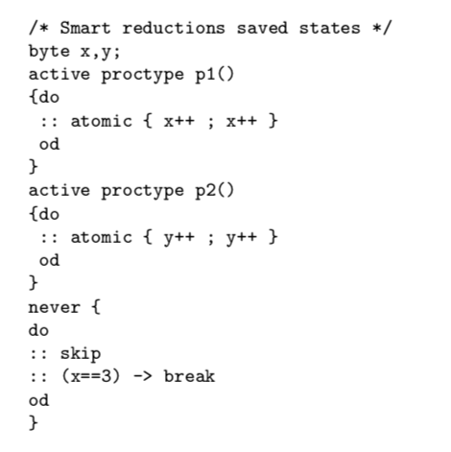
ex6

Slide 21
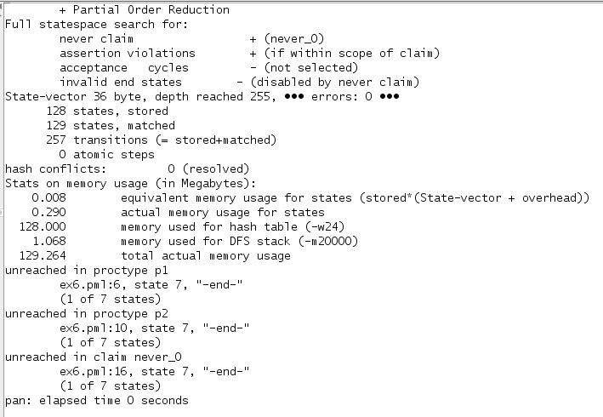
ex6

Slide 22
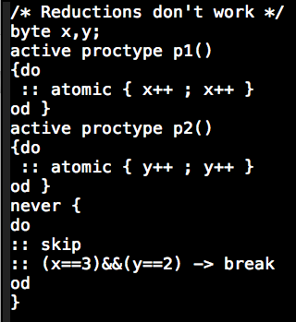
ex7

Slide 23
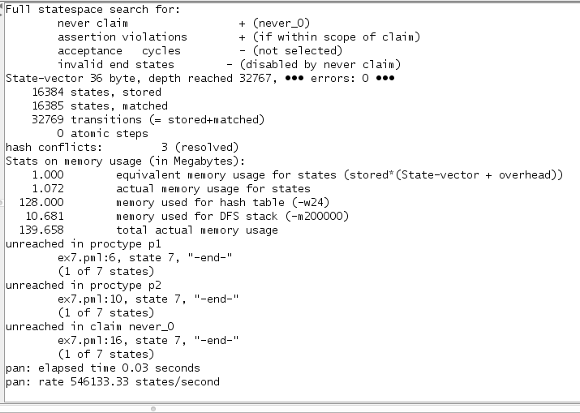
ex7 do the right depth setting!

Slide 24
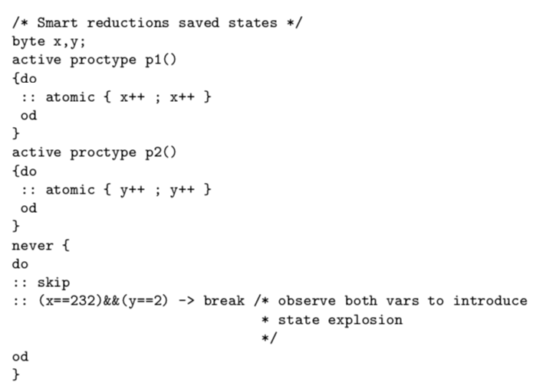
ex8 do the right depth setting!

Slide 25
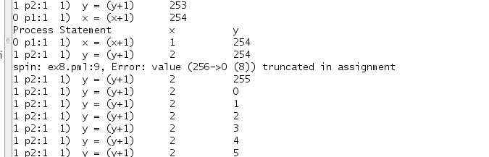
ex8 do the right depth setting!

Slide 26
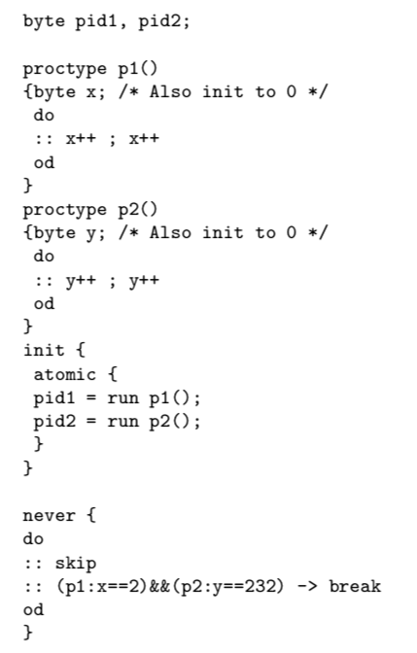
ex9

Slide 27
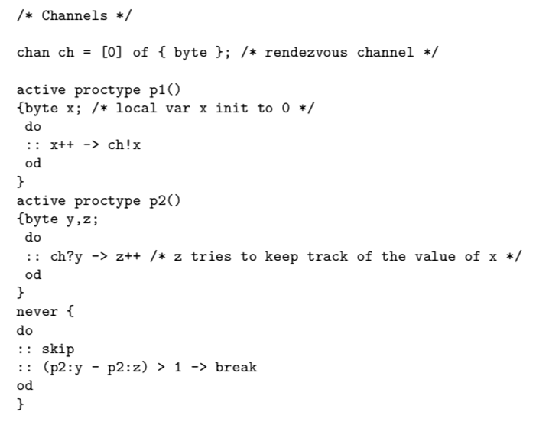
ex10

Slide 28
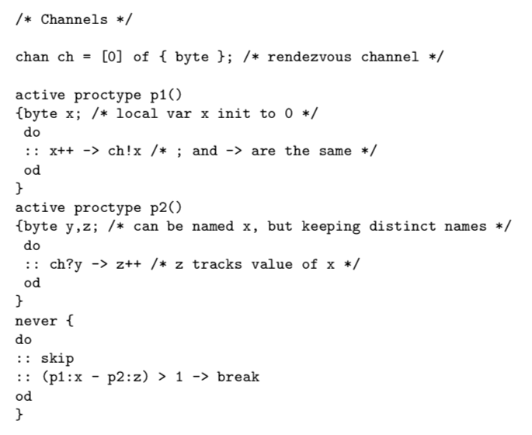
ex11

Slide 29
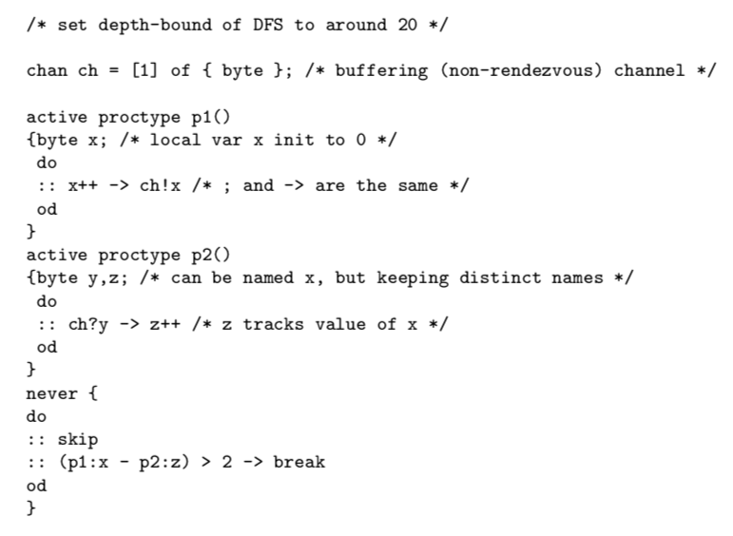
ex12

Slide 30
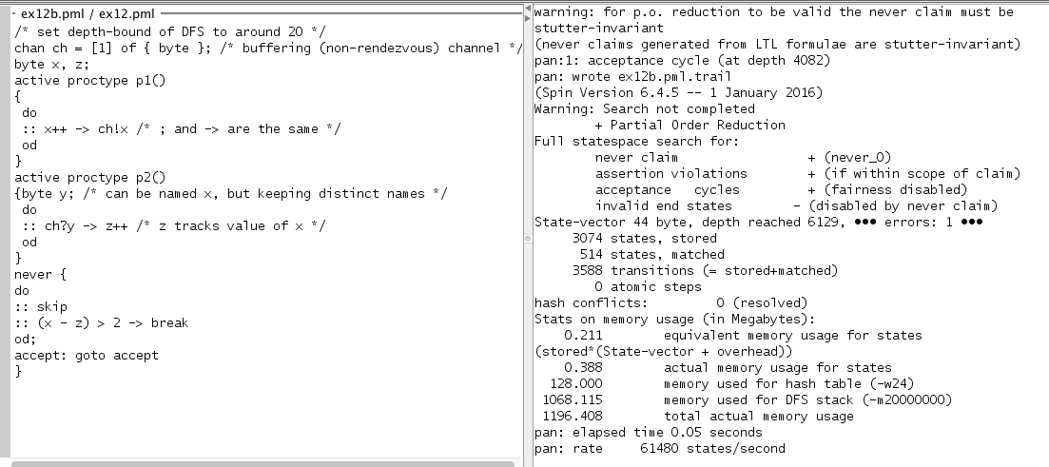
ex12b

Slide 31
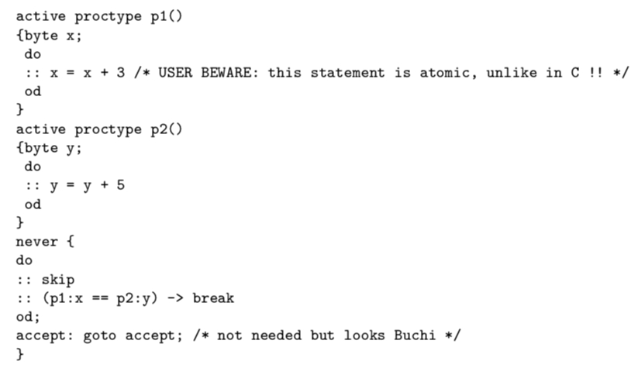
ex13

Slide 32
ex13
http://spinroot.com/spin/Man/Pan.html suggests using –DNOREDUCE
PO reductions not safe with remote references (must be stutter invariant)

Slide 33
ex13

Slide 34
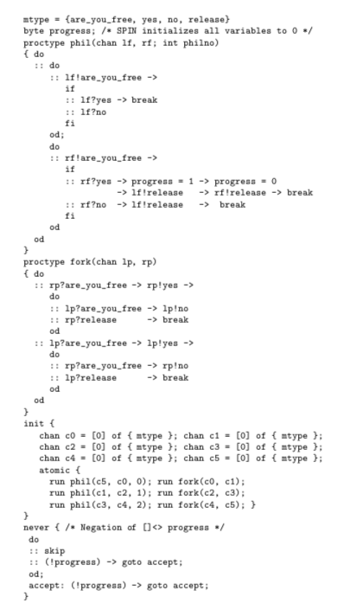
ex14

Slide 35
Lecture 4 : LTL model checking (CEAAT)

Slide 36
Question: What is the theory behind this checking? Answer: On-the-fly LTL Model Checking using Buchi Automata!

Slide 37
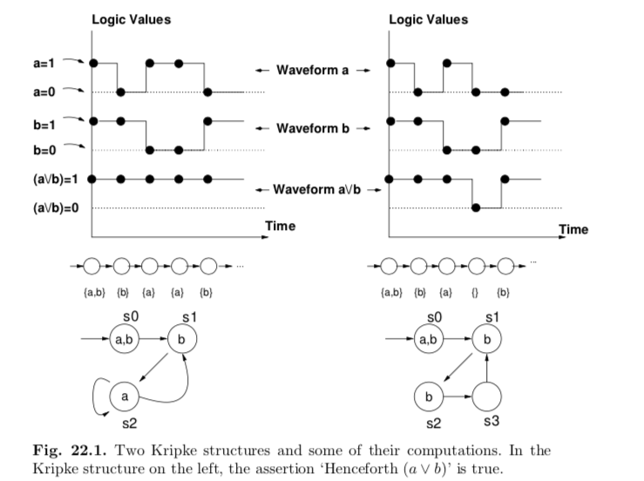
Lecture 4 : LTL model checking (CEAAT)

Slide 38
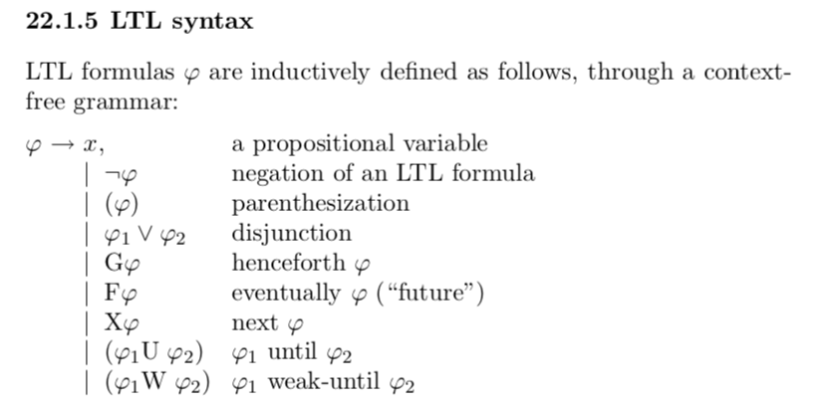
Lecture 4 : LTL model checking (CEAAT)

Slide 39
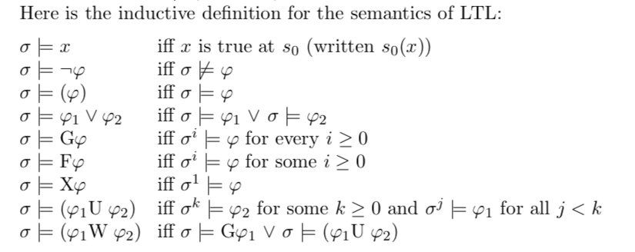
Lecture 4 : LTL model checking (CEAAT)

Slide 40

Lecture 4 : LTL model checking (CEAAT)

Slide 41
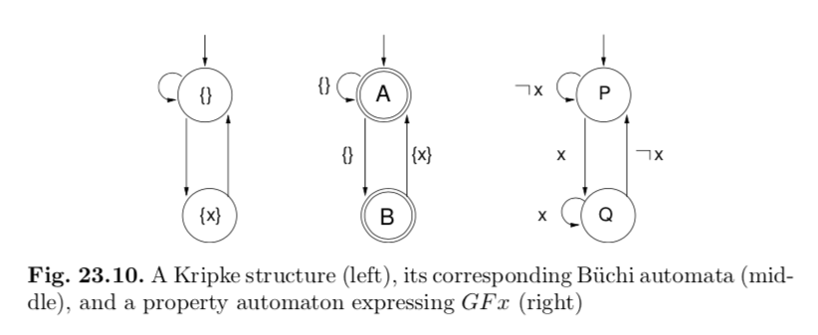
Lecture 4 : LTL model checking (CEAAT)

Slide 42
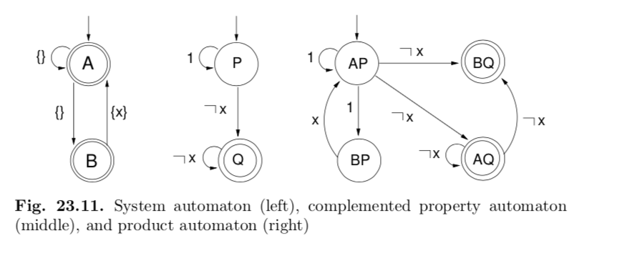
Lecture 4 : LTL model checking (CEAAT)

Slide 43
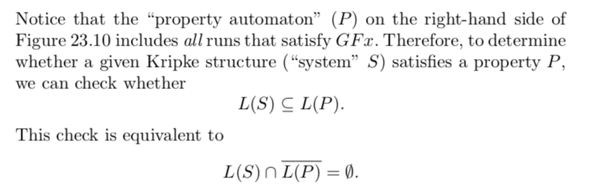
Lecture 4 : LTL model checking (CEAAT)

Slide 44

Lecture 4 : LTL model checking (CEAAT)

Slide 45
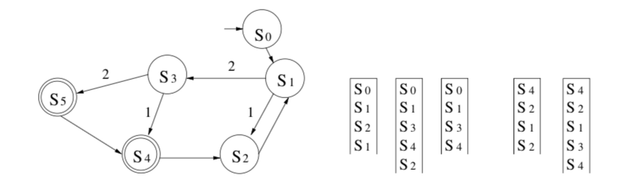
Lecture 4 : LTL model checking (CEAAT)

