Slide 1

CS 5/6110, Software Correctness Analysis, Spring 2021
Ganesh Gopalakrishnan
School of Computing
University of Utah
Salt Lake City, UT 84112

Slide 2
18
Least Fixpoint of Functionals
Fixpoint Theory to Explain Context-Free Grammars
Fixpoint Theory for Computational Tree Logic

Slide 3
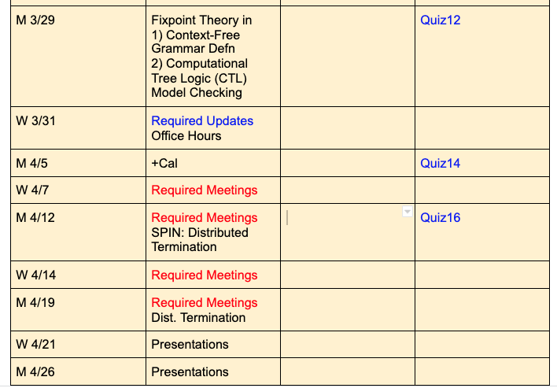
Where we are

Slide 4
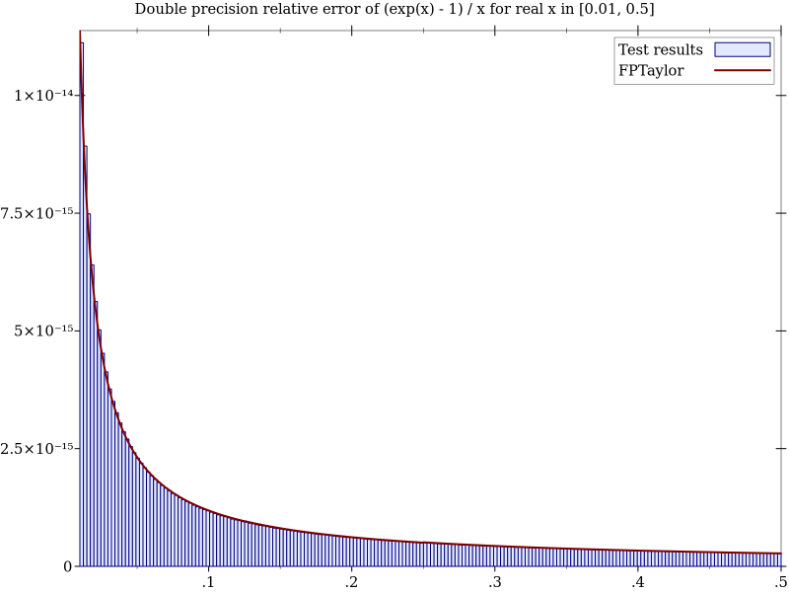
Example of non-monotonicity (FP example)
This example was discussed last class – here are the plots

Slide 5
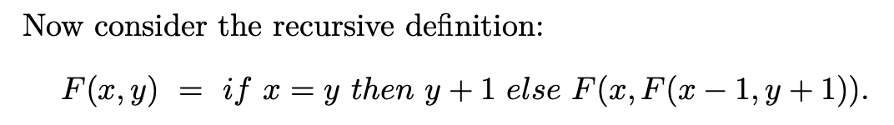
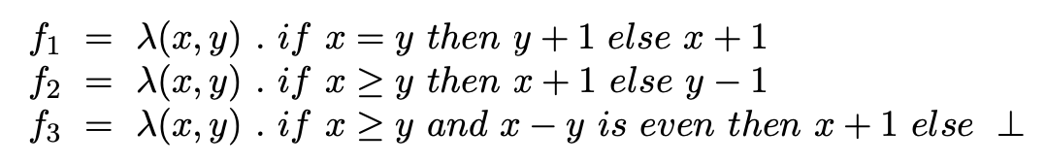
Recap : This pertains to the quiz … ask if I should show you how to get “Tau”…
Function f3 corresponds to lim_i { Tau^i [ Bottom_fn ] }
Where Tau for “F” above is: …fill this… and is called
the “functional underlying the recursive definition (in Manna’s book)
In Chapter 18 of Book-3, it is called the “pre” function (e.g. PreFact etc) on
which the Y combinator is applied.
Applying the Y combinator gives the same effect as computing the limit of this chain of functions
What does Tau^1[Bottom] correspond to? What about Tau^2 ? Tau^3 ? …fill this…

Slide 6
Uniqueness of Least Fixpoints
Least fixpoints exist and are unique when Tau is
Monotonic
Continuous
For infinite lattices
Continuity implies Monotonicity
For finite lattices
Monotonicity implies Continuity

Slide 7
Fixpoint Theory to Explain CFGs
Context-free Grammars re-interpreted as recursive equations
S -> aSbS | bSaS | SS | epsilon
Versus
S -> aSbS | bSaS | epsilon
Then discuss the system
S -> epsilon | ( W S
W -> ( W W | )

Slide 8
Fixpoint Theory to Explain CFGs
Context-free Grammars re-interpreted as recursive equations
S -> aSbS | bSaS | epsilon
Solve the recursive language equation
L_S = {a} L_S {b} L_S U {b} L_S {a} L_S U {e}

Slide 9
Fixpoint Theory to Explain CFGs
Context-free Grammars re-interpreted as recursive equations
S -> aSbS | bSaS | epsilon
Solve the recursive language equation
L_S = {a} L_S {b} L_S U {b} L_S {a} L_S U {e}
What do we get when we iterate from L_S = {} “upwards” ?

Slide 10
Fixpoint Theory to Explain CFGs
Context-free Grammars re-interpreted as recursive equations
S -> aSbS | bSaS | SS | epsilon
L_S = {a} L_S {b} L_S U {b} L_S {a} L_S U {e} U L_S L_S

Slide 11
Fixpoint Theory to Explain CFGs
Context-free Grammars re-interpreted as recursive equations
S -> aSbS | bSaS | SS | epsilon
L_S = {a} L_S {b} L_S U {b} L_S {a} L_S U {e} U L_S L_S
Are there 2 fixpoints? Which is found using iteration using {} as the bottom (going up)?

Slide 12
Fixpoint Theory to Explain CFGs
Then discuss the system
S -> epsilon | ( W S
W -> ( W W | )
Solve
(L_S, L_W) = ( {e} U {(} L_W L_S , {(} L_W L_W U {)} )

Slide 13
Fixpoint Theory to Explain CFGs
Then discuss the system
S -> epsilon | ( W S
W -> ( W W | )
Solve
(L_S, L_W) = ( {e} U {(} L_W L_S , {(} L_W L_W U {)} )
What fixpoint obtained by iterating up from ({} , {}) ?
What is the lattice ordering?

Slide 14
CTL Model Checking
Least fixpoints exist and are unique when Tau is
Monotonic
Continuous
For infinite lattices
Continuity implies Monotonicity
For finite lattices
Monotonicity implies Continuity

Slide 15
State-Space Travel via BDDs
We will use BDDs to represent Kripke Structure
We will model Transition Relations using BDDs
Use Boolean operations to obtain the set of reachable states

Slide 16
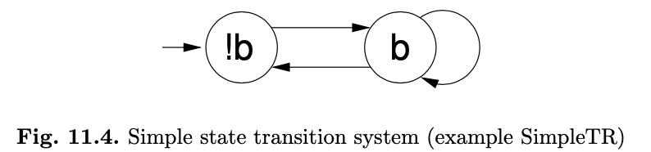

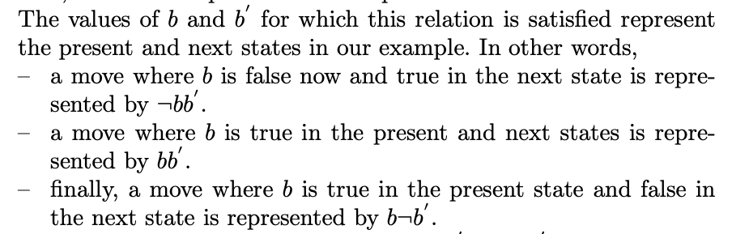
State Transition Systems via BDDs

Slide 17
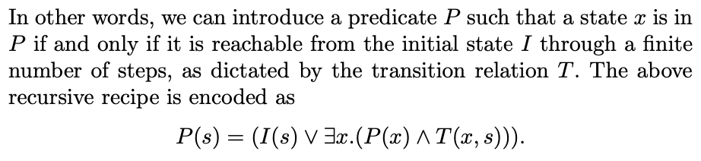
The set of reachable states defined by “P”

Slide 18
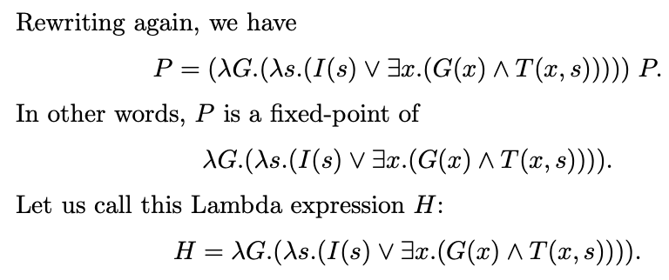

This can be computed via fixpoint iteration
Etc…

Slide 19
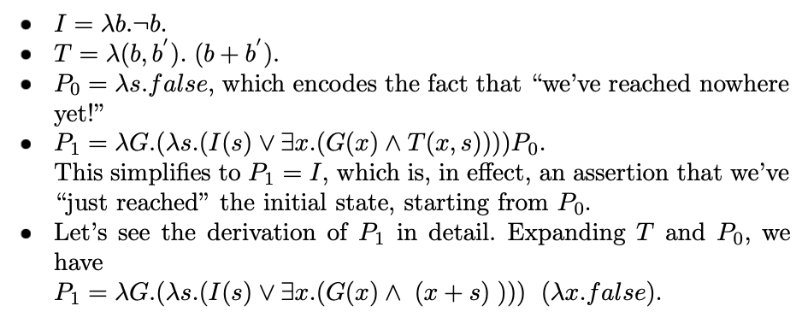
This can be computed via fixpoint iteration

Slide 20
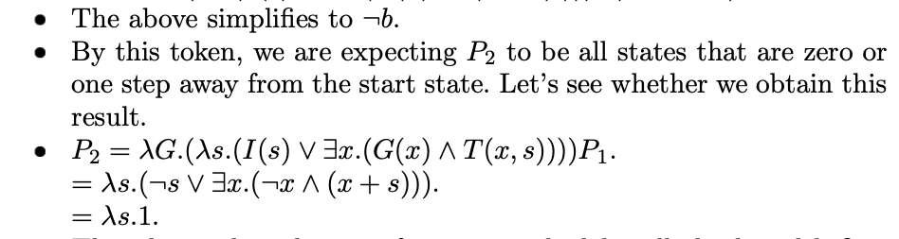
This can be computed via fixpoint iteration

Slide 21
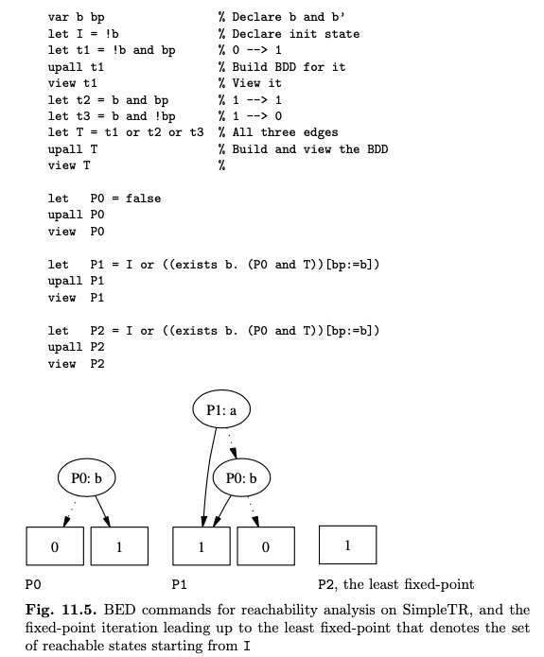
Forward Reahability via the BDD tool called “BED”

Slide 22
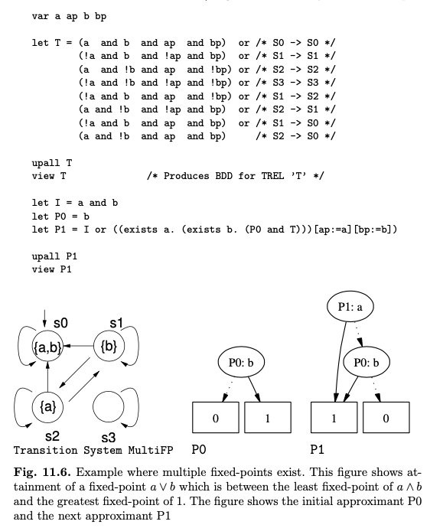
Forward Reahability via the BDD tool called “BED”: another example

Slide 23
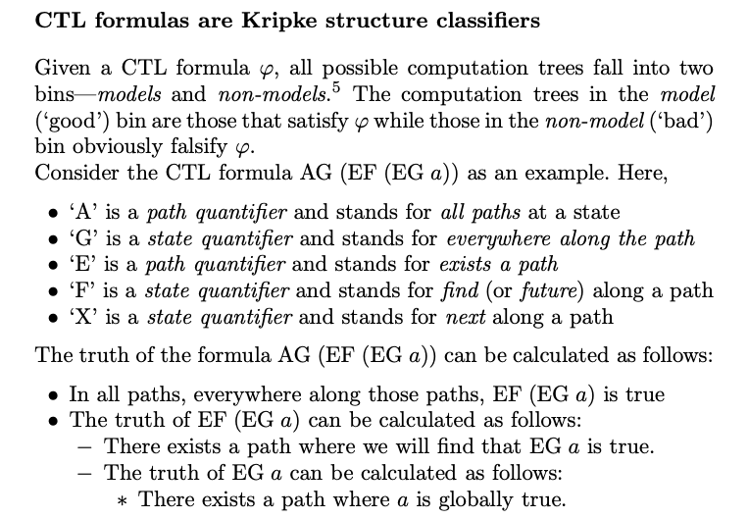
Now, for the CTL Logic, and Reachability using BDDs

Slide 24
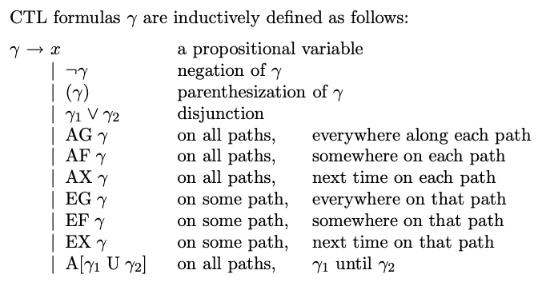
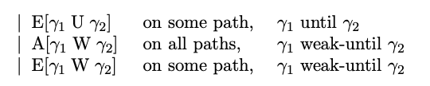
Now, for the CTL Logic, and Reachability using BDDs

Slide 25

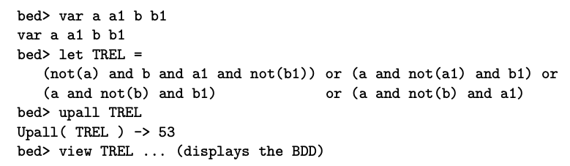
Now, for the CTL Logic, and Reachability using BDDs

Slide 26
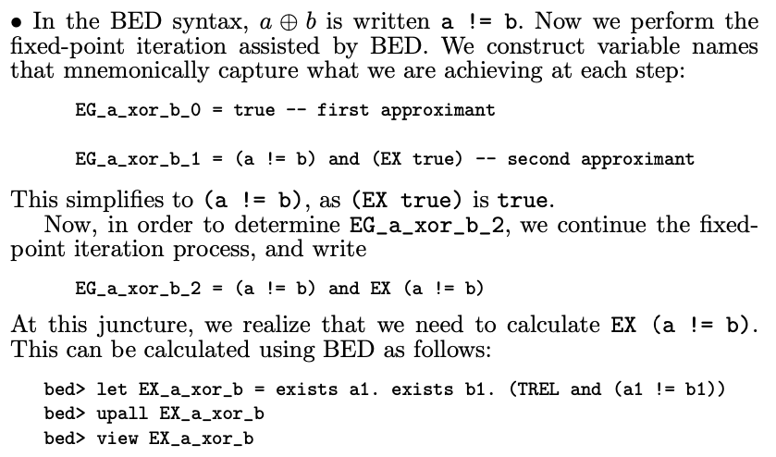
Now, for the CTL Logic, and Reachability using BDDs

Slide 27
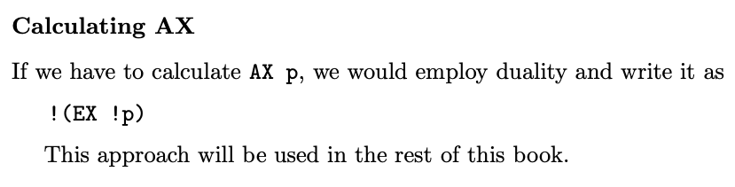
Now, for the CTL Logic, and Reachability using BDDs

Slide 28

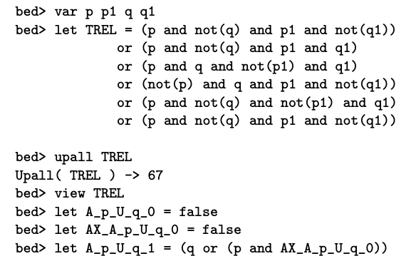
Now, for the CTL Logic, and Reachability using BDDs

Slide 29
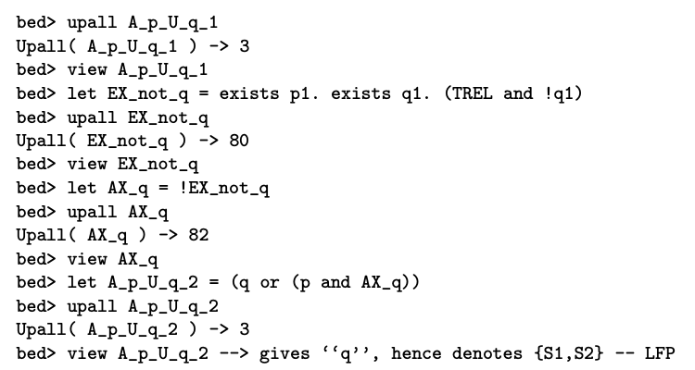
Now, for the CTL Logic, and Reachability using BDDs

Slide 30

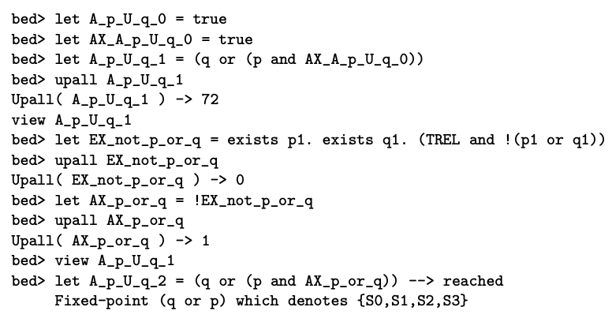
Now, for the CTL Logic, and Reachability using BDDs

Slide 31
Summary
Fixpoint theory is everywhere in CS
Static analysis
Recursive program analysis
CFG explanation
CTL model-checking
Finding lattices and monotonic + continuous functionals is key
Once set up this way, we usually go after the least fixpoint
Greatest fixpoints also “make sense”
But sometimes they are useless
as in the CFG example S -> aSbS | bSaS | SS | epsilon

Slide 32
Summary

