Slide 1

CS 5/6110, Software Correctness Analysis, Spring 2021
Ganesh Gopalakrishnan
School of Computing
University of Utah
Salt Lake City, UT 84112

Slide 2
16
Least Fixpoint of Functions, Computational Rules
Monotonicity, Continuity
Y Combinators

Slide 3
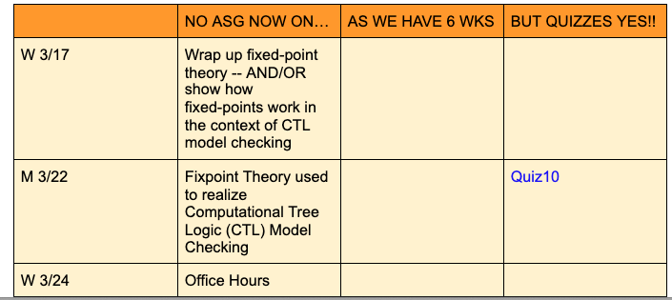
Where we are

Slide 4
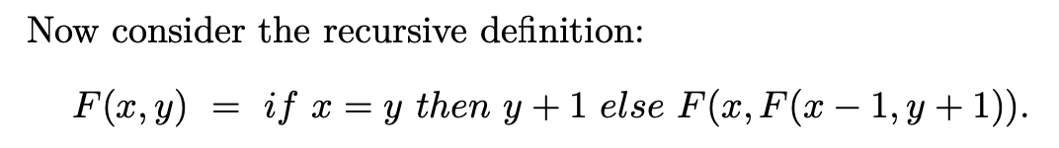
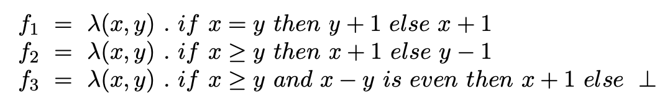
f1, f2, and f3 are solutions for F below. We can arrive at f3 (the least fixpoint by iterating up from ”Bottom”
Here, the “bottom” in f3 is the bottom value
For LFP, we have to substitute the bottom function in place of “F” and iterate

Slide 5
f1, f2, and f3 are solutions for F below. We can arrive at f3 (the least fixpoint by iterating up from ”Bottom”
The same f3 would also be obtained if we solve for the recursion of “F” using the Y combinator
This demo of the use of Y will be presented in later slides
plus using the Jove demo’s on the use of Y

Slide 6
Modeling Partial Functions
Discussions from manna-fp-theory-2.pdf
Manna uses “omega” instead of Bottom (for the undefined value) and Capital Omega for the undefined function
Manna calls second-order functions by the term “functional”

Slide 7
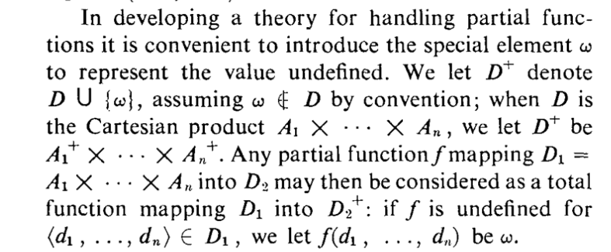
Modeling Partial Functions

Slide 8
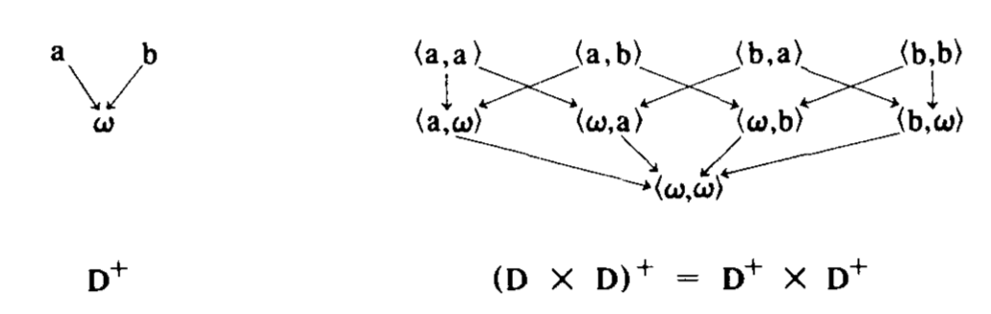
Lattice Ordering
How values are ordered in the information order is shown
How pairs of values are ordered is shown
No reflexive and transitive edges shown for clarity

Slide 9
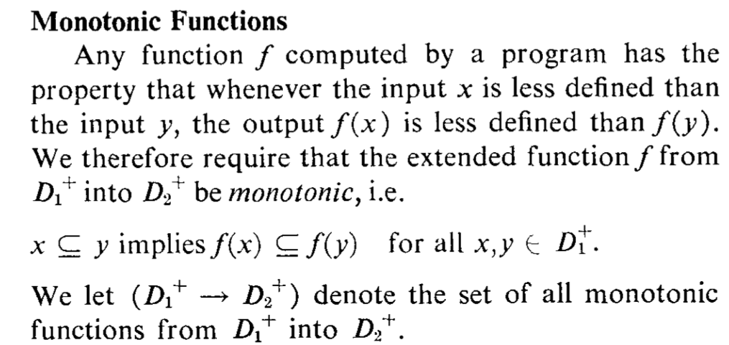
Monotonic functions act as per info order
Monotonic functions “respect the information order ” of their arguments

Slide 10
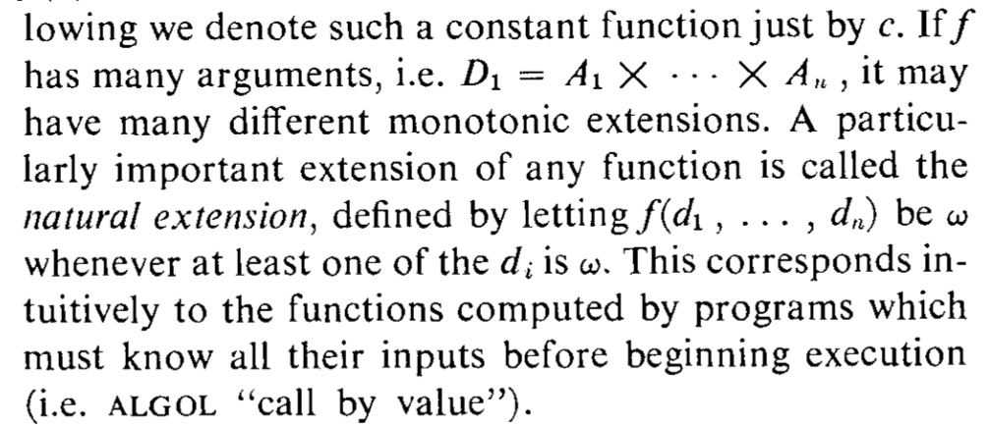
Monotonic functions act as per info order
For multiple arguments, there is a “natural extension” – useful for languages with the call-by-value semantics (“evaluate the arguments before applying the function body”)

Slide 11
Example where Call By Value makes a diff.
The call by value evaluation rule computes less than the least fixpoint – can terminate even when another computation rule can discover the answer – example from paper manna-fp-theory-1.pdf is below
Those other evaluation rules are
“normal order” evaluation rules: Example:
Leftmost Outermost
Popularly, these are known as Lazy Evaluation Order
See next slide for details!

Slide 12
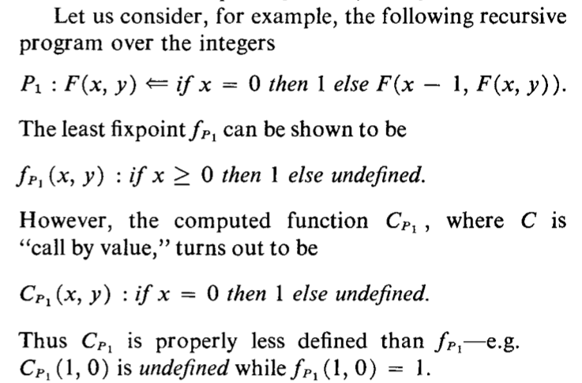
Example where Call By Value makes a diff.

Slide 13
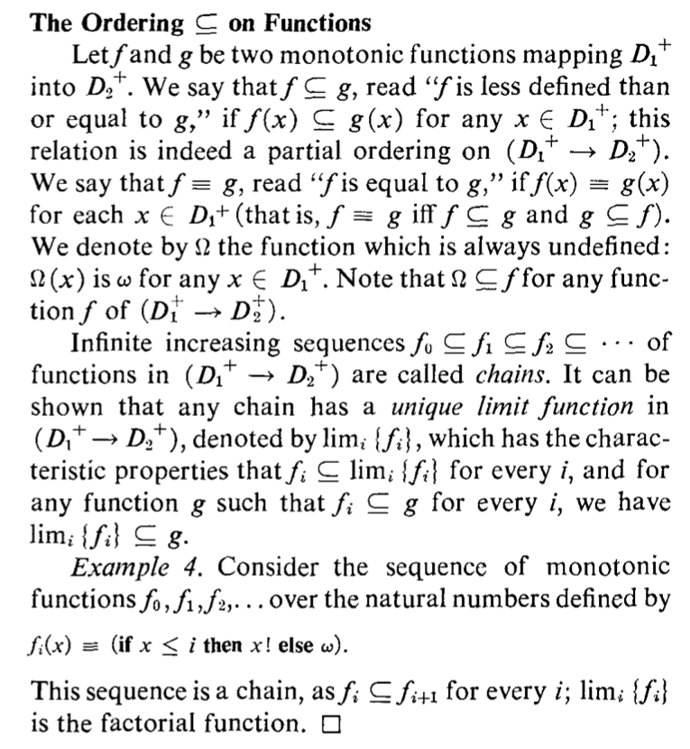
We construct increasing chains of monotonic functions from the functional obtained from the body of a recursive definition. Such chains have unique least fixpoints

Slide 14
Derivation of Least Fixpoint of Functionals
We need monotonicity and continuity
For finite lattices, monotonicity implies continuity
For infinite lattices, it does not
So let’s first understand monotonicity and continuity thru more examples before we dive in!

Slide 15
Monotonicity ensures the absence of “composition surprises”
Example:
Suppose the lattice ordering is reflective of the quality of an object
Example: a 5% tolerance resistor is better than a 10% tolerance resistor
Does it then mean that a circuit where we clip out a 10% resistor and solder-in a 5% resistor also improves?
Think of a circuit as a Lambda function and reason out …

Slide 16
Example
Parcomp(R1, R2) = R1R2 / (R1+R2)
Now we can ask: if R2’ [= R2’’
Does this hold : Parcomp(R, R’) [= Parcomp(R, R’’) for any R?
If so, Parcomp is a monotonic map
With this property preserved, we can improve one resistor and the whole circuit as a result improves

Slide 17
Monotonicity is sometimes violated!
Instead of Parcomp, what if it is a floating-point program where you optimize ONE expression?
The accuracy of the whole program can reduce, sometimes
Example: the introduction of the fused-multiply-add by a compiler may improve local accuracy, but can lead to the overall computation’s accuracy reducing
What if it is a real-time system where we make ONE component faster?
By one module’s output arriving faster, the whole system may slow down
Thus, “local improvements” may not be a global improvement
Monotonicity is what ensure this – and hence, highly preferred

Slide 18
Continuity: “no limit-surprise”
Most functions (and functionals) are continuous
Lack of continuity evidenced by the following:
One requires an “infinite amount of information” before emitting a finite (small) piece of information
If this behavior occurs, the function is not continuous
Continuity is manifested by situations where “as you provide more input”, the ”output grows more”
The lack of continuity is also evident in situations where you ”need to solve the halting problem” before you can answer something

Slide 19
Example from actual computations
Think of stream-based computations
A computer node can often be viewed as a stream function
Let the node be a factorial node!
Initial input (at time t0) = bottom → output = bottom
Input at t1: 1, bottom → 1, bottom
Input at t2: 1,2,bottom → 1,2,bottom
Input at t3: 1,2,3, bottom → 1,2,6,bottom
…
I.e. you are progressively providing more input to the node, the node computes more
Thus you have a stream-to-stream factorial function which is continuous
But in mathematics, you don’t need to do this: you can have a non-continuous and weird function
”I want all of Nat before I output anything”
In this sense, continuity is deeply tied to computability on actual machines
These are things I learned from Prof. Eugene Stark when I took his programming semantics course during my PhD. These things must be written down somewhere… but these days, not too many people talk about it.
I also learned these ideas from Prof. Prateek Misra, also an instructor during my PhD

Slide 20
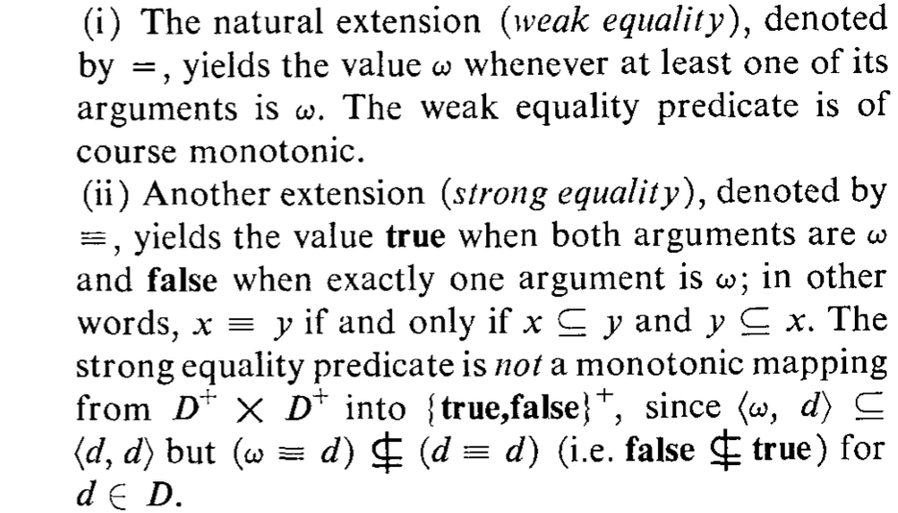
Example of a non-monotonic fn from Manna

Slide 21
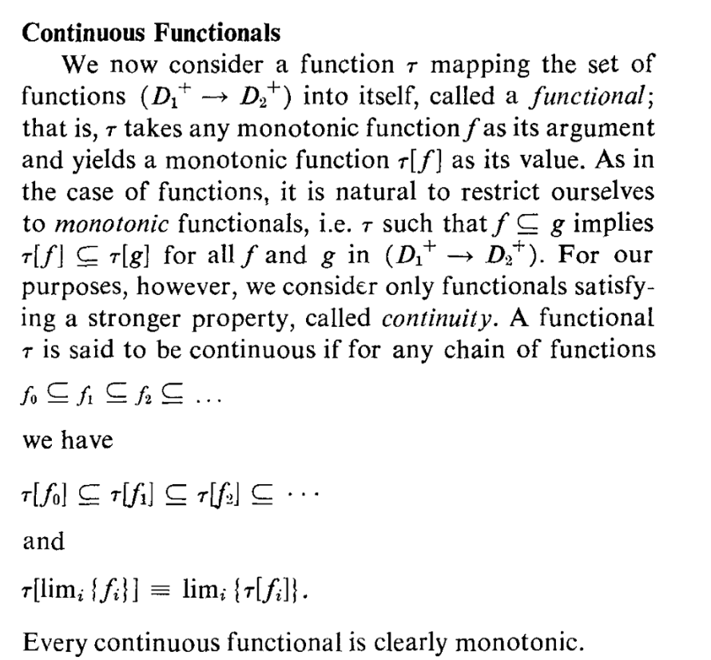
Defn of continuity

Slide 22
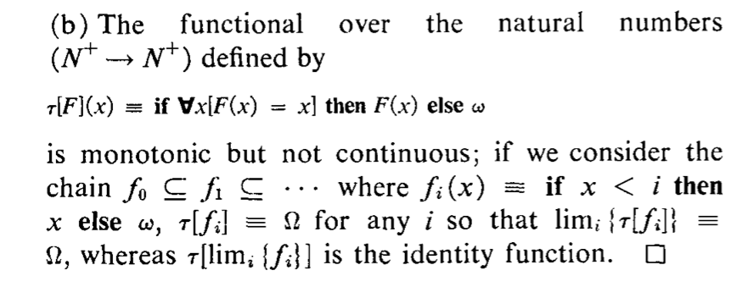
Example of a non-continuous fn from Manna

Slide 23
Theorem (Kleene, Others)
Continuous functions “tau” on lattices (or other structures such as CPOs) have a unique least fixpoint given by
tau^i (bottom)
* Derivation in class

Slide 24
Relationship with Lambda Calculus
One can compute least fixpoints also using “Y”
One can see that “YF” and “least fixpoint iteration” both behave similarly
Derivation in class

Slide 25
Demo using Jupyter (Jove) notebooks
See Chapter 18’s material from https://github.com/ganeshutah/Jove.git

