Slide 1
Refining the incoherent exclusivity cuts

Slide 2
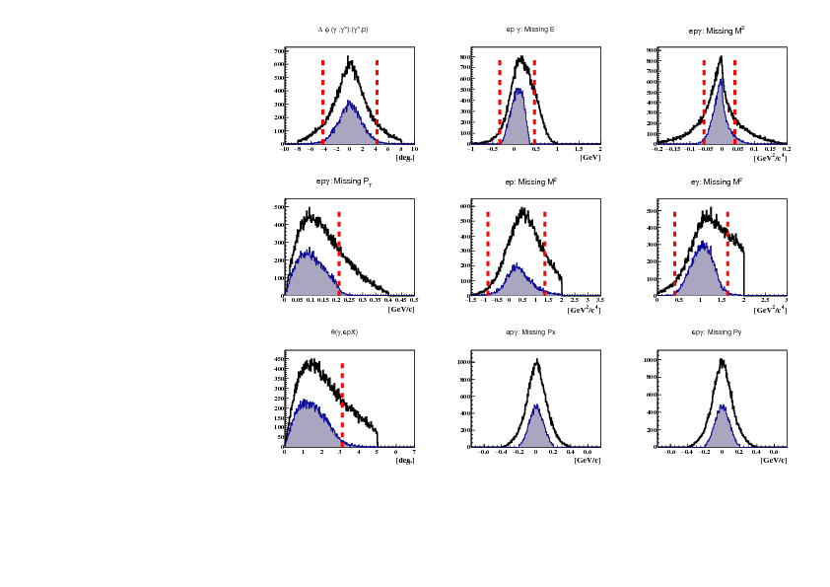
Old set of incoherent exclusivity cuts

Slide 3
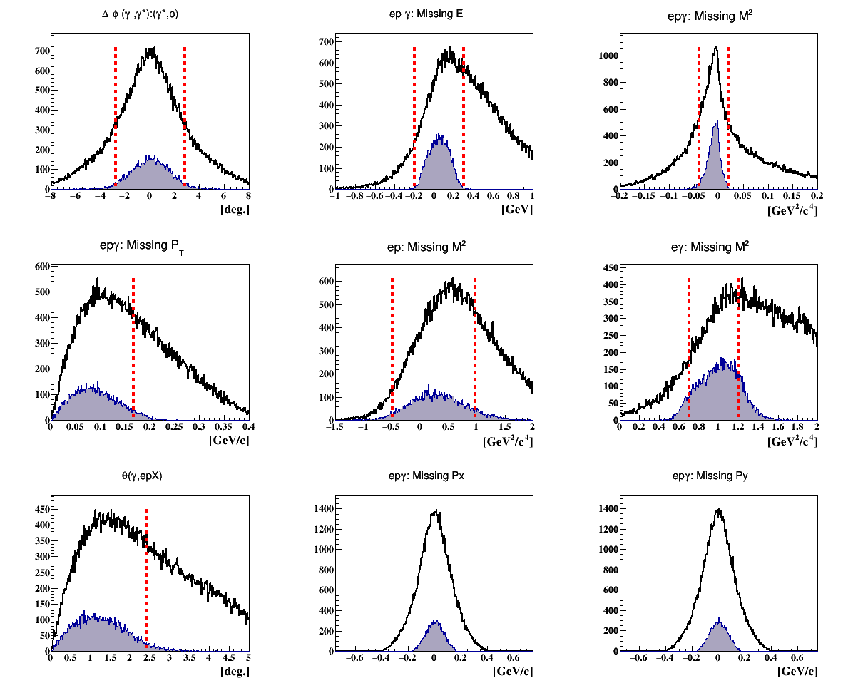
New set of incoherent exclusivity cuts

