Slide 1


Simulations of the Central Neutron Detector
Daria Sokhan
for the IPN Orsay group
CLAS 12 GeV Workshop, JLab
10th November 2010

Slide 2






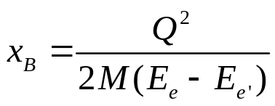
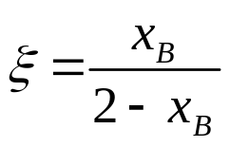

Neutron DVCS
Generalised Parton Distributions (GPDs) provide correlation between longitudinal momentum and transverse position of partons inside a nucleon and can give access to the contribution of orbital momentum of quarks to nucleon spin.
Effective way of studying GPDs is through Deep Virtual Compton Scattering (DVCS):
e’
Four GPDs accessible in DVCS at large Q²:
e
t
γ
and
γ_{L}*
(Q²)
which are functions of and .
x+ξ
x-ξ
~
~
Neutron DVCS:
needed for flavour separation
gives access to GPD E through the amplitude of the beam-spin asymmetry.
H, H, E, E (x,ξ,t)
p
p’
GPD E is currently least well known.
Important as it features in Ji’s Sum Rule, which relates E and H to the total angular momentum carried by each quark.
longitudinal momentum transfer

Slide 3


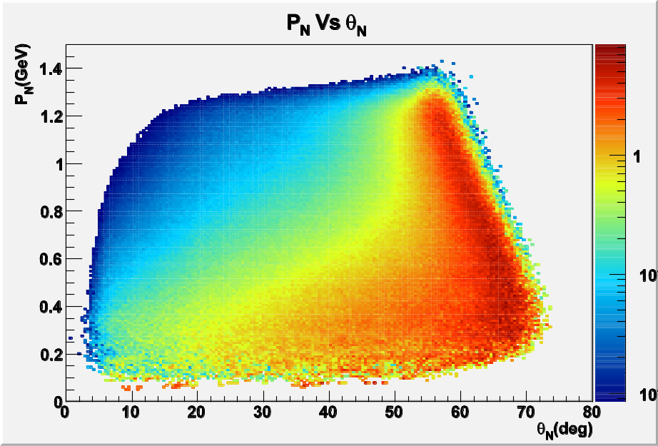
The recoil neutrons
Proposed experimental programme on neutron DVCS is complementary to
proton-target experiments at JLab aimed at accessing
For exclusive reconstruction of the DVCS process
require detection and measurement of all three final state particles.
Scattered electron and photon are typically produced at low forward
angles (into forward detector of CLAS 12).
← Simulation at E_{e}= 11 GeV
(Baptiste Guegin, Orsay).
Over 80% of neutrons recoil at θ_{lab} > 40° with peak momentum at ~ 0.4 GeV/c.
Requires central neutron detector sensitive to 0.2 < p_{n} < 1.2 GeV/c.

Slide 4
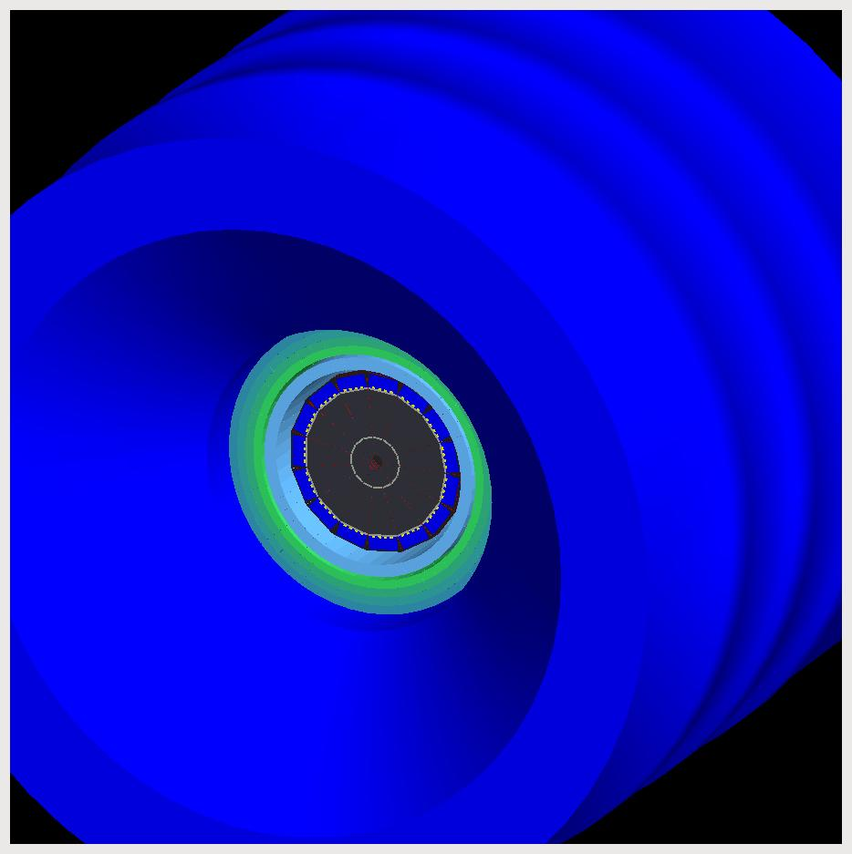
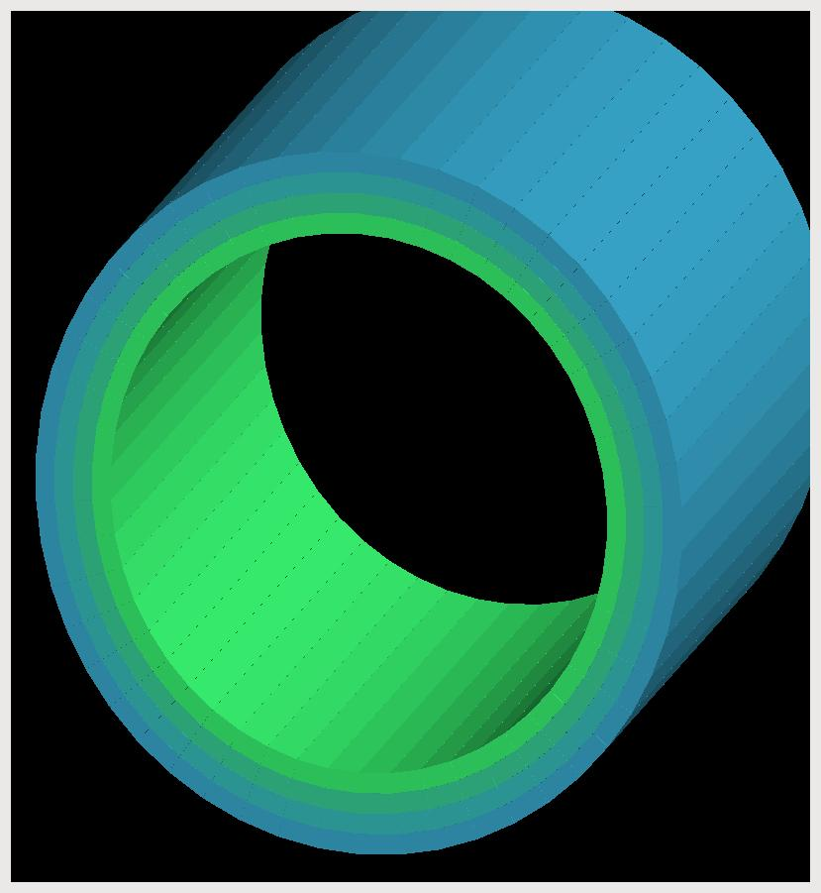
The Central Neutron Detector
Available: 10 cm of radial space in a high magnetic field between the CTOF and the solenoid magnet.
Proposed: Barrel geometry – plastic scintillator bars with trapezoid cross-section aligned along the beam - axis.
3 layers
48 paddles (azimuthal segments)
Inner radius 28.5 cm, outer 38.1 cm
Readout via photomultiplier tubes (PMTs)
Feasibility studied with Geant 4 simulations (GEMC).
y
Each bar:
Central
Tracker
CTOF
66 cm long
3 cm thick
x
CND
z

Slide 5
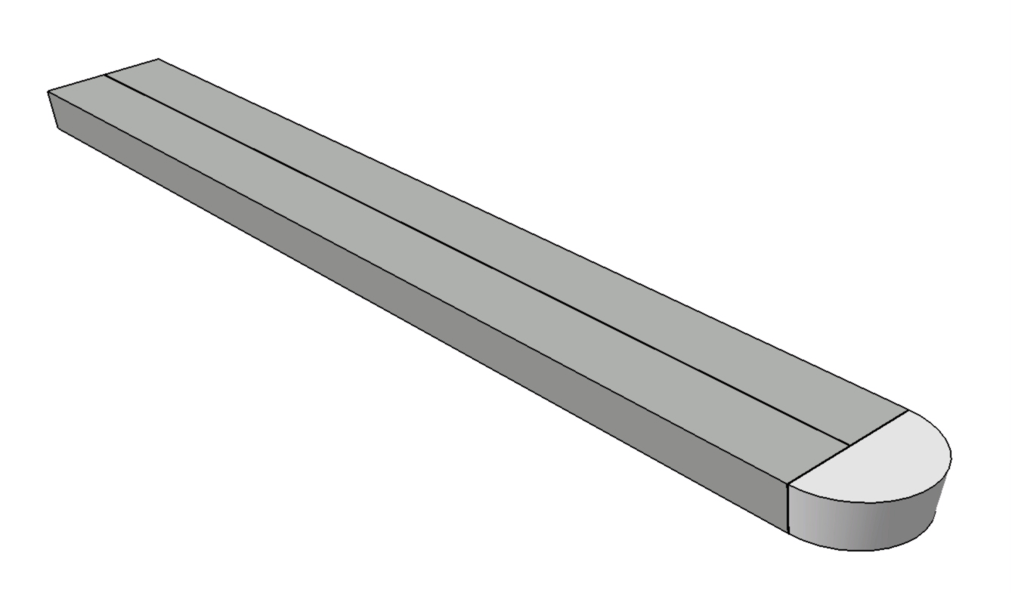
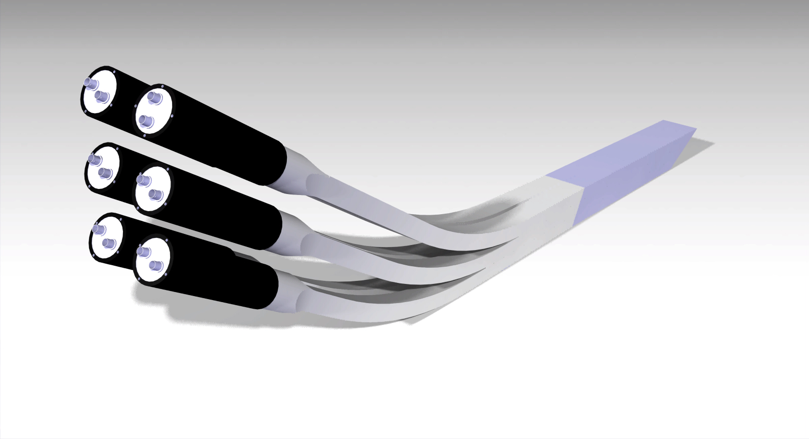
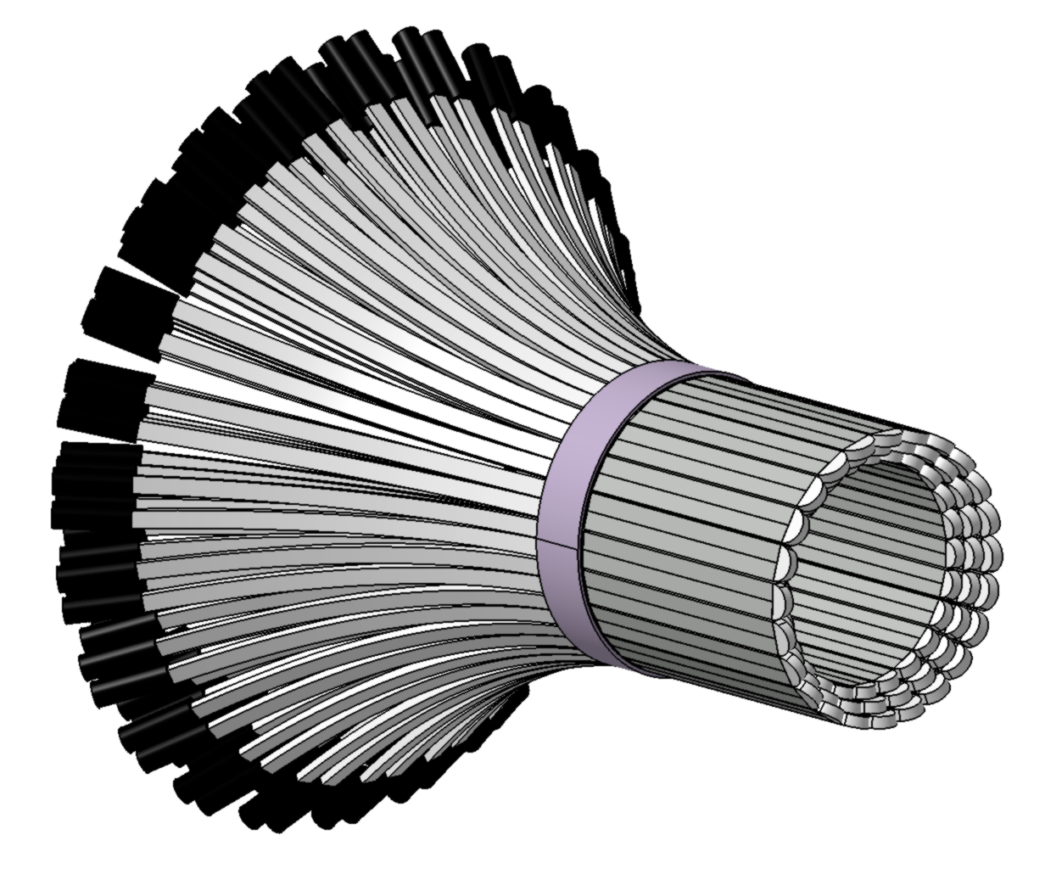
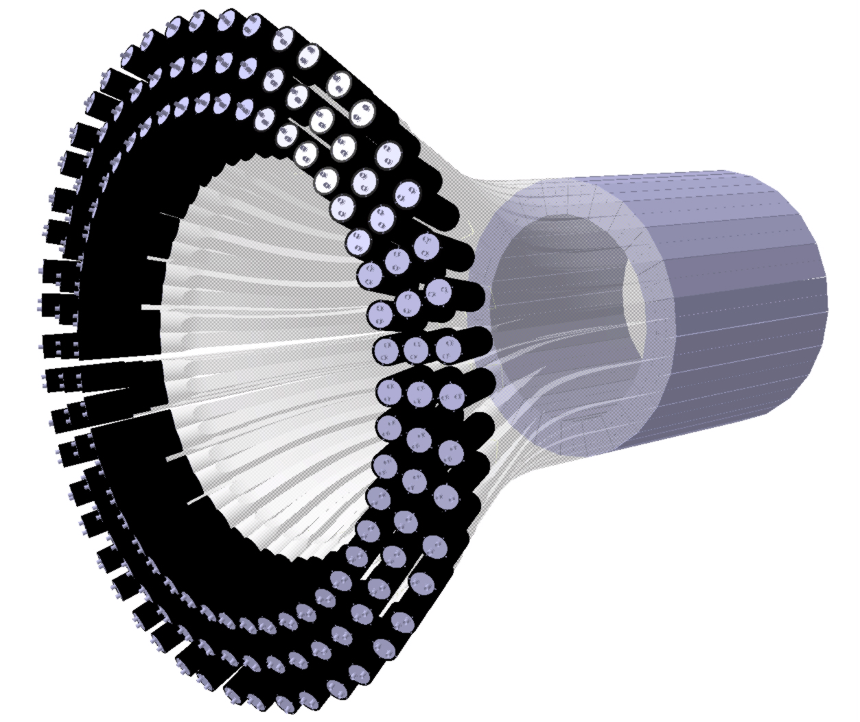
The U-Turn Geometry
Each couple of scintillator paddles connected at the downstream end with a semi-circular light-guide
At the upstream end, curved light-guides take the signal from each paddle to PMTs out of the magnetic field
Three-layer assembly, all PMTs on upstream end

Slide 6

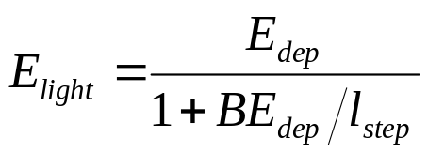
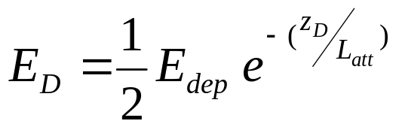
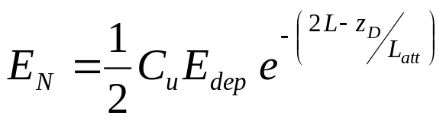
Hit reconstruction - Energy
Response of CND simulated with GEMC.
Hits in the detector are digitised to mimic the response of ADCs and TDCs
L
Energy loss in u-turn:
PMT-N
PMT-D
z_{D}
For each step of particle through material, calculate energy deposited converted into light:
B: Birk’s constant
Propagate the converted energy to the two PMTs:
LC: Light collection factor
Q: Quantum Efficiency
C_{adc}: Conversion factor from charge to ADC channels
P(x): Poisson distribution function with mean of x

Slide 7

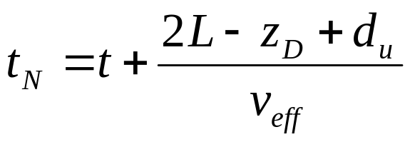
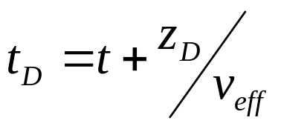
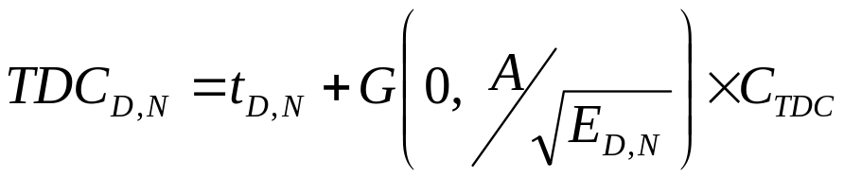
Hit reconstruction - Time
L
Distance for light travel around u-turn:
PMT-N
PMT-D
z_{D}
Time of signal arrival at the PMTs:
Conversion to TDC signal:
C_{tdc}: Conversion factor from charge to TDC channels
G(m,σ): Gaussian distribution function
A: Empirically determined constant – 0.24 based on tests at Orsay

Slide 8
Assembling steps into hits in GEMC
All steps taking place within a time window, currently 4 ns, are associated with the same hit.
The energy of the signal from every step arriving at each of the two PMTs is integrated, in the order of arrival.
A hit is recorded if the total energy passes a threshold, set at 100 keV.
The time of arrival of the step which takes the total energy over the threshold is recorded at the TDC_{D,N} for that hit.

Slide 9
Event reconstruction
What happens if there is more than one hit recorded in a scintillator couple?
Correct reconstruction:
PMT-N
PMT-D
Incorrect reconstructions:
PMT-N
Iterate through all combinations, choose only if a single combination yields hit position within the paddle.
If multiple hits within event, choose the first hit over the threshold and below the time cut.
PMT-P
PMT-N
PMT-P
PMT-N
PMT-P
Contamination from mis-reconstructed events, after all time and energy cuts have been applied, is 1 - 3 %.

Slide 10

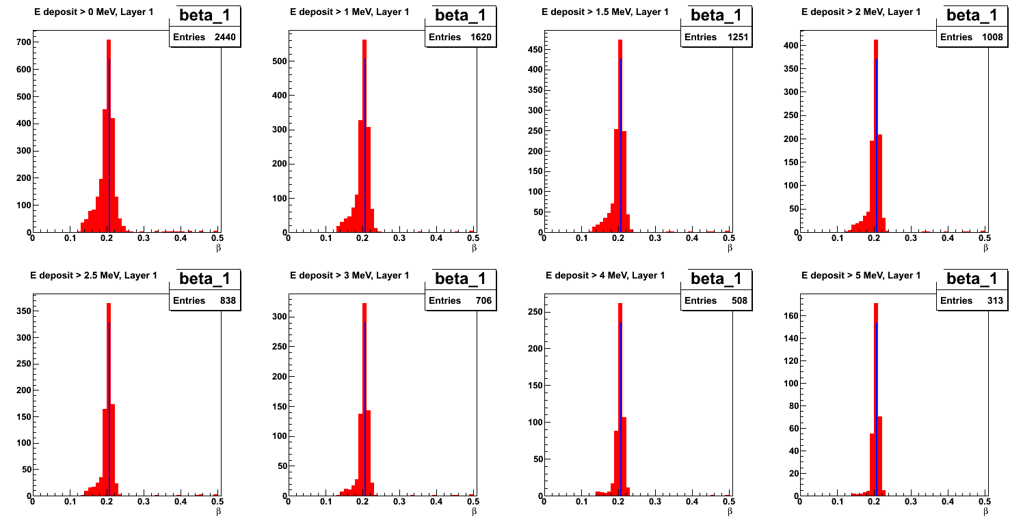
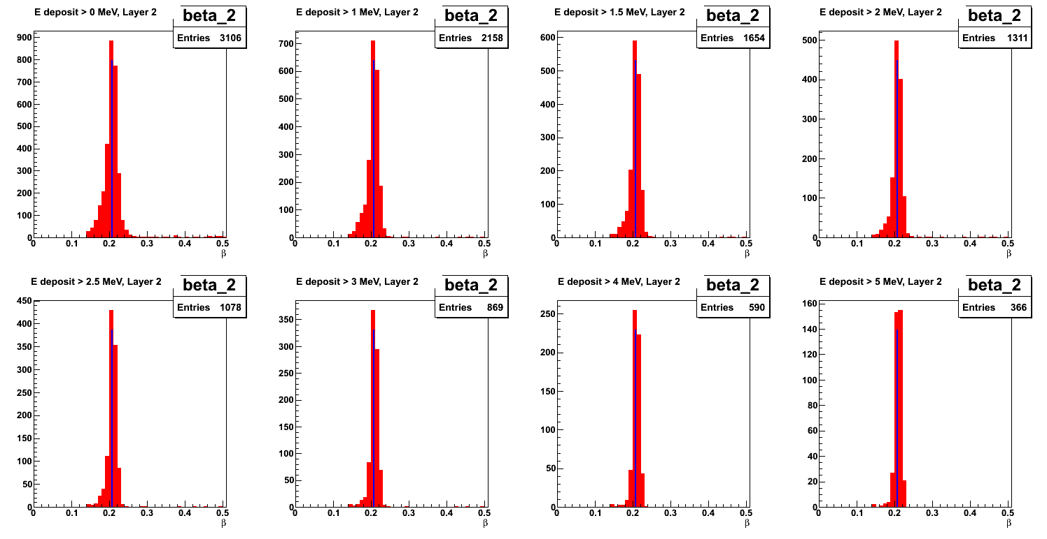
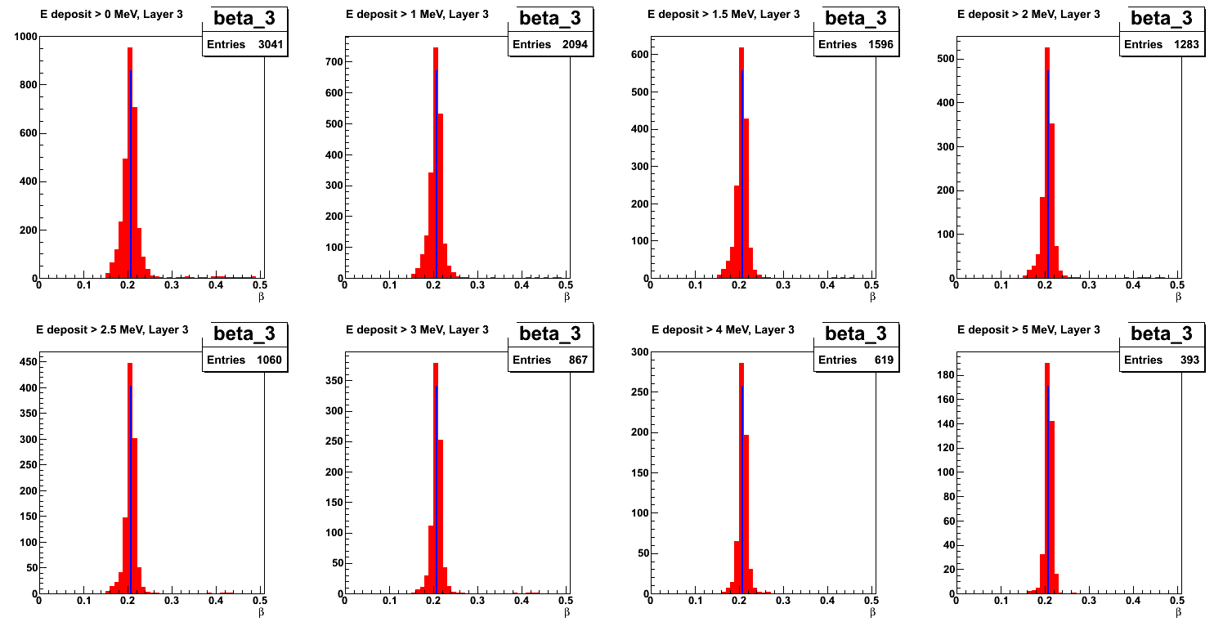
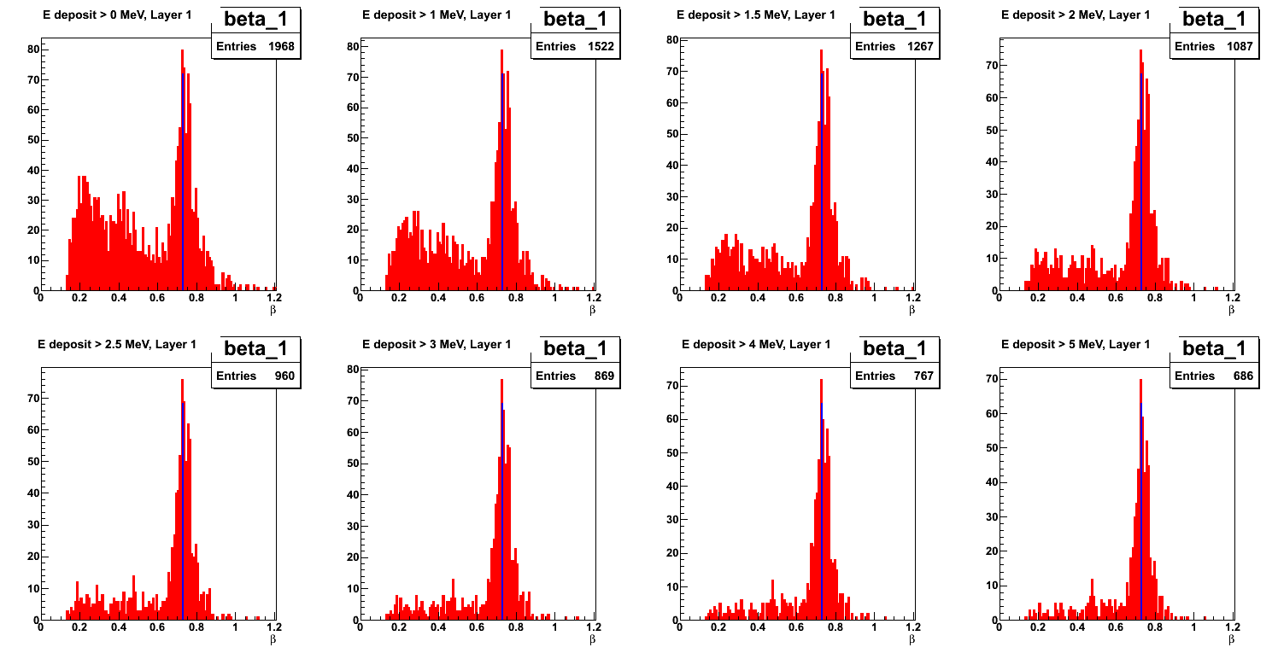
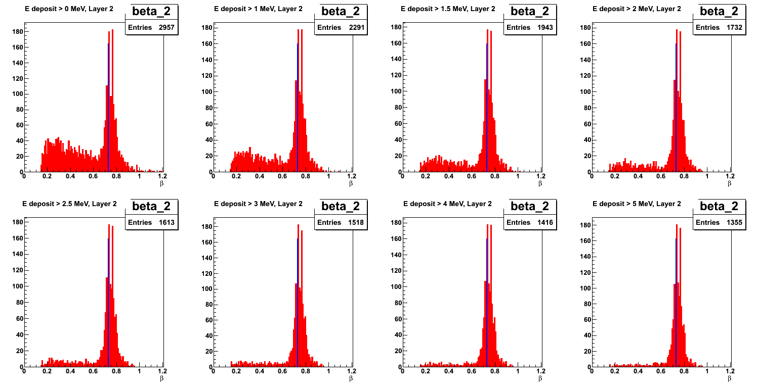
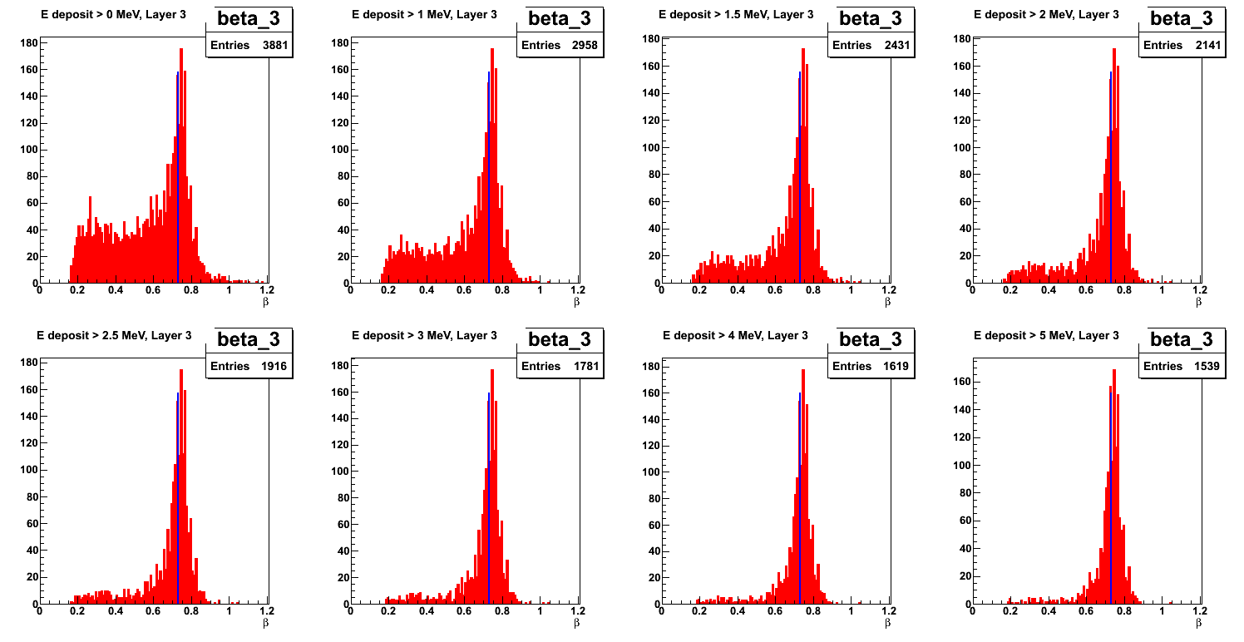
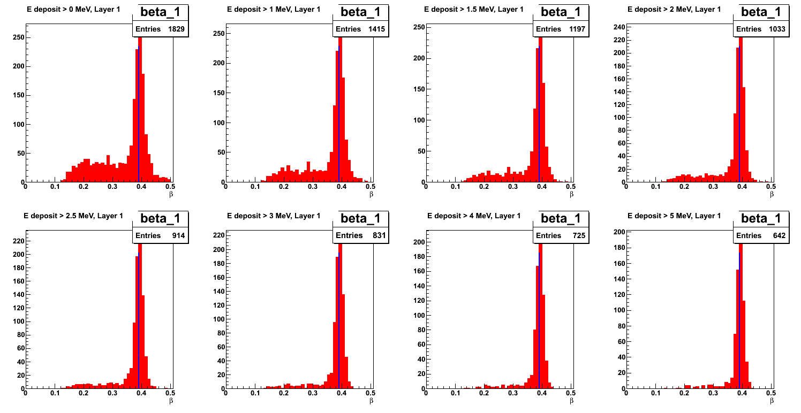
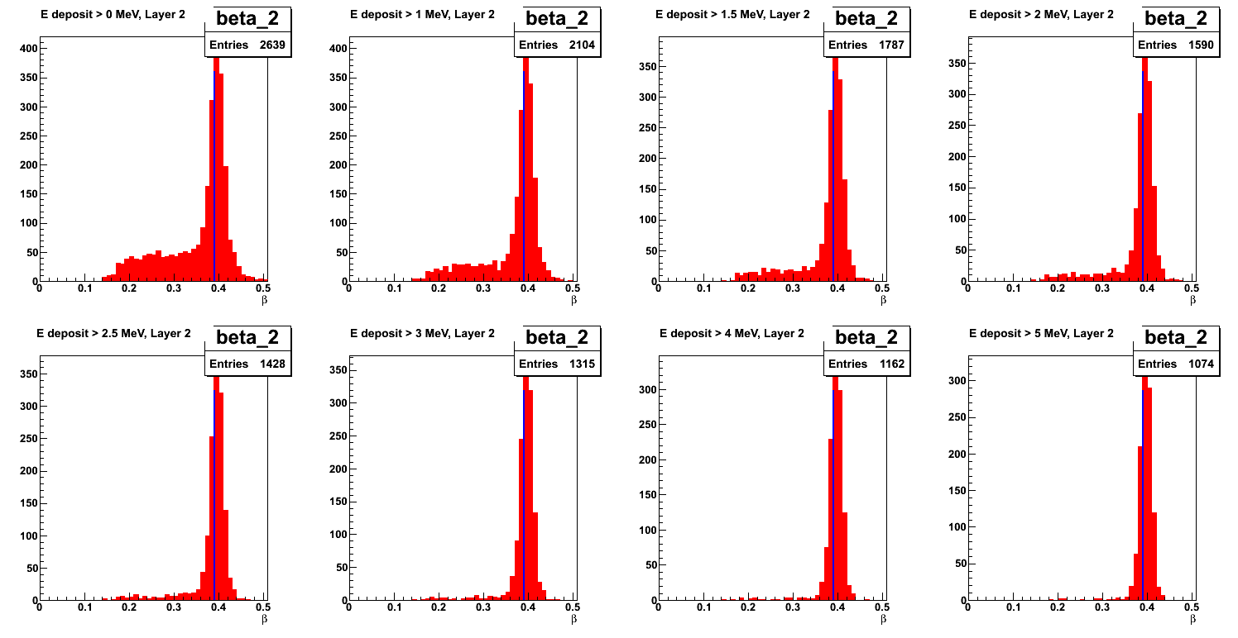
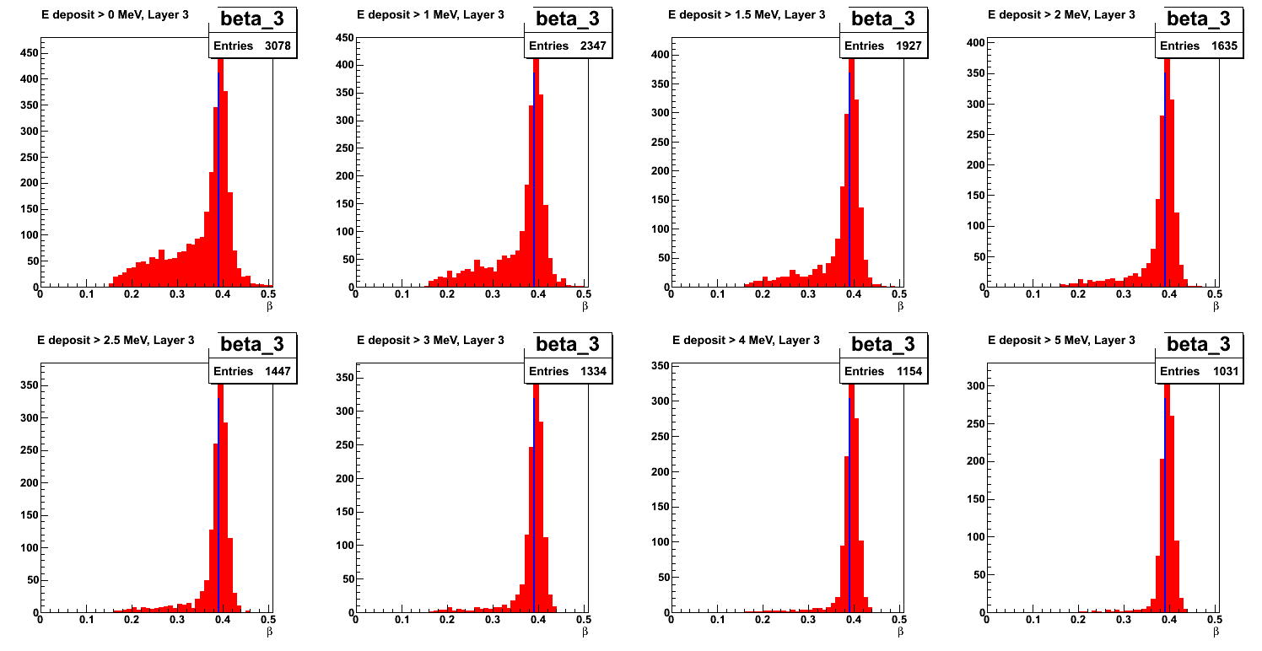
Cleaning β - distributions
Distinguishing neutrons and photons on the basis of
requires a clean distribution!
0 MeV
0 MeV
1 MeV
1 MeV
1.5 MeV
1.5 MeV
2 MeV
2 MeV
2.5 MeV
2.5 MeV
3 MeV
3 MeV
4 MeV
4 MeV
5 MeV
5 MeV
Tail of the beta distribution – can be effectively reduced by applying threshold on the reconstructed deposited energy of the hit and on the reconstructed time of hit (8 ns).

Slide 11
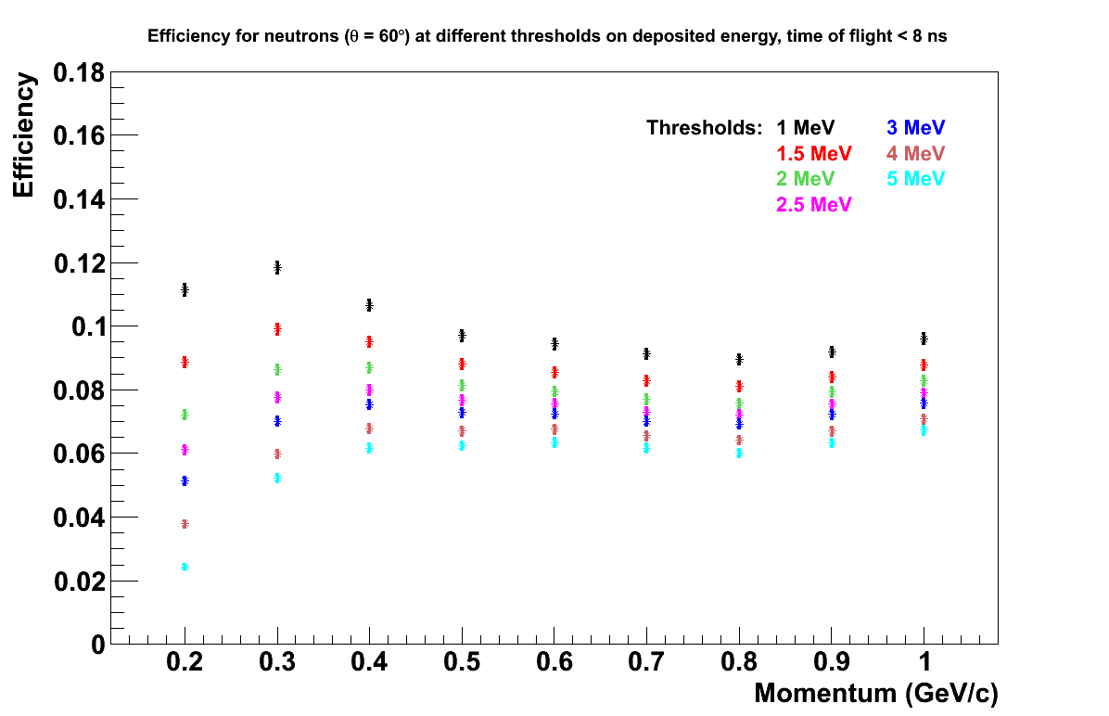
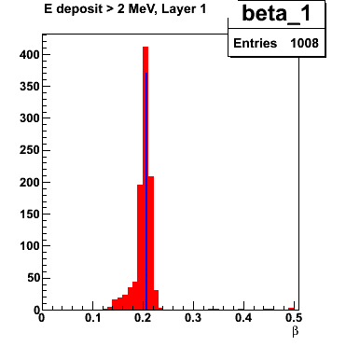
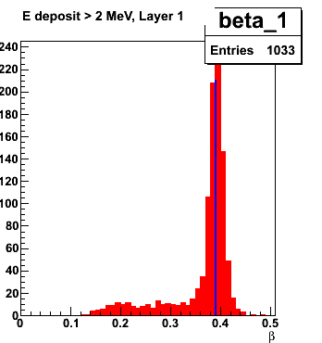
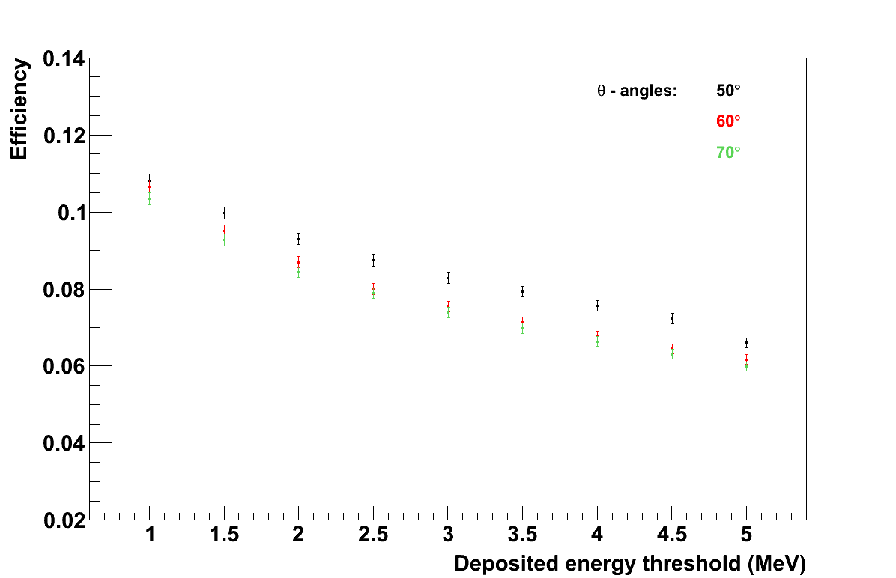
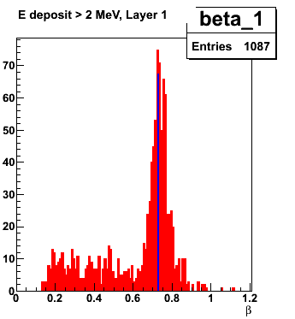
Effect of Energy Threshold on Efficiency
θ = 60°
0.2 GeV/c
0.4 GeV/c
P_{n}= 0.4 GeV/c
1 GeV/c
2 MeV threshold on reconstructed deposited energy of the hit: compromise between a clean beta distribution and a non-fatal loss of efficiency (8 – 9 %).

Slide 12
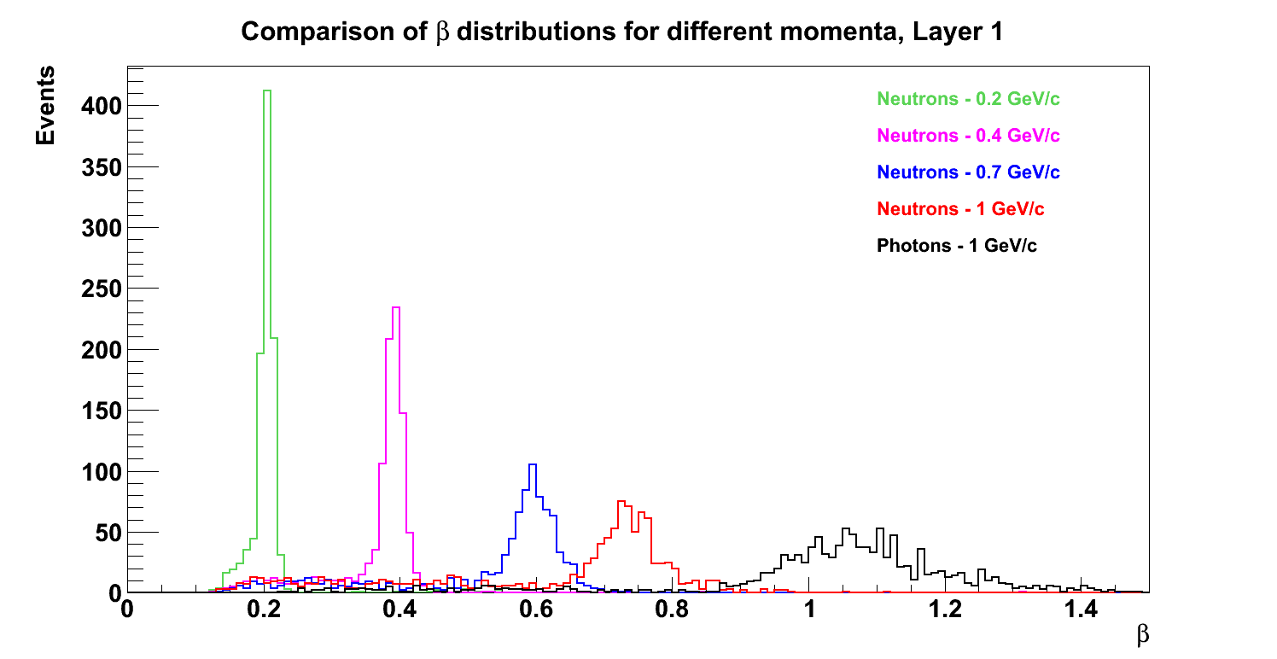
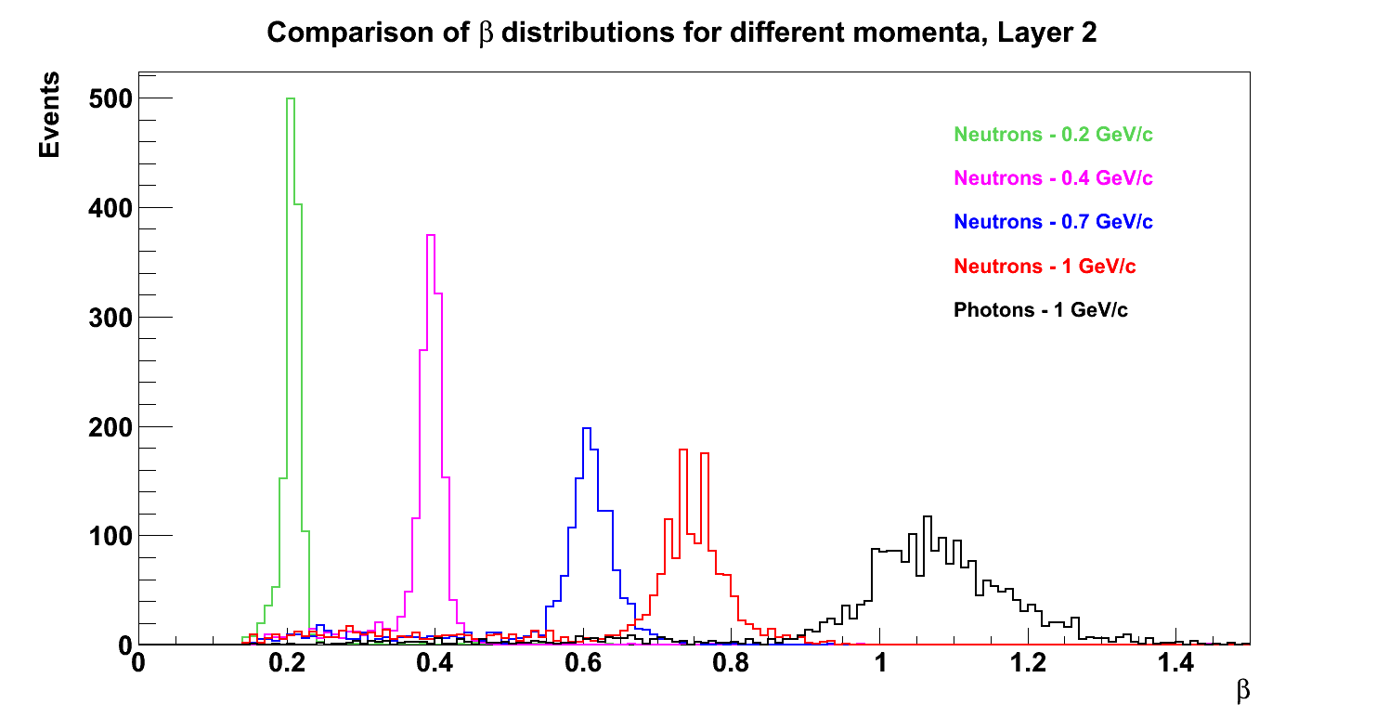
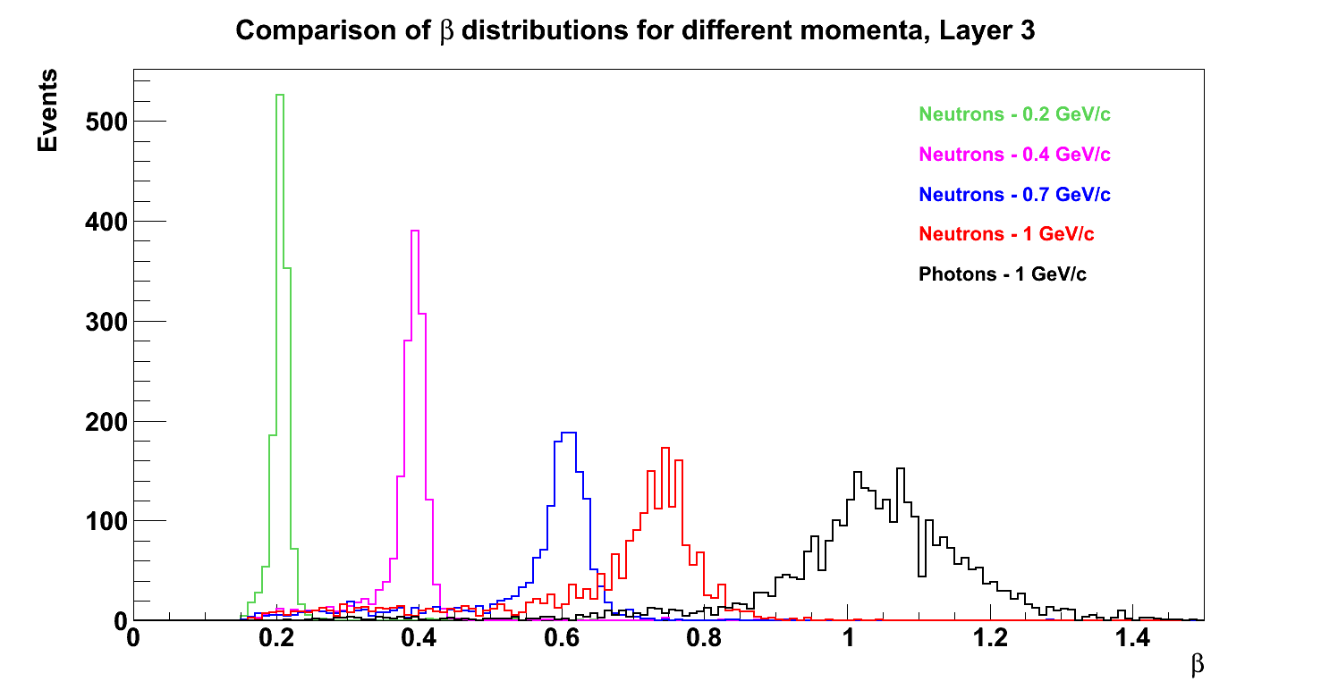
Neutron / Photon Separation
Layer 1
Layer 2
Layer 3
θ = 60° in all plots

Slide 13
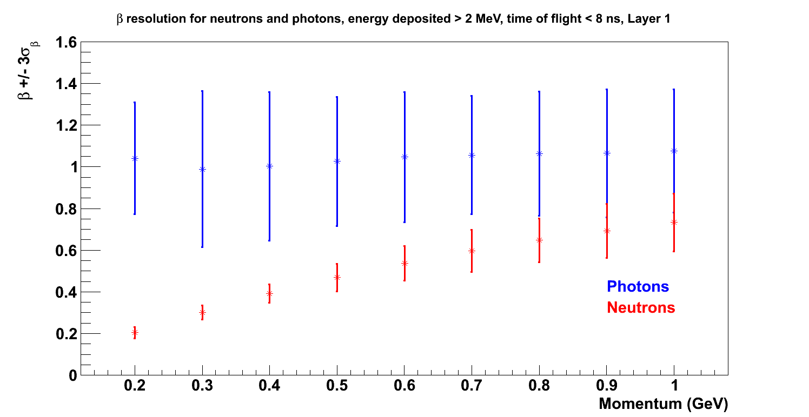
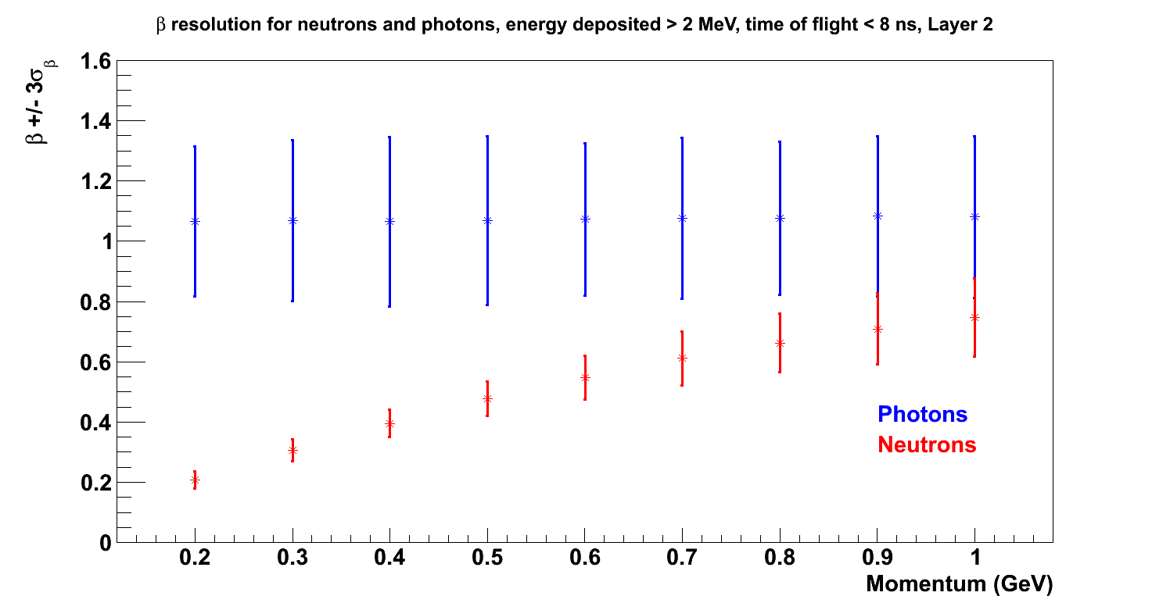

Neutron / Photon Separation
β
β
Error bars on the β - axis represent 3 σ
β
θ = 60° in all plots
Neutrons up to ~ 0.9 GeV/c can be well separated from photons on the basis of the measured β

Slide 14
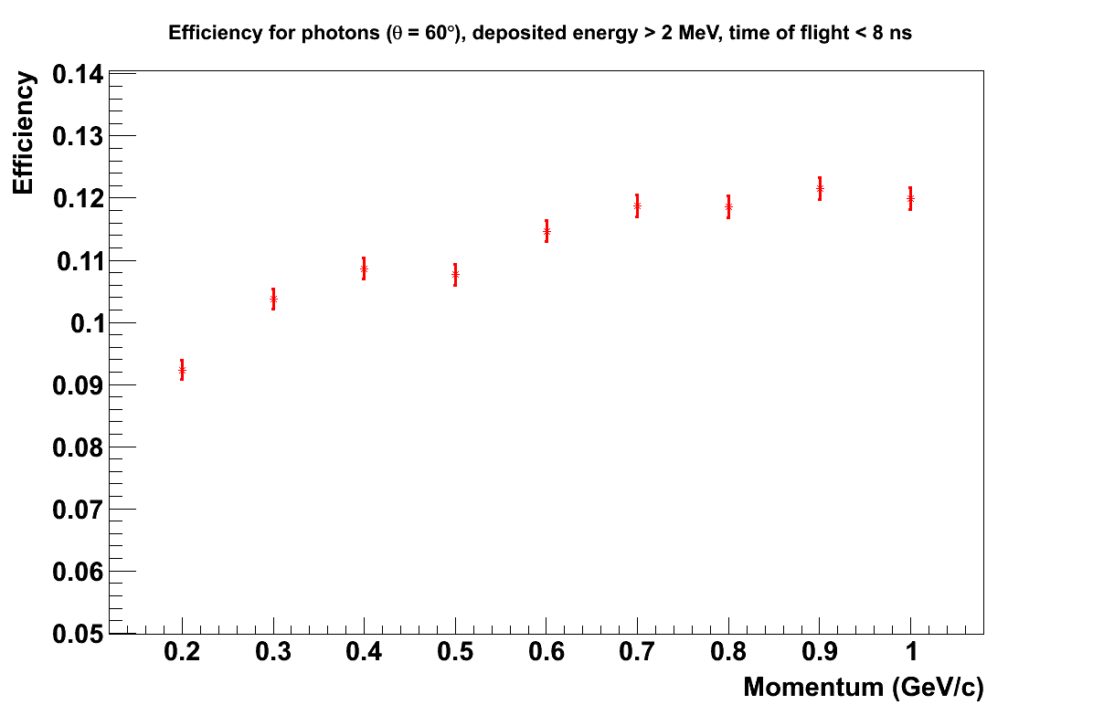
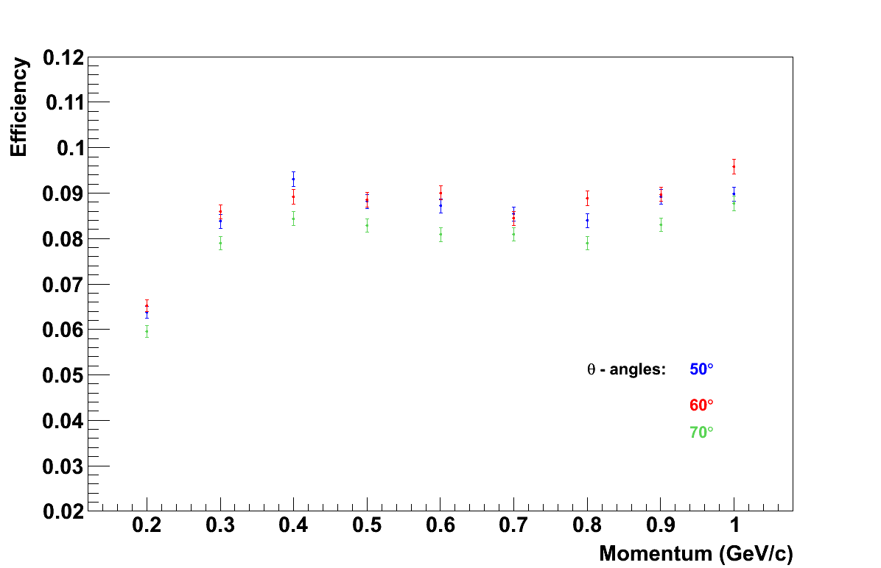
Efficiency
Photon efficiency is around 9 – 12%
photons, θ = 60°
neutrons
Neutron efficiency is mostly in the range 8 – 9.5 %, depending on momentum

Slide 15
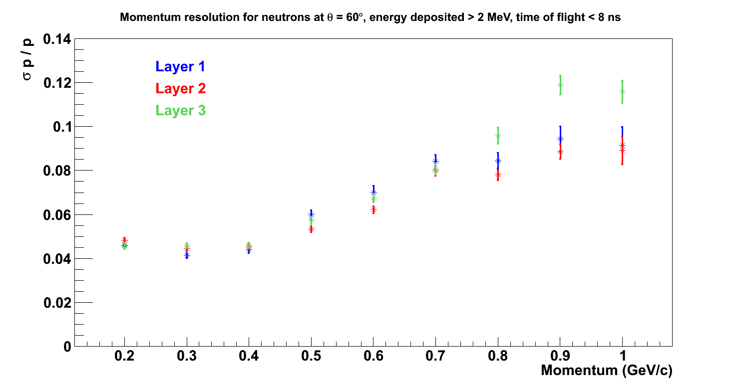
Momentum Resolution
θ = 60°
Momentum resolution in the range 4 – 10 %

Slide 16
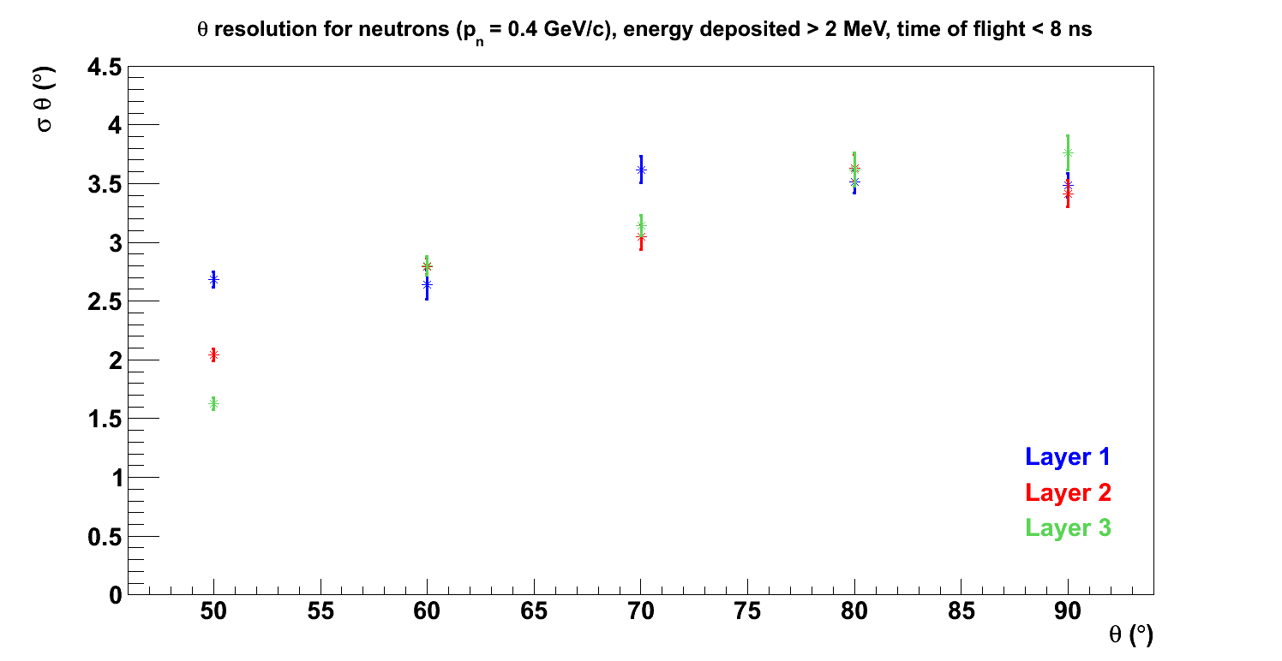
θ Resolution
P_{n} = 0.4 GeV/c
θ-resolution in the range 2° – 3.5°
φ-resolution determined by the azimuthal segmentation into 48 paddles, so 3.75°

Slide 17
Conclusions
A clean β-distribution can be obtained by application of a 2 MeV energy threshold on the reconstructed deposited energy of the hit and a maximum reconstructed time of 8 ns.
This enables a good separation of neutrons and photons up to ~ 0.9 GeV/c.
The time and energy thresholds applied result in efficiency of 8 – 9.5 % for the neutrons and a comparable 9 – 12 % for the photons.
Momentum resolution varies from 4 – 10 %, increasing with momentum.
Angular resolutions are 2 – 3.5° in θ and 3.75° in φ (determined by the azimuthal segmentation).

Slide 18
Back-up slides

Slide 19
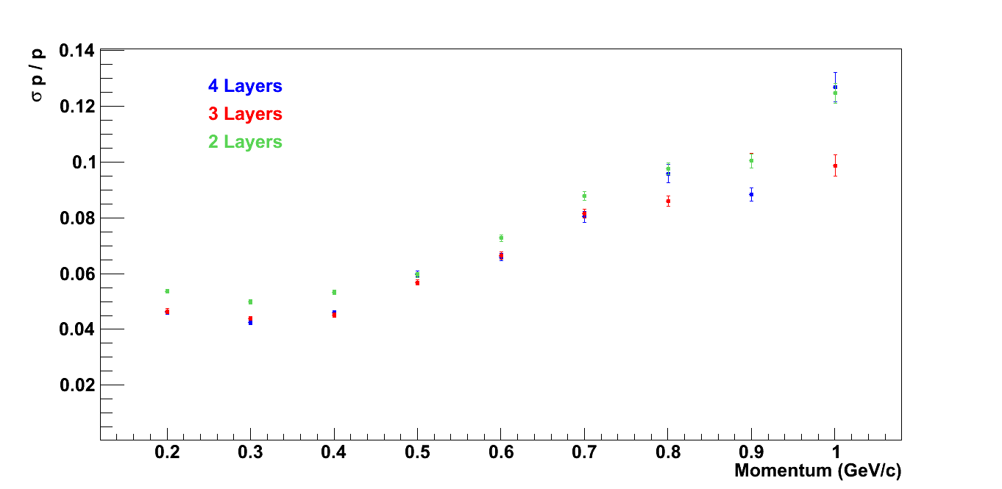
How many layers?
(Resolution averaged between all layers in geometry)
θ = 60°
Momentum resolution required < 10 %.
In the kinematic region of interest, using a 2-layer geometry as opposed to 3 or 4 layers reduces momentum resolution by 1 %. 4 layers are more expensive.
3 layers optimum!

Slide 20
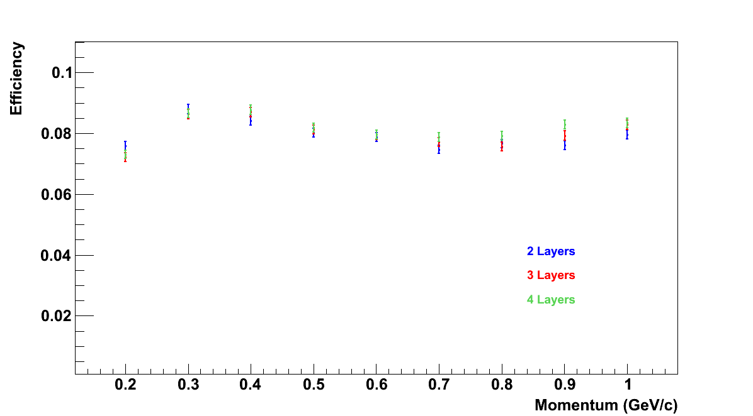
Efficiency with different layers

Slide 21
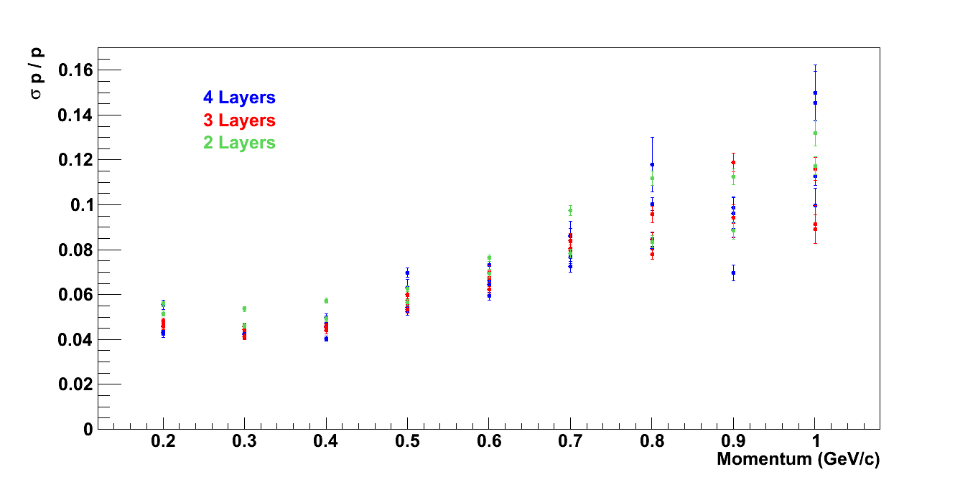
Momentum resolution,
all layers

