Slide 1
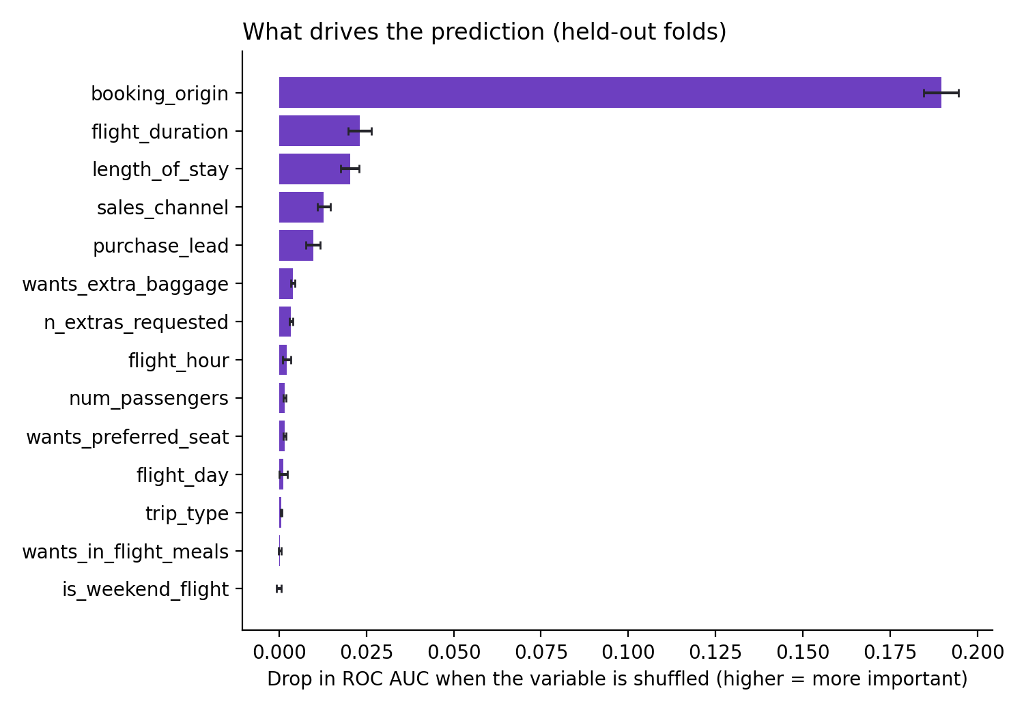
Where a customer books from predicts completion far better than anything else, but the model is a ranking tool, not a decision-maker
What I found
Only 15.0% of 50,000 enquiries completed a booking, so always predicting "no booking" is 85.0% accurate. Accuracy is the wrong yardstick here.
A random forest ranks bookings usefully: ROC AUC 0.766 (spread across 5 folds: 0.004), against 0.5 for chance.
Booking country dominates. Shuffling it costs 0.190 AUC; no other variable costs more than 0.023, and without it AUC falls from 0.766 to 0.679. Completion is 5.0% for bookings from Australia (17,872 rows) and 34.4% from Malaysia (7,174).
Day of week, flight hour, meals and weekend flights add almost nothing.
What it can and cannot do
At a 0.5 cut-off it flags 24.5% of enquiries and catches 54.9% of real bookings, but only 33.5% of flagged enquiries complete. Use it to prioritise follow-up, not to decide individual cases.
Next steps: add route and customer history, test on a later time period, and check whether the origin effect reflects markets, pricing or how the data was collected before acting on it.
Forage job simulation (not client work). 5-fold stratified cross-validation, importance measured on held-out folds. Code: github.com/HattieSpartan/BA-booking-prediction (to be created)

