Slide 1
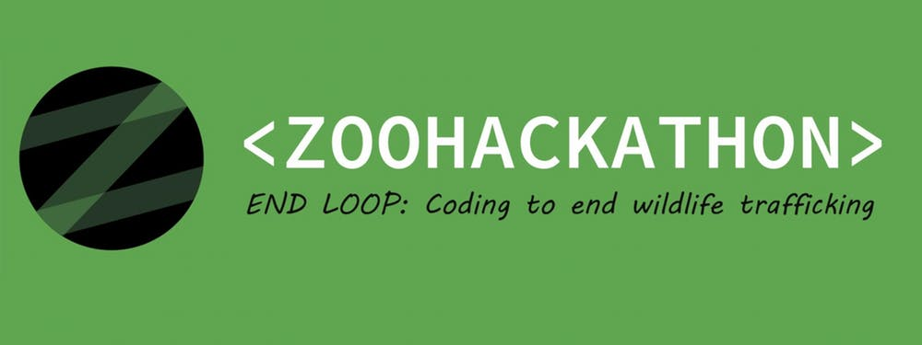
It costs how much?? Monitoring the changing price of wildlife online
Jenni Hautojärvi
Merja Hepoaho
Hilla Koskela

Slide 2
The problem
The sale of legal and illegal wildlife is moving online.
Monitoring is getting increasingly difficult with existing methods
Vendors switch on different websites or platforms
Key words to describe the products may evolve
Some advertisements are hoaxes or fraudulent sales
Specimen of wildlife can be offered for sale in multiple places
Different languages and currencies

Slide 3
Challenge
Create an easy to use tool that allows the conservationists to make specific searches without advanced coding skills
The tool should make internet search and provide back a summary of the data

Slide 4
Solution
Search tool that uses machine learning and data mining to get information about wildlife trade
Amount of species and specimen
Price range
Location
Legality of the trade

Slide 5




Technical Architecture
WWW
User
NLP

Slide 6
Data collecting Workflow
Website
Node-Red
List of:
Automated data mining
Collect all data that includes ”Iguana” from list of websites
NLP
Model 1: Checks if the advert is authentic or not
Websites
Variables, example ”Iguana”
Model 2: Collects data from authentic adverts
Database
Form CSV-file from the collected data results

Slide 7
UI Workflow
Website
User can make a search, example ”iguana”
Receive results
Search tool returns a collection of results, includin
Data Analyze
User receives analyzes from the results
Currency can be selected from a separate menu
Price
Location
Amount of specimen
Timestamp
Price shown in selected currency
Selected interval
Additional websites can be added for examination
The results of the analyzes can be customizable

Slide 8
Technology
Node-Red (Node.js)
HTML/CSS
Javascript (Cheerio)
Machine Learning
Unsupervised learning
NLP
Language datasets
Visual recognition

