Slide 1

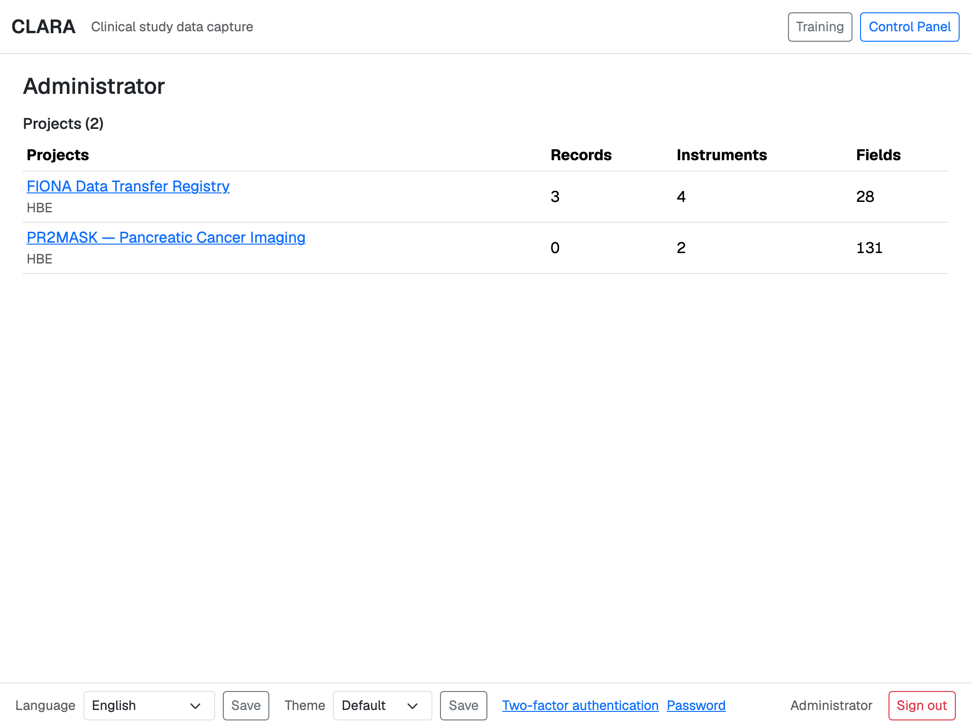
CLARA
Clinical Logbook for Automated Research Assistance
A new foundation for FIONA's research imaging — ready for many hospitals
Introduction for a non-technical audience · October 2026
Notes:
CLARA is a logbook for clinical research data — the name comes from a lighthouse logbook. This talk explains why we built it, what it does silently for FIONA, and what study teams see in the browser. The screenshots are from a demo installation as it looks on an iPad.

Slide 2

1
Why a new foundation
FIONA, its REDCap connection — and the step to several hospitals
Notes:
First part: the problem. FIONA works today; what changes is that it should serve several hospitals.

Slide 3





FIONA brings hospital images to research projects
STEP 1
STEP 2
STEP 3
STEP 4
Images are taken
FIONA registers
A researcher asks
FIONA delivers
The hospital's image archive sends each new study to FIONA.
FIONA notes every incoming study and each of its image series.
A study is requested for a specific research project.
FIONA removes the patient's identity and delivers the images.
Behind the scenes FIONA keeps its bookkeeping — projects, incoming studies, transfer requests — in a data store it talks to through the REDCap programming interface (API). CLARA replaces that store.
Notes:
FIONA is the research information system for radiology. It receives DICOM studies from the hospital archive (PACS), registers them, and on request anonymizes them and sends them to a research project. All of FIONA's bookkeeping sits behind the REDCap API — that is the part CLARA takes over.

Slide 4




Several hospitals, one foundation
What a multi-hospital FIONA needs
How CLARA provides it
FIONA must keep working exactly as it does today
CLARA answers the same REDCap-style requests — no change in FIONA
Staff of every hospital sign in with their own hospital account
Sign-in by hospital name, each linked to that hospital's login service
Projects and sites must not see each other's data
Personal access keys per project, roles, and data access groups
It must run inside the hospital network
Self-contained: everything is installed locally — no internet needed
Every action must be traceable
A complete audit trail of every change and every view
Notes:
Moving from one hospital to several changes the requirements: people from different hospitals log in differently, data must stay separated, the system must live inside the hospital network, and everything must be traceable. FIONA itself should not have to change.

Slide 5
Same requests, new engine
7
0
2
kinds of request FIONA sends — each answered the way REDCap answers it
changes needed in FIONA itself
faces: a silent API for FIONA, and a web interface for people
FIONA's seven requests, in plain words
Project information
Form definitions
Visits (events)
Which form at which visit
Field names
Next free record number
Records: read, write, delete
Notes:
FIONA uses seven kinds of REDCap API request: project, metadata, event, formEventMapping, exportFieldNames, generateNextRecordName and record (export, import, delete). CLARA answers all of them the REDCap way, so FIONA only needs a new address and token. Reading and writing records is the busiest of the seven.

Slide 6
2
The silent partner
CLARA's API — where FIONA keeps its books, day and night
Notes:
Second part: the API. Nobody sees it, but FIONA talks to it all the time.

Slide 7
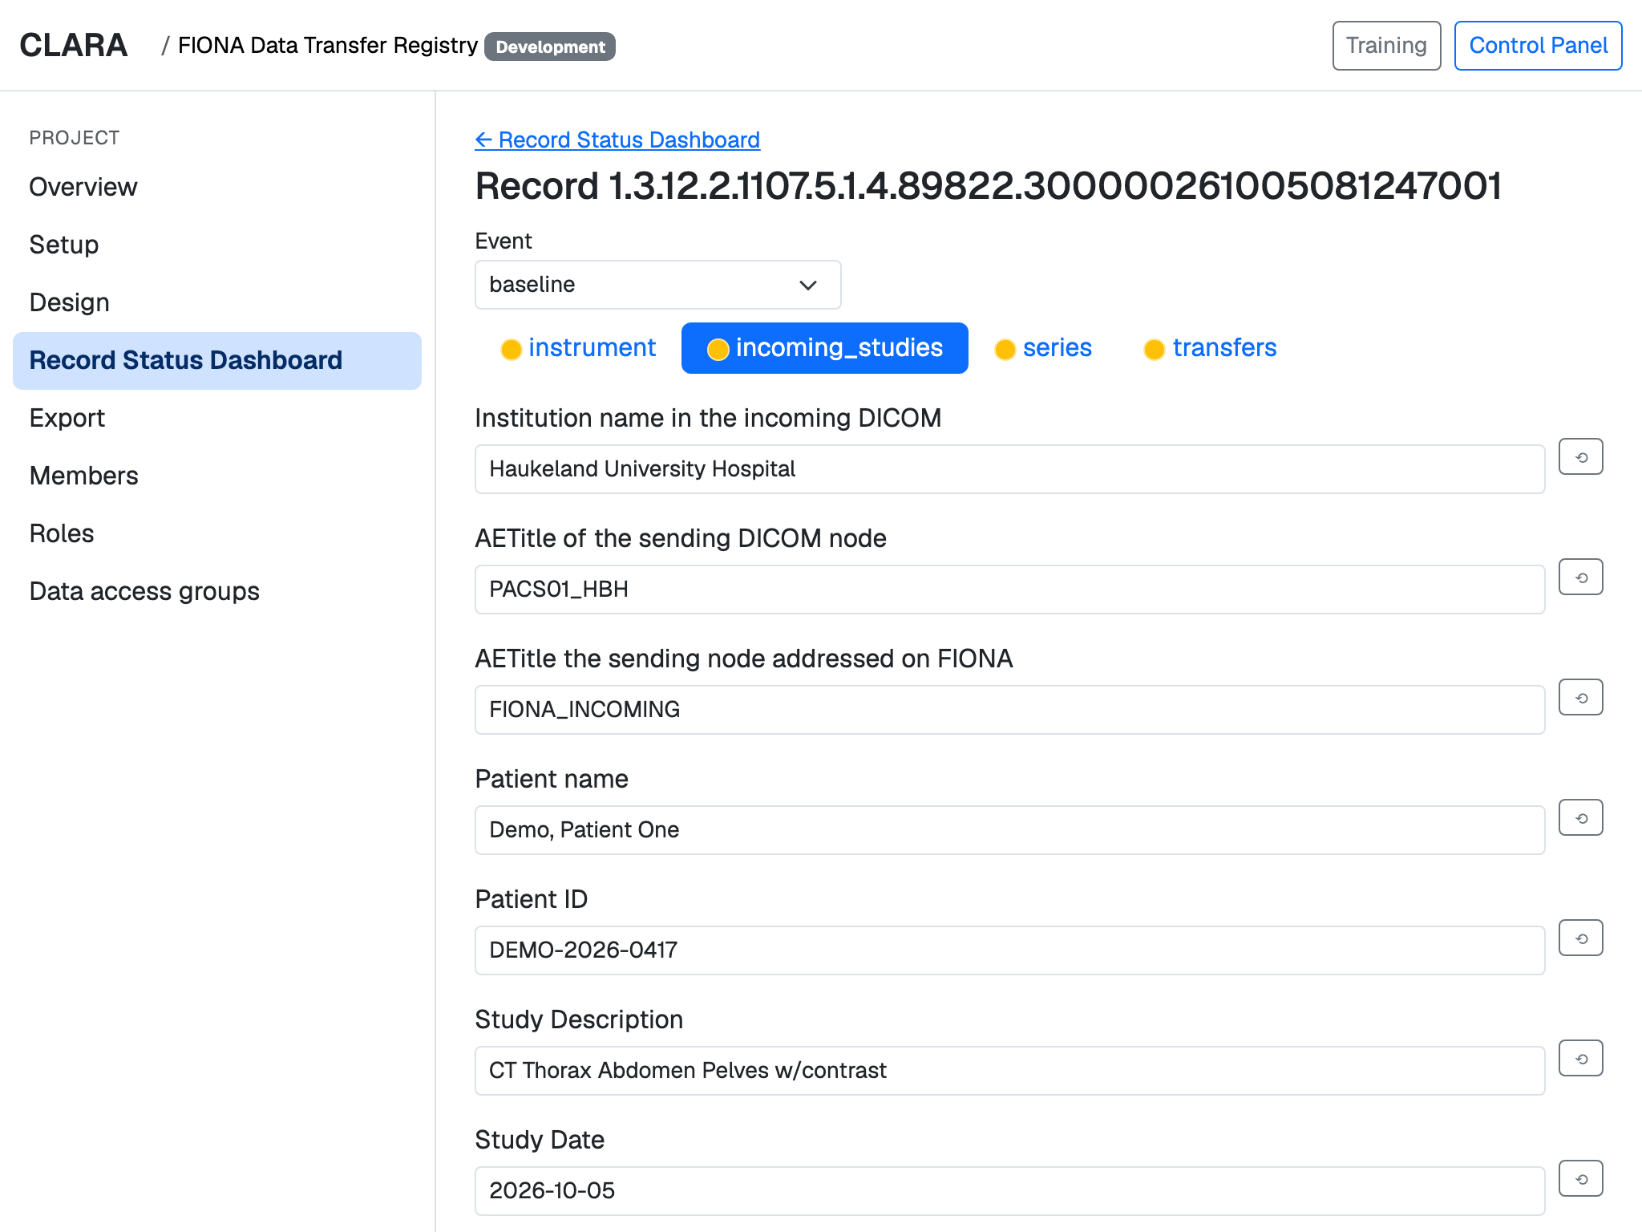
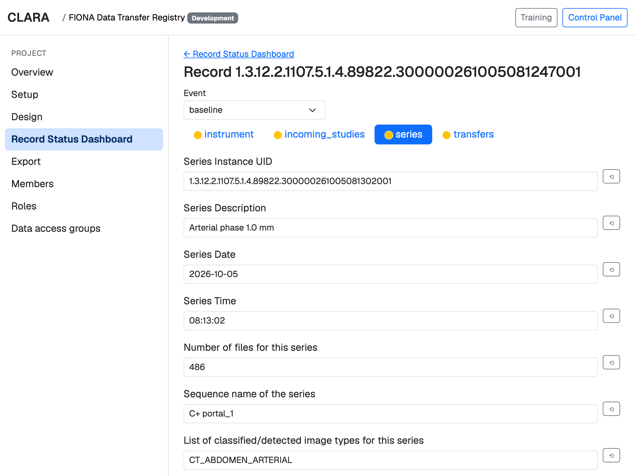
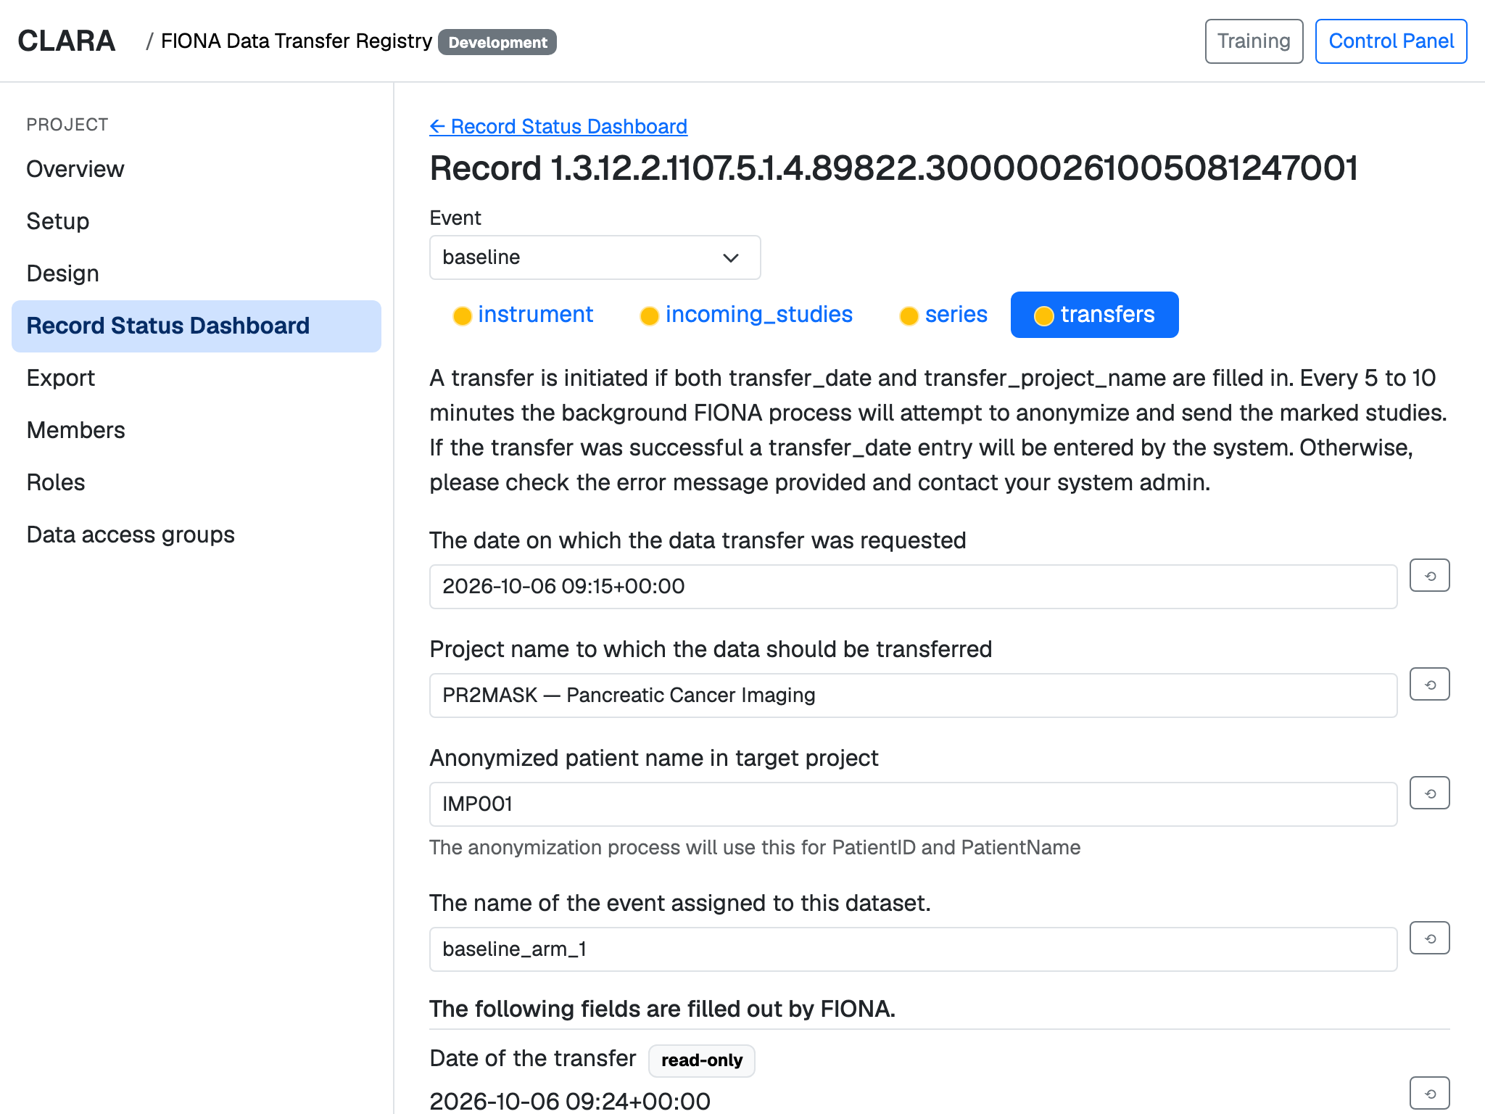

Three kinds of information FIONA keeps in CLARA
Incoming studies
Image series
Transfer requests
Each study that arrives: hospital, sending device, patient, description and date.
Each series inside a study: description, number of images, detected image type.
Where a study should go, under which anonymous name — and whether it has been sent.
Notes:
In the demo, the 'FIONA Data Transfer Registry' project is built from FIONA's real data dictionaries: incoming studies, their series, and transfer requests. FIONA fills these forms through the API; people can look at them in the browser.

Slide 8
A transfer request, start to finish
1
Images arrive
FIONA records the study and its series in CLARA — automatically, through the API.
2
A researcher asks
In the transfers form they name the target project and an anonymous participant name.
3
FIONA delivers
Every 5 to 10 minutes FIONA anonymizes the marked studies and sends them on.
4
CLARA shows it is done
FIONA writes the transfer date back; staff see the result — or an error to follow up.
Notes:
The transfers form explains itself: a transfer starts once a date and a target project are filled in. FIONA's background process picks it up within 5 to 10 minutes, anonymizes and sends the study, and writes the transfer date back. The fields FIONA fills are read-only for people.

Slide 9


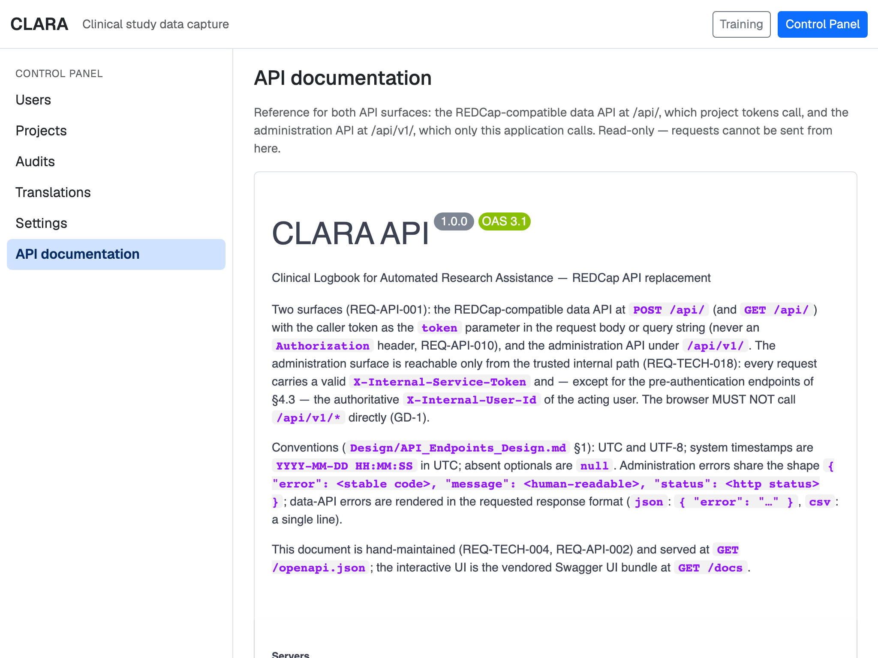

Built to be trusted
Personal access keys
Checked before stored
Each member gets their own key per project; it can be replaced at any time.
Every value is validated against the form definition before it is saved.
Every change recorded
Fully documented
Who changed what, and when — kept in an audit trail that cannot be edited.
A built-in reference describes every request, for FIONA's developers and others.
Notes:
Every API call carries a personal project key (token) that can be rotated. Values are validated before they are stored, every change is written to an audit trail, and the whole API is documented in the Control Panel.

Slide 10

3
The web interface
Everything a study team does — in the browser, on a laptop or an iPad
Notes:
Third part: what people see. Organized by theme, not by menu.

Slide 11




Six things the web interface does
Projects
Forms
Data collection
Organize studies and move them from development to production to analysis.
Design data collection forms — or import existing REDCap dictionaries.
Participants, visits and forms, with their status at a glance.
Export
Oversight
Help
Download data at exactly the level your role allows.
Audit trail, user accounts and settings for administrators.
Training guides, and the interface in English, Bokmål and Nynorsk.
Notes:
The following slides take these six themes one at a time.

Slide 12
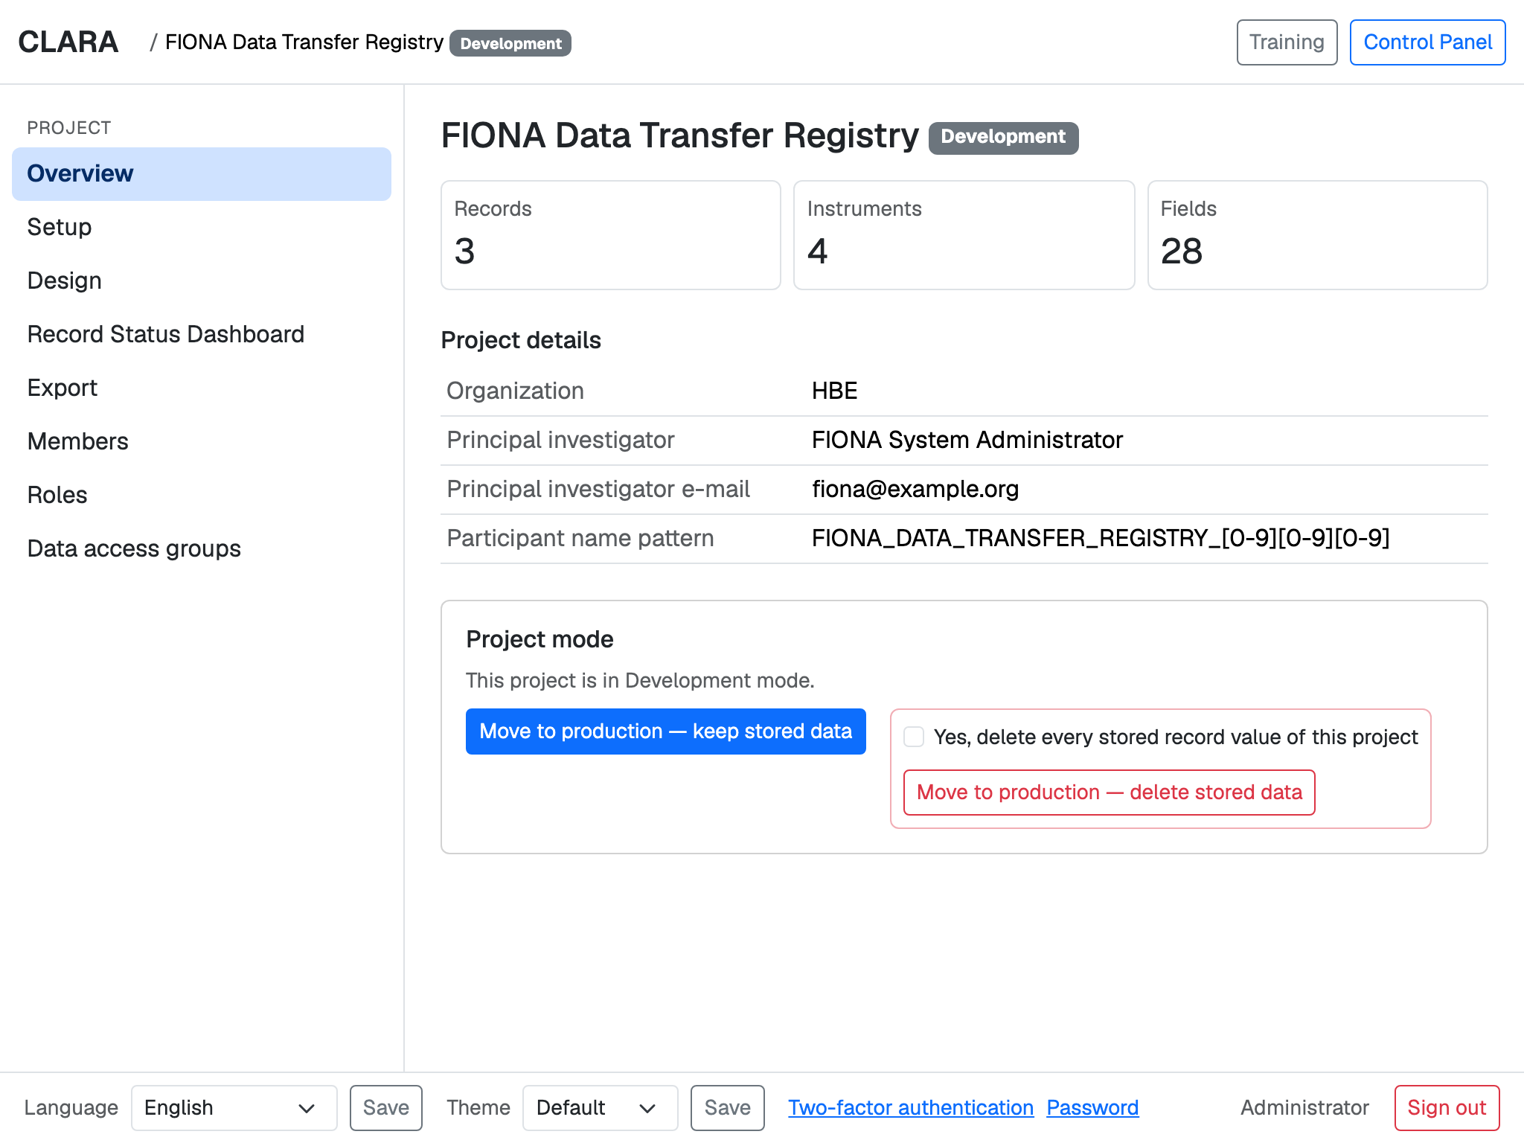
Projects: every team sees its own studies
Start page — only the projects you belong to, with their size at a glance.
Project overview — key facts and the project's mode: Development, Production or Analysis.
Notes:
After signing in, people see only their own projects. Each project has a mode: in Development everything can change; in Production design changes are staged and checked; in Analysis data entry stops and only viewing and export remain. Only system administrators change the mode.

Slide 13
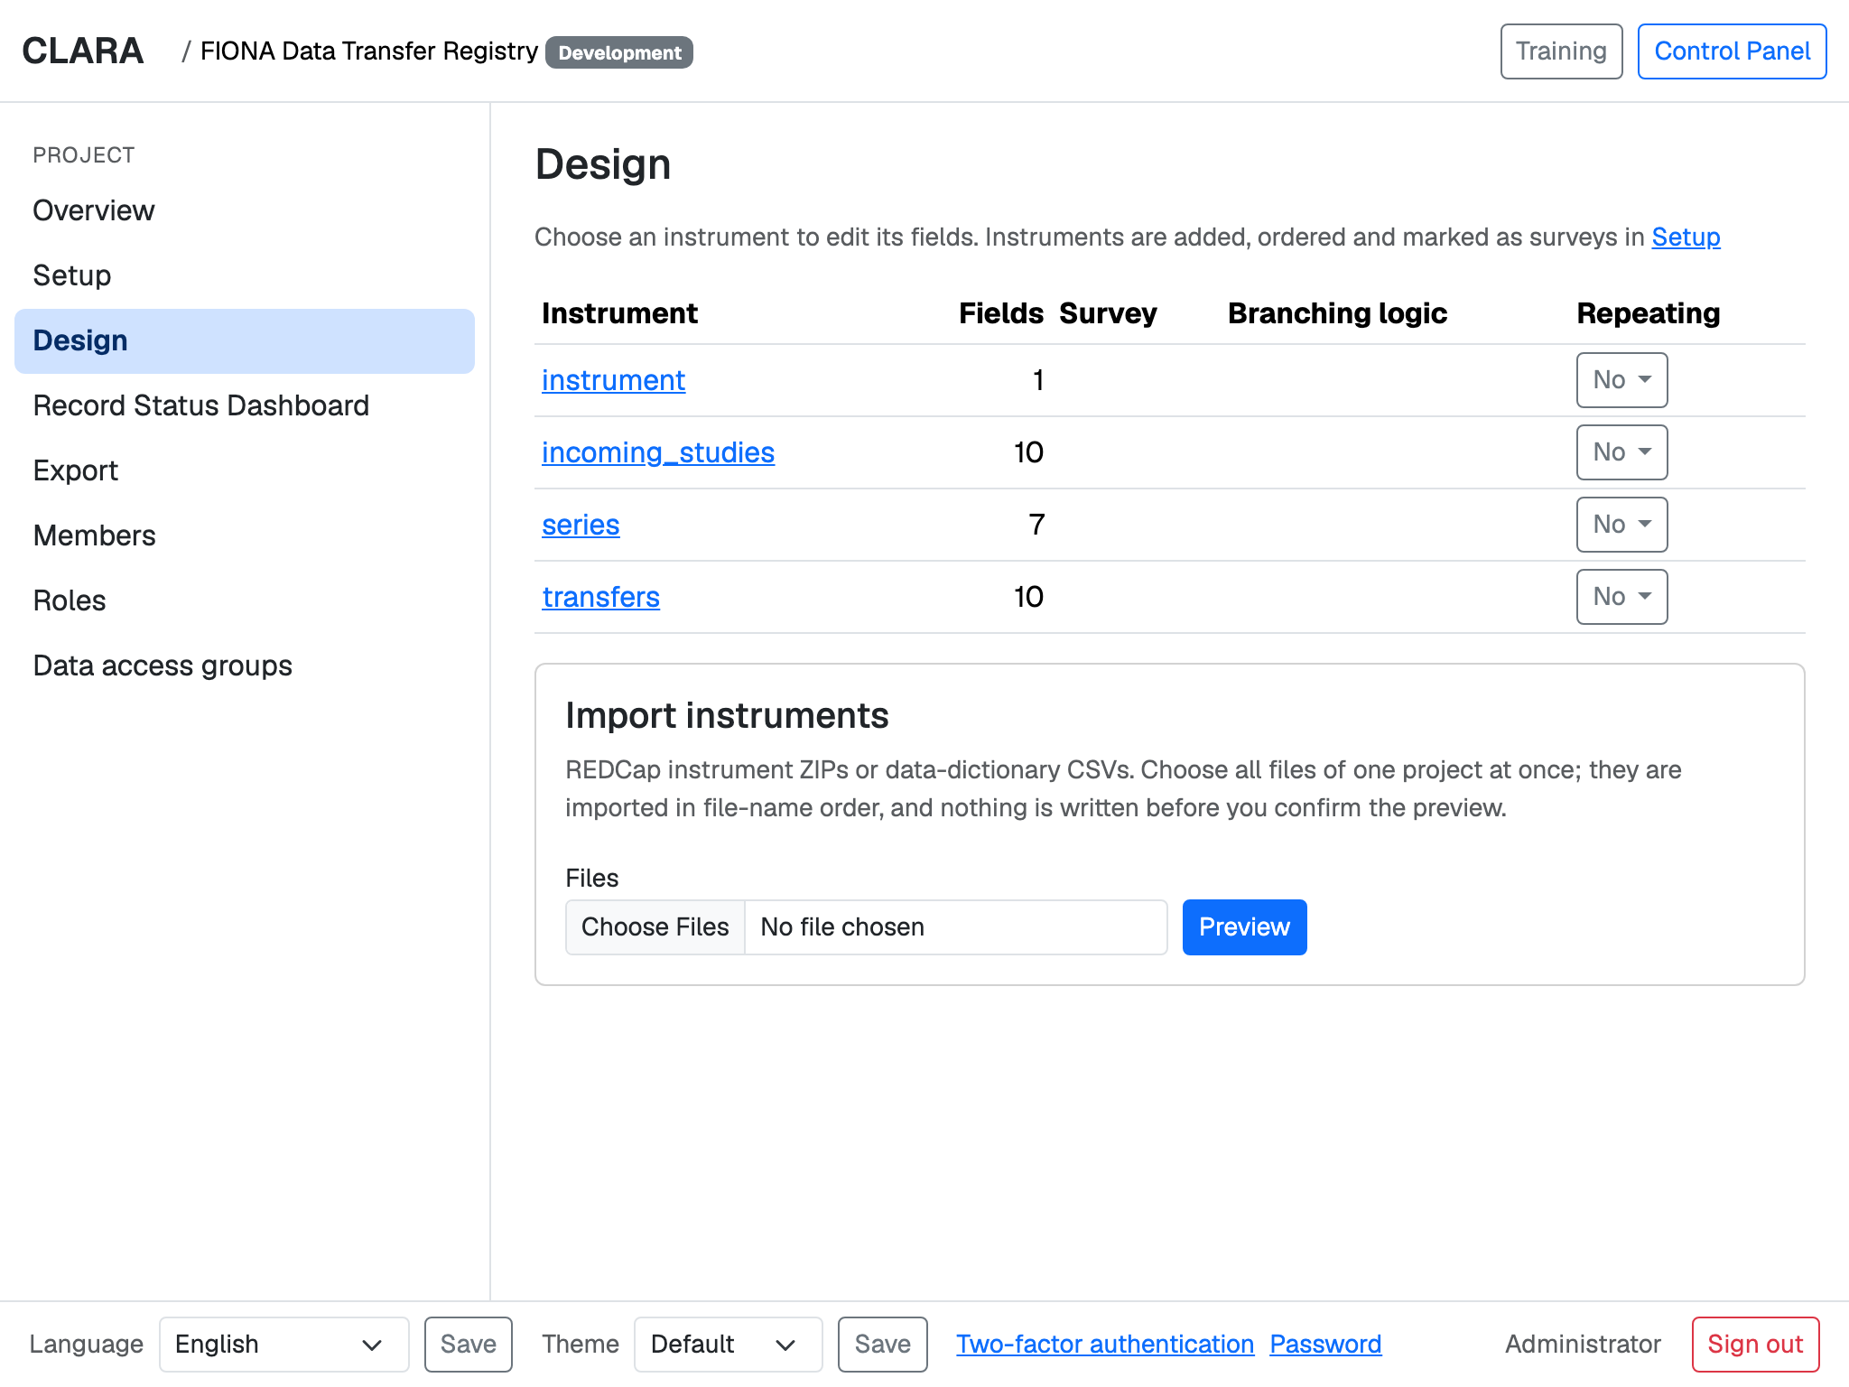






Forms: design what you collect
Visits and forms: arms, events, and which form belongs to which visit
Import existing REDCap data dictionaries — no retyping
Field types: text with checks, choices, checkboxes, yes/no, notes, calculations
Show a question only when it is relevant
Repeat a form as often as needed
In production, changes are staged and checked before they go live
Notes:
Setup defines the study's visits (events) and forms (instruments); Design edits the fields. Existing REDCap dictionaries import directly — the demo projects were created this way. Branching logic hides questions that do not apply; repeating forms can be filled several times per visit.

Slide 14
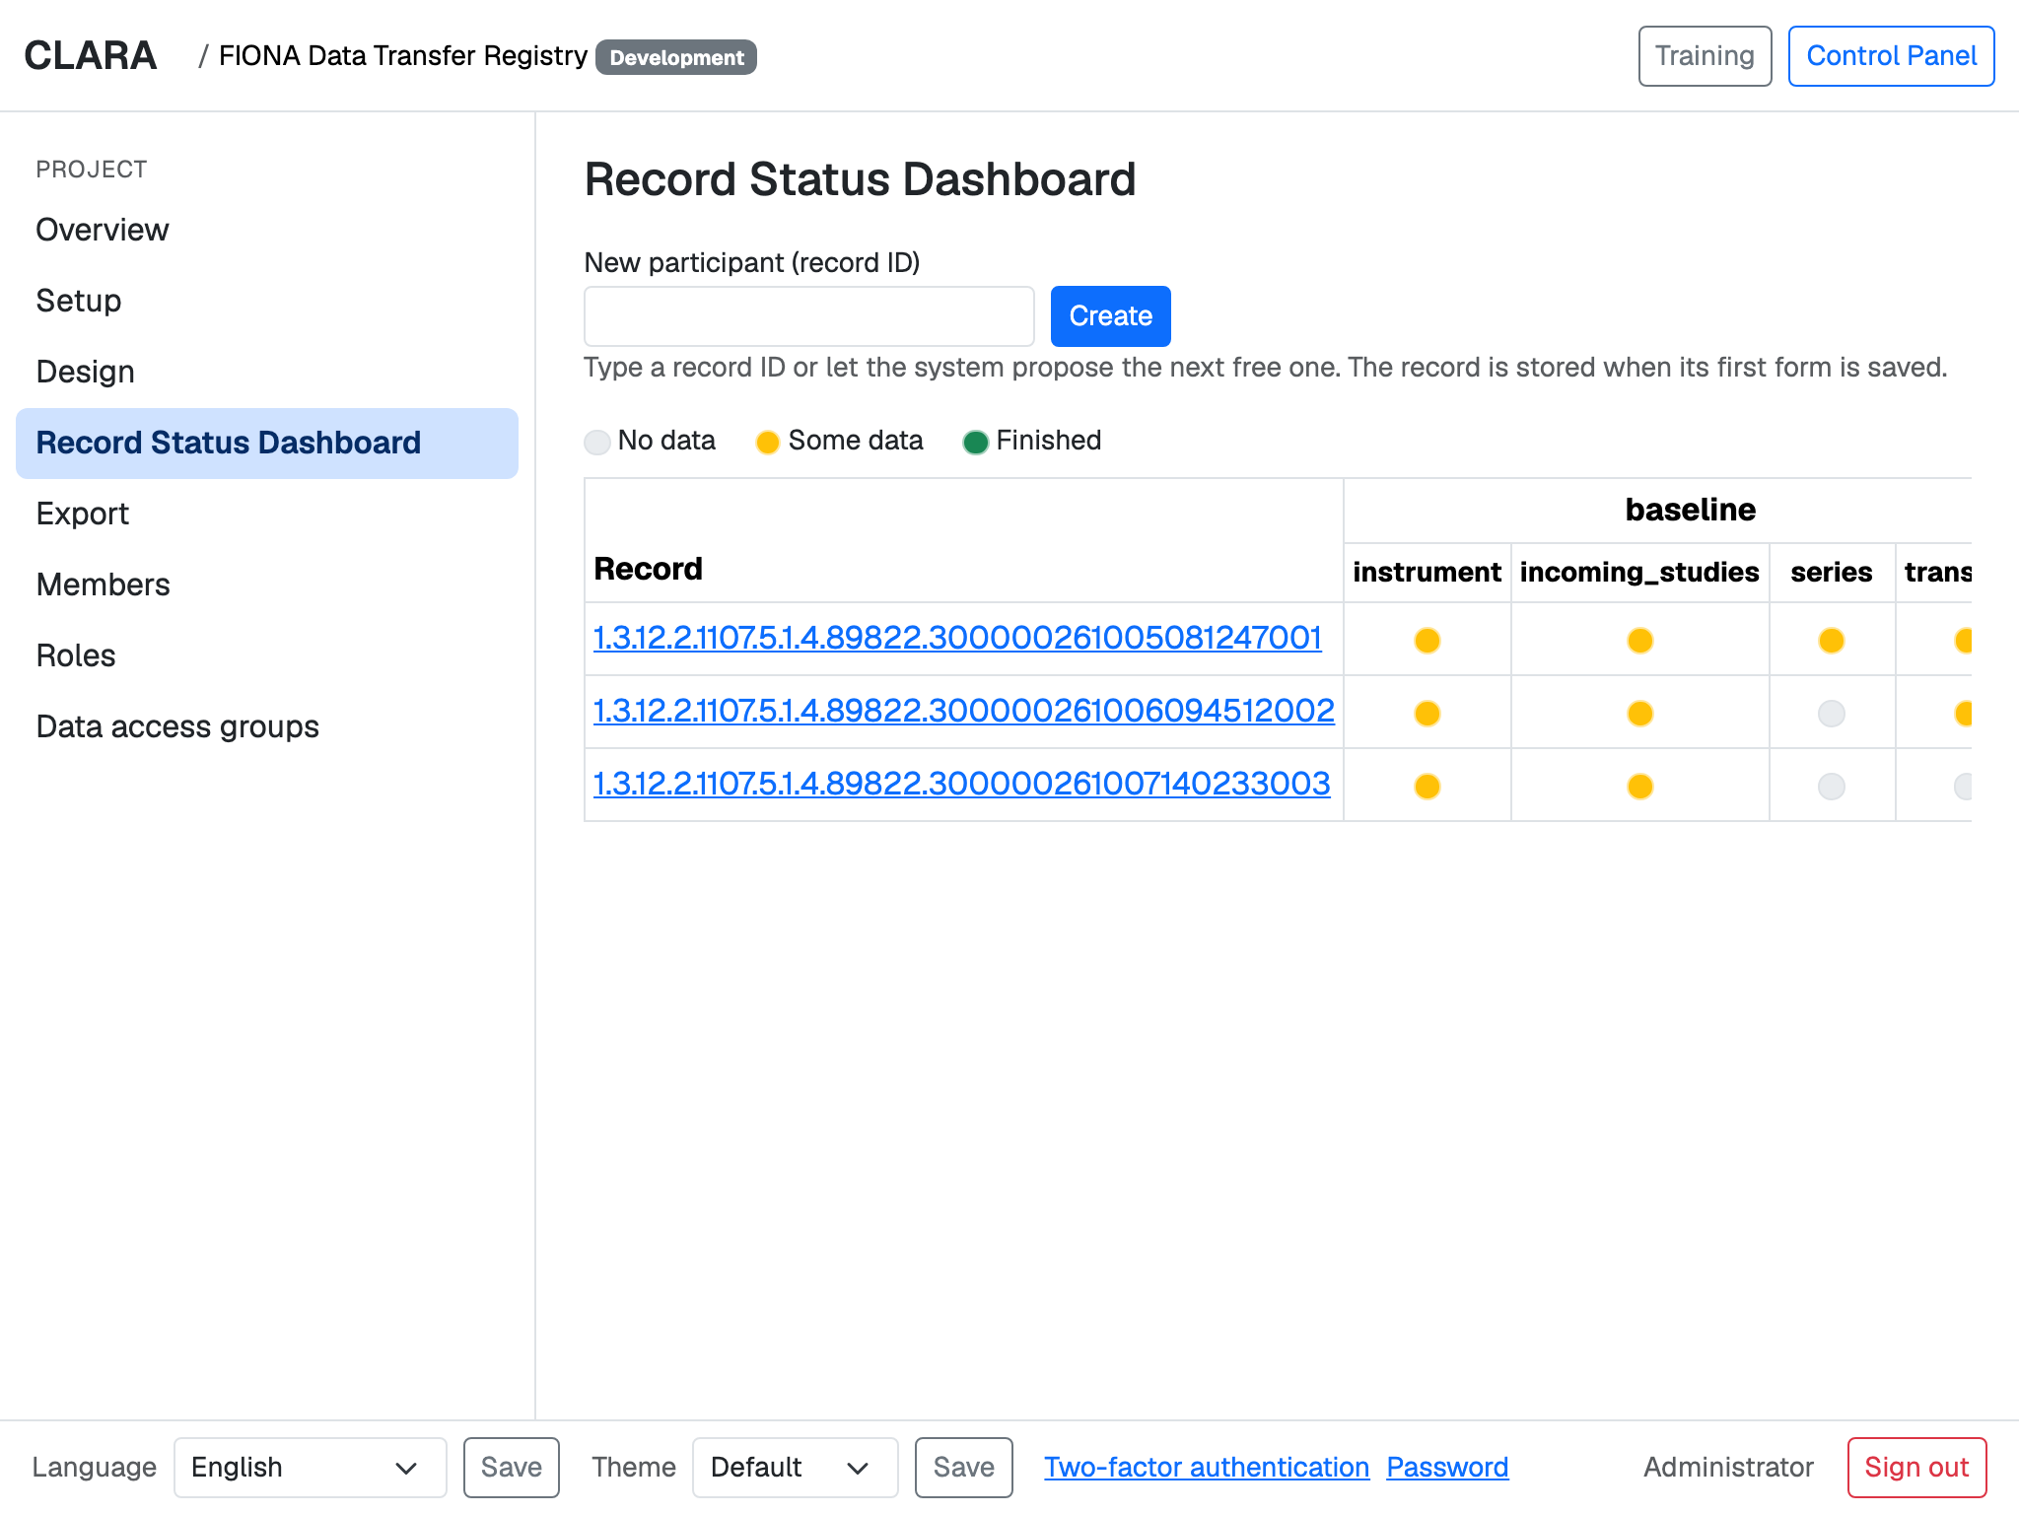
Collecting data: status at a glance
Record Status Dashboard — one row per participant, a dot per form: grey, yellow or green.
A form — every value keeps its history. Forms can also be sent out as a survey link.
Notes:
The dashboard shows each participant with a status dot per form: no data, some data, finished. Opening a form shows its fields; the small button next to each field shows its history — who entered which value and when. A form marked as survey can be filled by a participant through a personal link, without logging in.

Slide 15
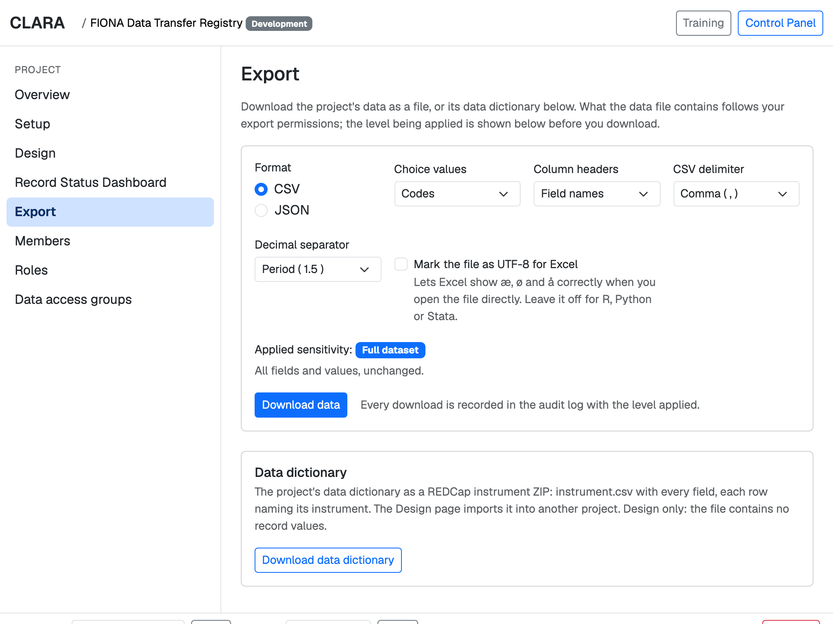
Export: share data, safely
Four export levels — set per role, form and visit
Full dataset
all fields and values, unchanged
No identifiers
every identifying field removed
De-identified
identifiers removed, personal fields hashed, dates shifted
None
no download
CSV or JSON · Excel-friendly (æ, ø, å) · every download logged
Notes:
What a person may export is part of their role. The export page shows which level applies before downloading. De-identified exports remove direct identifiers, hash personal fields and shift dates. Every download is written to the audit log.

Slide 16
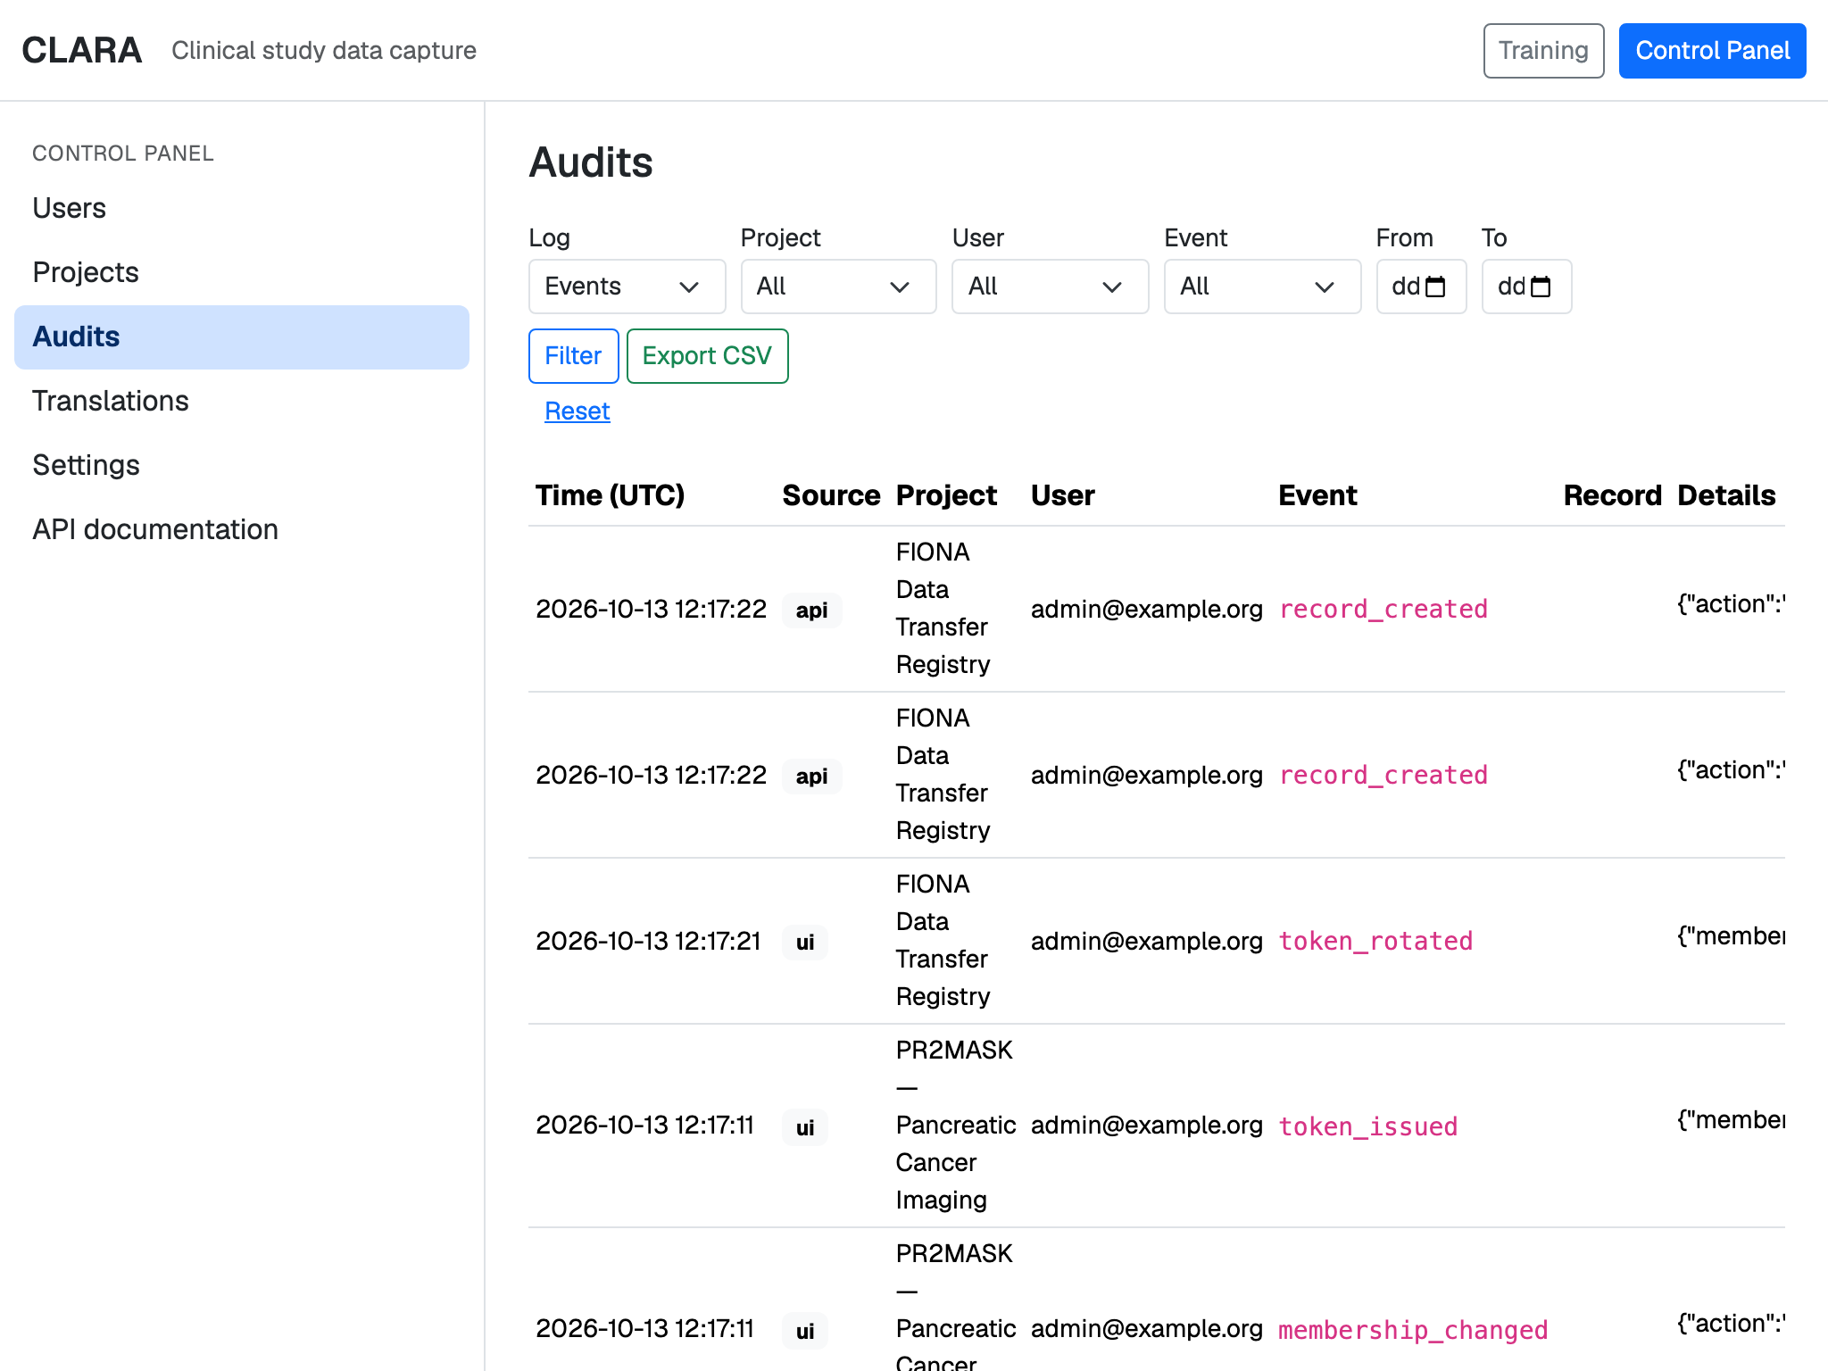
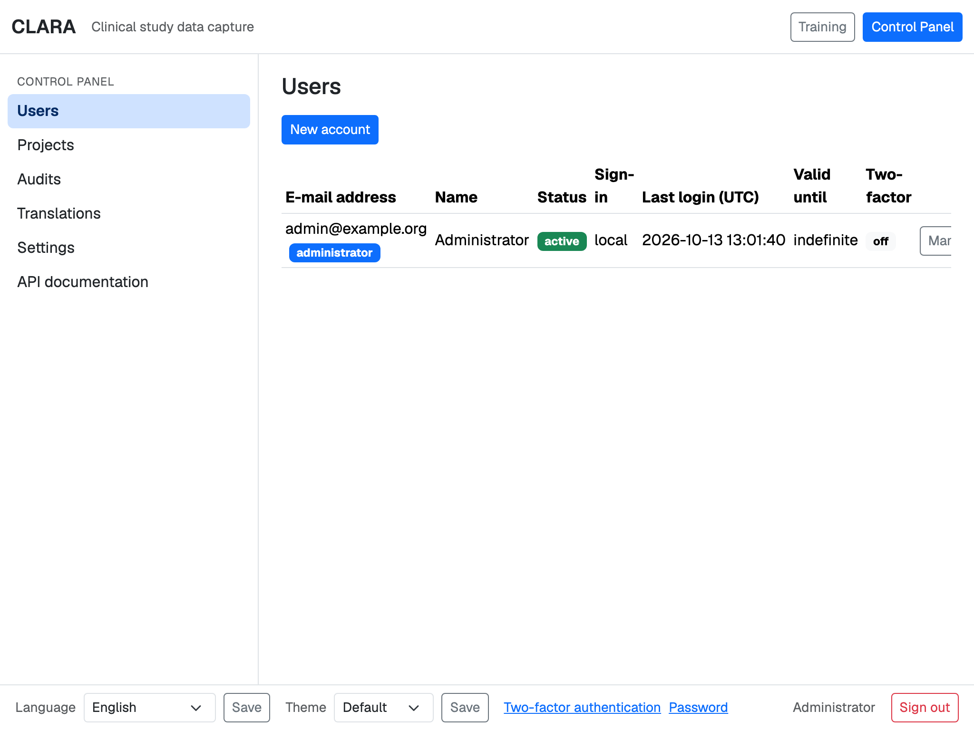
Oversight: who did what, and who may sign in
Audit trail — every change and every view; filter it and export it.
Users — accounts with an end date, locked after 180 days without sign-in (adjustable).
Notes:
Administrators work in the Control Panel. The audit trail records every change and every view of a record, can be filtered by project, user, event and date, and exported. User accounts can carry an end date and are disabled automatically after a period without sign-in until an administrator enables them again.

Slide 17
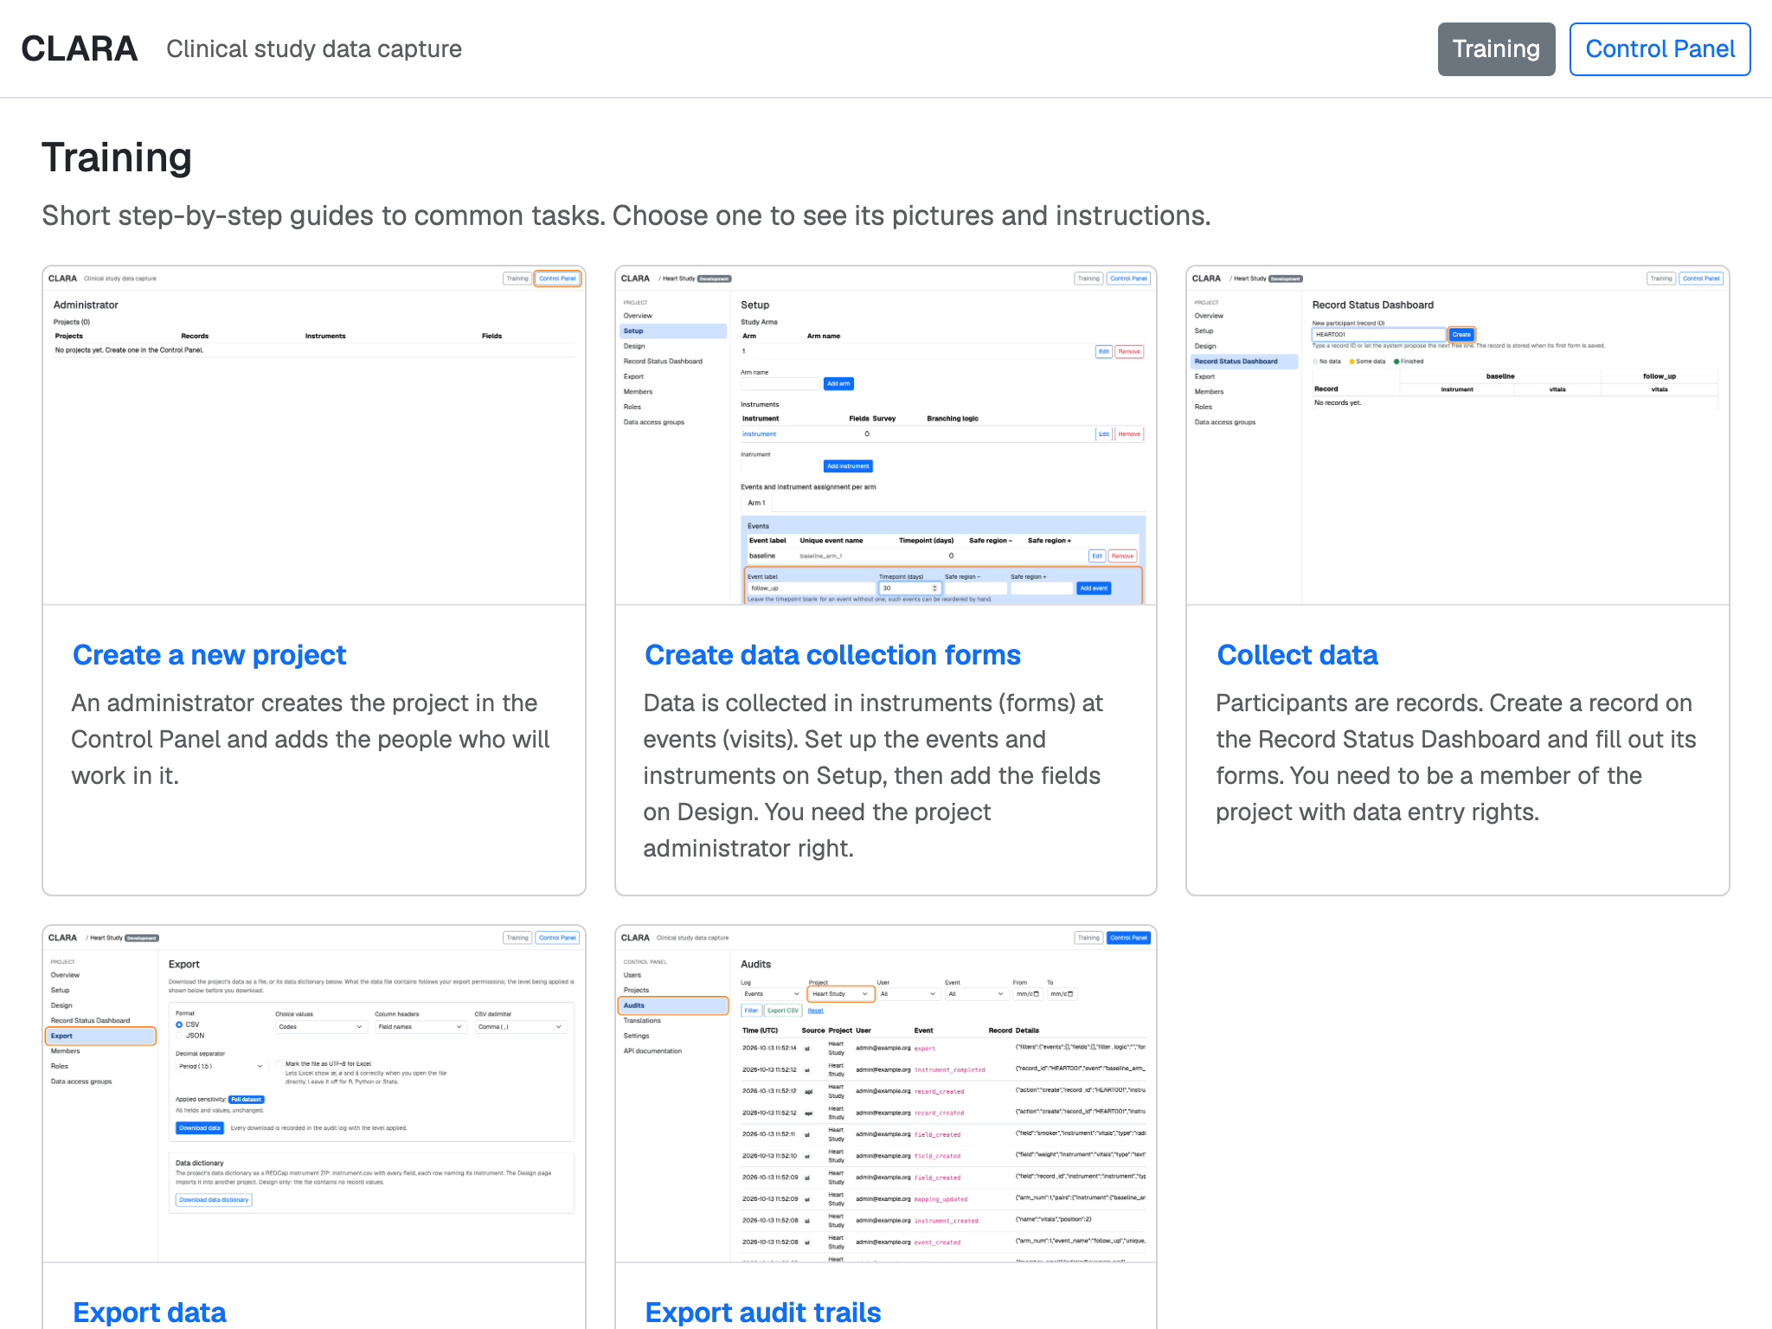

Help built in: training and languages
Training guides
Step-by-step pictures for common tasks — from a new project to exporting audit trails.
Your language
Each user picks English, Norsk bokmål or Nynorsk.
Easy to translate
Administrators export the texts as a spreadsheet, translate them, and import them again.
Notes:
The Training page holds short illustrated guides; new guides are just folders of pictures and text. The interface is translated into Bokmål and Nynorsk; administrators can update translations with a spreadsheet.

Slide 18

4
Signing in and permissions
Hospital names, ways to sign in, and who may do what
Notes:
Fourth part: how people get in, and what they may do once inside.

Slide 19
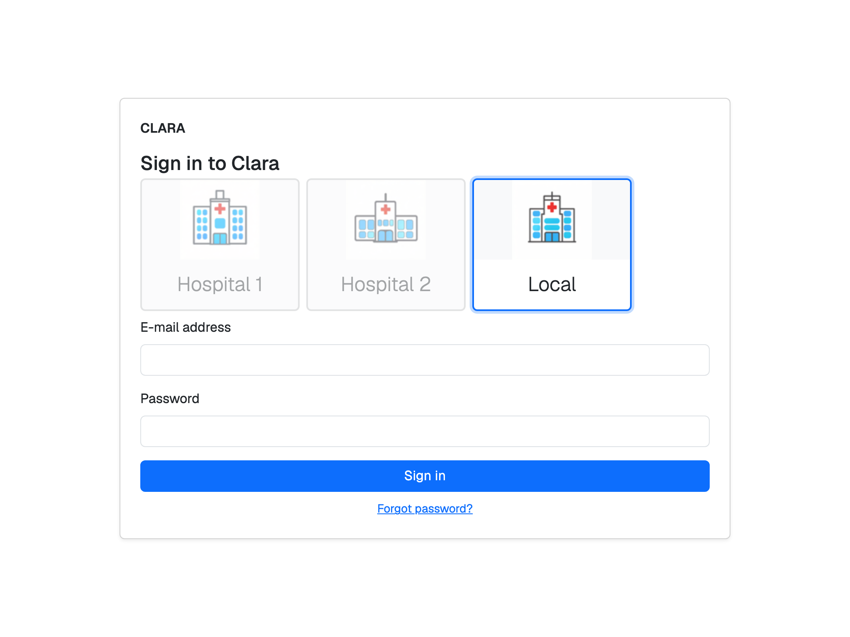
Sign in where you work: hospital names
Example
Hospital single sign-on (OAuth2)
Hospital 1
Hospital directory (LDAP)
CLARA account (password)
A name can stand for several sign-in services — they are tried at the same time, and the first success wins.
One service can appear under several names.
With only one name configured, the choice is skipped.
The sign-in page: pick your hospital, then sign in the way that hospital uses.
Your e-mail address identifies you, whichever way you sign in.
Notes:
Before signing in, people choose a name such as 'Hospital 1' or 'Hospital 2'. Behind each name the administrator connects one or more sign-in services: the hospital's single sign-on (OAuth2 / OpenID Connect), its directory (LDAP or LDAPS), or local CLARA accounts. Passwords are only sent to the services behind the chosen name, all at once; the first that says yes wins. In the demo, 'Local' stands for CLARA's own accounts.

Slide 20





Ways to sign in — and what protects them
Sign-in methods
Protection
Hospital single sign-on
Two-factor sign-in: authenticator app or e-mail code, recovery codes; can be required for everyone.
OAuth2 / OpenID Connect, several providers possible. The hospital's own login handles its second factor.
Lockout: 5 failed attempts within 10 minutes pause that account for 15 minutes.
Hospital directory
Account limits: an end date per account; disabled after 180 days without sign-in.
LDAP or LDAPS — several directory servers, asked at the same time.
Sessions: end after 30 minutes idle, or 8 hours in total.
CLARA accounts
E-mail invitation, forgotten-password reset and password change; passwords are kept only as a one-way hash.
Logged: every sign-in, failed attempt and sign-out.
Notes:
Three ways in: the hospital's single sign-on, the hospital's directory, or a CLARA account. Two-factor sign-in (authenticator app or e-mail code) protects the directory and CLARA-account logins; single sign-on uses the hospital's own second factor. The numbers shown are the defaults; the session times and the inactivity limit can be configured.

Slide 21
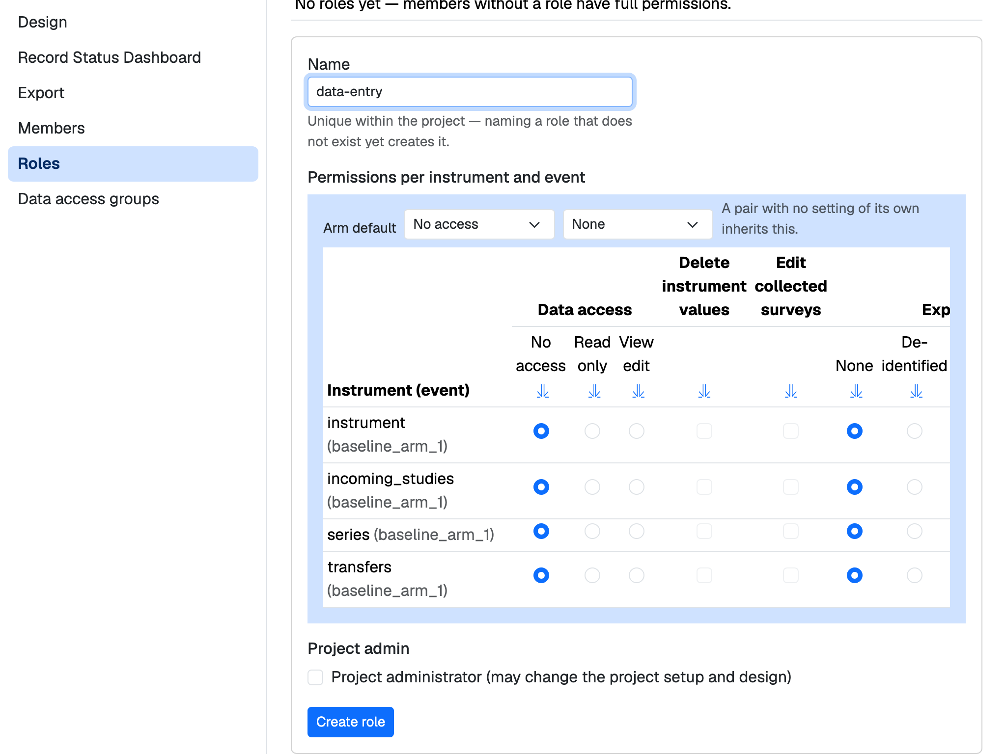


Who may do what: roles and permissions
Data access
No access
Read only
View & edit
Export
None
De-identified
No identifiers
Full
Set per form and visit for each role — roles are defined per project.
Project administrators change the setup; system administrators see every project.
Data access groups keep each site's records apart in a shared project.
Notes:
A role is a named set of permissions inside one project, for example data-entry or controller. For every form and visit it sets a data access level and an export level, plus two extra rights: deleting a form's values and editing collected surveys. Members without a role have full rights in that project. Data access groups let several sites share one project without seeing each other's records.

Slide 22
In short
1
2
3
FIONA keeps working
Every hospital signs in its own way
A complete tool for study teams
CLARA speaks REDCap's language, so FIONA needs no change.
Hospital names connect each site to its own login service.
Design, collect, export and audit — with permissions per form and visit.
Next steps
Configuration check · Performance measurements · Versioned upgrades · Technical-debt list
Notes:
Summary: FIONA continues unchanged on a foundation built for several hospitals; each hospital signs in its own way; study teams get a complete, auditable data capture tool. The next steps are taken from the open items in VISION_AND_REQUIREMENTS.md.

